Slide 1

WELCOME

Slide 2

Instant UNIFORM
By pavan & Ganesh
20U12917,20U12908
Under the guidance of
External Guide
Mr. Satish Naik
Faculty of Sathyam
Computer Education
Internal Guide
Mr. Anurag Naik
Faculty of Sathyam
Computer Education

Slide 3
Introduction

Slide 4
objectives
To reduce the human work load.
To make uniform instantly available.
To replace the normal process to computerized format.
To save the time.
To interconnect people from long distance.

Slide 5
Existing system
In existing system old uniform process is carried out manually.
People can not sell their old uniform.
People can not get uniform instantly.
Can not able to get uniforms of different college at one place.

Slide 6
Proposed system
In proposed system users can directly sell or buy uniform on our website.
No need of searching for the people who have the old uniform.
There will be security for users data.
User can buy old uniform according to size, gender, college etc.

Slide 7
Software and hardware requirements

Slide 8
Software requirement
The software requirement are:
Operating system : Windows 8 and later version.
Front end : HTML, CSS, PHP, Java Script.
Back end : My SQL.
Frame work : Apache Tomcat 2.4
Graphical software : Photoshop.

Slide 9
hardware requirement
The hardware requirement are:
RAM : 512 MB.
Processor : Intel Pentium or above.
HHD or SSD : 50 GB minimum.
Monitor : Any colour monitor.
Printer : 80 columns colour printer.

Slide 10
Diagrams

Slide 11
Data flow diagram
REGISTER /
LOGIN
MANAGE FEEDBACK
SELL UNIFORMS
MANAGE BUYING
Instant
uniform
BUY UNIFORMS
MANAGE SELLEING
GIVE FEEDBACK
MANAGE USER
ADMIN LOGIN

Slide 12
Data flow diagram for admin login level 1.0
ADMIN
Provides username and password
Checks
Validation
Login
Database
If invalid
If valid
DASHBOARD

Slide 13
Data flow diagram for admin level 2.0
ADMIN
Generates message
Fills ID and password
Login
Database
If invalid
If valid
Add employee
Add categories
Apply leave
Manage leave
Search leave
Employee
Database
Categories
Database
Apply leave
Database
Apply leave
Database
Apply leave
Database

Slide 14
SYSTEM development

Slide 15
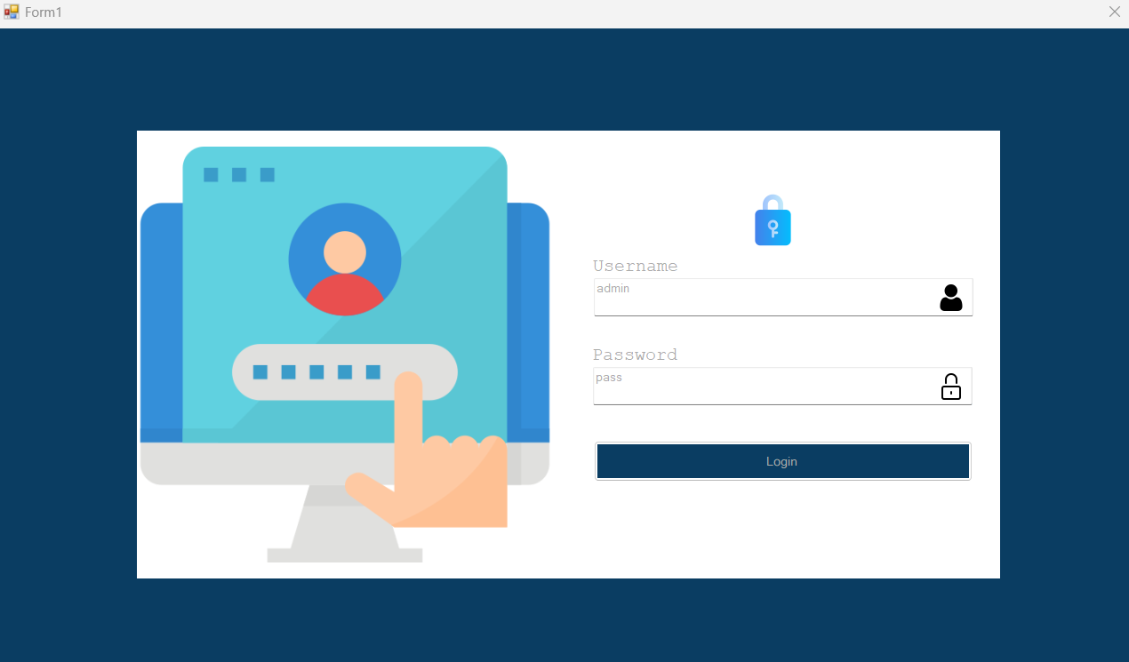
Login page

Slide 16
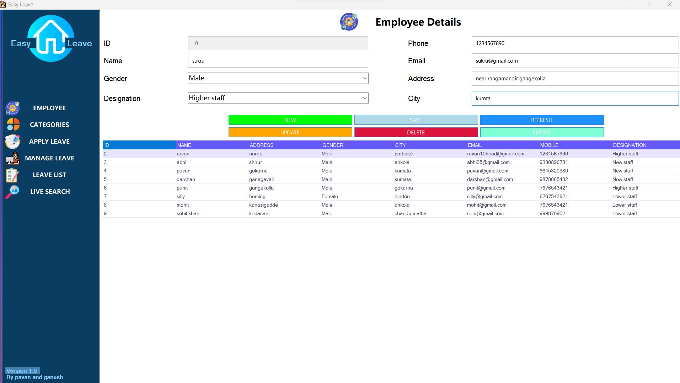
Employee details

Slide 17
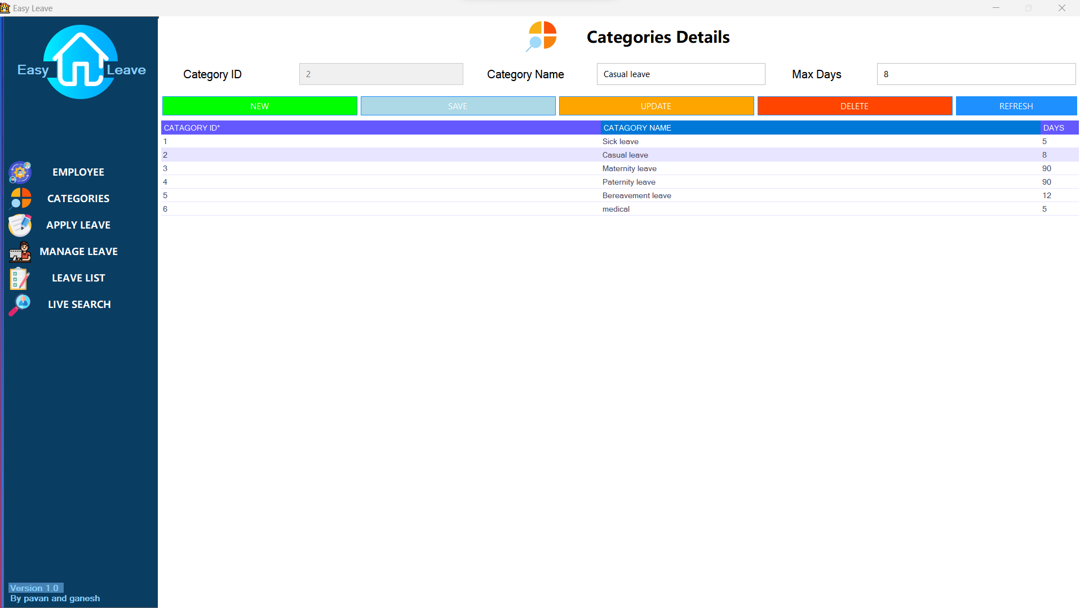
Categories details

Slide 18
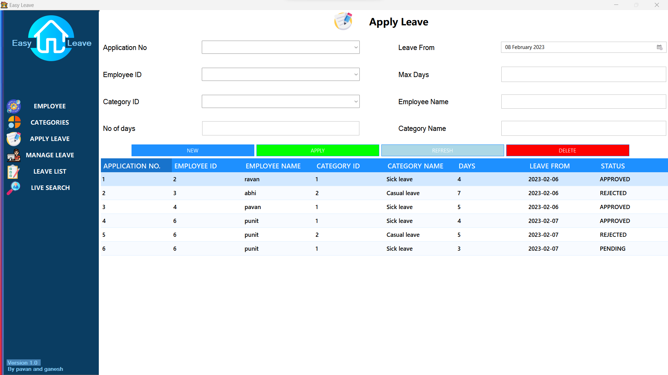
Apply leave

Slide 19
manage leave

Slide 20
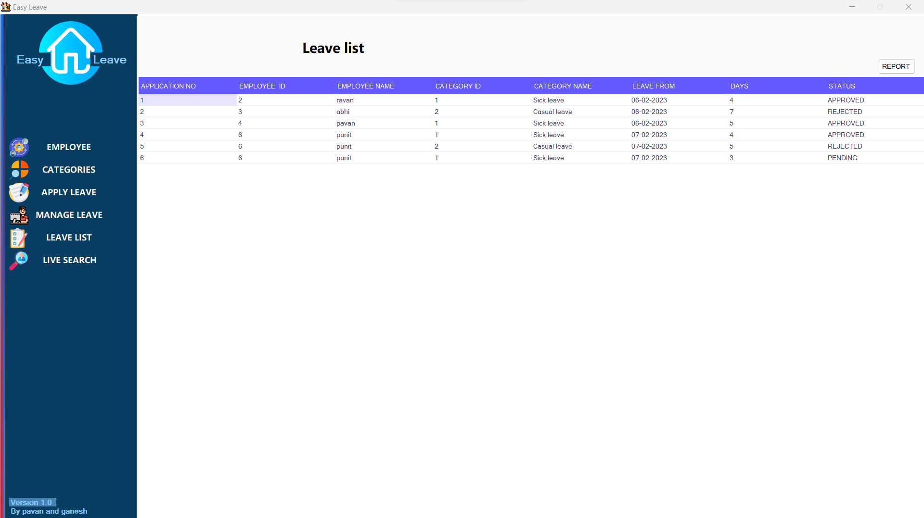
leave list

Slide 21
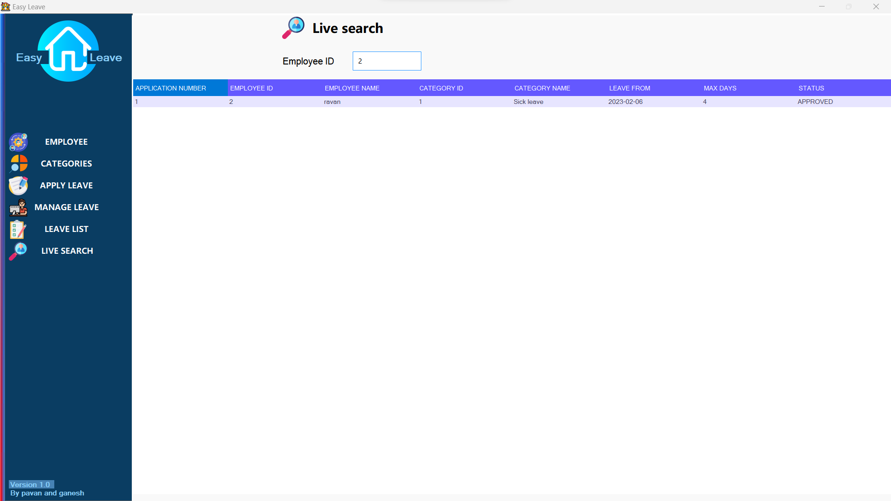
Search leave

Slide 22
Conclusion

Slide 23

Any questions ?

Slide 24


