Slide 1
Breaking java.util.HashMap
Giorgos Gaganis
http://giorgosgaganis.com
@ggaganis
© 2017 Giorgos Gaganis

Slide 2

Surprised how easy it is to break!… and how spectacular!

Slide 3

Today's Topics
Intro on Concurrency Bugs
The problem of proving a HashMap breaks
  Hypothesis - Problem and Code
  Illogical operation/Broken contract – Problem and Code
  Experiment boilerplate Code
Live Demo(or… not?)

Slide 4
Intro on Concurrency Bugs

Slide 5
Concurrency Bugs
A class of bugs that happen when code runs concurrently
Random and unpredictable nature.
Manifest under load in production
Can produce very weird and difficult to understand effects.
Lack of widespread and open tools to automatically detect/help reproduce them.

Slide 6
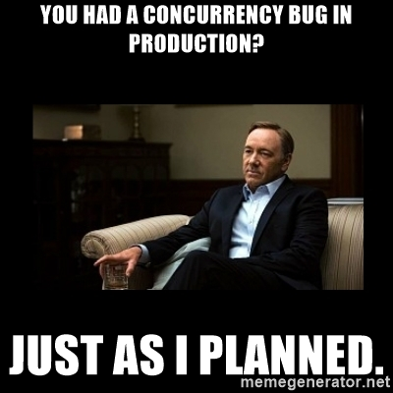

Slide 7
Concurrency in Java
Java Memory Model- JMM
Happens-Before
  The key concept in the JMM
  A write to a volatile field happens-before a read to the field by other threads
Inadequate Models
  Transaction Example
  Register – Cache – Main Memory(pre 1.5 java)

Slide 8
JMM Resources
Java Language Specification Chapter 17
  Very difficult to understand
Best Summary:
  https://docs.oracle.com/javase/7/docs/api/java/util/concurrent/package-summary.html#MemoryVisibility

Slide 9
Breaking the HashMap
Part I - Hypothesis

Slide 10
Problem

Slide 11
HashMap javadoc
https://docs.oracle.com/javase/8/docs/api/java/util/HashMap.html
Note that this implementation is not synchronized. If multiple threads access a hash map concurrently, and at least one of the threads modifies the map structurally, it must be synchronized externally.

Slide 12
What is proving?
Hypothesis - A set of steps/operations that when performed will cause HashMap to behave illogically.
Formally the hypothesis should make HashMap break it’s formal contract.

Slide 13
Strong hypothesis
A stronger hypothesis hast smallest number and most specific operations.
Eg “Running an enterprise application on production under load and loosing data is a weak hypothesis”.

Slide 14
Forming the hypothesis
Starting from the JavaDoc
  “If multiple threads access a hash map concurrently , and at least one of the threads modifies the map structurally… (A structural modification is any operation that adds or deletes one or more mappings...)”

Slide 15
Forming the hypothesis II
According to docs a break can happen with only one “writing” thread...
...but “reads” are fast and we need to make them both happen concurrently/ at the same time
… so I will only use “writes”
To increase concurrency one thread will put many entries and the other one

Slide 16
The hypothesis
“While one thread is putting new entries to the HashMap and at the same time another thread puts one new entry the Map can break.”

Slide 17
Code

Slide 18
ExecutorService
ExecutorServices used to execute Runnable tasks
Created using Executors static functions
e.g. Executors.newCachedThreadPool()
Runnables are submitted to an ExecutorService returning Future objects

Slide 19
Future
Represents the result of a task submitted to an ExecutorService
A call to Future.get() will block until it’s related task finishes execution.

Slide 20
Threads A & B
// The entries that will be put in the map by Thread A
Map<String, String> disruptorMap = new HashMap<>();
disruptorMap.put("0","0");
disruptorMap.put("1","1");
//Execute in first thread
Future<?> futureA = executorService.submit(
//Using a putAll to make it more likely we are going to interleave
() -> map.putAll(disruptorMap)
);
//Execute in second thread
Future<?> futureB = executorService.submit(
() -> map.put("a", "a")
);
futureA.get();
futureB.get();

Slide 21
Breaking the HashMap
Part II – Illogical behavior, Broken Contract

Slide 22
Problem

Slide 23
Detecting a broken HashMap
First thought:
  See if everything is present.
  Yes that will happen!
But.. while working on this, found map.size() and number of keys contained in map.keySet() can be different!

Slide 24
Code

Slide 25
Detecting the breakage
int keyCount = 0;
for (String key: map.keySet()) {
keyCount++;
}
boolean sizeIsCorrupt = keyCount != map.size();
…
Map<String, String> allExpectedEntries = new HashMap(disruptorMap);
allExpectedEntries.put("a","a");
boolean valuesAreMissingOrIncorrect = false;
for(String dKey: allExpectedEntries.keySet()) {
if(!map.containsKey(dKey)) {
valuesAreMissingOrIncorrect = true;
...
}
}

Slide 26
Breaking the HashMap
Part III – Experiment Boilerplate

Slide 27
Running tries
private final Map<String, String> map;
private final ExecutorService executorService = Executors.newCachedThreadPool();
public HashMapHypothesizer(Map<String, String> map) {
this.map = map;
}
private boolean runExperiment() throws Exception{
map.clear();
//Hypothesys and detection code!
}
private static void runExperimentsOnMap(Map<String, String> map) {
HashMapHypothesizer hypothesizer = new HashMapHypothesizer(map);
for(int i =0 ; i < MAX_TRIES; i++) {
if (!hypothesizer.runExperiment()){
System.out.println("Failed after " + i + " tries\n");
hypothesizer.executorService.shutdown();
return;
}
}
hypothesizer.executorService.shutdown();
System.out.println("Run was completed without error for "
+ MAX_TRIES + " # of experiment tries \n");
}

Slide 28
Verifying on ConcurrentHashMap
public static void main(String[] args) throws Exception {
System.out.println(
"---Running hypothesizer on a HashMap");
runExperimentsOnMap(new HashMap<>());
System.out.println(
"---Running hypothesizer on a ConcurrentHashMap");
runExperimentsOnMap(new ConcurrentHashMap<>());
}

Slide 29
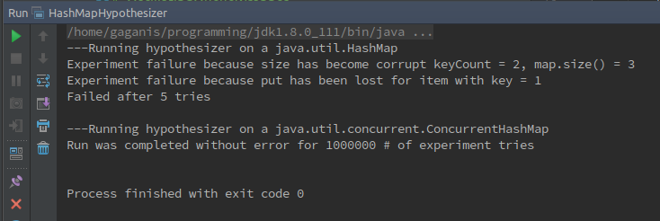
Demo(Hopefully Live!
...otherwise see offline below)

Slide 30
Summary
Be mindful concurrently using libraries
  Java standard library classes are well documented
When writing low-level concurrency, reason on the JMM
When dealing with suspected concurrency bugs, produce a strong hypothesis

Slide 31
Questions?
Giorgos Gaganis
http://giorgosgaganis.com
@ggaganis
© 2017 Giorgos Gaganis

