Slide 1

Dependency Injection - Google Guice
Our experience
Giorgos Gaganis
@ggaganis
http://duckseason.mobi

Slide 2
Dependency Injection

Slide 3


Building a House ...

Slide 4
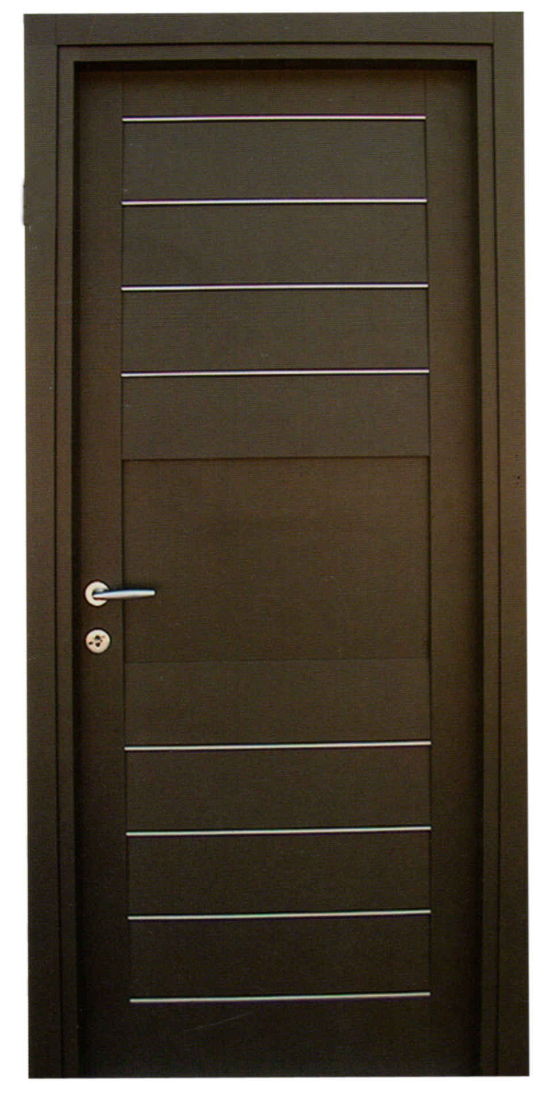
… and Adding the Door

Slide 5
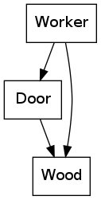
Example Class Dependencies
public class Worker {
public void buildHouse(){
//...
Wood wood = new Wood();
Door door = new Door(wood);
addDoor(door);
//...
}

Slide 6
Class Dependencies
Dependencies of a Class are the other classes it uses.
Stuff the developers need to know and handle to work on a class.

Slide 7
Example Class Dependencies
public class Worker {
public void buildHouse(){
//...
Wood wood = new Wood();
Door door = new Door(wood);
addDoor(door);
//...
}

Slide 8
Introducing Factories
public class DoorFactory {
public Door get() {
Wood wood = new WoodFactory.get();
Door door = new Door(wood);
return door;
}
}

Slide 9
Using the Factory
public class Worker {
public void buildHouse(){
//...
Door door = new DoorFactory().get();
addDoor(door);
//...
}//..}

Slide 10
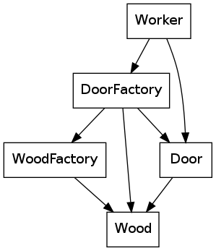
Graph with Factory

Slide 11
Dependency Injection
public class Worker {
private Door door;
public Worker(Door door) {
this.door = door;
}
public void buildHouse(){
addDoor(door);
//...

Slide 12

Graph with Dependency Injection

Slide 13
Using the DI Worker
Wood wood = new Wood();
Door door = new Door(wood);
Worker worker = new Worker(door);
worker.buildHouse();

Slide 14
Dependency Injection Framework
Handles the act of injection.
Resolves the dependencies automatically.
Allows configuring of the above.

Slide 15
Google Guice @Inject
Denotes the injected dependencies
Used on constructors or setters
Should be on all classes handled
@Inject
public Worker(Door door) { // Constructor
\\…
}

Slide 16
Getting an instance
Injector injector = Guice.createInjector();
Worker worker = injector.getInstance(Worker.class);
worker.buildHouse();

Slide 17
Why is this better?
Classes know and depend only on what they really need
Inversion of control
Less boilerplate code(eg factories)
More dynamic configuration

Slide 18
Configuring Injection
public class ConfigModule extends
com.google.inject.AbstractModule {
protected void configure() {
bind(Door.class).to(MetallicDoor.class);
}
}
Injector injector =
Guice.createInjector(new ConfigModule());

Slide 19
Adopting Guice at DuckSeason
Motivation
Major Problems
Things to have in mind for future adoptions
Effectiveness

Slide 20
Motivation
Deep dependency graphs
Better control of instance lifecycle – custom scopes
Code problems accumulating that could hinder project in the future.
Previous Experience

Slide 21
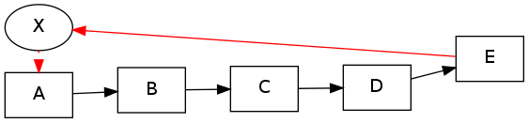
Deep Dependencies
A(){
X x = new X();
}
B(X x){
C c = C(x);
}
C(X x){
D c = D(x);
}
D(X x){
E e = E(x);
}

Slide 22
Problems
Readability – Hard to understand whats going on
  When and where instances are created
  What code exactly runs
More difficult navigating the code on IDE

Slide 23
Major Problems
Circular Dependencies
Circular Dependencies
Team members required lots of training and assistance
Intimidating and hard to read Stack Traces

Slide 24
Circular Dependencies
Become problem under certain conditions (code in constructors)
Code that evolved without design
Working code died after introducing Guice
Very difficult to refactor/resolve in practice
We came very close to drop the adoption
Required detailed understanding of the code function, components and interactions.

Slide 25
Having in mind when adopting
Adopt early, Adopt widely
On existing projects expect difficult refactoring
Requires commitment from team and management
Think more about dependencies
Avoid code in constructors - Only use them to inject dependencies.

Slide 26
Effectiveness
Goals achieved
  Deep dependencies handled cleanly
  Custom scopes more natural to our project
Collateral and Unexpected Gains
  Design and Code Quality issues exposed and solved
  Codebase became more Test friendly
  Modularity 'out of the box'
  Team Design and Code Quality skills improved significantly

Slide 27
References & Additional Material
http://martinfowler.com/articles/injection.html
http://en.wikipedia.org/wiki/Dependency_injection
https://www.youtube.com/watch?v=IKD2-MAkXyQ

