Slide 1
False Alarm Detection System
For : Genus IT Solution
Project Guide:
Dr. Balasaheb Bhamangol
BY:
Harshal Gosavi (MCA III)

Slide 2
Introduction:
This project was made for a chemical industry which had sensors installed in various parts of the factory to detect H2S gas which
is hazardous to health.
Every time one or multiple sensors detected the H2S
leak, an emergency alarm rings to alert the workers. for every alarm the industry calls a team, which sanitizes the place and check for the leak and this was a big cost to the company.
A few of the alarms that ring are not even hazardous, the
company gave us the data for each alarm with final column stating the alarm was dangerous or not.

Slide 3
The data was first pre-processed and analysis libraries like
NumPy and Pandas were used to make it ready to be utilized by
a machine learning algorithm.
Now whenever, there is a leakage and the alarm rings, the data is sent to us and we predict if it is dangerous or not. If found dangerous the only the team is called to sanitize the place and fix the leak. This saved a lot of money for the company.

Slide 4
Existing System:
The existing system involves a team to be called at the manufacturing unit and thus every time, there is a leak, the team comes and sanitizes the place.
There are various sensors already installed but even if one of them rings, the team is called for prevention measures.
For every alarm the industry calls a team, which sanitizes the place and check for the leak and this was a big cost to the company.

Slide 5
Need for system:
Reduce the cost of supporting team.
When the supporting team used to come the labors had to wait out which used to affect the production as it used to go on hold as we wanted to increase our production.
When the alarm (bell) used to ring the labors used to get restless and everything used to become more complex.
Security of all the peoples which work in chemical industry.

Slide 6
Operating Environment:
HARDWARE :
Operating System : Windows 10
RAM : 6 GB
Processor : Intel Pentium Series and above
Hard Disk : 2 GB
SOFTWARE :
IDE :Pycharm.
Browser : Chrome
Server : Apache HTTP server
Front End : HTML5, CSS3, JavaScript, Bootstrap
Back End : SQLITE3
Editor : Jupyter,Spyder
Language : Python.

Slide 7
Technology Used:
HTML5 :- HTML is the standard markup language for creating
Web pages.
CSS3 :- CSS3 is the latest evolution of the Cascading Style Sheets language and it use for designing web pages.
Java Script :- JavaScript is a lightweight, interpreted programming language and it use for validation purpose.
SQLITE3: Sqlite is a database, widely used for accessing querying, updating, and managing data in databases.

Slide 8
Python with ML: : Python is technology that allow software developers to create dynamically web application.
Postman Tool: Postman is currently one of the most popular tools used in API testing.
Rest API: An application programming interface (API) is a protocol intended to be used as an interface by software components to communicate with each other.

Slide 9
Limitations in the existing system:
The existing system has no machine learning algorithm and is completely human based, thus 99% of the times, the company incurs a cost to call the special team which sanitizes the entire manufacturing unit.
Also, a lot of time is wasted, and the production is paused every time a leak is reported, since the team comes, and everyone is asked to vacate.

Slide 10
Proposed System:
False alarm detection system is a web based system use in a chemical industry to manage H2S gas detection.
False alarm detection system is reduce to help supporting team cost. The system will be reliable and fast tool in the daily work and will also be ensure security solution of staff.

Slide 11
Scope:
The model can further be implemented in different areas of the industry and can be enhanced by training with the relevant data.
Machine learning algorithms used can be parameter tuned for each case.
The model will require a huge amount of data to be processed and if results are as expected various industries can fine tune it and use it in their automation to reduce the over-head cost and bring down the physical workforce and effort.

Slide 12
Objective:
The objective of making the model is to automate the process of human intervention in sanitizing the hazardous chemical leak.
The model will predict, and only if necessary; the team will be called to sanitize the manufacturing unit.
The model also aims to minimize the cost involved in calling the team and save the time that is wasted in case of a non-hazardous leak.

Slide 13
The data of the previous leaks will be used to train the machine learning algorithm and the major objective is to make sure a leak is not reported as hazardous in case of hazardous situation. Hence, we would work to reduce the false negatives to zero.

Slide 14
Modules:
Data fetching using pandas.
2) Data preprocessing –
Categorical data
Standard scaling of the data
Checking correlation
Handling missing values
3) Visualizing data using matplotlib and seaborn.
Horizontal splitting of the data using train test split techniques

Slide 15
Training the classifier on the training data.
Analyzing result using confusion matrices for various classifiers.
7) Testing on the new test data.

Slide 16
Analysis and Design:

Slide 17
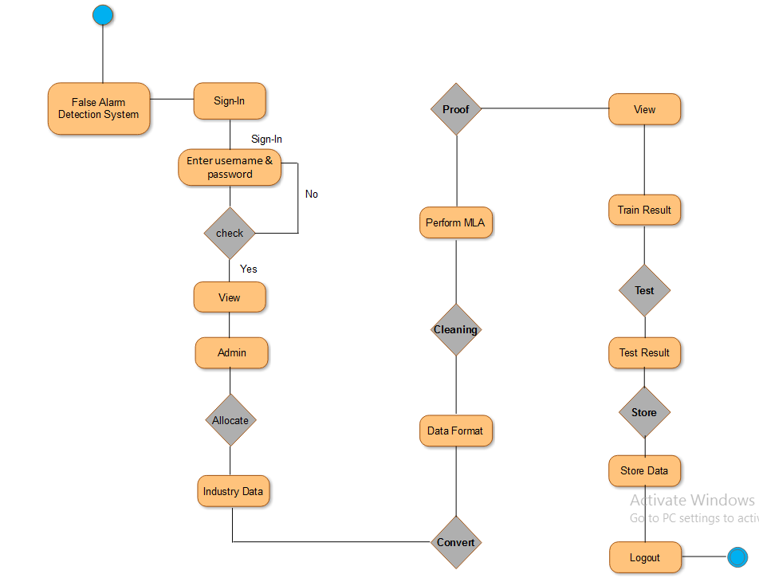
Activity Diagram :

Slide 18
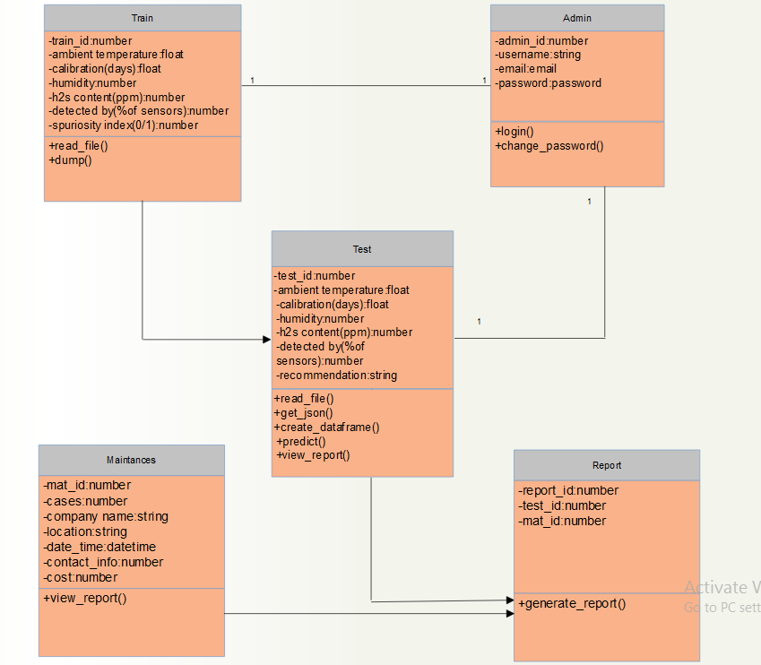
Class Diagram :

Slide 19
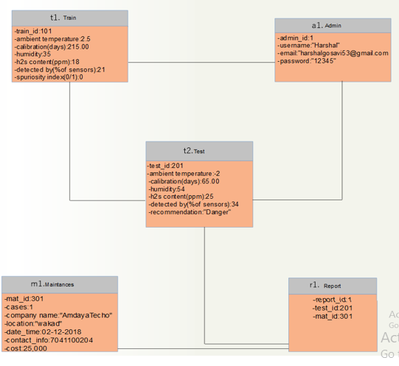
Object Diagram :

Slide 20
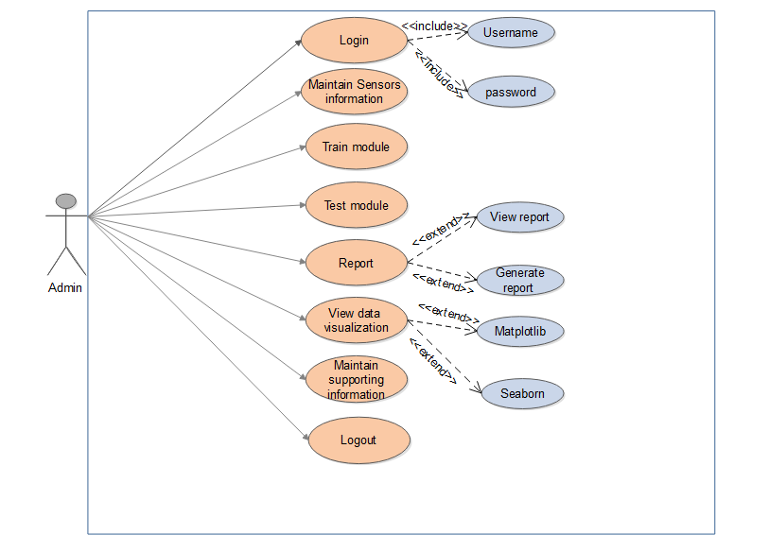
Use case Diagram :

Slide 21
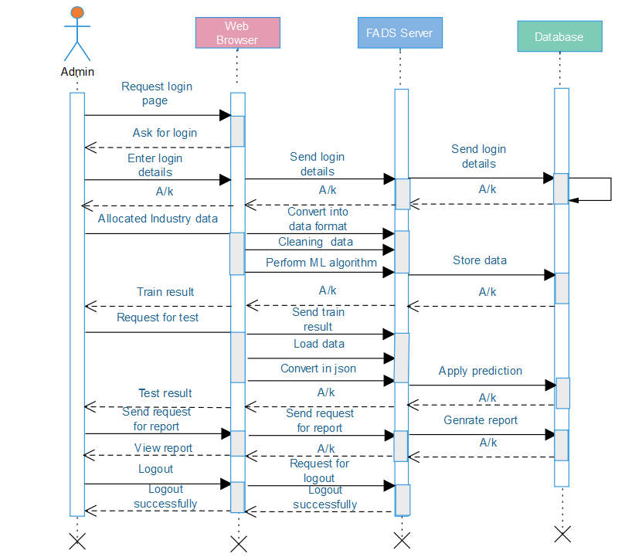
Sequence Diagram :

Slide 22
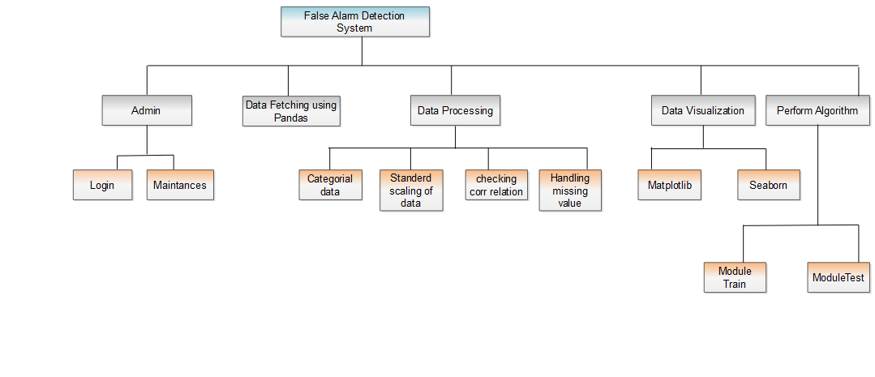
Module Hierarchy Diagram :

Slide 23
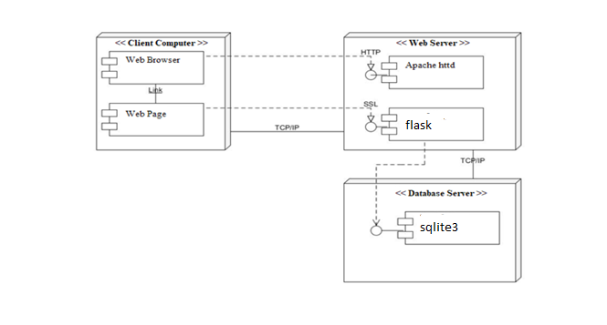
Component Diagram:

Slide 24
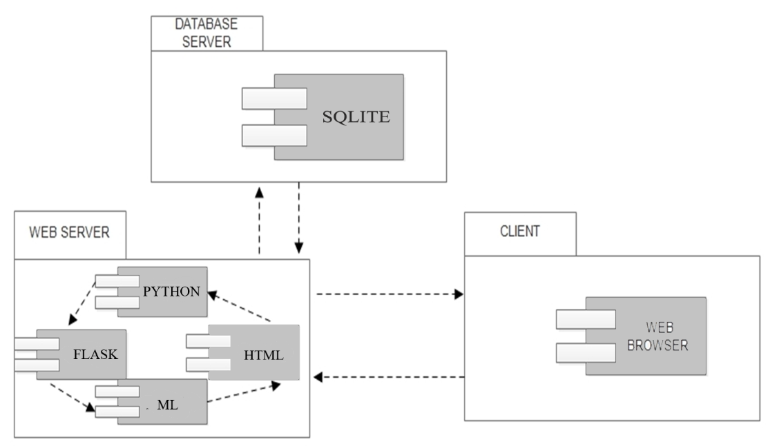
Deployment Diagram:

Slide 25
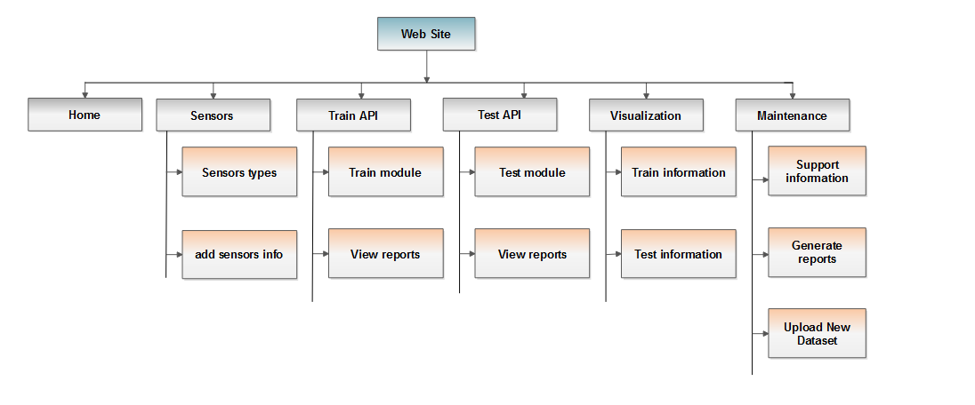
Web site map diagram:

Slide 26
System work flow:

Slide 27
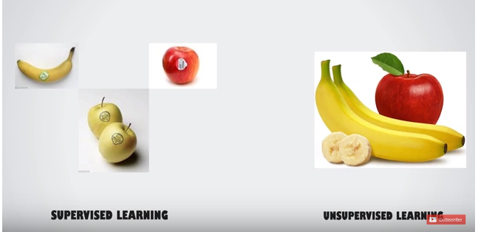
Machine leaning:
Machine learning is a technique .We will provide data to machine,
machine look the data it create some rules.
There are two type of machine learning :-

Slide 28
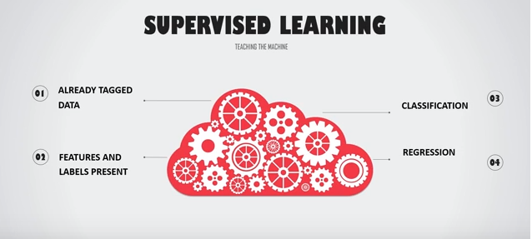
Supervised ML:

Slide 29
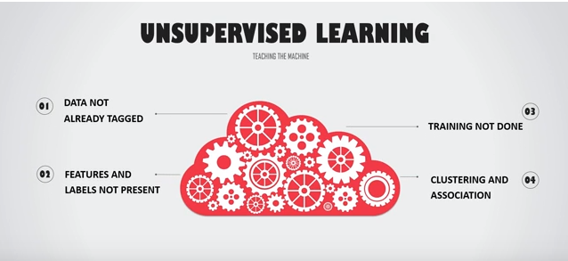
Unsupervised ML:

Slide 30
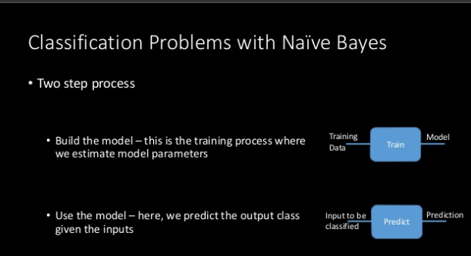
Classification problem

Slide 31
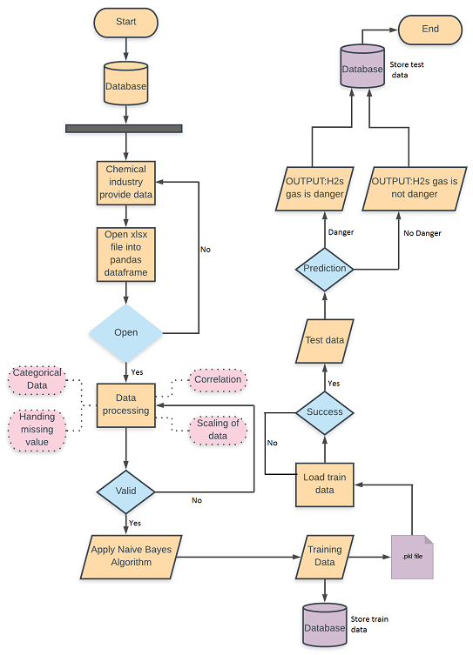
System work flow Diagram:

Slide 32
User Interface Design:

Slide 33
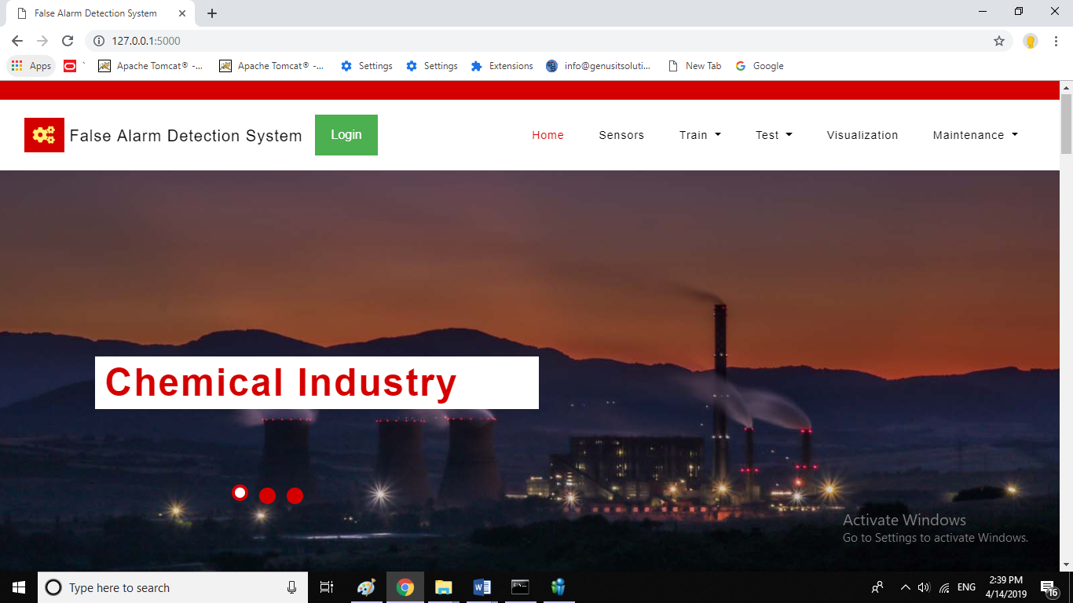
Home page:

Slide 34
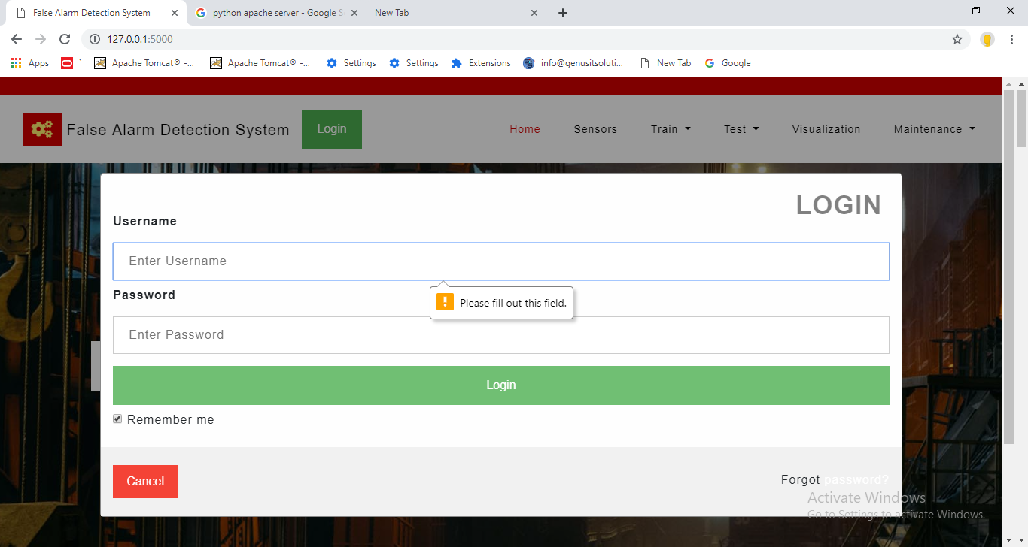
Login Validation Page:

Slide 35
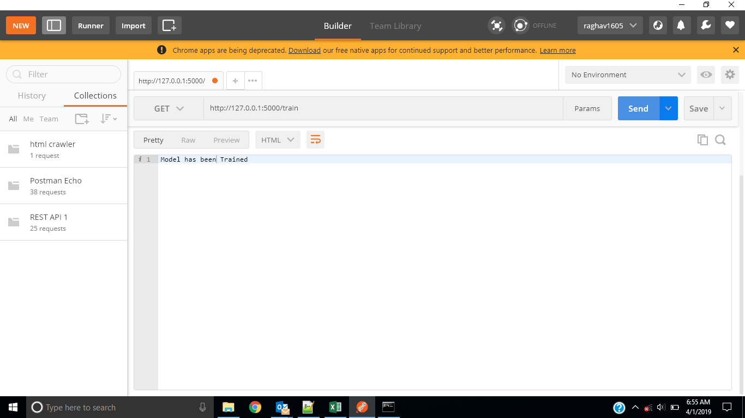
Train module:

Slide 36
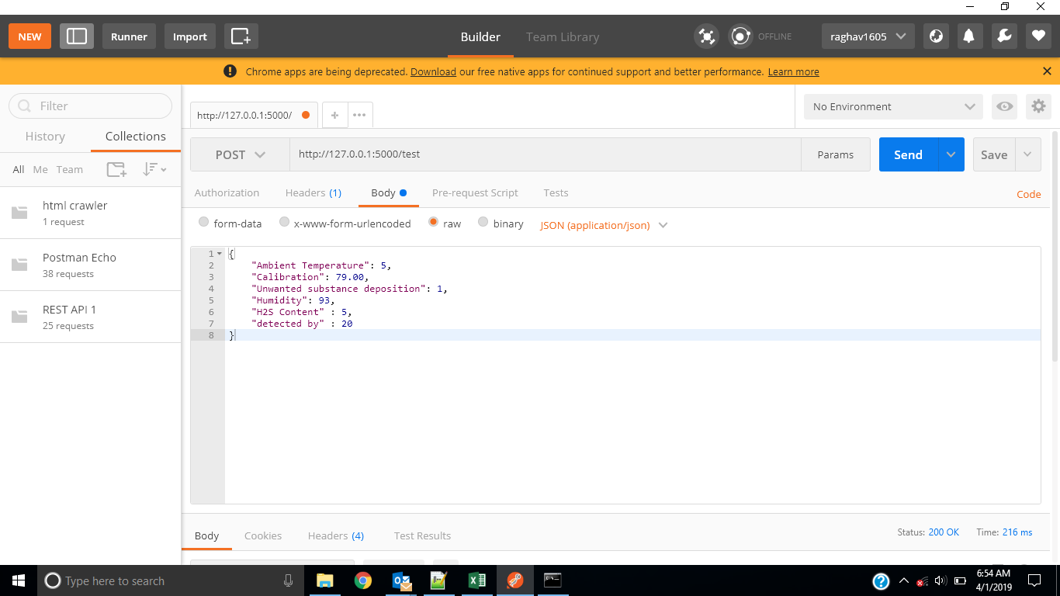
Test module:

Slide 37
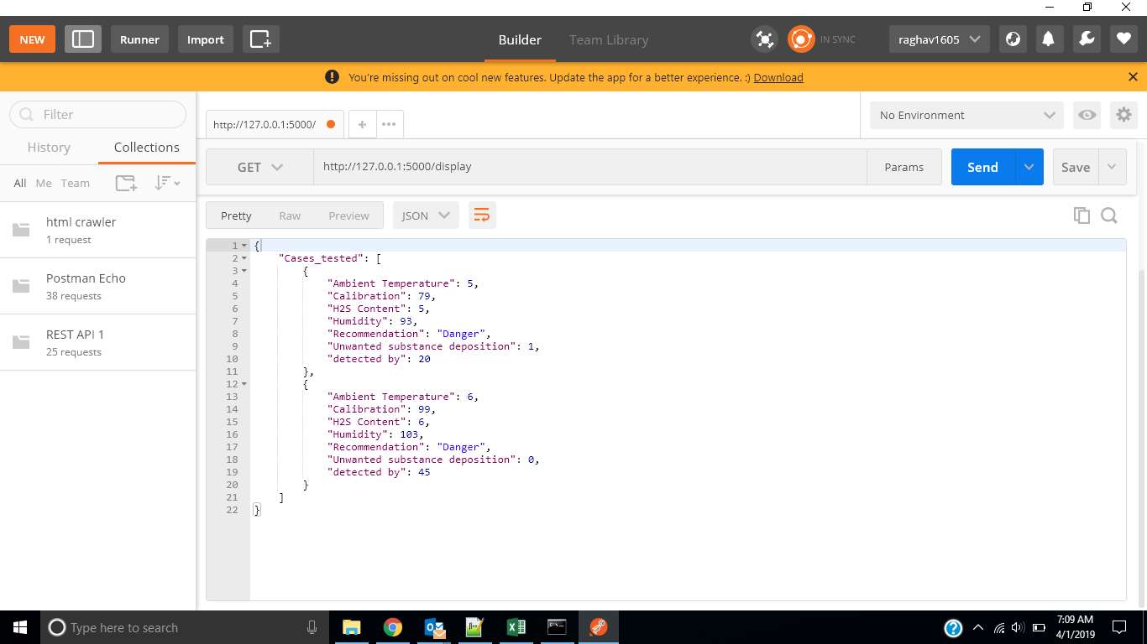
Display result:

Slide 38
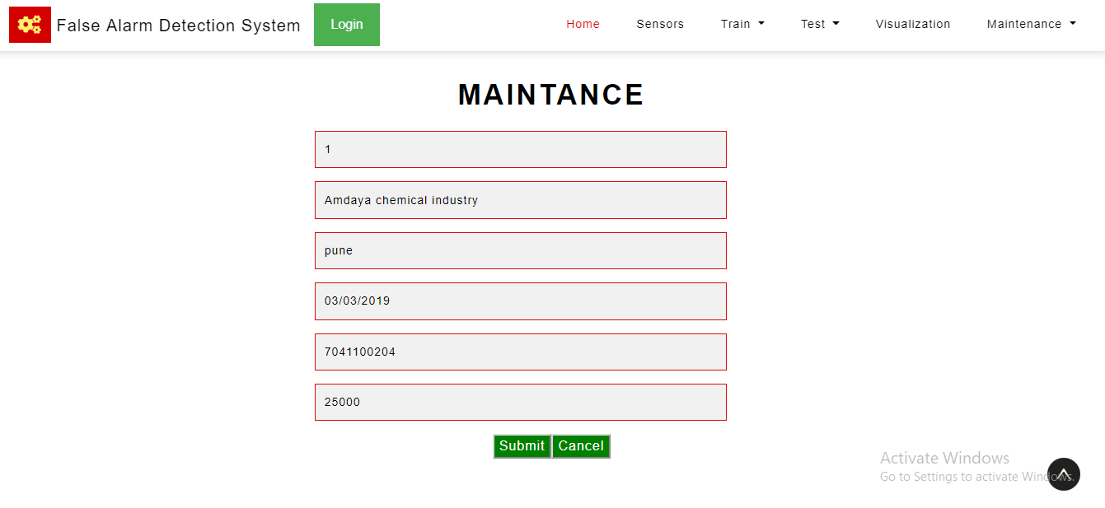
Maintenance:

Slide 39
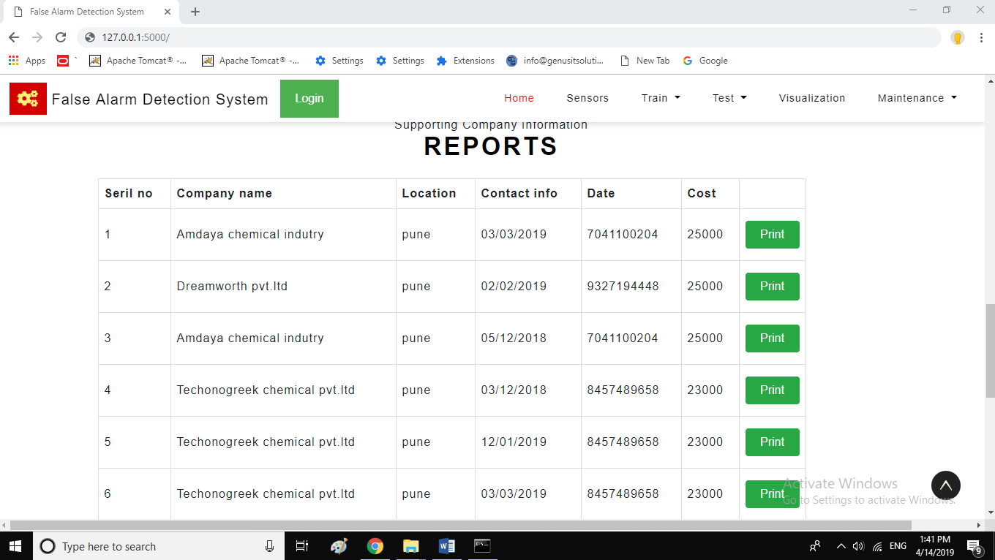
Report:

Slide 40
Table Structure:

Slide 41
Admin:
SR NO | FIELD NAME | DATA TYPE | SIZE | CONSTRAINT | DESCRIPTION
1 | Admin_Id | Integer | 10 | primary key | admin identification no
2 | Username | Text | 20 | not null | admin username
3 | Email | Text | 50 | not null | Login email
4 | Password | Text | 10 | not null | login password

Slide 42
Train:
SR NO | FIELD NAME | DATA TYPE | SIZE | CONSTRAINT | DESCRIPTION
1 | Train_id | Integer | 11 | Primary key | It is unique identification
2 | Ambient temperature | Real | 10 | not null | Ambient temperature is a degree formats
3 | Calibration(days) | Real | 20 | not null | Calibration is a day formats
4 | Humidity | integer | 20 | not null | Humidity is a percentage formats
5 | H2S content | integer | 10 | not null | H2s gas content is a ppm
6 | Detected by (%of sensor) | integer | 10 | not null | Detected is a percentage formats
7 | Superiority | integer | 10 | not null | Supporting team prediction

Slide 43
Test:
SR NO | FIELD NAME | DATA TYPE | SIZE | CONSTRAINT | DESCRIPTION
1 | Test_id | Integer | 11 | Primary key | It is unique identification
2 | Ambient temperature | Real | 10 | Not null | Ambient temperature is a degree formats
3 | Calibration(days) | Real | 20 | not null | Calibration is a day formats
4 | Humidity | integer | 20 | not null | Humidity is a percentage formats
5 | H2S content | integer | 10 | not null | H2s gas content is a ppm
6 | Detected by (%of sensor) | integer | 10 | Not null | Detected is a percentage formats
7 | Superiority Index(0/1) | integer | 10 | Not null | superiority represent danger or not danger

Slide 44
Maintenance:
SR NO | FIELD NAME | DATA TYPE | SIZE | CONSTRAINT | DESCRIPTION
1 | Mat_id | integer | 11 | Primary key | It is unique identification
2 | Cases | integer | 10 | Not null | Case of no
3 | Company name | text | 20 | not null | Company name of details
4 | Location | text | 25 | not null | Location of the company name
5 | Date | date time | 10 | not null | It represent when supporting team came
6 | Contact information | text | 50 | Not null | Contact details of the company
7 | Cost | integer | 30 | Not null | Paying cost

Slide 45
Report:
SR NO | FIELD NAME | DATA TYPE | SIZE | CONSTRAINT | DESCRIPTION
1 | Report_id | integer | 10 | Primary key | It represent unique identification
2 | Test_id | integer | 11 | Foreign key | It is a reference of test table
3 | Mat_id | integer | 11 | Foreign key | It is a reference of maintenance table

Slide 46
Drawbacks and Limitations:
If chemical industry help to provide new dataset to the maintenance team they have to send it manually (now automatic reflection is not possible).
Each module do not gives the accurate result hence every module is not perfect but every module is good.
Limitations:
The existing system has no machine learning algorithm.
It is Completely human based thus 99% of the times, the company incurs a cost to call the special team which sanitizes the entire manufacturing unit.

Slide 47
A lot of time is wasted, and the production is paused every time a leak is reported, since the team comes, and everyone is asked to vacate.

Slide 48
Proposed Enhancements:
Whenever the H2S gas is dangerous add that moment our system will given output by lighting the red light. Else lighting the yellow light.
The supporting system will get message only when H2S gas is dangerous.
The no of parameters we are using now in the system to check whether the H2S gas is linking or no, in future we will increase the number of parameters to get the accurate result.
In future we will provide such a functionality like chemical industry can directly upload new data set using admin panel to the maintains team.

Slide 49
Conclusion:
Working on the project was good experience. I understand the important of planning and designing as a part of software development. The system which I developed is very much useful for chemical industry who interested to properly detection of H2S gas. I am very satisfied with doing such project in technology like python with machine learning which provides me several features to make the user Interface and coding more attractive and easy to understand.
For implementing the system use technology like:
Python
NumPy
Pandas
Matplotlib
Seaborn
Machine learning algorithm

Slide 50



