Slide 1
Adaptive Resource Contract Engine (ARC)
Event-Driven OS Policy Engine — Monitoring, Contracts, Enforcement, Restoration
Operating Systems (BCSE303L) • Gagan Kishore (24BDE0073) • Shikhar Sahay (24BYB0029)
Under the guidance of Dr. Balasubramani M — School of Computer Science, Engineering and Information Systems

Slide 2
Agenda
• Problem: static resource policies vs dynamic workloads
• ARC in one line: trigger → actions → restoration
• Architecture & contract model
• Implementation highlights
• Live lifecycle demo walkthrough
• Experiments & results (latency, overhead, restoration, efficacy)
• Conclusion & future work

Slide 3
Problem Statement
Linux has the primitives — but no unified adaptive policy layer
• Linux exposes nice/renice, CPU affinity, cgroups, process control, /proc monitoring
• These mechanisms are configured independently and mostly statically
• No built-in mechanism to: continuously monitor → interpret user contracts → detect events → adapt policies
• Ad-hoc scripts are hard to maintain, coordinate, and reason about
• Research question: How can an event-driven policy engine dynamically enforce user-defined resource contracts on Linux based on changing runtime system conditions?

Slide 4
Literature Survey
Existing capabilities — used independently
Area | Existing approach | Limitation
CPU scheduling | nice, renice, scheduler policies | usually configured explicitly
CPU affinity | sched_setaffinity() | static CPU assignment
Isolation | Linux cgroups | predefined limits only
Monitoring | /proc, monitoring tools | monitoring does not enforce
Automation | Ananicy, systemd-oomd, TuneD | app-specific / narrow scope
Research | SmartOS (APSys'21) | learned preferences, not explicit contracts
• Gap: no lightweight contract abstraction connecting conditions → actions → restoration

Slide 5
Why ARC?
Less like a power plan — more like an event-driven operating policy engine
• Existing: resource limits configured manually or statically
  – ARC: dynamically adjusts policies based on runtime conditions
• Existing: policies require predefined actions
  – ARC: user-defined contracts specify conditions, actions AND restoration
• Existing: limited response to changing workloads
  – ARC: continuously monitors and adapts; reverts automatically
• OS concepts at the core: process management, CPU scheduling, resource allocation, system calls, concurrency, protection

Slide 6
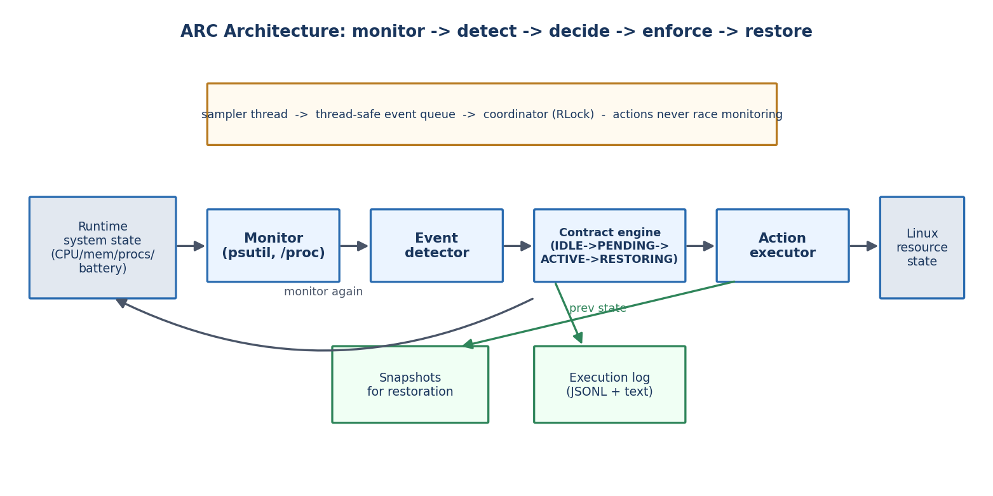
Architecture
Modular pipeline — every stage extensible in isolation

Slide 7
Contract Model
Declarative YAML: trigger → actions → restoration
contracts:
- name: compile-boost
trigger:
type: process_appears # also: metric_threshold, battery_below
match: "gcc|cc1plus|make"
debounce_sec: 1.0
actions:
- {type: set_nice, target: {match: "cc1plus"}, nice: -5}
- {type: set_nice, target: {match: "chromium"}, nice: 10}
restore: {mode: on_trigger_clear} # also: after_timeout, never
cooldown_sec: 5.0
• Triggers: process events, CPU/mem/load thresholds, battery
• Actions: nice, affinity, suspend/resume, cgroup limits, log
• Restoration: exact revert of every snapshot
• PID + create-time check defeats PID reuse

Slide 8
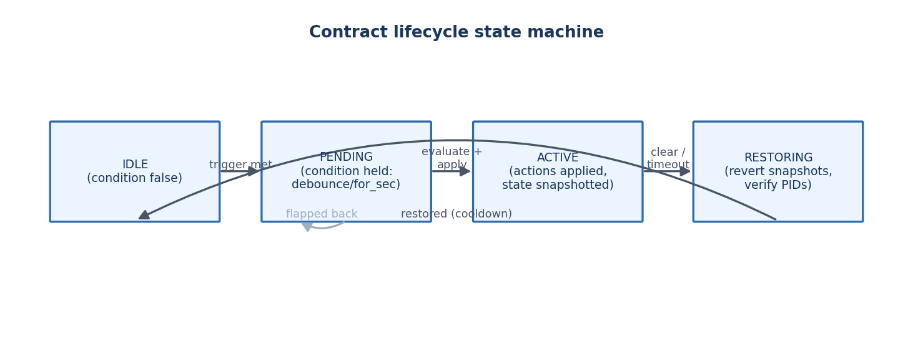
Contract Lifecycle
Every contract is a small state machine
• Debounce / hold windows prevent flapping; cooldown prevents re-trigger storms
• Engine shutdown restores all active contracts (no leaked policies)

Slide 9
Implementation
Portable Python + psutil; one codebase, four platforms
• 7 modules: monitor, events, contracts, actions, engine, logger, cli (~1,500 LOC)
• Concurrency: sampler thread → thread-safe event queue → coordinator (RLock)
• Capability layer: unsupported actions logged as SKIPPED, never crash
• Privilege handling: nice clamping, cgroup/affinity fallbacks, clear log warnings
• Cross-platform: Linux & WSL (full), macOS (no affinity), Windows (no signal suspend)
• CLI: arc validate | run | simulate | selftest | status
• 21 unit + integration tests (pytest), 100% pass in both privilege modes

Slide 10
Demo Walkthrough
compile-boost contract, live lifecycle
• 1. gcc/make appears → debounce 1 s → compiler boosted (nice −5), background apps deprioritized
• 2. Build finishes → trigger clears → original nice/affinity restored exactly
• 3. Battery drops below 25% → background workloads suspended; plugged in → resumed
• 4. Execution log shows every decision: trigger, action with before/after state, restore
  – Safe dry-run demo runs on any OS: bash demo/run_demo.sh

Slide 11
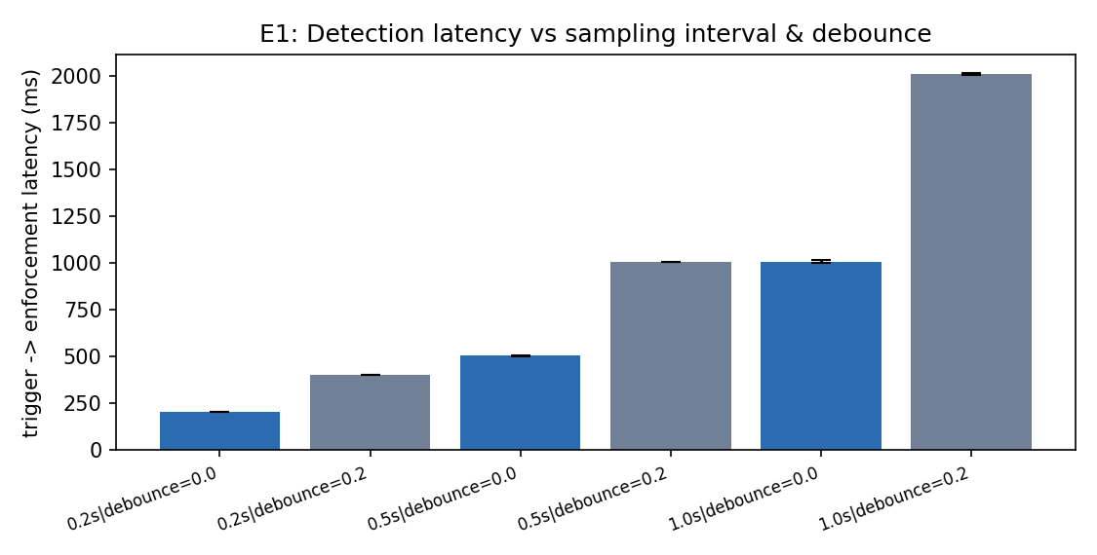
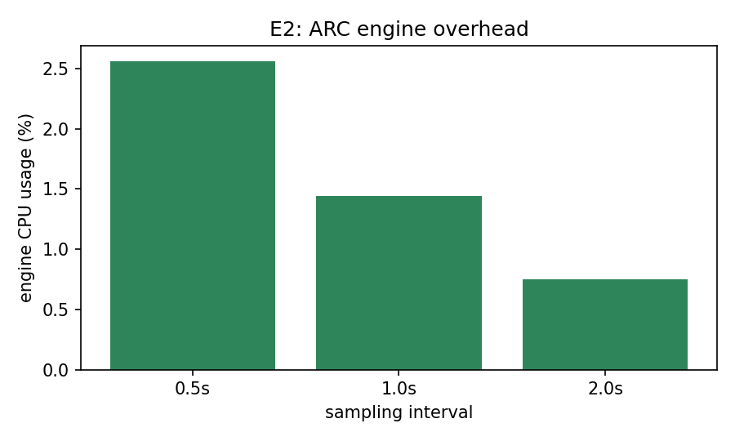
Results I — Latency & Overhead
E1 + E2: tunable response, tiny footprint
202.1 ms
trigger→action @ 0.2 s interval
1.44% / 18.6 MB
CPU & RAM @ 1 Hz sampling
< 6 ms
latency jitter (stdev)

Slide 12
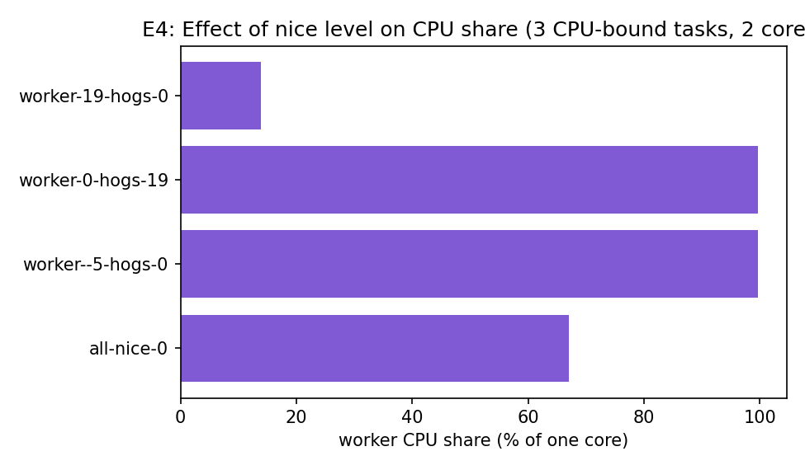
Results II — Restoration & Enforcement
E3 + E4: exact revert, measurable effect
• E3: 40/40 exact restorations (100%)
• Priority + affinity both revert bit-exact
• E4: protected workload 67% → 99.6% of a core
• Deprioritized workload drops to 13.9%
• Actions translate directly into scheduler behavior
100.0%
exact restorations
67% → 99.6%
CPU share when protected

Slide 13
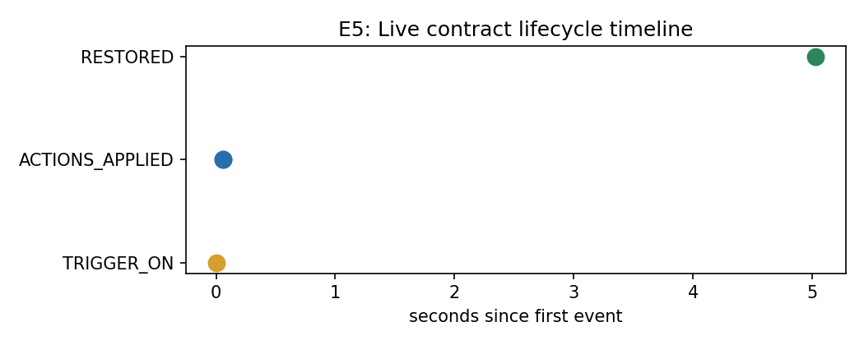
Results III — Live Lifecycle & Memory Guard
E5 + E6: complete condition→restoration loop
• E5: trigger→action 304.3 ms (live processes)
• E5: background nice restored exactly
• E6: memory 25%→70.0% under 900 MB load
• E6: contract triggered, hog nice→10, restored after clearance
304.3 ms
live trigger→action
40/40
exact restores
YES
memory guard lifecycle

Slide 14
Discussion
What the numbers mean
• Latency is deterministic and tunable: it equals the sampling interval operators choose
• Overhead low enough for always-on background operation
• Restoration solves the biggest flaw of ad-hoc scripting: policies that never get undone
• Limitations: sampling-based detection (not kernel events); privilege needed to raise priority on POSIX
• Works uniformly across Linux, WSL, macOS, Windows with graceful degradation

Slide 15
Conclusion & Future Work
• ARC = monitoring + event detection + contracts + dynamic enforcement + restoration in one layer
• Demonstrates OS concepts in a real system: scheduling, affinity, signals, cgroups, concurrency, protection
• Delivers full Review-3 scope: implementation, experimentation, performance evaluation
• Future: eBPF/proc-connector events, I/O + memory.high controls, contract conflict resolution, TUI/GUI manager, systemd packaging, publication extension

Slide 16
References
• [1] Linux Kernel Documentation, "Control Group v2." kernel.org
• [2] Linux Kernel Documentation, "The /proc Filesystem." kernel.org
• [3] Ananicy-cpp: An Auto Nice Daemon. github.com/CachyOS/ananicy-cpp
• [4] systemd-oomd.service. freedesktop.org
• [5] TuneD Project Documentation. tuned-project.org
• [6] S. Goodarzy et al., "SmartOS: Towards Automated Learning and User-Adaptive Resource Allocation in Operating Systems," APSys 2021
• [7] M. Kerrisk, "sched_setaffinity(2)," Linux man-pages
• [8] W. M. Stevens, S. A. Rago, Advanced Programming in the UNIX Environment, 3rd ed., 2013
• [9] psutil documentation. psutil.readthedocs.io

Slide 17
Thank You
Questions & Discussion • ARC demo available on Linux / WSL / macOS / Windows

