Slide 1
COVID-19 Global Impact Analysis & Visualization
Capstone Project Demonstration using Power BI
Presented by: Gagan Kumar J K
Course / Institution: Data Science/ IMARTICUS
September 2026
Notes:
Introduce the capstone and its purpose.

Slide 2
Project Overview
What the dashboard is designed to answer
• Analyze global COVID-19 trends over the available reporting period.
• Compare countries and WHO regions using cases, deaths, recoveries and active cases.
• Measure outcomes using Case Fatality Rate (CFR) and Recovery Rate.
• Use Power BI to turn raw records into interactive analytical views.
16,480,485
Latest global confirmed cases
654,036
Latest global deaths
3.97%
Latest global CFR
COVID-19 Capstone |
Notes:
Explain the project scope.

Slide 3
Dataset & Methodology
Actual uploaded dataset
35,156
Records
187
Countries
188
Dates
• Period: 22 January 2020 to 27 July 2020.
• 10 fields covering cumulative and daily COVID-19 measures plus WHO Region.
• Power Query supports preparation; DAX supports KPIs and rates.
• No vaccination variables are present, so vaccination is future scope.
COVID-19 Capstone |
Notes:
Explain the dataset and methodology.

Slide 4
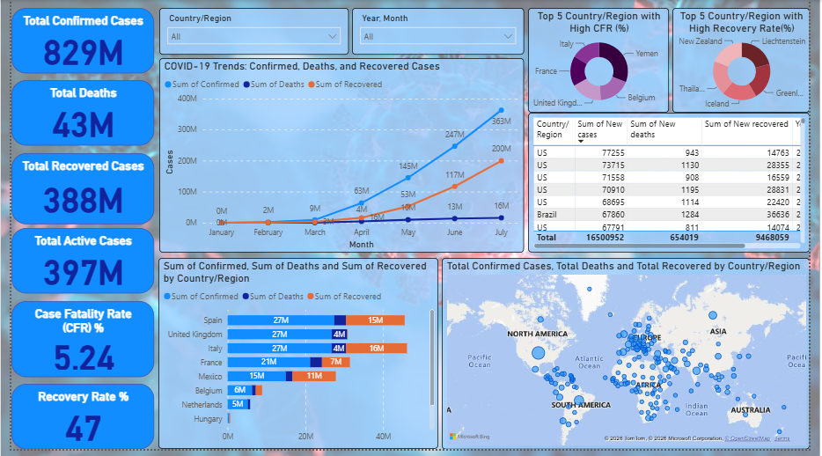
Dashboard Overview
COVID-19 Capstone |
Notes:
Walk through the KPI cards, trend, country comparison, CFR/recovery views and regional distribution.

Slide 5
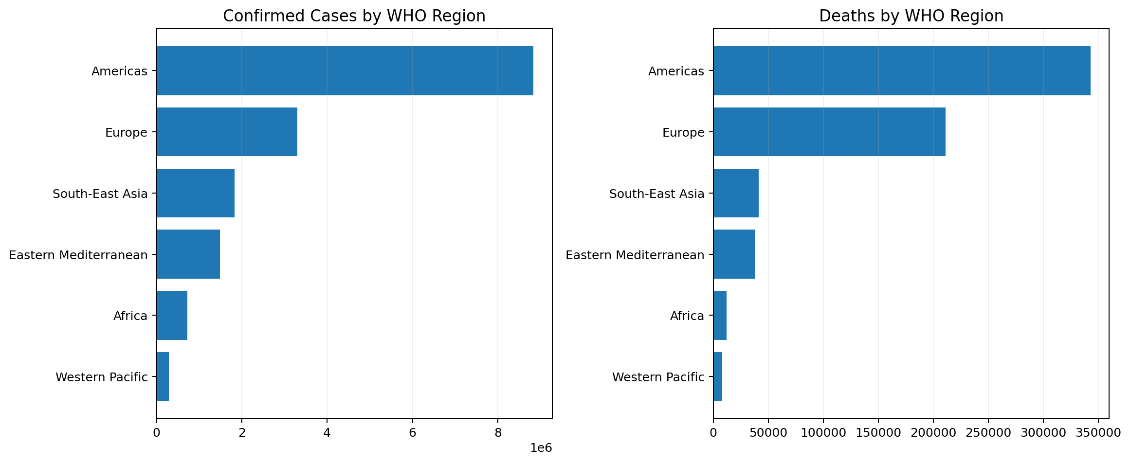
WHO Regional Analysis
Comparing COVID-19 burden across six WHO regions
• The Americas has the highest confirmed-case burden: 8,839,286.
• Regional impact is uneven across WHO regions.
• Deaths should be interpreted alongside case counts and CFR.
COVID-19 Capstone |
Notes:
The Americas has the highest confirmed-case burden at 8,839,286.

Slide 6
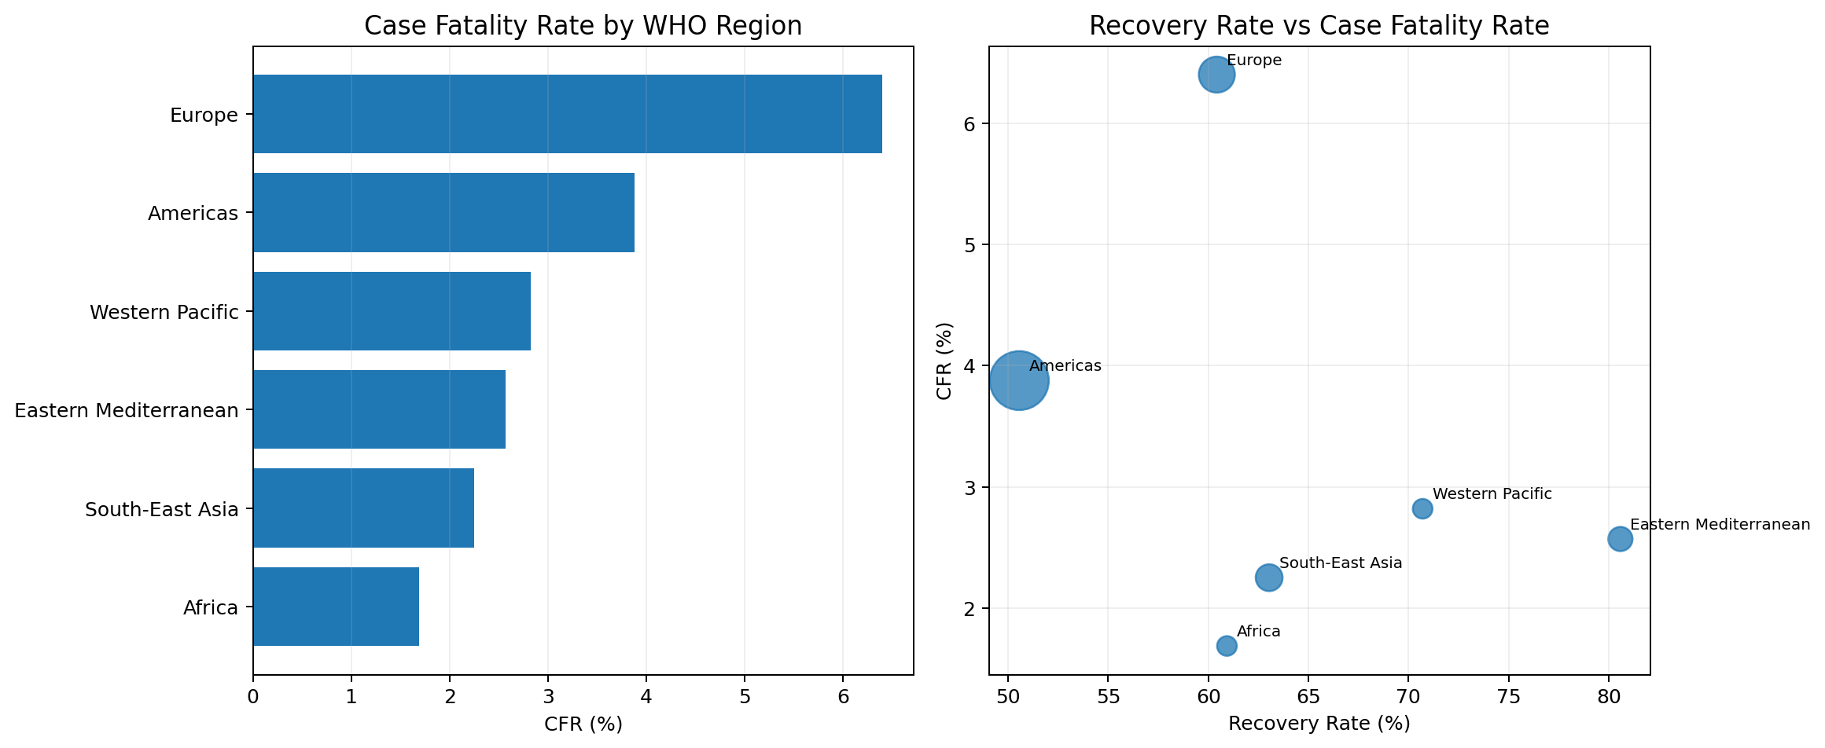
COVID-19 Severity Analysis
CFR and recovery provide outcome-focused measures
• CFR = Deaths ÷ Confirmed Cases × 100.
• Recovery Rate = Recovered ÷ Confirmed Cases × 100.
• Global CFR at final date: 3.97%.
• Global Recovery Rate at final date: 57.45%.
• The scatter view compares regional outcome patterns.
COVID-19 Capstone |
Notes:
Explain the rate calculations and avoid causal interpretation.

Slide 7
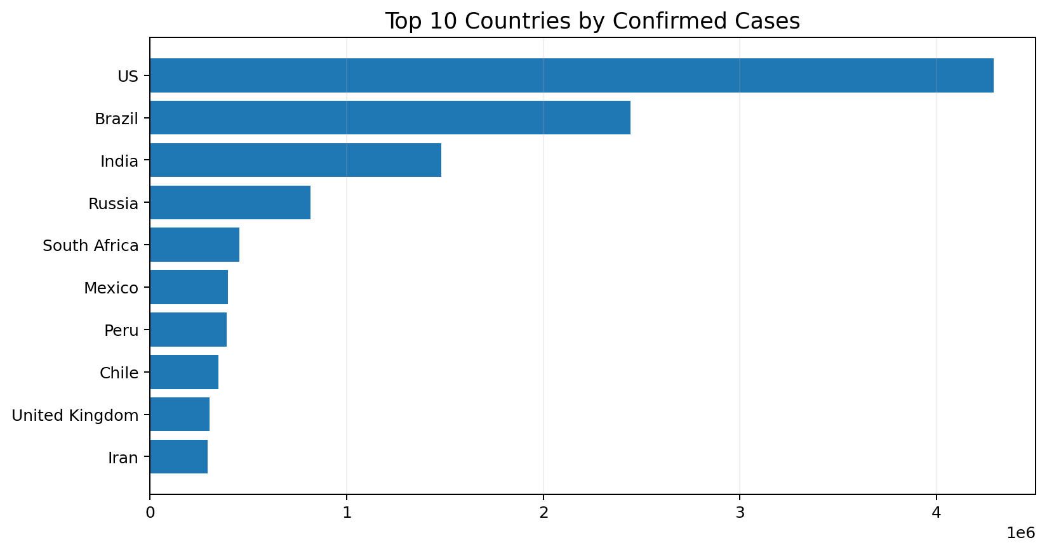
Country-Level Analysis
Top 10 countries by confirmed cases
• The leading country in confirmed cases is US with 4,290,259.
• Country comparison highlights concentration of case burden.
• Interactive filtering allows country-level investigation.
COVID-19 Capstone |
Notes:
Explain that the ranking uses the latest cumulative snapshot.

Slide 8
Key Insights
Evidence-backed observations from the dataset
16,480,485
Global confirmed cases
654,036
Global deaths
3.97%
Global CFR
57.45%
Global recovery rate
• The dataset reaches 16.48 million confirmed cases by 27 July 2020.
• The Americas has the largest confirmed-case burden among WHO regions.
• Daily new cases peak at 282,756 on 23 July 2020.
• COVID-19 burden and outcomes vary across countries and regions.
• CFR and Recovery Rate add outcome context beyond cumulative case counts.
COVID-19 Capstone |
Notes:
Present these as descriptive findings from the dataset.

Slide 9
Limitations
Important scope considerations
• The dataset ends on 27 July 2020 and does not represent the complete pandemic.
• No vaccination variables are included in the current dataset.
• Raw totals are not population-adjusted, so large countries can dominate rankings.
• The analysis is descriptive and does not establish causal relationships.
• Reporting practices and data quality may differ across countries.
COVID-19 Capstone |
Notes:
Acknowledge limitations.

Slide 10
Data Cleaning & Threshold Validation
How the raw CSV was checked before visualization
1. Structure & types
• Verified Date as date type
• Confirmed numeric fields
• Standardized field names and headers
2. Missing-value check
• Checked all 35,156 records
• Missing cells found: 0
• No missing values required imputation
3. Duplicate check
• Checked complete rows
• Duplicate rows found: 0
• No duplicate records required removal
4. Threshold / validity rules
• Cumulative cases, deaths and recoveries should be ≥ 0
• Daily counts are expected to be ≥ 0
• CFR should be between 0% and 100%
• Recovery Rate should be between 0% and 100%
5. Anomalies detected
• Active < 0: 2 records
• New deaths < 0: 38 records
• New recovered < 0: 77 records
These are reporting/reconciliation corrections, so they should be flagged rather than blindly deleted.
6. Transformation
• Aggregated country rows by Date for global trends
• Grouped countries into WHO regions
• Created DAX measures for dynamic KPIs
• Used latest-date logic for cumulative totals
Key point: Cleaning was not simply deleting unusual values. The data was validated against logical thresholds, while negative daily changes were treated as possible reporting corrections and considered when interpreting the dashboard.
COVID-19 Capstone |
Notes:
Explain the difference between cleaning and threshold validation. The dataset has no missing or duplicate rows. A small number of negative daily changes exist; these can reflect retrospective reporting corrections, so do not claim they were all deleted. Mention the logical thresholds used to validate measures.

Slide 11
DAX Measures & Business Logic
How Power BI converts raw fields into meaningful KPIs
Total Confirmed Cases
Total Confirmed Cases = SUM(full_grouped[Confirmed])
Total Deaths
Total Deaths = SUM(full_grouped[Deaths])
Total Recovered
Total Recovered = SUM(full_grouped[Recovered])
Fatality Rate (CFR)
Fatality Rate(CFR) = IF([Total Confirmed Cases]<>0, DIVIDE([Total Deaths],[Total Confirmed Cases])*100, 0)
Recovery Rate
Recovery Rate = if([Total Confirmed Cases]<>0,DIVIDE([Total Recovered],[Total Confirmed Cases])*100,0)
Total Active Cases
Total Active Cases = [Total Confirmed Cases]-[Total Deaths]-[Total Recovered]
COVID-19 Capstone project
Notes:
Explain that cumulative measures must use the latest date in the current filter context. The original SUM across every row produces a misleading value such as ~829M because it adds cumulative snapshots repeatedly. CFR and Recovery Rate are percentages created from the latest-date totals. The moving average uses daily new cases, not cumulative cases.

Slide 12
Conclusion & Future Scope
Closing the capstone story
• The project converts raw COVID-19 records into an interactive Power BI analytical dashboard.
• The dashboard supports global, country and WHO regional comparisons.
• Trend, CFR and recovery analysis provide complementary views of pandemic impact.
• The project demonstrates practical use of data preparation, DAX and visualization.
• Integrate vaccination and hospitalization datasets.
• Add population-adjusted rates.
• Explore forecasting and machine-learning models.
• Connect to refreshed or real-time sources.
• Add socioeconomic and healthcare-capacity indicators.
Thank You
Questions & Discussion
COVID-19 Capstone |
Notes:
Close by summarizing achievements and future scope.

