Slide 1
TITANIC
Survival Prediction
Data Cleaning • EDA • Decision Tree • Random Forest
Class Imbalance Handling • Model Comparison
Presented By: GAGAN KUMAR J K
CHETAN KUMAR
CHITHRA
NEHAAL R

Slide 2
Project Roadmap
The story of the project from raw data to model selection
01 Understand data
02 Clean & engineer
03 EDA
04 Train baseline models
05 Handle imbalance
06 Compare & interpret

Slide 3
1. Problem Statement
What are we predicting?
Target variable
survived → 0 = did not survive, 1 = survived
Learn patterns from passenger information.
Predict survival for unseen passengers.
Compare a single Decision Tree with ensemble methods.
Test whether imbalance-handling improves minority-class detection.
Problem type
Supervised learning • Binary classification

Slide 4
2. Dataset & Initial Inspection
The notebook begins with structure, statistics, nulls and duplicates
Original rows
891
Titanic records
Original columns
15
Variables
Duplicates
107
Removed in notebook
Final rows
784
After cleaning
df.info() → data types and non-null counts
df.describe(include='all') → statistical summary
df.isnull().sum() → missing-value inspection
df.duplicated().sum() → duplicate detection

Slide 5
3. Data Cleaning
Why each transformation was performed
Age
Median imputation
177 missing values
Embarked
Mode imputation
2 missing values
Deck
Create deck_known, then drop deck
Avoid large missing-category problem
Alive
Drop
Directly reveals survival → target leakage
who / alone / adult_male
Drop
Redundant or derived information
class / embark_town
Drop
Duplicate representations of pclass / embarked

Slide 6
4. Feature Engineering
Create features that express passenger context
family_size
sibsp + parch + 1
Captures the total family group size.
Final predictors
pclass • sex • age • fare • embarked • deck_known • family_size
deck_known
1 if deck information is present, otherwise 0.
Retains missingness information without using the mostly-missing deck category.
Encoding
Object/categorical columns are converted to numeric category codes before modeling.

Slide 7
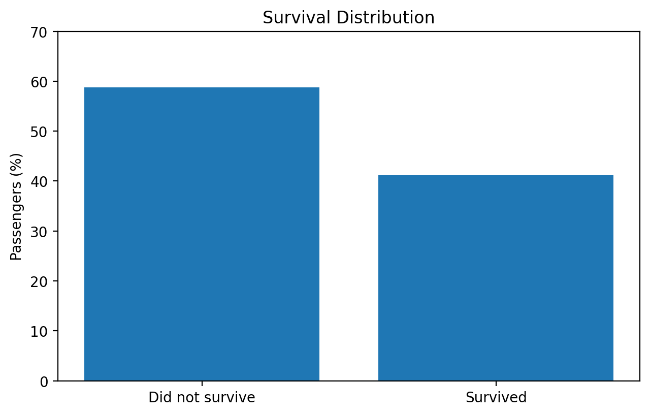
5. EDA — Survival Distribution
Understand the target before modeling
After the notebook cleaning, the target is approximately 58.8% class 0 and 41.2% class 1.
The classes are not perfectly balanced.
This provides a reason to test resampling methods.
Sampling must be applied to training data—not the test set.

Slide 8
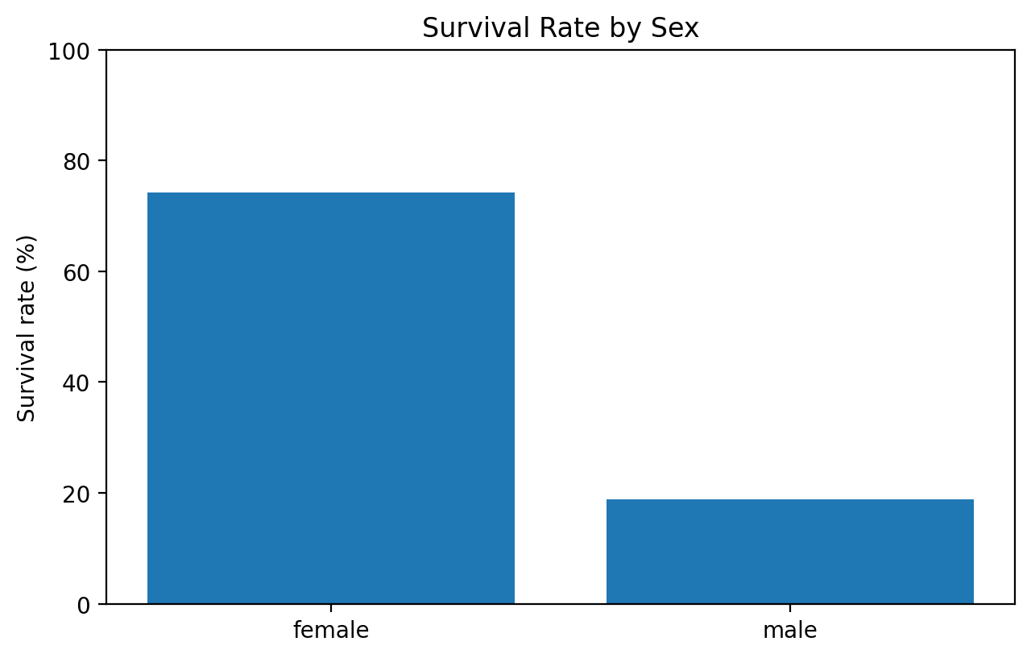
6. EDA — Survival by Sex
A strong relationship visible in the data
Female
74.2%
survival rate
Male
18.9%
survival rate
Sex becomes an important predictive variable.
EDA helps explain why the tree may choose sex-related splits.

Slide 9
7. Train / Test Split
How we prevent an overly optimistic evaluation
Training data — 70%
Used to learn model parameters and perform sampling.
test_size = 0.30
random_state = 42 → reproducible split
stratify = y → preserves target-class proportions
Resampling is performed only on training data.
Test data — 30%
Held back for final evaluation.

Slide 10
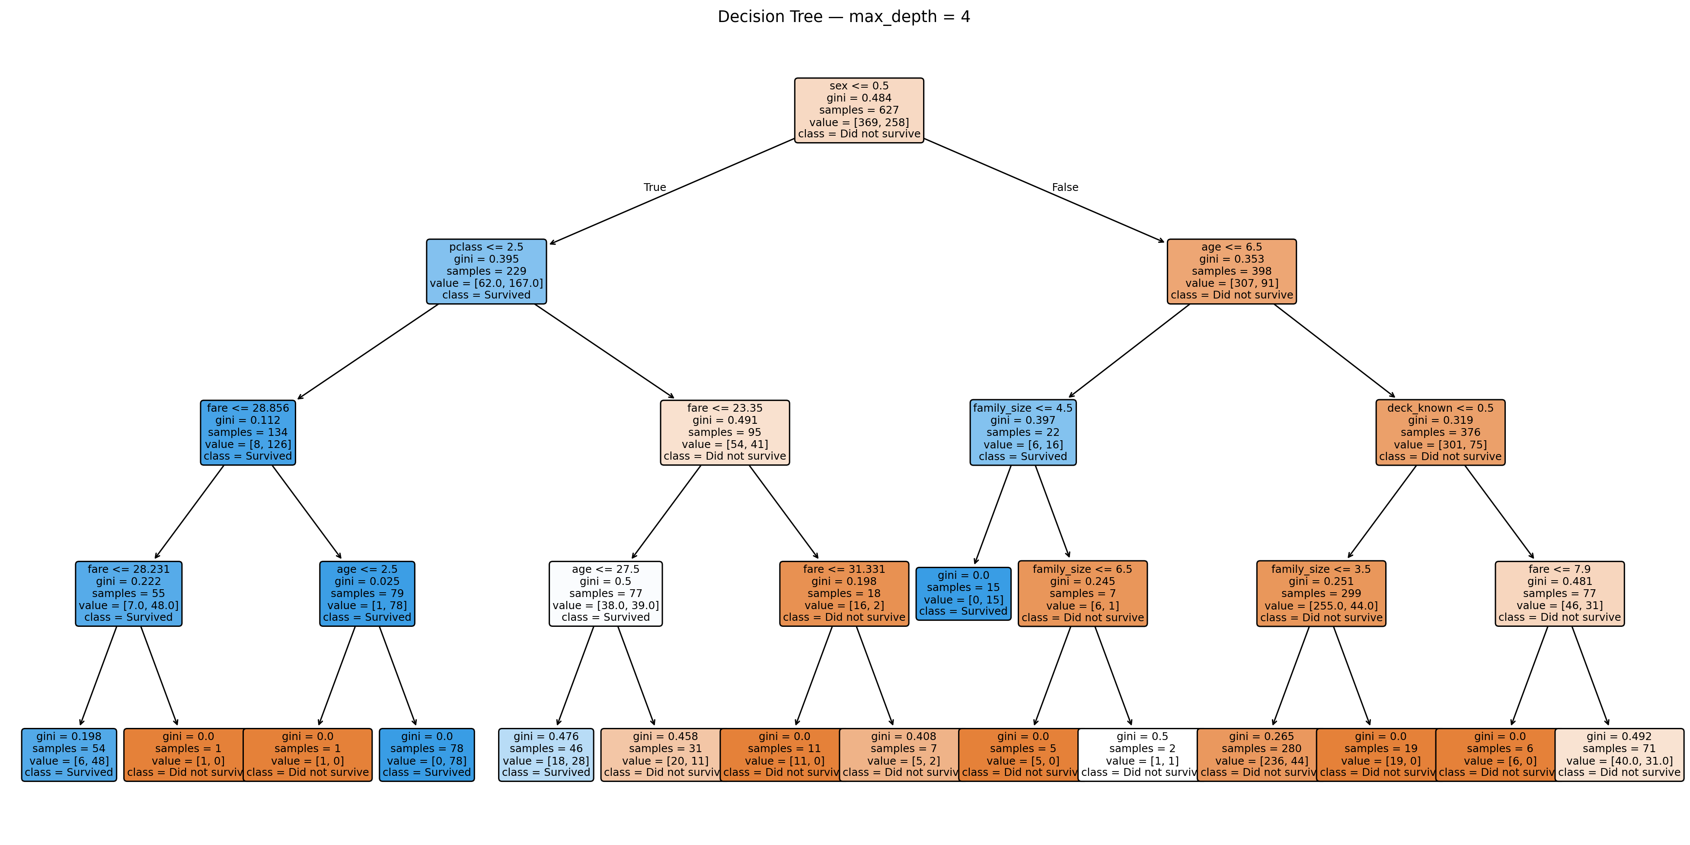
8. Decision Tree — How the Model Thinks
A tree makes sequential if/then decisions
max_depth = 4
The tree can grow to at most four decision levels.
Node
A condition such as a feature threshold/category code.
It splits the data.
Leaf
Final prediction based on the class distribution reaching that leaf.

Slide 11
9. Decision Tree Structure — Read One Path
How to interpret the tree visually
ROOT
First split chosen by the algorithm
INTERNAL NODE
Another condition
BRANCH
Condition outcome
LEAF
Prediction
The algorithm searches for splits that make the resulting groups more class-pure.
At a leaf, the model assigns the class with the strongest learned evidence.
max_depth = 4 limits how many levels can be used.
A shallow tree is easier to explain but may miss complex interactions.

Slide 12
10. Decision Tree — What Your Result Means
Baseline: Decision Tree
Accuracy
79.62%
Precision
86.67%
Recall
60.00%
F1
70.91%
The tree has high precision but comparatively low recall.
Interpretation: when it predicts survival, it is often correct, but it misses a substantial number of actual survivors.
This motivates testing class-imbalance methods.

Slide 13
11. Random Forest — From One Tree to Many
Ensemble learning
Tree 1
vote
Tree 3
vote
Random Forest trains many decision trees.
Bootstrap samples and feature randomness make the trees less identical.
The final prediction is based on the ensemble.
Baseline Random Forest in your results: 82.17% accuracy.
Tree 2
vote
Tree 4
vote
Aggregation
Combine tree predictions → final class

Slide 14
12. Why Sampling?
The objective is better minority-class learning
RandomOverSampler
Duplicates minority examples.
SMOTE
Creates synthetic minority examples using nearby minority observations.
ADASYN
Creates more synthetic examples in harder minority regions.
SMOTE-Tomek
SMOTE + removes some overlapping/borderline pairs.
SMOTEENN
SMOTE + removes samples judged noisy/ambiguous by ENN.
Bagging
Trains multiple models on bootstrap samples and aggregates predictions.

Slide 15
13. RandomOverSampler (ROS)
Simple duplication strategy
Find the minority class.
Randomly duplicate minority observations.
Train the model on the more balanced training set.
No synthetic values are created.
ROS + RF
83.44%
accuracy
Recall
87.69%
highest in table
F1
81.43%
highest in table
Precision
76.00%
trade-off

Slide 16
14. SMOTE
Synthetic Minority Over-sampling Technique
Select a minority-class observation.
Find nearby minority-class neighbors.
Create a synthetic point between them.
Repeat until the desired training balance is reached.
Your result — SMOTE + RF
Accuracy 82.80% • Recall 86.15% • F1 80.58%
Why it differs from ROS
SMOTE adds new synthetic observations rather than exact duplicates.

Slide 17
15. ADASYN
Adaptive Synthetic Sampling
ADASYN is related to SMOTE.
It adapts synthetic generation toward minority examples that are harder to learn.
This can emphasize difficult decision-boundary regions.
Its performance depends on the dataset and classifier.
ADASYN + DT
82.80%
accuracy
Precision
86.54%
high precision
Recall
69.23%
lower recall
F1
76.92%

Slide 18
16. SMOTE-Tomek
Oversampling + boundary cleaning
Step 1
SMOTE generates synthetic minority examples.
Step 2
Tomek links identify very close opposite-class pairs.
Step 3
Remove some ambiguous/overlapping observations.
Accuracy
83.44%
Recall
86.15%
F1
81.16%

Slide 19
17. SMOTEENN
Oversampling + aggressive cleaning
SMOTE
Generate synthetic minority examples.
ENN
Remove samples whose nearest-neighbor class pattern suggests noise/ambiguity.
Your result
78.34% RF • 77.07% DT
In this experiment, SMOTEENN produced lower accuracy than the other approaches.
That does not mean SMOTEENN is universally poor; it means this particular combination did not perform as well on this dataset/setup.

Slide 20
18. BaggingClassifier
Bootstrap Aggregating
Create multiple bootstrap training samples.
Train a base estimator on each sample.
Aggregate the predictions.
You tested both Decision Tree and Random Forest as ensemble components.
Bagging + DT
81.53%
accuracy
Precision
90.91%
highest precision
Bagging + RF
81.53%
accuracy
Recall
61.54–66.15%
lower recall

Slide 21
19. Evaluation Metrics — Know the Difference
Use the confusion matrix to understand the numbers
Accuracy
(TP + TN) / all predictions
Overall correctness.
Precision
TP / (TP + FP)
How reliable positive predictions are.
Recall
TP / (TP + FN)
How many actual positives were found.
F1 Score
2 × Precision × Recall / (Precision + Recall)
Balances both.
Baseline RF: high precision (87.76%) but recall only 66.15%.
ROS + RF: precision falls to 76.00%, while recall rises to 87.69%.
This demonstrates the precision–recall trade-off created by resampling.

Slide 22
20. Complete Model Comparison
Exact results supplied for the project
Model | Accuracy | Precision | Recall | F1 Score
SMOTE-Tomek + Random Forest | 0.8344 | 0.7671 | 0.8615 | 0.8116
ROS + Random Forest | 0.8344 | 0.7600 | 0.8769 | 0.8143
ADASYN + Decision Tree | 0.8280 | 0.8654 | 0.6923 | 0.7692
SMOTE + Random Forest | 0.8280 | 0.7568 | 0.8615 | 0.8058
ADASYN + Random Forest | 0.8217 | 0.7534 | 0.8462 | 0.7971
Random Forest | 0.8217 | 0.8776 | 0.6615 | 0.7544
Bagging Classifier RF | 0.8153 | 0.8600 | 0.6615 | 0.7478
Bagging Classifier DT | 0.8153 | 0.9091 | 0.6154 | 0.7339
ROS + Decision Tree | 0.8025 | 0.7179 | 0.8615 | 0.7832
SMOTE-Tomek + Decision Tree | 0.8025 | 0.8542 | 0.6308 | 0.7257
SMOTE + Decision Tree | 0.7962 | 0.7463 | 0.7692 | 0.7576
Decision Tree | 0.7962 | 0.8667 | 0.6000 | 0.7091
SMOTEENN + Random Forest | 0.7834 | 0.6962 | 0.8462 | 0.7639
SMOTEENN + Decision Tree | 0.7707 | 0.6933 | 0.8000 | 0.7429

Slide 23
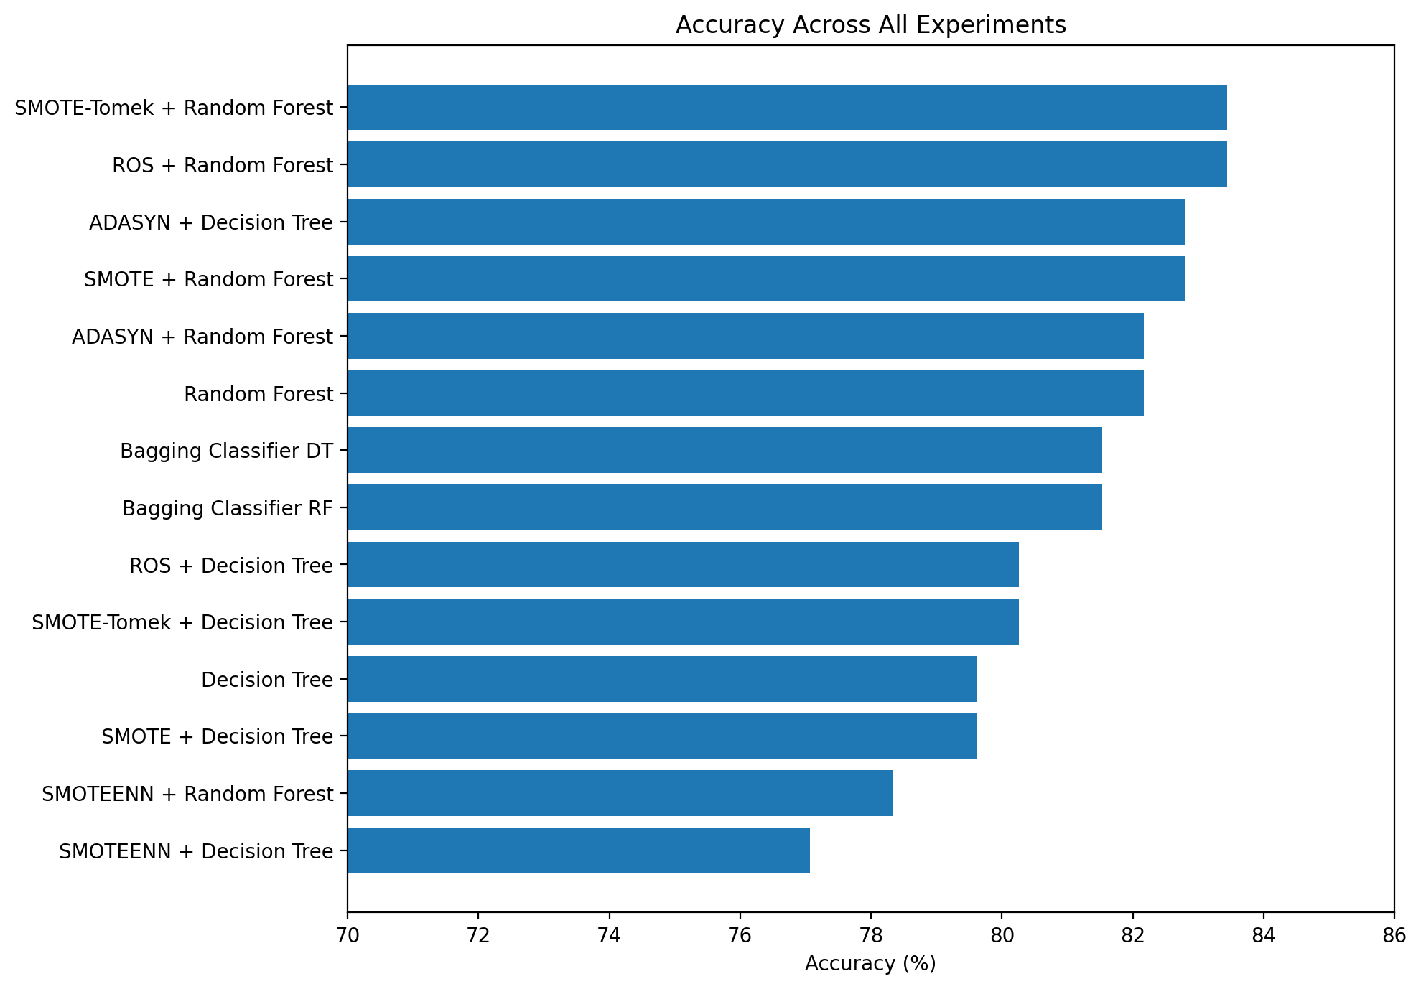
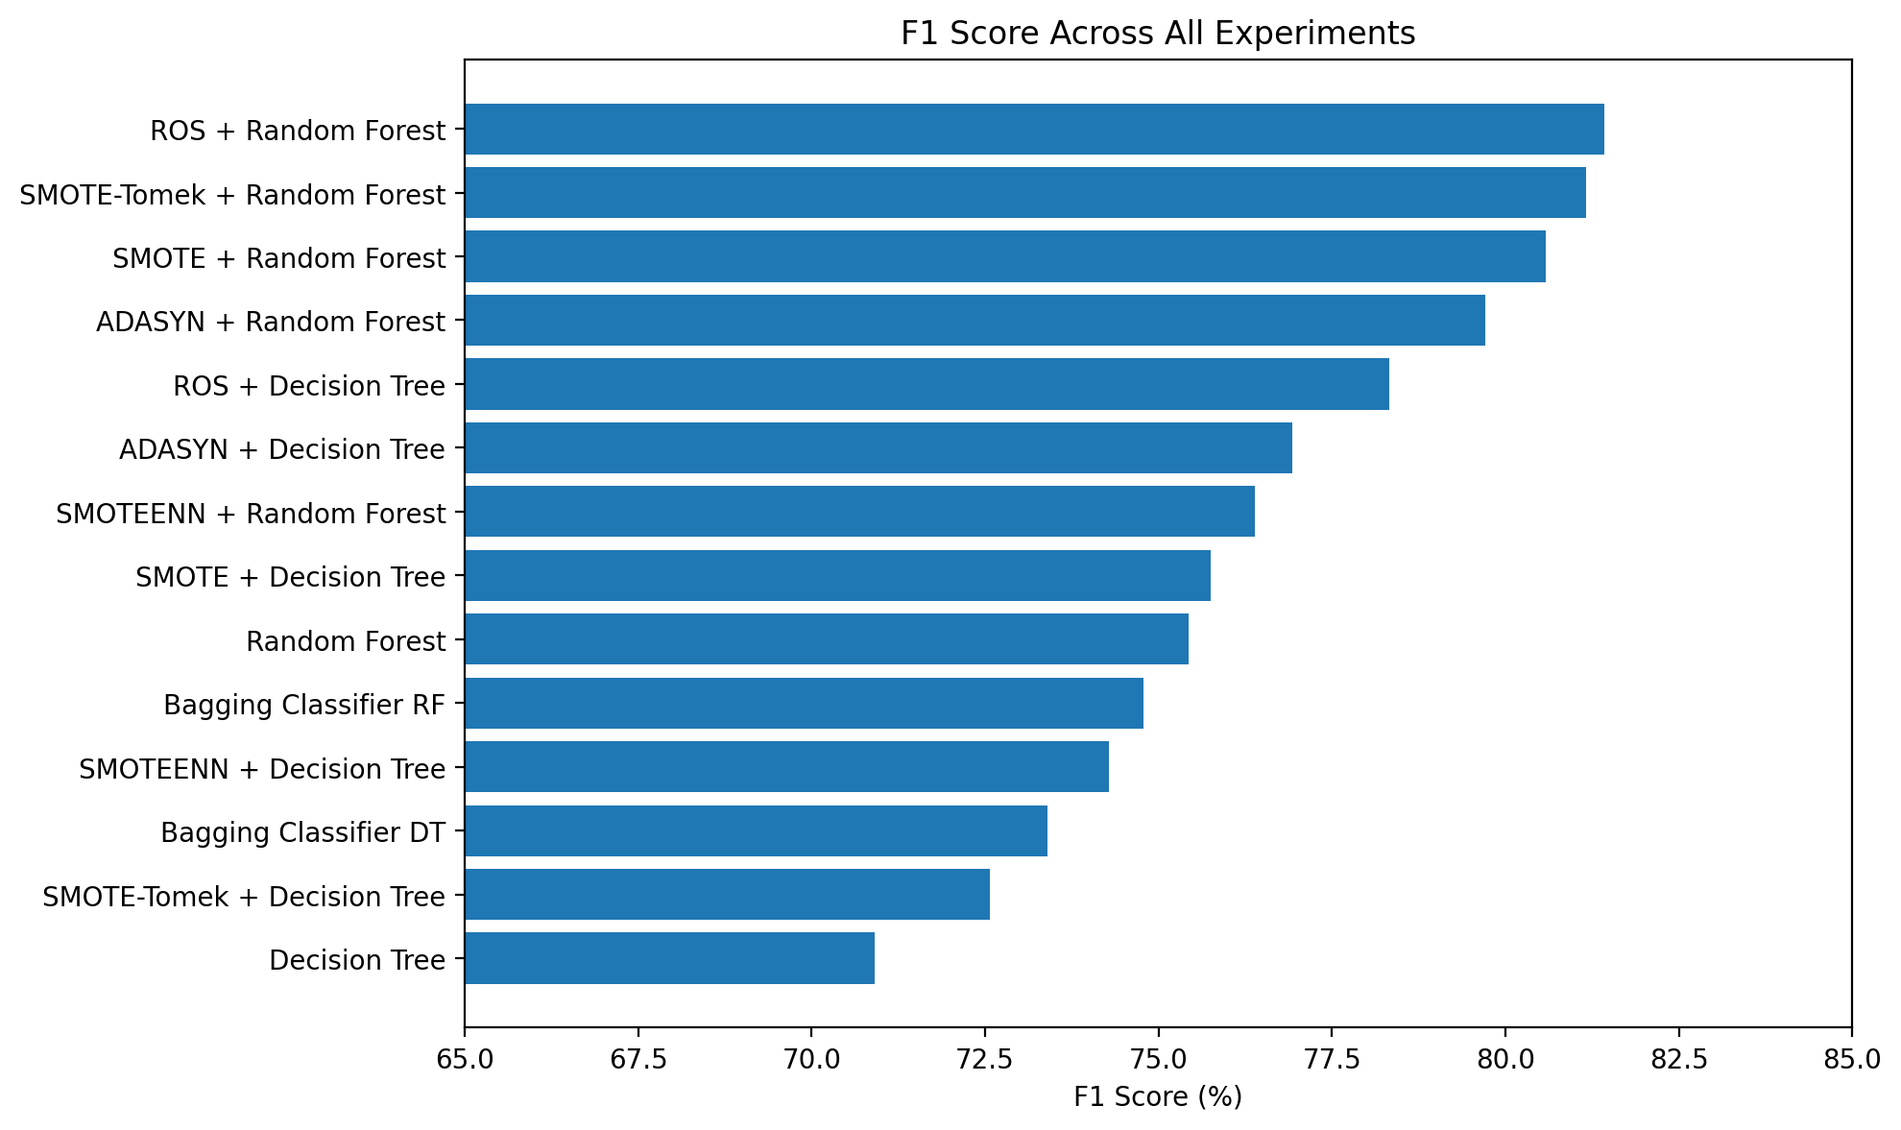
21. Results at a Glance
Accuracy and F1 across all experiments

Slide 24
22. Interpreting the Best-Performing Models
Use the metric profile, not accuracy alone
SMOTE-Tomek + Random Forest
83.44% accuracy • 76.71% precision • 86.15% recall • 81.16% F1
ROS + Random Forest
83.44% accuracy • 76.00% precision • 87.69% recall • 81.43% F1
Accuracy is tied at 83.44%.
ROS + RF has higher recall and higher F1 in the supplied table.
SMOTE-Tomek + RF has slightly higher precision.
Therefore, if the presentation uses F1/Recall as the main selection criteria, ROS + Random Forest is the strongest candidate among these tested models.
Final selection should still be validated with cross-validation before claiming generalization.

Slide 25
24. Next Steps to Make the Result Stronger
How to turn this into a more rigorous ML project
5-Fold Cross-Validation
Check whether the top performance is stable across folds.
Hyperparameter Tuning
Tune max_depth, min_samples_split, min_samples_leaf, n_estimators and max_features.
Pipeline
Keep sampling inside each training fold to prevent leakage.
Do not select a model only because it produced the highest score on one test split.
Compare mean CV Accuracy, F1 and ROC-AUC plus variability.
Keep the final test set untouched until the model-selection process is finished.

Slide 26
25. Final Takeaways
The complete story in four points
Highest Accuracy
83.44%
2 models tied
Highest Recall
87.69%
ROS + RF
Highest F1
81.43%
ROS + RF
Baseline RF
82.17%
before sampling
Decision Tree gives interpretability; Random Forest gives an ensemble of trees.
Sampling changes the precision–recall balance, not just the accuracy.
ROS + Random Forest is the strongest candidate in the supplied results when considering F1 and Recall together.
Cross-validation and hyperparameter tuning are the logical next steps before treating the result as final.

Slide 27
26. SMOTE-Tomek + Random Forest — Confusion Matrix
Detailed evaluation using the confusion matrix you provided
 |  | Predicted
 | Class | 0 | 1
Actual | 0 | 74 | 18
 | 1 | 9 | 56
True Negative (TN)
74 correctly predicted as did not survive.
False Positive (FP)
18 predicted to survive but did not.
False Negative (FN)
9 survived but were predicted not to survive.
True Positive (TP)
56 correctly predicted as survivors.
Key observation
56 of 65 actual survivors were detected; 74 of 92 actual non-survivors were correctly identified.

Slide 28
27. SMOTE-Tomek + Random Forest — Sensitivity & Specificity
Detailed calculation and interpretation
Sensitivity / Recall — 86.15%
TP / (TP + FN)
= 56 / (56 + 9)
= 56 / 65 = 86.15%
Specificity — 80.43%
TN / (TN + FP)
= 74 / (74 + 18)
= 74 / 92 = 80.43%
Precision — 75.68%
TP / (TP + FP)
= 56 / (56 + 18)
= 56 / 74 = 75.68%
Sensitivity: detecting actual survivors
There were 65 actual survivors. The model correctly identified 56 and missed 9. Therefore, it detected 86.15% of the actual survivors.
Specificity: detecting actual non-survivors
There were 92 actual non-survivors. The model correctly identified 74 and incorrectly predicted 18 as survivors. Therefore, specificity was 80.43%.
Presentation takeaway
The model detects actual survivors at 86.15% sensitivity and actual non-survivors at 80.43% specificity.

Slide 29
28. Why SMOTE-Tomek + Random Forest?
How the sampling method and ensemble model work together
1. SMOTE
Generates synthetic minority-class examples from nearby minority observations, giving the learner more balanced training information.
2. Tomek Links
Identifies very close observations from opposite classes and removes some ambiguous or overlapping pairs, helping clean the class boundary.
3. Random Forest
Combines predictions from many decision trees, allowing the ensemble to capture different patterns in the training data.
Your supplied model result
SMOTE-Tomek + RF: 83.44% accuracy, 76.71% precision, 86.15% recall, and 81.16% F1.
What to say
“SMOTE-Tomek balances the minority class and cleans some borderline overlap, while Random Forest combines multiple trees. In our experiments this combination achieved strong accuracy and high recall.”
Consistency note
Your supplied matrix [[74, 18], [9, 56]] implies 82.80% accuracy (130/157), while the comparison table lists 83.44%. This suggests the matrix may be from a different run/split. Use one consistent run in the final presentation.

Slide 30
THANK YOU

