Slide 1
Plant Leaf Disease Classification
End-to-End Machine Learning & Deep Learning Project
Traditional ML → CNN → MobileNetV2 Transfer Learning → EfficientNetB0
1

Slide 2
1. Problem Statement & Objective
Plant diseases can reduce crop health and yield; visual identification can be difficult when symptoms look similar.
Objective: build an image-classification system that predicts the plant disease class from a leaf image.
Scope: 23 PlantVillage classes covering Apple, Corn, Pepper, Potato and Tomato leaves.
Compare traditional machine learning with deep learning and transfer-learning approaches.
Create a reusable prediction function for a new leaf image.
2

Slide 3
2. Dataset Overview
Dataset: PlantVillage image dataset; class labels are represented by folder names.
Original class counts were imbalanced: the smallest class had 152 images and the largest had 3,208 images.
To create a controlled comparison, 150 images were sampled from each of the 23 classes.
Final balanced working dataset: 23 × 150 = 3,450 images.
Images were originally 256 × 256 RGB; model pipelines resized them to 224 × 224 for transfer learning.
23
classes
150
images/class
3,450
total images
256²
source size
3

Slide 4
3. Class Distribution After Balancing
Class group | Classes | Images/class | Total images
Apple | 4 | 150 | 600
Corn | 4 | 150 | 600
Pepper | 2 | 150 | 300
Potato | 3 | 150 | 450
Tomato | 10 | 150 | 1500
TOTAL | 23 | 150 each | 3450
Balancing reduced the influence of classes with much larger original sample counts.
The resulting dataset gives every class equal representation during the main experiments.
This makes accuracy comparisons across classes easier to interpret.
4

Slide 5
4. Data Cleaning & Preprocessing
Collected image paths and labels directly from the class-folder structure.
Converted images to RGB to ensure a consistent three-channel input.
Verified image dimensions on sampled images; source images were 256 × 256.
Traditional ML pipeline: resized to 64 × 64, converted to float32 and normalized to 0–1.
Deep-learning pipeline: resized to 224 × 224 for MobileNetV2 / EfficientNetB0.
Applied data augmentation during training: horizontal flip, rotation, zoom and contrast; stronger experiments also tested translation.
Labels were encoded into 23 numeric classes.
5

Slide 6
5. Exploratory Data Analysis (EDA)
Reviewed all 23 class folders and class names.
Displayed representative images from every class to understand visual differences.
Inspected image dimensions and RGB format.
Checked the class distribution before and after balancing.
EDA showed that several diseases have visually similar symptoms, especially within tomato and apple categories.
This visual similarity explains why class-level precision/recall is important in addition to overall accuracy.
23
classes inspected
256×256
source resolution
6

Slide 7
6. Train / Validation / Test Strategy
Deep-learning split: 70% training, 15% validation, 15% test, stratified by class.
Train set: 2,415 images.
Validation set: 517 images.
Test set: 518 images.
The test set was kept separate for final evaluation.
Traditional ML used a separate 80/20 train-test split: 2,760 training and 690 test images.
Because the protocols differ, traditional-ML test accuracy and deep-learning test accuracy should be presented as separate experiments rather than a single perfectly controlled benchmark.
2,415
Train • 70%
517
Validation • 15%
518
Test • 15%
23
classes
7

Slide 8
7. Traditional Machine Learning Baseline
Images were flattened after 64 × 64 preprocessing.
StandardScaler + PCA (95% variance) reduced the flattened feature space to 489 components.
Logistic Regression: 54.78%
KNN: 38.99%
Random Forest: 46.09%
SVM with RBF kernel: 67.10% — strongest traditional baseline.
8

Slide 9
8. CNN Model from Scratch
Input: 224 × 224 × 3 RGB leaf image.
Augmentation: horizontal flip, rotation and zoom.
Convolution blocks: 32 → 64 → 128 filters with max-pooling.
Global Average Pooling followed by Dense(128) and Dropout(0.5).
Final layer: 23-class softmax.
The earlier 64 × 64 CNN reached 73.89% validation accuracy after 20 epochs.
The CNN demonstrated the benefit of learned image features, but transfer learning was explored to improve performance and convergence.
73.89%
earlier CNN best validation
23
softmax classes
9

Slide 10
9. MobileNetV2 Transfer Learning
MobileNetV2 was loaded with ImageNet pretrained weights; this is the transfer-learning stage.
The pretrained convolutional base was initially frozen.
A classification head was added: Global Average Pooling → Dense(256) → Dropout(0.4) → Dense(23, softmax).
Training used Adam optimizer, categorical-classification loss and validation monitoring.
Data augmentation was applied to improve robustness to image variation.
This approach reuses features learned from a large image dataset instead of learning all visual features from scratch.
ImageNet
pretrained weights
224×224
input size
10

Slide 11
10. MobileNetV2 Fine-Tuning
After the frozen-base stage, the last 40 MobileNetV2 layers were unfrozen.
Fine-tuning used a much smaller learning rate (1e-5) to make controlled updates to pretrained features.
The better fine-tuning run achieved a best validation accuracy of approximately 89.17%.
Final held-out test evaluation of the saved model best_plant_disease_224_finetuned.keras: 89.19% accuracy.
Test loss: 0.3379.
The gap between training and validation accuracy was monitored to identify overfitting.
89.94%
best validation reported
89.19%
held-out test
0.3379
test loss
11

Slide 12
11. EfficientNetB0 Experiment
EfficientNetB0 was tested as a second transfer-learning architecture at 224 × 224.
The base network was initially frozen and trained with a classification head.
Frozen-base run: final training accuracy 92.26%; final validation accuracy 88.39%; best validation accuracy 89.55%.
Fine-tuning was then attempted by unfreezing the last 30 layers with learning rate 1e-5.
Fine-tuning did not improve validation performance; the shown final validation accuracy was 88.39%, with best around 88.59%.
The experiment therefore did not replace the MobileNetV2 model as the final saved model.
89.55%
best validation
92.26%
final train accuracy
12

Slide 13
12. Model Comparison — Accuracy Results
Model | Evaluation metric | Result | Notes
Logistic Regression | Test accuracy | 54.78% | Traditional baseline
KNN | Test accuracy | 38.99% | Lowest baseline
Random Forest | Test accuracy | 46.09% | Tree-based baseline
SVM (RBF) | Test accuracy | 67.10% | Best traditional ML
CNN from scratch | Best validation | 73.89% | Earlier 64×64 CNN run
MobileNetV2 | Best validation | 89.94% | 224×224 fine-tuning run
MobileNetV2 | Held-out test | 89.19% | Final saved model
EfficientNetB0 | Best validation | 89.55% | No held-out test result captured
13

Slide 14
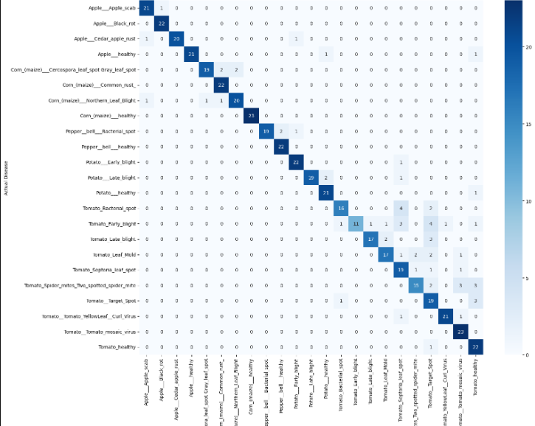
14. Confusion Matrix — Final MobileNetV2 Test Results
How to read it
• Rows show the actual disease class; columns show the predicted class.
• Dark diagonal cells represent correct classifications.
• Off-diagonal values represent misclassified leaves.
What the matrix shows
• Apple classes are concentrated strongly along the diagonal.
• Corn Common Rust and Corn Healthy show strong correct-class counts.
• Potato Early Blight, Potato Late Blight and Potato Healthy are also predominantly diagonal.
• More confusion appears among the Tomato disease classes because their leaf symptoms are visually similar.
• Tomato Early Blight shows notable confusion with other tomato diseases, including Tomato Late Blight and Target Spot.
• Tomato Spider Mites and Tomato Target Spot also have visible off-diagonal errors.
Key takeaway
The model performs well on several classes, but the confusion matrix identifies visually similar tomato diseases as the main area for improvement.
14

Slide 15
14. Class-Level Performance — Final MobileNetV2
Class / group | Precision | Recall | F1
Corn common rust | 1.00 | 1.00 | 1.00
Corn healthy | ≈0.98 | ≈0.98 | ≈0.98
Potato early blight | ≈0.98 | ≈0.98 | ≈0.98
Potato healthy | ≈0.98 | ≈0.98 | ≈0.98
Pepper healthy | ≈0.94 | ≈0.94 | ≈0.94
Tomato Septoria leaf spot | ≈0.93 | ≈0.93 | ≈0.93
Tomato Yellow Leaf Curl Virus | ≈0.91 | ≈0.91 | ≈0.91
Tomato mosaic virus | ≈0.90 | ≈0.90 | ≈0.90
Tomato healthy | ≈0.90 | ≈0.90 | ≈0.90
Tomato Early Blight | 0.83 | 0.43 | 0.57
Tomato Spider Mites | 0.53 | 0.83 | 0.64
Tomato Leaf Mold | 1.00 | 0.52 | 0.69
15

Slide 16
15. Why MobileNetV2 Was Used
CNN architecture designed for efficient image feature extraction with comparatively low computational cost.
ImageNet pretraining provides reusable visual representations such as edges, textures and higher-level patterns.
Global Average Pooling reduces the number of parameters compared with a large flattened feature vector.
Fine-tuning adapts the later pretrained features to plant-leaf disease patterns.
The 224 × 224 MobileNetV2 pipeline achieved 89.19% on the held-out test set.
The model was saved as best_plant_disease_224_finetuned.keras and a class-name JSON file was saved for inference.
16

Slide 17
16. New Leaf Prediction Pipeline
Load best_plant_disease_224_finetuned.keras.
Load the 23 class names from plant_disease_class_names.json.
Open a new leaf image and convert it to RGB.
Resize to 224 × 224 and add the batch dimension.
Run model.predict() and select the class with the highest probability.
Display predicted disease and confidence; optionally return Top-3 predictions.
Important: a real-world photo may perform differently from PlantVillage images because of lighting, background, camera angle and image quality.
224×224
inference size
23
possible classes
17

Slide 18
17. End-to-End Workflow
Dataset
PlantVillage
23 classes
Balance
150/class
3,450 images
Clean
RGB + resize
label encoding
EDA
class + image
inspection
Baseline
ML models
SVM 67.10%
Deep Learning
CNN
MobileNetV2
Fine-tune
last 40 layers
LR 1e-5
Evaluate
test set
89.19%
Predict
new leaf
Top-1 / Top-3
The project combines data preparation, exploratory analysis, classical ML benchmarking, CNN development, transfer learning, fine-tuning and deployment-oriented inference.
18

Slide 19
18. Key Findings & Limitations
Traditional ML established a baseline; SVM performed best among the tested classical models at 67.10% test accuracy.
CNN-based deep learning improved the validation performance substantially over the traditional baselines.
MobileNetV2 transfer learning + fine-tuning produced the final held-out test accuracy of 89.19%.
EfficientNetB0 achieved up to 89.55% validation accuracy in the recorded experiment, but its fine-tuning did not improve the result and no final held-out test score was captured.
PlantVillage-style images are relatively controlled; performance on phone photographs can be lower because of domain shift.
Random image-level splitting can also make evaluation optimistic if near-duplicate/augmented variants are present; a group-aware or external-field test set would strengthen future validation.
19

Slide 20
19. Conclusion & Future Scope
Successfully developed a 23-class plant leaf disease classification pipeline.
Prepared and balanced 3,450 images and evaluated multiple machine-learning and deep-learning approaches.
Final saved MobileNetV2 fine-tuned model achieved 89.19% held-out test accuracy.
The system supports single-image inference through a reusable prediction function.
Future work: collect field images, add an external validation set, improve hard tomato classes, test stronger augmentation, and consider model calibration / confidence thresholds.
Potential deployment: lightweight web or mobile interface for image-based preliminary disease classification.
20

Slide 21
Thank You
Plant Leaf Disease Classification Using Deep Learning
MobileNetV2 • Transfer Learning • Fine-Tuning • 89.19% Test Accuracy
22

