Slide 1
Group Chat App
Submitted By : Group 9
Abhishek Kumar - 17114005
Gagan Kumre - 17114028
Gandhi Ronnie - 17114029
Hemant Singh - 17114038
Kishan Kumar - 17114046
Siddhant Nayak - 17114071

Slide 2
Introduction
We have used Socket programming to build a platform for reliable conveyance and smooth flow of information from the administration to the students alongside functionality of students being able to communicate with each other as well. The platform(Group chat app) has authentication feature as well so only relevant people(Students of same college) can participate and use the platform.

Slide 3
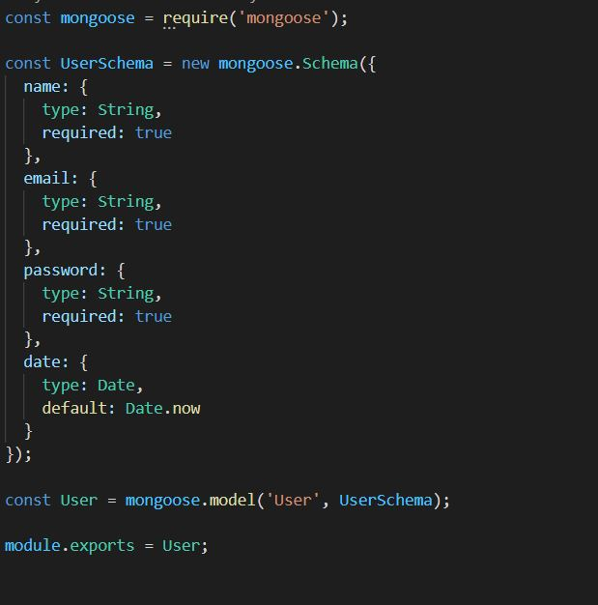
Backend Architecture for User Model
The app has a User model that defines basic information of a user like name, email, password and date.
The information for all users is stored in a MongoDB database

Slide 4
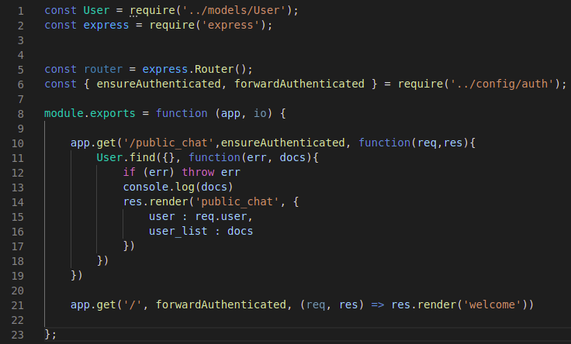
Index.Js
It integrates the user model to the public_chat page route.

Slide 5
Authentication
Passport.js: provides encryption with serializers and deserializer functions and makes login a secure process for the users
auth.js: it makes sure only trusted and authenticated emails are allowed else it will show an error message.
users.js : used in registering the new user and validation of his details (checking of password length, checking the domain of email, comparison of confirm password and password, checking if user already exists etc.)

Slide 6
Authentication
Front end
Back end
auth/login/signup
users.js
auth.js &
passport.js
Validation of email and hashing of password
------------------
login/signup
auth/login failed
serialize/
deserialize user
find/
create user
auth/logout
auth/login success
mongodb
public_chat

Slide 7
Backend Architecture for creating routes
There are following route for each purpose:
user.js : It integrates the user model to the login page route, register page route, and also takes care of logout on the public chat page.
public_chat.Js: It handles integration of socket.io with the rest of the backend of the app by building a connection.

Slide 8
No
Valid Cred-entials
Starting Page
On clicking Login button
Login page
No Errors
On clicking Register button
Check for errors?
Yes
Register Page
Public Chat
Detected some errors

Slide 9
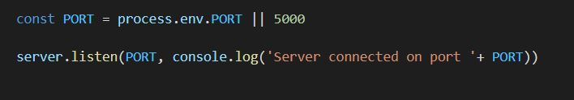
Socket programming
Set the environment variable PORT to tell the web server what port to listen on.
Created an event to send the username to the server when people click on the button.
Created the server to accept the new username sent by client and update all users.
Created the server to accept connections from the client.

Slide 10
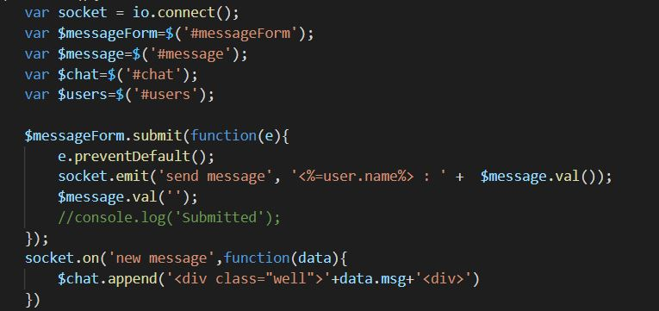
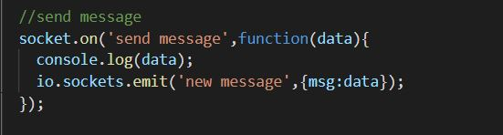
Socket Programming
Created the link between server and client for messaging. (i) Client Side for the messaging (ii) Server Side of the messaging
Created an event to disconnect clients from the server.

Slide 11
User Interface
The UI for this app consists of:
A welcome page asking if you are a new user or want to login.
Then there is a register pager or login page based on what user chooses. In case user registers, he/she is forwarded to login
After the user logs in, the public chat page is shown. Here every user
can see messages posted from other users
post message themselves also.

Slide 12
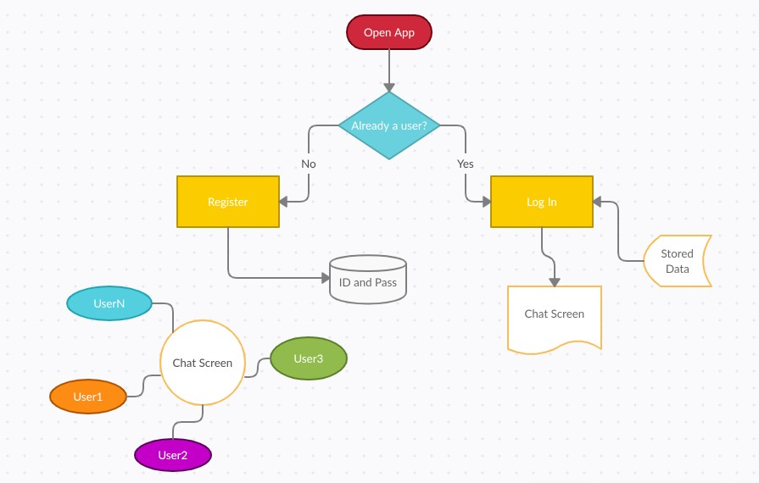

Slide 13
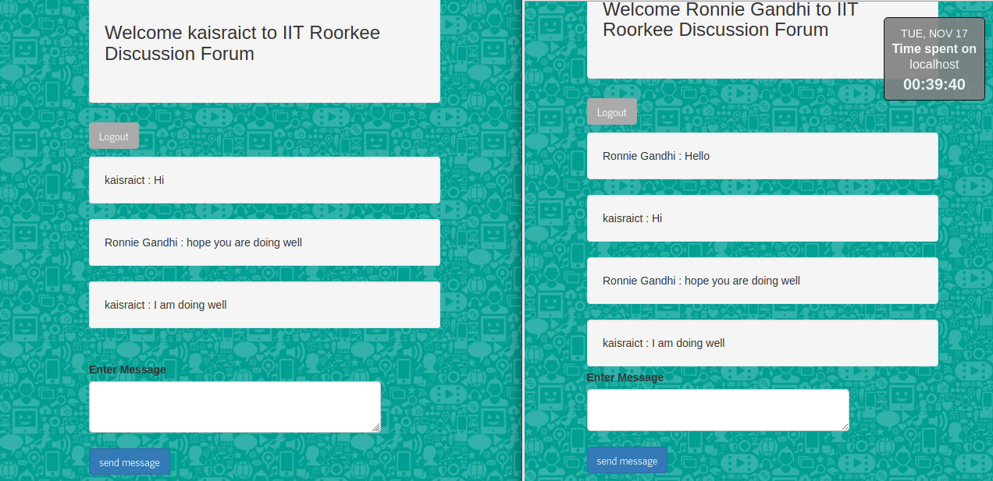
User Interface
The UI for this app consists of:
A welcome page asking if you are a new user or want to login.
Then there is a register pager or login page based on what user chooses. In case user registers, he/she is forwarded to login
After the user logs in, the public chat page is shown. Here every user
can see messages posted from other users
post message themselves also.

Slide 14
User Interface Code
welcome.ejs: Created the welcome page with container having chat app logo + title + asking user to register or login.
login.ejs: It asks already registered users to login with a username, i.e. their email and password and sends them to public_chat page after they press the login button. If username is not registered then ask the user for the same and send him to the registration page.
register.ejs: It takes care of registering only authenticated, with iitr email , users and stores their data in the database by connecting with the backend user model. If user already has an account, it asks user for the same and sends user to login page.
public_chat.ejs: Creating the chatting area, with a welcome note for the user. It has a scrollable chat messages container and a “Enter Message” textbox with a send button and a logout button. The socket.io code to access the newly received message and send a new message to the client is applied here.

Slide 15
Thanks!

