Slide 1
COVID-19 spread through Mobility and Weather
Team : RogerThat
Lokesh Babu Rao
Gagan Preet Singh
G Sai Nikhil

Slide 2
Introduction
This project ventures to determine the following two correlations with COVID-19 spread
1) Precipitation/Temperature on a landscape
2) Mobility of people in various sectors like, Grocery & Essentials, parks, residentials and Workplaces etc.

Slide 3
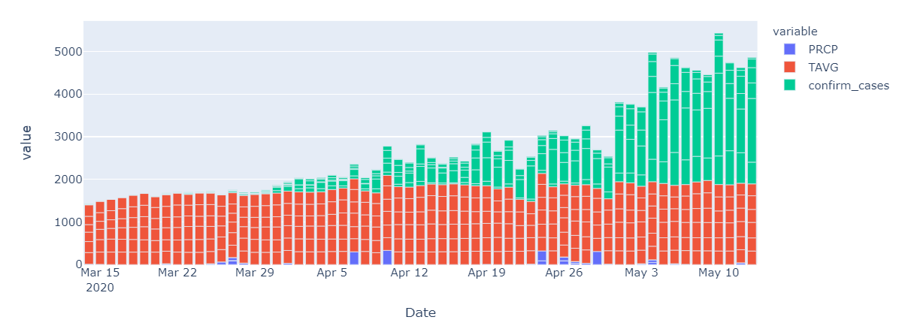
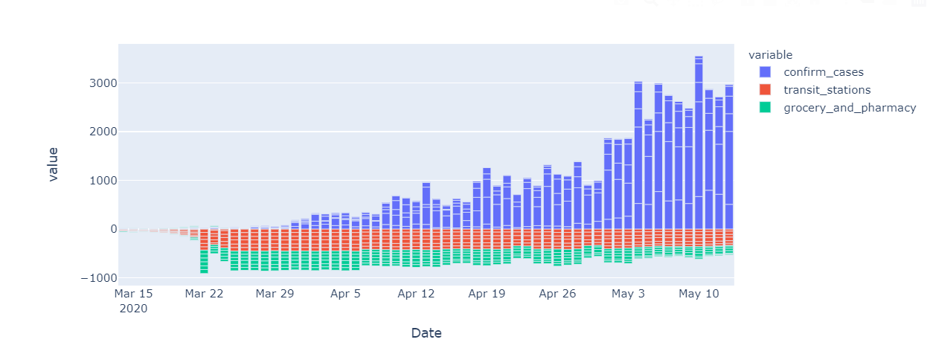
Combining Covid Data with Mobility and Weather Data
Weather Data – Precipitation and Average Temperature
Daily Confirmed Cases
Mobility – Transit Stations & Grocery / Pharmacy
Daily Confirmed Cases

Slide 4
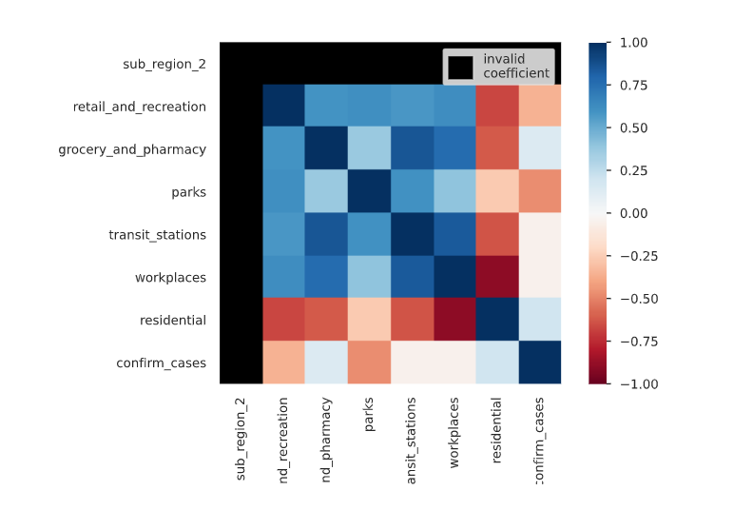
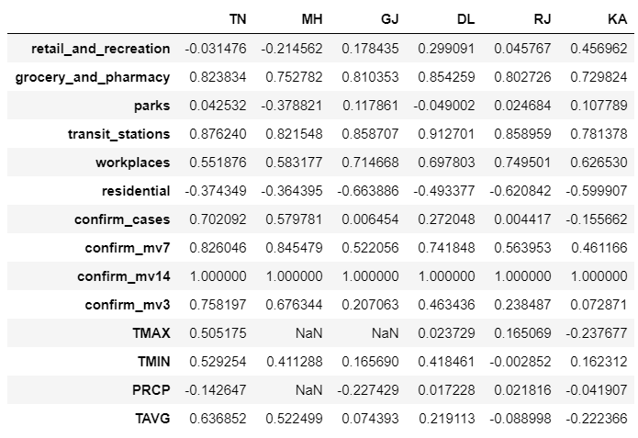
Data Analysis

Slide 5
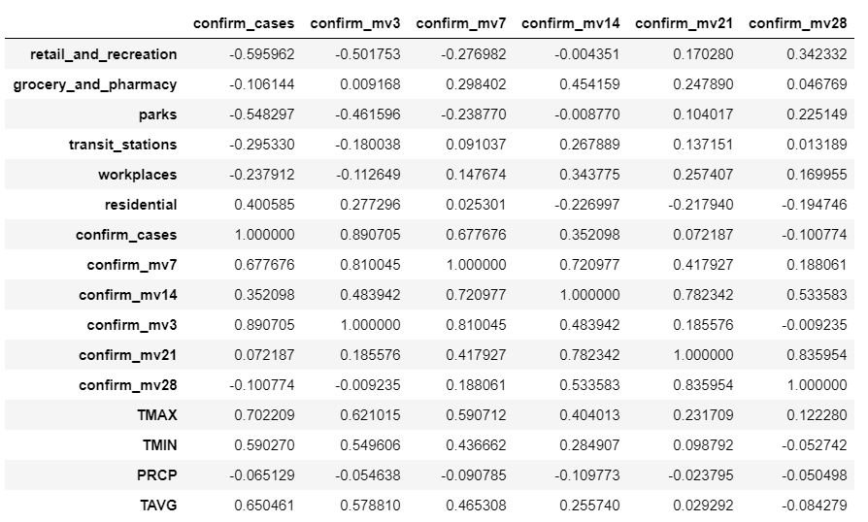
Focus
- Spearman correlation of different metrics has being calculated and observed some correlation between states which have higher COVID-19 confirmed cases and states which have lower COVID-19 cases in the following metrics.
1) Transit metric
2) Temperature metric
- We also observed 14 day moving avg data have better correlation with the metrics,
- We need to study/focus more on transit related phenomenon and temperature related features.
- Further studies will surely help on predicting when and where COVID-19 spread will occur.

