Slide 1
Information Architecture Final Project Proposal

Slide 2
Project analysis slide 2
Content
Project Overview
Dataset Summary
Data Pipeline
Architecture Tool Blueprint
Project Timeline
Project RACI

Slide 3

Project analysis slide 2
Project Overview
Objective
To construct a comprehensive data warehouse and business intelligence solution utilizing AWS.
We are focusing on the "Yellow Taxi Trip Data" from NYC Open Data.
Intention is to leverage the wealth of information in this dataset to unearth valuable insights into the dynamics of New York City's transportation system
Datasets
"2021 Yellow Taxi Trip Data" from NYC Open Data. (Via API call in JSON format)
NYC Taxi Zones from Data Gov. (csv file: structured data)

Slide 4


Project analysis slide 2
Project Overview
Insights
Identify peak taxi usage times
Determine the average fare and tip amounts
Uncover geographic hotspots for taxi pick-ups and drop-offs
Observe temporal trends in taxi usage
Goal
Enhance taxi dispatch efficiency, provide valuable data for policy-makers and urban planners, and contribute to a more thorough understanding of urban mobility patterns in New York City.

Slide 5
Project analysis slide 2
Dataset Summary
Attributes
Dataset | 2021 Yellow Taxi Trip Data | NYC Taxi Zones
Source | NYC Open Data | Data Gov
Descriptions | These records, submitted by yellow taxi Technology Service Providers (TSPs), each represent a single yellow taxi trip in 2020. They include details like dates/times, locations, distances, fares, rate and payment types, and passenger counts for each trip. | This dataset displays NYC Taxi Zones, aligning with pickup and drop-off LocationIDs in the Yellow, Green, and FHV Trip Records available on Open Data. These zones, based on the NYC Department of City Planning’s Neighborhood Tabulation Areas (NTAs), approximate neighborhoods, showing the pickup and drop-off neighborhoods for passengers.
Rows & Columns | 30.9M rows & 18 Columns | 263 rows & 7 Columns
Access | via NYC Open Data API | via CSV file
Data Quality | • Clean, well-maintained, clear schema, and consistent data types • Data Profiling required | • Clean, well-maintained, clear schema, and consistent data types • Data Profiling required

Slide 6















Project analysis slide 3
Data Pipeline
AWS Glue
Files/Documents
S3
Data Source
Collection
Processing
Storage
Consumption
Batch
&
Streaming Data
Data Ingestion
Validation, Clearing & Transformation
Data Warehouse / Data Lakes
Analytics
&
Business Insights

Slide 7
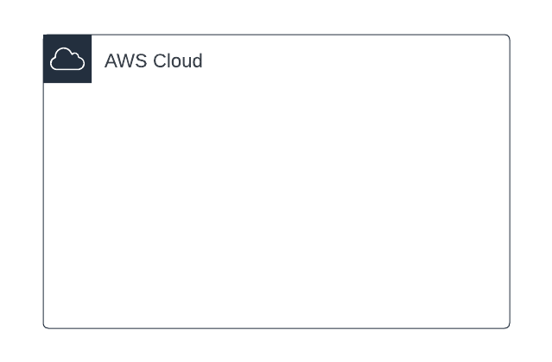



Project analysis slide 4
Architecture Tool Blueprint
AWS Glue
Lambda
function
S3
S3
Files/Documents
Landing
zone
Transformed
data
BI Tool
Note: Architecture may have a slight change as moving forward with the project.

Slide 8
Project analysis slide 2
Project Timeline
Sep 26 - Oct 9
Dec 5 - Dec 15
1. Project Planning &
Data Acquisition
1. Project Planning &
Data Acquisition
6. Documentation &
Project Wrap-up
Oct 10 - Oct 23
PROJECT
TIMELINE
Nov 21 - Dec 4
2. Data Preprocessing &
AWS Setup
5. Data Analysis &
Visualization
2. Data Preprocessing &
AWS Setup
Oct 24 - Nov 6
Nov 7 - Nov 20
3. Design &
Development
4. Testing &
Debugging

Slide 9
Project analysis slide 2
Project Timeline
3. Design &
Development
1. Project Planning &
Data Acquisition
Sep 26 - Oct 9
Define project scope and objectives.
Download and initial exploration of the "Yellow Taxi Trip Data" & “NYC Taxi Zone” from NYC Open Data & Data Gov.
Set up AWS S3 and upload the raw dataset.
4. Testing &
Debugging
2. Data Preprocessing &
AWS Setup
Oct 10 - Oct 23
Clean and preprocess the dataset to handle missing or inconsistent entries.
Use Apache Airflow to automate and manage the preprocessing tasks.
Set up necessary AWS services. Initialize AWS Glue for ETL jobs and AWS Redshift for data warehousing.

Slide 10
Project analysis slide 2
Project Timeline
5. Data Analysis &
Visualization
3. Design &
Development
Oct 24 - Nov 6
Design the data warehouse schema in AWS Redshift.
Develop ETL scripts in AWS Glue and load it into the data warehouse.
Use Apache Airflow to manage and schedule the ETL jobs.
4. Testing &
Debugging
6. Documentation &
Project Wrap-up
Nov 7 - Nov 20
Test ETL scripts and data warehouse functionality.
Debug any issues that arise during testing.
Validate the accuracy of data in the data warehouse.
Ensure seamless integration between Apache Airflow, AWS Glue, and AWS Redshift.

Slide 11
Project analysis slide 2
Project Timeline
5. Data Analysis &
Visualization
Nov 21 - Dec 4
Use AWS Athena for performing ad-hoc data analysis and answering project objectives.
Create visualizations of key findings using AWS Quicksight or other visualization tools.
6. Documentation &
Project Wrap-up
Dec 5 - Dec 15
Document the project process, data schema, ETL scripts, and analysis findings.
Review and finalize the project.
Prepare project presentation and report.

Slide 12
Project analysis slide 2
Project RACI
Task | Gagan | Rahul | Karina
Project Planning & Data Acquisition | A/R | C | C
2. Data Preprocessing & AWS Setup | A/R | R | C
3. Design & Development | A/R | R | I
4. Testing & Debugging | A/R | R | C
5. Data Analysis & Visualization | A/R | I | R
6. Documentation & Project Wrap-up | A/R | C | R
R | Responsible
A | Accountable
C | Consulted
I | Informed
Roles Summary:
Gagan | Takes the lead/accountable role for all tasks including architecture setup and data pipeline Also does the actual work (R role) for technical tasks
Rahul | Assists with technical tasks and takes lead on technical task
Karina | Provides inputs and assists but leads analysis and documentation

Slide 13
Thank You

