Slide 1

Software Engineering

Slide 2

Who ?
Team: IC3
Gagan Sharma
Shubham Gupta
Jiayong Li
Vineet Kaushik
Chang Long
Zhaohe Xu

Slide 3
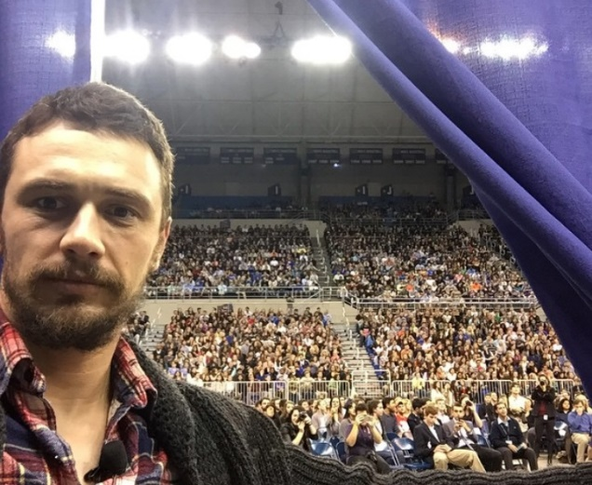

Problem !!!!!!
Hard to look up for events happening on Campus
People have to scroll down a lot of separate web-pages to get relative information
One misses out and gets to know later that “James Franco” was here…!!!!!!!!!

Slide 4


Solution
gatorEvents
All UF events at one Place
Users can search events from various categories
Can receive notifications for favorite events
Organizers can post events

Slide 5

How ?
Interface (UI): Android Application
Back-End: Web Based
Technologies:
Android
PHP/Python
Oracle MySQL
Apache Web-Server

Slide 6
Thanks ☺

