Slide 1

A COMPARISON OF DIFFERENT METHODS FOR CALCULATING TANGENT-STIFFNESS MATRICES
IN A MASSIVELY PARALLEL COMPUTATIONAL
PERIDYNAMICS CODE
Michael Brothers
John T. Foster, Advisor
University of Texas at San Antonio
Notes:
Hello, my name is Michael Brothers a masters student at UTSA and I'll be presenting:
A complex-step method for tangent stiffness calculation in a massively parallel computation peridynamics code
Co-authored by Dr. John Foster, Dr. Harry Millwater and myself

Slide 2


Acknowledgements
Notes:
Computing resources included the Stampede HPC cluster housed at the Texas Advanced Computing Center based out of UT Austin
This project is affiliated with the center for Simulation Visualization and Real Time Prediction at UT San Antonio.

Slide 3
Outline
-Research Objectives
-Derivation of CTSE
-CTSE and finite-difference, subtractive cancellation
-How to produce a tangent-stiffness (Jacobian) matrix
-Study on verification problem in illustrative code
-Scalability study in Peridigm [2] M.L. Parks, D.J. Littlewood, J.A. Mitchell, and S.A. Silling
Notes:
The talk will be organized as follows:
First I will show a derivation of CTSE and provide an analytical example of how it works.
Then, I'll talk about how CTSE resists subtractive cancellation and show how that provides an advantage over finite difference.
With CTSE explained, it will be simple to show how Complex-Step works.
Then I'll finish with a brief description of how I implemented Complex-Step in Peridigm and present the results of two series of tests evaluating Complex-Step versus Central Difference, Forward Difference and Automatic Differentiation

Slide 4
Research Objectives
-To experimentally test the veracity of complex Taylor Series expansion (CTSE), also called complex-step, for computing Jacobian matrices
-Exam CTSE as an alternative to automatic-differentiation (AD) and finite-difference probing methods for tangent-stiffness (TS) calculation
-To profile the performance in context of Jacobian calculation methods specifically in a production scale, parallelized, code
Notes:
Why was the Complex-Step method developed? The first reason was to demonstrate the no-so-new yet underused Complex Taylor Series Expansion method for computing first derivatives numerically. The next most important reason was to provide a way to compute tangent-stiffness matrices for use with a Newton's method based nonlinear solver.
Complex-Step was especially intended as an alternative to Symbolic differentiation by hand or by computer for those cases that symbolic differentiation is too slow, too difficult, or inappropriate.
Complex-Step was also intended as an alternative to Automatic Differentiation, for those cases that an AD library doesn't exist or can't or won't be used.
Complex-Step was intended to shine as a replacement for finite difference methods because its potential for superior accuracy.
My goals today are to:
introduce the CTSE method that underpins the Complex-Step method,
to talk about implementing Complex-Step in Peridigm,
and to present the results of evaluating Complex-Step versus competing methods Central Difference, Forward Difference, and Automatic Differentiation.

Slide 5

Derivation of CTSE
Taylor expand in the complex plane
Taking the imaginary part of both sides and solving for the first derivative…
Derivation example adapted from work by John Foster and Eric Breseno based upon: Squire and Trapp [3]
Notes:
Here's a derivation of CTSE taken from a paper by Squire and Trapp.
First we take a real function and Taylor expand in the complex plane.
We neglect the higher order terms like h squared and above.
Next, we take the imaginary part of both sides and solve for the first derivative. This expression is the CTSE formula.

Slide 6


Analytical derivative example
Find the derivative of the cosine function…
Perturb along the imaginary axis
Trig expand
Take imaginary part, divide by h...
Notes:
We'll use the CTSE formula to find the first derivative of an expression analytically.
Take for example cosine of x. Let's plug it into our formula and see if we get the correct derivative.
First, we evaluate the function with a complex step of magnitude h.
Next a trig identity is used to rewrite the expression in terms of real and imaginary parts.
Then on the next slide, we'll take the imaginary part of the expression and divide it by h.

Slide 7
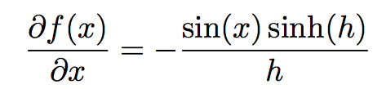
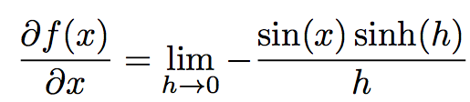
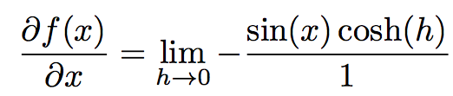
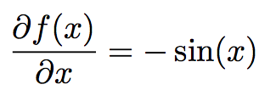
Analytical derivative example (contd.)
Apply the previously defined approximation.
Let h → 0
Apply L’Hôpital’s Rule
Finally...
Notes:
So we plugged cosine into the CTSE formula and now we need to take care of our assumptions.
We neglected higher order terms. This is safe to do for small h, so let's take the limit as h approaches zero.
Turning the crank we come up with df/dx equal negitive sine of x which is exactly right.

Slide 8
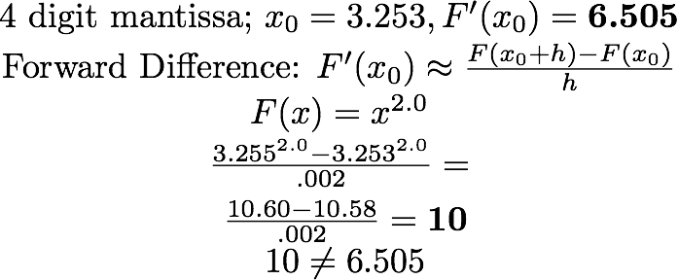
CTSE and FD, subtractive cancellation
Any time you subtract two [floating point] numbers [in a computer program] which are almost equal, subtractive cancellation will occur, and the difference will not have as much precision as either of the subtrahend or the minuend.[4] –
Douglas Wilhelm Harder, Department of Electrical and Computer Engineering,University of Waterloo
Subtractive cancellation [4]:
Notes:
So why use CTSE when it is so vaguely similar to finite difference? The reason is finite difference is vulnerable to subtractive cancellation for small h.
Douglas Harder of University of Waterloo says that any time you subtract two floating point numbers in a computer program which are almost equal, subtractive cancellation will occur and the difference will not have as much precision as either of the subtrahend or the minuend. This is because a computer stores floating point numbers with limited precision.
Here's one of Mr. Harder's examples of subtractive cancellation. Suppose we want to use a fictional computer that only stores 3 significant digits of each floating point number to evaluate the forward difference formula. So we take our parameters and plug them into our expression, and out we get a very inaccurate estimate. What happened was that 10.60 was so close to 10.58, because our step size h was so small, that their difference was lower than the least significant digit of either, meaning it has zero significant figures. That's subtractive cancellation.

Slide 9
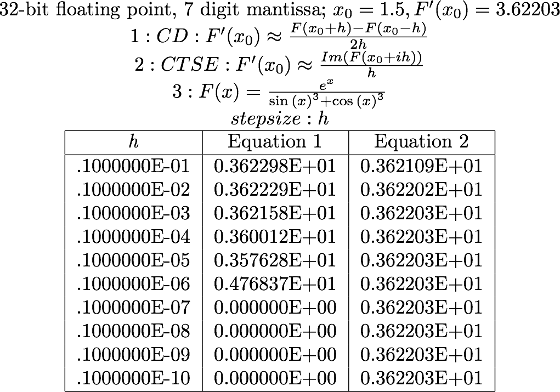
Example from: Squire and Trapp [3]
Notes:
But that was a canned example. For this example we're using a normal data-type: 32 bit floating point numbers with 7 digit mantissas. Double the number of significant digits as before. This time we're pitting CTSE against central difference and trying to induce subtractive cancellation.
The first equation is central difference, the second is CTSE and the third is the expression being evaluated. Xo is 1.5 and the real derivative is 3.62203
Column one shows step size h, column 2 the estimates from equation one and column three, the estimates from equation 2.
As step size h decreases, we induce what Squire and Trapp attribute to subtractive cancellation in equation 1, while equation 2, CTSE isn't affected

Slide 10
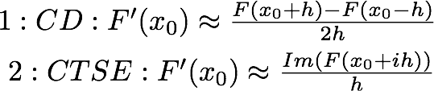
CTSE resists subtractive cancellation
The how is simple:
-no difference is taken as in finite-differencing
Notes:
How did CTSE resist subtractive cancellation?
First, unlike in the central difference formula the CTSE formula takes no differences.
Second, because imaginary and real parts are stored separately we don't have to worry using a small h with a large x0.

Slide 11
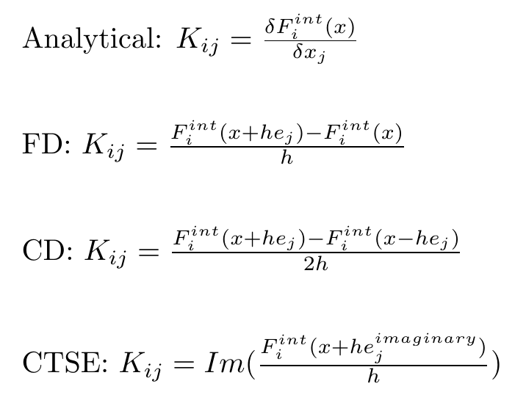
How to produce a tangent-stiffness (Jacobian) matrix
* 'int' signifies derivative of internal force WRT
displacement
Notes:
Now that we thoroughly understand CTSE, explaing the complex step method is simple. It boils down to applying the CTSE formula for every entry in the tangent-stiffness matrix. If you already know how to program a finite difference scheme for producing a Jacobian, you now know everything you need to implement CTSE and Complex-Step.

Slide 12
How the Jacobian is used to solve a force equilibrium problem: algorithm of illustrative code
Inputs: Function pointer for model evaluation, solver parameters
1)Setup:
a) Define residual
b) Define convergence criteria
2) Main loop:
a) Guess equilibrium solution
b) Compute Jacobian
c) Compute Newton update using LAPACK GETRF for LU
factorization and LAPACK GETRS to solve.
d) Compute change in residual
e) Evaluate convergence criteria
3) Report last configuration and performance data
4) Finish or choose another target as for a subsequent load-step
Notes:
Now that we thoroughly understand CTSE, explaing the complex step method is simple. It boils down to applying the CTSE formula for every entry in the tangent-stiffness matrix. If you already know how to program a finite difference scheme for producing a Jacobian, you now know everything you need to implement CTSE and Complex-Step.

Slide 13
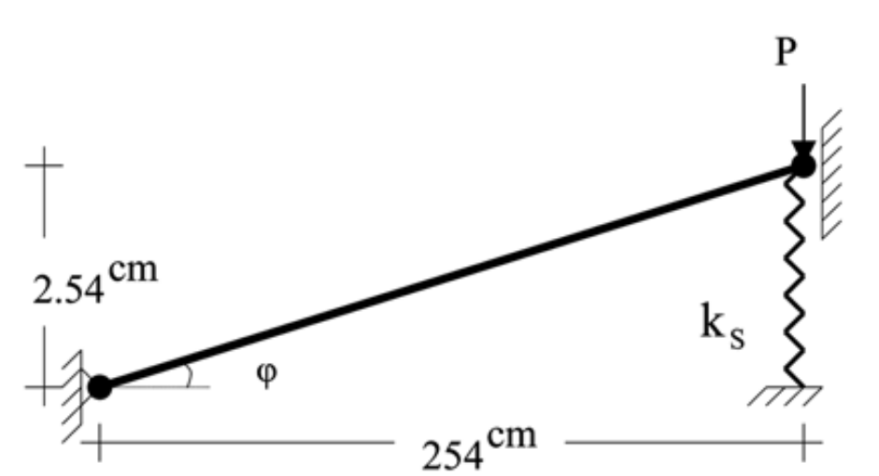
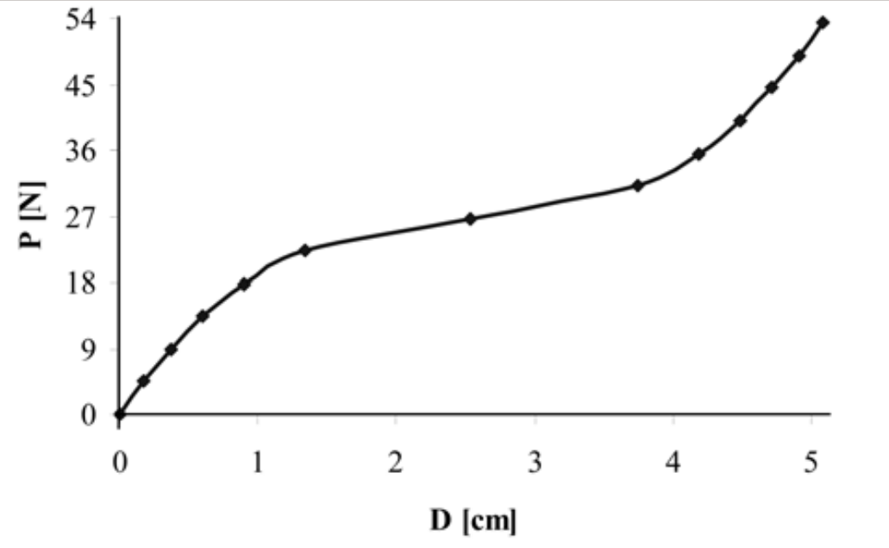
Case study: verification
-Illustrative code implemented with data structures and wrappers
from Trilinos library [5]
-Serves double duty as simple example implementation of each
method, relative to Peridigm code
-Verification problem taken from Rezaiee Pajand, M., Alamatian, J.
[6] and results reproduced for each method
Notes:
Now that we thoroughly understand CTSE, explaing the complex step method is simple. It boils down to applying the CTSE formula for every entry in the tangent-stiffness matrix. If you already know how to program a finite difference scheme for producing a Jacobian, you now know everything you need to implement CTSE and Complex-Step.

Slide 14
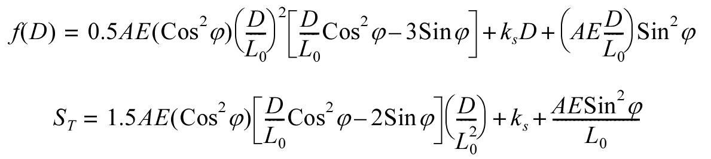
Case study: verification: problem setup
-Force function and analytical Jacobian given
-Apply force boundary condition in 12 load steps, each an
Increment of 4.448 N, vary step-size h to measure accuracy
response
-Verification is suggested when using a method results in
minimum discrepancy wrt 'analytical' solution
Notes:
Now that we thoroughly understand CTSE, explaing the complex step method is simple. It boils down to applying the CTSE formula for every entry in the tangent-stiffness matrix. If you already know how to program a finite difference scheme for producing a Jacobian, you now know everything you need to implement CTSE and Complex-Step.

Slide 15
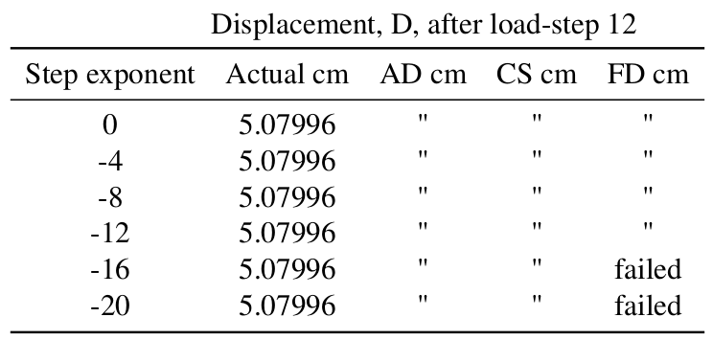
Case study: verification: results
Notes:
Now that we thoroughly understand CTSE, explaing the complex step method is simple. It boils down to applying the CTSE formula for every entry in the tangent-stiffness matrix. If you already know how to program a finite difference scheme for producing a Jacobian, you now know everything you need to implement CTSE and Complex-Step.

Slide 16
Case study: convergence rate
-Same problem and code as before, now measuring number
of iterations taken, not quality of solution
-Step-size is varied to measure effect on convergence rate
-Ideal convergence rate is supposed as the number of iterations
the 'analytical' solution method takes.
-Study meant to give context to Peridigm iteration speed results,
informally
Notes:
Now that we thoroughly understand CTSE, explaing the complex step method is simple. It boils down to applying the CTSE formula for every entry in the tangent-stiffness matrix. If you already know how to program a finite difference scheme for producing a Jacobian, you now know everything you need to implement CTSE and Complex-Step.

Slide 17
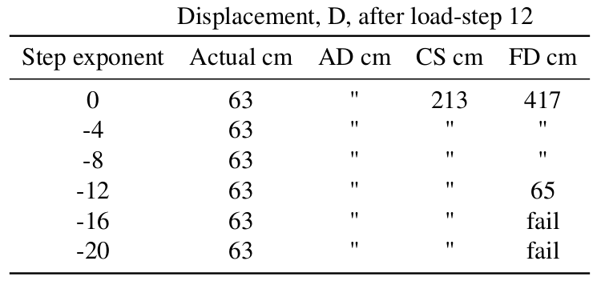
Case study: convergence rate: results
Notes:
Now that we thoroughly understand CTSE, explaing the complex step method is simple. It boils down to applying the CTSE formula for every entry in the tangent-stiffness matrix. If you already know how to program a finite difference scheme for producing a Jacobian, you now know everything you need to implement CTSE and Complex-Step.

Slide 18

Implementing CTSE in: Peridigm
Scope Stats:
-Refactored code:
3137 lines
-Workflow scripts:
2097 lines
-1 sample CPU load:
2280 hours
(¼ yr on 1 core)
-Simulations:
36 completed
-Change data-types where
possible, cast everywhere else
-Modify copied finite difference model evaluation code to follow CTSE formula
-Add logic to select CTSE for use
-Instrument code for performance comparison
-Compare CTSE, CD, FD, AD for a series of test problems each for single-core and multi-core cases
Notes:
To evaluate the use of Complex-Step in a real application, I have written an implementation for Peridigm, a computational peridynamics code developed out of Sandia National Labs.
In general terms these were the additions that had to be made.

Slide 19
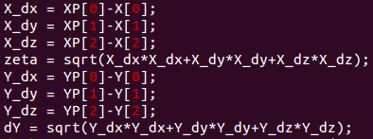
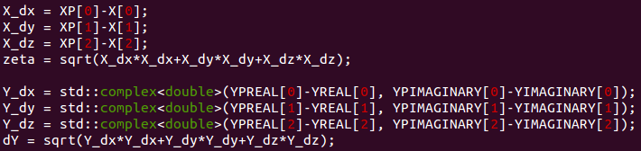
Representative modification: calculating the displacement of a node
-All finite difference methods
-CTSE: trivially more complicated

Slide 20
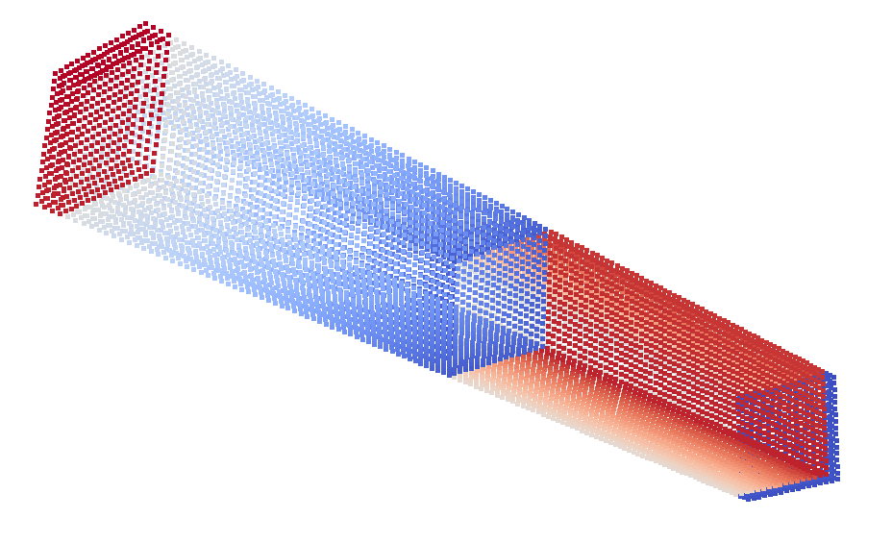
Single Core Tests
Mesh Properties:
-Modeled a rectangular prism
-Same object dimensions
-Same number of nodes per family
-Differing horizon, differing number of peridynamic nodes (1000 to 32000 nodes)
Loading Properties:
-Tensile loading in elastic regime
-Same material properties
-Equivalent volume constraints and equivalent load steps
Notes on Operation:
-Each Jacobian calculation method uses same displacement guess
-Speed, accuracy and efficiency are compared between AD, FD, CD and CTSE

Slide 21
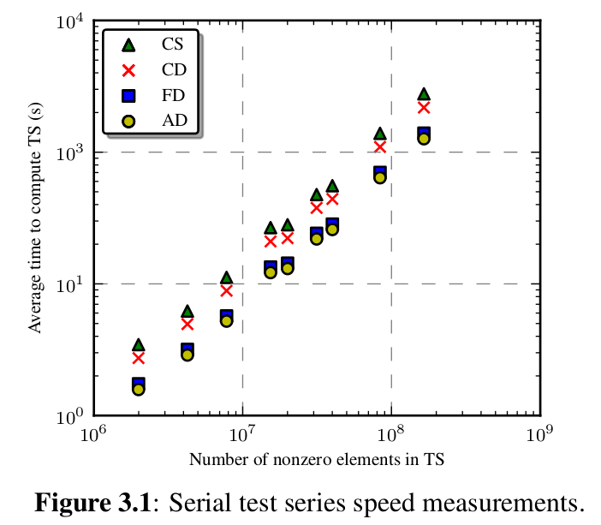
Notes:
On the y axis is average time to compute a jacobian matrix in seconds.
X axis is number of nonzero elements in the jacobian matrix. The x axis is on a log scale.
Time to compute increases slowly with the number of nonzero elements in the Jacobian, as does the difference between the methods. My implementation of CTSE turns out to be the slowest method among the four tested.

Slide 22
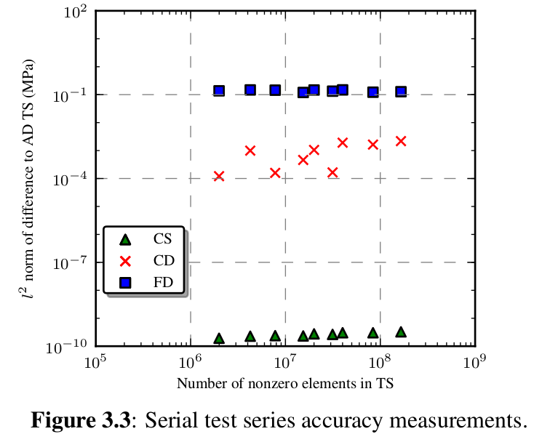
Notes:
On the y axis is the frobenius norm of the difference to the jacobian calculated with automatic differentiation. The units are megapascals.
On the x axis is number of nonzero elements in the Jacobian, on a log scale.
CTSE turns out to be some orders of magnitude more accurate than the finite difference methods, under the assumption the AD jacobian is the standard.

Slide 23
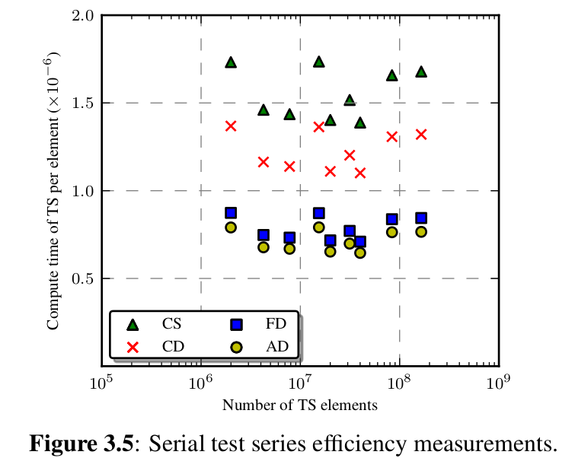
Notes:
On the y axis is average time to compute a jacobian matrix per nonzero matrix element. The units are seconds per matrix element.
On the x axis is number of nonzero jacobian matrix elements on a log scale.
The plot indicates that when we consider only the entries in the jacobian that Peridigm actively calculates and stores, problem size my not have a clear effect on efficiency. Unfortunately, no matter how you slice it, this implementation of CTSE falls behind in efficiency.

Slide 24
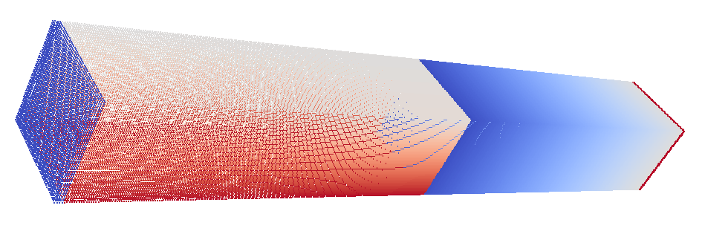
Multi-core Tests
Mesh Properties:
-Modeled a rectangular prism
-Same object dimensions
-Same horizon, same number of peridynamic nodes (3 million dof)
Loading Properties:
-Tensile loading in elastic regime
-Same material properties
-Equivalent volume constraints, equivalent load steps
Notes on Operation:
-Each Jacobian calculation method uses same displacement guess
-Differing number of cores (32 to 128) used to solve problem, with mesh decomposition differing
-Speed, accuracy and efficiency are compared between AD, FD, CD and CTSE

Slide 25
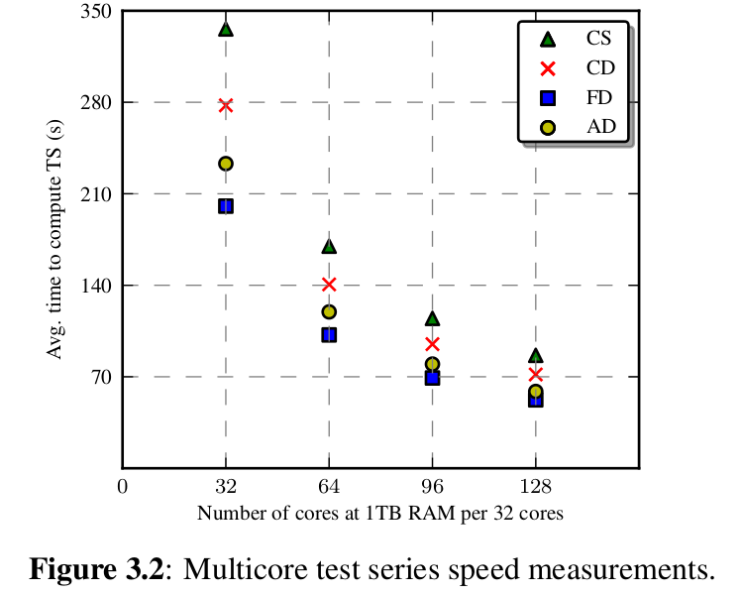
Notes:
Instead of varying problem size for the multicore test, I chose a single, rather large problem and compared results between varying core counts.
On the y axis is average to time compute a jacobian matrix in seconds.
On the x axis is number of cores used to run the problem.
Since this is a linear scaled plot it is clear to see that there is a nonlinear relationship between core count and computation time. CTSE is still the slowest, but FD and AD have switched places.

Slide 26
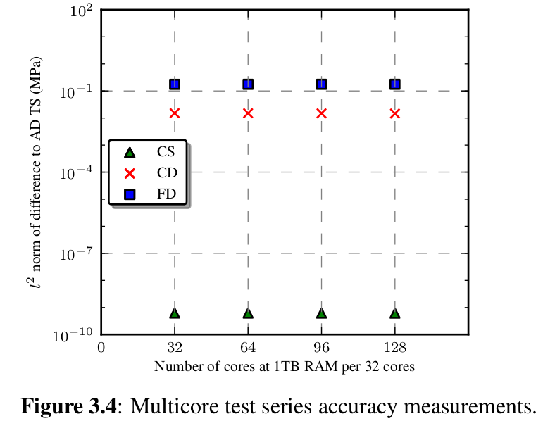
Notes:
On the y axis is frobenius norm of difference to AD jacobian in megapascals.
On the x axis is core count.
CTSE maintains its accuracy advantage under multicore use. Core count may not strongly affect difference of the any of the methods to AD.

Slide 27
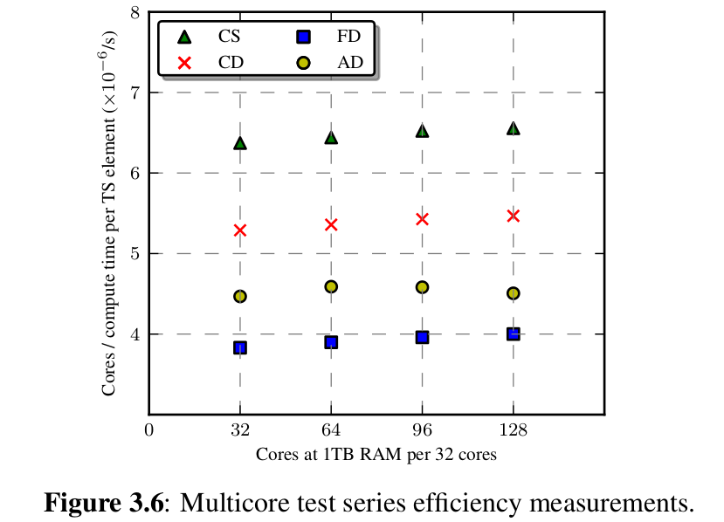
Notes:
On the y axis is number of cores times average time to compute a jacobian matrix per nonzero matrix elements.
The x axis is core count.
The same patterns seen in the previous plot hold. The obvious reason in that the same problem was run for each core count, baring slight differences in mesh decomposition results.

Slide 28
Conclusions
Numeric benefits of CTSE:
-high accuracy Jacobians
-resists subtractive cancellation
-fast convergence rate
Practical, but abstract benefits of CTSE:
-requires fewer external libraries than AD does
-native, byte-copyable data-types
-easier for programmer to understand than AD
Drawbacks of CTSE:
-requires complex data-type
-slow iteration speed in a normal implementation

Slide 29
References
[1] Voorhees, Andrew, Harry Millwater, and Ronald Bagley. "Complex Variable Methods for Shape Sensitivity of Finite Element Models." Finite Elements in Analysis and Design 47 (2011): 1146-156. Print.
[2] M.L. Parks, D.J. Littlewood, J.A. Mitchell, and S.A. Silling, Peridigm Users’ Guide, Tech. Report SAND2012-7800, Sandia National Laboratories, 2012.
[3] Squire, William, and George Trapp. "Using Complex Variables to Estimate Derivatives of Real Functions." SIAM Review 40.1 (1998): 110. Print.
[4] Harder, Douglas W. "Numerical Analysis for Engineering." Weaknesses with Floating-point Numbers. Department of Electrical and Computer Engineering: University of Waterloo, n.d. Web. 18 June 2013.

Slide 30
References
[5] Heroux, M., Bartlett, R., Howle, V., Hoekstra, R., Hu, J., Kolda, T., Lehoucq, R., Long, K., Pawlowski, R., Phipps, E., Salinger, A., Thornquist, H., Tuminaro, R., Willenbring, J., Williams, A., Stanley, K.: An overview of the trilinos project. ACM Trans. Math. Softw. 31(3), 397–423 (2005). DOI http://doi.acm.org/10.1145/1089014.108902
[6] Rezaiee Pajand, M., ALAMATIAN, J.: The dynamic relaxation method using new formulation for fictitious mass and damping. Structural Engineering and Mechanics 34 (2010)

Slide 31
Data and experimental materials are available at:
http://idl.utsa.edu/jtfoster/paper-repositories/

