Slide 1

Implementing Fault-Tolerant Services Using State Machines
: Beyond Replication
Implementing Fault-Tolerant Services Using State Machines
Vijay K. Garg
Electrical and Computer Engineering
The University of Texas at Austin
Email: garg@ece.utexas.edu
Disc’2010

Slide 2
Fault Tolerance: Replication
Server 1
Server 2
Server 3
2 Fault
Tolerance
1 Fault
Tolerance
Notes:
3 servers
First slide just the servers
Second slide: back ups appear
Third slide: fusion

Slide 3
Fault Tolerance: Fusion
Server 1
Server 2
Server 3
1 Fault
Tolerance

Slide 4
Fault Tolerance: Fusion
Server 1
Server 2
Server 3
2 Fault
Tolerance
`Fused’ Servers : Fewer Backups than Replication

Slide 5
Motivation
 | Coding | Replication | Fusion
Space | Efficient | Wasteful | Efficient
Recovery | Expensive | Efficient | Expensive
Updates | Expensive | Efficient | Efficient
Probability of failure is low => expensive recovery is ok
Notes:
Replace this by the comparison table

Slide 6
Outline
Crash Faults
  Space savings
  Message savings
  Complex Data Structures
Byzantine Faults
  Single Fault (f=1), O(1) data
  Single Fault, O(m) data
  Multiple Faults (f>1), O(m) data
Conclusions & Future Work

Slide 7
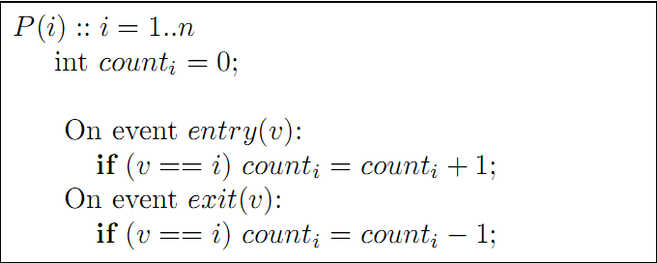
Example 1: Event Counter
n different counters counting n different items
count_{i}= entry(i) – exit(i)
What if one of the processes may crash?

Slide 8
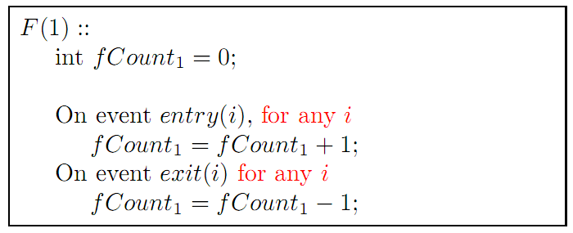
Event Counter: Single Fault
fCount₁ keeps the sum of all counts
Any crashed count can be recovered using remaining counts

Slide 9
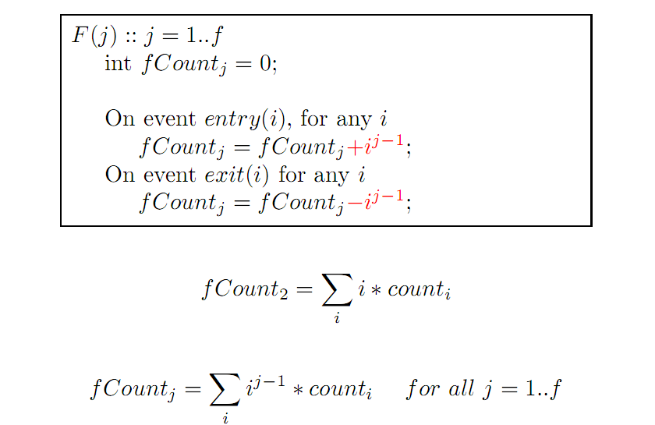
Event Counter: Multiple Faults

Slide 10
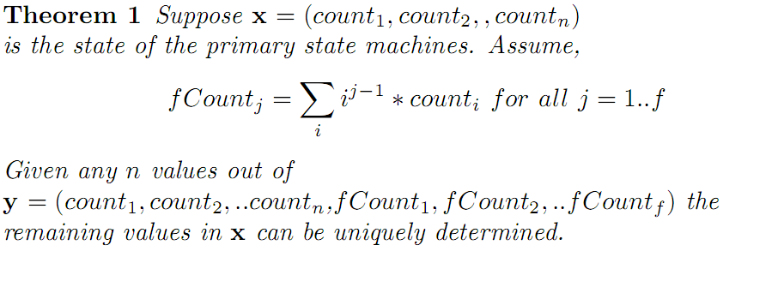
Event Counter: Theorem

Slide 11
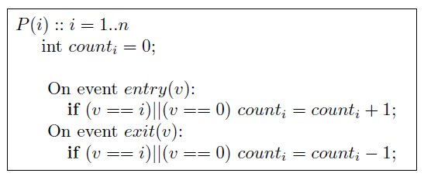
Shared Events: Aggregation
Suppose all processes act on entry(0) and exit(0)

Slide 12
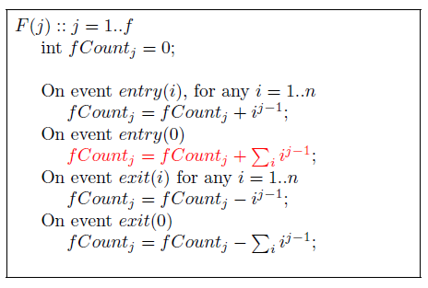
Aggregation of Events

Slide 13
Some Applications of Fusion
Causal Ordering of Messages for n Processes
  O(n²) matrix at each process
  Replication to tolerate one fault: O(n³) storage
  Fusion to tolerate one fault: O(n²) storage
Ricart and Agrawala’s Algorithm
  O(n) storage per process, 2(n-1) messages/mutex
  Replication: n backup processes each with O(n) storage,
    2(n-1) additional messages
  Fusion: 1 fused process with O(n) storage
    Only n additional messages

Slide 14
Outline
Crash Faults
  Space savings
  Message savings
  Complex Data Structures
Byzantine Faults
  Single Fault (f=1), O(1) data
  Single Fault, O(m) data
  Multiple Faults (f>1), O(m) data
Conclusions & Future Work

Slide 15
Example: Resource Allocation, P(i)
user: int initially 0;// resource idle
waiting: queue of int initially null;
On receiving acquire from client pid
if (user == 0) {
send(OK) to client pid; user = pid;
} else waiting.append(pid);
On receiving release
if (waiting.isEmpty()) user = 0;
else { user = waiting.head();
send(OK) to user;
waiting.removeHead(); }

Slide 16
Complex Data Structures: Fused Queue
Head_{A}
Head_{B}
head
a₁
a₂
a₃ + b₁
a₁
a₂
a₄ + b₂
a₃
a₅ + b₃
a₄
b₁
b₂
head
a₆ + b₄
a₈
a₅
b₅
a₇ + b₅
a₇
a₆
b₄
b₃
a₈ + b₆
tail
tail
tail_{A}
tail_{B}
(i) Primary Queue A
(i) Primary Queue B
(iii) Fused Queue F
Fused Queue that can tolerate one crash fault
Notes:
Circular Queue

Slide 17
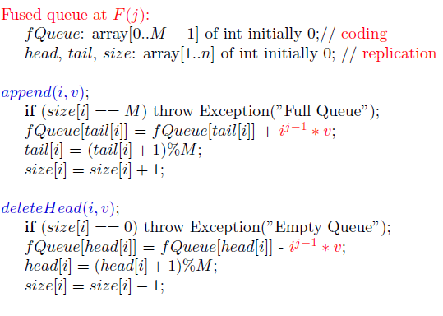
Fused Queues: Circular Arrays

Slide 18
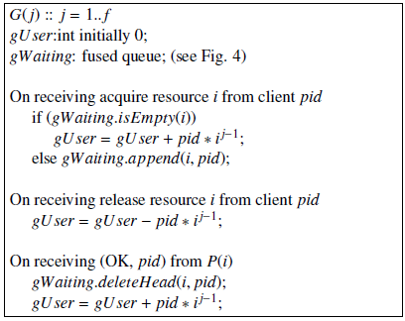
Resource Allocation: Fused Processes

Slide 19
Outline
Crash Faults
  Space savings
  Message savings
  Complex Data Structures
Byzantine Faults
  Single Fault (f=1), O(1) data
  Single Fault, O(m) data
  Multiple Faults (f>1), O(m) data
Conclusions & Future Work

Slide 20
Byzantine Fault Tolerance: Replication
13
8
45
13
8
45
13
8
45
(2f+1)*n processes
Notes:
3 servers
First slide just the servers
Second slide: back ups appear
Third slide: fusion

Slide 21
Goals for Byzantine Fault Tolerance
Efficient during error-free operations
Efficient detection of faults
  No need to decode for fault detection
Efficient in space requirements

Slide 22
Byzantine Fault Tolerance: Fusion
13
8
45
P(i)
13
11
8
45
Q(i)
66
F(1)
Notes:
3 servers
First slide just the servers
Second slide: back ups appear
Third slide: fusion

Slide 23
Byzantine Faults (f=1)
Assume n primary state machine P(1)..P(n), each with an O(1) data structure.
Theorem 2: There exists an algorithm with additional n+1 backup machines with
  same overhead as replication during normal operations
  additional O(n) overhead during recovery.
Notes:
Follow the sheets

Slide 24
Byzantine FT: O(m) data
a₁
a₂
a₃
a₄
b₁
a₈
a₅
b₅
b₂
P(i)
a₇
a₆
b₄
b₃
a₁
a₂
a₃
g
Q(i)
b₁
a₄
b₂
a₈
a₅
b₅
b₄
b₃
Head_{A}
x
a₇
a₆
Head_{B}
Crucial location
a₁
a₂
a₃ + b₁
a₄ + b₂
a₅ + b₃
a₆ + b₄
a₈ + b₆
a₇ + b₅
F(1)
tail_{A}
tail_{B}
Notes:
3 servers
First slide just the servers
Second slide: back ups appear
Third slide: fusion

Slide 25
Byzantine Faults (f=1), O(m)
Theorem 3: There exists an algorithm with additional n+1 backup machines such that
  normal operations : same as replication
  additional O(m+n) overhead during recovery.
  No need to decode F(1)
Notes:
Follow the sheets

Slide 26
Byzantine Fault Tolerance: Fusion
3
1
4
P(i)
3
3
1
8
4
Single mismatched primary
3
5
1
4
1*3 + 2*1 + 3*4
1*3+4*1+9*4
3
5
1
4
1*3+1*1+1*4
8
10
17
43
F(1)
F(3)
Notes:
3 servers
First slide just the servers
Second slide: back ups appear
Third slide: fusion

Slide 27
Byzantine Fault Tolerance: Fusion
3
1
7
4
P(i)
3
3
1
8
4
Multiple mismatched primary
3
5
1
4
3
5
1
4
8
8
17
43
F(1)
F(3)
Notes:
3 servers
First slide just the servers
Second slide: back ups appear
Third slide: fusion

Slide 28
Byzantine Faults (f>1), O(1) data
Theorem 4: Algorithm with additional fn+f state machines for f Byzantine faults with same overhead as replication during normal operations.
Notes:
Follow the sheets

Slide 29
Liar Detection (f > 1), O(m) data
Z := set of all f+1 unfused copies
While (not all copies in Z identical) do
  w := first location where copies differ
  Use fused copies to find v, the correct value of state[w]
  Delete unfused copies with state[w] != v
Invariant: Z contains a correct machine.
No need to decode the entire fused state machine!
Notes:
Follow the sheets

Slide 30
Fusible Structures
Fusible Data Structures
  [Garg and Ogale, ICDCS 2007]
  Linked Lists, Stacks, Queues, Hash tables
  Data structure specific algorithms
  Partial Replication for efficient updates
  Multiple faults tolerated using Reed-Solomon Coding
Fusible Finite State Machines
  [Ogale, Balasubramanian, Garg IPDPS 09]
  Automatic Generation of minimal fused state machines

Slide 31
Conclusions
Coding | Replication | Fusion
Crash Faults | n+nf | n+f
Byzantine Faults | n+2nf | n+nf+f
n: the number of different servers
Replication: recovery and updates simple,
tolerates f faults for each of the primary
Fusion: space efficient
Can combine them for tradeoffs

Slide 32
Future Work
Optimal Algorithms for Complex Data Structures
Different Fusion Operators
Concurrent Updates on Backup Structures
Notes:
Follow the sheets

Slide 33
Thank You!

Slide 34
Questions?
Crash Faults
  Event Counters: Space savings
  Mutex Algorithm: Message savings
  Resource Allocator: Complex Data Structures
Byzantine Faults
  Single Fault (f=1), Detection and Correction
  Liar Detection
  Multiple Faults (f>1)
Conclusions & Future Work

Slide 35
Backup Slides

Slide 36
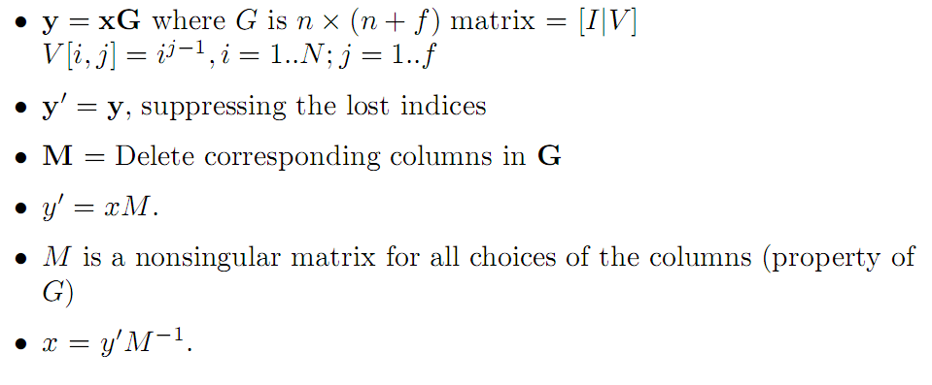
Event Counter: Proof Sketch

Slide 37
Model
The servers (primary and backups) execute independently (in parallel)
Primaries and backups do not operate in lock-step
Events/Updates are applied on all the servers
All backups act on the same sequence of events
Notes:
backup

Slide 38
Model contd…
Faults:
  Fail Stop (crash): Loss of current state
  Byzantine: Servers can `lie` about their current state
For crash faults, we assume the presence of a failure detector
For Byzantine faults, we provide detection algorithms
Infrequent Faults

Slide 39
Byzantine Faults (f=1), O(m)
Theorem 3: There exists an algorithm with additional n+1 backup machines such that
  normal operations : same as replication
  additional O(m+n) overhead during recovery.
Proof Sketch:
  Normal Operation: Responses by P(i) and Q(i), identical
  Detection: P(i) and Q(i) differ for any response
  Correction: Use liar detection
  O(m) time to determine crucial location
  Use F(1) to determine who is correct
  No need to decode F(1)
Notes:
Follow the sheets

Slide 40
Byzantine Faults (f>1)
Proof Sketch:
  f copies of each primary state machine and f overall fused machines
  Normal Operation: all f+1 unfused copies result in the same output
  Case 1: single mismatched primary state machine
    Use liar detection
  Case 2: multiple mismatched primary state machines
    Unfused copy with the largest tally is correct
Notes:
Follow the sheets

Slide 41
Resource Allocation Machine
Request
Queue 3
R₁
R₂
R₃
R₄
R₁
R₂
Request
Queue 1
Lock Server 3
Lock Server 1
R₁
R₂
R₃
Request
Queue 2
Lock Server 2
Notes:
Circular Queue

Slide 42
Byzantine Fault Tolerance: Fusion
13
8
45
P(i)
13
11
8
45
Q(i)
66
F(1)
(f+1)*n + f processes
Notes:
3 servers
First slide just the servers
Second slide: back ups appear
Third slide: fusion

