Slide 1
Designing a DHT for low latency and high throughput
Robert Vollmann
30.11.2004
P2P Information Systems

Slide 2
Overview
I. Introduction to DHT‘s
II. Technical Background
III. Latency
IV. Throughput
V. Summary

Slide 3
Distributed Hash Tables
Hash table
Data structure that uses hash function to map keys to hash values to determine where the data is stored
Allows quick access to keys through lookup algorithm
Distributed hash table
Hash table is distributed over all participating nodes
Lookup algorithm determines the node responsible for a specific key
Requirements
Find data
High availability
Balance load
Fast moving of data
Problems
Link capacity of nodes
Physical distance of nodes
Congestion of network and packet loss

Slide 4
Technical Background
DHash++
Values are mapped to keys using SHA-1 hash function
Stores key/value pairs (so-called blocks) on different nodes
Uses Chord and Vivaldi
Chord
Lookup protocol to find keys with runtime O(log N)
Vivaldi
Decentralized Network Coordinate System to compute and manage synthetic coordinates which are used to predict inter-node latencies
No additional traffic because synthetic coordinates can piggy-back on DHash++‘s communication patterns
Hardware
Test-bed of 180 hosts which are connected via Internet2, DSL, cable or T1
Additional testing
Simulation with delay matrix filled with delays between 2048 DNS Servers

Slide 5
Low latency
Data layout
DHash++ is designed for read-heavy applications that demand
low-latency and high throughput.
Examples
SFR (Semantic Free Referencing system)
Designed to replace DNS (Domain Name System)
Uses DHT to store small data records representing name bindings
UsenetDHT
Distributed version of Usenet which splits large articles into small blocks to achieve load balancing
DHash++:
Can be seen as a Network Storage System with shared global infrastructure
Uses small blocks of 8kb length
Uses random distribution of blocks via hash Function

Slide 6

Low latency
Recursive vs. iterative
Iterative lookup
Send lookup query to each
successive node in lookup path
Can detect node failure
But
Must wait for response before
proceeding

Slide 7
Low latency
Recursive vs. iterative
Recursive lookup
Direct query forwarding to
next node
Less queries -> less congestion
But
Impossible to detect failed nodes

Slide 8
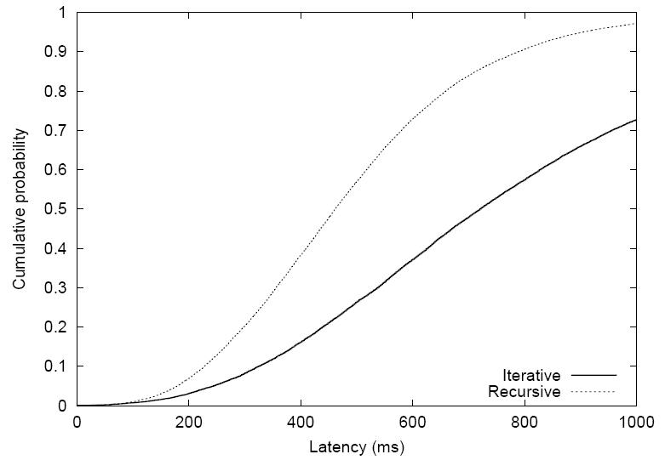
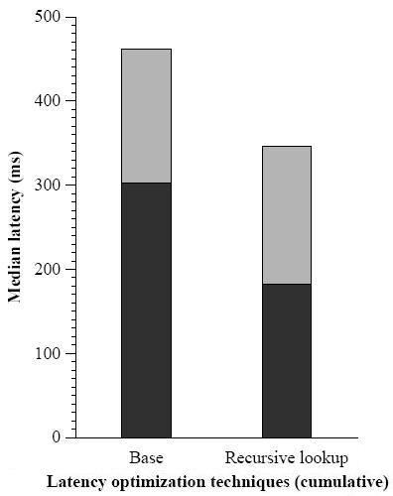
Low latency
Recursive vs. iterative
Left Figure: Simulation of 20,000 lookups with random hosts for random keys
Recursive lookup takes 0.6 times as long as iterative
Right Figure: 1,000 lookups in test-bed
Result of simulation confirmed
Trade-off: DHash++ uses recursive routing but switches to iterative routing after persistent link failures

Slide 9

Low latency
Proximity neighbor selection
Idea
Chose nearby nodes to decrease latency
Realisation
ID-Space range of ith finger table entry of node a:
Every finger table entry points to first available ID in this range
Get the latency of the the first x available nodes in this ID-Space range from successor list
Route lookups through node with lowest latency
What is a suitable value for x?

Slide 10
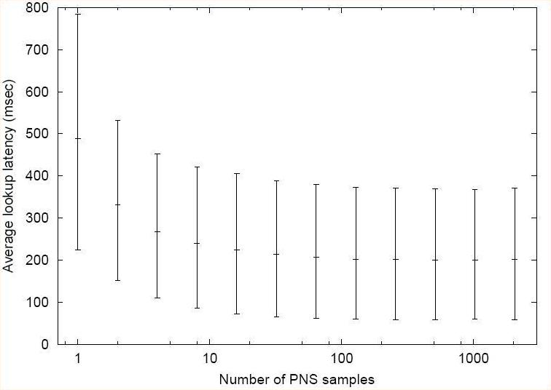
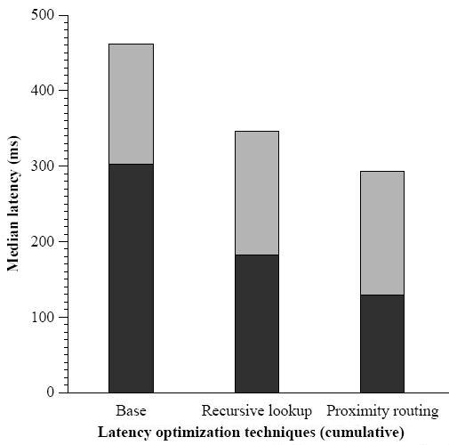
Low latency
Proximity neighbor selection
Right Figure: Simulation of 20 000 lookups with random hosts for random keys
1 – 16 Samples: highly decreasing latency
16 – 2048 Samples: barely decreasing latency
Right figure: 1 000 lookups in test-bed
Decreased lookup latency
→ DHash++ uses 16 Samples

Slide 11
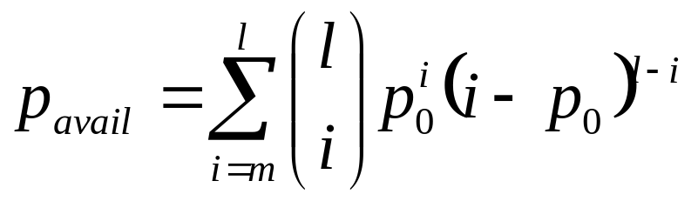
Low latency
Erasure-coding vs. replication
Erasure-coding
Data block split into l fragments
m different fragments are necessary to reconstruct the block
Redundant storage of data
Replication
Node stores entire block
Special case: m = 1 and l is number of replicas
Redundant information spread over fewer nodes
Comparison of both methods
r = l / m amount of redundancy
Probability that a block p is available:

Slide 12
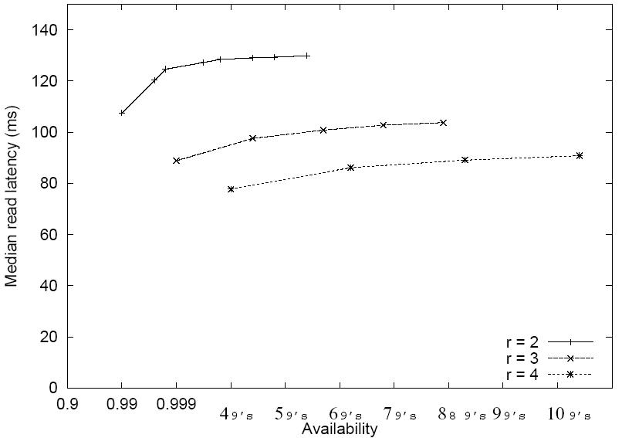
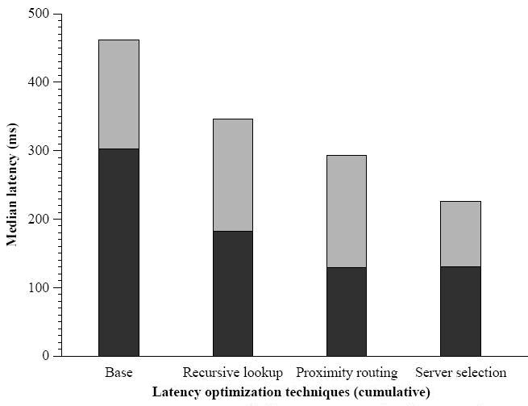
Low latency
Erasure-coding vs. replication
Replication
Only slightly lower latency than erasure-coding for same r if r is high
Less congestion than erasure-coding because less files have to be distributed
Erasure-coding
Higher availability of fragments
More choice because of more fragments
DHash++ uses Erasure-coding with m = 7 and l = 14

Slide 13
Low latency
Integration
Remember proximity neighbor selection
Little advantage in the last steps
Also remember last step in lookup procedure
Originator contacts a key‘s direct predecessor to obtain successor list
But full successor list not neccessarily needed
Why?
List has length s
l successors store fragments of the block
m fragments are needed
s-m predecessors of a key have lists with at least m nodes

Slide 14
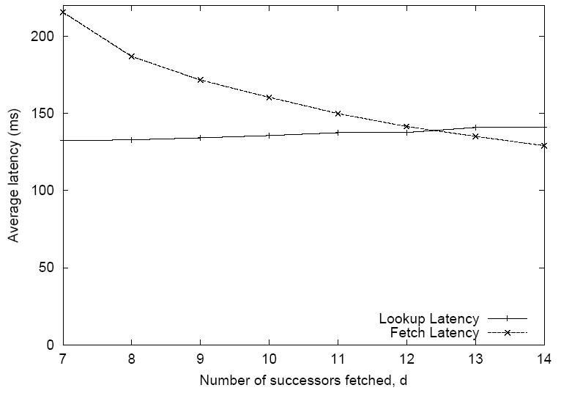
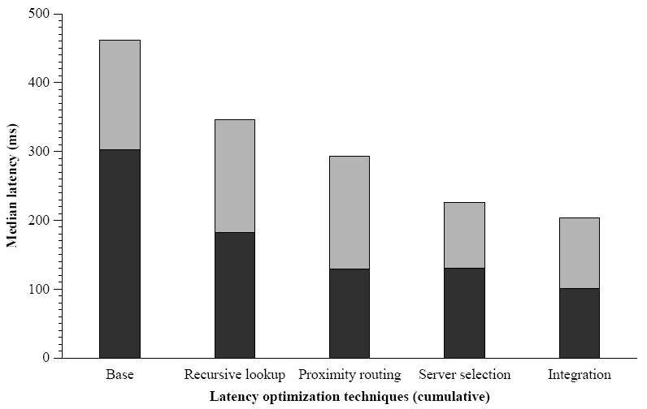
Low latency
Integration
d: Number of successors in successor list with needed fragment
Trade-off between lookup time and fetch latency while choosing d
Large d: more hops for lookup but more choice between nodes
Small d: less hops but higher fetch latency
Optimum: d = l

Slide 15
High throughput
Overview
Requirements for a DHT
Parallel sending and receiving of data
Congestion control to avoid packet loss and re-transmissions
Recover from packet loss
Difficulty: Data is spread over a large set of servers
→ Efficient transport protocol needed
First possibility: Use existing transport protocol
TCP (Transport Control Protocol)
Provides congestion control, but
Optimal congestion control and timeout estimation require some time
Imposes start-up latency
Number of simultaneous connections limited
Approach by DHash++
Small number of TCP connections to neighbours
Whole communication over these neighbours

Slide 16
High throughput
STP
Second Possibility: Design alternative transport protocol
STP (Striped Transport Protocol)
Receiving and transmitting data directly to other nodes in single instance
No per-destination states, decisions based on recent network behavior and synthetic coordinates (Vivaldi)
Remote Procedure Call (RPC)
Calls a procedure that is located at another host on the network
Example: lookup calls procedure on host to retrieve finger table entry
Round-trip-time (RTT)
The time it takes to send a packet to a host and receive a response
Used to measure delay on a network

Slide 17
High throughput
STP
Congestion Window Control
w simultaneous RPCs
New RPC only when old is finished
Congestion: If RPC is answered w is increased by 1/w, otherwise w is decreased by w/2
Retransmit timers
TCP predicts new RTT with deviation of old RTTs
In general no repeated sending of RPCs to the same node
→ must predict RTT before sending, therefore uses Vivaldi
Retransmit policy
No direct resending if timer expires
Notifies application (DHash++)
→ On lookup: send to next-closest finger
→ On fetch: query successor that is next-closest in predicted latency

Slide 18
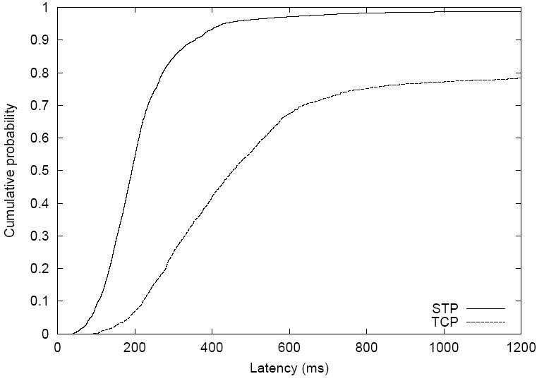
High throughput
TCP vs. STP
Sequence of single random fetches of 24 nodes
Median fetch time: 192 ms with STP, 447ms with TCP
On average: 3 hops to complete lookup
But
TCP fetch through 3 TCP connections consecutively
STP fetch through 1 single STP connection

Slide 19
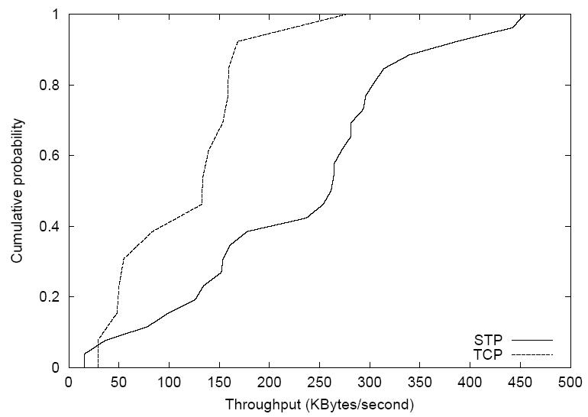
High throughput
TCP vs. STP
Simultaneous fetches of different nodes
Median throughput: 133 KB/s with TCP, 261 KB/s with STP
Same reason for result as in previous slide

Slide 20
Summary
Different design decisions
Recursive routing → reducing number of sent packets
Proximity neighbor selection → searching nearby nodes
Erasure-coding → increasing availability of data
Integration → reducing number of hops for lookup
Result:
Reduced the lookup and fetch latency up to a factor of 2
Alternative Transport Protocol STP
Fitted to the needs of DHash++
Direct connection between nodes
→Higher throughput than TCP
→Lower latency than TCP
Result:
Further reduced latency and optimized throughput by factor 2

Slide 21
Thanks for Your Attention

