Slide 1
Distributed Systems:
Motivation, Time, Mutual Exclusion

Slide 2
Announcements
Prelim II coming up next week:
  In class, Thursday, November 20th, 10:10—11:25pm
  203 Thurston
  Closed book, no calculators/PDAs/…
  Bring ID
Topics:
  Everything after first prelim
  Lectures 14-22, chapters 10-15 (8th ed)
Review Session Tuesday, November 18th, 6:30pm–7:30pm
  Location: 315 Upson Hall

Slide 3
Today
Motivation
What is the time now?
Distributed Mutual Exclusion

Slide 4
Distributed Systems
Definition:
Loosely coupled processors interconnected by network
Distributed system is a piece of software that ensures:
  Independent computers appear as a single coherent system
Lamport: “A distributed system is a system where I can’t get my work done because a computer has failed that I never heard of”

Slide 5
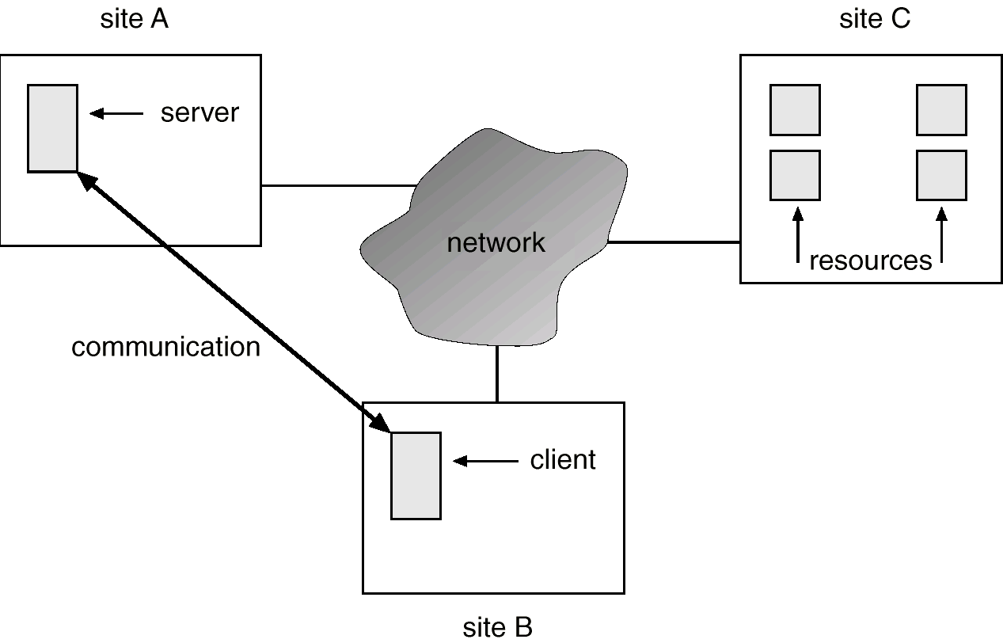
A Distributed System
-<number>

Slide 6
Loosely Coupled Distributed Systems
Users are aware of multiplicity of machines. Access to resources of various machines is done explicitly by:
  Remote logging into the appropriate remote machine.
  Transferring data from remote machines to local machines, via the File Transfer Protocol (FTP) mechanism.
-<number>

Slide 7
Tightly Coupled Distributed-Systems
Users not aware of multiplicity of machines. Access to remote resources similar to access to local resources
Examples
  Data Migration – transfer data by transferring entire file, or transferring only those portions of the file necessary for the immediate task.
  Computation Migration – transfer the computation, rather than the data, across the system.
-<number>

Slide 8
Distributed-Operating Systems (Cont.)
Process Migration – execute an entire process, or parts of it, at different sites.
  Load balancing – distribute processes across network to even the workload.
  Computation speedup – subprocesses can run concurrently on different sites.
  Hardware preference – process execution may require specialized processor.
  Software preference – required software may be available at only a particular site.
  Data access – run process remotely, rather than transfer all data locally.
-<number>

Slide 9
Why Distributed Systems?
Communication
  Dealt with this when we talked about networks
Resource sharing
Computational speedup
Reliability
-<number>

Slide 10
Resource Sharing
Distributed Systems offer access to specialized resources of many systems
  Example:
    Some nodes may have special databases
    Some nodes may have access to special hardware devices (e.g. tape drives, printers, etc.)
DS offers benefits of locating processing near data or sharing special devices
-<number>

Slide 11
OS Support for resource sharing
Resource Management?
  Distributed OS can manage diverse resources of nodes in system
  Make resources visible on all nodes
    Like VM, can provide functional illusion but rarely hide the performance cost
Scheduling?
  Distributed OS could schedule processes to run near the needed resources
  If need to access data in a large database may be easier to ship code there and results back than to request data be shipped to code
-<number>

Slide 12
Design Issues
Transparency – the distributed system should appear as a conventional, centralized system to the user.
Fault tolerance – the distributed system should continue to function in the face of failure.
Scalability – as demands increase, the system should easily accept the addition of new resources to accommodate the increased demand.
Clusters vs Client/Server
  Clusters: a collection of semi-autonomous machines that acts as a single system.
-<number>

Slide 13
Computation Speedup
Some tasks too large for even the fastest single computer
  Real time weather/climate modeling, human genome project, fluid turbulence modeling, ocean circulation modeling, etc.
  http://www.nersc.gov/research/GC/gcnersc.html
What to do?
  Leave the problem unsolved?
  Engineer a bigger/faster computer?
  Harness resources of many smaller (commodity?) machines in a distributed system?
-<number>

Slide 14
Breaking up the problems
To harness computational speedup must first break up the big problem into many smaller problems
More art than science?
  Sometimes break up by function
    Pipeline?
    Job queue?
  Sometimes break up by data
    Each node responsible for portion of data set?
-<number>

Slide 15
Decomposition Examples
Decrypting a message
  Easily parallelizable, give each node a set of keys to try
  Job queue – when tried all your keys go back for more?
Modeling ocean circulation
  Give each node a portion of the ocean to model (N square ft region?)
  Model flows within region locally
  Communicate with nodes managing neighboring regions to model flows into other regions
-<number>

Slide 16
Decomposition Examples (con’t)
Barnes Hut – calculating effect of bodies in space on each other
  Could divide space into NxN regions?
  Some regions have many more bodies
Instead divide up so have roughly same number of bodies
Within a region, bodies have lots of effect on each other (close together)
Abstract other regions as a single body to minimize communication
-<number>

Slide 17
Linear Speedup
Linear speedup is often the goal.
  Allocate N nodes to the job goes N times as fast
Once you’ve broken up the problem into N pieces, can you expect it to go N times as fast?
  Are the pieces equal?
  Is there a piece of the work that cannot be broken up (inherently sequential?)
  Synchronization and communication overhead between pieces?
-<number>

Slide 18
Super-linear Speedup
Sometimes can actually do better than linear speedup!
Especially if divide up a big data set so that the piece needed at each node fits into main memory on that machine
Savings from avoiding disk I/O can outweigh the communication/ synchronization costs
When split up a problem, tension between duplicating processing at all nodes for reliability and simplicity and allowing nodes to specialize
-<number>

Slide 19
OS Support for Parallel Jobs
Process Management?
  OS could manage all pieces of a parallel job as one unit
  Allow all pieces to be created, managed, destroyed at a single command line
  Fork (process,machine)?
Scheduling?
  Programmer could specify where pieces should run and or OS could decide
    Process Migration? Load Balancing?
  Try to schedule piece together so can communicate effectively
-<number>

Slide 20
OS Support for Parallel Jobs (con’t)
Group Communication?
  OS could provide facilities for pieces of a single job to communicate easily
  Location independent addressing?
  Shared memory?
  Distributed file system?
Synchronization?
  Support for mutually exclusive access to data across multiple machines
  Can’t rely on HW atomic operations any more
  Deadlock management?
  We’ll talk about clock synchronization and two-phase commit later
-<number>

Slide 21
Reliability
Distributed system offers potential for increased reliability
  If one part of system fails, rest could take over
  Redundancy, fail-over
!BUT! Often reality is that distributed systems offer less reliability
  “A distributed system is one in which some machine I’ve never heard of fails and I can’t do work!”
  Hard to get rid of all hidden dependencies
  No clean failure model
    Nodes don’t just fail they can continue in a broken state
    Partition network = many many nodes fail at once! (Determine who you can still talk to; Are you cut off or are they?)
    Network goes down and up and down again!
-<number>

Slide 22
Robustness
Detect and recover from site failure, function transfer, reintegrate failed site
  Failure detection
  Reconfiguration
-<number>

Slide 23
Failure Detection
Detecting hardware failure is difficult.
To detect a link failure, a handshaking protocol can be used.
Assume Site A and Site B have established a link. At fixed intervals, each site will exchange an I-am-up message indicating that they are up and running.
If Site A does not receive a message within the fixed interval, it assumes either (a) the other site is not up or (b) the message was lost.
Site A can now send an Are-you-up? message to Site B.
If Site A does not receive a reply, it can repeat the message or try an alternate route to Site B.
-<number>

Slide 24
Failure Detection (cont)
If Site A does not ultimately receive a reply from Site B, it concludes some type of failure has occurred.
Types of failures:
- Site B is down
- The direct link between A and B is down
- The alternate link from A to B is down
- The message has been lost
However, Site A cannot determine exactly why the failure has occurred.
B may be assuming A is down at the same time
Can either assume it can make decisions alone?
-<number>

Slide 25
Reconfiguration
When Site A determines a failure has occurred, it must reconfigure the system:
1. If the link from A to B has failed, this must be broadcast to every site in the system.
2. If a site has failed, every other site must also be notified indicating that the services offered by the failed site are no longer available.
When the link or the site becomes available again, this information must again be broadcast to all other sites.
-<number>

Slide 26
Distributed Time

Slide 27
What time is it?
In distributed system we need practical ways to deal with time
  E.g. we may need to agree that update A occurred before update B
  Or offer a “lease” on a resource that expires at time 10:10.0150
  Or guarantee that a time critical event will reach all interested parties within 100ms

Slide 28
But what does time “mean”?
Time on a global clock?
  E.g. with GPS receiver
… or on a machine’s local clock
  But was it set accurately?
  And could it drift, e.g. run fast or slow?
  What about faults, like stuck bits?
… or could try to agree on time

Slide 29
Event Ordering
Fundamental Problem: distributed systems do not share a clock
  Many coordination problems would be simplified if they did (“first one wins”)
Distributed systems do have some sense of time
  Events in a single process happen in order
  Messages between processes must be sent before they can be received
  How helpful is this?

Slide 30
Lamport’s approach
Leslie Lamport suggested that we should reduce time to its basics
  Time lets a system ask “Which came first: event A or event B?”
  In effect: time is a means of labeling events so that…
    If A happened before B, TIME(A) < TIME(B)
    If TIME(A) < TIME(B), A happened before B

Slide 31
Drawing time-line pictures:
snd_{p}(m)
p
m
q
D
rcv_{q}(m) deliv_{q}(m)

Slide 32
Drawing time-line pictures:
A, B, C and D are “events”.
  Could be anything meaningful to the application
  So are snd(m) and rcv(m) and deliv(m)
What ordering claims are meaningful?
snd_{p}(m)
p
A
B
m
q
C
D
rcv_{q}(m) deliv_{q}(m)

Slide 33
Drawing time-line pictures:
A happens-before B, and C happens-before D
  “Local ordering” at a single process
  Write and
snd_{p}(m)
p
A
B
m
q
C
D
rcv_{q}(m) deliv_{q}(m)

Slide 34
Drawing time-line pictures:
snd_{p}(m)
snd_{p}(m) also happens-before rcv_{q}(m)
  “Distributed ordering” introduced by a message
  Write
p
A
B
m
q
C
D
rcv_{q}(m) deliv_{q}(m)

Slide 35
Drawing time-line pictures:
A happens-before D
  Transitivity: A happens-before snd_{p}(m), which happens-before rcv_{q}(m), which happens-before D
snd_{p}(m)
p
A
B
m
q
C
D
rcv_{q}(m) deliv_{q}(m)

Slide 36
Drawing time-line pictures:
Does B happen before D?
B and D are concurrent
  Looks like B happens first, but D has no way to know. No information flowed…
snd_{p}(m)
p
A
B
m
q
C
D
rcv_{q}(m) deliv_{q}(m)

Slide 37
Happens before “relation”
We’ll say that “A happens-before B”, written A→B, if
    A→^{P}B according to the local ordering, or
    A is a snd and B is a rcv and A→^{M}B, or
    A and B are related under the transitive closure of rules (1) and (2)
So far, this is just a mathematical notation, not a “systems tool”

Slide 38
Logical clocks
A simple tool that can capture parts of the happens before relation
First version: uses just a single integer
  Designed for big (64-bit or more) counters
  Each process p maintains LogicalTimestamp (LT_{p}), a local counter
  A message m will carry LT_{m}

Slide 39
Rules for managing logical clocks
When an event happens at a process p it increments LT_{p}.
  Any event that matters to p
  Normally, also snd and rcv events (since we want receive to occur “after” the matching send)
When p sends m, set
  LT_{m} = LT_{p}
When q receives m, set
  LT_{q} = max(LT_{q}, LT_{m})+1

Slide 40
Time-line with LT annotations
LT(A) = 1, LT(snd_{p}(m)) = 2, LT(m) = 2
LT(rcv_{q}(m))=max(1,2)+1=3, etc…
snd_{p}(m)
p
A
B
LT_{p} | 0 | 1 | 1 | 2 | 2 | 2 | 2 | 2 | 2 | 3 | 3 | 3 | 3
m
q
C
D
rcv_{q}(m) deliv_{q}(m)
LT_{q} | 0 | 0 | 0 | 1 | 1 | 1 | 1 | 3 | 3 | 3 | 4 | 5 | 5

Slide 41
Logical clocks
If A happens-before B, A→B,
then LT(A)<LT(B)
But converse might not be true:
  If LT(A)<LT(B) can’t be sure that A→B
  This is because processes that don’t communicate still assign timestamps and hence events will “seem” to have an order

Slide 42
Total ordering?
Happens-before gives a partial ordering of events
We still do not have a total ordering of events

Slide 43
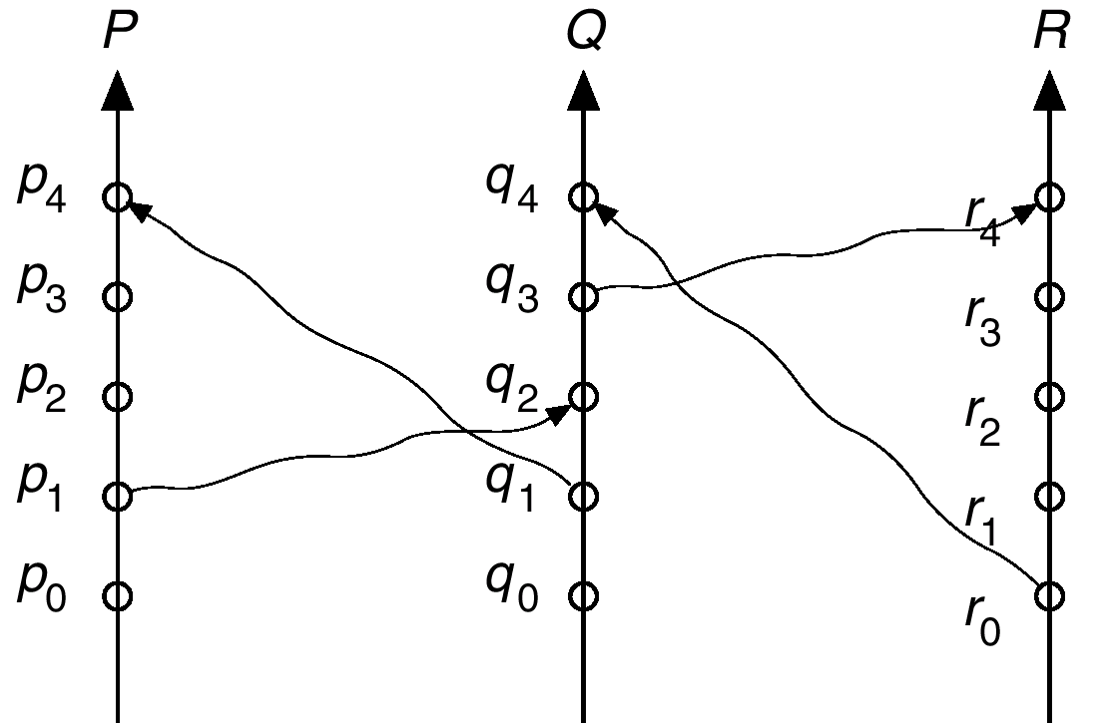
Partial Ordering
Pi ->Pi+1; Qi -> Qi+1; Ri -> Ri+1
R0->Q4; Q3->R4; Q1->P4; P1->Q2

Slide 44
Total Ordering?
P0, P1, Q0, Q1, Q2, P2, P3, P4, Q3, R0, Q4, R1, R2, R3, R4
P0, Q0, Q1, P1, Q2, P2, P3, P4, Q3, R0, Q4, R1, R2, R3, R4
P0, Q0, P1, Q1, Q2, P2, P3, P4, Q3, R0, Q4, R1, R2, R3, R4

Slide 45
Logical Timestamps w/ Process ID
Assume each process has a local logical clock that ticks once per event and that the processes are numbered
  Clocks tick once per event (including message send)
  When send a message, send your clock value
  When receive a message, set your clock to MAX( your clock, timestamp of message + 1)
    Thus sending comes before receiving
    Only visibility into actions at other nodes happens during communication, communicate synchronizes the clocks
  If the timestamps of two events A and B are the same, then use the network/process identity numbers to break ties.
This gives a total ordering!
Notes:
Problem with physical clocks? If clock runs fast or slow?
Event A1 at time 1 Event B1 at time 1
Event A2 is send to B Event B2 at time 2
Event A3 is at time 1+2d Event B2 at time 1+d (where d is time to send a message)
??

Slide 46
Distributed Mutual Exclusion (DME)

Slide 47
Distributed Mutual Exclusion (DME)
Example: Want mutual exclusion in distributed setting
  The system consists of n processes; each process P_{i} resides at a different processor
  Each process has a critical section that requires mutual exclusion
Problem: We can no longer rely on just an atomic test and set operation on a single machine to build mutual exclusion primitives
Requirement
  If P_{i} is executing in its critical section, then no other process P_{j} is executing in its critical section.

Slide 48
Solution
We present three algorithms to ensure the mutual exclusion execution of processes in their critical sections.
  Centralized Distributed Mutual Exclusion (CDME)
  Fully Distributed Mutual Exclusion (DDME)
  Token passing

Slide 49
CDME: Centralized Approach
One of the processes in the system is chosen to coordinate the entry to the critical section.
  A process that wants to enter its critical section sends a request message to the coordinator.
  The coordinator decides which process can enter the critical section next, and its sends that process a reply message.
  When the process receives a reply message from the coordinator, it enters its critical section.
  After exiting its critical section, the process sends a release message to the coordinator and proceeds with its execution.
3 messages per critical section entry

Slide 50
Problems of CDME
Electing the master process? Hardcoded?
Single point of failure? Electing a new master process?
Distributed Election algorithms later…

Slide 51
DDME: Fully Distributed Approach
When process P_{i} wants to enter its critical section, it generates a new timestamp, TS, and sends the message request (P_{i}, TS) to all other processes in the system.
When process P_{j} receives a request message, it may reply immediately or it may defer sending a reply back.
When process P_{i} receives a reply message from all other processes in the system, it can enter its critical section.
After exiting its critical section, the process sends reply messages to all its deferred requests.

Slide 52
DDME: Fully Distributed Approach (Cont.)
The decision whether process P_{j} replies immediately to a request(P_{i}, TS) message or defers its reply is based on three factors:
  If P_{j} is in its critical section, then it defers its reply to P_{i}.
  If P_{j} does not want to enter its critical section, then it sends a reply immediately to P_{i}.
  If P_{j} wants to enter its critical section but has not yet entered it, then it compares its own request timestamp with the timestamp TS.
    If its own request timestamp is greater than TS, then it sends a reply immediately to P_{i} (P_{i} asked first).
    Otherwise, the reply is deferred.

Slide 53
Problems of DDME
Requires complete trust that other processes will play fair
  Easy to cheat just by delaying the reply!
The processes needs to know the identity of all other processes in the system
  Makes the dynamic addition and removal of processes more complex.
If one of the processes fails, then the entire scheme collapses.
  Dealt with by continuously monitoring the state of all the processes in the system.
Constantly bothering people who don’t care
  Can I enter my critical section? Can I?
Notes:
Processes that have not entered their critical section must pause frequently to assure other processes that they intend to enter the critical section. This protocol is therefore suited for small, stable sets of cooperating processes.

Slide 54
Token Passing
Circulate a token among processes in the system
Possession of the token entitles the holder to enter the critical section
Organize processes in system into a logical ring
  Pass token around the ring
  When you get it, enter critical section if need to then pass it on when you are done (or just pass it on if don’t need it)

Slide 55
Problems of Token Passing
If machines with token fails, how to regenerate a new token?
A lot like electing a new coordinator
If process fails, need to repair the break in the logical ring

Slide 56
Compare: Number of Messages?
CDME: 3 messages per critical section entry
DDME: The number of messages per critical-section entry is 2 x (n – 1)
  Request/reply for everyone but myself
Token passing: Between 0 and n messages
  Might luck out and ask for token while I have it or when the person right before me has it
  Might need to wait for token to visit everyone else first
Notes:
DDME: This is the minimum number of required messages per critical-section entry when processes act independently and concurrently.

Slide 57
Compare : Starvation
CDME : Freedom from starvation is ensured if coordinator uses FIFO
DDME: Freedom from starvation is ensured, since entry to the critical section is scheduled according to the timestamp ordering. The timestamp ordering ensures that processes are served in a first-come, first served order.
Token Passing: Freedom from starvation if ring is unidirectional
Caveats
  network reliable (I.e. machines not “starved” by inability to communicate)
  If machines fail they are restarted or taken out of consideration (I.e. machines not “starved” by nonresponse of coordinator or another participant)
  Processes play by the rules

Slide 58
Summary
Why Distributed Systems?
  Communication, Resource sharing, Computational speedup, Reliability
  However, these goals often made more difficult in distributed system
What time did an event occur?
  Rather, Lamport’s notion of time
  Did a particular event occur before another?
  Happens-before relation used for event ordering
    Happens-before gives a partial ordering
    But what about a total ordering
  Logical Timestamp with process id used for tie breakers
    gives a total order
Distributed mutual exclusion
  Requirement: If P_{i} is executing in its critical section, then no other process P_{j} is executing in its critical section
  Compare three solutions
    Centralized Distributed Mutual Exclusion (CDME)
    Fully Distributed Mutual Exclusion (DDME)
    Token passing

