Slide 1

YouTube Analytics
Ian Aliman, LaRue Brown, Hannah Jordan, Gayathri Sanjeev

Slide 2
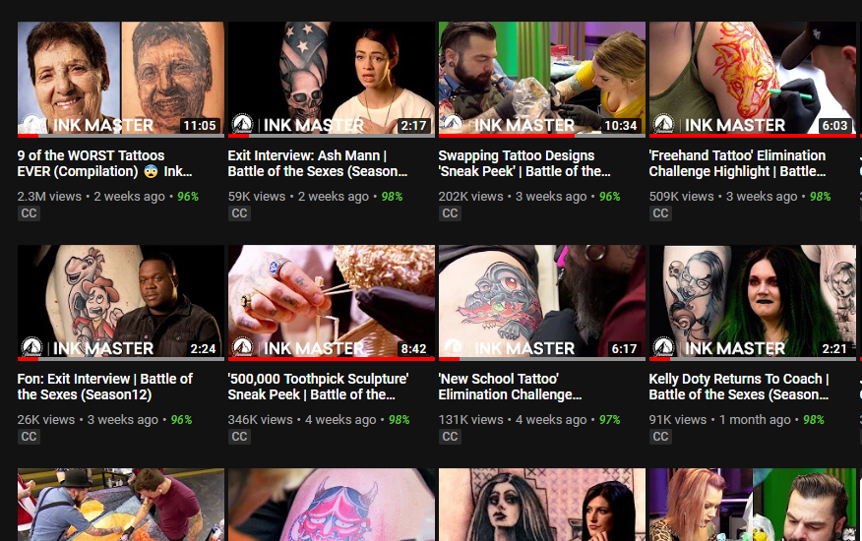


Introduction
Ink Master Videos (10)
Comments (12,113)
Timestamps (2026)
Captions
Relative Retention (Higher vs. Lower)

Slide 3
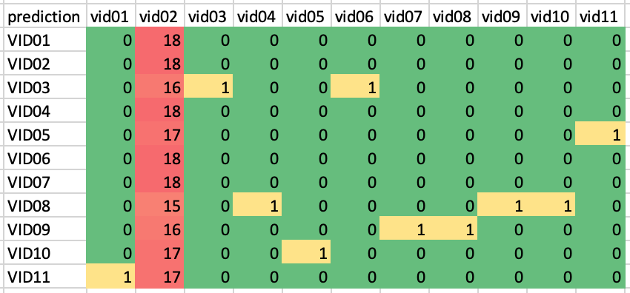
Comment-Based Clustering
198 comments analyzed
Comment content was similar across videos
Differentiators:
VID03 - "balloon"
VID05 - "hold" "hands"
VID08 - "thumbnail"
VID09 - "primary" "colors"
VID10 - "koi"
VID11 - "kelly"

Slide 4

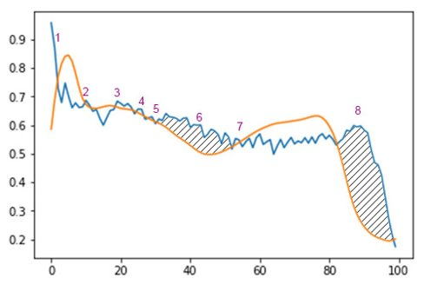
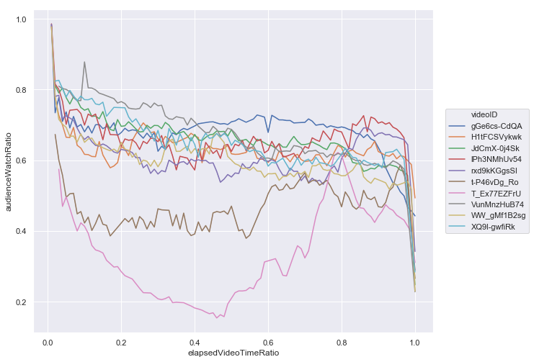
About the Analytics
Audience Watch Ratio, 10 videos
Comments ~= watch preference

Slide 5
About the Analytics
Example: how labels were created for one video
Relative Retention Performance
Audience Watch Ratio

Slide 6
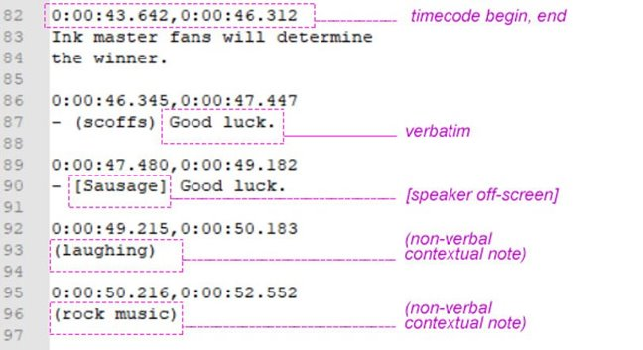
Label Creation

Slide 7

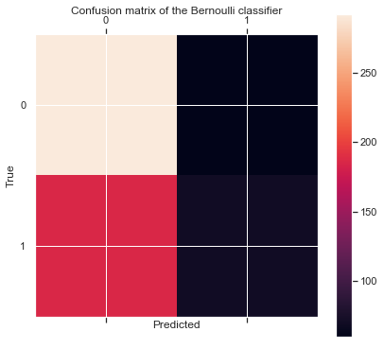
Bernoulli Naïve Bayes
Future Tuning:
Balance 40/60 category split
Gold Parse
Accuracy: 0.595
SpaCy pipeline
 | OVER | UNDER
TRUE | 292 | 60 | 352
 | 186 | 70
 | 478 | 130
 | PREDICT

Slide 8

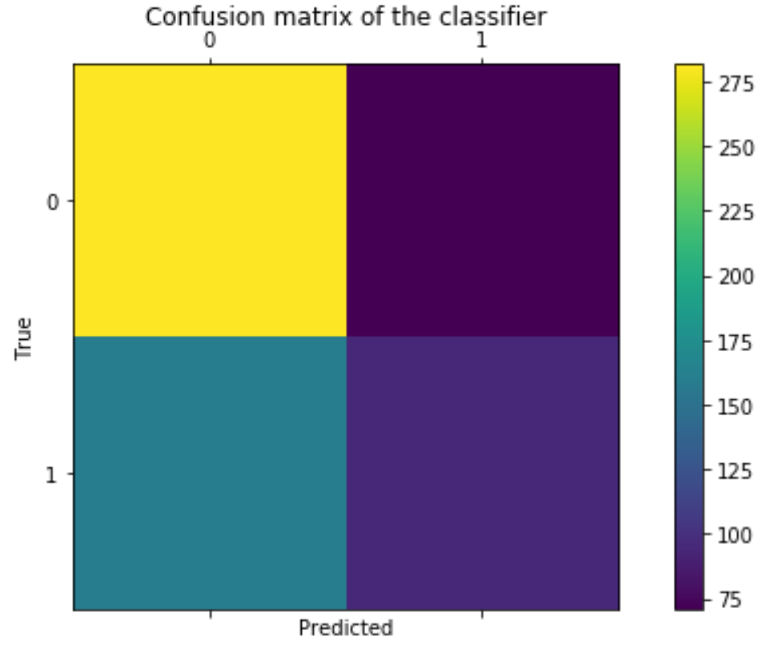
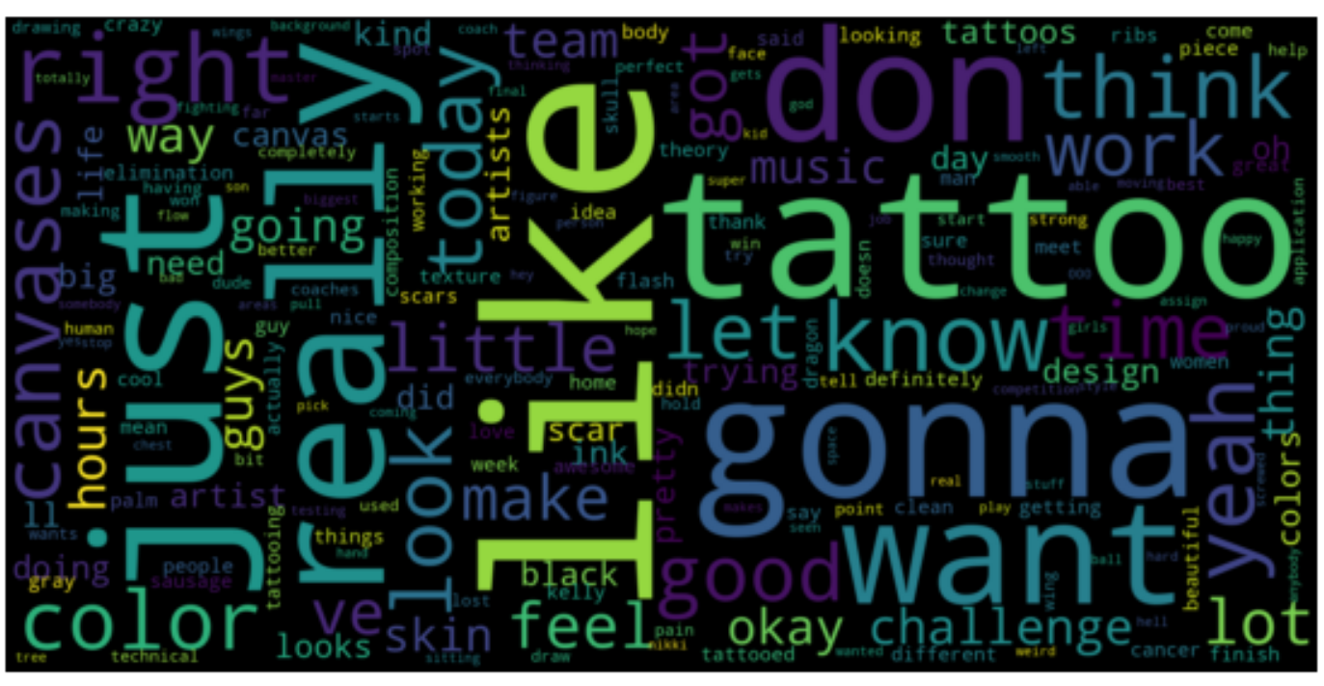
Multinomial Naïve Bayes
Predicts lower retention rate videos with good accuracy
Overall accuracy rate – 62%

Slide 9
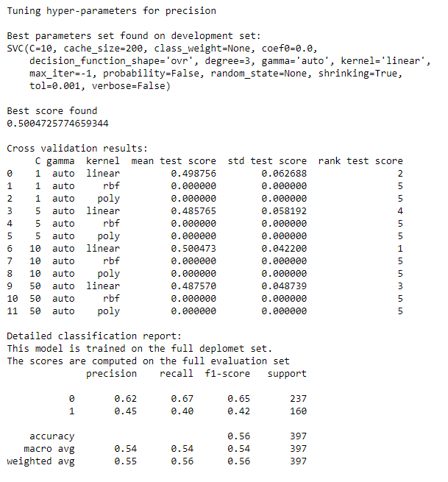
Support Vector Machines
Kernel | Penalty | Optimized For | Best Score | Accuracy | Precision (lower) | Recall (lower) | F1-Score (lower) | Precision (higher) | Recall (higher) | F1-Score (higher)
linear | 5 | precision | 0.521 | 0.57 | 0.63 | 0.7 | 0.66 | 0.47 | 0.39 | 0.42
linear | 50 | recall | 0.456 | 0.58 | 0.64 | 0.66 | 0.65 | 0.47 | 0.45 | 0.46
linear | 10 | precision | 0.5 | 0.56 | 0.62 | 0.67 | 0.65 | 0.45 | 0.4 | 0.42
linear | 50 | recall | 0.428 | 0.55 | 0.62 | 0.63 | 0.62 | 0.44 | 0.43 | 0.44
Analyze both unigrams and bigrams
Analyze 'linear', 'rbc', and 'poly' kernels
Penalty 1 – 50
Models optimized for precision and recall
10-fold CV
Linear kernel with a penalty of 5
Accuracy: 52.1%
50/50

Slide 10

Conclusions
For SVM, the linear kernel performs the best at predicting relative retention
Multinomial Naïve Bayes better at predicting relative retention than SVM

Slide 11
Q&A

