Slide 1


“Online Examination System”
Presented By:
Jayanti Shrestha
Ganesh Gaha Magar

Slide 2
Content
1. Introduction
2. Objectives
3. Literature Review
4. Methodology
5. Outcome
6. Conclusion
7. Future scope
8. Reference

Slide 3

Introduction
An online examination system is a computer based system that can be used to conduct computer based tests online.
Multiple steps, such as the organizing and printing of papers before the examination, the distributing and collecting of papers during the examination, the marking and arranging after the examinations, are reduced to one or two steps. Therefore, it needs less manpower to handle the examination.

Slide 4
Objectives
Automatically checked answers
Prevents cheatings
Time management

Slide 5
Literature Review
Computerized systems have been increasing in education nowadays. Online Examination systems applications support the interaction between different parties participating in the learning platform via the network, as well as the management of the data involved in the process.
Students can take exam using computerized system; they don’t need paper-based exam. They save time and money when using computer system in their studies.

Slide 6
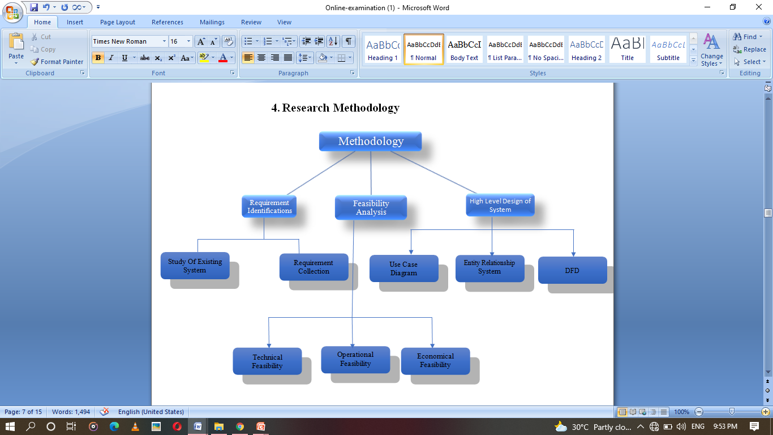
Research Methodology

Slide 7
I. Requirement Identification
Study of Existing System
Computers and the internet have made dramatic changes in the education system. An online examination is the conducting of an examination or test online to measure a student’s academic performance.
With an online examination, all these traditional elements continue to persist, however, the mode of test-taking has changed – instead of a physical examination hall, students instead log into an online examination system through which they access the question paper and share their answers.

Slide 8
Requirement Collection
Requirement collection is the crucial aspect as many times communication gaps arise in this phase and this leads to validation errors and bugs in the software program.
Datasets are required for continuous training of data to increase accuracy.

Slide 9
II. Feasibility Analysis
Technical feasibility
Technical feasibility centers on the existing manual system of the test management process and to what extent it can support the system.
The system offers greater levels of user friendliness combined with greater processing speed. Therefore, the cost of maintenance can be reduced.

Slide 10
Operational Feasibility
The project is operationally feasible as there is no need for users to have good knowledge of computers before using it.
The user can learn and use the system with easiness; he/she just needs to read the manual or tutorial from the developers.

Slide 11
Economical Feasibility
Economic analysis is most frequently used for evaluation of the effectiveness of the system.
More commonly knows as cost/benefit analysis the procedure is to determine the benefit and saving that are expected from a system and compare them with costs, decisions is made to design and implement the system.

Slide 12
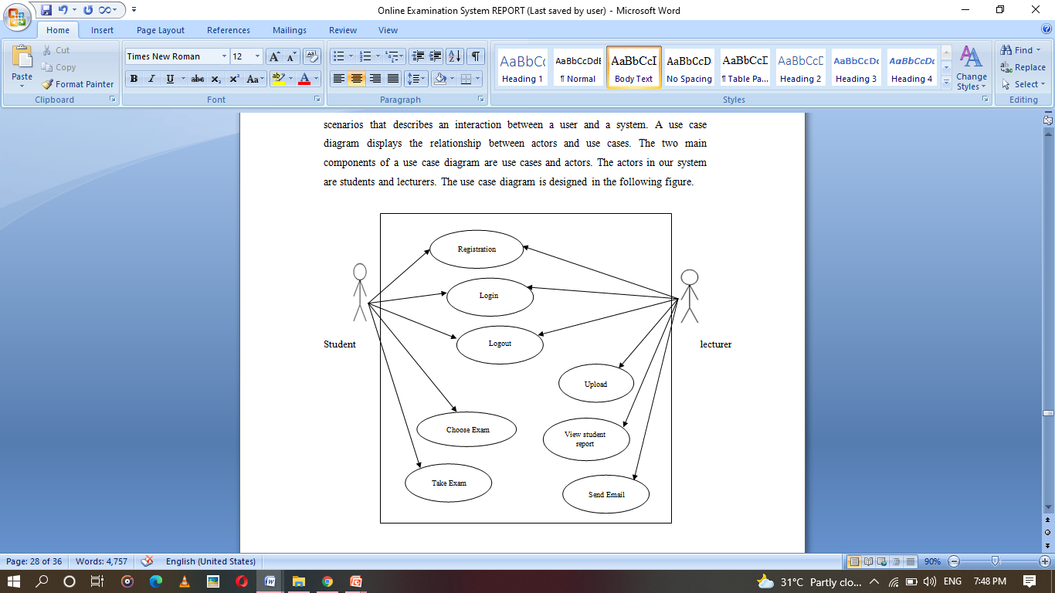
III. High-Level Design of Systems
Case Diagram

Slide 13
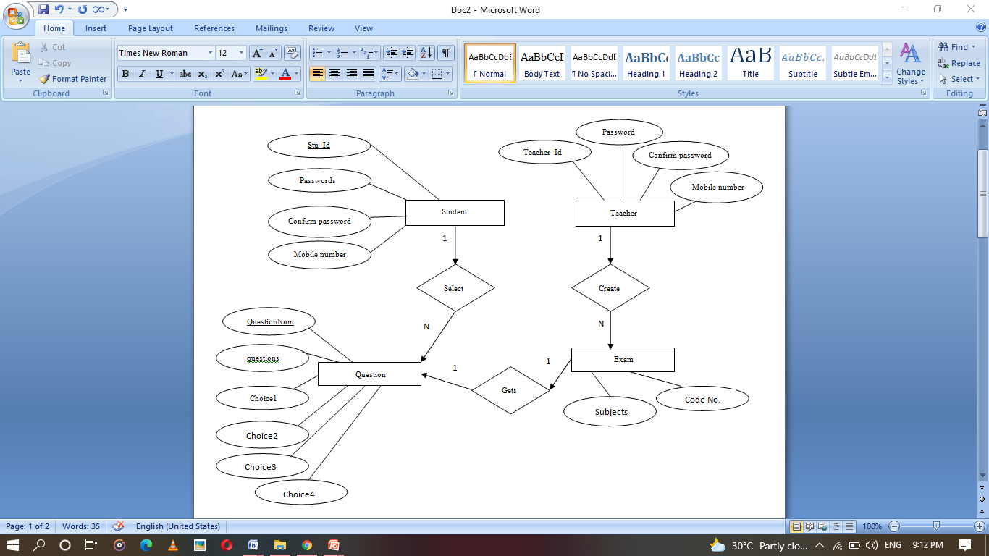
ER Diagram

Slide 14
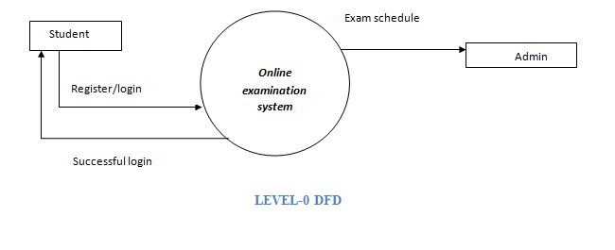
DFD

Slide 15
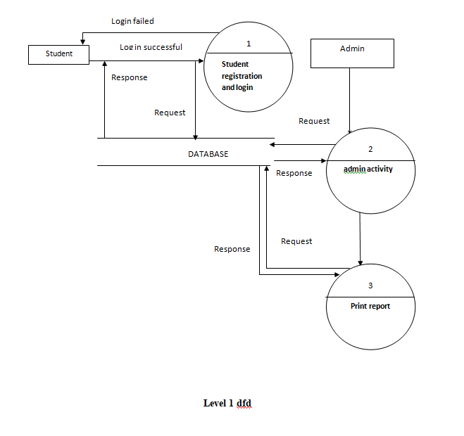
DFD

Slide 16
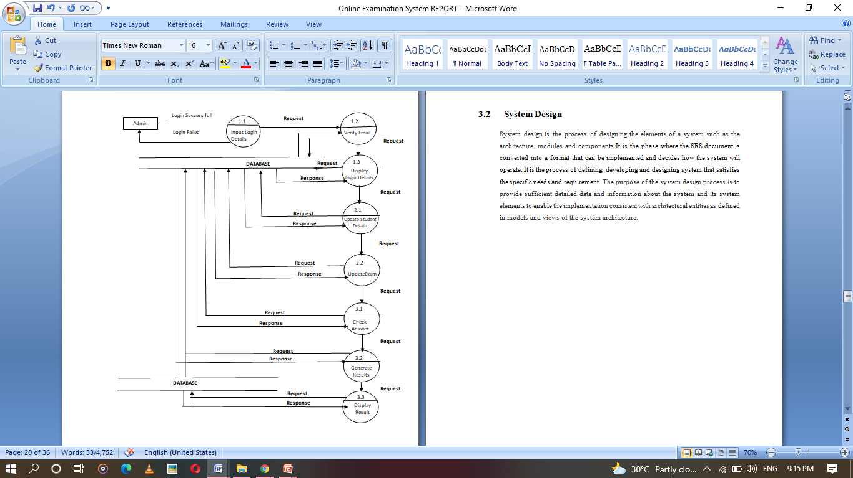
DFD

Slide 17
Outcome
This online examination system is to effectively evaluate the student thoroughly through a totally automated system that not only reduce the required time but also obtain fast and accurate results.
It is secure with a proper mechanism to store results and also provides time management. It maintains the confidentiality of exams, so there’s no room for malpractices.

Slide 18
Conclusion
Online Examination System is a web application. The key concept is to minimize the amount of paper and convert all forms of documentation to digital form.
The system is operated at a high level of efficiency and all the teachers and user associated with the system understands its advantage. So, OES is a user friendly system, which is very easy and convenient to use.

Slide 19
Future Scope
Since the system is dynamic, further enhancements can be incorporated into the system. First, an sms server which enable students to get real time notifications of results. Secondly, the user are able to do the subjective questions that can’t be copy. And a new feature with a very strong security. Also, a mail server to enable users register with the correct valid emails so that when they register, a link can be send to their emails so that they mail click it to activate their registration.

Slide 20
References
[1] Q. JIA, “Design of a Student’s Online Examination System Based on Web,” DEStech Trans. Soc. Sci. Educ. Hum. Sci., no. emass, pp. 4–7, 2017, doi: 10.12783/dtssehs/emass2016/6761.
[2] I. A. Baba, “Online Examination System for Introduction to Management course Online Examination System for Introduction to Management course,” no. January, 2013.
[3] K. T. Askarali, “Online examination system,” J. Interdiscip. Multidiscip. Res., vol. 2, no. 5, 2015, doi: 10.26438/ijcse/v6i7.745749.

Slide 21
…THANK YOU…

