Slide 1
GPU programming: CUDA
Acknowledgement: the lecture materials are based on the materials in NVIDIA teaching center CUDA course materials, including materials from Wisconsin (Negrut), North Carolina Charlotte (Wikinson/Li) and NCSA (Kindratenko).

Slide 2
CUDA
CUDA is Nvidia’s scalable parallel programming model and a software environment for parallel computing
Lanugage: CUDA C, minor extension to C/C++
Let the programmer focus on parallel algorithms not parallel programming mechanisms.
A heterogeneous serial-parallel programming model
Desinged to program heterogeneous CPU+GPU systems
CPU and GPU are separate devices with separate memory

Slide 3
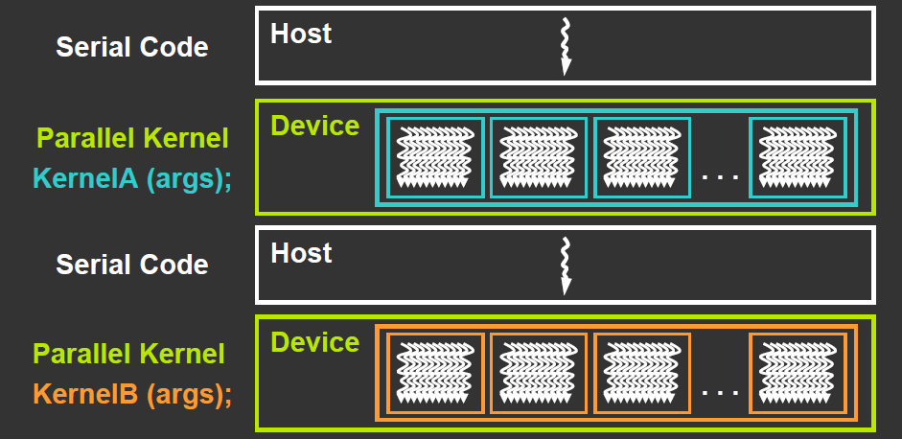
Heterogeneous programming with CUDA
Fork-join model: CUDA program = serial code + parallel kernels (all in CUDA C)
Serial C code executes in a host thread (CPU thread)
Parallel kernel code executes in many device threads (GPU threads)

Slide 4
CUDA kernel
Kernel code is regular C code except that it will use thread ID (CUDA built-in variables) to make different threads operate on different data
Also variables for the total number of threads
When a kernel is reached in the code for the first time, it is launched onto GPU.

Slide 5
CPU and GPU memory
CPU and GPU have different memories:
CPU memory is called host memory
GPU memory is called device memory
Implication:
Explicitly transfer data from CPU to GPU for GPU computation, and
Explicitly transfer results in GPU memory copied back to CPU memory
CPU
CPU main memory
Copy from CPU to GPU
Copy from GPU to CPU
GPU global memory
GPU

Slide 6
Basic CUDA program structure
int main (int argc, char **argv ) {
1. Allocate memory space in device (GPU) for data
2. Allocate memory space in host (CPU) for data
3. Copy data to GPU
4. Call “kernel” routine to execute on GPU
(with CUDA syntax that defines no of threads and their physical structure)
5. Transfer results from GPU to CPU
6. Free memory space in device (GPU)
7. Free memory space in host (CPU)
return;
}

Slide 7
1. Allocating memory in GPU (device)
The cudaMalloc routine:
int size = N *sizeof( int); // space for N integers
int *devA, *devB, *devC; // devA, devB, devC ptrs
cudaMalloc( (void**)&devA, size) );
cudaMalloc( (void**)&devB, size );
cudaMalloc( (void**)&devC, size );
2. Allocating memory in host (CPU)?
The regular malloc routine

Slide 8
3. Transferring data from/to host (CPU) to/from device (GPU)
CUDA routine cudaMemcpy
cudaMemcpy( devA, &A, size, cudaMemcpyHostToDevice);
cudaMemcpy( devB, &B, size, cudaMemcpyHostToDevice);
DevA and devB are pointers to destination in device (return from cudaMalloc and A and B are pointers to host data

Slide 9
3. Defining/invoking kernel routine
Define: CUDA specifier __global__
#define N 256
__global__ void vecAdd(int *A, int *B, int *C) { // Kernel definition
int i = threadIdx.x;
C[i] = A[i] + B[i];
}
int main() {
// allocate device memory &
// copy data to device
// device mem. ptrs devA,devB,devC
vecAdd<<<1, N>>>(devA,devB,devC);
…
}
Each thread performs one pair-wise addition:
Thread 0: devC[0] = devA[0] + devB[0];
Thread 1: devC[1] = devA[1] + devB[1];
Thread 2: devC[2] = devA[2] + devB[2];
This is the fork-join statement in Cuda
Notice the devA/B/C are device memory
pointer

Slide 10
CUDA kernel invocation
<<<…>>> syntax (addition to C) for kernel calls:
myKernel<<< n, m >>>(arg1, … );
<<< … >>> contains thread organization for this particular kernel call in two parameters, n and m:
vecAdd<<<1, N>>>(devA,devB,devC): 1 dimension block with N threads
Threads execute very efficiently on GPU: we can have fine-grain threads (a few statements)
More thread organization later
arg1, … , -- arguments to routine myKernel typically pointers to device memory obtained previously from cudaMallac.

Slide 11
5. Transferring data from device (GPU) to host (CPU)
CUDA routine cudaMemcpy
cudaMemcpy( &C, dev_C, size, cudaMemcpyDeviceToHost);
dev_C is a pointer in device memory and C is a pointer in host memory.

Slide 12
6. Free memory space
In “device” (GPU) -- Use CUDA cudaFree routine:
cudaFree( dev_a);
cudaFree( dev_b);
cudaFree( dev_c);
In (CPU) host (if CPU memory allocated with malloc) -- Use regular C free routine:
free( a );
free( b );
free( c );

Slide 13
Complete CUDA examples
See vecadd.cu
Compare the speed of vecadd.c and vecadd.cu
See also vec_complex.c and vec_complex.cu
Compiling CUDA programs
Use the gpu.cs.fsu.edu (gpu1, gpu2, gpu3)
Naming convention .cu programs are CUDA programs
NVIDIA CUDA compiler driver: nvcc
To compile vecadd.cu: nvcc –O3 vecadd.cu

Slide 14
Compilation process
nvcc “wrapper” divides code into host and device parts.
Host part compiled by regular C compiler
Device part compiled by NVIDIA “ptxas” assembler
Two compiled parts combined into one executable
nvcc
ptxas
gcc
executable
Executable file a “fat” binary” with both host and device code

Slide 15
CUDA C extensions
Declaration specifiers to indicate where things live
__global__ void mykernel(…) // kernel function on GPU
__device__ int globalVar; // variable in device
__shared__ int sharedVar; // in per block shared memory
Parallel kernel launch
Mykernel<<<500,128>>> (…); // launch 500 blocks with 128 threads each
Special variables
Dim3 threadIdx, blockIdx; // thread/block ID
Dim3 blockDim, gridDim; //thread/block size
Intrinsics for specific operations in kernel
__syncthreads(); // barrier synchronization

Slide 16
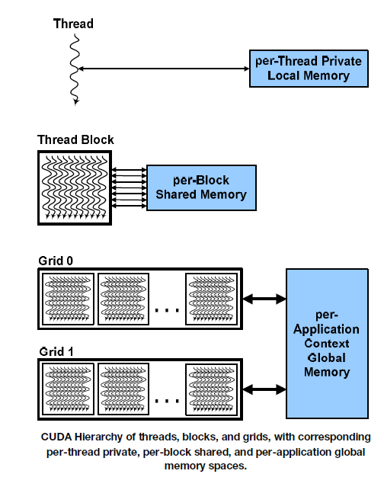
CUDA thread organization
hierarchy of threads
Blocks of threads in 1 or 2 dimensions, the collection of block is called a grid.
Blocks can be 1D, 2D, or 3D.
Can easily deal with 1D, 2D, and 3D data arrays.

Slide 17
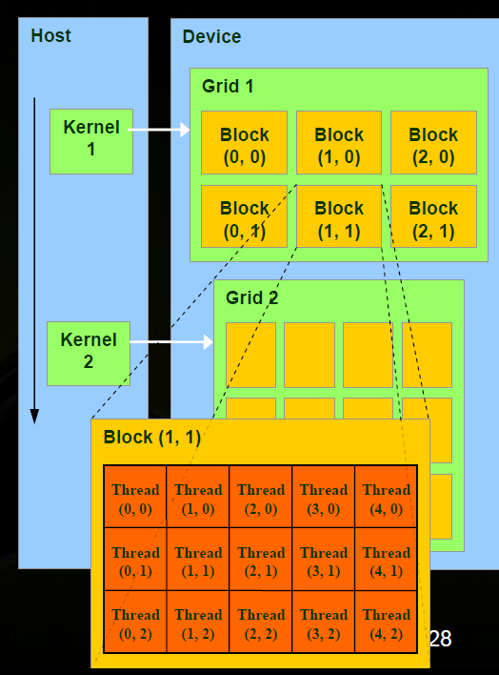
Cuda thread organization
Threads and blocks have IDs
So each thread can decide what data to work on.
Block ID (blockIdx): 1D or 2D
Thread ID (threadIdx): 1D, 2D or 3D.

Slide 18
Device characteristics – hardware limitations
NVIDIA defined “compute capabilities” 1.0, 1.1, … with limits and features
Give the limits of threads per block, total number of blocks, etc.
Compute capability 1.0
Max number of threads per block = 512
Max sizes of x- and y-dimension of thread block = 512
Maximum size of each dimension of grid of thread blocks = 65535

Slide 19
Specifying Grid/Block structure
The programmer need to provide each kernel call with:
Number of blocks in each dimension
Threads per block in each dimension
myKernel<<< B, T >>>(arg1, … );
B – a structure that defines the number of blocks in grid in each dimension (1D or 2D).
T – a structure that defines the number of threads in a block in each dimension (1D, 2D, or 3D).
B and T are of type dim3 (uint3).

Slide 20
1-D grid and/or 1-D blocks
For 1-D structure, one can use an integer for each of B and T in:
myKernel<<< B, T >>>(arg1, … );
B – An integer would define a 1D grid of that size
T –An integer would define a 1D block of that size
myKernel<<< 1, 100 >>>(arg1, … );
Grids can be 2D and blocks can be 2D or 3D
struct dim3 {x; y; z;} threadIdx, blockIdx;
Grid/block size
Dim3 gridDim; size of grid dimension x, y (z not used)
Dim3 blockDim; - size of grid dimension,

Slide 21
Compute global 1-D thread ID
dim3
threadIdx.x -- “thread index” within block in “x” dimension
blockIdx.x -- “block index” within grid in “x” dimension
blockDim.x -- “block dimension” in “x” dimension (i.e. number of threads in a block in the x dimension)
Full global thread ID in x dimension can be computed by:
x = blockIdx.x * blockDim.x + threadIdx.x;
how to fix vecadd.cu to make it work for larger vectors? See vecadd1.cu. What is the right number of threads per block?

Slide 22
Compute global 1-D thread ID
Global ID 18
threadIdx.x
threadIdx.x
threadIdx.x
0
1
2
3
4
5
6
7
0
1
2
3
4
5
6
7
0
1
2
3
4
5
6
7
blockIdx.x = 0
blockIdx.x = 1
blockIdx.x = 2
gridDim = 3 x 1
blockDim = 8 x 1
Global thread ID = blockIdx.x * blockDim.x + threadIdx.x
= 2 * 8 + 2 = thread 18 with linear global addressing

Slide 23
1D grid/block examples
__global__ void vecadd(float* A, float* B, float* C)
{ int i = threadIdx.x; // threadIdx is a CUDA built-in variable
C[i] = A[i] + B[i];
}
Vecadd<<<1,n>>>( dev_A, dev_B, dev_C );
__global__ void vecadd(float* A, float* B, float* C)
{ int i = blockIdx.x * blockDim.x + threadIdx.x;
C[i] = A[i] + B[i];
}
vecadd<<<32,n/32>>>( dev_A, dev_B, dev_C );

Slide 24
Higher dimensional grids/blocks
Grids can be 2D and blocks can be 2D or 3D
struct dim3 {x; y; z;};
Grid/block size
Dim3 gridDim size of grid dimension x, y (z not used)
Dim3 blockDim - size of grid dimension,

Slide 25
2D grid/blocks
To set dimensions, use for example:
dim3 grid(16, 16); // Grid -- 16 x 16 blocks
dim3 block(32, 32); // Block -- 32 x 32 threads
myKernel<<<grid, block>>>(...);
which sets:
gridDim.x = 16
gridDim.y = 16
blockDim.x = 32
blockDim.y = 32
blockDim.z = 1

Slide 26
2-D grids and 2-D blocks
blockIdx.y * blockDim.y + threadIdx.y
threadID.y
threadID.x
blockIdx.x * blockDim.x + threadIdx.x

Slide 27
Flaten 2 dimension array into linear memory
Generally memory allocated dynamically on device (GPU) and we cannot not use two-dimensional indices (e.g. A[row][column]) to access array as we might otherwise.
Need to know how array is laid out in memory and then compute distance from the beginning of the array.
Row major and column major order storage of multi-dimensional arrays.

Slide 28
Flattening an array
Number of columns, N
column
0
N-1
0
Array element
a[row][column] = a[offset]
offset = column + row * N
where N is the number of items in a row
row
row * number of columns

Slide 29
2D grid/block example: matrix addition
#define N 2048 // size of arrays
__global__void addMatrix (int *a, int *b, int *c) {
int col = blockIdx.x*blockDim.x+threadIdx.x;
int row =blockIdx.y*blockDim.y+threadIdx.y;
int index = col + row * N;
if ( col < N && row < N) c[index]= a[index] + b[index];
}
int main() {
...
dim3 dimBlock (16,16);
dim3 dimGrid (N/dimBlock.x, N/dimBlock.y);
addMatrix<<<dimGrid, dimBlock>>>(devA, devB, devC);
…
}

