Slide 1
Database Architectures for New Hardware
a tutorial by
Anastassia Ailamaki
Database Group
Carnegie Mellon University
http://www.cs.cmu.edu/~natassa

Slide 2
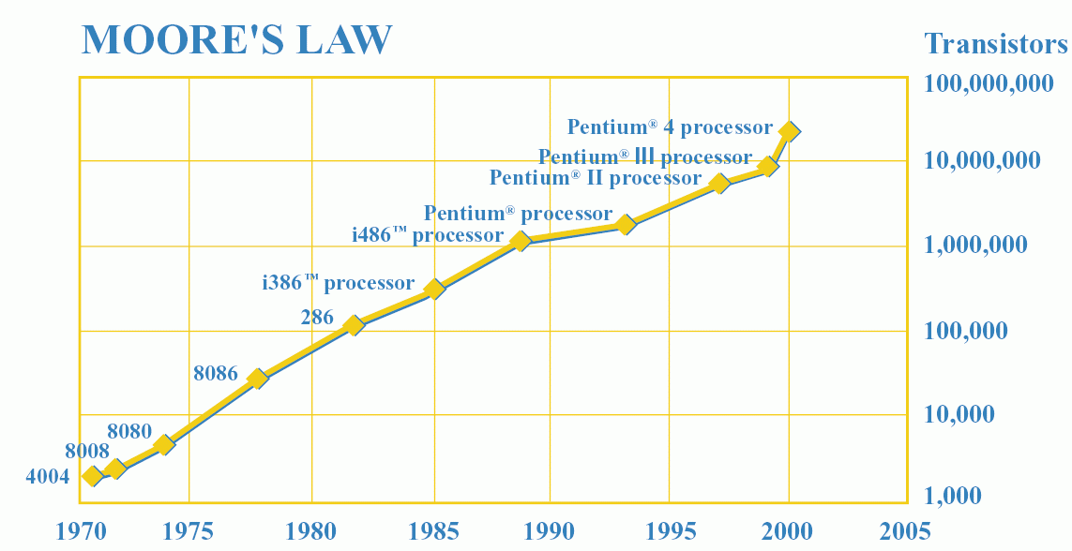
…on faster, much faster processors
Trends in processor (logic) performance
  Scaling # of transistors, innovative microarchitecture
  Higher performance, despite technological hurdles!
  Processor speed doubles every 18 months
Processor technology focuses on speed

Slide 3
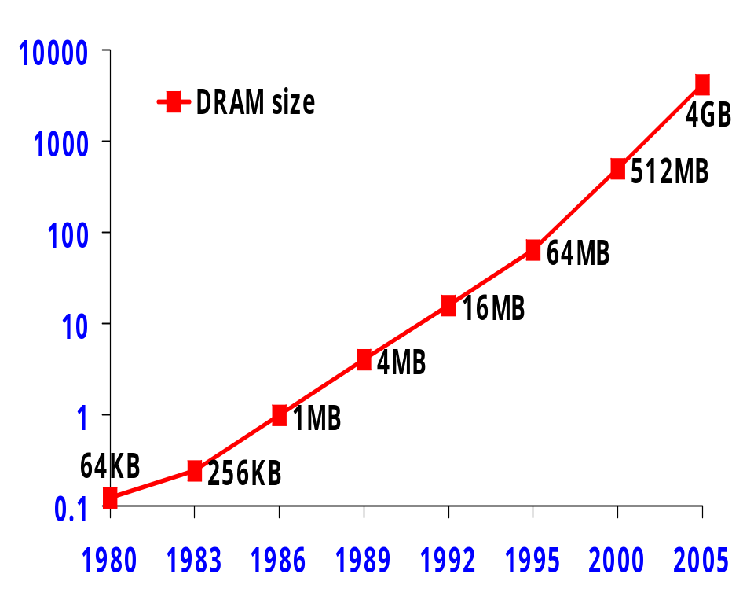
…on larger, much larger memories
Trends in Memory (DRAM) performance
  DRAM Fabrication primarily targets density
  Slower increase in speed
D
R
A
M
S
P
E
E
D
T
R
E
N
D
S
2
5
0
6
4
K
b
i
t
2
5
6
K
b
i
t
C
Y
C
L
E
T
I
M
E
(
n
s
)
S
L
O
W
E
S
T
R
A
S
(
n
s
)
2
0
0
1
M
b
i
t
F
A
S
T
E
S
T
R
A
S
(
n
s
)
C
A
S
(
n
s
)
4
M
b
i
t
)
1
5
0
s
n
(
1
6
M
b
i
t
D
E
E
1
0
0
P
S
6
4
M
b
i
t
5
0
0
1
9
8
0
1
9
8
2
1
9
8
4
1
9
8
6
1
9
8
8
1
9
9
0
1
9
9
2
1
9
9
4
Y
E
A
R
O
F
I
N
T
R
O
D
U
C
T
I
O
N
Memory capacity increases exponentially

Slide 4
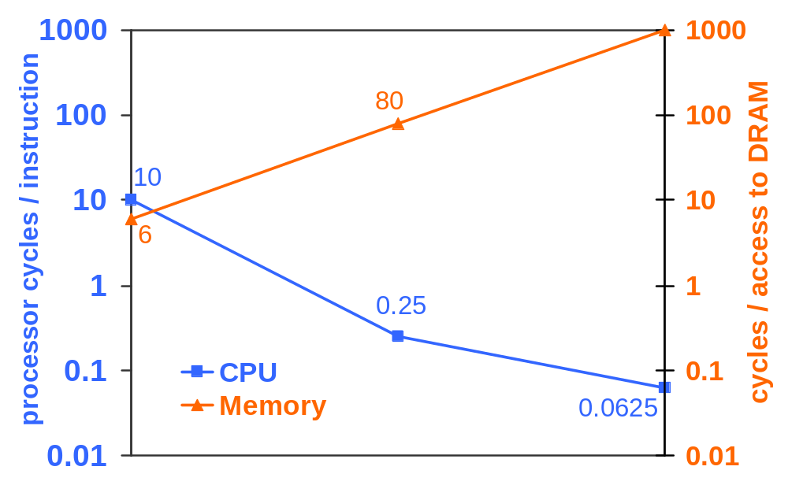
The Memory/Processor Speed Gap
VAX/1980
PPro/1996
2010+
A trip to memory = millions of instructions!
Notes:
Database performance on modern processors hurts because of the processor/memory speed gap.
The problems is due to (a) memories getting bigger (b) storage managers are smart and hide disk I/O
And (c) DBMS have too many knobs, benchmarks too complex to be used in early processor design stages
Database instruction streams contain many data accesses (=accesses to memory hierarchy)
And many dependencies (=>instruction-level parallelism is hard)
So on a 1980 machine (VAX 11/750) the access time to memory was about as long as the time to execute one instruction, whereas the access time to memory in 2000 (Pentium II) was equivalent to the time needed to execute 1000’s of instructions. The trend is going even faster; On the Pentium 4 the memory latency is 300 cycles, which is one more order of magnitude in only 2 years time. We project that soon the caches will play the role of memory (on-chip memory), the main memory will become the disk and the disk will be tertiary storage.
This means that unless the cache usage (cache=fast on-chip memory) is optimal, memory latency will dominate, and no matter how fast the processor is, database applications will be slow.
Therefore the cache-aware database research.

Slide 5
New Processor and Memory Systems
CPU
Caches trade off capacity for speed
Exploit I and D locality
Demand fetch/wait for data
[ADH99]:
Running top 4 database systems
At most 50% CPU utilization
100 clk
1000 clk
1 clk
10 clk
L1 64K
L2 2M
L3 32M
4GB
to
1TB
100G
Memory

Slide 6
Modern storage managers
Several decades work to hide I/O
Asynchronous I/O + Prefetch & Postwrite
  Overlap I/O latency by useful computation
Parallel data access
  Partition data on modern disk array [PAT88]
Smart data placement / clustering
  Improve data locality
  Maximize parallelism
  Exploit hardware characteristics
…and much larger main memories
  1MB in the 80’s, 10GB today, TBs coming soon
DB storage mgrs efficiently hide I/O latencies
Notes:
On the software side, modern database storage managers (and other system software like operating systems) have been focusing on improving the I/O performance for many decades. Here we listed the most successful and widely used techniques that alleviate (eliminate) the I/O limitations. In the systems applying asynchronous I/O, I/O operations run in the background without blocking the user applications as in the synchronous I/O model. Database storage manager take advantage of this ability to overlap processing and I/O. The techniques of prefetch and postwrite can go even further by fetching the future data and writing dirty pages back during the “free” cycles which have little influence on the processing. Innovations in disk subsystems, like RAID, provide the opportunities to the storage manager to exploit the intrinsic parallelism of the database workloads. Enormous partitioning strategies balancing I/O accesses have been proposed to hide the I/O latencies. Another effort direction is at a higher level above the parallel data access where semantics are taken into account to store and access data in a smarter way. For example, data are clustered according to their common properties so that we can get best localities when accessing them. Or hot spot data are distributed evenly so that we can maximize the parallelism provided by the underlying storage devices.
In a word, modern database storage managers are quite effective at hiding I/O latencies which dramatically improves the I/O performance, thus shifts the tradition performance bottleneck from I/O subsystems to the CPU-main memory level.

Slide 7
Why should we (databasers) care?
4
DB
Cycles per instruction
1.4
DB
0.8
0.33
Theoretical
minimum
Desktop/
Engineering
(SPECInt)
Decision
Support (TPC-H)
Online
Transaction
Processing (TPC-C)
Database workloads under-utilize hardware
New bottleneck: Processor-memory delays

Slide 8
Breaking the Memory Wall
DB Community’s Wish List for a Database Architecture:
that uses hardware intelligently
that won’t fall apart when new computers arrive
that will adapt to alternate configurations
Efforts from multiple research communities
Cache-conscious data placement and algorithms
Novel database software architectures
Profiling/compiler techniques (covered briefly)
Novel hardware designs (covered even more briefly)

Slide 9
Detailed Outline
Introduction and Overview
New Processor and Memory Systems
  Execution Pipelines
  Cache memories
Where Does Time Go?
  Tools and Benchmarks
  Experimental Results
Bridging the Processor/Memory Speed Gap
  Data Placement Techniques
  Query Processing and Access Methods
  Database system architectures
  Compiler/profiling techniques
  Hardware efforts
Hip and Trendy Ideas
  Query co-processing
  Databases on MEMS-based storage
Directions for Future Research

Slide 10
Outline
Introduction and Overview
New Processor and Memory Systems
  Execution Pipelines
  Cache memories
Where Does Time Go?
Bridging the Processor/Memory Speed Gap
Hip and Trendy Ideas
Directions for Future Research

Slide 11
This section’s goals
Understand how a program is executed
  How new hardware parallelizes execution
  What are the pitfalls
Understand why database programs do not take advantage of microarchitectural advances
Understand memory hierarchies
  How they work
  What are the parameters that affect program behavior
  Why they are important to database performance

Slide 12
Sequential Program Execution
Sequential Code
Instruction-level Parallelism (ILP)
i1: xxxx
i1
i2
i3
i1
i2: xxxx
pipelining
superscalar execution
i2
i3: xxxx
i3
Modern processors do both!
Precedences: overspecifications
Sufficient, NOT necessary for correctness
Notes:
The implied sequential precedences are overspecifications. It is sufficient but not necessary to ensure program correctness.

Slide 13
Pipelined Program Execution
FETCH
EXECUTE
RETIRE
T_{pipeline} = T_{base} / 5
Write results
Instruction stream
fetch
decode
execute
memory
write
t₀
t₁
t₂
t₃
t₄
t₅
Inst₁
F
D
E
M
W
Inst₂
F
D
E
M
W
Inst₃
F
D
E
M
W

Slide 14
Pipeline Stalls (delays)
Reason: dependencies between instructions
E.g., Inst₁: r1 ← r2 + r3
Inst₂: r4 ← r1 + r2
Read-after-write (RAW)
d = peak ILP
t₀
t₀
t₁
t₁
t₂
t₂
t₃
t₃
t₄
t₄
t₅
t₅
Inst₁
Inst₁
F
F
D
D
E
E
M
M
W
W
Inst₂
Inst₂
F
F
D
D
E
E Stall
M
W
E
M
W
F
F
D
D Stall
E
M
D
W
E
M
Peak instruction-per-cycle (IPC) = CPI = 1
DB programs: frequent data dependencies

Slide 15
Higher ILP: Superscalar Out-of-Order
peak ILP = d*n
t₀
t₁
t₂
t₃
t₄
t₅
Inst_{1…n}
F
D
E
M
W
at most n
Inst_{(n+1)…2n}
F
D
E
M
W
Inst_{(2n+1)…3n}
F
D
E
M
W
Peak instruction-per-cycle (IPC)=n (CPI=1/n)
Out-of-order (as opposed to “inorder”) execution:
  Shuffle execution of independent instructions
  Retire instruction results using a reorder buffer
DB programs: low ILP opportunity

Slide 16
Even Higher ILP: Branch Prediction
Which instruction block to fetch?
  Evaluating a branch condition causes pipeline stall
xxxx
if C goto B
A: xxxx
xxxx
xxxx
xxxx
B: xxxx
xxxx
xxxx
xxxx
xxxx
xxxx
C?
IDEA: Speculate branch while evaluating C!
  Record branch history in a buffer, predict A or B
  If correct, saved a (long) delay!
  If incorrect, misprediction penalty
    =Flush pipeline, fetch correct instruction stream
Excellent predictors (97% accuracy!)
Mispredictions costlier in OOO
  1 lost cycle = >1 missed instructions!
false: fetch A
true: fetch B
DB programs: long code paths => mispredictions

Slide 17
Outline
Introduction and Overview
New Processor and Memory Systems
  Execution Pipelines
  Cache memories
Where Does Time Go?
Bridging the Processor/Memory Speed Gap
Hip and Trendy Ideas
Directions for Future Research

Slide 18
Memory Hierarchy
Make common case fast
  common: temporal & spatial locality
  fast: smaller, more expensive memory
Keep recently accessed blocks (temporal locality)
Group data into blocks (spatial locality)
Registers
Faster
Caches
Memory
Larger
Disks
DB programs: >50% load/store instructions

Slide 19
Cache Contents
Keep recently accessed block in “cache line”
address
state
data
On memory read
  if incoming address = a stored address tag then
    HIT: return data
  else
    MISS: choose & displace a line in use
    fetch new (referenced) block from memory into line
    return data
Important parameters:
cache size, cache line size, cache associativity

Slide 20
Cache Associativity
means # of lines a block can be in (set size)
Replacement: LRU or random, within set
Line Set/Line Set
0
1
2
3
4
5
6
7
0
1
2
3
0
1
0
1
0
1
0
1
0
1
2
3
4
5
6
7
Fully-associative
a block goes in any frame
Set-associative
a block goes in any frame in exactly one set
Direct-mapped
a block goes in exactly one frame
lower associativity ⇒ faster lookup

Slide 21
Miss Classification (3+1 C’s)
compulsory (cold)
  “cold miss” on first access to a block
  — defined as: miss in infinite cache
capacity
  misses occur because cache not large enough
  — defined as: miss in fully-associative cache
conflict
  misses occur because of restrictive mapping strategy
  only in set-associative or direct-mapped cache
  — defined as: not attributable to compulsory or capacity
coherence
  misses occur because of sharing among multiprocessors
Parameters that affect miss rate:
Cache size (C), Block size (b), cache associativity (a)

Slide 22

Lookups in Memory Hierarchy
EXECUTION PIPELINE
L1: Split, 16-64K each.
As fast as processor (1 cycle)
L1 I-CACHE
L1 D-CACHE
L2: Unified, 512K-8M
Order of magnitude slower than L1
L2 CACHE
$$$
(there may be more cache levels)
Memory: Unified, 512M-8GB
~400 cycles (Pentium4)
MAIN MEMORY
Trips to memory are most expensive

Slide 23
Miss penalty
means the time to fetch and deliver block
Modern caches: non-blocking
EXECUTION PIPELINE
L1D: low miss penalty, if L2 hit (partly overlapped with OOO execution)
L1 I-CACHE
L1 D-CACHE
L1I: In critical execution path. Cannot be overlapped with OOO execution.
L2 CACHE
$$$
L2: High penalty (trip to memory)
MAIN MEMORY
DB: long code paths, large data footprints

Slide 24
Typical processor microarchitecture
Processor
I-Unit
E-Unit
Regs
L1 I-Cache
I-TLB
D-TLB
L1 D-Cache
L2 Cache (SRAM on-chip)
L3 Cache (SRAM off-chip)
TLB: Translation Lookaside Buffer (page table cache)
Main Memory (DRAM)
Will assume a 2-level cache in this talk

Slide 25
Summary
Fundamental goal in processor design: max ILP
  Pipelined, superscalar, speculative execution
  Out-of-order execution
  Non-blocking caches
  Dependencies in instruction stream lower ILP
Deep memory hierarchies
  Caches important for database performance
  Level 1 instruction cache in critical execution path
  Trips to memory most expensive
DB workloads perform poorly
  Too many load/store instructions
  Tight dependencies in instruction stream
  Algorithms not optimized for cache hierarchies
  Long code paths
  Large instruction and data footprints

Slide 26
Outline
Introduction and Overview
New Processor and Memory Systems
Where Does Time Go?
  Tools and Benchmarks
  Experimental Results
Bridging the Processor/Memory Speed Gap
Hip and Trendy Ideas
Directions for Future Research

Slide 27
This section’s goals
Understand how to efficiently analyze microarchitectural behavior of database workloads
  Should we use simulators? When? Why?
  How do we use processor counters?
  Which tools are available for analysis?
  Which database systems/benchmarks to use?
Survey experimental results on workload characterization
  Discover what matters for database performance

Slide 28
Simulator vs. Real Machine
Real machine
Limited to available hardware counters/events
Limited to (real) hardware configurations
Fast (real-life) execution
  Enables testing real: large & more realistic workloads
Sometimes not repeatable
Tool: performance counters
Simulator
Can measure any event
Vary hardware configurations
(Too) Slow execution
  Often forces use of scaled-down/simplified workloads
Always repeatable
Virtutech Simics, SimOS, SimpleScalar, etc.
Real-machine experiments to locate problems
Simulation to evaluate solutions
Notes:
Both simulators and real machines are widely used platforms for database workloads characterizations research. We compare and contrast them here based on their applicability. Simulators are suitable to evaluate innovative designs and analyze performance trend. This is because first, real machines do not have the new functionalities yet while it is easy to “implement” them and explore design options on simulators; second, simulators have various hardware configurations while the choices for real machines are very limited because of the budget. Real machines are suitable to the researches which focus on identifying existing performance bottlenecks in the current systems.
Simulators can collect any performance statistics while real machines are confined by available hardware counters and events.
Characterization research on real machines can do experiments with large-scale and real workloads while this is impossible for simulator because of the slow execution which might be several orders of magnitude slower than their real counterparts.
Both simulators and real machines are important platforms to the Where Does Time Go? research. We list several references here for the interested audience.

Slide 29
Hardware Performance Counters
What are they?
  Special purpose registers that keep track of programmable events
  Non-intrusive counts “accurately” measure processor events
  Software API’s handle event programming/overflow
  GUI interfaces built on top of API’s to provide higher-level analysis
What can they count?
  Instructions, branch mispredictions, cache misses, etc.
  No standard set exists
Issues that may complicate life
  Provides only hard counts, analysis must be done by user or tools
  Made specifically for each processor
    even processor families may have different interfaces
  Vendors don’t like to support because is not profit contributor

Slide 30
Evaluating Behavior using HW Counters
Stall time (cycle) counters
  very useful for time breakdowns
  (e.g., instruction-related stall time)
Event counters
  useful to compute ratios
  (e.g., # misses in L1-Data cache)
Need to understand counters before using them
  Often not easy from documentation
  Best way: microbenchmark (run programs with pre-computed events)
    E.g., strided accesses to an array

Slide 31
Example: Intel PPRO/PIII
Cycles | CPU_CLK_UNHALTED
Instructions | INST_RETIRED
L1 Data (L1D) accesses | DATA_MEM_REFS
L1 Data (L1D) misses | DCU_LINES_IN
L2 Misses | L2_LINES_IN
Instruction-related stalls | IFU_MEM_STALL
Branches | BR_INST_DECODED
Branch mispredictions | BR_MISS_PRED_RETIRED
TLB misses | ITLB_MISS
L1 Instruction misses | IFU_IFETCH_MISS
Dependence stalls | PARTIAL_RAT_STALLS
Resource stalls | RESOURCE_STALLS
“time”
Lots more detail, measurable events, statistics
Often >1 ways to measure the same thing
Notes:
Sources: Intel PPRO Developer’s Manual, man pages, Pat Fay (Intel), www.sandpile.org
Processor details: (PPRO)
32 bit processor
3-way superscalar
speculative execution
multiple branch prediction
1 FPU, 2 integer, 2 address, 1 load/store
(P II)
PPRO + MMX, doubled cache, processor card (not IC pkg)
2 perf counters
Note: instructions vs. micro-ops
Note: AMD K7--3-way superscalar+perf counters +Alpha EV6 bus(promised)
Note: Merced next generation 64-bit, counters???

Slide 32
Producing time breakdowns
Determine benchmark/methodology (more later)
Devise formulae to derive useful statistics
Determine (and test!) software
  E.g., Intel Vtune (GUI, sampling), or emon
  Publicly available & universal (e.g., PAPI [DMM04])
Determine time components T1….Tn
  Determine how to measure each using the counters
  Compute execution time as the sum
Verify model correctness
  Measure execution time (in #cycles)
  Ensure measured time = computed time (or almost)
  Validate computations using redundant formulae

Slide 33
Execution Time Breakdown Formula
Hardware
Resources
Branch
Mispredictions
Stalls
Memory
Overlap opportunity:
Load A
D=B+C
Load E
Computation
Execution Time = Computation + Stalls - Overlap
Execution Time = Computation + Stalls

Slide 34
Where Does Time Go (memory)?
Hardware
Resources
L1I
Instruction lookup missed in L1I, hit in L2
Branch
Mispredictions
L1D
Data lookup missed in L1D, hit in L2
Memory
L2
Instruction or data lookup missed in L1, missed in L2, hit in memory
Computation
Memory Stalls = Σ_{n}(stalls at cache level n)

Slide 35
What to measure?
Decision Support System (DSS:TPC-H)
  Complex queries, low-concurrency
  Read-only (with rare batch updates)
  Sequential access dominates
  Repeatable (unit of work = query)
On-Line Transaction Processing (OLTP:TPCC, ODB)
  Transactions with simple queries, high-concurrency
  Update-intensive
  Random access frequent
  Not repeatable (unit of work = 5s of execution after rampup)
Often too complex to provide useful insight
Notes:
This slide shows the popular database workloads used by most database Where Does Time Go? researches. They belong to two categories. One is DSS-like workload. DSS workloads are typically characterized by long, complex queries running on very large datasets at low concurrency levels. They are featured in sequential access patterns (through table scans or clustered index scans.) Read is the dominant operation in this type of workload. TPC-H and TPC-D designed by TPC (Transaction Processing Council) are the most famous representatives of this category. By contrast, on-line transaction processing workloads consist of shore read-write query statements grouped in transactions. OLTP workloads have high concurrency levels, and the users run many transactions at the same time. The queries in the transactions typically use non-clustered indexes and access few records, therefore OLTP workloads are characterized by concurrent random accesses. TPC-B, TPC-C designed by TPC and ODB designed by Oracle are the mostly used OLTP workloads.

Slide 36
Microbenchmarks
What matters is basic execution loops
Isolate three basic operations:
  Sequential scan (no index)
  Random access on records (non-clustered index)
  Join (access on two tables)
Vary parameters:
  selectivity, projectivity, # of attributes in predicate
  join algorithm, isolate phases
  table size, record size, # of fields, type of fields
Determine behavior and trends
  Microbenchmarks can efficiently mimic TPC microarchitectural behavior!
  Widely used to analyze query execution [KPH98,ADH99,KP00,SAF04]
Excellent for microarchitectural analysis

Slide 37
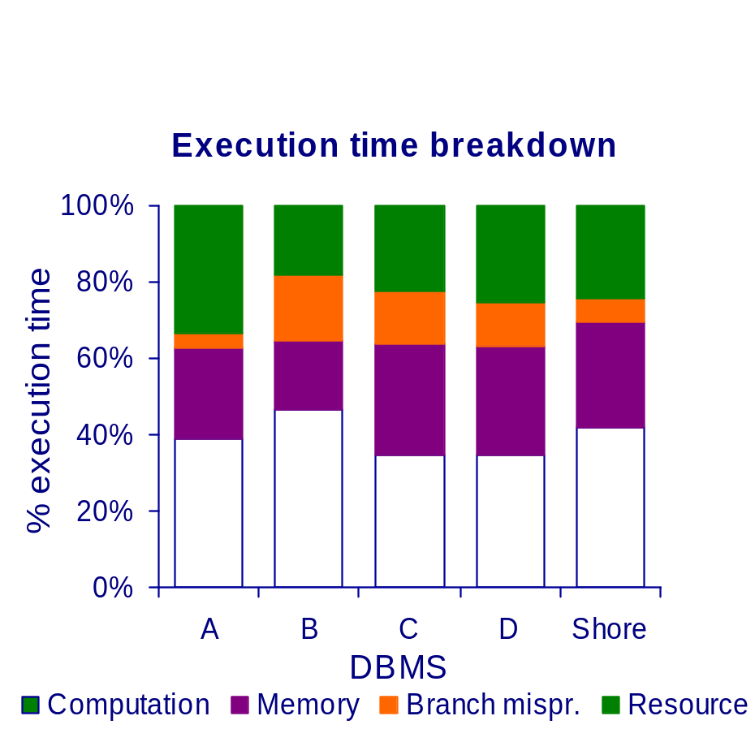
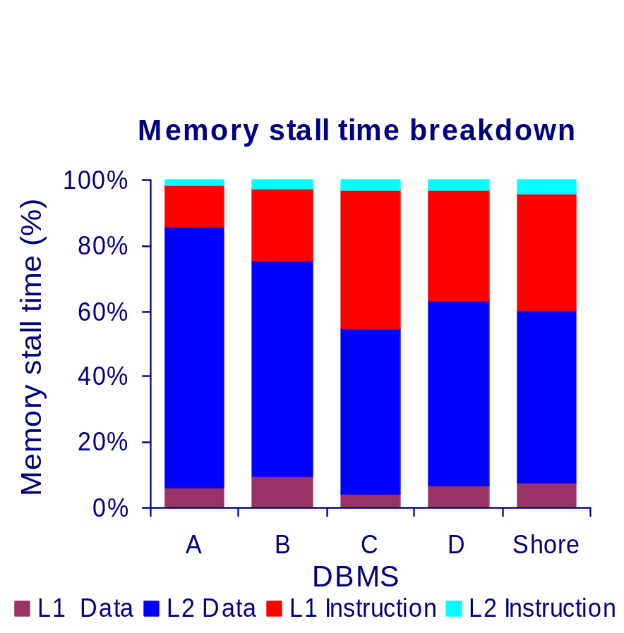
On which DBMS to measure?
Commercial DBMS are most realistic
  Difficult to setup, may need help from companies
Prototypes can evaluate techniques
  Shore [ADH01] (for PAX), PostgreSQL[TLZ97] (eval)
  Tricky: similar behavior to commercial DBMS?
Shore: YES!

Slide 38
Outline
Introduction and Overview
New Processor and Memory Systems
Where Does Time Go?
  Tools and Benchmarks
  Experimental Results
Bridging the Processor/Memory Speed Gap
Hip and Trendy Ideas
Directions for Future Research

Slide 39
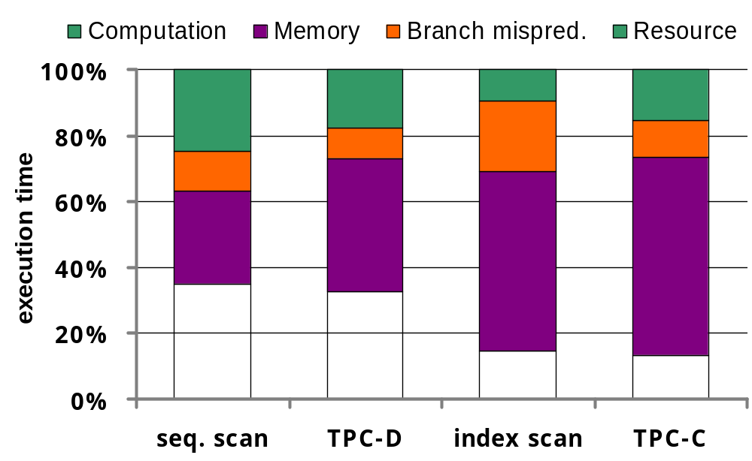
DB Performance Overview
[ADH99, BGB98, BGN00, KPH98]
PII Xeon
NT 4.0
Four DBMS: A, B, C, D
Microbenchmark behavior mimics TPC
[ADH99]
At least 50% cycles on stalls
Memory is the major bottleneck
Branch misprediction stalls also important
  There is a direct correlation with cache misses!
Notes:
Due to the sophisticated techniques used for hiding I/O latency and the complexity of modern database applications, DBMSs are becoming computer and memory bound. Identifying new performance bottlenecks in modern database systems is a prerequisite step of any performance improvement researches.
The graph shown here is taken from the paper “Experimental Results” by Natassa et. al. It shows the execution time breakdown for a modern database system with four workloads: a simple sequential scan with 10% selectivity, TPC-D, an index scan with 10% selectivity, and TPC-C. It shows the even without I/O limitations, database applications fail to fully exploit the advanced features of modern processors: more than 50% cycles are wasted on various stalls among them memory is the major bottleneck. Other papers in the literatures corroborate this observations. The implication here is to show the future performance improvement efforts.

Slide 40
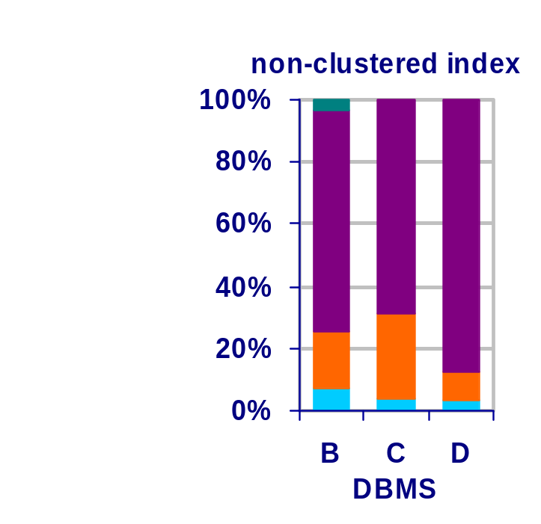
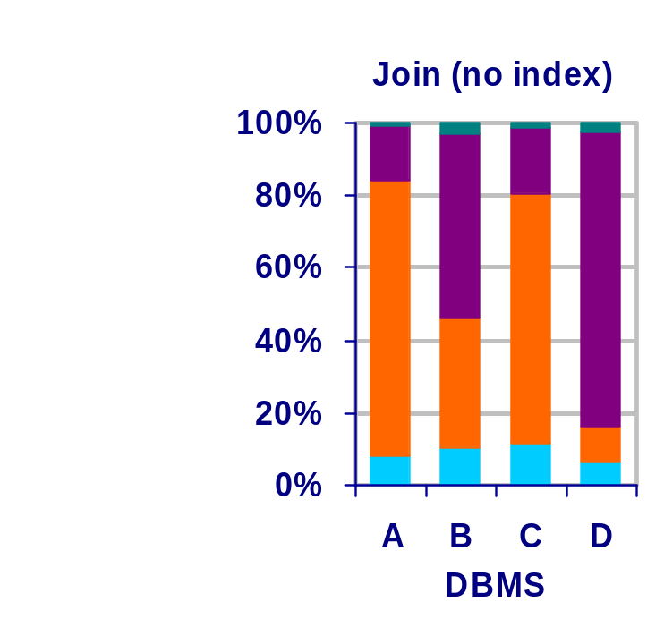
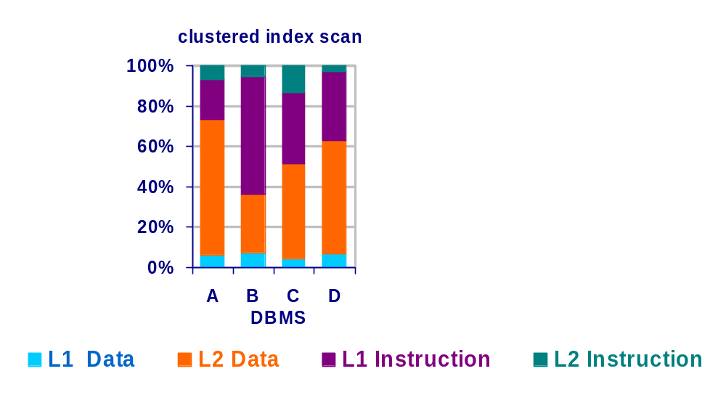
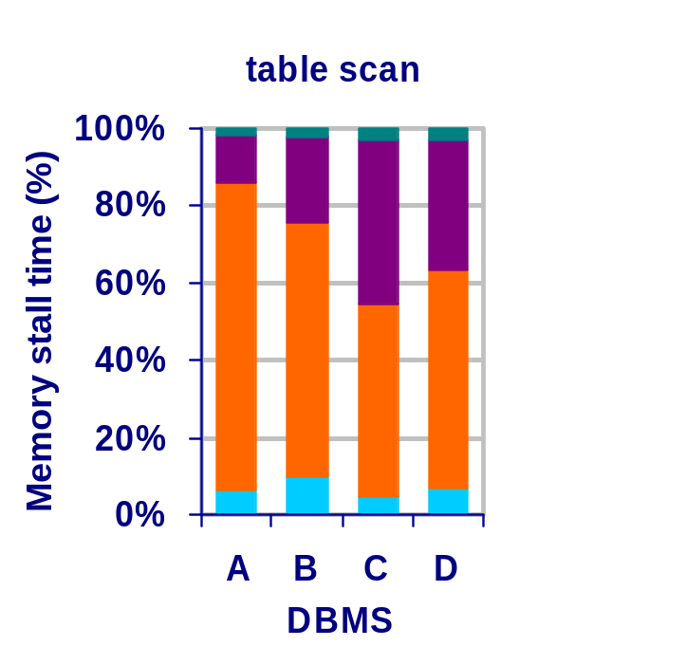
DSS/OLTP basics: Cache Behavior
[ADH99,ADH01]
PII Xeon running NT 4.0, used performance counters
Four commercial Database Systems: A, B, C, D
Optimize L2 cache data placement
Optimize instruction streams
OLTP has large instruction footprint
Notes:
Color of L1D legend does not match the color of the graph part
Emphasize L1D barking up the wrong tree

Slide 41
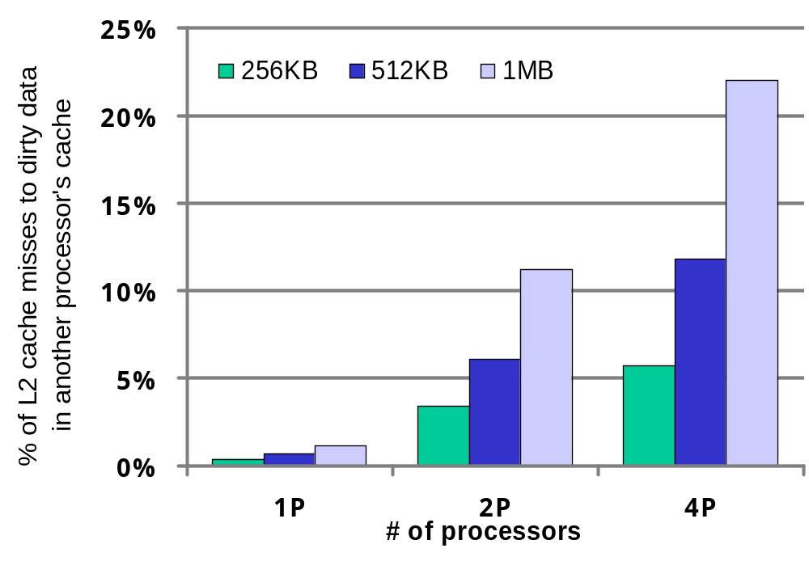
Impact of Cache Size
Tradeoff of large cache for OLTP on SMP
  Reduce capacity, conflict misses
  Increase coherence traffic [BGB98, KPH98]
DSS can safely benefit from larger cache sizes
Diverging designs for OLTP & DSS
[KEE98]
Notes:
This slide shows the cache size impact on OLTP and DSS performance on SMP machines. Two papers by Kimberly Keeten and Luiz Andre Barroso observed that increasing the L2 cache size has the potential to increase the number of coherence cache misses. The graph here shows that doubling the size of the cache nearly doubles the percentage of L2 misses to dirty data. Similarly, doubling the number of processors roughly doubles the percentage of L2 misses to dirty data. As the cache size increases, this percentage could be quiet large. Barroso reports that roughly 60% of misses requires a cache-to-cache transfer for dirty data for an 8MB cache. This implies that the improvement of L2 cache miss rate by simply increasing cache size is very limited. While cold miss rate might be reduced, coherent cache miss will increase and eventually becomes a major bottleneck.
Contrary to the OLTP, DSS can always benefit from larger cache size because of its read-only features.
Here we observed the diverging design options for OLTP & DSS workloads.
---------------------------------------------------------------------
In Keeton's paper [KPH98], they ran TPC-C on a quad machine with four
Pentium Pro processors running at 200MHz. It is equipped with 4GB of
4-way interleaved 60ns main memory. The DBMS of their experiments is a
tuned prototype version of Informix Online Dynamic Server, running on
Windows NT 4.0 with service pack 3. The dataset size and the number of
clients are not mentioned in the paper. I think it should be larger than
100GB. Here are the configurations of cache:
L1: 8KB instr. 8KB data 4-way
L2: 1MB unified 8-way
In their experiments, they changed the size of L2 and also the number of
processors to study the impact of L2 cache size on coherent misses.
------------------------------------------------------------------------
In Barroso's paper ([BGB98]), they ran TPC-B as OLTP and TPC-D as DSS on
both an AlphaServer 4100 with four 300MHz 21164 processors and 2GB of
memory and a simulator based on SimOS. Their simulator models the
micro-architecture of the Alpha 21164 processor.
Real machine configuration:
Each processor has 8KB direct-mapped on-chip instruction and write-through
data caches, a 96KB on-chip combined 3-way set associative 2nd-level cache
(called Scache) and 2MB direct-mapped board-level cache (Bcache).
But the architecture trend experiments are all done on the simulator which
mainly focuses on the configuration of a 2-way Bcache.
Both the real machine and the simulator are running Oracle 7.3.2 on
Digital Unix 4.0. The size of TPC-B is 900MB (so it is almost
memory-resident), the size of TPC-D is 500MB.
--------------------------------------------------------------------------
So Keeton et. al. tested L2 cache while Barroso et.al tested Bcache. I
think we can summarize both as off-chip large caches?
The implication I got is that improving the cache performance by enlarging
the L2 cache size is limited. Although we can reduce the capacity or
conflict cache misses, the coherent cache miss won't benefit from that and
will eventually become the major type of cache misses. So the techniques
that optimize L2 data placement or access pattern will perform an
important role here.

Slide 42
Impact of Processor Design
Concentrating on reducing OLTP I-cache misses
  OLTP’s long code paths bounded from I-cache misses
Out-of-order & speculation execution
  More chances to hide latency (reduce stalls)
[KPH98, RGA98]
Multithreaded architecture
  Better inter-thread instruction cache sharing
  Reduce I-cache misses [LBE98, EJK96]
Chip-level integration
  Lower cache miss latency, less stalls [BGN00]
Need adaptive software solutions
Notes:
This slide summaries important processor impacts on database workload performance reported in the literature. Keeon and Ranganathan showed independently in their papers that out of order and speculation execution are effective to improve OLTP and DSS workload by providing more chances to hide cache miss latencies which means less stalls. With RSIM simulation infrastructure, Ranganathan reported gains of 1.5 and 2.6 times over an in-order single-issue processor for OLTP and DSS, respectively.
Jack Lo et. al. and Richard Eickemeyer et. al. reported in their papers that multithread architecture has better inter-thread instruction cache sharing thus can reduce the I-cache related misses.
Luiz Andre Barroso et. al. examines the chip-level integration of traditionally off-chip modules in a context of OLTP workload. They found that for uniprocessors, integration of the L2 cache and the resulting lower hit latency is the primary factor in performance improvement. For multiprocessors, the improvement comes from both the integration of the L2 cache and the integration of other memory system components, such as memory controller.
These researches examines the possible ways to reduced the stalls shown in the previous slide from a micro-architectural perspective. They provide us invaluable insights in designing database-friendly micro-architecture.

Slide 43
Outline
Introduction and Overview
New Processor and Memory Systems
Where Does Time Go?
Bridging the Processor/Memory Speed Gap
  Data Placement Techniques
  Query Processing and Access Methods
  Database system architectures
  Compiler/profiling techniques
  Hardware efforts
Hip and Trendy Ideas
Directions for Future Research

Slide 44
Addressing Bottlenecks
D
D-cache
DBMS
Memory
I
I-cache
DBMS + Compiler
B
Branch
Mispredictions
Compiler + Hardware
R
Hardware
Resources
Hardware
Data cache: A clear responsibility of the DBMS

Slide 45
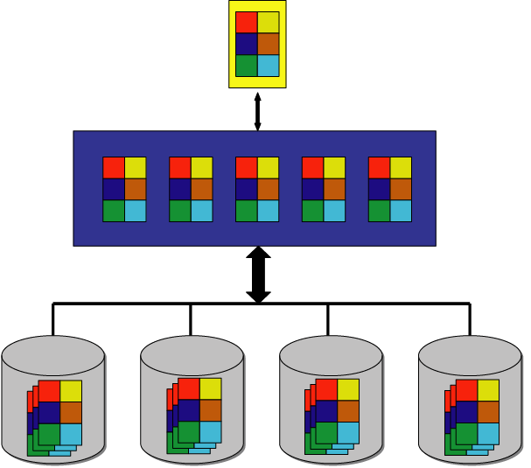
Current Database Storage Managers
multi-level storage hierarchy
  different devices at each level
  different ways to access data on each device
variable workloads and access patterns
  device and workload-specific data placement
  no optimal “universal” data layout
CPU cache
main memory
non-volatile storage
Goal: Reduce data transfer cost in memory hierarchy

Slide 46
Static Data Placement on Disk Pages
Commercial DBMSs use the N-ary Storage Model (NSM, slotted pages)
  Store table records sequentially
  Intra-record locality (attributes of record r together)
  Doesn’t work well on today’s memory hierarchies
Alternative: Decomposition Storage Model (DSM) [CK85]
  Store n-attribute table as n single-attribute tables
  Inter-record locality, saves unnecessary I/O
  Destroys intra-record locality => expensive to reconstruct record
Goal: Inter-record locality + low reconstruction cost

Slide 47
NSM (n-ary Storage Model, or Slotted Pages)
Static Data Placement on Disk Pages
R
PAGE HEADER
RH1
1237
Jane
30
RH2
4322
John
RID | SSN | Name | Age
1 | 1237 | Jane | 30
2 | 4322 | John | 45
3 | 1563 | Jim | 20
4 | 7658 | Susan | 52
5 | 2534 | Leon | 43
6 | 8791 | Dan | 37
45
RH3
1563
Jim
20
RH4
7658
Susan
52
•
•
•
•
Records are stored sequentially
Attributes of a record are stored together

Slide 48
NSM Behavior in Memory Hierarchy
BEST
select name
from R
where age > 50
Query accesses all attributes (full-record access)
Query evaluates attribute “age” (partial-record access)
PAGE HEADER
1237
Jane
PAGE HEADER
1237
Jane
30
4322
Jo
Block 1
30
4322
John
45
1563
30
4322
John
45
1563
hn
45
1563
Block 2
Jim
20
7658
Susan
52
Jim
20
7658
Susan
52
Block 3
Jim
20
7658
Susan
52
Block 4
MAIN MEMORY
CPU CACHE
DISK
Optimized for full-record access
Slow partial-record access
  Wastes I/O bandwidth (fixed page layout)
  Low spatial locality at CPU cache

Slide 49
Decomposition Storage Model (DSM)
[CK85]
EID | Name | Age
1237 | Jane | 30
4322 | John | 45
1563 | Jim | 20
7658 | Susan | 52
2534 | Leon | 43
8791 | Dan | 37
Partition original table into n 1-attribute sub-tables

Slide 50
DSM (cont.)
R1
PAGE HEADER
1
1237
RID
EID
2
4322
3
1563
4
7658
1
1237
2
4322
R2
8KB
3
1563
RID
Name
4
7658
1
Jane
PAGE HEADER
1
Jane
5
2534
2
John
6
8791
2
John
3
Jim
4
Suzan
3
Jim
R3
4
Suzan
RID
Age
8KB
5
Leon
1
30
6
Dan
2
45
PAGE HEADER
1
30
2
3
20
45
3
20
4
52
4
52
5
43
8KB
6
37
Partition original table into n 1-attribute sub-tables
Each sub-table stored separately in NSM pages

Slide 51
DSM Behavior in Memory Hierarchy
Query accesses all attributes (full-record access)
Query accesses attribute “age” (partial-record access)
select name
from R
where age > 50
BEST
PAGE HEADER
1
1237
PAGE HEADER
1
1237
1
30
2
45
block 1
2
4322
3
1563
4
7658
2
4322
3
1563
4
7658
3
20
4
52
5
block 2
PAGE HEADER
1
Jane
2
Costly
PAGE HEADER
1
Jane
2
John
3
Jim
4
Suzan
John
3
Jim
4
Suzan
Costly
PAGE HEADER
1
30
2
45
PAGE HEADER
1
30
2
45
3
20
4
52
5
43
3
20
4
52
5
43
CPU CACHE
DISK
MAIN MEMORY
Optimized for partial-record access
Slow full-record access
  Reconstructing full record may incur random I/O

Slide 52
Partition Attributes Across (PAX)
[ADH01]
NSM PAGE
PAX PAGE
PAGE HEADER
RH1
1237
PAGE HEADER
1237
4322
Jane
30
RH2
4322
John
1563
7658
45
RH3
1563
Jim
20
RH4
7658
Susan
52
Jane
John
Jim
Susan
mini
page
•
•
•
•
30
52
45
20
•
•
•
•
Partition data within the page for spatial locality

Slide 53
Predicate Evaluation using PAX
PAGE HEADER
1237
4322
1563
7658
30
52
45
20
block 1
Jane
John
Jim
Suzan
•
•
•
•
CACHE
30
52
45
20
select name
from R
where age > 50
MAIN MEMORY
Fewer cache misses, low reconstruction cost

Slide 54
PAX Behavior
BEST
Partial-record access in memory
Full-record access on disk
BEST
PAGE HEADER
1237
4322
PAGE HEADER
1237
4322
30
52
45
20
block 1
1563
7658
1563
7658
Jane
John
Jim
Susan
Jane
John
Jim
Susan
cheap
30
52
45
20
30
52
45
20
DISK
MAIN MEMORY
CPU CACHE
Optimizes CPU cache-to-memory communication
Retains NSM’s I/O (page contents do not change)

Slide 55
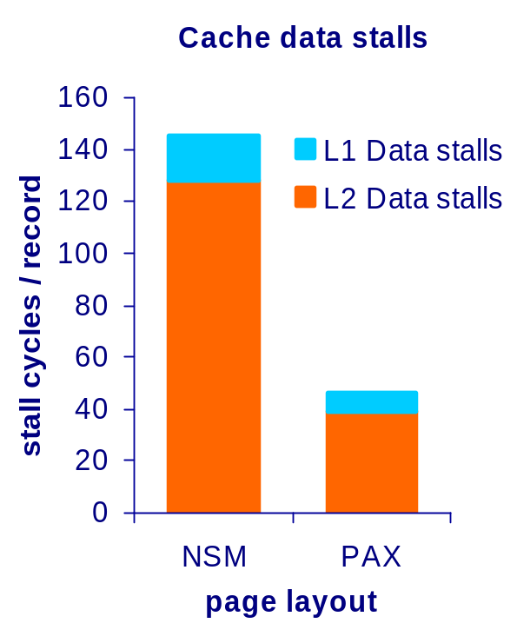
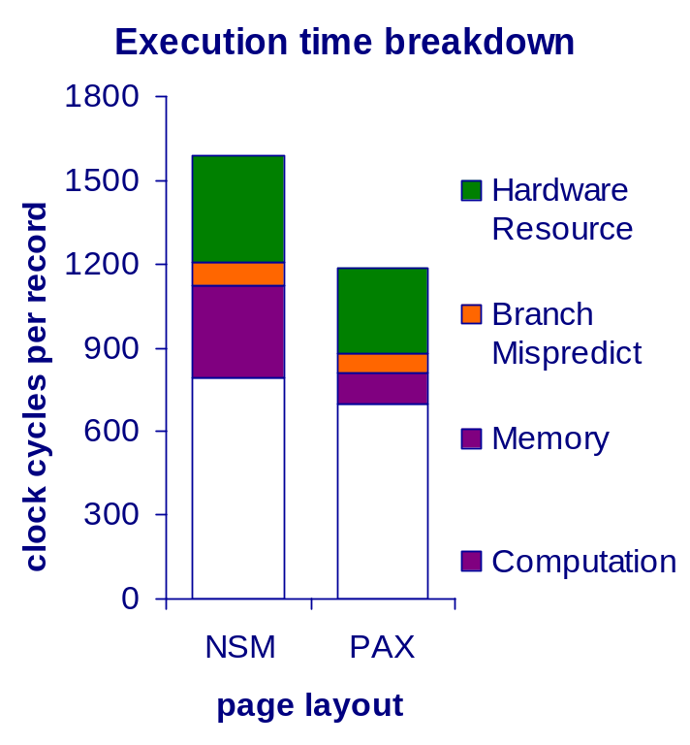
PAX Performance Results (Shore)
PII Xeon Windows NT4 16KB L1-I, 16KB L1-D, 512 KB L2, 512 MB RAM
Query: select avg (a_{i}) from R where a_{j} >= Lo and a_{j} <= Hi
Validation with microbenchmark:
  70% less data stall time (only compulsory misses left)
  Better use of processor’s superscalar capability
TPC-H performance: 15%-2x speedup in queries
  Experiments with/without I/O, on three different processors

Slide 56
Data Morphing [HP03]
A general case of PAX
  Attributes accessed together are stored contiguously
  Partition dynamically updated with changing workloads
Partition algorithms
  Optimize total cost based on cache misses
  Study two approaches: naïve & hill-climbing algorithms
Less cache misses
  Better projectivity scalability for index scan queries
  Up to 45% faster than NSM & 25% faster than PAX
Same I/O performance as PAX and NSM
Unclear what to do on conflicts
Notes:
Data morphing is proposed as a general case of PAX in which the idea of minipages changes to the notion of zones which can contain multiple attributes organized in the NSM fashion. The attributes in the same zone are those that will be accessed collectively for the future workload. Since these attributes are stored contiguously, data morphing will incur less cache misses than PAX when accessing them together. Data morphing has two steps: first, it calculates the best partitions for a certain table which has the minimal cost caused by cache misses. Second, it reorganizes pages according to the recommended partitions. They proposed and examined two algorithms to calculate the optimal partitions. The naïve approach does an exhaustive search to find the optimal solution with high computation cost. An alternative called hill-climbing approach applies a greedy strategy to trade the optimality for faster calculation. Details are in their paper. Data morphing incurs less cache misses than NSM and PAX, therefore it has less stalls which makes it up to 45% faster than NSM and up to 25% faster than PAX.
Data morphing reorganizes pages after fetching them from disk, so it has the same I/O performance as NSM and PAX.

Slide 57
Alternatively: Repair DSM’s I/O behavior
We like DSM for partial record access
We like NSM for full-record access
Solution: Fractured Mirrors [RDS02]
1. Get the data placement right
ID | A
1 | A1
2 | A2
3 | A3
4 | A4
5 | A5
Sparse
B-Tree on ID
Dense
B-Tree on ID
3
1 A1
2 A2
3 A3
4 A4
5 A5
1 A1 A2 A3
4 A4 A5
Preserves lookup by ID
Scan via leaf pages
Eliminates almost 100% of space overhead
No B-Tree for fixed-length values
Lookup by ID
Scan via leaf pages
Similar space penalty as record representation
One record per attribute value

Slide 58
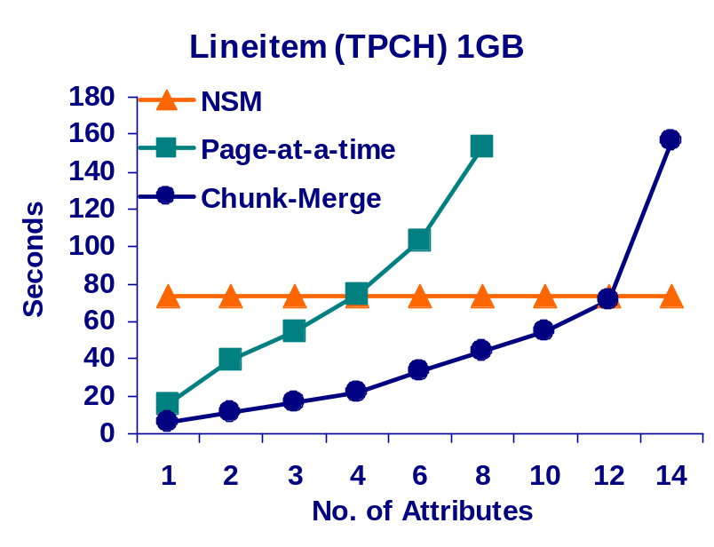
Fractured Mirrors [RDS02]
2. Faster record reconstruction
Instead of record- or page-at-a-time…
Chunk-based merge algorithm!
Read in segments of M pages ( a “chunk”)
Merge segments in memory
Requires (N*K)/M disk seeks
For a memory budget of B pages, each partition gets B/N pages in a chunk
3. Smart (fractured) mirrors
Disk 1
Disk 2
Disk 1
Disk 2
NSM Copy
DSM Copy
NSM Copy
DSM Copy

Slide 59
Summary thus far
Page layout | Cache-memory Performance |  | Memory-disk Performance
 | full-record access | partial record access | full-record access | partial record access
NSM
DSM
PAX
☺ ☹ ☺ ☹
☹ ☺ ☹ ☺
☺ ☺ ☺ ☹
Need new placement method:
Efficient full- and partial-record accesses
Maximize utilization at all levels of memory hierarchy
Difficult!!! Different devices/access methods
Different workloads on the same database

Slide 60
The Fates Storage Manager
[SAG03,SSS04,SSS04a]
IDEA: Decouple layout!
CPU cache
Operators
Clotho
page hdr
Buffer
pool
main memory
Main-memory
Manager
Lachesis
Storage Manager
data directly placed via scatter/gather I/O
Atropos
LV Manager
disk 0
disk 1
non-volatile storage
disk array

Slide 61
Clotho: decoupling memory from disk [SSS04]
DISK
select EID from R where AGE>30
In-memory page:
Tailored to query
Great cache performance
PAGE HEADER (EID &AGE)
PAGE HEADER
1237
4322
1563
7658
1237
4322
1563
7658
Jane
John
Jim
Susan
30
52
45
20
2865
1015
2534
8791
Independent layout
  Fits different hardware
Just the data you need
  Query-specific pages!
  Projection at I/O level
Low reconstruction cost
  Done at I/O level
  Guaranteed by Lachesis and Atropos [SSS04]
30
52
45
20
PAGE HEADER
31
25
54
33
2865
1015
2534
8791
MAIN MEMORY
Tom
Jerry
Jean
Kate
31
25
54
33
On-disk page:
PAX-like layout
Block boundary aligned

Slide 62
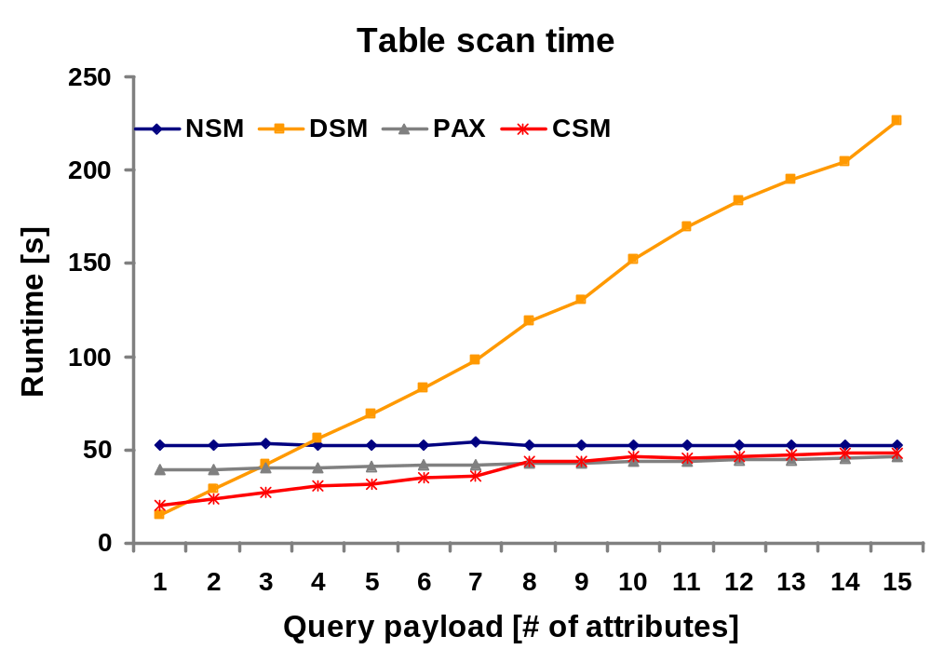
Clotho: Summary of performance resutlts
Table: a1 … a15 (float)
Query: select a1, … from R where a1 < Hi
Validation with microbenchmarks
  Matching best-case performance of DSM and NSM
TPC-H: Outperform DSM by 20% to 2x
TPC-C: Comparable to NSM (6% lower throughput)

Slide 63
Outline
Introduction and Overview
New Processor and Memory Systems
Where Does Time Go?
Bridging the Processor/Memory Speed Gap
  Data Placement Techniques
  Query Processing and Access Methods
  Database system architectures
  Compiler/profiling techniques
  Hardware efforts
Hip and Trendy Ideas
Directions for Future Research

Slide 64
Query Processing Algorithms
Idea: Adapt query processing algorithms to caches
Related work includes:
Improving data cache performance
  Sorting
  Join
Improving instruction cache performance
  DSS applications
Notes:
Outline slide for query processing algorithms.
In this section, we will first talk about cache conscious algorithms to improve data cache performance for query processing.
Then we discuss approaches to improving instruction cache performance.
Finally, we describe studies that use special hardware to reduce the computational cost of spatial operations.

Slide 65
Sorting
[NBC94]
In-memory sorting / generating runs
AlphaSort
Use quick sort rather than replacement selection
  Sequential vs. random access
  No cache misses after sub-arrays fit in cache
Sort (key-prefix, pointer) pairs rather than records
  3:1 cpu speedup for the Datamation benchmark
L2
cache
L1
Quick Sort
Replacement-selection
Notes:
Cache-conscious sorting is useful for in-memory sorting or for generating runs in external sorting.
We can use either replacement-selection or quick sort for generating runs. However, quicksort
has much friendly cache behavior. Quick sort accesses the full array in a sequential manner,
comparing each key with a pivot key. It divides the array into an array of keys less than the pivot
and an array of keys greater than the pivot. Then quick sort recursively sorts the two smaller
Arrays. First of all, sequential access has good cache utilization (good spatial locality). Second,
after the array size is smaller than cache size, sorting the array will not cause further cache misses.
In contrast, visiting the tournament tree in the replacement selection is almost random accesses,
Which have very poor cache performance.
Another useful technique is to sort key prefix, pointer pairs. This can effectively reduce data movement cost
in quick sort.
-------------------------------
NOTE:
1) the performance description “3:1 cpu speedup …” is taken from the paper. I think it means 3X speedup.
2) The paper does not clearly give a speedup number for quicksort over replacement selection.
On page 236, under figure 4 in point 2, when discussing the computational costs, the paper gives a 2.5:1 speedup
for quicksort over the best tournament sort. But the whole paragraph talks about computational costs, so the number
may mean that when all data fit in cache, quicksort can still get 2.5:1 speedup because of less computational overhead.
So I think this number can not be used here to summarize cache behavior.

Slide 66
Hash Join
Build Relation
Probe Relation
Hash Table
Random accesses to hash table
  Both when building AND when probing!!!
Poor cache performance
  ≥ 73% of user time is CPU cache stalls [CAG04]
 Approaches to improving cache performance
  Cache partitioning
  Prefetching
Notes:
The hash join algorithm is one of the most widely used join algorithms.
In its simplest form, it builds a hash table on the smaller (build) relation. Then it probes every tuple in the larger (probe) relation
for matches. Because the hash table visits are inherently random, hash join has very poor cache performance.
(According to a recent study, over 73% of its user time is cpu cache stalls)
In the following, we describe two approaches to improving hash join cache performance.
Cache partitioning and prefetching.

Slide 67
Cache Partitioning [SKN94]
[SKN94]
Idea similar to I/O partitioning
  Divide relations into cache-sized partitions
  Fit build partition and hash table into cache
  Avoid cache misses for hash table visits
cache
Build
Probe
1/3 fewer cache misses, 9.3% speedup
>50% misses due to partitioning overhead
Notes:
The first approach is called cache partitioning. Its idea is similar to the I/O partitioning technique to reduce
random disk accesses for hash joins.
[use animation]
The idea is to divide source relations into cache-sized partitions so that a build parition
and its hash table can fit into cache. In this way, the number of cache misses of joining
a pair of build and probe partitions is greatly reduced.
However, what is the overhead of the additional partition step?
-------------------------------------
Performance:
machine: DECstation 5000/125, Dec 3K/300, HP 9k/720, SUN 10/51
The two source relations are in the main memory in slotted pages. The join result is in the form of an in-memory join index.
Each relation has 50,000 tuples. Each tuple is 100B long.
1 build tuple matches approx. 1 probe tuple.
Algorithm: extract (key, pointer) pairs, then do cache partitioning
Performance: up to 9.3% speedup over hash join
Partitioning overhead is discussed but not quantified.

Slide 68
Hash Joins in Monet
Monet main-memory database system [B02]
  Vertically partitioned tuples (DSM)
Join two vertically partitioned relations
  Join two join-attribute arrays [BMK99,MBK00]
  Extract other fields for output relation [MBN04]
Output
Build
Probe
Notes:
Several studies on hash join cache performance are based on the Monet main memory database environment.
The tuples are vertically partitioned in monet db, therefore, joining two relations is reduced to
joining two join attribute arrays of the relations and then retrieving other fields after the join.
[animation]
For each step, there are performance problems involved in naïve algorithms.
We look at how monet reduces partition cost for the join step first.

Slide 69
Monet: Reducing Partition Cost
Join two arrays of simple fields (8 byte tuples)
  Original cache partitioning is single pass
  TLB thrashing if # partitions > # TLB entries
  Cache thrashing if # partitions > # cache lines in cache
Solution: multiple passes
  # partitions per pass is small
  Radix-cluster [BMK99,MBK00]
    Use different bits of hashed keys for
    different passes
    E.g. In figure, use 2 bits of hashed
    keys for each pass
Plus CPU optimizations
  XOR instead of %
  Simple assignments instead of memcpy
2-pass partition
Up to 2.7X speedup on an Origin 2000
Results most significant for small tuples
Notes:
The original cache partitioning only performs a single pass. The Monet papers proposed the idea of doing multiple passes.
Just imagine the # of partitions >> # TLB entries (e.g. 64), then copying any tuple (which is a 8B (tupleID, key) pair in Monet) causes
a TLB miss. In contrast, if using two passes, it is possible to make # of partitions < 64. Imagine a page is 4KB, which contains 512 tuples.
Then there will be a TLB miss per 512 tuples. This is a great improvement.
Based on this idea, Monet papers proposed radix-cluster algorithm, which is a way to do multiple passes.
But the result is less significant when large tuples are involved.
When joining two arrays of join attributes, for example, two arrays of integers in primary-foreign key joins, Monet employs cache partitioning for good cache performance.
A problem is that if the number of partitions required to generate cache-sized partition is too large.
When it is larger than some hardware parameters, such as number of TLB entries, number of
cache lines in cache, partitioning will cause TLB or cache thrashing, i.e. copying every array element causes a TLB/cache miss.
To solve this problem, Monet team proposed to use multiple passes to generate all the partitions. For example, in the figure, two passes are used to generate 16 partitions. In this way, the number of partitions per pass can be made small enough so that thrashing won’t occur. The proposed algorithm is called radix-cluster, which uses different bits in keys for different partition passes.
-----------------------------------------------
Performance: [MBK00] Table 3 has absolute number for the whole joins.
Machine: Origin 2000, 32KB L1 cache (1024 lines of 32B), 4MB L2 cache (32,768 lines of 128B), page size is 16KB, 64 TLB entries.
Source relations have 8 byte tuples.
Output is join index
Gain because of multiple passes <= 2.7X (def_phj / def_shj)
Note that the gain in the table also includes the cpu optimization, which is not described here.
- cpu optimization is about computing hash code by using XOR instead of % modulo operation.
- and replace memcpy by simple assignments
*** but the benefit should reduce greatly for large tuples, moreover as processor gets faster and faster, the cost of these
operations will be faster. Therefore, I omitted the description.

Slide 70
Monet: Extracting Payload
[MBN04]
Two ways to extract payload:
  Pre-projection: copy fields during cache partitioning
  Post-projection: generate join index, then extract fields
Monet: post-projection
  Radix-decluster algorithm for good cache performance
Post-projection good for DSM
  Up to 2X speedup compared to pre-projection
Post-projection is not recommended for NSM
  Copying fields during cache partitioning is better
Paper presented in this conference!
Notes:
The result of joining two attribute arrays is essentially a join index. Now, to complete the join, it is necessary to extract other useful fields from the source relations to form the output relation. The problem here is that extracting fields according to the join index order incurs random accesses. How to avoid random accesses?
The Monet team publishes a paper in this conference addressing this issue. The algorithm achieves good performance in Monet’s DSM environment. But it is not recommended for traditional tuple layout. Also this algorithm is quite involved, so we omit the details here. Please go to the talk or read the paper.
--------------------------------------
Performance:
The paper only compares the overall join performance to other schemes.
The paper does not directly report speedup numbers.
The figures have log scale on Y axis. So I can only roughly tell the speedups.
Results:
DSM: when comparing the total join performance of using this algorithm and pre-projection, the speedup is up to 2X.
NSM: pre-projection is better than generating join index then extracting fields.

Slide 71

What do we do with cold misses?
Answer: Use prefetching to hide latencies
Non-blocking cache:
  Serves multiple cache misses simultaneously
  Exists in all of today’s computer systems
Prefetch assembly instructions
  SGI R10000, Alpha 21264, Intel Pentium4
pref 0(r2)
pref 4(r7)
pref 0(r3)
pref 8(r9)
CPU
Main Memory
L2/L3
Cache
L1
Cache
Goal: hide cache miss latency
Notes:
The second approach to improving hash join cache performance is through prefetching.
Modern processors have non-blocking caches. That is, a cache can serve multiple cache misses simultaneously.
Moreover, more and more processors support prefetch assembly instructions, which allows programs to control timing of memory references, so that data can be loaded into caches before actual use to hide cache miss latency with computation and other cache misses.

Slide 72
Simplified Probing Algorithm
[CGM04]
Hash Cell
(hash code, build tuple ptr)
Hash
Bucket
Headers
Build
Partition
0
Cache miss latency
1
foreach probe tuple
{
(0)compute bucket number;
(1)visit header;
(2)visit cell array;
(3)visit matching build tuple;
}
2
3
tim e
0
1
2
Idea: Exploit inter-tuple parallelism
3
Notes:
Let’s look at a simplified probing algorithm, and a concrete in-memory hash table structure.
Every iteration processes a probe tuple, first it computes the bucket number of the hash table, then it visits the header, visits the cell array, finally visit the matching build tuple.
The execution of the loop can be represented by the left time line. Here different colored lines represent cache misses of different data structures.
Tuples are processed one after another. No cache misses are hidden.
Note that inside a hash table visit, there are a lot of dependences, the execution of the steps all depend on the previous results.
Dependences make prefetching difficult. But fortunately, subsequent tuples in hash joins are mostly independent of each other, next we show how we can exploit inter-tuple parallelism for prefetching.

Slide 73
Group Prefetching
[CGM04]
foreach group of probe tuples {
foreach tuple in group {
(0)compute bucket number;
prefetch header;
}
foreach tuple in group {
(1)visit header;
prefetch cell array;
}
foreach tuple in group {
(2)visit cell array;
prefetch build tuple;
}
foreach tuple in group {
(3)visit matching build tuple;
}
}
a group
0
0
0
1
1
1
2
2
2
3
3
3
0
0
0
1
1
1
2
2
2
3
3
3
Notes:
Group prefetching tries to hide cache miss latency across a group tuples.
We combine the processing of a group of tuples into a single loop body and rearrange the probe operations into stages. We process all the tuples for a stage and then move on to the next stage.
now we add prefetch instructions to the algorithm. The resulting cache behavior is shown in the right.
We issue prefetch instructions in one code stage for the memory references in the next code stage.
In this way, we can overlap cache miss latency across all tuples in a group.
Note that we mainly overlap cache miss latency of the same color, i.e., cache miss latency of the same code stage here.

Slide 74
Software Pipelining
[CGM04]
Prologue;
for j=0 to N-4 do {
tuple j+3:
(0)compute bucket number;
prefetch header;
tuple j+2:
(1)visit header;
prefetch cell array;
tuple j+1:
(2)visit cell array;
prefetch build tuple;
tuple j:
(3)visit matching build tuple;
}
Epilogue;
0
prologue
1
0
2
1
0
j+3
3
2
1
0
j
3
2
1
0
3
2
1
0
3
2
1
0
3
2
1
epilogue
3
2
3
Notes:
Software-pipelined prefetching overlaps cache misses across different code stages of different tuples.
Here in each loop iteration, we combine the processing of four tuples together. In the right graph, a dashed rectangle is a loop iteration. Imagine for tuple j, we have already processed all its previous stages in previous iterations. Now in this iteration, we process the last stage, stage 3, for tuple j. We process stage 2 for tuple j+1, stage 1 for tuple j+2, and for tuple j+3, we start its processing in this iteration.
Note that the code stages of the same tuple are processed in subsequent iterations.
In this way, we can overlap the cache miss latency of a tuple across all processing in an iteration.
We need a prologue to set up the software pipeline and an epilogue to wrap up the processing.

Slide 75
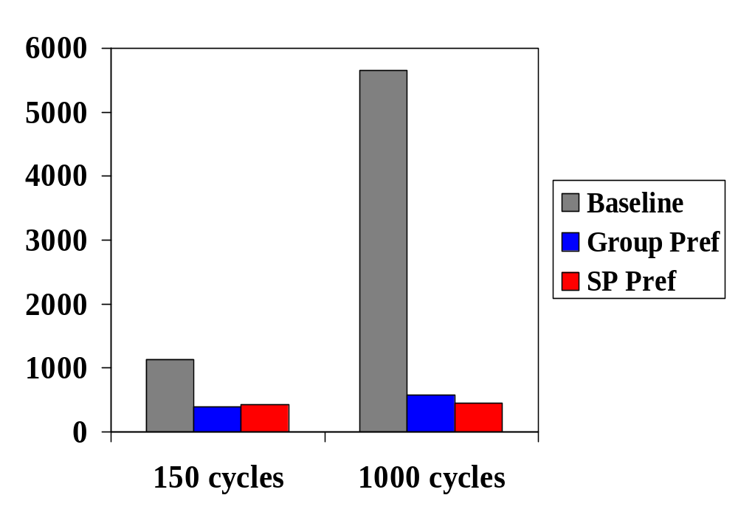
Prefetching: Performance Results
[CGM04]
Techniques exhibit similar performance
Group prefetching easier to implement
Compared to cache partitioning:
  Cache partitioning costly when tuples are large (>20b)
  Prefetching about 50% faster than cache partitioning
9X speedups over baseline at 1000 cycles
Absolute numbers do not change!
execution time (M cycles)
processor to memory latency
Notes:
The paper also describes an alternative prefetching method:
Software-pipelined prefetching, which overlaps cache misses across different code stages of different tuples.
The two prefetching schemes achieve similar performance. The paper also points out that group prefetching is easier to implement.
Moreover, the paper compares prefetching and cache partitioning and finds out that cache partitioning with large tuples (>= 20B) are more costly.
The problem of the pure prefetching approach is that it requires high memory bandwidth. So a future direction would be to combine other techniques to reduce cache misses with prefetching for lower bandwidth consumption.
---------------------------------
Please note that: 50% faster means 1.5X speed up in the paper.

Slide 76
Improving DSS I-cache performance
[ZR04]
Demand-pull execution model: one tuple at a time
  ABABABABABABABABAB…
  If A + B > L1 instruction cache size
  Poor instruction cache utilization!
Solution: multiple tuples at an operator
  ABBBBBAAAAABBBBB…
Two schemes:
  Modify operators to support a block of tuples [PMA01]
  Insert “buffer” operators between A and B [ZR04]
    “buffer” calls B multiple times
    Stores intermediate tuple pointers to serve A’s request
    No need to change original operators
A
B
Query Plan
12% speedup for simple TPC-H queries
Notes:
Last bullet: basically Amdahl’s law. Time to generate a tuple at an operator = instruction cache miss + processing
When processing is large, the instruction cache miss only takes a small fraction of total time. Thus removing it
is less significant.
When the query is complex and has high selectivity, an operator performs a lot of processing before generating a tuple.
In such a situation, instruction cache misses is not significant.
-----------------------------------------------------------------------------
In the above, we talk about how to improve data cache performance for query processing.
Here we change our focus to instruction cache performance.
The conventional execution model for a query plan may have poor instruction cache utilization.
This is because it generates one tuple at a time. In the “open-next-close” iterator interface,
“next” is used to obtain a single tuple from child operator. Therefore the execution sequence for a simple query plan is A then B to retrieve a tuple then A to generate output, then B A B A …
However, if the total effective size of A and B are larger than L1 cache size, processing a tuple at an operator leads to a large number of L1 cache misses.
The idea to solve this problem is to generate multiple tuples at an operator. Loading the instructions of an operator into L1 cache then use them for multiple tuples. Getting an execution sequence like …
Recent studies proposed two schemes to realize this idea. The first scheme is to modify all the operator implementations to use an interface that supports a block of tuples. The second scheme avoids the human effort to modify the operators. The idea is to implement a special buffer operator and insert it into the query plan, e.g. here in between A and B. The buffer operator is very simple. It calls B multiple times and stores intermediate tuple pointers in an internal array. It uses the buffered tuples to serve A’s request. In this way, the ideal pattern is achieved.
Note that instruction cache utilization problem is significant only when the computation in an operator is low, otherwise icache performance only occupies a small portion of the total performance.
----------------------------------------------
Performance:
machine: Pentium 4 1.8GHz, 1GB RDRAM, L1 instruction trace cache can contain 12K uops, L2 cache 256KB
PostgreSQL 7.3.4, redhat 7.3 (linux 2.4.18)
Database is TPC-H database with scale factor 0.2, memory resident
Beneficial to 4 TPC-H queries: query 1, 5, 6, 14, up to 12% improvement

Slide 77
Outline
Introduction and Overview
New Processor and Memory Systems
Where Does Time Go?
Bridging the Processor/Memory Speed Gap
  Data Placement Techniques
  Query Processing and Access Methods
  Database system architectures
  Compiler/profiling techniques
  Hardware efforts
Hip and Trendy Ideas
Directions for Future Research

Slide 78
Access Methods
Optimizing tree-based indexes
Key compression
Concurrency control

Slide 79
Main-Memory Tree Indexes
Good news about main memory B⁺ Trees!
  Better cache performance than T Trees [RR99]
  (T Trees were proposed in main memory database literature under uniform memory access assumption)
Node width = cache line size
  Minimize the number of
  cache misses for search
  Much higher than traditional
  disk-based B-Trees
So trees are too deep
How to make trees shallower?
Notes:
The main memory database literature in the mid 80s proposed T Trees as a good index structure under the assumption that every memory access has the same cost.
However, in modern computer systems, a cache miss is far more costly than a cache hit. Clearly this uniform memory access assumption is not true.
Rao et al. reexamined main memory index structures and found out that main memory B+ Trees have better cache performance than T Trees.
To minimize the number of cache misses for search, the optimal node size of the B+ Tree is one cache line long.
A cache line is typically 64B-128B long. Compared to the disk based traditional Btrees, the main memory B-Trees are much higher.
And several studies focus on making B+trees shallower to get better performance.

Slide 80
Reducing Pointers for Larger Fanout
[RR00]
Cache Sensitive B⁺ Trees (CSB⁺ Trees)
Layout child nodes contiguously
Eliminate all but one child pointers
  Double fanout of nonleaf node
B⁺ Trees
CSB⁺ Trees
K₁
K₂
K₁
K₂
K₃
K₄
K₃
K₄
K₅
K₆
K₇
K₈
K₁
K₂
K₃
K₄
K₁
K₂
K₃
K₄
K₁
K₂
K₃
K₄
K₁
K₂
K₃
K₄
K₁
K₂
K₃
K₄
Up to 35% faster tree lookups
But, update performance is up to 30% worse!
Notes:
One idea is to layout child nodes of a non-leaf node contiguously in memory.
Then only store the pointer to the first child node in the parent node. All other child node addresses can be computed easily.
In this way, CSB+ Trees eliminate all but one child pointers in the nonleaf nodes.
For integer keys, the pointer and the key sizes are the same. This scheme almost doubles the fanout of nonleaf nodes, leading to shallower trees.
However, to keep the contiguous child layout, update performance suffers. A node split means child node group split,
copying child nodes to make new child group.
---------------------------------
Performance:
machine: Ultra Sparc II 296MHz cpu, 1GB RAM, 16KB direct-map L1 cache (32B lines), 1MB direct-map L2 cache (64B lines).
and Pentium II 333MHz, 128M RAM, 16KB 4-way L1 cache (32B lines), 512KB 4-way L2 cache (32B lines)
2. Figure 7(a)
3. Search performance: up to (0.6/0.45=1.33) speedup
4. Insersion performance: up to (1.38/1.05=1.31) slow down
5. Since this is estimated from the figure, make the number accurate to 5%.

Slide 81
Prefetching for Larger Nodes
[CGM01]
Prefetching B⁺ Trees (pB+ Trees)
Node size = multiple cache lines (e.g. 8 lines)
Prefetch all lines of a node before searching it
Cost to access a node only increases slightly
Much shallower trees, no changes required
Improved search AND update performance
Cache miss
Time
>2x better search and update performance
Approach complementary to CSB+ Trees!
Notes:
[NATASSA] don’t we do binary search here?
----------------------------------------------------------
depending on the node size and the memory parameters, the costs vary.
e.g. the time to load one cache line = 150 cycles, the additional time to load a second independent cache line in parallel = 10 cycles
Then if the node is 2 cache line large, the total cost is 160 cycles.
If the node is 8 cache line large, the total cost is 220 cycles.
Compared to the time to load a single line (150 cycles), the cost only increases slightly.
----------------------------------------
Another idea is to use node size of multiple cache lines and then before searching a node, prefetch all the cache lines of the node in parallel.
In this way, as shown in the figure, subsequent cache line loads costs much less than the first cache line load. Therefore, cost to access a node only increases slightly, while the height of the trees is greatly reduced. This gives both good search and good update performance.
-----------------------------------------
Performance is based on simulation.

Slide 82
How large should the node be?
[HP03]
Cache misses are not the only factor!
Consider TLB miss and instruction overhead
One-cache-line-sized node is not optimal !
Corroborates larger node proposal [CGM01]
Based on a 600MHz Intel Pentium III with
  768MB main memory
  16KB 4-way L1 32B lines
  512KB 4-way L2 32B lines
  64 entry Data TLB
Node should be >5 cache lines
Notes:
[NATASSA] Add punchline
The paper basically says that if considering TLB miss and other costs in the cost model, the optimal node size is > 1 cache line.
-------------------------
This paper observes that cache miss is not the only factor. If considering TLB miss and instruction overhead,
the optimal node size is no longer one cache line. It is often larger than one cache line. (larger than 160B in the experiments)
This result corroborate previous result: we should use larger nodes than a cache line.

Slide 83
Prefetching for Faster Range Scan
[CGM01]
B⁺ Tree range scan
Prefetching B⁺ Trees (cont.)
Leaf parent nodes contain addresses of all leaves
Link leaf parent nodes together
Use this structure for prefetching leaf nodes
Leaf parent nodes
pB+ Trees: 8X speedup over B⁺ Trees
Notes:
We talked about search performance in the above. Range scan is another important access pattern in B+trees.
[animation] press twice
Given a begin key and an end key, a range scan retrieves all the keys in between.
It first searches for the begin key, as soon as it reaches the leaf level, it follows the leaf linked pointer to retrieve keys until it encounters the end key.
[press to remove the scan explanations]
Ideally, one can issue prefetch instructions for leaf nodes to overlap their cache misses. A requirement is to know the leaf node addresses.
Note that the leaf parent nodes contain addresses of all leaf nodes [press]
If we link leaf parent nodes together, we have a structure that contains all leaf node addresses. By accessing this structure, we can prefetch for the leaf nodes.
-----------------------------------------
Performance is based on simulation.

Slide 84
Cache-and-Disk-aware B+ Trees
[CGM02]
Fractal Prefetching B⁺ Trees (fpB+ Trees)
Embed cache-optimized trees in disk-optimized tree nodes
fpB-Trees optimize both cache AND disk performance
Compared to disk-based B⁺ Trees, 80% faster in-memory searches with similar disk performance
Notes:
Cache optimized trees often have node sizes of a few cache lines, while disk-based B+trees have node sizes equal to disk pages, typically 4KB-64KB large.
This discrepancy makes the disk-based B+trees have poor cache performance and if cache-optimized B+trees can not fit in main memory, its disk performance is poor, too.
The goal of this study is to design an index structure that is good for both disk and cache performance.
The idea is to embed cache optimized trees inside disk-optimized trees.
The paper described two alternative approaches to achieving this goal. Please refer to the paper for their algorithms.
--------------------------------------
Basically when the memory is very large, and many B+ Tree pages stay in buffer pool. This scheme improves the cache performance a lot.
But at the same time, if a B+ Tree page is not in buffer pool, the disk performance is still good.
Cache performance is based on simulation. Disk performance is based on counting the number of disk page accesses for operations.

Slide 85
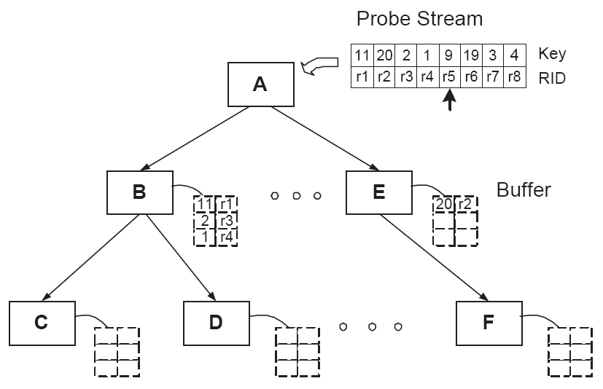
Buffering Searches for Node Reuse
[ZR03a]
Given a batch of index searches
Reuse a tree node across multiple searches
Idea:
  Buffer search keys reaching a node
  Visit the node for all keys buffered
  Determine search keys
  for child nodes
Up to 3x speedup for batch searches
Notes:
Another interesting proposal improves a batch of index searches. For example, in a nested loop indexed join algorithm, a tree is used to look up a lot of keys.
In such a situation, the study aims to reuse a tree node across multiple searches, so that the number of cache misses is reduced.
The idea is to create buffers for tree nodes. The buffer is intended to contain search keys reaching the corresponding node. Then search a node for all the buffered keys so that the node is reused across all the buffered keys. This will determine which key should go to which child node.
The figure shows one of the scheme to realize the idea. It creates a fixed buffer for each node. The buffer size is three here. Given a batch of search keys and their identifiers (here the RID is the outer relation tuple ID in a nested loop index join), the algorithm search node A and put search keys into buffers of its child nodes. When a child node’s buffer is full, the algorithm searches the child node and divides the buffered keys among the grand children, so on so forth.
----------------------------------------------
Performance:
1.machines: Pentium 4 (16KB L1, 64B lines, 256KB L2, 128B lines) , Pentium 3 (16KB L1 32B lines, 256KB L2 32B lines), UltraSparc (16KB L1 32B lines, 1MB L2 64B lines)
2. Up to 3X speedup for batch searches.

Slide 86
Key Compression to Increase Fanout
[BMR01]
Node size is a few cache lines
Low fanout if key size is large
Solution: key compression
Fixed-size partial keys
Given K_{s} > K_{i-1},
K_{s} > K_{i}, if diff(K_{s},K_{i-1}) < diff(K_{i},K_{i-1})
K_{s} > K_{i}, if diff(K_{s},K_{i-1}) < diff(K_{i},K_{i-1})
K_{i-1}
0
0
1
1
• • •
K_{i}
0
1
1
0
• • •
1
•
•
•
• • •
Partial Key i
rec
diff:1
1
0
L bits
0
0
1
•
• • •
Record containing
the key
Up to 15% improvements for searches,
computational overhead offsets the benefits
Notes:
Since the node size of cache conscious index trees is a few cache lines, if key size is large, the fanout of the tree will be quite low.
This will lead to a lot of cache misses for search. The solution to this problem is key compression.
This work proposed a key compression scheme using fixed-size partial keys.
A partial key of key i is computed based on the previous key i-1. The partial key contains the bit position of the first different bit, fixed number of bits after the different bit, and a pointer to the record containing the actual key. Partial key is used in trees.
Using this partial key, in most situations, one can decide if a search key is greater than or less than key i, if one knows the different bit position between the search key and key i-1.
--------------------------------------
Performance:
UltraSparc II 296MHz, 256MB RAM, 16KB L1 32B lines, 2M direct-mapped L2 64B lines.
The experiments vary key sizes from 4B to 36B. The keys are generated as follows. Every byte of a key is chosen from n possible bytes.
The experiments report two cases for n: n=220 or n=12.
3. When key is big, compression becomes important. When n is small, it is more probable to see the same byte, so compression is more effective.
Best speedup is achieved with largest key and smallest n.
4. Figure 9: up to 15% improvements
L2 cache misses are reduced a lot. But computational overhead is big.

Slide 87
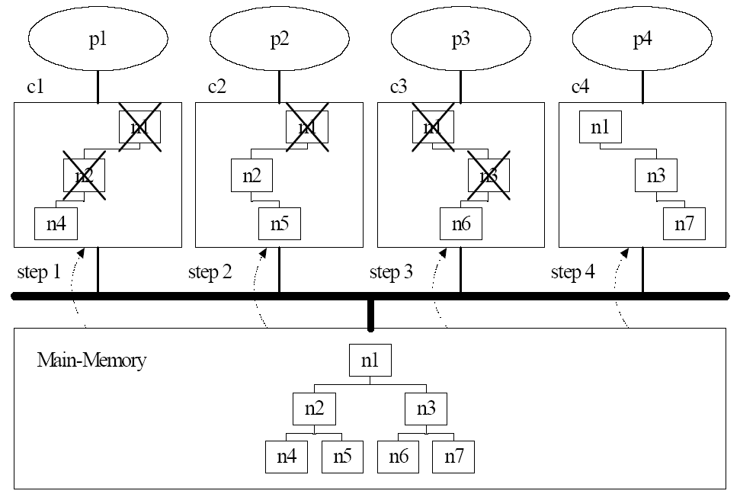
Concurrency Control
[CHK01]
Multiple CPUs share a tree
Lock coupling: too much cost
  Latching a node means writing
  True even for readers !!!
  Coherence cache misses due to writes from different CPUs
Solution:
  Optimistic approach for readers
  Updaters still latch nodes
  Updaters also set node versions
  Readers check version to ensure correctness
Search throughput: 5x (=no locking case)
Update throughput: 4x
Notes:
Figure 1 illustrates how the coherence cache misses occur with the index tree consisting of nodes n1 to n7. For the simplicity, let’s assume that each node corresponds to a cache block and contains a latch. Let the processor p1 traverse the path n1, n2, and n4 upon the cold start of the main memory query processing system, and then these nodes are replicated in the cache c1 of p1. Latches are held and released on n1, n2, and n4 on the way. Let p2 traverse the path n1, n2, and n5, then these nodes are copied into c2 and the nodes n1 and n2 cached in c1 are invalidated by p2 latching on these nodes. Note that these cache invalidation occurs even if there is enough room in the cache c1. If p3 traverses the path n1, n3, and n6, then the n1 in c2 gets invalidated. Finally, if p4 traverses the path n1, n3, and n7, the n1 and n3 in c3 get invalidated.
Performance:
Sun Enterprise 5500 Server with 8 CPUs (UltraSPARC II, 400MHz) running Solaris 7.
Figure 7 and figure 8:
- search throughput is close to no concurrency control case, up to 5X over lock coupling
- update throughput is up to 4X over lock coupling,

Slide 88
Additional Work
Cache-oblivious B-Trees [BEN00]
  Asymptotic optimal number of memory transfers
  Regardless of number of memory levels, block sizes and relative speeds of different levels
Survey of techniques for B-Tree cache performance [GRA01]
  Existing heretofore-folkloric knowledge
  E.g. key normalization, key compression, alignment, separating keys and pointers, etc.
Lots more to be done in area – consider interference and scarce resources
Notes:
As written in the slide

Slide 89
Outline
Introduction and Overview
New Processor and Memory Systems
Where Does Time Go?
Bridging the Processor/Memory Speed Gap
  Data Placement Techniques
  Query Processing and Access Methods
  Database system architectures
  Compiler/profiling techniques
  Hardware efforts
Hip and Trendy Ideas
Directions for Future Research

Slide 90
Thread-based concurrency pitfalls
[HA03]
: component loading time
Q1
Current
Q2
Q3
CPU
context-switch points
TIME
Q1
Q2
Components loaded multiple times for each query
No means to exploit overlapping work
Desired
Q3
CPU

Slide 91
Staged Database Systems
[HA03]
Proposal for new design that targets performance and scalability of DBMS architectures
Break DBMS into stages
Stages act as independent servers
Queries exist in the form of “packets”
Develop query scheduling algorithms to exploit improved locality [HA02]

Slide 92

Staged Database Systems
[HA03]
ISCAN
AGGR
IN
OUT
connect
parser
optimizer
send
JOIN
results
FSCAN
SORT
Staged design naturally groups queries per DB operator
Improves cache locality
Enables multi-query optimization

Slide 93
Outline
Introduction and Overview
New Processor and Memory Systems
Where Does Time Go?
Bridging the Processor/Memory Speed Gap
  Data Placement Techniques
  Query Processing and Access Methods
  Database system architectures
  Compiler/profiling techniques
  Hardware efforts
Hip and Trendy Ideas
Directions for Future Research

Slide 94
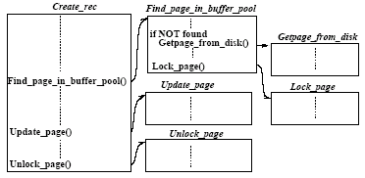
[APD03]
Call graph prefetching for DB apps
Targets instruction-cache performance for DSS
Basic idea: exploit predictability in function-call sequences within DB operators
Example: create_rec always calls find_ , lock_ , update_ , and unlock_ page in the same order
Build hardware to predict next function call using a small cache (Call Graph History Cache)
Notes:
DBMS code typically follows a layered software design. For example, the query scheduler invokes the relational operators, and each operator, in turn, invokes the storage manager.
Given a specific action, e.g., create a record, there is a sequence of function calls that always take place: find page, lock page, update page, unlock page.
The authors propose to build hardware to analyze the call graph of a DBMS and try to predict, using a small cache (Call Graph History Cache), which function is likely to be called next.

Slide 95
Call graph prefetching for DB apps
[APD03]
Instructions from next function likely to be called are prefetched using next-N-line prefetching
If prediction was wrong, cache pollution is N lines
Experimentation: SHORE running Wisconsin Benchmark and TPC-H queries on SimpleScalar
Two-level 2KB+32KB history cache worked well
Outperforms next-N-line, profiling techniques for DSS workloads
Notes:
Then, they will prefetch the instructions of that function into the L1-I cache. They use next-N-line prefetching, because if they prefetch the entire function they may pollute the cache and also pay a large penalty if the prediction was wrong.
Evaluation is through the SimpleScalar simulator, running SHORE and Wisconsin Benchmark + some TPC-H queries.

Slide 96
Buffering Index Accesses
[ZR03]
Targets data-cache performance of index structures for bulk look-ups
Main idea: increase temporal locality by delaying (buffering) node probes until a group is formed
Example:
probe stream: (r1, 10) (r2, 80) (r3, 15)
RID
key
(r1, 10)
RID
key
(r2, 80)
RID
key
(r3, 15)
r1
10
root
r1
10
r2
80
r1
10
r2
80
r3
15
B
C
B
C
B
C
D
E
buffer
(r2,80) is buffered
B is accessed,
(r1,10) is buffered
before accessing C
buffer entries are
before accessing B
divided among children

Slide 97
Buffering Index Accesses
[ZR03]
Flexible implementation of buffers:
  Can assign one buffer per set of nodes (virtual nodes)
  Fixed-size, variable-size, order-preserving buffering
  Can flush buffers (force node access) on demand
  => can guarantee max response time
Techniques work both with plain index structures and cache-conscious ones
Results: two to three times faster bulk lookups
Main applications: stream processing, index-nested-loop joins
Similar idea, more generic setting in [PMH02]

Slide 98
[ZR02]
DB operators using SIMD
SIMD: Single – Instruction – Multiple – Data Found in modern CPUs, target multimedia
Example: Pentium 4,
128-bit SIMD register
holds four 32-bit values
Assume data is stored columnwise as contiguous array of fixed-length numeric values (e.g., PAX)
Scan example
X3
X2
X1
X0
Y3
Y2
Y1
Y0
OP
OP
OP
OP
X3 OP Y3
X2 OP Y2
X1 OP Y1
X0 OP Y0
8
12
6
5
SIMD 1st phase:
x[n+3]
x[n+2]
x[n+1]
x[n]
if x[n] > 10
result[pos++] = x[n]
produce bitmap
vector with 4
10
10
10
10
comparison results
>
>
>
>
in parallel
original scan code
0
1
0
0
Notes:
SIMD: Single – Instruction – Multiple – Data
These extensions appeared in modern CPUs to accelerate multimedia applications.
For example, in Pentium 4, a 128-bit SIMD register can hold and operate on 4 32-bit values.
SIMD instructions provide ways to express comparisons, logical/arithmetic operations for a set of values, on parallel.
The authors describe ways to rewrite inner loops of most DB operators:
scan-like operators that (a) may return first match (b) return all matches (c) performing scalar aggregations: sum, count, min/max
Algorithms manipulating B-Trees
Nested-loop join
Best case is linear speedup to degree of parallelism. Note that we may not be able to express a specific algorithm in SIMD (example: SQL “like” operator)
May achieve even superlinear results because of reduced branch misspredictions: using SIMD arithmetic we avoid “if” statements in the predicate evaluation.

Slide 99
DB operators using SIMD
[ZR02]
Scan example (cont’d)
SIMD pros: parallel comparisons, fewer “if” tests
=> fewer branch mispredictions
Paper describes SIMD B-Tree search, N-L join
For queries that can be written using SIMD, from 10% up to 4x improvement
0
1
0
0
SIMD 2nd phase:
keep this result
if bit_vector == 0, continue
else copy all 4 results, increase pos when bit==1
Notes:
SIMD: Single – Instruction – Multiple – Data
These extensions appeared in modern CPUs to accelerate multimedia applications.
For example, in Pentium 4, a 128-bit SIMD register can hold and operate on 4 32-bit values.
SIMD instructions provide ways to express comparisons, logical/arithmetic operations for a set of values, on parallel.
The authors describe ways to rewrite inner loops of most DB operators:
scan-like operators that (a) may return first match (b) return all matches (c) performing scalar aggregations: sum, count, min/max
Algorithms manipulating B-Trees
Nested-loop join
Best case is linear speedup to degree of parallelism. Note that we may not be able to express a specific algorithm in SIMD (example: SQL “like” operator)
May achieve even superlinear results because of reduced branch misspredictions: using SIMD arithmetic we avoid “if” statements in the predicate evaluation.

Slide 100
STEPS: Cache-Resident OLTP
[HA04]
Targets instruction-cache performance for OLTP
Exploits high transaction concurrency
Synchronized Transactions through Explicit Processor Scheduling: Multiplex concurrent transactions to exploit common code paths
thread A
thread B
thread A
thread B
CPU
CPU
00101
1001
00010
1101
110
10011
0110
00110
00101
1001
00010
1101
110
10011
0110
00110
00101
1001
00010
1101
110
10011
0110
00110
00101
1001
00010
1101
110
10011
0110
00110
code
fits in
I-cache
instruction
cache
capacity
window
CPU executes code
CPU performs context-switch
context-switch
point
before
after

Slide 101
STEPS: Cache-Resident OLTP
[HA04]
STEPS implementation runs full OLTP workloads (TPC-C)
Groups threads per DB operator, then uses fast context-switch to reuse instructions in the cache
STEPS minimizes L1-I cache misses without increasing cache size
Up to 65% fewer L1-I misses, 39% speedup in full-system implementation

Slide 102
Outline
Introduction and Overview
New Processor and Memory Systems
Where Does Time Go?
Bridging the Processor/Memory Speed Gap
  Data Placement Techniques
  Query Processing and Access Methods
  Database system architectures
  Compiler/profiling techniques
  Hardware efforts
Hip and Trendy Ideas
Directions for Future Research

Slide 103
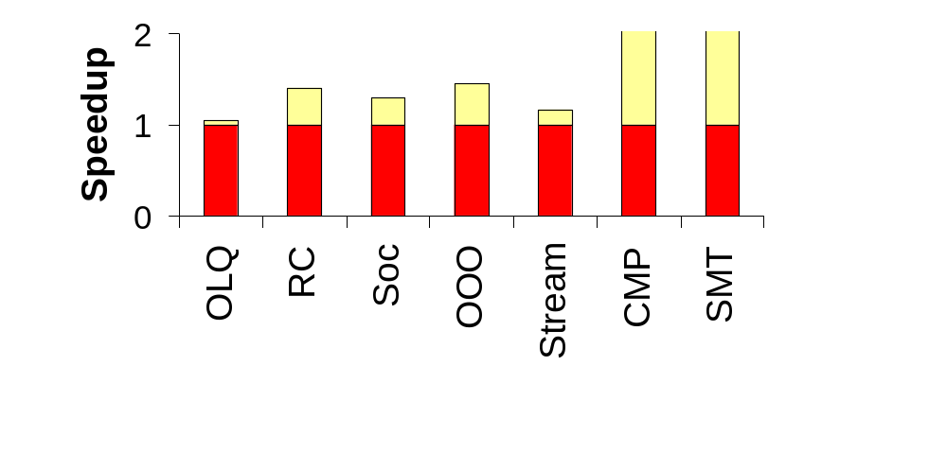
Hardware Impact: OLTP
OLQ: Limit # of “original” L2 lines
[BWS03]
RC: Release Consistency vs. SC
[RGA98]
SoC: On-chip L2+MC+CC+NR
[BGN00]
OOO: 4-wide Out-Of-Order
[BGM00]
Stream: 4-entry Instr. Stream Buf
[RGA98]
CMP: 8-way Piranha [BGM00]
SMT: 8-way Sim. Multithreading
[LBE98]
2.9
3.0
Mem
Latency
ILP
TLP
Thread-level parallelism enables high OLTP throughput
Notes:
OLQ : Allow only a small number of original (dirty or exclusive) lines in L2
High cache-to-cache transfer component in OLTP on MPs
By flushing dirty data, the next sharer will take them from memory (not another cpu’s cache) and save 1 network hop
RC: Impact of release consistency on OLTP running on 4-issue OOO
By relaxing the consistency model, mem latency can be tolerated
Still difficult to hide it completely due to the prevalence of dependent loads
SoC: similar to system-on-chip idea: put L2, memory controller, coherence controler and network router on chip
Integration allows for implementation of higher assoc in L2, and low-latency high-bandwidth communication with the other components
OOO: impact of 4-issue superscalar on OLTP over a single-issue in-order
OOO allows for ILP and may hide latency by utilizing the cpu while misses are in-flight
Stream: impact of a small (4-entry) instruction stream buffer on OLTP
Large instruction stall time component (dominated by L1 misses)
Large portion of instruction references follow a streaming pattern
CMP: Impact of chip multiprocessing (based on 8-core Piranha) on OLTP
Abudance of explicit thread-level parallelism in OLTP, but limited ILP
Implement a simpler & slower cpu design using standard asic libraries to exploit TLP, and ouperform a highly customized OOO that exploits ILP
SMT: Impact of simultaneous multithreading on OLTP
SMT fetches multiple instructions from multiple threads on each cycle, and switches threads on L1 misses, therby hiding latency
Leads to better inter-thread instruction cache sharing (35% fewer L1-I misses) and also exploits thread-level parallelism.
Lowers zero-fetch and zero-issue cycles by 65%. Fills all issue slots 1/3 of time (vs 8.6%)

Slide 104
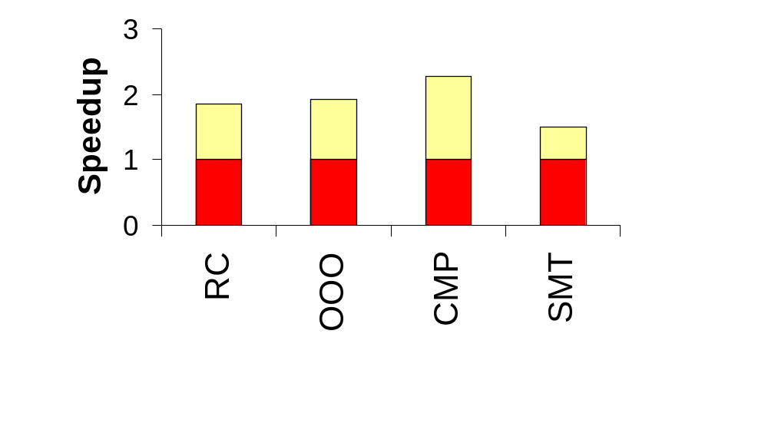
Hardware Impact: DSS
RC: Release Consistency vs. SC
[RGA98]
OOO: 4-wide out-of-order
[BGM00]
CMP: 8-way Piranha [BGM00]
SMT: 8-way Sim. Multithreading
[LBE98]
Mem
Latency
ILP
TLP
High ILP in DSS enables all speedups above
Notes:
RC: Impact of release consistency on DSS running on 4-issue OOO
By relaxing the consistency model, mem latency can be tolerated, allowing even higher ILP
DSS on SC has significant write stall time. RC completely overlaps it
DSS has few dependent loads, so RC is effective in hiding mem latency
OOO: impact of 4-issue superscalar on DSS over a single-issue in-order
DSS is compute intensive and exhibits high ILP (reminiscent of sci apps)
Its main limitation is # functional units [RGA98]
OOO exploits high ILP nature of DSS
CMP: Impact of chip multiprocessing (based on 8-core Piranha) on DSS
Implement a simpler & slower (half) cpu design using standard asic libraries
Computer intensive nature of DSS allows CMP to achieve almost linear speedup with Piranha’s 8 cores, still beating a twice as fast 4-wide OOO
SMT: Impact of simultaneous multithreading on DSS
SMT fetches multiple instructions from multiple threads on each cycle, and switches threads on L1 misses, therby hiding latency and enabling even more ILP
Instruction and data cache-critical working sets mostly fit in the cache
98% of instr are on 6KB, 75% of PGA on 15KB, 97% of SGA-other on 3KB. Data bufs are not cache critical (working set is entire footprint)
Eliminates entirely zero-fetch and zero-issue cycles. Fills all issue slots 59% vs 22% of time.

Slide 105
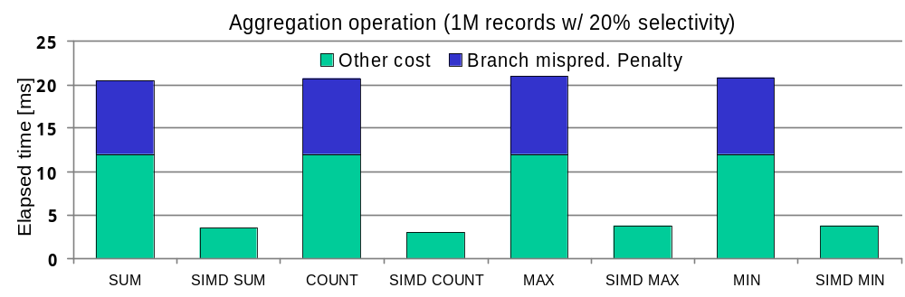
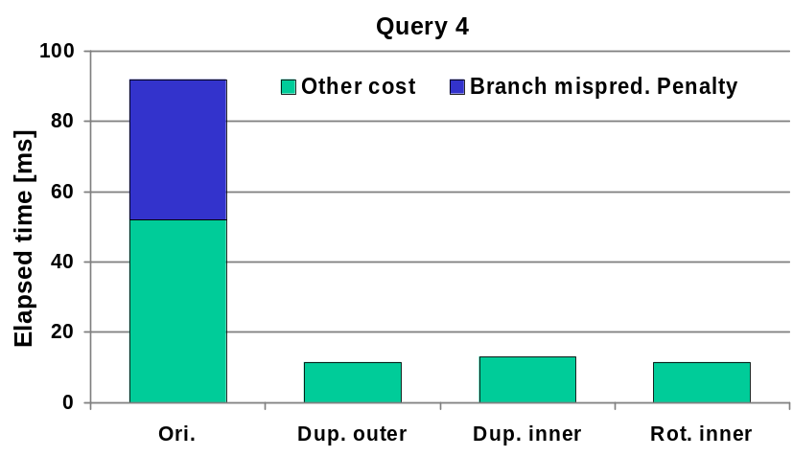
Accelerate inner loops through SIMD
[ZR02]
What SIMD can do for database operation? [ZR02]
  Higher parallelism on data processing
  Elimination of conditional branch instruction
    Less misprediction leads to huge performance gain
SIMD brings performance gain from 10% to >4x
Improve nested-loop joins
Query 4:
SELECT FROM R,S
WHERE R.Key < S.KEY < R. Key + 5
Notes:
Modern CPUs have instructions that allow basic operations to be performed on several data elements in parallel, which are called SIMD (single instruction multiple data) instructions. These instructions are originally designed for multimedia programs where the data processing involves simple and same operations on large volume of data. Most of today’s commercial general processors are now equipped with SIMD instructions to accelerate the multimedia programs. An interesting question here is that since basic database operations such as scan and aggregate share the similar property of multimedia program, can the “take for free” SIMD instructions do any good to database performance? Jinren Zhou and Kenneth Ross raised this question in their paper “implementing database operations using SIMD instructions”. They reported that SIMD instructions can improve database performance through two aspects: 1. SIMD provides higher parallelism on data processing which is the essential idea of SIMD and 2. SIMD eliminates the conditional branch instructions by doing arithmetic on the results of the SIMD operations. This will result in less misprediction which can lead to huge performance gain. They reimplement the basic database operations using SIMD instructions and compare the performance with traditional implementations without SIMD support.
The first graph compares the elapsed time of various aggregation operations with and without SIMD support. As we can see from the graph, branch misprediction stalls have been removed completely and the other cost also be reduced more than 2 times. The second graph evaluates the SIMD nested-loop joins (the experiment query is on the right next to the graph), the left three bars representing new implementation with SIMD achieves 8X less execution time than the original implementation.

Slide 106
Outline
Introduction and Overview
New Processor and Memory Systems
Where Does Time Go?
Bridging the Processor/Memory Speed Gap
Hip and Trendy Ideas
  Query co-processing
  Databases on MEMS-based storage
Directions for Future Research

Slide 107
Reducing Computational Cost
Spatial operation is computation intensive
  Intersection, distance computation
  Number of vertices per object↑, cost↑
Use graphics card to increase speed [SAA03]
Idea: use color blending to detect intersection
  Draw each polygon with gray
  Intersected area is black because of color mixing effect
  Algorithms cleverly use hardware features
Intersection selection: up to 64% improvement using hardware approach
Notes:
[NATASSA] Add punchline!
-------------------------------------------
Sometimes it is possible to use special hardware features to reduce computational cost.
For example, a recent study focuses on spatial operations, such as intersection and distance computation.
When the number of vertices per object is very large, the spatial computation cost usually becomes the dominant cost of spatial appliication.
The idea of this paper is to use graphics card hardware to increase speed of spatial computation.
If we draw each polygon with gray, then the intersected area will be black. We can check if there exists any black pixel to find out if the two
polygon intersects with each other. The algorithms in the paper cleverly uses hardware operations provided by the graphics card to reduce
the computational cost.
----------------------------------------------
Performance:
machine: AMD Athlon XP 1800+, 1GB DDR memory, Graphics card has Nvidia GeForce4 Ti4600 processor and 128MB on-board memory.
Datasets: 5 real-world polygon datasets
Intersection selection: up to 64% improvement using hardware approach

Slide 108
Fast Computation of DB Operations
Using Graphics Processors [GLW04]
Exploit graphics features for database operations
  Predicate, Boolean operations, Aggregates
Examples:
  Predicate: attribute > constant
    Graphics: test a set of pixels against a reference value
    pixel = attribute value, reference value = constant
  Aggregations: COUNT
    Graphics: count number of pixels passing a test
Good performance: e.g. over 2X improvement for predicate evaluations
Peak performance of graphics processor increases 2.5-3 times a year
Notes:
This work exploits graphics operations to improve general predicate, Boolean operations, and aggregate computations.
For example, one can perform a predicate “attribute > constant” as follows. A common graphics operation is to test a set of pixel values against a specified reference value. If one sets a pixel value to be an attribute value from a tuple, and set the reference value as the constant in the predicate. The graphics operation performs the predicate computation.
Another example is the count aggregate. There is a graphics operation to count the number of pixels passing a test. Then one can, for example, use this operation to count the number of tuples passing the above predicate test.
The performance is very good. For example, over 2X improvement for predicate evaluation queries.
But what’s important is that the peak performance of graphics processors has been increasing at the rate of 2.5-3 times a year, much faster than general purpose cpus. In other words, at this rate, the graphics processors’ peak performance may move into the teraflop range by 2006. The performance gain of the methods will increase.
---------------------------------
Performance:
Dell Precision Workstation with dual 2.8GHz Intel Xeon Processors, NVIDIA GeForceFX 5900 Ultra graphics processors with 256MB video memory, the graphics processor can process up to 8 pixels at processor clock rate of 450 MHz.
Benchmarks: TCP/IP monitoring traffic data, census database of monthly income information
Over 2X improvement for predicate evaluation query
And there are results for range query, multi-attribute query, min/max (k-th largest number) etc.

Slide 109
Outline
Introduction and Overview
New Processor and Memory Systems
Where Does Time Go?
Bridging the Processor/Memory Speed Gap
Hip and Trendy Ideas
  Query co-processing
  Databases on MEMS-based storage
Directions for Future Research

Slide 110
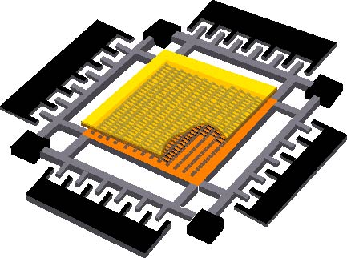
MEMStore (MEMS-based storage)
On-chip mechanical storage - using MEMS for media positioning
Read/write
tips
Actuators
Recording
media (sled)
Notes:
MEMS stands for microelectromechanical systems, which are microscopic mechanical machines that are built out of silicon, similarly to standard integrated circuits. The main difference, of course, is that they are actually mechanical and have moving parts. MEMS-based storage devices (or MEMStores) use MEMS to position some recording medium to be accessed by an array of read/write tips, which you can think of as the read/write heads in a disk drive. All of the devices described in the literature share this basic architecture. The media is coated onto a moving platform, which we call the sled (shown here in orange). The media is positioned by a set of actuators, shown along the sides of the media. The read/write tips are fixed above the media and access the data stored within.

Slide 111
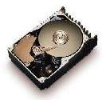
MEMStore (MEMS-based storage)
Single
read/write
head
Many parallel
heads
60 - 200 GB capacity
  4 – 40 GB portable
100 cm³ volume
10’s MB/s bandwidth
< 10 ms latency
  10 – 15 ms portable
2 - 10 GB capacity
< 1 cm³ volume
~100 MB/s bandwidth
< 1 ms latency
So how can MEMS help improve DB performance?
Notes:
MEMS-based storage (or MEMStores) are an interesting new storage technology that has been described as a potential competitor to future disk drives. They have exciting characteristics, such as small physical size and fast access times. Just to give you a quick comparison of MEMStores and disk drives, here are some of the high-level characteristics.
(Go through bullets quickly)
Notice that this isn’t a fair comparison because I’m comparing future technologies to disk drives of today. In terms of capacity we can expect a larger gap in the future, but in terms of access latency and volume, disks are not expected to improve significantly over the next few years.
(Click)
The main difference that is interesting for storing databases on MEMStores is that there are many read/write heads that can access data in parallel, as opposed to a disk drive, which can access data with only one head at a time. There are a lot of details here and I encourage you to read our paper, but I’m going to show a simple example of how this works and how it can improve database performance.

Slide 112
Two-dimensional database access
[SSA03]
Attributes
0
33
54
1
34
55
2
35
56
3
30
57
4
31
58
5
32
59
6
27
60
7
28
61
8
29
62
15
36
69
16
37
70
17
38
71
Records
12
39
66
13
40
67
14
41
68
9
42
63
10
43
64
11
44
65
18
51
72
19
52
73
20
53
74
21
48
75
22
49
76
23
50
77
24
45
78
25
46
79
26
47
80
Exploit inherent parallelism
Notes:
On the left, I’m showing a simple database table with three attributes. On the right is a simplified MEMStore. The MEMStore has nine read/write heads each of which addresses its own square of nine data blocks, labeled with their LBN number. Of these nine read/write heads, three can be activated in parallel, and we can choose which three to activate dynamically.
(Click)
Normally, records in a table would be stored on the storage device in a serial fashion – as in the ubiquitous NSM page layout.
(Click)
But, when storing the table on the MEMStore, we lay the data out such that it can be accessed efficiently by sets of read/write heads.
(Click)
Now, when we want to access a single record of the table, we turn on a row of heads.
(Click)
We can continue reading rows sequentially using the same heads.
(Click)
However, when we want to access just a single column of the table, we activate the appropriate column of heads and access the data. This offers a significant benefit over the standard, serialized layout of NSM in which, to access just a single attribute of the table, we would have had to have accessed all of the other attributes. As you can see, the table can be mapped very naturally to the MEMStore, and we can flexibly choose which access we want to make, and that access is efficient in either order.

Slide 113
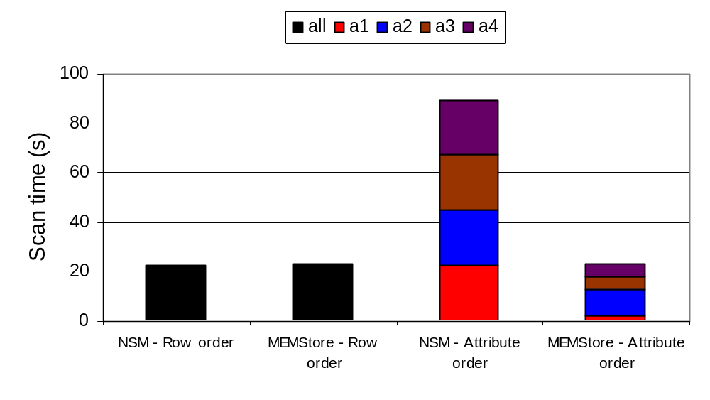
Two-dimensional database access
[SSA03]
Excellent performance along both dimensions
Notes:
Now, let’s look at how the flexible layout helps. On this slide, I’m showing the result of a full scan of an example table, comparing the performance of the serialized layout (NSM) to the layout enabled by the MEMStore. The table has four attributes, a1 through a4.
(Click)
The first two bars show the time to scan the entire table in row (or record) order using NSM and the MEMStore layout. In both cases, the scan is sequential, and completes in a little over 20 seconds.
(Click)
The next bar shows the time to scan the entire table one attribute at a time when the layout is serialized. As we expect, scanning a single attribute requires reading the entire table, so the overall scan time is four times longer.
(Click)
However, the MEMStore layout allows us to scan one attribute at a time efficiently. So the overall time to scan the entire table one attribute at a time is the same as scanning the entire table one record at a time – just over 20 seconds. The scan time of an individual attribute is proportional to the size of that attribute. In this case, a1 is one byte, a2 is four bytes, and a3 and a4 are eight bytes.

Slide 114
Outline
Introduction and Overview
New Processor and Memory Systems
Where Does Time Go?
Bridging the Processor/Memory Speed Gap
Hip and Trendy Ideas
Directions for Future Research

Slide 115
Future research directions
Rethink Query optimization – with all the complexity, cost-based optimization may not be ideal
Multiprocessors and really new modular software architectures to fit new computers
  Current research in DBs only scratches surface
Automatic data placement and memory layer optimization – one level should not need to know what others do
  Auto-everything
Aggressive use of hybrid processors

Slide 116
ACKNOWLEDGEMENTS

Slide 117

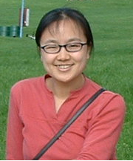


Special thanks go to…
Shimin Chen, Minglong Shao, Stavros Harizopoulos, and Nikos Hardavellas for their invaluable contributions to this talk
Ravi Ramamurthy for slides on fractured mirrors
Steve Schlosser for slides on MEMStore
Babak Falsafi for input on computer architecture

Slide 118
REFERENCES
(used in presentation)

Slide 119
References
Where Does Time Go? (simulation only)
[ADS02] Branch Behavior of a Commercial OLTP Workload on Intel IA32 Processors. M. Annavaram, T. Diep, J. Shen. International Conference on Computer Design: VLSI in Computers and Processors (ICCD), Freiburg, Germany, September 2002.
[SBG02] A Detailed Comparison of Two Transaction Processing Workloads. R. Stets, L.A. Barroso, and K. Gharachorloo. IEEE Annual Workshop on Workload Characterization (WWC), Austin, Texas, November 2002.
[BGN00] Impact of Chip-Level Integration on Performance of OLTP Workloads. L.A. Barroso, K. Gharachorloo, A. Nowatzyk, and B. Verghese. IEEE International Symposium on High-Performance Computer Architecture (HPCA), Toulouse, France, January 2000.
[RGA98] Performance of Database Workloads on Shared Memory Systems with Out-of-Order Processors. P. Ranganathan, K. Gharachorloo, S. Adve, and L.A. Barroso. International Conference on Architecture Support for Programming Languages and Operating Systems (ASPLOS), San Jose, California, October 1998.
[LBE98] An Analysis of Database Workload Performance on Simultaneous Multithreaded Processors. J. Lo, L.A. Barroso, S. Eggers, K. Gharachorloo, H. Levy, and S. Parekh. ACM International Symposium on Computer Architecture (ISCA), Barcelona, Spain, June 1998.
[EJL96] Evaluation of Multithreaded Uniprocessors for Commercial Application Environments. R.J. Eickemeyer, R.E. Johnson, S.R. Kunkel, M.S. Squillante, and S. Liu. ACM International Symposium on Computer Architecture (ISCA), Philadelphia, Pennsylvania, May 1996.

Slide 120
References
Where Does Time Go? (real-machine/simulation)
[RAD02] Comparing and Contrasting a Commercial OLTP Workload with CPU2000. J. Rupley II, M. Annavaram, J. DeVale, T. Diep and B. Black (Intel). IEEE Annual Workshop on Workload Characterization (WWC), Austin, Texas, November 2002.
[CTT99] Detailed Characterization of a Quad Pentium Pro Server Running TPC-D. Q. Cao, J. Torrellas, P. Trancoso, J. Larriba-Pey, B. Knighten, Y. Won. International Conference on Computer Design (ICCD), Austin, Texas, October 1999.
[ADH99] DBMSs on a Modern Processor: Experimental Results A. Ailamaki, D. J. DeWitt, M. D. Hill, D.A. Wood. International Conference on Very Large Data Bases (VLDB), Edinburgh, UK, September 1999.
[KPH98] Performance Characterization of a Quad Pentium Pro SMP using OLTP Workloads. K. Keeton, D.A. Patterson, Y.Q. He, R.C. Raphael, W.E. Baker. ACM International Symposium on Computer Architecture (ISCA), Barcelona, Spain, June 1998.
[BGB98] Memory System Characterization of Commercial Workloads. L.A. Barroso, K. Gharachorloo, and E. Bugnion. ACM International Symposium on Computer Architecture (ISCA), Barcelona, Spain, June 1998.
[TLZ97] The Memory Performance of DSS Commercial Workloads in Shared-Memory Multiprocessors. P. Trancoso, J. Larriba-Pey, Z. Zhang, J. Torrellas. IEEE International Symposium on High-Performance Computer Architecture (HPCA), San Antonio, Texas, February 1997.

Slide 121
References
Architecture-Conscious Data Placement
[SSS04] Clotho: Decoupling memory page layout from storage organization. M. Shao, J. Schindler, S.W. Schlosser, A. Ailamaki, G.R. Ganger. International Conference on Very Large Data Bases (VLDB), Toronto, Canada, September 2004.
[SSS04a] Atropos: A Disk Array Volume Manager for Orchestrated Use of Disks. J. Schindler, S.W. Schlosser, M. Shao, A. Ailamaki, G.R. Ganger. USENIX Conference on File and Storage Technologies (FAST), San Francisco, California, March 2004.
[YAA03] Tabular Placement of Relational Data on MEMS-based Storage Devices. H. Yu, D. Agrawal, A.E. Abbadi. International Conference on Very Large Data Bases (VLDB), Berlin, Germany, September 2003.
[ZR03] A Multi-Resolution Block Storage Model for Database Design. J. Zhou and K.A. Ross. International Database Engineering & Applications Symposium (IDEAS), Hong Kong, China, July 2003.
[SSA03] Exposing and Exploiting Internal Parallelism in MEMS-based Storage. S.W. Schlosser, J. Schindler, A. Ailamaki, and G.R. Ganger. Carnegie Mellon University, Technical Report CMU-CS-03-125, March 2003
[YAA04] Declustering Two-Dimensional Datasets over MEMS-based Storage. H. Yu, D. Agrawal, and A.E. Abbadi. International Conference on Extending DataBase Technology (EDBT), Heraklion-Crete, Greece, March 2004.
[HP03] Data Morphing: An Adaptive, Cache-Conscious Storage Technique. R.A. Hankins and J.M. Patel. International Conference on Very Large Data Bases (VLDB), Berlin, Germany, September 2003.
[RDS02] A Case for Fractured Mirrors. R. Ramamurthy, D.J. DeWitt, and Q. Su. International Conference on Very Large Data Bases (VLDB), Hong Kong, China, August 2002.
[ADH02] Data Page Layouts for Relational Databases on Deep Memory Hierarchies. A. Ailamaki, D. J. DeWitt, and M. D. Hill. The VLDB Journal, 11(3), 2002.
[ADH01] Weaving Relations for Cache Performance. A. Ailamaki, D.J. DeWitt, M.D. Hill, and M. Skounakis. International Conference on Very Large Data Bases (VLDB), Rome, Italy, September 2001.
[BMK99] Database Architecture Optimized for the New Bottleneck: Memory Access. P.A. Boncz, S. Manegold, and M.L. Kersten. International Conference on Very Large Data Bases (VLDB), Edinburgh, the United Kingdom, September 1999.

Slide 122
References
Architecture-Conscious Access Methods
[ZR03a] Buffering Accesses to Memory-Resident Index Structures. J. Zhou and K.A. Ross. International Conference on Very Large Data Bases (VLDB), Berlin, Germany, September 2003.
[HP03] Effect of node size on the performance of cache-conscious B+ Trees. R.A. Hankins and J.M. Patel. ACM International conference on Measurement and Modeling of Computer Systems (SIGMETRICS), San Diego, California, June 2003.
[CGM02] Fractal Prefetching B+ Trees: Optimizing Both Cache and Disk Performance. S. Chen, P.B. Gibbons, T.C. Mowry, and G. Valentin. ACM International Conference on Management of Data (SIGMOD), Madison, Wisconsin, June 2002.
[GL01] B-Tree Indexes and CPU Caches. G. Graefe and P. Larson. International Conference on Data Engineering (ICDE), Heidelberg, Germany, April 2001.
[CGM01] Improving Index Performance through Prefetching. S. Chen, P.B. Gibbons, and T.C. Mowry. ACM International Conference on Management of Data (SIGMOD), Santa Barbara, California, May 2001.
[BMR01] Main-memory index structures with fixed-size partial keys. P. Bohannon, P. Mcllroy, and R. Rastogi. ACM International Conference on Management of Data (SIGMOD), Santa Barbara, California, May 2001.
[BDF00] Cache-Oblivious B-Trees. M.A. Bender, E.D. Demaine, and M. Farach-Colton. Symposium on Foundations of Computer Science (FOCS), Redondo Beach, California, November 2000.
[RR00] Making B+ Trees Cache Conscious in Main Memory. J. Rao and K.A. Ross. ACM International Conference on Management of Data (SIGMOD), Dallas, Texas, May 2000.
[RR99] Cache Conscious Indexing for Decision-Support in Main Memory. J. Rao and K.A. Ross. International Conference on Very Large Data Bases (VLDB), Edinburgh, the United Kingdom, September 1999.

Slide 123
References
Architecture-Conscious Query Processing
[MBN04] Cache-Conscious Radix-Decluster Projections. Stefan Manegold, Peter A. Boncz, Niels Nes, Martin L. Kersten. In Proceedings of the International Conference on Very Large Data Bases, 2004.
[GLW04] Fast Computation of Database Operations using Graphics Processors. N.K. Govindaraju, B. Lloyd, W. Wang, M. Lin, D. Manocha. ACM International Conference on Management of Data (SIGMOD), Paris, France, June 2004.
[CAG04] Improving Hash Join Performance through Prefetching. S. Chen, A. Ailamaki, P. B. Gibbons, and T.C. Mowry. International Conference on Data Engineering (ICDE), Boston, Massachusetts, March 2004.
[ZR04] Buffering Database Operations for Enhanced Instruction Cache Performance. J. Zhou, K. A. Ross. ACM International Conference on Management of Data (SIGMOD), Paris, France, June 2004.
[SAA03] Hardware Acceleration for Spatial Selections and Joins. C. Sun, D. Agrawal, A.E. Abbadi. ACM International conference on Management of Data (SIGMOD), San Diego, California, June,2003.
[CHK01] Cache-Conscious Concurrency Control of Main-Memory Indexes on Shared-Memory Multiprocessor Systems. S. K. Cha, S. Hwang, K. Kim, and K. Kwon. International Conference on Very Large Data Bases (VLDB), Rome, Italy, September 2001.
[PMA01] Block Oriented Processing of Relational Database Operations in Modern Computer Architectures. S. Padmanabhan, T. Malkemus, R.C. Agarwal, A. Jhingran. International Conference on Data Engineering (ICDE), Heidelberg, Germany, April 2001.
[MBK00] What Happens During a Join? Dissecting CPU and Memory Optimization Effects. S. Manegold, P.A. Boncz, and M.L.. Kersten. International Conference on Very Large Data Bases (VLDB), Cairo, Egypt, September 2000.
[SKN94] Cache Conscious Algorithms for Relational Query Processing. A. Shatdal, C. Kant, and J.F. Naughton. International Conference on Very Large Data Bases (VLDB), Santiago de Chile, Chile, September 1994.
[NBC94] AlphaSort: A RISC Machine Sort. C. Nyberg, T. Barclay, Z. Cvetanovic, J. Gray, and D.B. Lomet. ACM International Conference on Management of Data (SIGMOD), Minneapolis, Minnesota, May 1994.

Slide 124
References
Profiling and Software Architectures
[HA04] STEPS towards Cache-resident Transaction Processing. S. Harizopoulos and A. Ailamaki. International Conference on Very Large Data Bases (VLDB), Toronto, Canada, September 2004.
[APD03] Call Graph Prefetching for Database Applications. M. Annavaram, J.M. Patel, and E.S. Davidson. ACM Transactions on Computer Systems, 21(4):412-444, November 2003.
[SAG03] Lachesis: Robust Database Storage Management Based on Device-specific Performance Characteristics. J. Schindler, A. Ailamaki, and G. R. Ganger. International Conference on Very Large Data Bases (VLDB), Berlin, Germany, September 2003.
[HA02] Affinity Scheduling in Staged Server Architectures. S. Harizopoulos and A. Ailamaki. Carnegie Mellon University, Technical Report CMU-CS-02-113, March, 2002.
[HA03] A Case for Staged Database Systems. S. Harizopoulos and A. Ailamaki. Conference on Innovative Data Systems Research (CIDR), Asilomar, CA, January 2003.
[B02] Monet: A Next-Generation DBMS Kernel For Query-Intensive Applications. P. A. Boncz. Ph.D. Thesis, Universiteit van Amsterdam, Amsterdam, The Netherlands, May 2002.
[PMH02] Computation Regrouping: Restructuring Programs for Temporal Data Cache Locality. V.K. Pingali, S.A. McKee, W.C. Hseih, and J.B. Carter. International Conference on Supercomputing (ICS), New York, New York, June 2002.
[ZR02] Implementing Database Operations Using SIMD Instructions. J. Zhou and K.A. Ross. ACM International Conference on Management of Data (SIGMOD), Madison, Wisconsin, June 2002.

Slide 125
References
Hardware Techniques
[BWS03] Improving the Performance of OLTP Workloads on SMP Computer Systems by Limiting Modified Cache Lines. J.E. Black, D.F. Wright, and E.M. Salgueiro. IEEE Annual Workshop on Workload Characterization (WWC), Austin, Texas, October 2003.
[GH03] Technological impact of magnetic hard disk drives on storage systems. E. Grochowski and R. D. Halem IBM Systems Journal 42(2), 2003.
[DJN02] Shared Cache Architectures for Decision Support Systems. M. Dubois, J. Jeong , A. Nanda, Performance Evaluation 49(1), September 2002 .
[G02] Put Everything in Future (Disk) Controllers. Jim Gray, talk at the USENIX Conference on File and Storage Technologies (FAST), Monterey, California, January 2002.
[BGM00] Piranha: A Scalable Architecture Based on Single-Chip Multiprocessing. L.A. Barroso, K. Gharachorloo, R. McNamara, A. Nowatzyk, S. Qadeer, B. Sano, S. Smith, R. Stets, and B. Verghese. International Symposium on Computer Architecture (ISCA). Vancouver, Canada, June 2000.
[AUS98] Active disks: Programming model, algorithms and evaluation. A. Acharya, M. Uysal, and J. Saltz. International Conference on Architecture Support for Programming Languages and Operating Systems (ASPLOS), San Jose, California, October 1998.
[KPH98] A Case for Intelligent Disks (IDISKs). K. Keeton, D. A. Patterson, J. Hellerstain. SIGMOD Record, 27(3):42--52, September 1998.
[PGK88] A Case for Redundant Arrays of Inexpensive Disks (RAID). D. A. Patterson, G. A. Gibson, and R. H. Katz. ACM International Conference on Management of Data (SIGMOD), June 1988.

Slide 126
References
Methodologies and Benchmarks
[DMM04] Accurate Cache and TLB Characterization Using hardware Counters. J. Dongarra, S. Moore, P. Mucci, K. Seymour, H. You. International Conference on Computational Science (ICCS), Krakow, Poland, June 2004.
[SAF04] DBmbench: Fast and Accurate Database Workload Representation on Modern Microarchitecture. M. Shao, A. Ailamaki, and B. Falsafi. Carnegie Mellon University Technical Report CMU-CS-03-161, 2004 .
[KP00] Towards a Simplified Database Workload for Computer Architecture Evaluations. K. Keeton and D. Patterson. IEEE Annual Workshop on Workload Characterization, Austin, Texas, October 1999.

Slide 127
Useful Links
Info on Intel Pentium4 Performance Counters: ftp://download.intel.com/design/Pentium4/manuals/25366814.pdf
AMD counter info
http://www.amd.com/us-en/Processors/DevelopWithAMD/
PAPI Performance Library
http://icl.cs.utk.edu/papi/

