Slide 1
Secure data hiding in image using steganography
CAPSTONE PROJECT
Presented By
Student Name : Abhinav Gahlaut
College Name & Department : FET, GLS University

Slide 2
OUTLINE
Problem Statement
Technology used
Wow factor
End users
Result
Conclusion
Git-hub Link

Slide 3
Problem Statement
This project aims to develop a steganography-based image encryption and decryption website that enables users to securely hide text within images. By embedding messages inside image pixels, this method ensures that confidential information remains hidden in plain sight. The solution also incorporates password protection to enhance security, preventing unauthorized access.

Slide 4
Technology used
Programming Language: Python – Core language used for implementing backend logic, encryption, and decryption.
Web Framework: Flask – A lightweight Python web framework used to create the web server, handle HTTP requests, and serve HTML templates.
Frontend: HTML5, CSS3 – Used for building and styling the user interface. The layout features a dark theme with a modern, responsive design.
JavaScript: For client-side interactivity, such as form submission and handling encryption/decryption processes via AJAX requests.
Image Processing: OpenCV (cv2) – Used to read, modify, and save images. It stores the encrypted text within the image's pixels.
File Handling: OS Module – Handles file uploads and saves images in the "uploads"

Slide 5
Wow factors
Password-Based Encryption: The project not only hides the text within the image but also incorporates an additional layer of security by requiring a password for both encryption and decryption. This ensures that only users who know the correct password can retrieve the hidden message.
Customizable Image and Text: Users can select their own image and input their secret message, making the process personalized. Additionally, the password is integrated into the encryption process, which adds a custom element to the encryption workflow.
Intuitive Web Interface: Unlike many steganography tools that may require technical knowledge, this project provides an intuitive, visually appealing user interface. The design ensures accessibility to non-technical users, making it easy for anyone to encrypt and decrypt messages with images.
Real-Time Image Upload & Download: The project allows for immediate image upload and the retrieval of the encrypted image as a downloadable file after encryption, making the process seamless and fast.
Seamless Integration of Frontend and Backend: With Flask powering the backend and JavaScript handling frontend interactivity, the project allows real-time processing without page reloads. This provides a smooth user experience when encrypting or decrypting images.
End Marker for Text Retrieval: The use of a special "##END##" marker at the end of the hidden text ensures that the decryption process can cleanly extract the text without running into issues where the text could overlap with image data. This helps maintain data integrity.
Customizable Styling with Modern Design: The use of modern CSS styling, such as a dark theme, smooth hover effects, and transitions, creates a visually appealing interface that not only serves functionality but also improves the overall user experience.

Slide 6
End users
Privacy-Conscious Individuals: Users who want to share sensitive information (like passwords, private messages, or confidential data) in a way that is less detectable than traditional methods. Steganography offers them a way to securely store or transmit messages.
Cybersecurity Enthusiasts: People interested in cryptography and digital security who wish to explore and understand steganography techniques for safeguarding data.
Journalists or Whistleblowers: Individuals in sensitive fields, such as journalism or activism, who need to communicate confidential information securely, ensuring it remains undetected by unauthorized parties.
Digital Artists: Artists who may want to embed hidden messages or metadata within their artwork (such as images) to communicate with others or preserve certain data in a creative way.
Students and Learners: Individuals studying cybersecurity, cryptography, or digital forensics who want to experiment with steganography and gain hands-on experience.
Small Businesses or Organizations: Small businesses or individuals running organizations that need to exchange secure information (like confidential documents, contracts, or business data) without using traditional encryption tools.
Tech Enthusiasts or Hobbyists: People who enjoy experimenting with new technologies or projects related to data security and encryption, looking for a simple and accessible way to hide and recover secret messages.
Legal and Financial Professionals: Professionals in fields where confidential data transmission is crucial, such as lawyers, accountants, or financial advisors, who need to securely share sensitive information in a visual form.

Slide 7
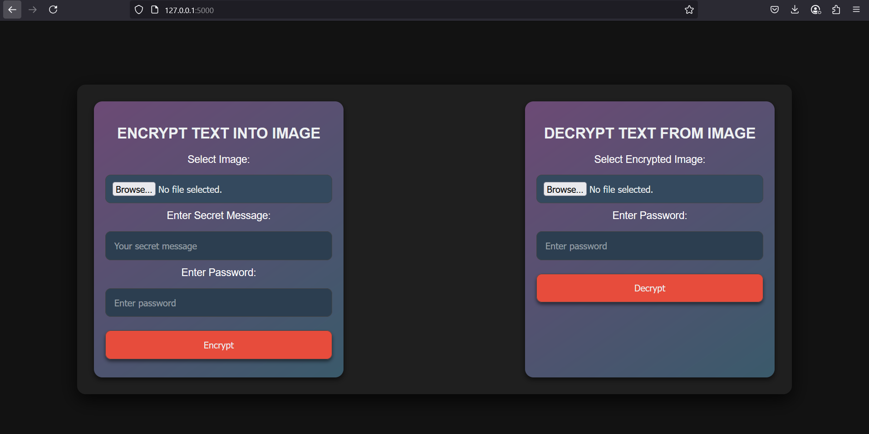
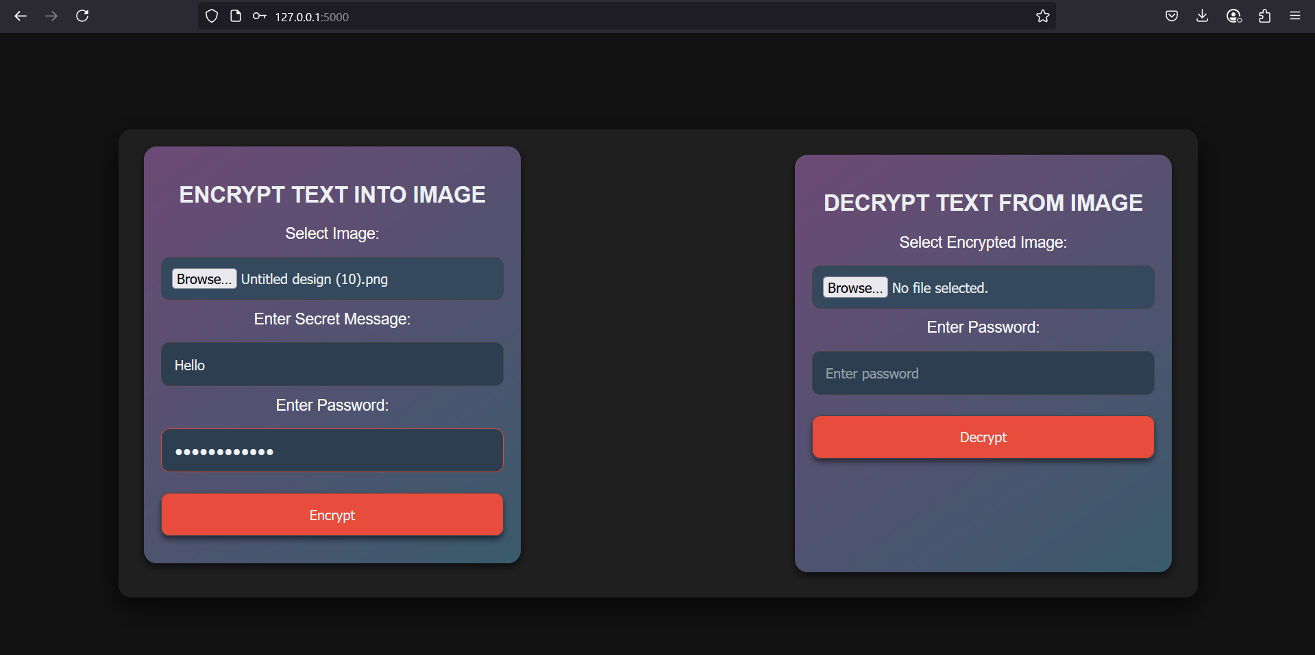
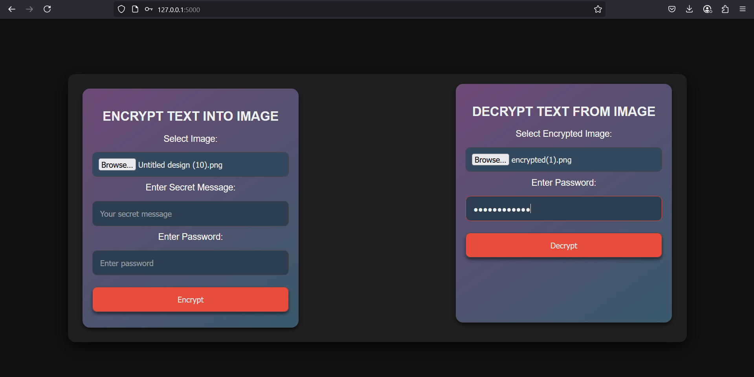
Results

Slide 8
Conclusion
In conclusion, the STEGANOGRAPHY-WEBSITE project effectively addresses the problem of securely embedding and retrieving sensitive information in a user-friendly and accessible manner. The project leverages steganography to hide text within images and ensures that the hidden data is protected by requiring a password for both encryption and decryption.
The web-based platform provides an intuitive interface, allowing users, regardless of their technical expertise, to easily encrypt and decrypt messages. The integration of image upload and real-time processing ensures a seamless experience, while the use of modern encryption techniques guarantees data privacy and security.
This project not only serves as an educational tool for those interested in cryptography and cybersecurity but also offers practical applications for individuals and professionals who need to securely share sensitive information in a covert manner.
By combining simplicity, security, and accessibility, this project fulfills the need for a reliable, easy-to-use steganography solution, allowing users to communicate securely in a digital age.

Slide 9
GitHub Link
https://github.com/gahlautabhinav/STEGANOGRAPHY-WEBSITE

Slide 10
THANK YOU

