Slide 1
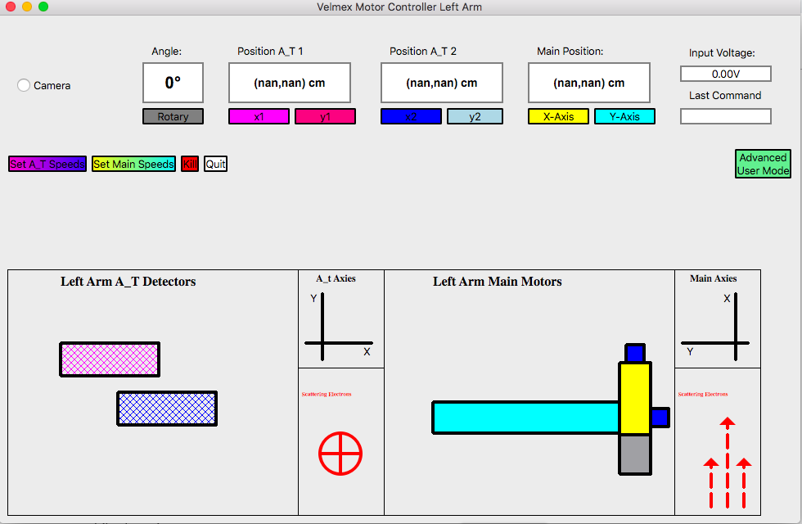
GUI

Slide 2
Position Displays
Input voltage
Angle of the Rotary Motor
X and Y positions of A_T detector motors
X and Y positions of Main motors
Last command sent to motors

Slide 3
Motor Controls
Moves specified Motor
Changes the Speed the motors move. note there are two separate buttons for the main and A_T motors respectively
Shuts of connection to motors as well as GUI. Recommend instead of using the close button
Kills the motor movement

Slide 4
Graphics
The A_T display
Only shows the detectors
Not the motors
Axis of display
Axis of display
Approx. direction of scattering electrons
Graphics are color coded to the position buttons

Slide 5
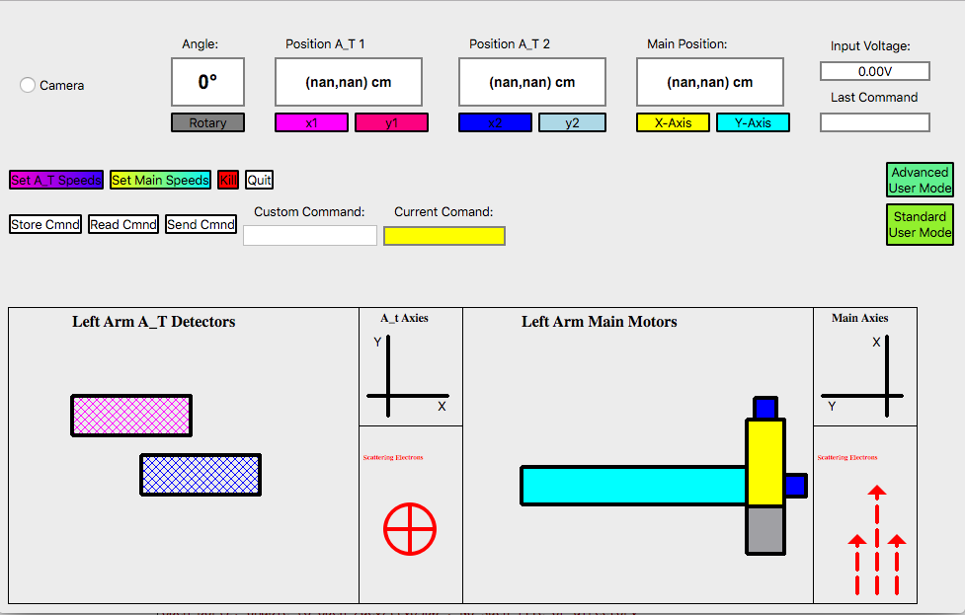
Camera
Toggle radio button and follow instructions in the readme.txt file to display camera stream
Displays current stored command
Open Adv. mode
Advanced User Mode
2. Store Command
3. Send Command
1.Type in Custom command
Back to standard mode
To send custom command follow steps 1-3 above

