Slide 1
The Use of Loaded Antennas as Scattering Relays for Post-Cellular Networks with Closely Spaced Terminals
Intermediate Presentation, Bernhard Gahr
Supervisor: Yahia Hassan
Professor: Armin Wittneben

Slide 2
Outline
Motivation
System Setup
Receiver - Overview
Impact of Coupling
Analysis of Interference
Cost Function
Gradient Search
Simulation Results
Outlook

Slide 3
Motivation/Problem Description
Future systems are expected to be characterized by
Very high density of nodes (e.g. sensor networks, coverage in stadium)
Large number of antennas
Lower frequencies
This leads to closely spaced antennas that are coupled
One of the most crucial bottlenecks is the interference
Idea is to improve achievable rates by using only passive relays and matching networks
Coupling between the relays and the receivers is used to minimize the interference.
Approach of improving the rates is gradient search.

Slide 4
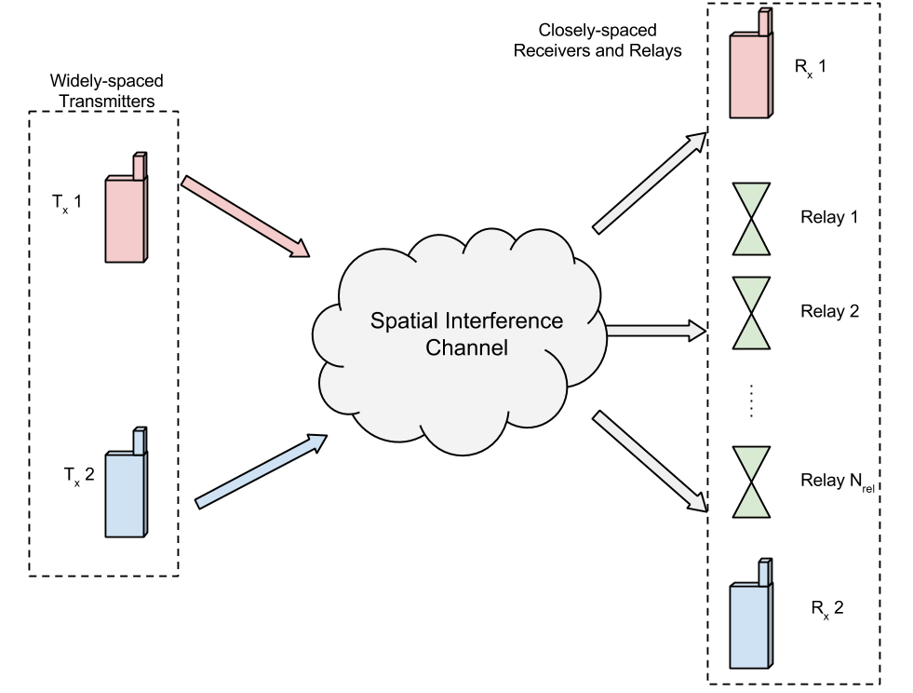
System Setup
No Coupling between the transmitters
Coupling between the relays and the receivers
Passive relays
Relays interact only by their coupling
Connection pairs
Rx1 and Tx1
Rx2 and Tx2

Slide 5
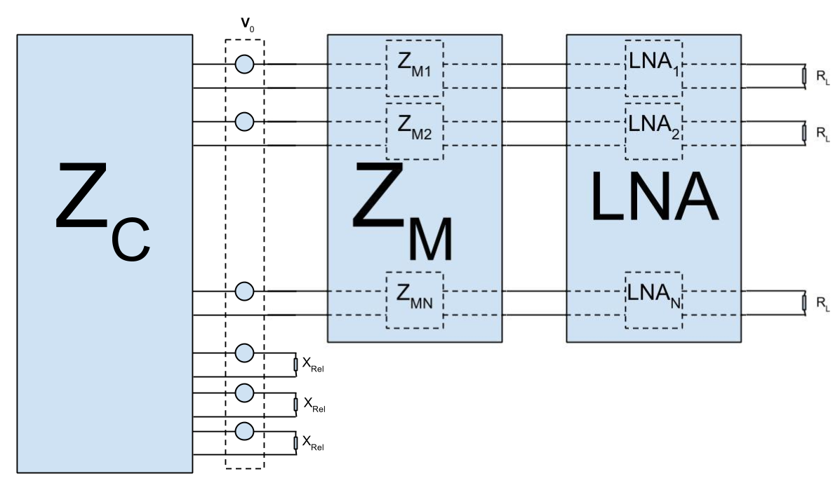
Receiver - Schematic
Coupling matrix Z_{c}
Open circuit voltages V_{o} at the antennae
Uncoupled matching network Z_{M}
Low-noise Amplifier
Further circuitry represented by R_{L}
Passive relays represented by pure imaginary X_{Rel}
4 Noise sources, in the following only one considered

Slide 6




Uncoupled Matching
Each antenna has its own matching network
No connection between the matching networks
For antenna $i$ the matching network is
$$Z_{Mi}=\left(\begin{matrix}z_{Mi11} & z_{Mi12} \\ z_{Mi12} & z_{Mi22}\end{matrix}\right)$$
Simplest way of representation is using the T network:
$$z_{Mi11}−z_{Mi12}$$
$$z_{Mi22}−z_{Mi12}$$
$$z_{Mi12}$$

Slide 7
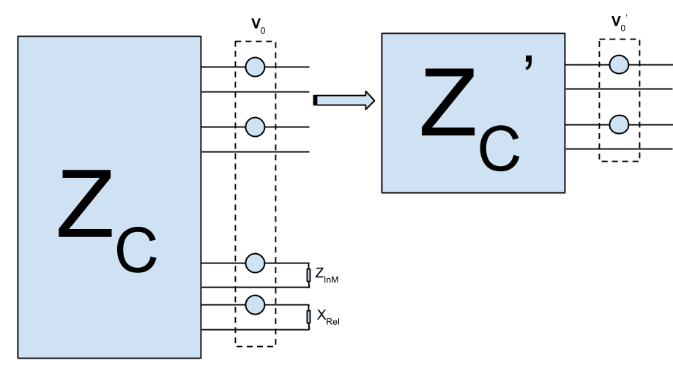

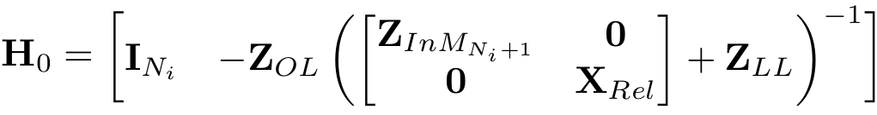
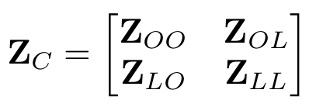
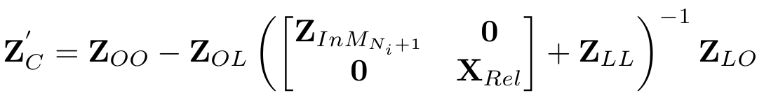
Receiver - Impact of Coupling
Find an equivalent circuit, with only the required branches
V’₀ contains the signal at the antenna and the Signal from the coupling
Z_{C’} is affected by the equivalent input impedances of the other receivers and the Antennae loads

Slide 8
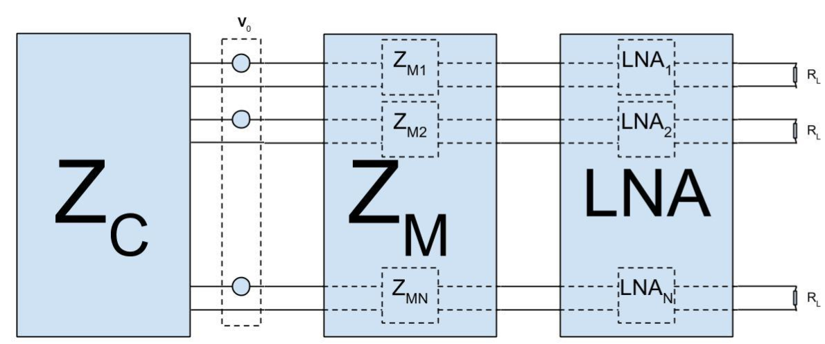

Receiver - Transfer Function
Transfer the open circuit voltages to parallel input voltages
The remaining transfer functions (H_{L,LNA} and H_{LNA,M}) are independent of X_{Rel}.
H_{L,0’}
H_{M,0’}
H_{LNA,M}
H_{L,LNA}

Slide 9
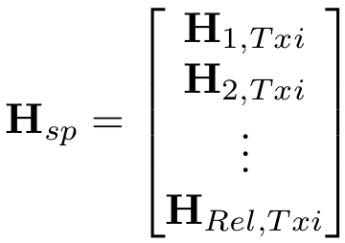
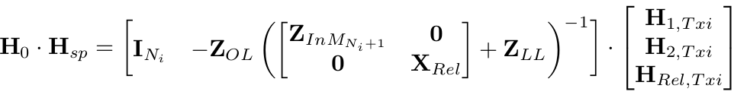
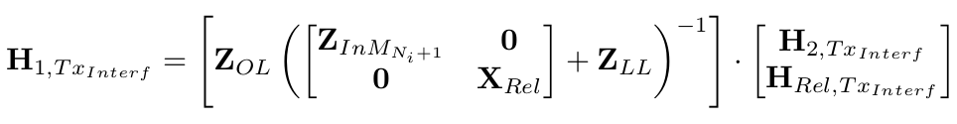
Receiver - Interference
To cancel the interference it is sufficient to look at the coupling transfer function (c.f. 6) and the spatial channel from the interferer
,and
As every later transfer function is applied as well to the signal part as to the interference part, an interference free connection is only achieved, if the following property holds

Slide 10
Receiver - Interference
To cancel the interference it is sufficient to look at the coupling transfer function (c.f. 6) and the spatial channel from the interferer
,and
As every later transfer function is applied as well to the signal part as to the interference part, an interference free connection is only achieved, if the following property holds

Slide 11


Cost Functions
User rate for user i:
Lp-Norm, in the following we look at the sum rate (p=1)
In the following, we try to maximize the cost function by gradient search

Slide 12
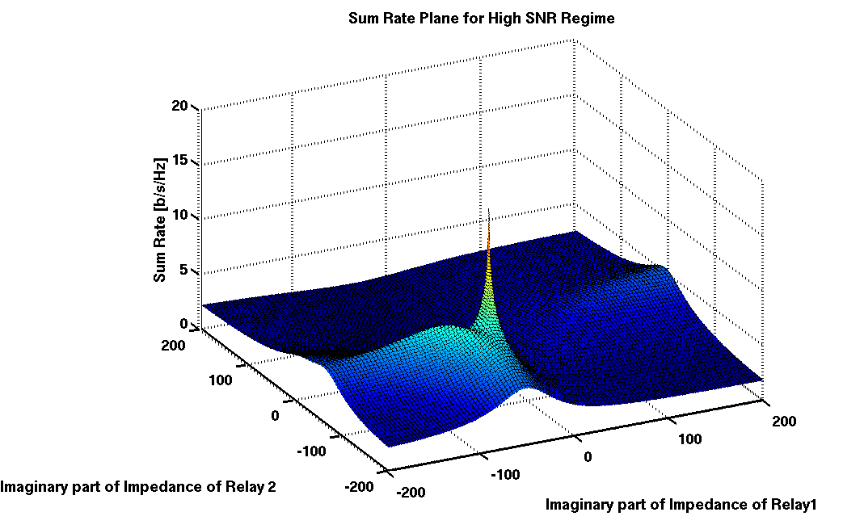
Behavior of the Function
We consider only two relays
We evaluate the sum rate
against different load values
at different input power
<Clip,Seed94>

Slide 13
Behavior of the Function
Difficulties in finding the global maximum due to
Non convex problem
Optimal value shifts for different input power
Large performance difference between local optimas

Slide 14
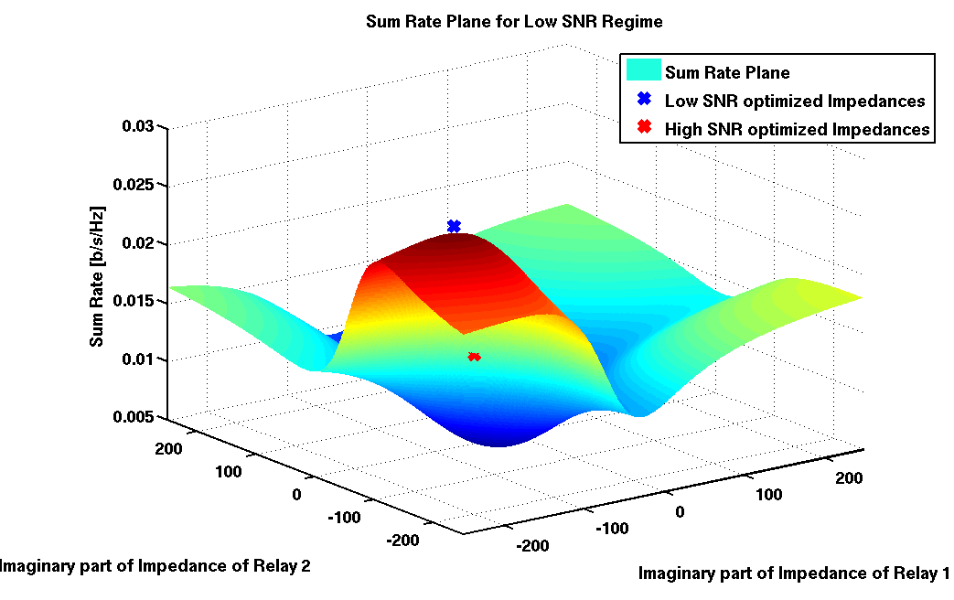
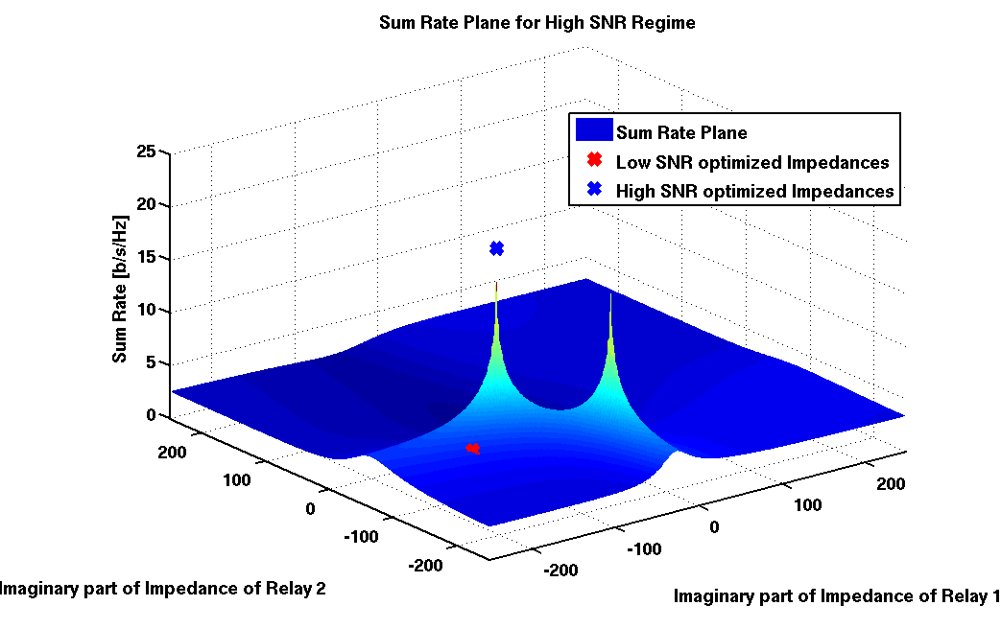
Gradient Search Optimization - Optimum Shifts
Difficulties in finding the global maximum due to
Non convex problem
Optimal value shifts for different input power
Large performance difference between local optimas

Slide 15
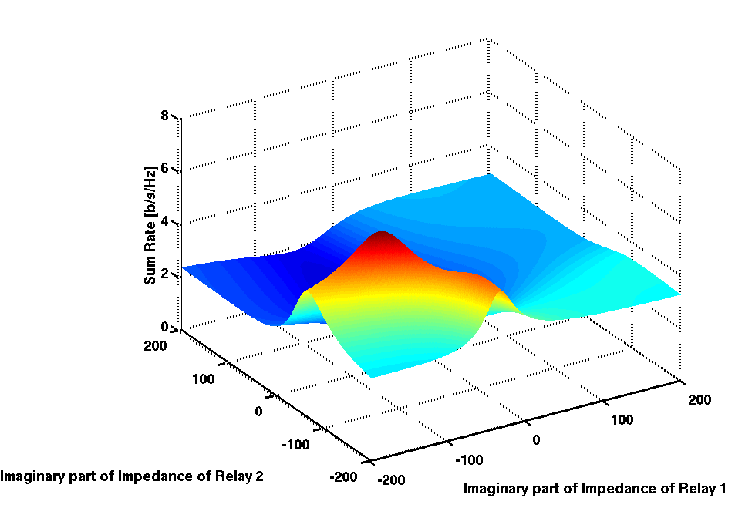
Behavior of the Function
Difficulties in finding the global maximum due to
Non convex problem
Optimal value shifts for different input power
Large performance difference between local optimas

Slide 16
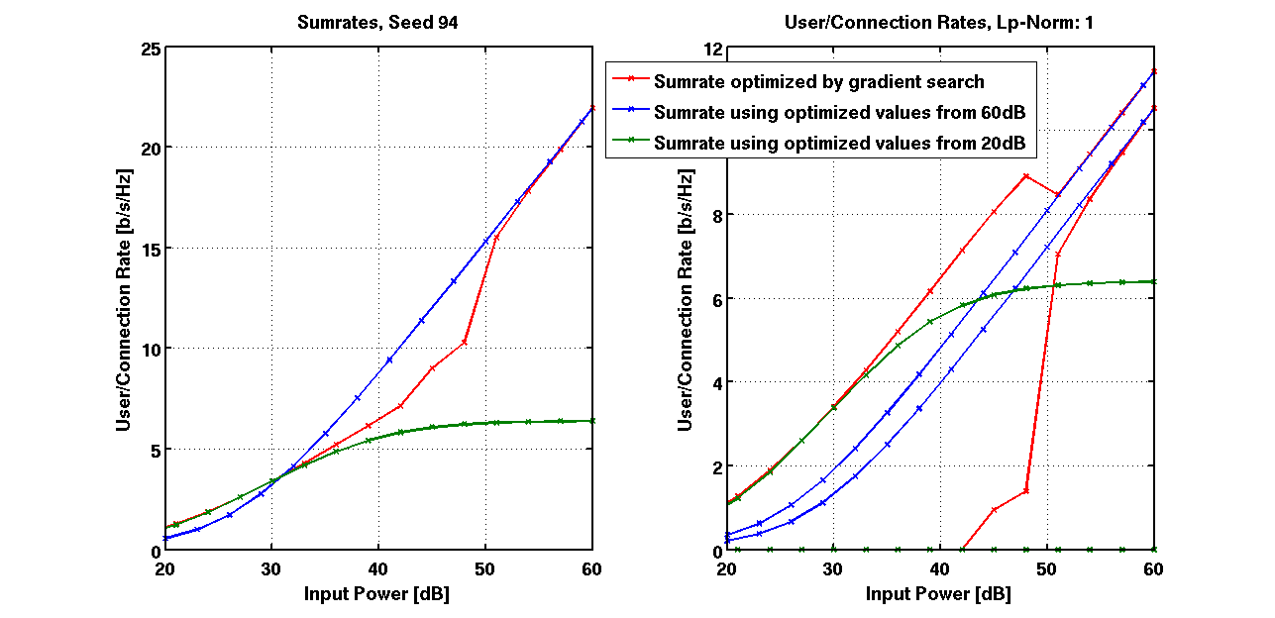
Gradient Search Optimization - Optimum Shifts
Up to 30dB: optimizing only one of the connection pair and eliminating the other leads to a better performance.
Over 30dB: gradient search runs into a local maximum - only for high SNR, the second connection is enabled.

Slide 17
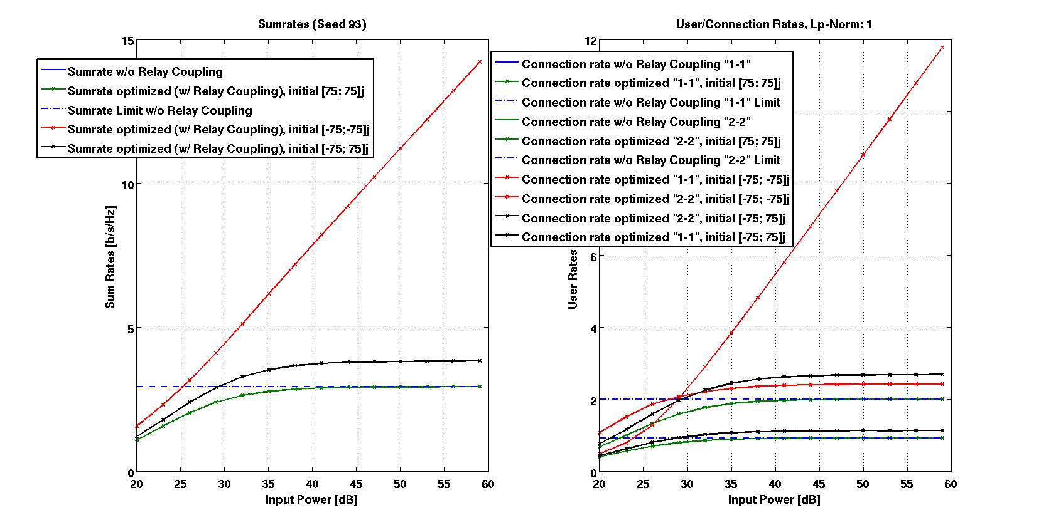
Gradient Search Optimization - Local Optimas

Slide 18
Optimization
For the gradient search, the analytical gradient was derived
The constraints we have are
The relays are pure imaginary
The submatrices of the matching network must be diagonal and pure imaginary
An adaptive step size is used for faster convergence
For correctness it was compared to
The numerical gradient
The existing method from Yahia for a point to point MIMO
The built-in function fminunc

Slide 19
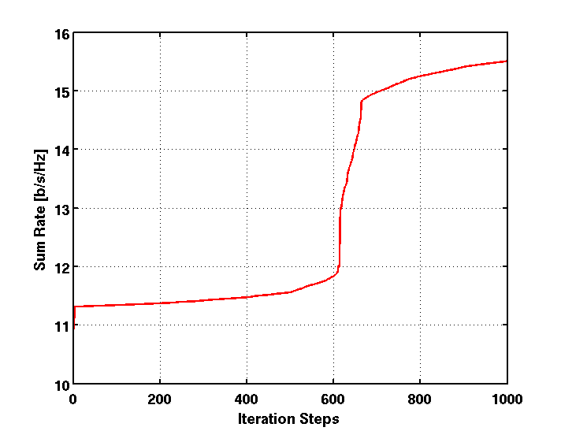
Gradient Search Optimization - Convergence
Sum rate vs gradient iteration steps
Even after 500 iterations, we may have an abrupt change in the sum rate

Slide 20
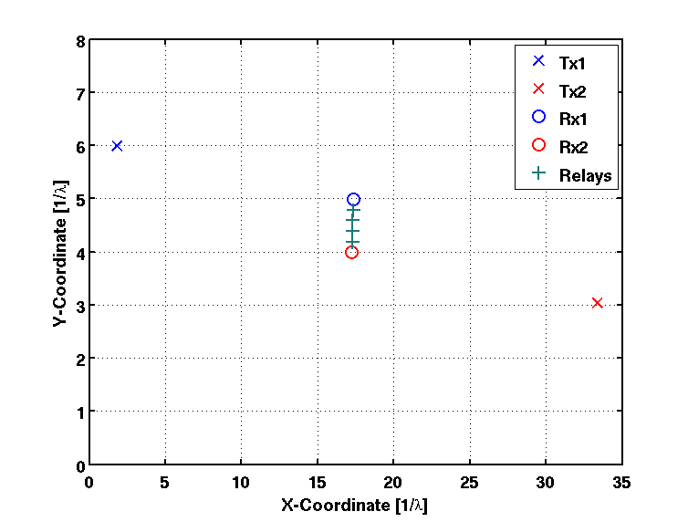
Simulation Settings
For the simulations, the following settings were used
No. of Relays: 4
No. of Tx: 2
No. of Tx antennae: 1
No. of Rx: 2
No. of Rx antennae: 1
Lp-Norm: 1
Gradient Iteration: 1500

Slide 21
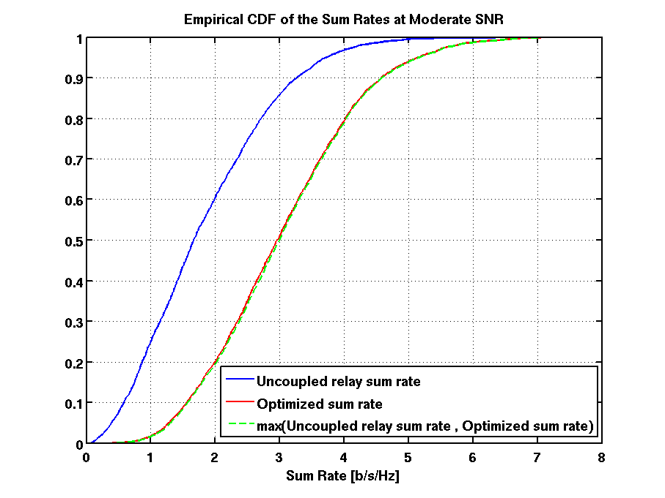
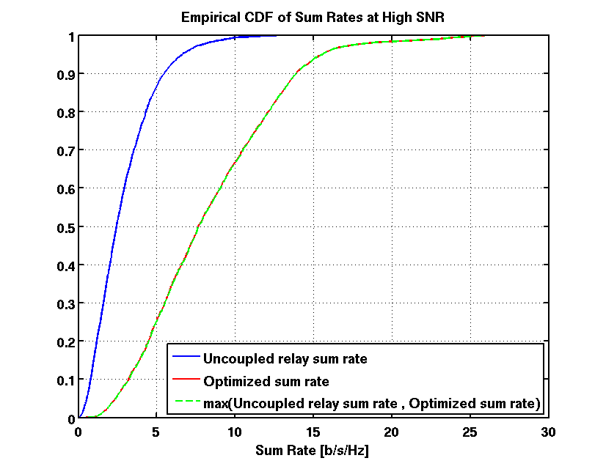
Simulation Results
Empirical CDF-Plots at different SNRs for 4030 channel realizations

Slide 22
Simulation Results
Empirical CDF-Plots at different SNRs for XX channel realizations for only two relays

Slide 23
Outlook
Simulations with
Larger number of transmit and receive antennae
Different receiver structures (LMMSE)
Larger number of relays
Larger number of connection pairs
Different precoding matrices at the transmitters

Slide 24
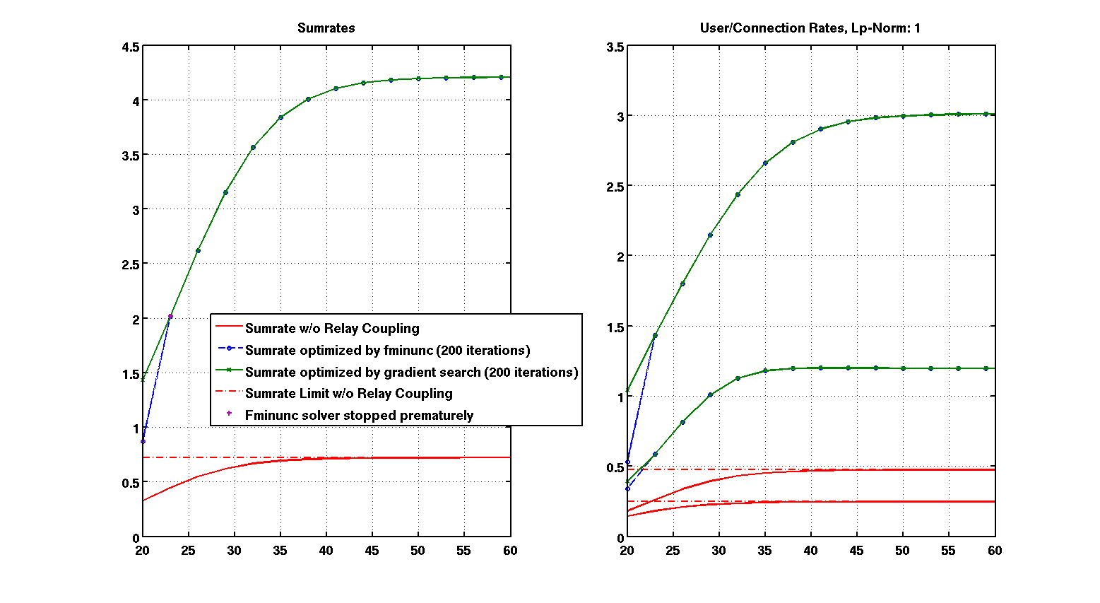
Gradient Search Optimization - Performance

