Slide 1
REPRODUCTION OF BRAIN DYNAMICS BY BOOLEAN NETWORKS.
Candidate: Gaia De Martino.
Supervisor: Giuseppe Alì.

Slide 2
CAN PHYSICS STUDY BRAIN DYNAMICS? You will find out the answer at the end of this presentation.
The brain can be considered as a complex system, an arrangement made of a great number of elements related to each other with complicated interconnections. These types of systems need to be modeled due to their complexity. These entities are made by a lot of elements, each of them is called node and pairs of them are connected to each other by a link called edge.
In this work of thesis the brain brain dynamics is studied by Boolean Networks (BNs) used in a code written in Wolfram Mathematica.

Slide 3

AN INTRODUCTION TO THE BOOLEAN NETWORKS
In 1969 Stuart Kauffman created the first model of a Boolean Network for studying genetics but, later, this technique has been improved due to allow scientists to study other types of complex systems.
A general BN consists of a triplet: a graph G, a set S of values and a function f.
-The graph can be written as G = {V, E} , where V = {v1...vn} (n stands for the number of elements v called vertices) and E = {ε1...εs} is a set containing the edges between the vertices. Each vertex can be 0n or off.
S = {0, 1}.
f is a function that follows an evolution rule f : C → C, where C represents the space of all possible configurations. The values of the states of all the nodes give the configuration C and its cardinality is equal to $2^{n}$.
There are different types of BNs, but the ones used in this simulation are the Classic Random Boolean Networks (CRBNs): the update of the states of the nodes of the network happens simultaneously for every state and this process runs until the reaching of a stable point.

Slide 4
THE THREE STEPS OF THE SIMULATION
THE FIRST STEP.
MAPPING
COGNITION.
THE SECOND STEP.
BOOLEAN NETWORK MODELING.
THE LAST STEP.
LOCAL AND GLOBAL COGNITIVE DYNAMIC ANALYSIS.

Slide 5
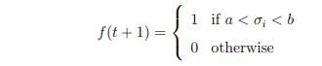
THE ANALYSIS OF THE FIRST STEP
A connectome is the mathematical representation of the brain through nodes and edges, it can be found on BrainMap.com. After the conversion of the brain areas into coordinates, it is necessary to set the initial conditions on Wolfram Mathematica. The cognitive process analyzed in this work is “Action-Execution” that, like every process, at a time t=0 has some areas that are active and some areas that stay “turned off”. The active ones are set equal to 1, the non-active ones are set equal to 0. Defined as σi =(s1i (t) + … +s 1k (t)) the sum of the states in a neighbour (the set of all nodes), the updating function will be:

Slide 6
THE ANALYSIS OF THE FIRST STEP
Before the beginning of the simulation, it is important to give the last definitions:
X is a correlation threshold related to the connection matrix (it’s a matrix that shows the connections between the various Broadmann areas) whose values, below x, will be set equal to 0 and, above it, will be set equal to 1. Single nodes will exhibit dynamics that can be correlated with the dynamics of other nodes.
Z is another threshold useful for identifying which dynamics have correlations above this value and, consequently, discovering which nodes are correlated with each other.
a and b are parameters that go from 1 to 13 because, after this value, the system converges to a configuration for which all states go to zero.

Slide 7
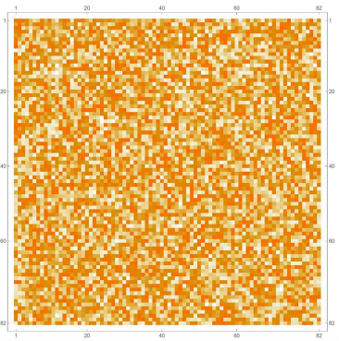

THE ANALYSIS OF THE FIRST STEP

Slide 8
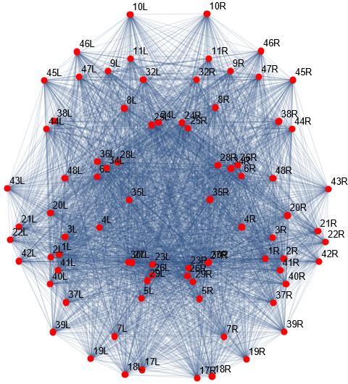
THE ANALYSIS OF THE FIRST STEP

Slide 9
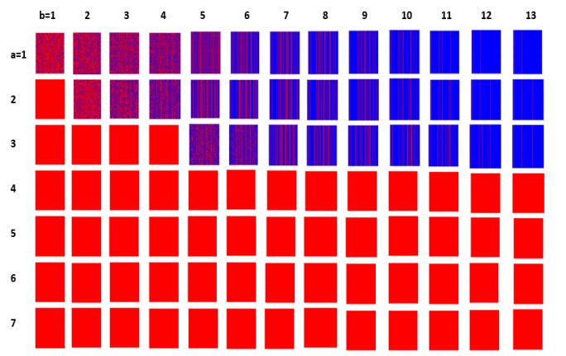
THE ANALYSIS OF THE SECOND STEP
The simulation starts running and the behaviour of the network can be seen. Varying a and b, this is the result (red means off and blue means on):

Slide 10
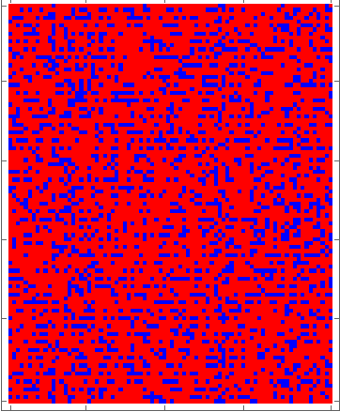
THE ANALYSIS OF THE SECOND STEP
a=1 and b=1.

Slide 11
THE ANALYSIS OF THE SECOND STEP
As you can see in the previous picture, the behaviour of the system starts in a chaotic way and it ends with a stable configuration. Now it’s possible to do the most important thing of the whole simulation: the extraction of the brain circuits and the analysis of this result.

Slide 12
THE ANALYSIS OF THE LAST STEP
After an amount of simulations, we found out that the most interesting one has z=0.9 and x=0.88 because of its behaviour. After the last step, only certain areas remain on and they are involved in new brain circuits. The following table shows our results:

Slide 13
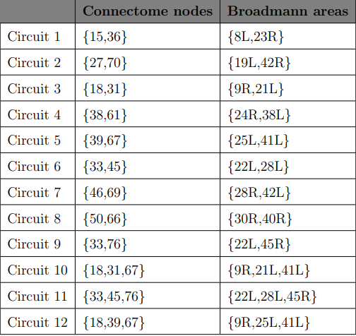
THE ANALYSIS OF THE LAST STEP

Slide 14
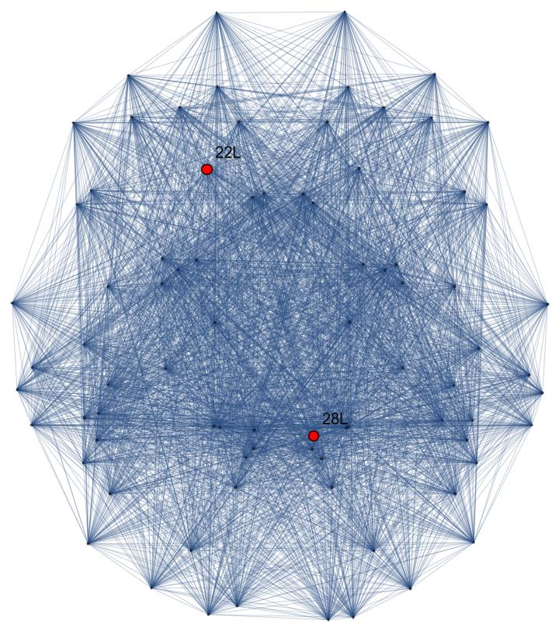
THE ANALYSIS OF THE LAST STEP
An example of the graph of one of the extracted circuits. This is the sixth.

Slide 15
THE ANALYSIS OF THE LAST STEP
The first circuit is made by a correlation between the Broadmann areas called 8L and the 23R. The first one has an important role in controlling visual and eye movements. The other one’s function is receive the olfactory sensory stimulus. The second circuit is made by 19L and 42R and the functions of these areas are the following:
• 19L it is one of the visual cortices and is involved in the creation of images.
• 42R works with the perception of sound.
The third circuit is made by an area (9R) involved in strategic processes in memory recovery and another area involved in contemplating at a distance, the recognition of familiar faces, and the recognition of the meaning of words while reading.
The 4th circuit is made by a brain area that is particularly active in an individual subject to stress or in paranoid individuals. The other area of the circuit it is the most rostral part of the superior and middle temporal gyri in which specific sound frequencies are perceived.

Slide 16
THE ANALYSIS OF THE LAST STEP
Both areas of the sixth circuit have connections to vast regions of the cerebral cortex and have functions related to sound processing. The 7th circuit is composed (again) by two areas involved in sound processing. The region called 30R, which makes up the eighth circuit, presides over the coordination between sensitive affections and emotional elaborations. The other region, 40R, is part of the somatosensory associative cortex, which interprets tactile sensory data and is involved in the perception of the position of spaces and limbs. The 8th circuit presides over the coordination between sensitive affections and emotional elaborations. The ninth circuit is composed of regions employed in linguistic comprehension and expression and in the elaboration of higher psychic activities. Circuit 10 is formed by areas that have the function of recognition: they are the regions of the brain that recognize the familiar faces, the meaning of words during reading and the sounds.

Slide 17
THE ANALYSIS OF THE LAST STEP
Circuit 11 consists of three nodes corresponding to three different regions: the first one deals with the motor activity of the body, the second with hearing and the last with the elaboration and understanding of language. The last one is a very interesting circuit, since it is composed of regions involved in strategy creation, planning, emotion control, attention, concentration, impulse self-control and other such functions. The second of these regions is also involved in the transport of seratonin.

Slide 18
THE ANALYSIS OF THE LAST STEP
Are these results believable? The answer is yes but, due to a big semplification of the system, they are not completely reliable. Despite the first critics of the biologists about BNs, scientists from all parts of the world realized that these represent an idealized Boolean abstraction model of many networks studied in biology that captures some important aspects of real biologic world. Ian Stewart, a scientist, said: ”It is not useful to criticize these models on the grounds of what they leave out: the test is what they predict, and how well it fits the appropriate aspects of reality.”

Slide 19
THE END.

