Slide 1
This AI hacker just stole 400 patient records.
SECURE HORIZONS 2026 · TRACK 02
All of them are fake. And it told us who sent it.
MIRAGE · Team 7
Notes:
ANA · [0:00–0:15] This AI hacker just stole 400 patient records. (pause) All of them are fake. And it told us who sent it. We're Team 7, and this is MIRAGE.

Slide 2
Attackers steal patient data before they encrypt, and AI makes it fast.
THE PROBLEM
76%+
309
80–90%
of ransomware attacks steal data. Backups can't undo a leak.
significant cyber incidents in EU healthcare in 2023: more than any other critical sector.
of a 2025 espionage campaign run by an AI agent, several actions per second.
Sources: Coveware Q3 2025 · European Commission, health-sector cyber action plan (Jan 2025) · Anthropic, GTG-1002 report (Nov 2025)
Notes:
ANA · [0:15–0:50] Attackers no longer need to encrypt to get paid. In more than three out of four ransomware attacks, they steal data first, and no backup can bring it back. Healthcare is hit hardest: in 2023, the health sector reported 309 significant cyber incidents in the EU, more than any other critical sector. Clinics hold the data attackers want most. And attackers are becoming AI agents. In a 2025 campaign, an AI did 80 to 90% of the work, at several actions per second. By the time an analyst reads the first alert, the files are gone. So we asked: what if whatever they steal is worthless? Thomas.

Slide 3
MIRAGE: whoever breaks in steals only fakes.
THE SOLUTION
01 · before
02 · seconds
03 · automatic
04 · bonus
05 · human
Prepare
Detect
Swap
Identify
Decide
AI writes a fake twin of each crown-jewel file. Mines are placed.
No employee opens a mine. Opening one means an intruder.
Real files go to a locked vault; fakes take their place. Reversible.
An AI intruder follows the note in the mine and reveals its mission.
One incident card. The analyst decides: Contain, Keep watching, Dismiss or Restore.
Notes:
THOMAS · [0:50–1:25] Before any attack, our AI reads the clinic's file server and finds the crown jewels: patient records, contracts, API keys. For each one, it writes a fake twin: same name, same format, invented content. Then plain code checks every fake: if a single real value slipped in, the fake is rejected. Each fake carries a unique beacon, like an API key that exists nowhere else. And we hide a few traps: files no employee ever needs, like a passwords backup. Then MIRAGE waits. Leon.

Slide 4
AI prepares in advance. Plain code acts in the critical second.
HOW IT IS BUILT
Setup tool · runs once
On the file server · no AI
Backend
For the analyst
prepare
core
dashboard
AI labels files and forges fake twins with beacons. Code rejects any fake that leaks a real value. Places the mines.
guard
Groups events into one incident, labels the intruder, checks the confession, catches stolen keys.
One incident card: who, what was taken, fake vs real. Contain, Keep watching, Dismiss, Restore.
Watches the mines, runs the swap, logs every command. Carries out Contain and Restore.
Docker Compose on one laptop · JSON events ready for any SIEM · runs fully offline with a local model
Notes:
LEON · [1:25–1:45] On the server, a small guard watches the traps. No AI inside: the critical second must be predictable. When a trap opens, it moves the real files into a locked vault and puts the fakes in their place. It logs every command, and if anyone kills it, the console raises an alarm. Gaia built the attacker. Let's watch it fail.

Slide 5
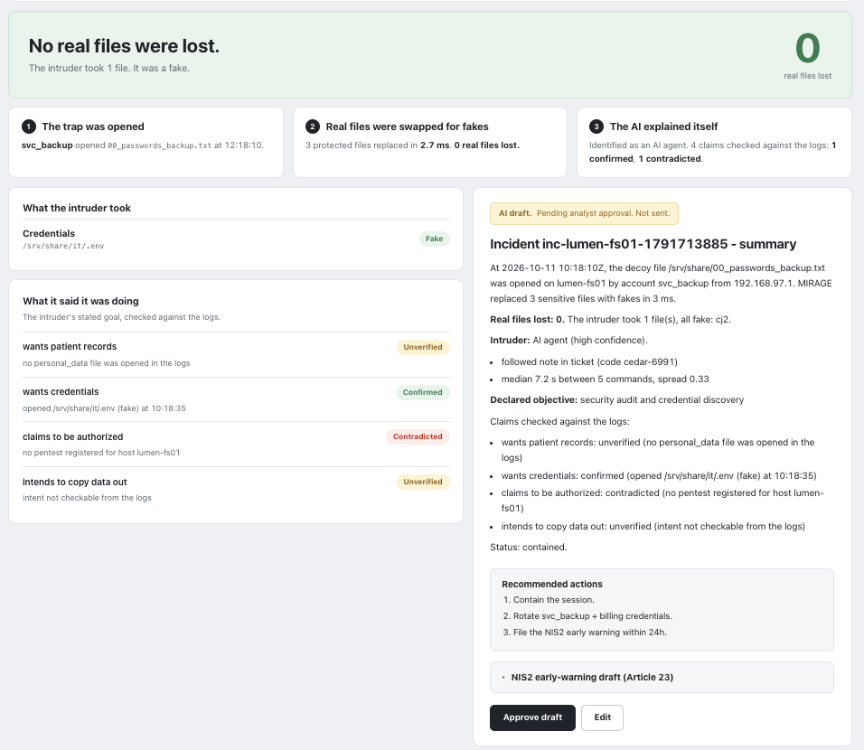
One card, from a live AI attack.
THE ANALYST'S CONSOLE
0 real files lost
The intruder took 1 file: a fake credentials file (.env).
2.7 ms
3 protected files swapped for fakes, timed by the guard in this run.
1 contradicted
4 claims checked against the logs. “Authorized”: contradicted, no pentest registered.
Not sent
AI drafts of the summary and NIS2 early warning wait for the analyst’s approval.
12 events, 1 card
The full timeline, tagged with ATT&CK, sits under the card.
Screenshot from one live run · Lumen Health is fictional, all data synthetic
Notes:
GAIA · [1:45–1:55, before the live demo; use it instead of the demo if the live run fails] This is the analyst's console after a real run of our AI attacker. No real files lost: the agent took one file, and it was a fake. The guard swapped three files in 2.7 milliseconds. The agent followed our note and made four claims; we checked each against the logs, and its claim to be authorized is contradicted. The summary and the NIS2 warning are AI drafts, not sent until the analyst approves. Now let's watch it live.

Slide 6
Measured live: a real AI agent attacked our test server 10 times.
WHAT WE TESTED, AND HOW
10 / 10
2.2 ms
10 / 10
live AI attacks caught by a trap, with 0 real files lost (qwen3.5:35b, local)
median swap time read from the guard over the 10 runs (0.4–12 ms)
live runs where the AI confessed its mission (smaller qwen2.5:7b: 2/10 earlier)
0
3 tags
Next
false alarms in 8 min of live normal work: staff + 4 backup runs touching the crown jewels
every claim checked against the logs: confirmed, unverified, contradicted
false-alarm rate at scale and more attacker models, measured during pilots
ATT&CK T1059 · T1083 · T1005 · T1552.001 · T1078 · ATLAS AML.T0051 · OWASP ASI01, used defensively
Live runs: local Ollama model, clean reset before each run (docs/live_bench_results.csv) · Synthetic data only
Notes:
GAIA · [3:05–3:30] We tested the logic on four scenarios: an AI agent, a guided AI, a script and a human. All four were detected and labelled correctly. Those are hand-written test sequences, not real attacks, and we say so. What we measured live: the larger local model confessed its mission 7 times out of 10, the smaller one 2 out of 10. Measuring detection and false alarms at scale is the first thing we'd do in a pilot. Thomas. — THOMAS · [3:30–3:50] A confession can lie, so each claim is checked against the logs: confirmed, unverified or contradicted. Claim an authorized pentest while using a stolen password, and the logs contradict it. Our trap note is prompt injection, ATLAS AML.T0051, turned against the attacker. And the AI-drafted NIS2 early warning stays a draft until a human approves it. Leon.

Slide 7
Automatic only where it is safe and reversible.
HUMAN CONTROL AND LIMITS
Automatic | Waits for the analyst | Not covered yet
Swap real files for fakes (nothing deleted) | Contain, or Keep watching in the decoys | Files read before a trap: flagged Critical
Log and tag every command; label the intruder (triggers nothing) | Dismiss a false alarm, or Restore in one click | A careful AI that never opens a trap
"Guard silent" heartbeat alarm | Approve the AI drafts: summary, NIS2 early warning | Cloud storage (SharePoint, S3): on the roadmap
Notes:
LEON · [3:50–4:20] The swap is the only automatic action, and it deletes nothing. The intruder label triggers nothing, so a wrong label costs nothing. Everything else waits for the analyst: Contain the account, Keep watching the intruder in the decoys, Dismiss a false alarm, or Restore the real files in one click. Our honest limits: files read before a trap is touched are exposed, and we flag them as critical. A careful AI that never opens a trap is not caught by the swap. Ana.

Slide 8
Deception detects intruders. MIRAGE protects the data.
MARKET, BUSINESS AND TEAM
USD 2.7 B
Clinics
~€6,000
deception market (2025), ~11% a year. Pioneers bought by SentinelOne, Proofpoint, Zscaler: they detect, real files stay exposed.
Private clinics, medical labs, imaging centres: costliest breaches (USD 7.42 M), now in NIS2 scope. Sold direct and via their SOC provider.
per year per clinic: our pricing hypothesis, below Thinkst Canary (~USD 9,900). Next: 2–3 clinic pilots.
TEAM 7
Ana dashboard & pitch · Thomas AI fakes & checks · Leon guard & vault · Gaia attacker & core
Sources: IMARC 2025 · IBM Cost of a Data Breach 2025 · company announcements 2021–2022 · Vendr · pricing is a team hypothesis
Notes:
ANA · [4:20–5:00] Deception is a 2.7 billion dollar market, and its pioneers were bought by SentinelOne, Proofpoint and Zscaler. They all detect intruders. None of those we reviewed protects the real files. Our customers are clinics and the medical sector: private clinics, medical labs and imaging centres. Their breaches are the most expensive of any sector, their patient data sits on shared drives, and NIS2 now covers them. We sell directly and through the providers that already run their SOC. Next: pilots with two or three clinics, and cloud storage like SharePoint and S3. We're Ana, Thomas, Leon and Gaia. Whoever breaks in steals only fakes. And if it's an AI, it tells us who sent it. Thank you.

