Slide 1
CLIENT PROJECT PRESENTATION
FOR GAIADHI
BY TEAM 6

Slide 2

MEET THE TEAM
Visrutha Balashanmugam
Leo Police
Prachi Mahajan
Ragavi Kannaiyan
Juanita Jayabalan
Prerna Anegundi
Parita Pankajbhai Bharadiya

Slide 3
ABOUT THE PROJECT

Slide 4

PROJECT DESCRIPTION
Holos uses NASA Power API to obtain current and historical weather at any latitude and longitude.
While NASA Power is very flexible, we have been informed it is not localized and may also vary seasonally with localized observation
GOAL: Goal is to (unless/until other higher accuracy sources are identified) use NASA Power as it is API driven and has data at any point.

Slide 5

PROJECT OBJECTIVES
Benchmarking Weather Data Accuracy Using Anchor Points: Calculate the base error using anchor points in simulations to establish a reference for comparing the accuracy of alternative models.
Localizing NASA Data using ML: Utilize IMD data as anchor points to localize NASA data, employing machine learning algorithms to predict and adjust NASA data for specific geographical regions
Utilize machine learning to predict future temperature and rainfall, aiding in strategic crop selection decisions​

Slide 6
DATA COLLECTION &
PREPROCESSING

Slide 7
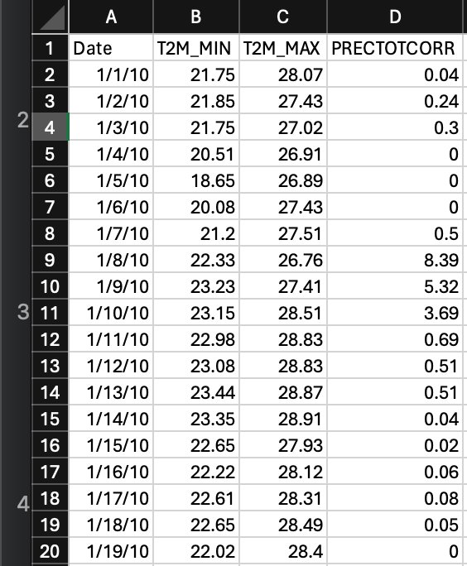
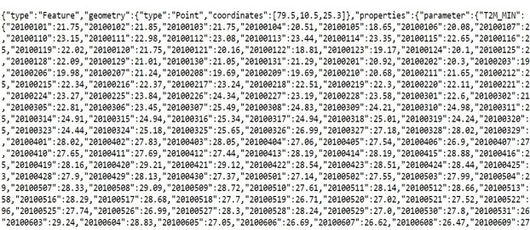
ABOUT THE DATA - NASA
API CALL
Converted JSON into excel​
https://power.larc.nasa.gov/api/temporal/daily/point?start={start_date}&end={end_date}&latitude={lat}&longitude={lon}&community=ag&parameters=T2M_MIN%2CT2M_MAX%2CPRECTOTCORR&format=json&header=true&time-standard=lst
Outcome from the API CALL (JSON)

Slide 8
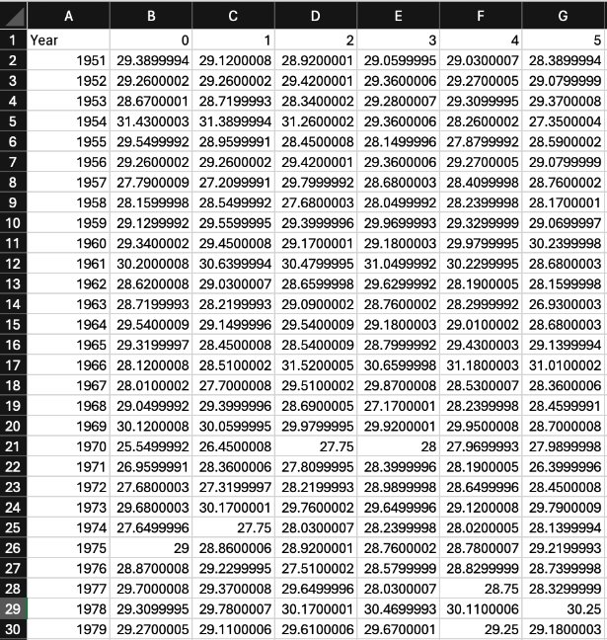
ABOUT THE DATA - IMD
STEPS
Retrieving data from .nc files​
​Converted them into excel
Sample example,
This data is from year 1951 till 2010, for one anchor point (10.5,79.5) for 365 days in each row.

Slide 9
TEMPORAL DATA ANALYSIS TRANSITION
From Time series to Panel Data
Initial Data Structure
Transition to Panel Data
Improved Model Accuracy
Single geographic point data (10.5, 79.5)​
One dimension time series data​
Limitation: Insufficient for complex analysis
Multiple reference points over years​
Time series for multiple anchor points​
Benefit: Comprehensive spatial-temporal analysis
Broader assessment across locations and time​
Application of advanced learning techniques​
Enhanced pattern recognition and predictive power

Slide 10
EXPLORATORY DATA ANALYSIS (EDA)

Slide 11
TMIN

Slide 12
TMAX

Slide 13
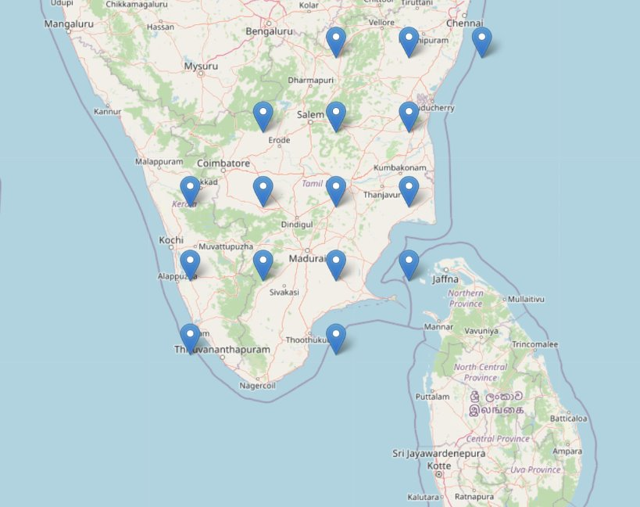
LATITUDE & LONGITUDE POINTS COVERED
8.5, 76.5​ 9.5, 76.5​ 10.5, 76.5​ 8.5, 78.5​ 9.5, 77.5​ 10.5, 77.5​ 11.5, 77.5​ 9.5, 78.5​ | 10.5, 78.5​ 11.5, 78.5​ 9.5, 79.5​ 10.5, 79.5​ 12.5, 78.5​ 12.5, 79.5​ 12.5, 80.5​ 11.5, 79.5​

Slide 14
MODELS AND RESULTS
(BEFORE SEASONALITY COMPONENT)

Slide 15
TMIN MODEL METRICS
Model​ | Mean Squared Error (MSE)​ | Mean Absolute Error (MAE)​ | R-Squared​
Benchmark​ | 11.00497​ | 2.6295501​ | ​
Ridge​ | 3.99737​ | 1.69302​ | 0.40053​
Linear Regression​ | 3.70138​ | 1.58902​ | 0.380053​
Lasso​ | 4.61636​ | 1.75913​ | 0.226802​
SVM​ | 3.74383​ | 1.60143​ | 0.472943​

Slide 16
TMIN MODEL COMPARISON

Slide 17
TMAX MODEL METRICS
Model​ | Mean Squared Error (MSE)​ | Mean Absolute Error (MAE)​ | R-Squared​
Benchmark​ | 10.978653​ | 2.3964127​ | ​
Ridge​ | 7.38148​ | 2.19886​ | 0.141186​
Linear Regression​ | 7.25142​ | 2.25456​ | 0.139186​
Lasso​ | 8.18803​ | 2.69795 | 0.0280014​
SVM​ | 7.25299​ | 2.29209​ | 0.1429​

Slide 18
TMAX MODEL COMPARISON

Slide 19
INCORPORATING SEASONALITY

Slide 20
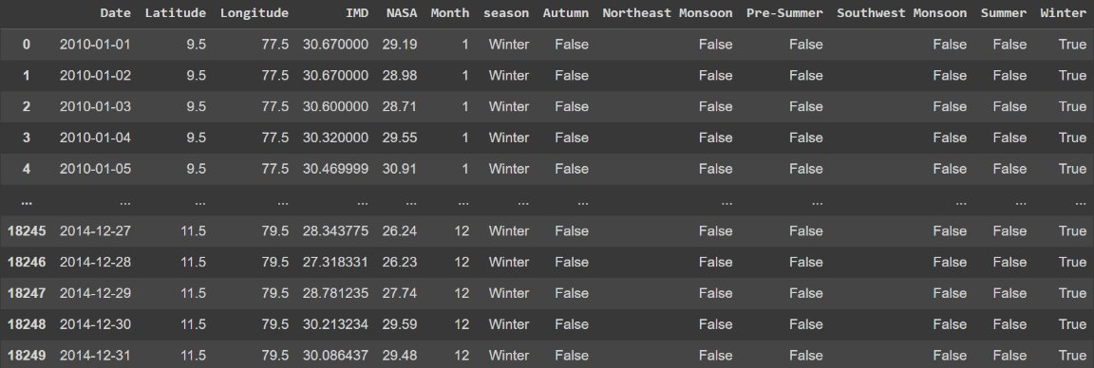
SEASONS CONSIDERED
Autumn, Northeast Monsoon, Pre-Summer, Southwest Monsoon, Summer and Winter

Slide 21
TMIN MODEL METRICS
Model​ | Mean Squared Error | Mean Absolute Error | R-Squared​
Linear Regression​ | 3.36087​ | 1.4525​ | 0.57614​
Ridge​ | 3.36098​ | 1.452504​ | 0.576142​
Lasso​ | 4.62725​ | 1.72639​ | 0.416433​
SVM​ | 3.41084​ | 1.43817​ | 0.56984​
Benchmark | 8.38806 | 2.44042

Slide 22
TMAX MODEL METRICS
Model​ | Mean Squared Error | Mean Absolute Error | R-Squared​
Benchmark​ | 9.32402 | 2.3201 | ​
Linear Regression​ | 3.36087​ | 1.4525​ | 0.57614​
Ridge​ | 3.36097​ | 1.4525​ | 0.57614​
Lasso​ | 4.62725​ | 1.72639​ | 0.41643​
SVM​ | 3.41084​ | 1.43817​ | 0.56984​

Slide 25
PROJECT
IMPLEMENTATION

Slide 26
BEST MODEL
Utilized Linear Regression for modeling both minimum and maximum temperatures.
Evaluated model performance using key metrics: MAE, MSE, and R2.
Achieved satisfactory results indicating the effectiveness of linear regression for capturing the relationship between variables.
Consistency in model performance observed across both temperature ranges.
Linear Regression Evaluation:
Minimum Temperature:
  Mean Absolute Error (MAE): 3.36087
  Mean Squared Error (MSE): 1.4525
  R-squared (R2): 0.57614
Maximum Temperature:
  Mean Absolute Error (MAE): 3.36087
  Mean Squared Error (MSE): 1.4525
  R-squared (R2): 0.57614

Slide 27
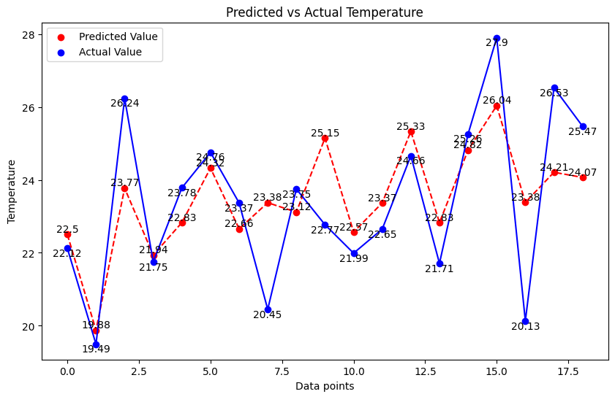
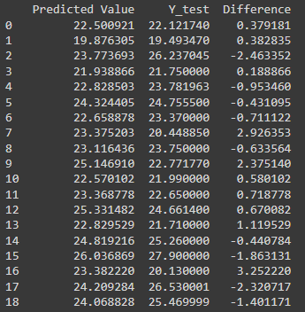
LINEAR REGRESSION RESULTS

Slide 28
RISKS AND MITIGATION
Handling Large Volume of Panel Data
Overfitting and Model Complexity
Increased computational costs
Data Quality Issues
Scalability Issues
Bias and Fairness

Slide 29
FUTURE SCOPE

Slide 30

Location Based Effect​
Incorporating location-based effects.
Making use of geographical coordinates.​
Determining how temperature varies with anchor points of different latitude and longitude.

Slide 31

Utilize all Anchor Points​
Limited by availability of processing power
Make use of all available anchor points.
Utilized increased processing capabilities​.

Slide 32

Convolutional Neural Network (CNN)​
Advantages:​
  Ability to Model Non-linear Relationships​
  Scalability and Performance with Large Datasets​
  Flexibility and Customization​

Slide 33
CONCLUSION

