Slide 1
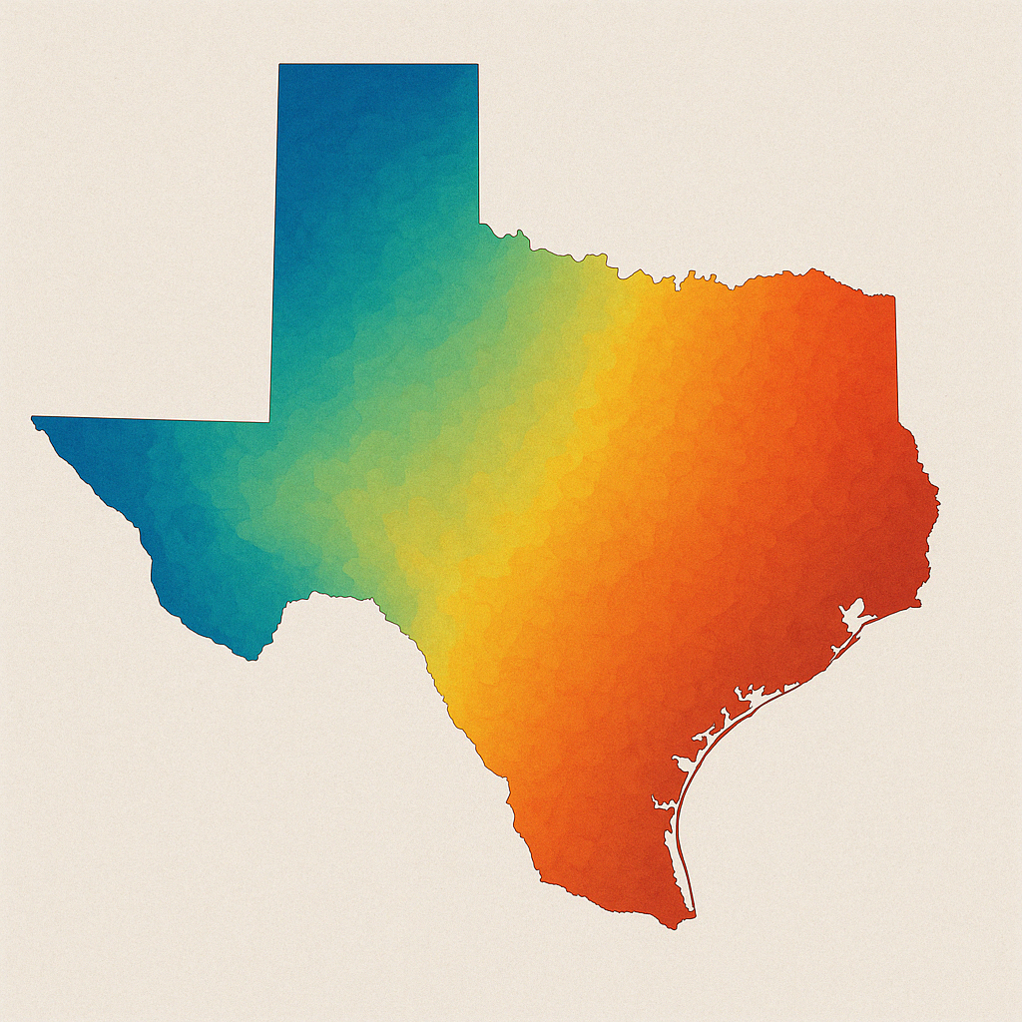


Temporal Prediction of Weather (Temperature)
Capstone Project Final Presentation
Team-3
Abhishek Basnet
Jayaram Amgoth
Naveenkumar Sellappan
Sushmitha Ashok Ugle
Venkat Sai Reddy Tipparthi
Yuvarekha Mahendran
GaiaDhi

Slide 2


Introduction
GaiaDhi – an agro-based startup company. They have a Crop Modeling as a Service (CMaaS) platform named Holos.
Holos executes crop simulation models (CSMs). Holos platform combines machine learning and crop science to optimize crop yields and promote sustainable farming practices, offering tailored solutions for farmers across various regions and crop varieties.
We need to predict the local weather condition based on (NOAA) Ground station data fused with other required information from NASA data in USA.

Slide 3


Objectives
Accurate weather prediction is critical for agriculture, disaster management, and resource planning.
Primary Objective:
To build a ML model that accurately predicts Temperature based on Local Ground Station data. Evaluate temporal prediction efficacy for 7 days and then to 14 days max.
Secondary Objective:
Check available AI-driven weather forecasting Process based ML models such as Google GraphCast, Meteomatics, IBM Environmental Intelligence Suite and give detailed information about the Integration feasibility, Tenure, Cost and computational requirements.

Slide 4
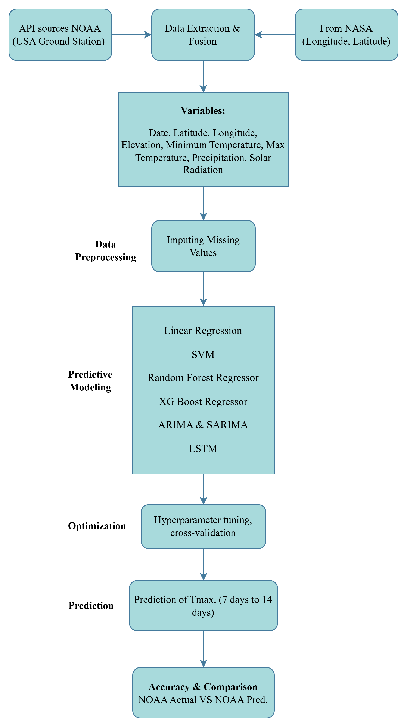
Project Framework

Slide 5
Data Collection
We will use meteorological data from two primary sources:
1) NOAA (Provided by GaiaDhi for 8 counties in Texas)
https://www.noaa.gov/
2) NASA Power API :
https://power.larc.nasa.gov/api/temporal/daily/point?parameters=PRECTOTCORR&community=ag&longitude={longitude}&latitude={latitude}&start={start}&end={end}&format=JSON
Our dataset spans from January 1, 2015, to February 2, 2025. The dataset includes the following variables:
STATION – Unique identifier for each weather station.
NAME – Location of the station.
LATITUDE, LONGITUDE, ELEVATION – Geographical attributes of the station.
DATE – Date of recorded weather observations.
PRCP (Precipitation) – Daily recorded precipitation (in inches).
TMAX (Maximum Temperature) – Highest temperature recorded for the day (in °F).
TMIN (Minimum Temperature) – Lowest temperature recorded for the day (in °F).
RADN (Solar Radiation)- Solar energy received at the station (W/m²) or (MJ/m²).

Slide 6
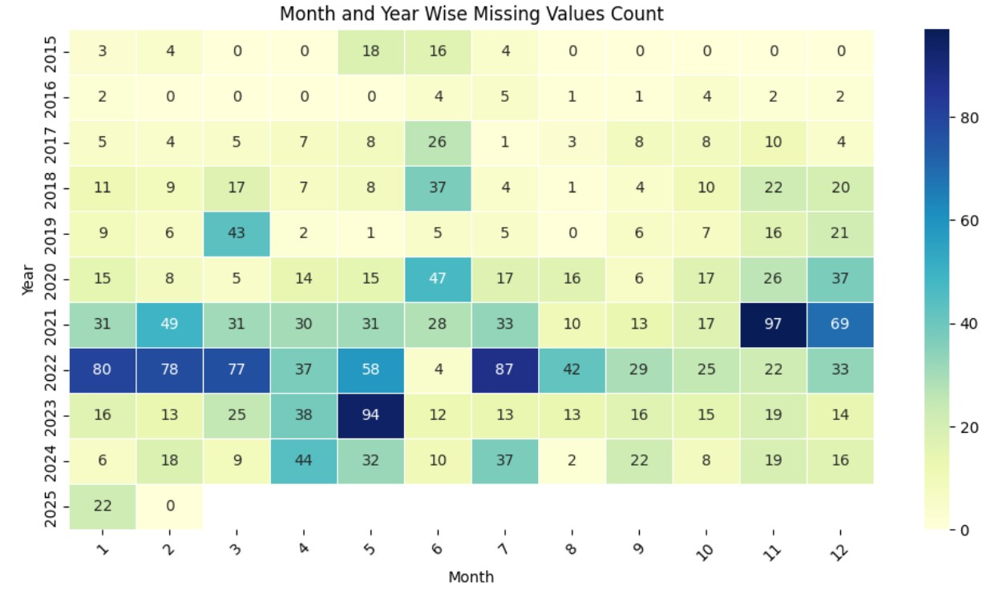
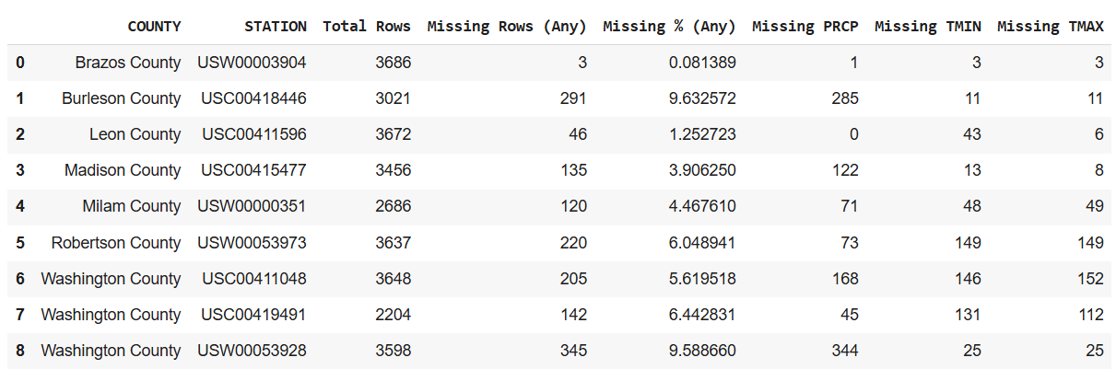
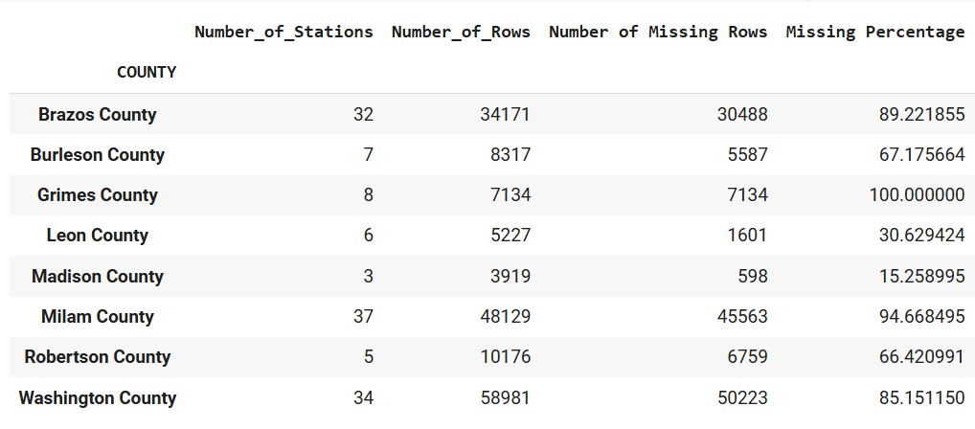
Data Insights
Row Labels | Count of TMIN | Count of TMAX | Total Rows
Brazos County | 3683 | 3683 | 34171
Burleson County | 3010 | 3010 | 8317
Grimes County | 0 | 0 | 7134
Leon County | 3629 | 3666 | 5227
Madison County | 3443 | 3448 | 3919
Milam County | 2638 | 2637 | 48129
Robertson County | 3488 | 3488 | 10176
Washington County | 9148 | 9161 | 58981
Grand Total | 29039 | 29093 | 176054

Slide 7
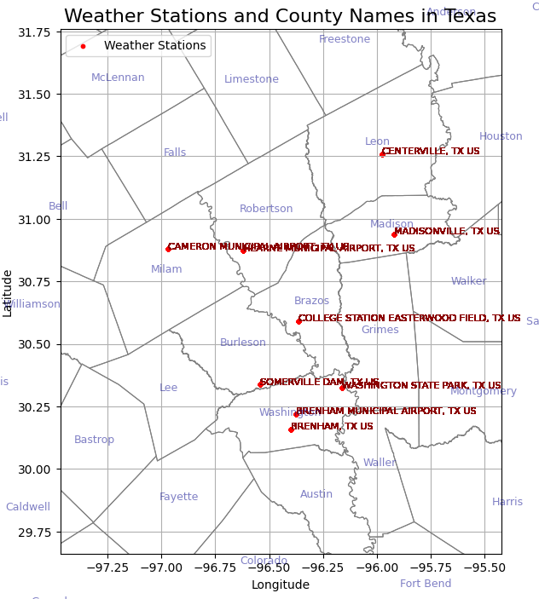
Data Insights Cntd….

Slide 8

Data Preprocessing
Missing Values Identified:
PRCP: 1109, TMAX: 515, TMIN: 569
Imputation Techniques:
🔹 K-Nearest Neighbors (KNN) imputation– Mean of 3 nearest values.
Bias Detection & Mitigation(Initial work):
✔ Demographic Parity Check – Ensures balanced distributions over time
✔ Disparate Impact Analysis – Detects seasonal imbalances
✔ Correlation Analysis – Verifies imputed values do not distort trends
Data Fusion
NOAA Data Sufficiency: The NOAA dataset alone is sufficient for developing a temperature forecasting model for a 7- to 14-day period.
Value of Additional Variables: Although not essential, incorporating solar radiation and precipitation data can significantly improve model accuracy.
Enhanced Predictive Power: These additional variables help capture seasonality, trends, and correlations, thereby enhancing the model's generalization capabilities.
Data Fusion: To achieve this, solar radiation data was sourced from NASA based on location and merged with the NOAA dataset to create a consolidated dataset for model development

Slide 9
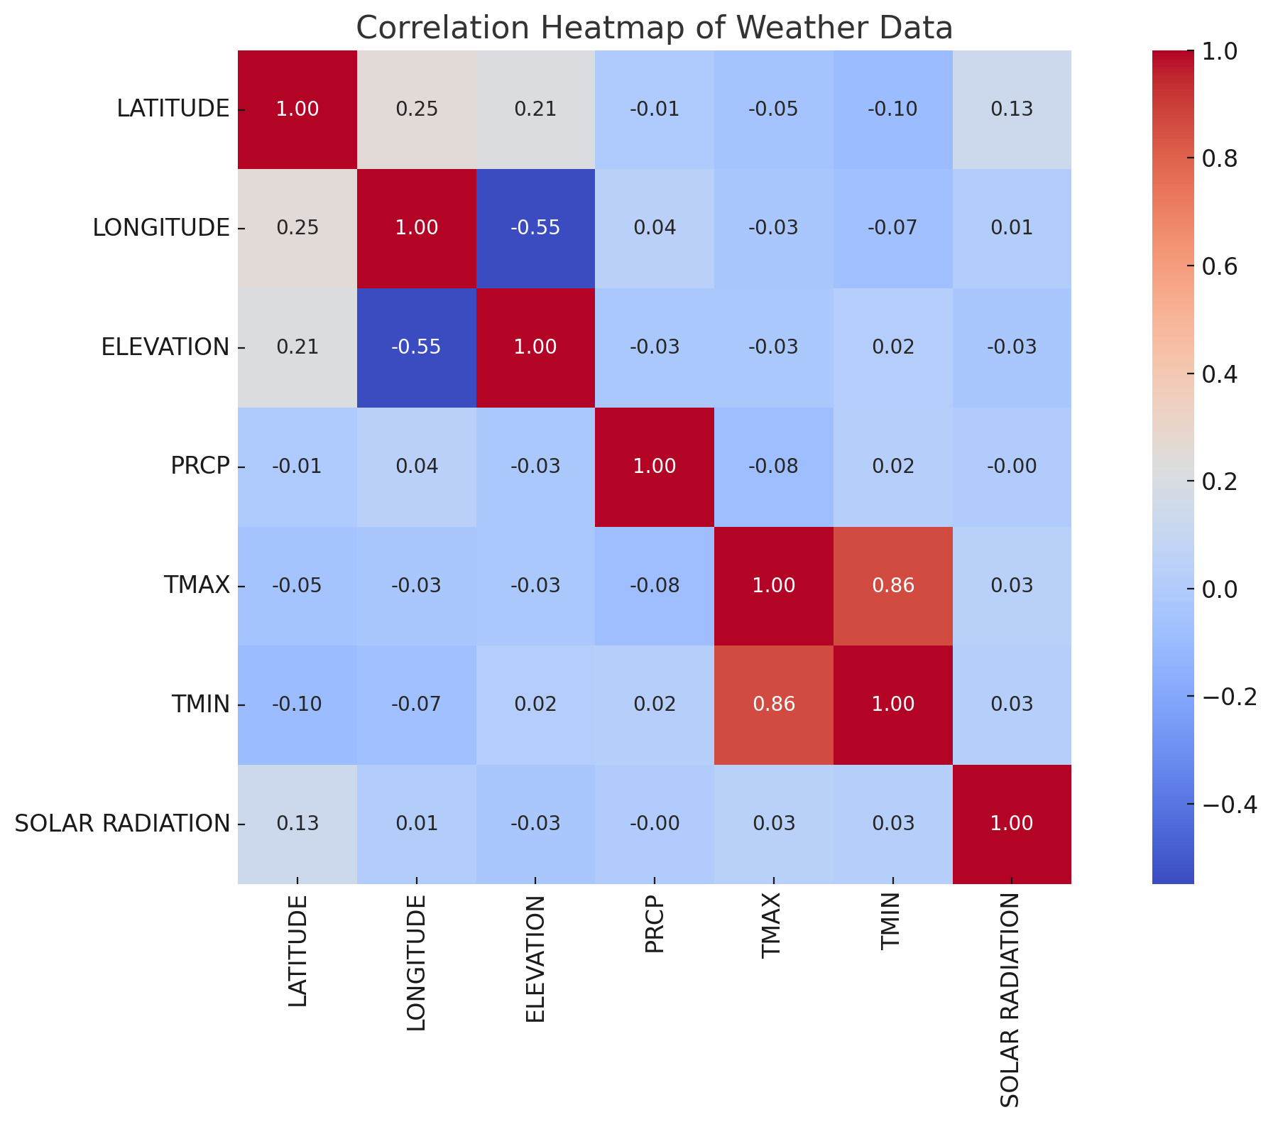
EDA

Slide 10


Approach
Start with single Station in Washington County
Find out the Best Model which gives Maximum Accuracy
Use it to predict for other Stations.

Slide 11

Models & Hyperparameter Tuning
1) Models:
Random Forest Regressor, XG Boost Regressor, ARIMA, SARIMA, Linear Regression, SVM, LSTM
2) Hyperparameter Tuning:
Random Forest Regression-Used RandomizedSearch CV with parameters like n_estimators with range 100, 500,50, Max depth like 5,10,15, Min_samples_split like 2,5,10 and cv=3 with different iterations.
XG Boost Regression-Used RandomizedSearch CV with parameters like n_estimators with range 100,200,300, Max depth like 3,5,7, learning_rate=0.01,0.05,0.1, subsample=0.7,0.9,1.0, colsample_bytree=0.7,0.9,1.0 and cv=3 with different iterations.
ARIMA,SARIMA-Tried different models with initial model as (1,1,1)
Linear Regression-Used RandomizedSearch CV with parameters like fit_intercept, positive, copy_X with number of iterations as 10,cv=3, random_state=42, verbose=1, n_jobs=-1
SVM-Used RandomizedSearch CV with parameters like ’C’:1,10, ‘gamma’:’scale’,0.1, ‘kernel’:rbf with number of iterations as 4,cv=3, random_state=42, verbose=1, n_jobs=-1
LSTM-64 units, Activation functions like 'relu','linear',Kernel Initializer like 'he_normal','adam' optimizer, '0.001' as Learning Rate, Number of epochs as '100’
3) Evaluation Metrics:
Mean Squared Error, R-Squared, Mean Absolute Error, Root Mean Squared Error
STATION PICKED: USC00411048 - BRENHAM, TX US

Slide 12
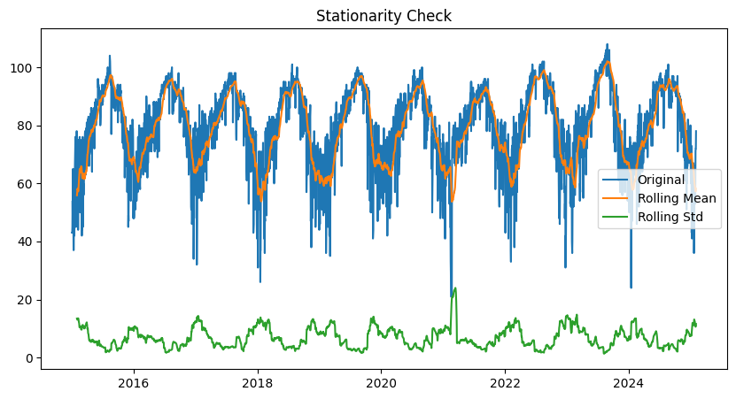
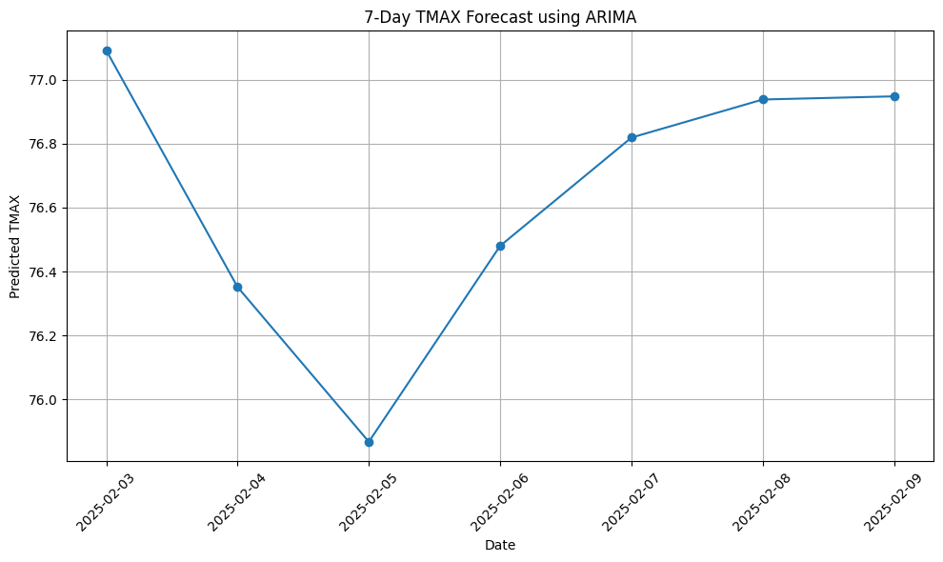
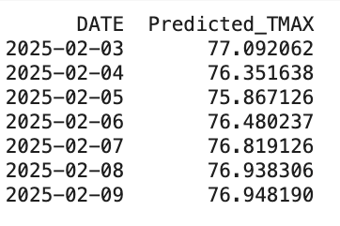
ARIMA
80/10/10 split
arima_orders = [
(1, 1, 0),(1, 1, 1),(2, 1, 2),
(0, 1, 1),(2, 1, 0),(1, 0, 1),
(1, 0, 0),(1, 1, 4),(1, 1, 6),
(2, 1, 4),(2, 1, 6),(3, 1, 3),
(4, 0, 0)]

Slide 13
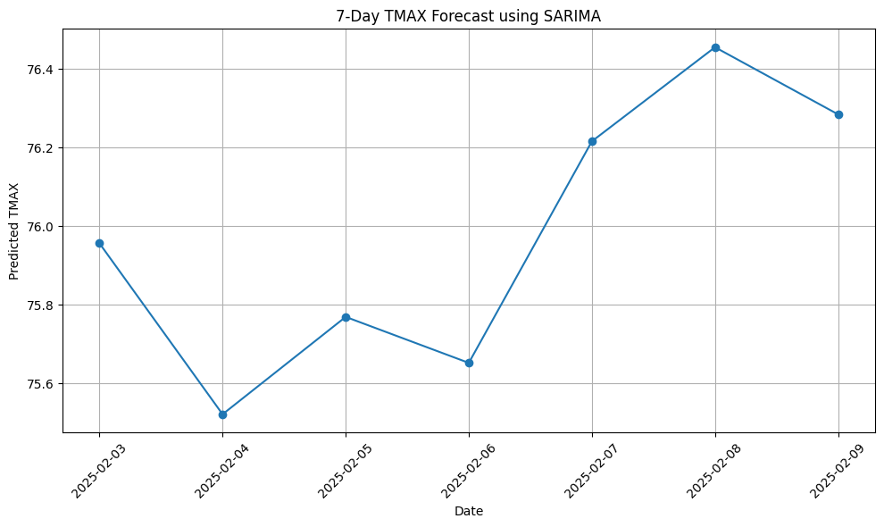
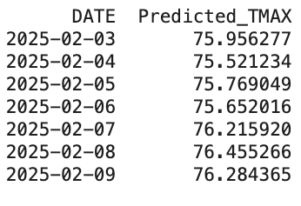
SARIMA
sarima_orders = [
((0,1,1), (0,1,1,26)),
((1,1,1), (1,1,1,26)),
((2,1,2), (1,1,1,26)),
((1,1,1), (0,0,0,26)),
((4,0,0), (0,1,0,26))]

Slide 14
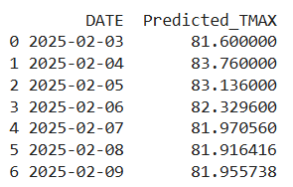


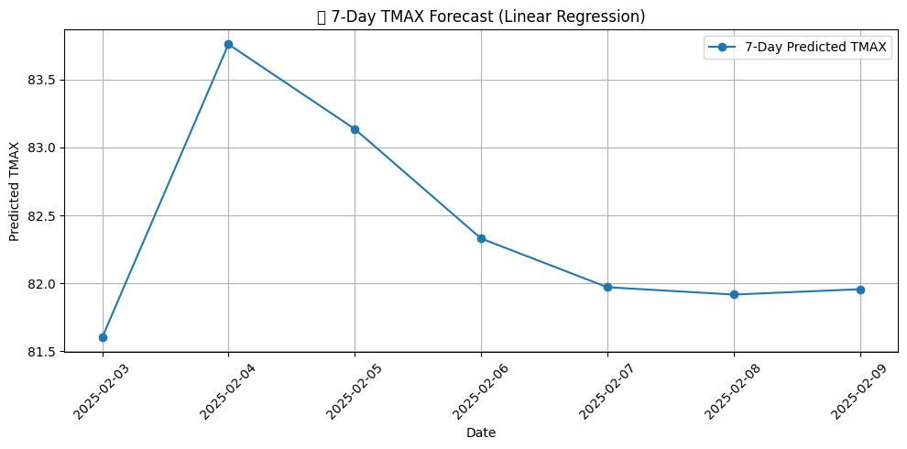
Linear Regression
Linear Regression-Used RandomizedSearch CV with parameters like fit_intercept, positive, copy_X with number of iterations as 10,cv=3, random_state=42, verbose=1, n_jobs=-1

Slide 15
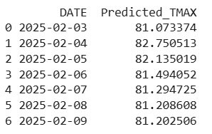


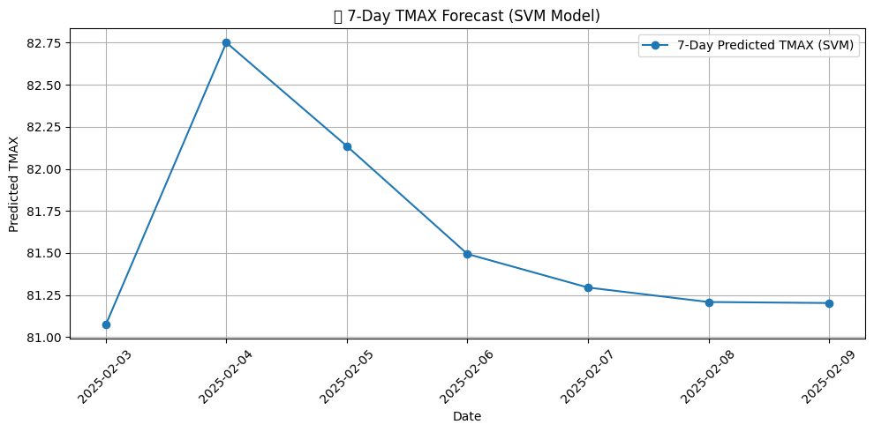
SVM
SVM-Used RandomizedSearch CV with parameters like ’C’:1,10, ‘gamma’:’scale’,0.1, ‘kernel’:rbf with number of iterations as 4,cv=3, random_state=42, verbose=1, n_jobs=-1

Slide 16
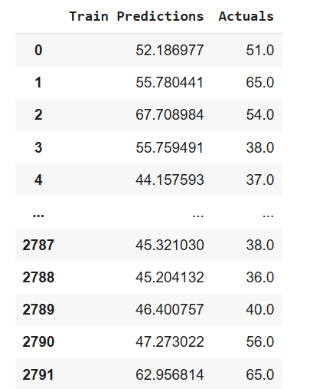
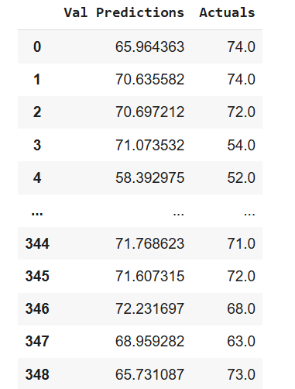
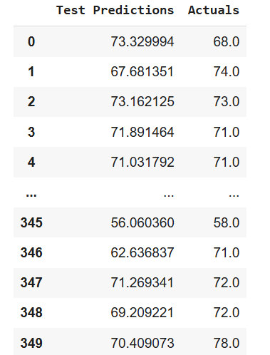
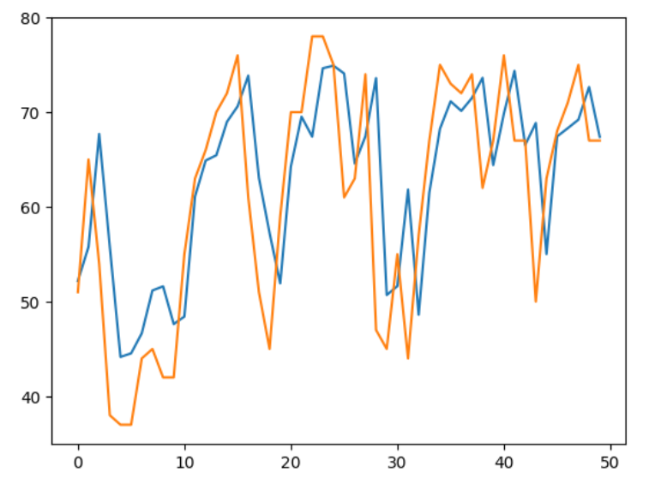
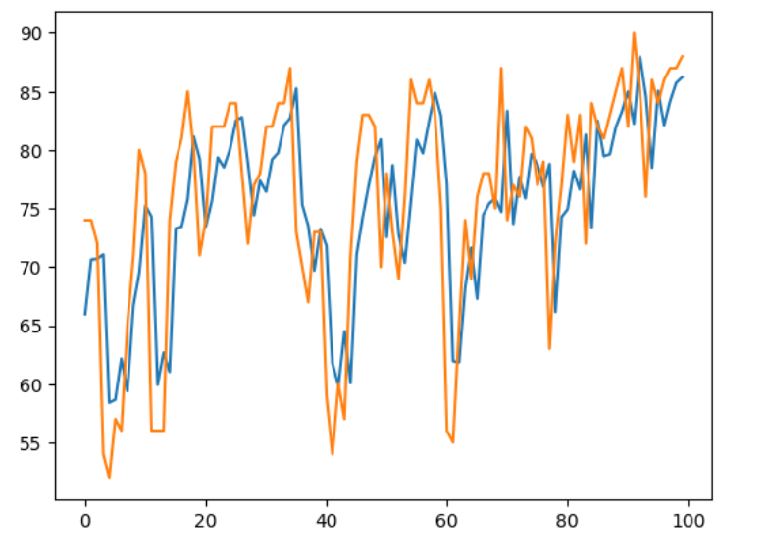
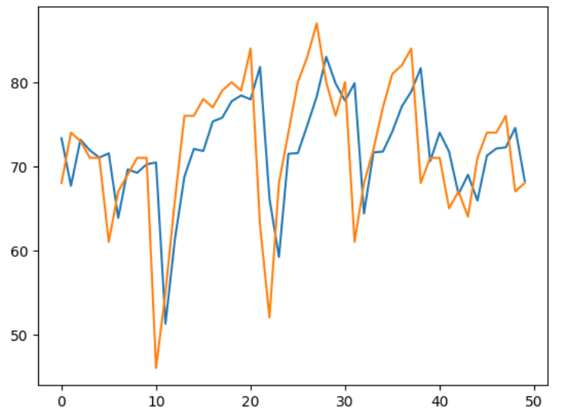
LSTM
LSTM-64 units, Activation functions like 'relu','linear',Kernel Initializer like 'he_normal','adam' optimizer, '0.001' as Learning Rate, Number of epochs as '100’

Slide 17
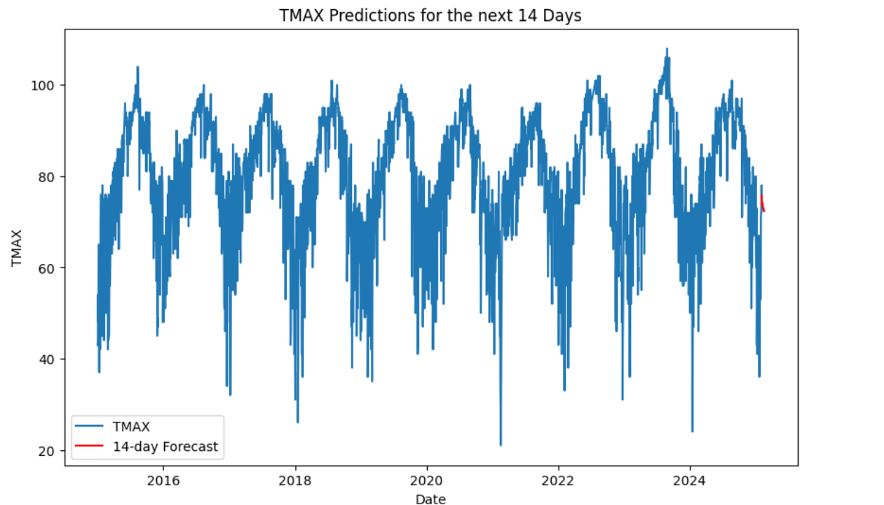
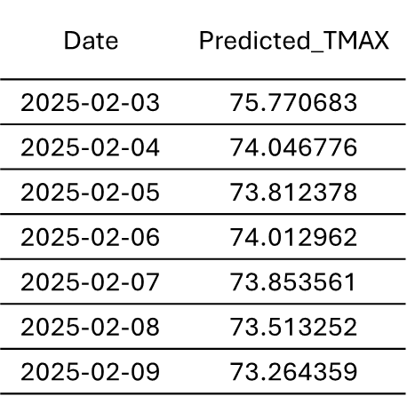

LSTM Contd..

Slide 18
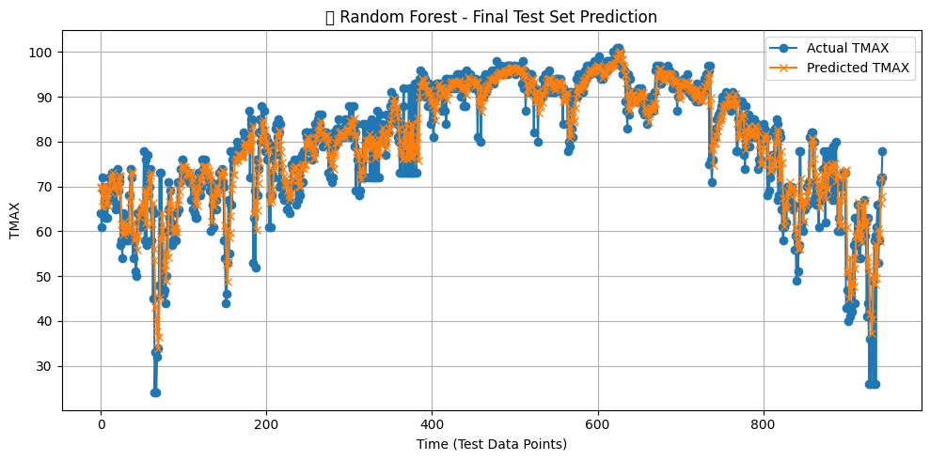
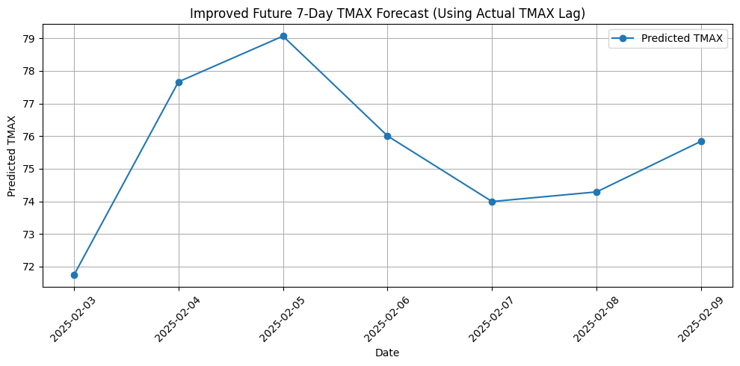
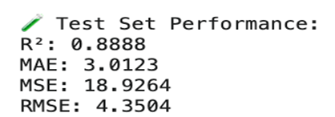
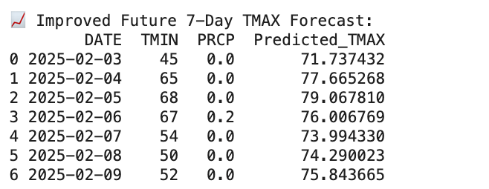
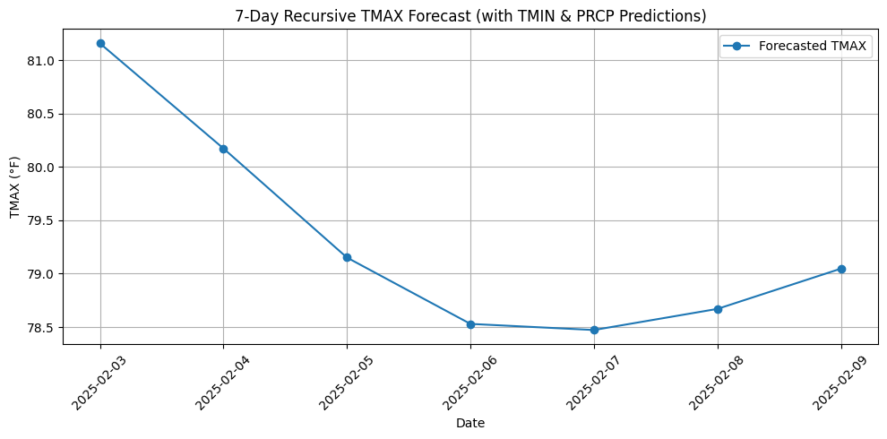
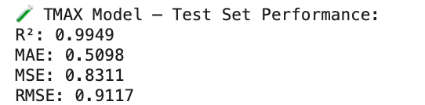
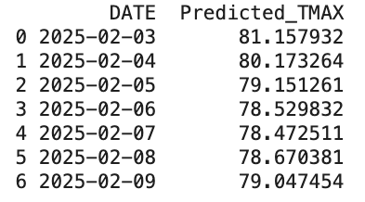
Random Forest
Forecasting 7 days temperature by manual input of TMIN and PRCP
Predicting TMIN & PRCP and using those to predict TMAX

Slide 19
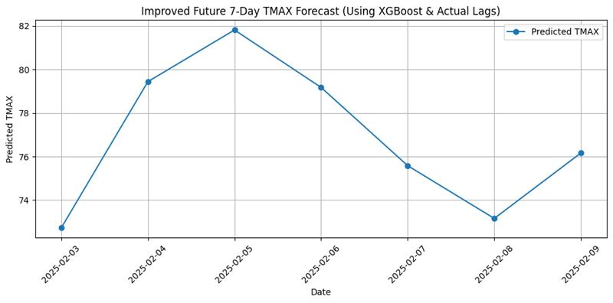
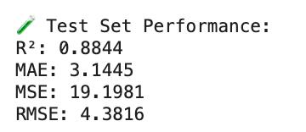
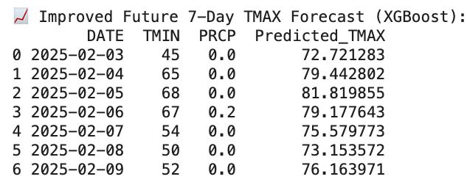
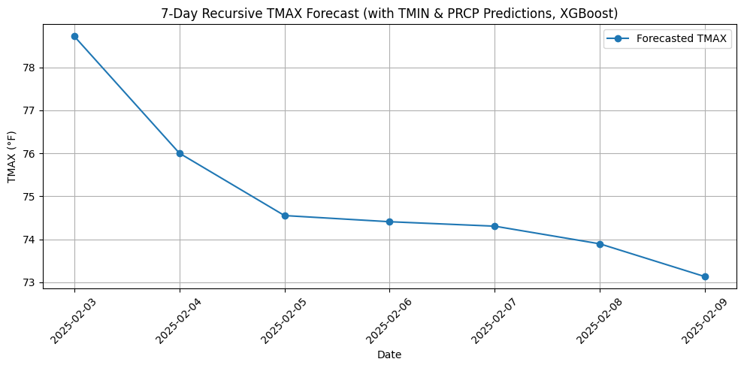
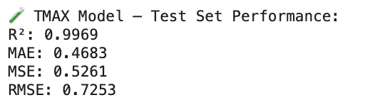
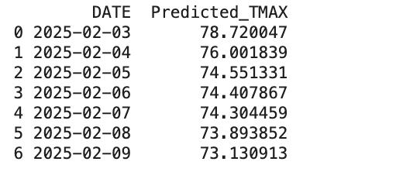
XG BOOST Regressor
Forecasting 7 days temperature by manual input of TMIN and PRCP
Predicting TMIN, PRCP and using those values to predict TMAX recursively

Slide 20
Performance Evaluation

Slide 21
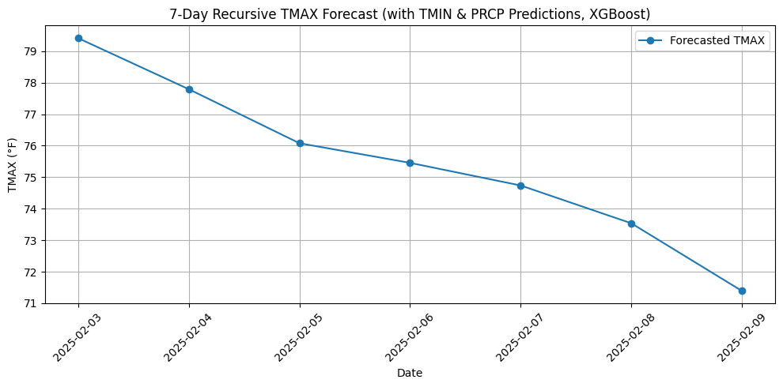
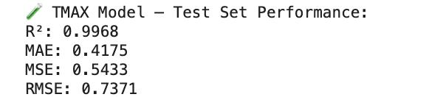
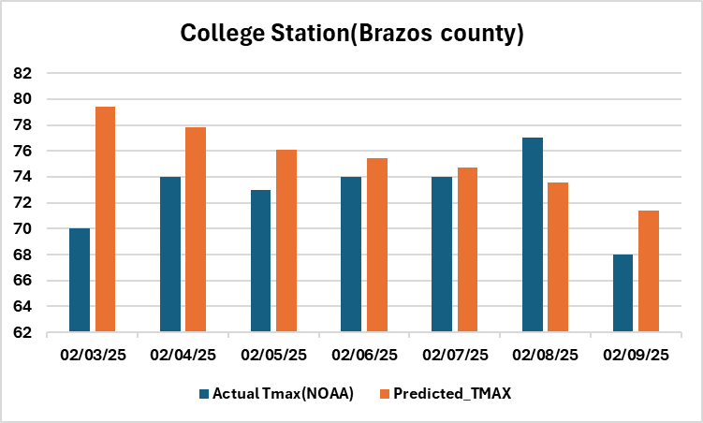
Prediction
COLLEGE STATION EASTERWOOD FIELD, TX US (Brazos county)

Slide 22


Challenges & Limitations
Data Availability: Sourcing accurate weather data
Data Challenges: Lacks humidity, wind speed, pressure → limits forecasting depth
Handling Missing Values & Model Accuracy because Imputation may reduce accuracy for extreme values
Traditional models underperformed
Deep learning models (LSTM) require high compute power
Future Recommendations
Enhance Input Features
Strengthen Model Architecture
Explore hybrid/ensemble models that combine machine learning
Fine-tune sequence-based deep learning models
Improve Generalization
Train models across climate zones
Use transfer learning between stations
Deployment & Scale
Extend forecast horizon using seasonal patterns
Boost Transparency
Use SHAP/LIME for model explainability & interpretability
Add more weather variables (humidity, wind, pressure) to improve predictive performance.

Slide 23

GraphCast & Meteomatics : Feasibility Analysis for GaiaDhi
Feature | GraphCast (AI Model) | Meteomatics (Weather API)
Forecasting Method | Uses a Graphical Neural Network trained on historical weather data | Provides high-resolution weather data via an API
Benefits | - Highly accurate 10-day forecasts - Helps optimize farming operations | - Localized and high-resolution forecasts - Easier to integrate than AI models
Challenges | - High hardware & computing power requirements - Expensive AI model training and data processing | - Premium access to precise weather data is costly - Requires technical expertise to interpret data
Feasibility for GaiaDhi | Less feasible due to high infrastructure and integration costs | More feasible, but cost of premium data and reliance on external sources are concerns
Overview
We explored GraphCast (AI-based weather forecasting) and Meteomatics (weather data API solutions) to assess their potential for GaiaDhi, an agricultural company.
Conclusion
While tools offer valuable forecasting capabilities, the cost, hardware requirements, and integration challenges make them less feasible for GaiaDhi in their current form.

Slide 24



