Slide 1
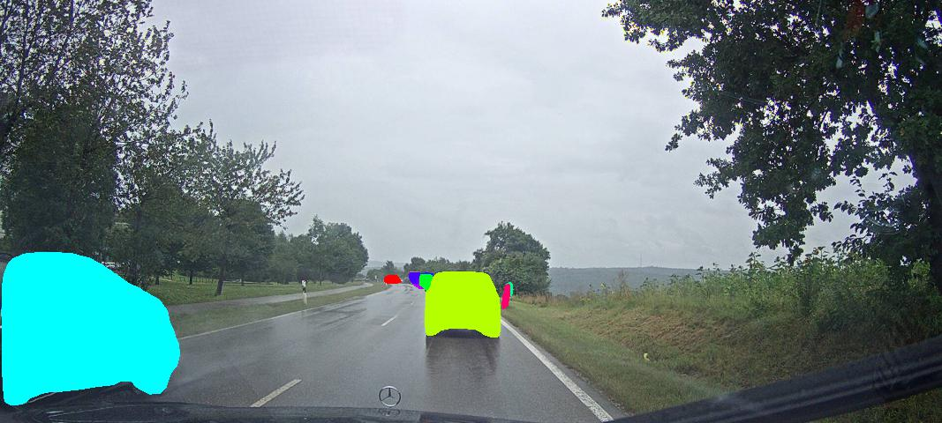
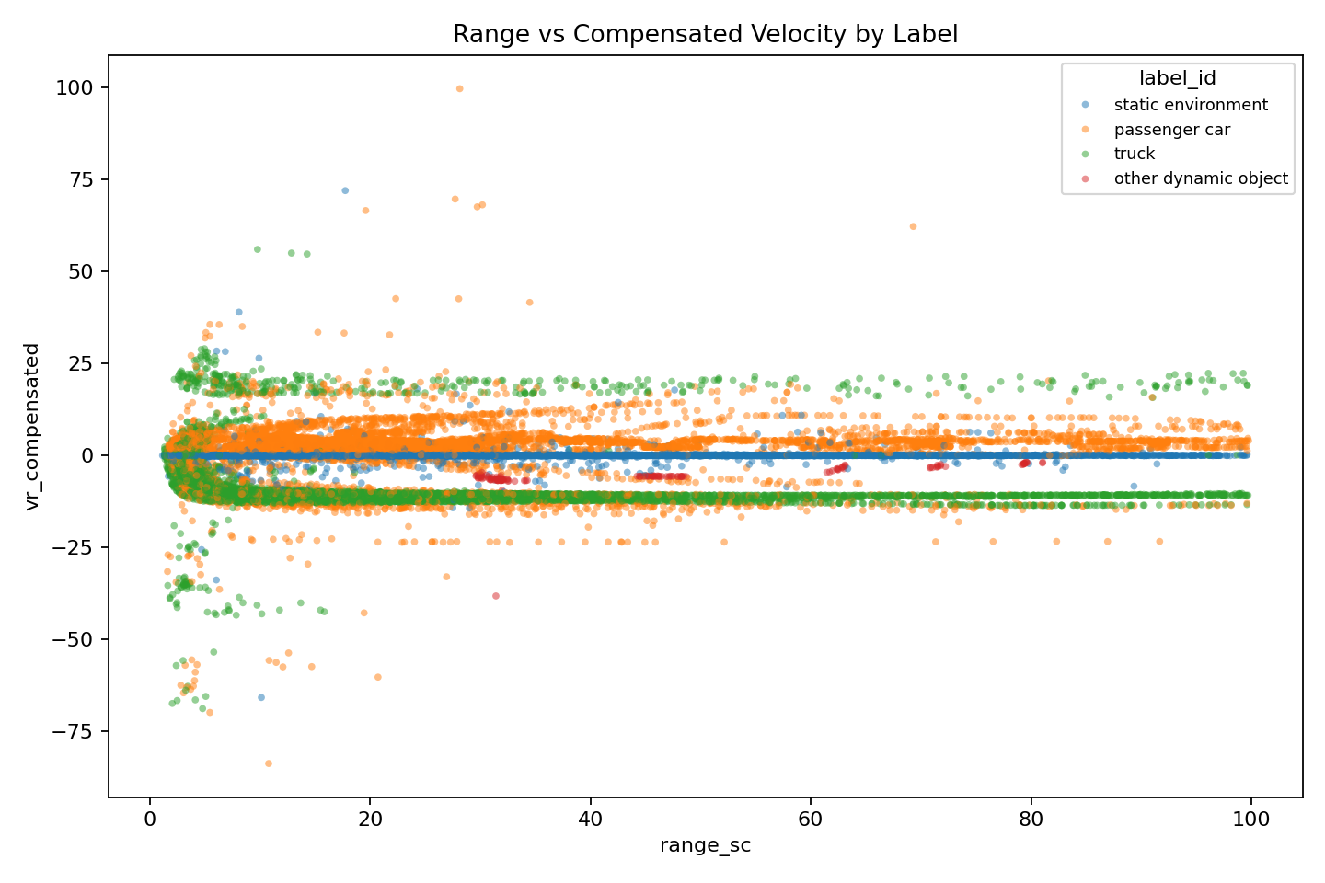
Radar Perception Analysis
Semantic recognition in sparse automotive radar data
A working Sequence 102 prototype that links radar signal parameters to object labels, with model evaluation and parameter-by-parameter interpretation.
Camera frame from Sequence 102/images/22549827067641.jpg.
DATA
MODEL
ACCURACY
Sequence 102
Random Forest
98%
local prototype
100 trees
balanced split
Current Status: completed prototype and analysis pipeline; full 50-sequence evaluation remains future work.
Two-parameter plot: range vs compensated velocity, colored by final label. Source: outputs/parameter_relationships/plots/pair_range_sc_vs_vr_compensated_by_label.png.
Radar Perception Analysis | Sequence 102 prototype | Gaïa Mezaïb Boti
1

Slide 2
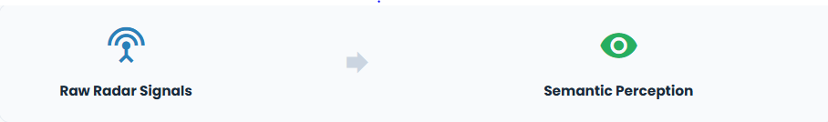
01
Presentation Structure
Context → Problem → Data → Model → Relationships → Results → Next steps
Radar Perception Analysis | Sequence 102 prototype
2

Slide 3
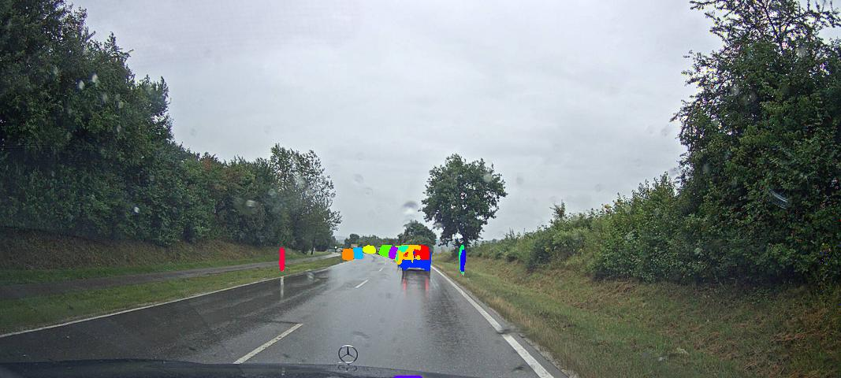
CONTEXT
Context: why radar perception matters
Radar strengths
Works in poor lighting and difficult weather
Measures radial velocity directly with Doppler
Useful for ADAS and autonomous driving perception
Radar challenge
Camera frame from Sequence 102/images/22549811066427.jpg.
Sparse point detections rather than dense images
No visual texture or object outline
Semantic labels must be inferred from physical signal patterns
Camera frame from Sequence 102/images/22549827067641.jpg.
Radar Perception Analysis | Sequence 102 prototype
3

Slide 4
PROBLEM
Problem definition: the end goal
Predict the semantic radar label from physical radar measurements.
Core model question
How do velocity, compensated velocity, RCS, range, azimuth, and x/y position relate to the final label_id?
label_id = f(vr, vr_compensated, rcs, range_sc, azimuth_sc, x_cc, y_cc)
Why this matters?
Current Development Stage
Radar works in low-visibility conditions
Semantic perception helps autonomous vehicles better understand their surroundings
Understanding feature behavior supports interpretable AI
Interactive radar feature-space visualization
Prototype tested on Sequence 102
Preparing multi-sequence evaluation and classification
Radar Perception Analysis | Sequence 102 prototype
4

Slide 5
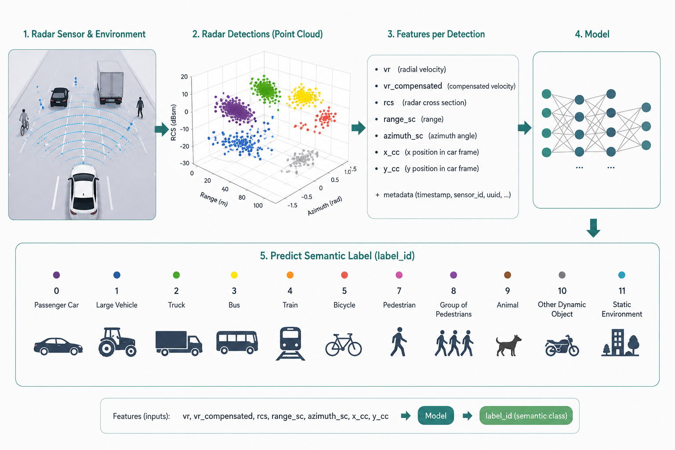
5

Slide 6
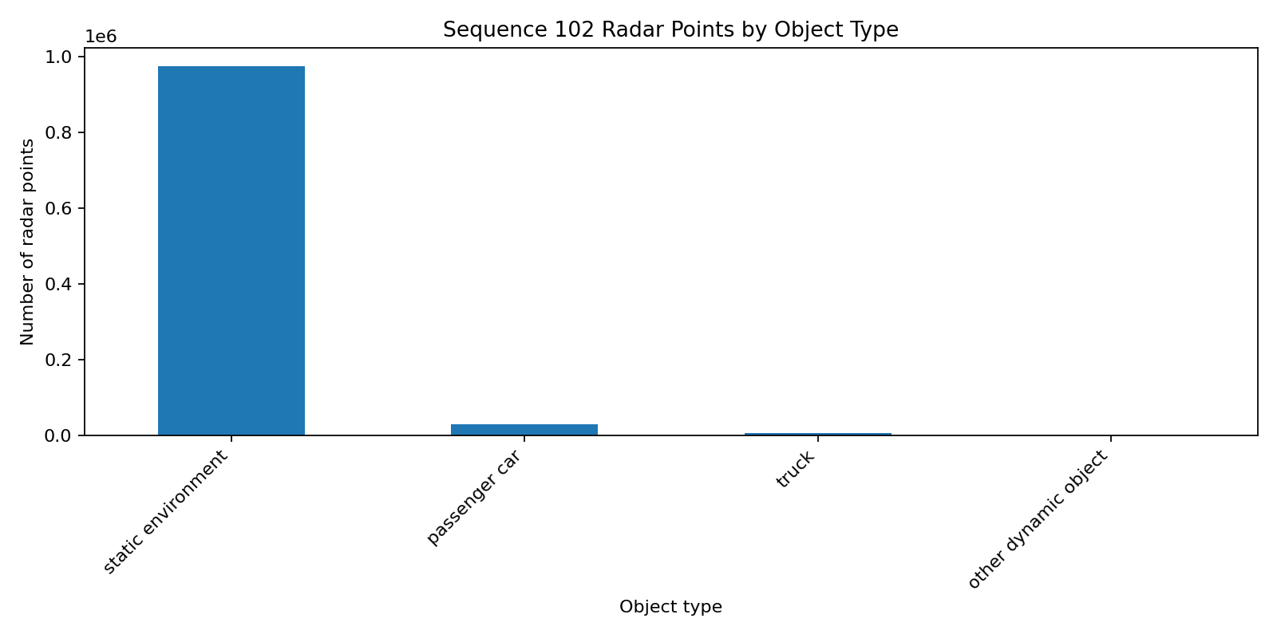
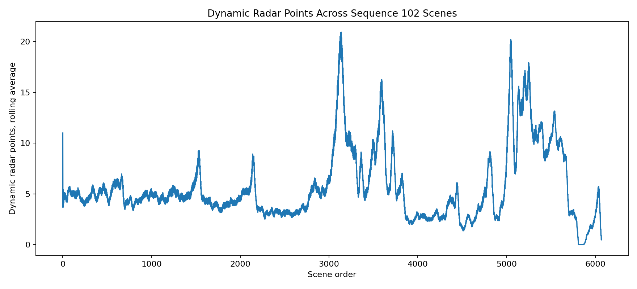
DATA
Data: what is available locally
RADAR ROWS
ODOMETRY ROWS
SEQUENCE
H5 KEYS
1,009,955
11,711
102
2
radar_data, odometry
Class distribution in Sequence 102. Source: Sequence 102/outputs/plots/object_type_counts.png, generated by Sequence 102/sequence102_radar_scene_report.py.
Dynamic radar detections over scene order. Source: Sequence 102/outputs/plots/dynamic_points_across_scenes.png.
Validation: Sequence 102 H5 timestamps match scenes.json, so radar points can be linked to sequence metadata.
Radar Perception Analysis | Sequence 102 prototype
6

Slide 7
DATA
Data issue: severe class imbalance
label_id | Class | Points
0 | Passenger car | 28,604
2 | Truck | 5,399
10 | Other dynamic | 123
11 | Static environment | 975,829
Class distribution in Sequence 102. Source: Sequence 102/outputs/plots/object_type_counts.png, generated by Sequence 102/sequence102_radar_scene_report.py.
Why this matters
Without balancing, a model could predict static environment too often and still look accurate. The prototype keeps all dynamic points and samples the static class.
Radar Perception Analysis | Sequence 102 prototype
7

Slide 8
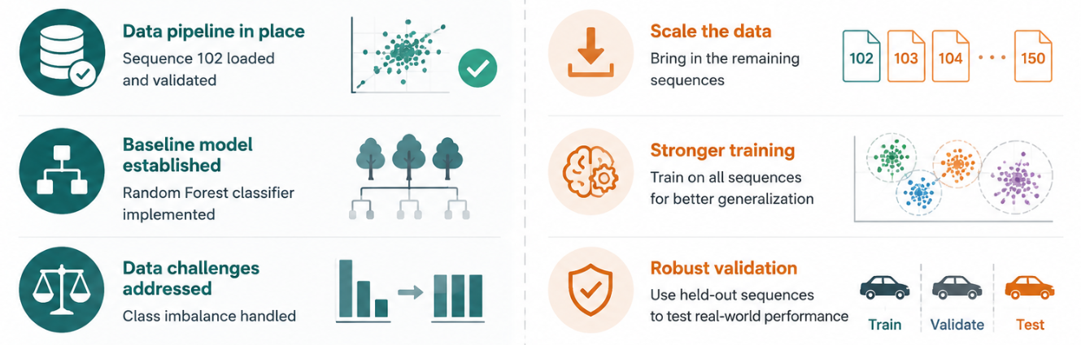
SCOPE
Current state vs. Looking forward
Explored
Not done yet
Generated evaluation metrics and plots
Analyzed each parameter relationship
Prepared HTML documentation and folders
Other 49 sequences not downloaded locally
No all-sequence training yet
No held-out-sequence validation yet
98% is prototype performance
Radar Perception Analysis | Sequence 102 prototype
8

Slide 9



MODEL
Mathematical model
Input vector
Target
Classifier
In words: the model receives one radar point and predicts the object class with the highest estimated probability.
Radar Perception Analysis | Sequence 102 prototype
9

Slide 10
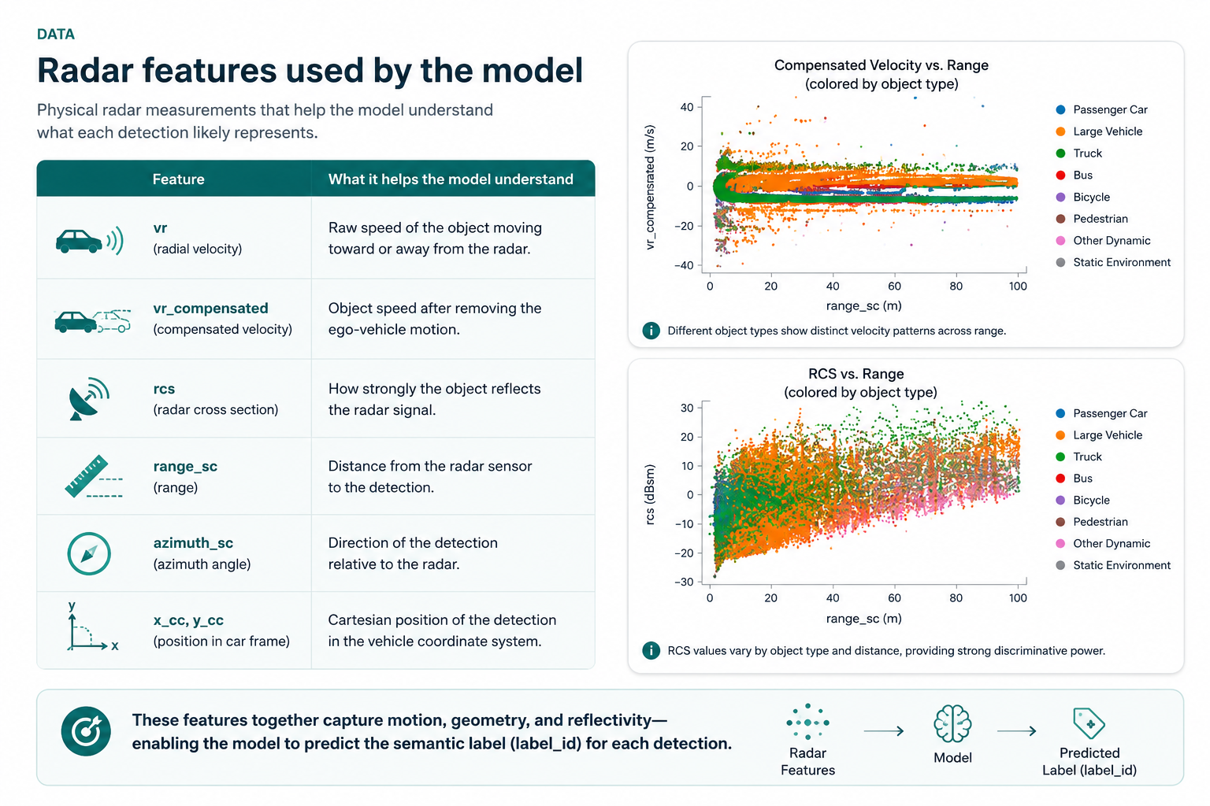
10

Slide 11
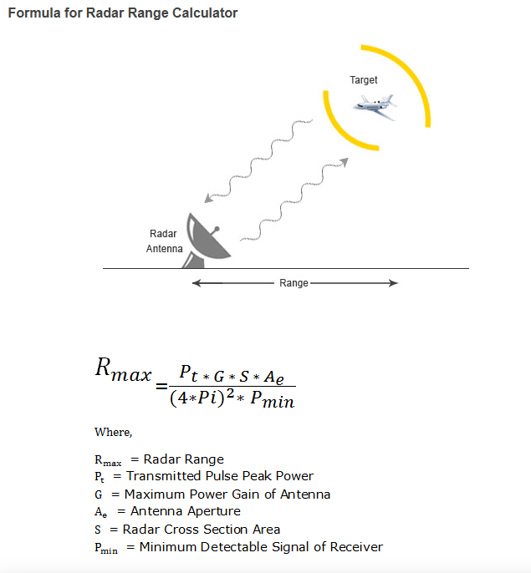
11

Slide 12
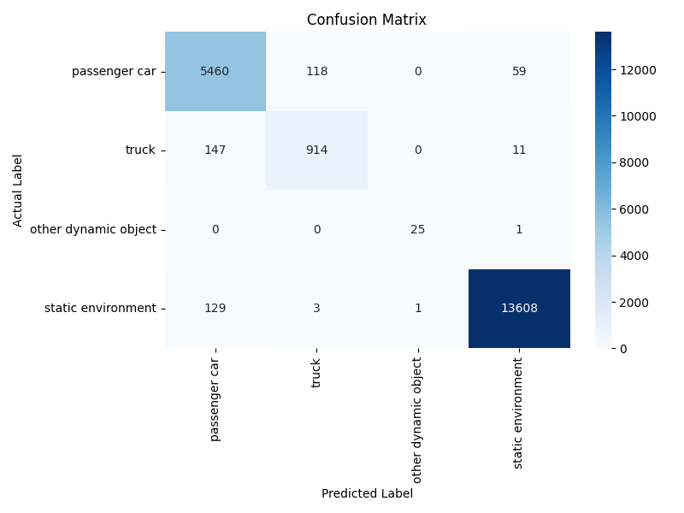
RESULTS
Model results: Sequence 102 test split
ACCURACY
MACRO F1
WEIGHTED F1
0.98
0.95
0.98
Interpretation
Strong Sequence 102 prototype performance
Truck class is harder than passenger car/static
Result is not yet full-dataset proof
Confusion matrix for the Random Forest test split. Source: outputs/model_evaluation/confusion_matrix.png, generated by scratch_model_evaluation.py.
Radar Perception Analysis | Sequence 102 prototype
12

Slide 13
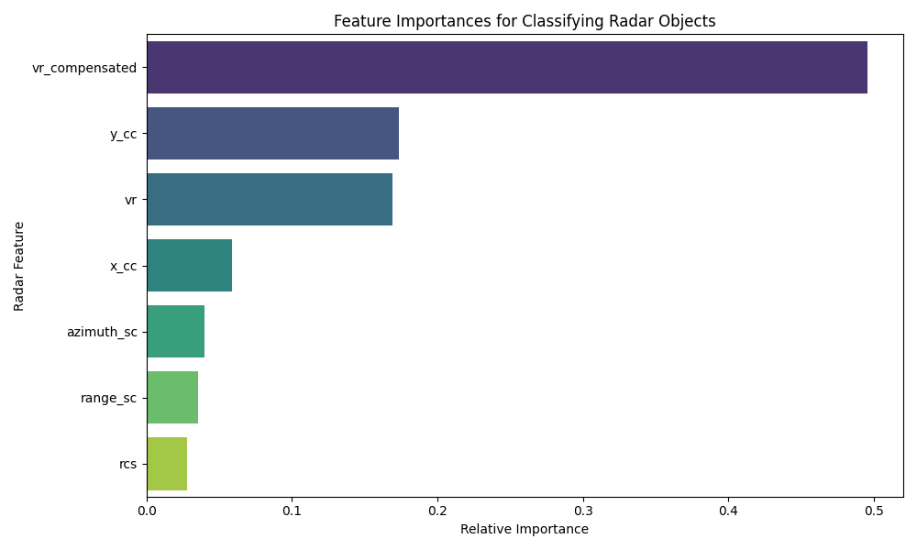
RESULTS
What the model relies on most
Main reading
vr_compensated is the strongest feature
Position variables help describe scene geometry
Raw velocity still contributes
RCS and range support the decision rather than solving it alone
Random Forest feature importance. Source: outputs/model_evaluation/feature_importance.png, generated by scratch_model_evaluation.py.
Radar Perception Analysis | Sequence 102 prototype
13

Slide 14
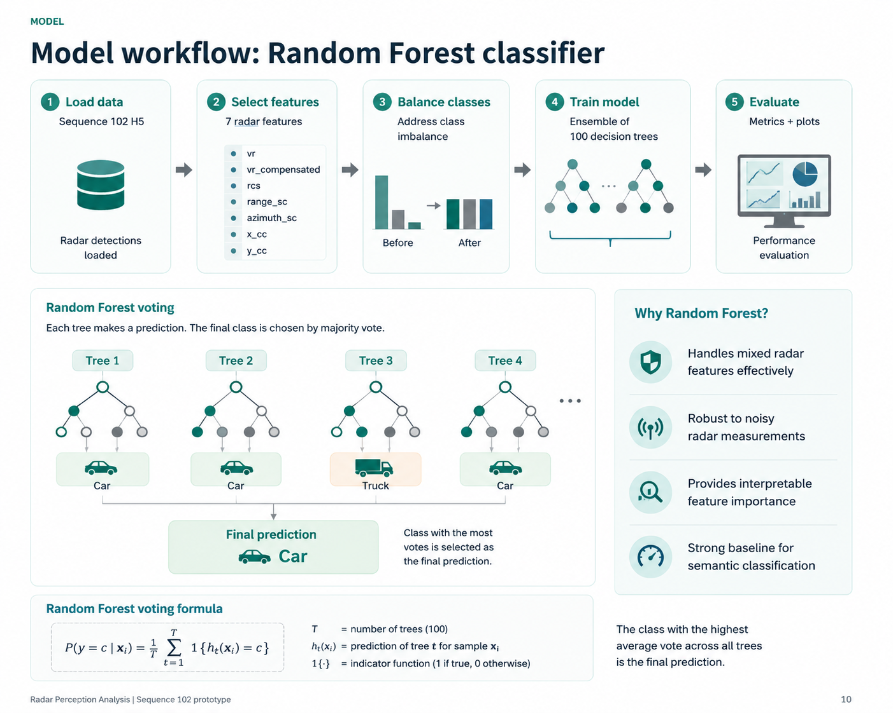
14

Slide 15
Model Architecture and Mechanism
Random Forest is an ensemble machine learning method that combines many decision trees to improve prediction accuracy and robustness.
Each decision tree learns a set of feature-based rules from radar measurements to classify object types.
The model uses bootstrapping (random sampling with replacement) so every tree is trained on a slightly different subset of the dataset.
At each split, the algorithm selects a random subset of features instead of using all variables, increasing diversity between trees and reducing overfitting.
15

Slide 16
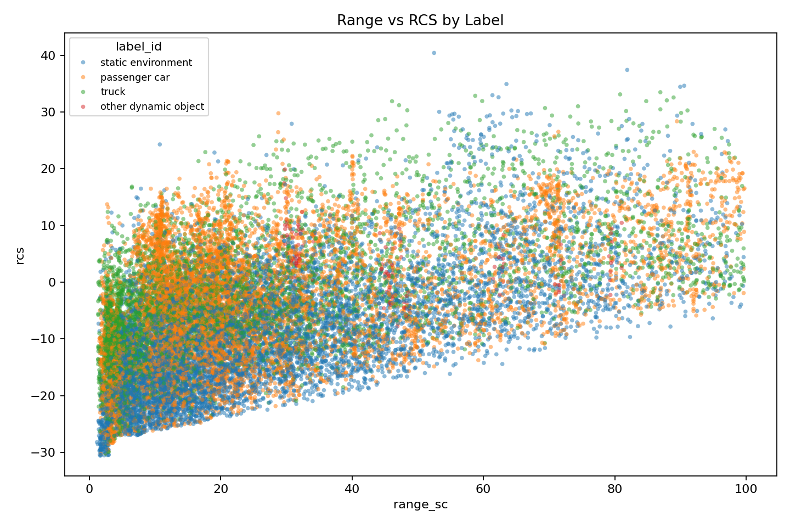
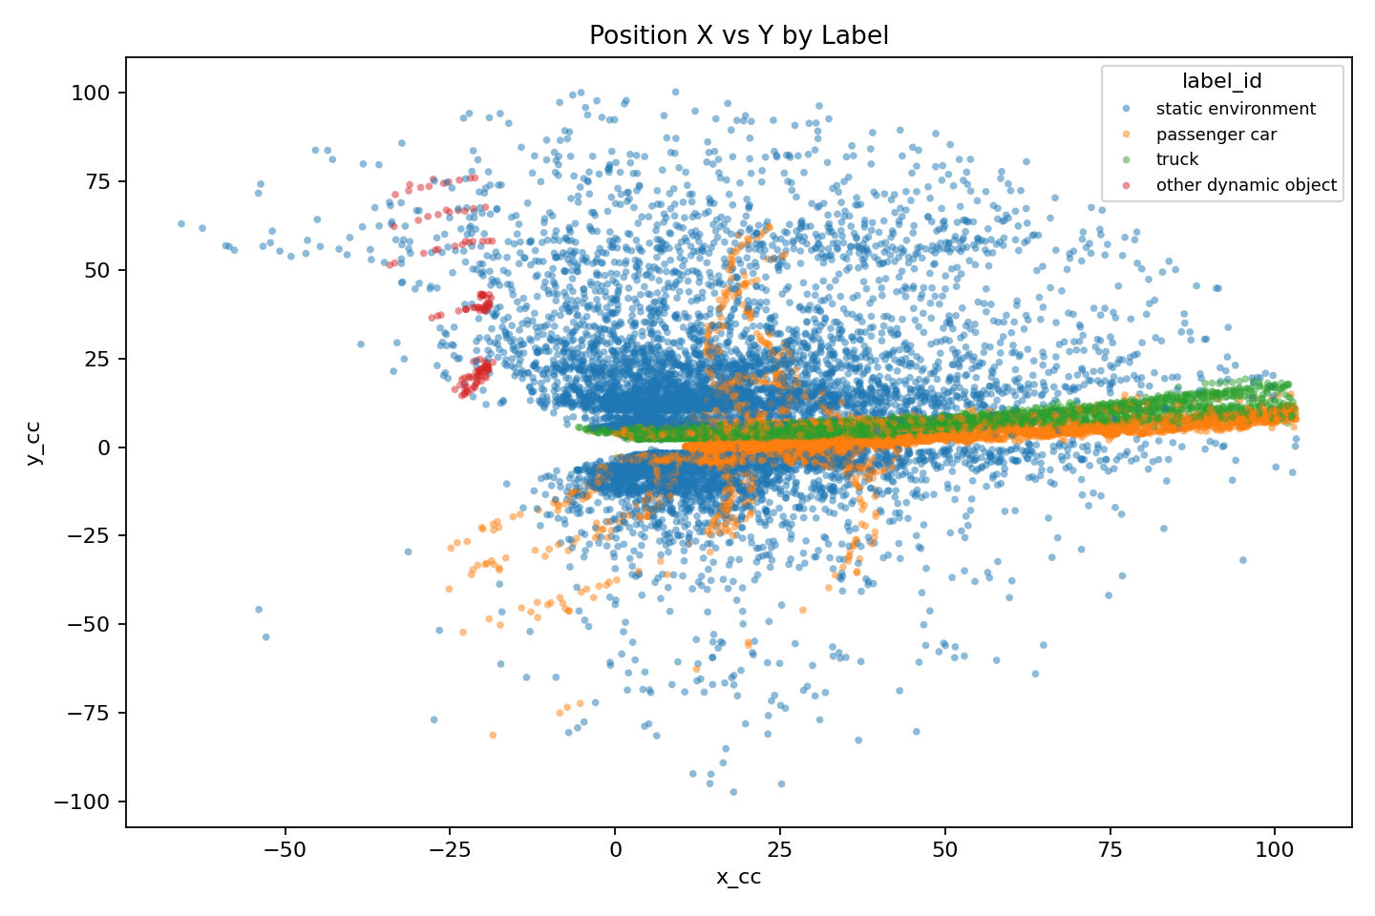
RELATIONSHIPS
Parameter relationships (individual)
Two-parameter plot: range vs compensated velocity, colored by final label. Source: outputs/parameter_relationships/plots/pair_range_sc_vs_vr_compensated_by_label.png.
Two-parameter plot: range vs RCS, colored by final label. Source: outputs/parameter_relationships/plots/pair_range_sc_vs_rcs_by_label.png.
Two-parameter plot: x/y spatial layout by final label. Source: outputs/parameter_relationships/plots/pair_x_cc_vs_y_cc_by_label.png.
What these plots add
They show each parameter with respect to the final label_id, then show paired relationships and model-effect curves. This explains the classifier instead of only reporting accuracy.
Radar Perception Analysis | Sequence 102 prototype
16

Slide 17
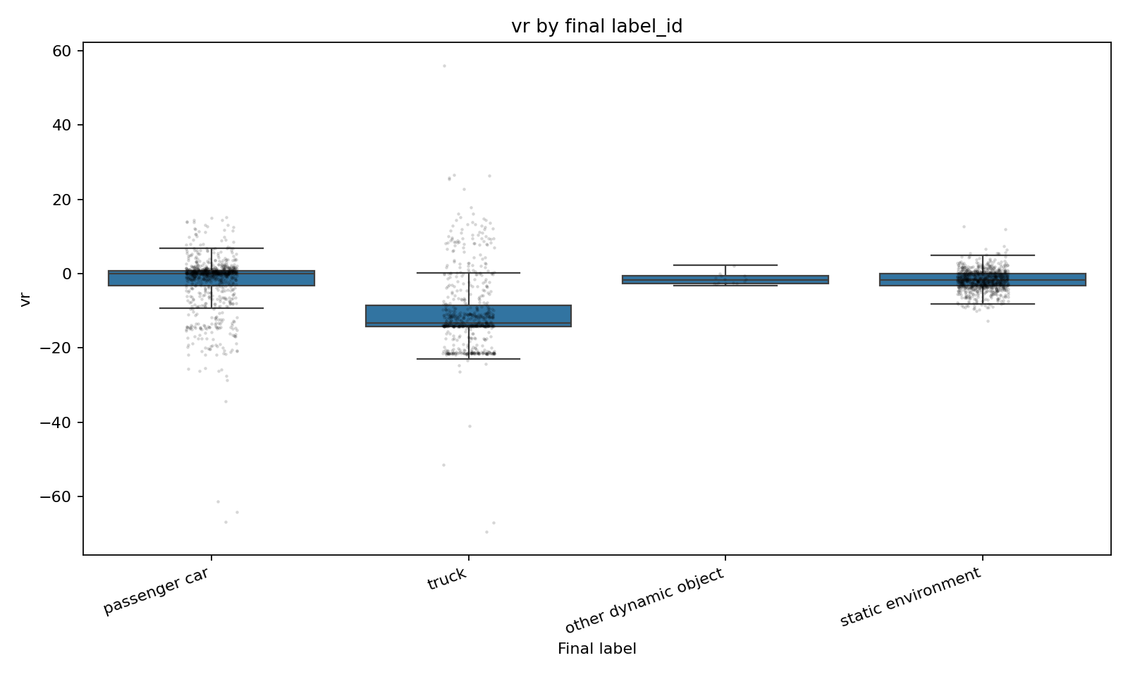
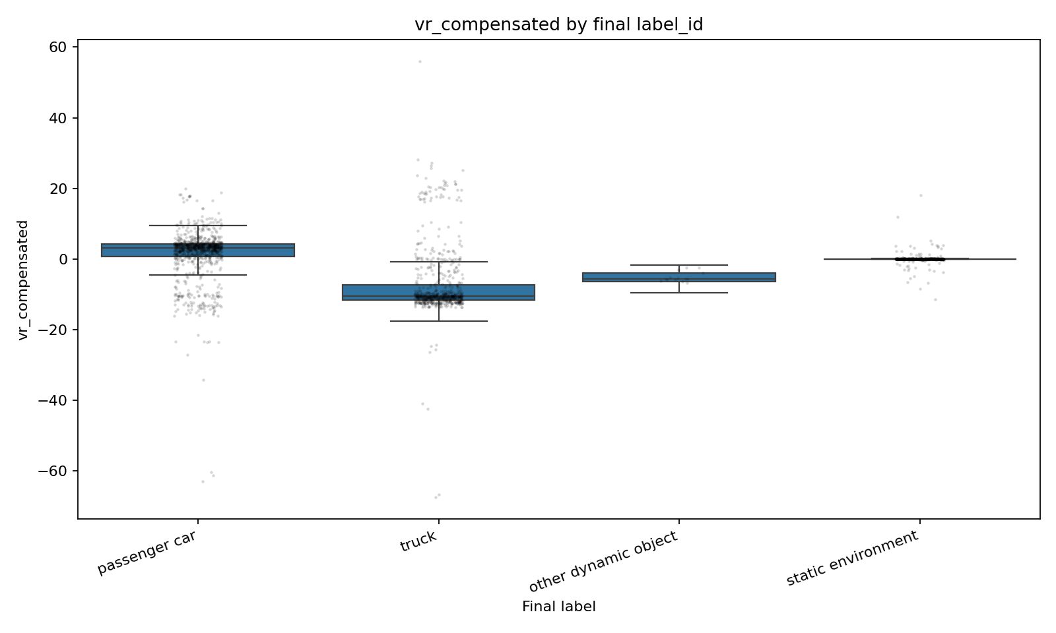
RELATIONSHIPS
Velocity relationship
Raw radial velocity distribution by final label_id. Source: outputs/parameter_relationships/plots/actual_vr_by_label.png.
Compensated velocity distribution by final label_id. Source: outputs/parameter_relationships/plots/actual_vr_compensated_by_label.png.
Interpretation
Raw velocity helps, but compensated velocity is clearer because static environment is centered close to zero after ego-motion correction.
Radar Perception Analysis | Sequence 102 prototype
17

Slide 18
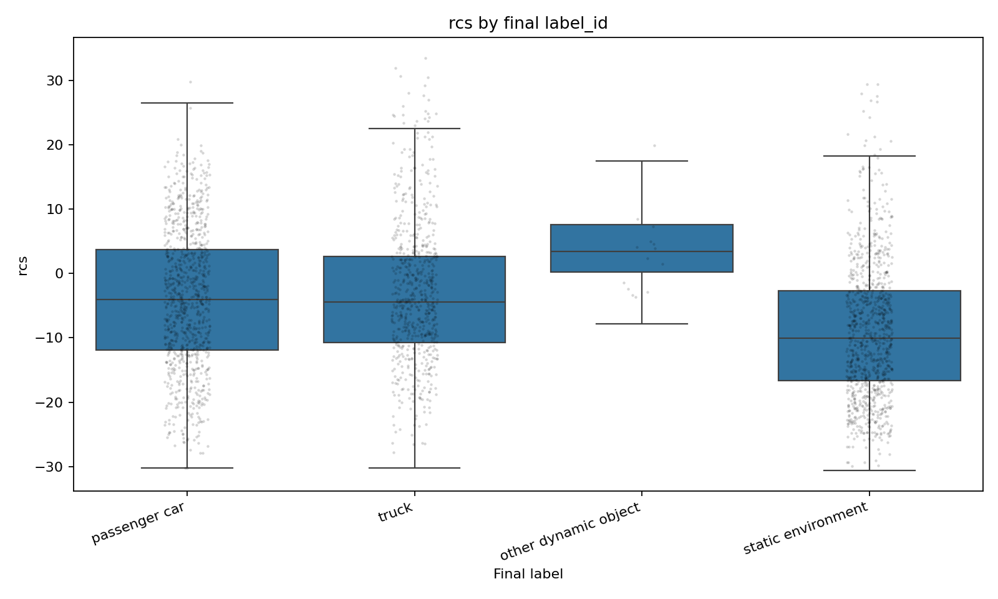
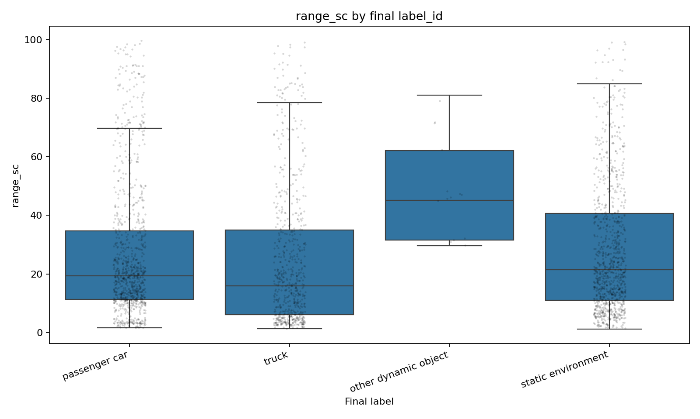
RELATIONSHIPS
RCS and range relationship
Radar Cross Section distribution by final label_id. Source: outputs/parameter_relationships/plots/actual_rcs_by_label.png.
Range distribution by final label_id. Source: outputs/parameter_relationships/plots/actual_range_sc_by_label.png.
Interpretation
RCS adds reflectivity and range adds distance context. Neither variable alone identifies the class; the model combines them with motion and position.
Radar Perception Analysis | Sequence 102 prototype
18

Slide 19
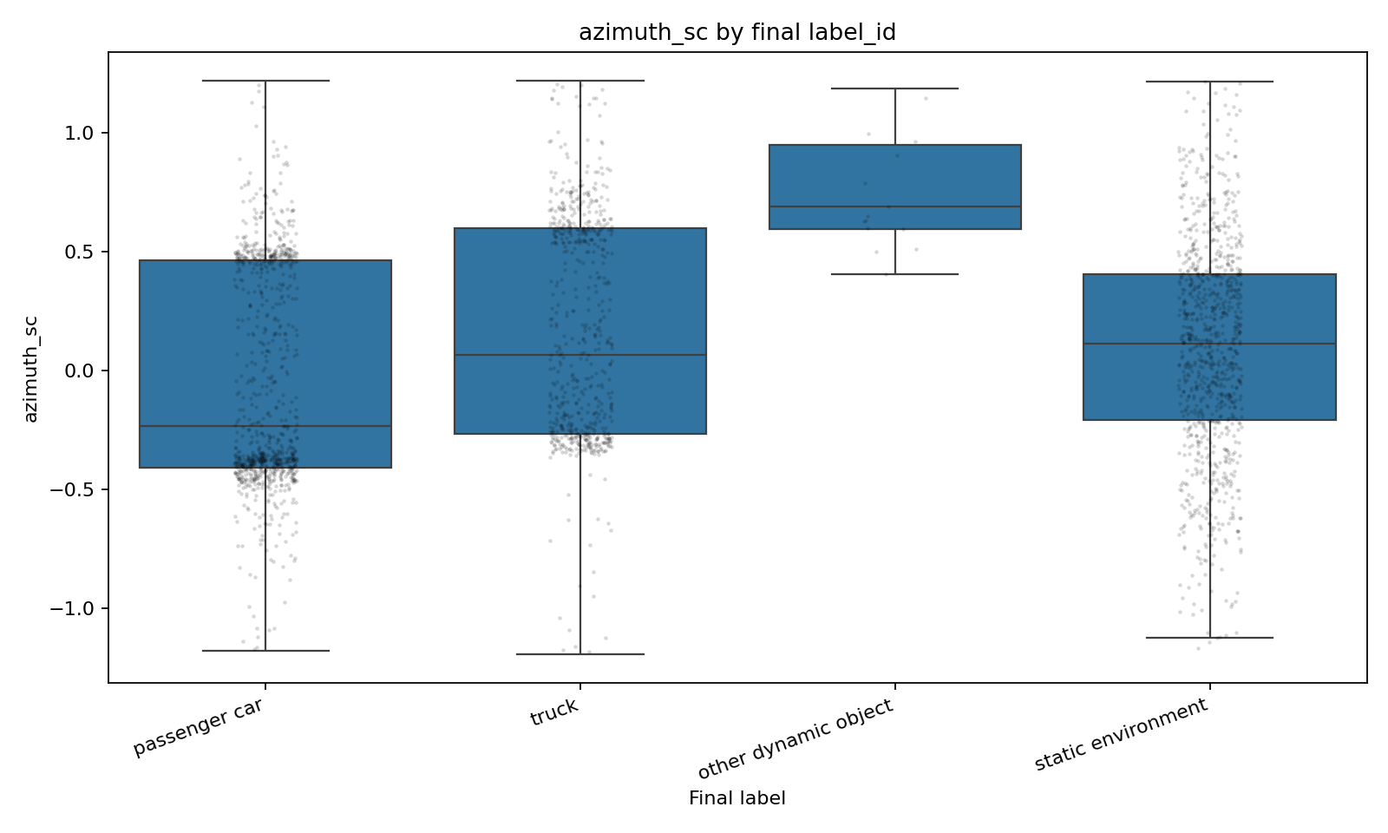
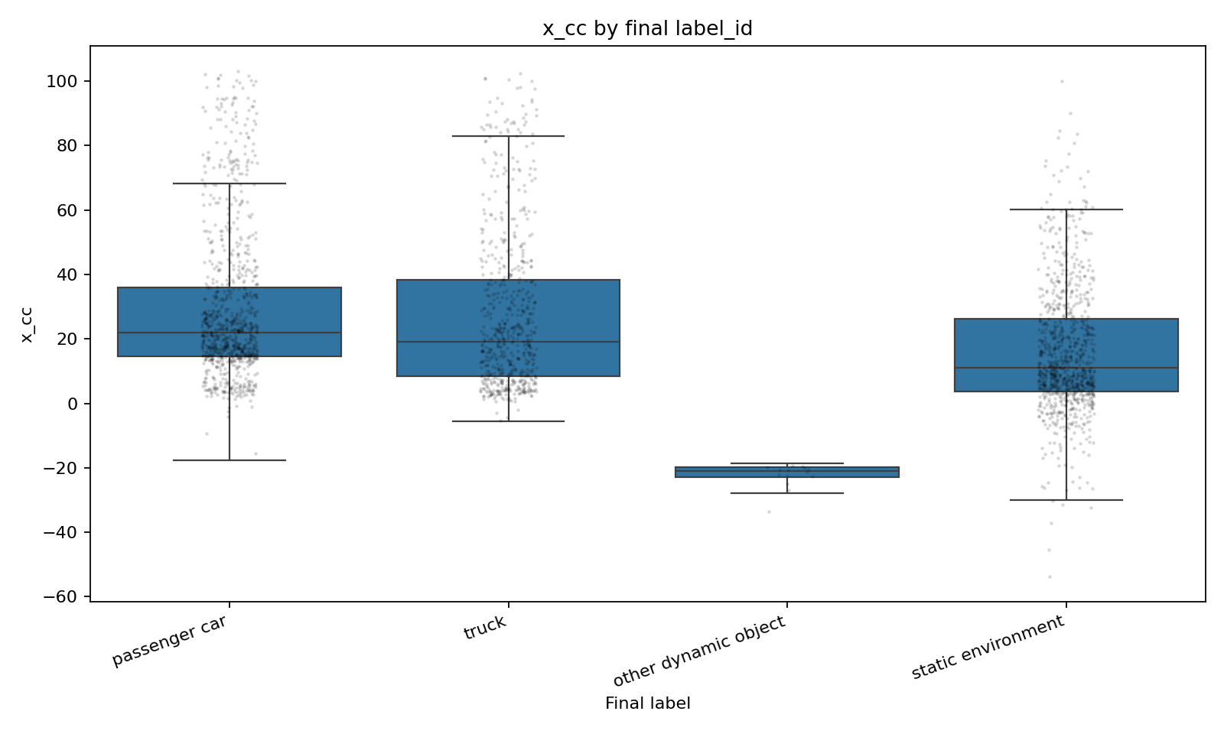
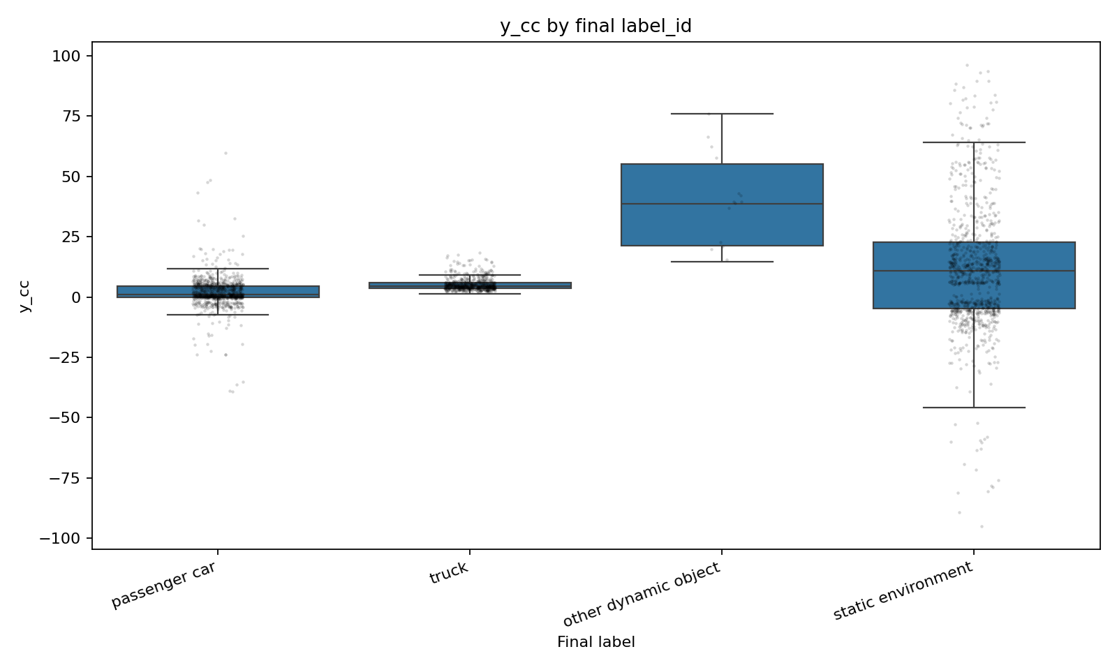
RELATIONSHIPS
Direction and position relationship
Azimuth angle distribution by final label_id. Source: outputs/parameter_relationships/plots/actual_azimuth_sc_by_label.png.
X-position distribution by final label_id. Source: outputs/parameter_relationships/plots/actual_x_cc_by_label.png.
Y-position distribution by final label_id. Source: outputs/parameter_relationships/plots/actual_y_cc_by_label.png.
Interpretation
Azimuth and x/y coordinates locate detections in the vehicle frame. They help the model, but must be validated across more sequences so the model does not overfit one scene layout.
Radar Perception Analysis | Sequence 102 prototype
19

Slide 20
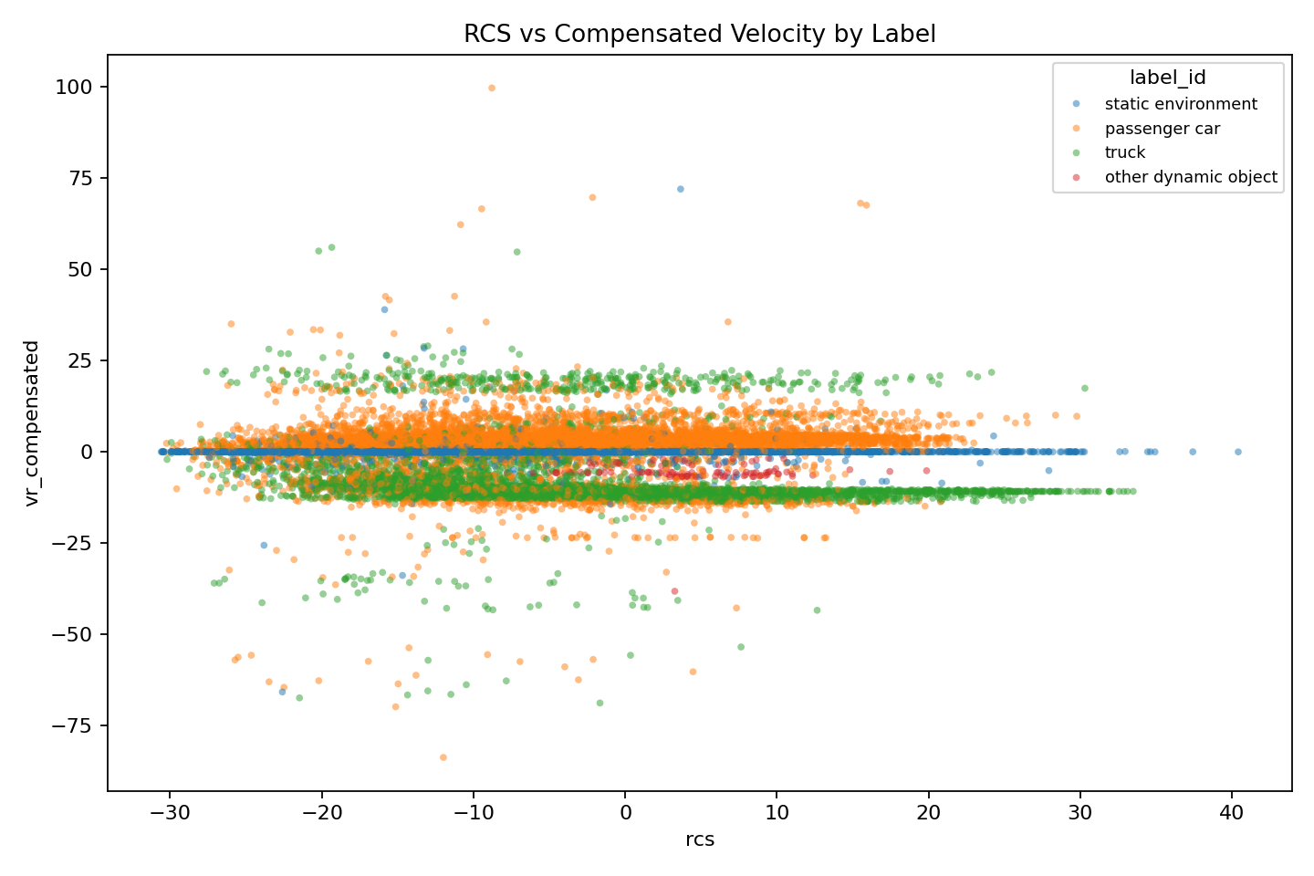
RELATIONSHIPS
Two-parameter relationships
Two-parameter plot: range vs RCS, colored by final label. Source: outputs/parameter_relationships/plots/pair_range_sc_vs_rcs_by_label.png.
Two-parameter plot: range vs compensated velocity, colored by final label. Source: outputs/parameter_relationships/plots/pair_range_sc_vs_vr_compensated_by_label.png.
Two-parameter plot: RCS vs compensated velocity by final label. Source: outputs/parameter_relationships/plots/pair_rcs_vs_vr_compensated_by_label.png.
Reading
Range + compensated velocity is especially informative
RCS + velocity combines reflectivity and motion
X/Y shows spatial layout learned by the model
Two-parameter plot: x/y spatial layout by final label. Source: outputs/parameter_relationships/plots/pair_x_cc_vs_y_cc_by_label.png.
Radar Perception Analysis | Sequence 102 prototype
20

Slide 21
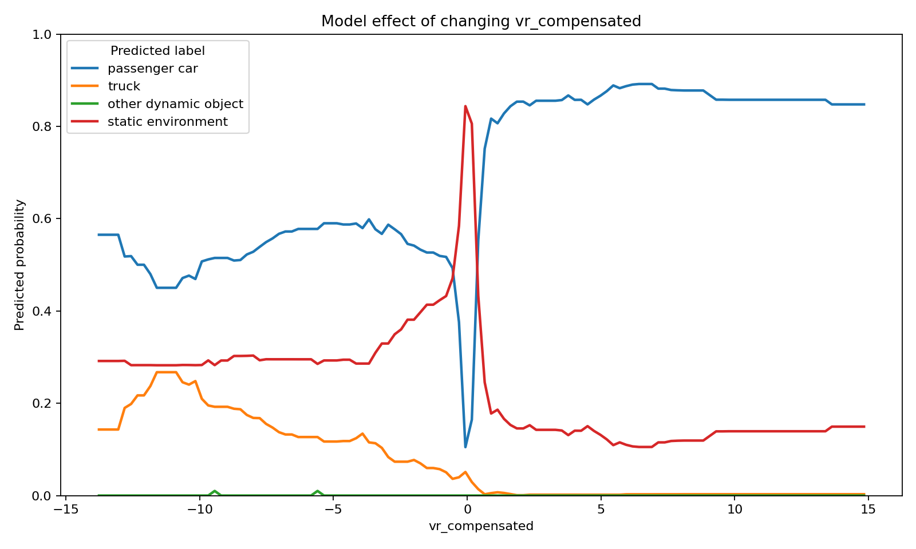
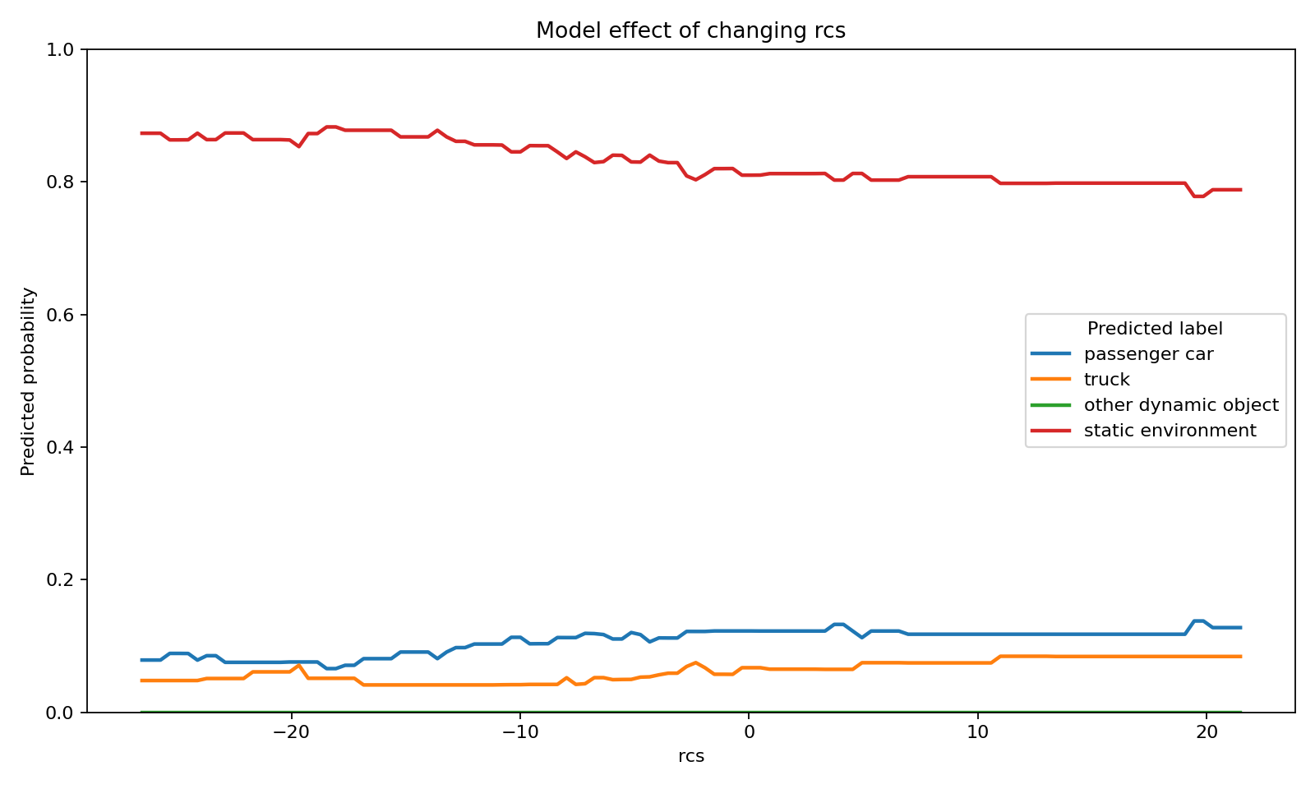
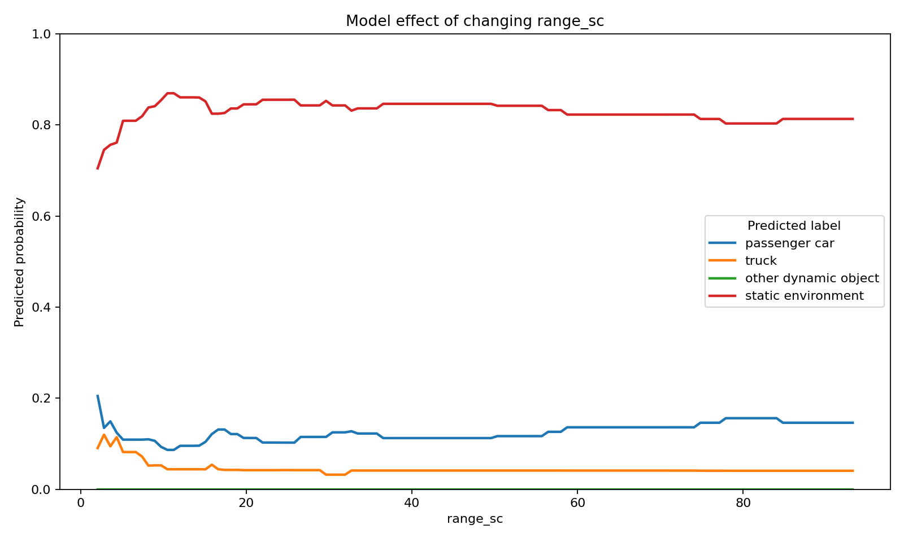
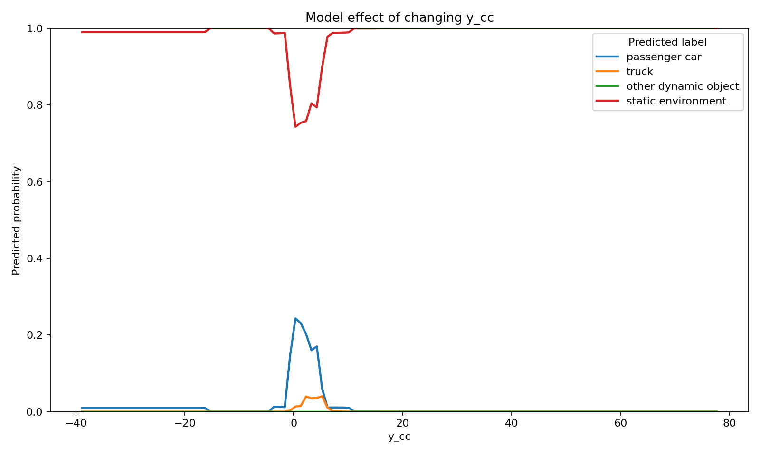
RELATIONSHIPS
Model-effect plots: changing one parameter
Model-effect curve: predicted class probability as compensated velocity changes. Source: parameter_relationship_plots.py.
Model-effect curve: predicted class probability as RCS changes. Source: parameter_relationship_plots.py.
Model-effect curve: predicted class probability as range changes. Source: parameter_relationship_plots.py.
Interpretation
These are model explanations: one parameter changes while the others stay at median values, showing how predicted class probabilities move.
Model-effect curve: predicted class probability as y-position changes. Source: parameter_relationship_plots.py.
Radar Perception Analysis | Sequence 102 prototype
21

Slide 22
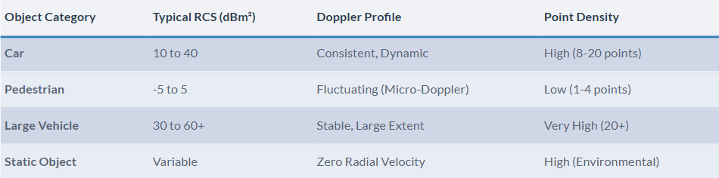
INTERPRETATION
Synthesis: how variables connect to label_id
What each family contributes
Why the model works
Velocity: motion signal
Compensated velocity: strongest dynamic/static separator
RCS: reflectivity signal
Range + azimuth: where detection is relative to sensor
X/Y position: scene geometry in vehicle coordinates
No single parameter is sufficient
Random Forest combines variables non-linearly
Feature importance and relationship plots agree
Interpretation is currently Sequence 102-specific
Radar Perception Analysis | Sequence 102 prototype
22

Slide 23
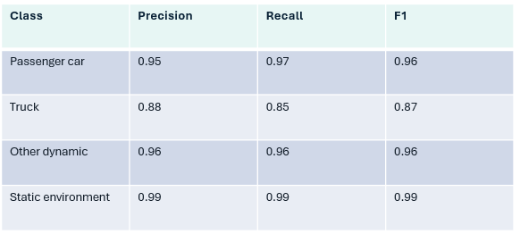
DELIVERABLES
Deliverables created
Files to show
Scripts to reproduce
presentation_summary.html
outputs/parameter_relationships/parameter_relationship_interpretation.html
outputs/model_evaluation/confusion_matrix.png
outputs/model_evaluation/feature_importance.png
teacher_submission folder
python verify_project.py
python scratch_model_evaluation.py
python parameter_relationship_plots.py
python "Sequence 102\\sequence102_radar_scene_report.py"
Radar Perception Analysis | Sequence 102 prototype
23

Slide 24
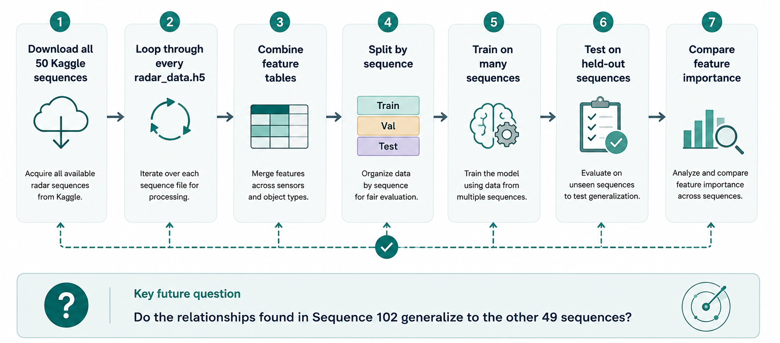
NEXT STEPS
Future work: scaling to 50 sequences
24

Slide 25
25
Backup slides
Radar Perception Analysis | Sequence 102 prototype
25

Slide 26
LIMITATIONS
Limitations: what not to overclaim
For now:
The full Kaggle 50-sequence model is NOT finished.
First steps:
I completed and verified a Sequence 102 prototype and analysis pipeline, ready to scale to all sequences.
Why
Scientific next step
Only one sequence is local
No held-out sequence test yet
Some classes have small support
Download all sequences
Train on many sequences
Test on unseen sequences
Radar Perception Analysis | Sequence 102 prototype
26

Slide 27
NEXT STEPS
Future work: scaling to 50 sequences
STEP 1
STEP 2
STEP 3
STEP 4
Download all 50 Kaggle sequences
Loop through every radar_data.h5
Combine feature tables
Split by sequence
STEP 5
STEP 6
STEP 7
Train on many sequences
Test on held-out sequences
Compare feature importance
Key future question: do the relationships found in Sequence 102 generalize to the other 49 sequences?
Radar Perception Analysis | Sequence 102 prototype
27

Slide 28
NEXT STEPS
Future work: scaling to 50 sequences
SEP 1
STEP 2
STEP 3
STEP 4
Download all 50 Kaggle sequences
Loop through every radar_data.h5
Combine feature tables
Split by sequence
STEP 5
STEP 6
STEP 7
Train on many sequences
Test on held-out sequences
Compare feature importance
Key future question: do the relationships found in Sequence 102 generalize to the other 49 sequences?
Radar Perception Analysis | Sequence 102 prototype
28

Slide 29
Q&A
Prepared answers for questions
Likely technical questions
Likely project questions
Why Random Forest? Tabular, interpretable, strong baseline
Why balancing? Static environment dominates
Why compensated velocity? Removes ego-motion
Why not final? Missing 49 sequences locally
What is done? Prototype + plots + docs
What proves it works? Metrics + reproducible scripts
What explains it? Parameter relationship report
What next? 50-sequence validation
Radar Perception Analysis | Sequence 102 prototype
29

Slide 30
CLOSING
Conclusion
Completed: a working, evaluated, and explained radar classification prototype.
Main result
Random Forest predicts label_id from radar signal and position features with 98% accuracy on the balanced Sequence 102 test split.
Main interpretation
Compensated velocity is the strongest separator; RCS, range, azimuth, and position add supporting physical and spatial context.
Best final wording: validated Sequence 102 prototype, ready to scale to the full Kaggle dataset.
Radar Perception Analysis | Sequence 102 prototype
30

Slide 31
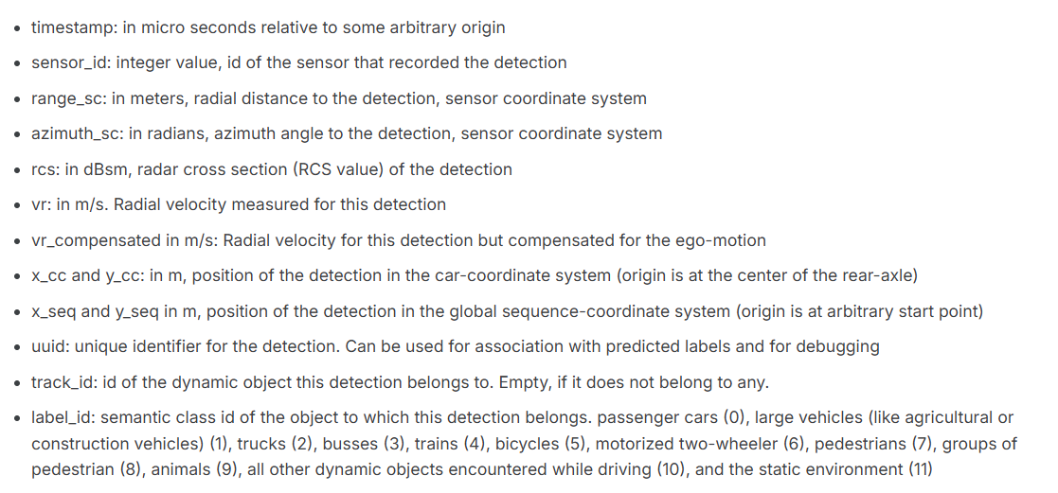
99
Backup slides
Use these only if the question session goes deeper.
Radar Perception Analysis | Sequence 102 prototype
31

Slide 32
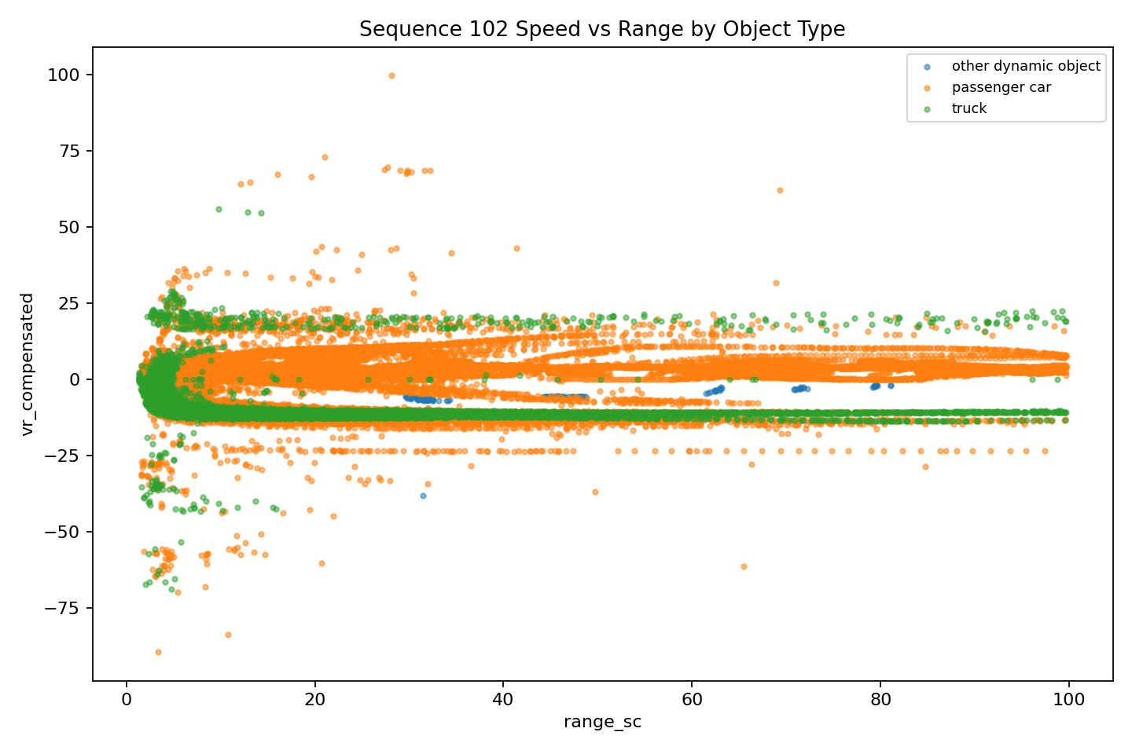
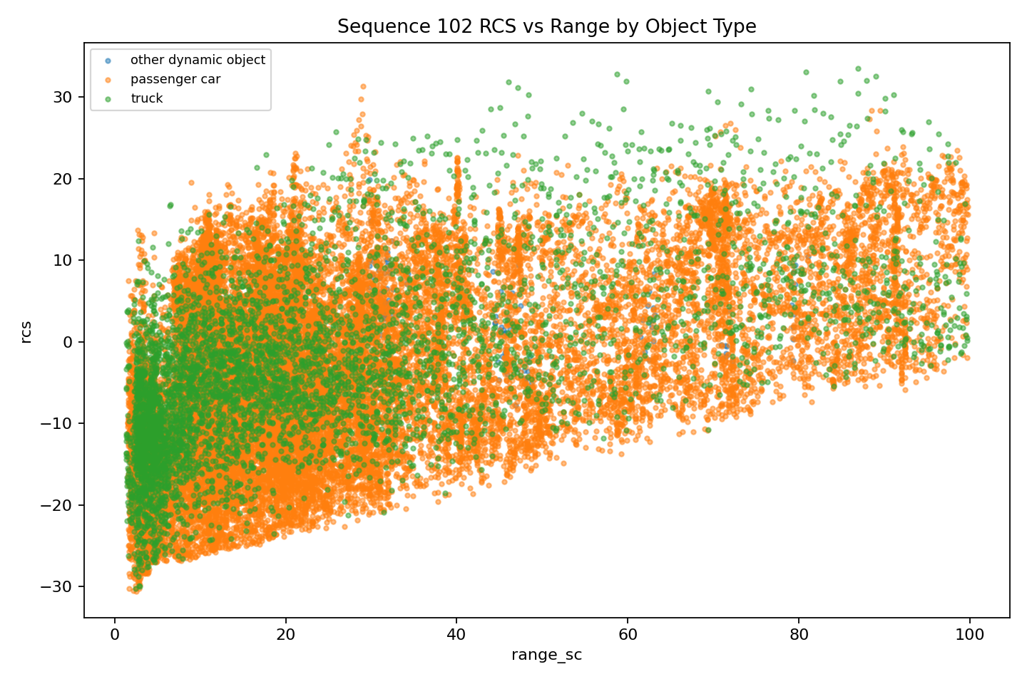
DATA
Radar features used by the model
Feature | Role in classification
vr | raw radial motion toward/away from sensor
vr_compensated | motion after ego-vehicle correction
rcs | reflection strength / radar cross section
range_sc | distance context
azimuth_sc | bearing angle / direction
x_cc, y_cc | position in vehicle coordinate frame
Compensated velocity vs range by object type. Source: Sequence 102/outputs/plots/speed_vs_range_by_object_type.png.
RCS vs range by object type. Source: Sequence 102/outputs/plots/rcs_vs_range_by_object_type.png.
Radar Perception Analysis | Sequence 102 prototype
32

Slide 33
BACKUP
Backup: class-level metrics
Class | Precision | Recall | F1
Passenger car | 0.95 | 0.97 | 0.96
Truck | 0.88 | 0.85 | 0.87
Other dynamic | 0.96 | 0.96 | 0.96
Static environment | 0.99 | 0.99 | 0.99
Interpretation
Truck is the hardest common class
Static environment performs best
Label 10 needs more examples
Why full data matters
More sequences should provide more examples and a stronger generalization test.
Confusion matrix for the Random Forest test split. Source: outputs/model_evaluation/confusion_matrix.png, generated by scratch_model_evaluation.py.
Radar Perception Analysis | Sequence 102 prototype
33

Slide 34

MODEL
Model workflow: Random Forest classifier
1 Load
Sequence 102 H5
2 Select
7 radar features
3 Balance
sample static class
4 Train
100 decision trees
5 Evaluate
metrics + plots
Random Forest voting:
Final prediction = class with the most tree votes
Radar Perception Analysis | Sequence 102 prototype
34

Slide 35
35

Slide 36
BACKUP
Backup: file map
Open these
Run these
presentation_summary.html
outputs/parameter_relationships/parameter_relationship_interpretation.html
README.md
teacher_submission/
python verify_project.py
python scratch_model_evaluation.py
python parameter_relationship_plots.py
python "Sequence 102\\sequence102_radar_scene_report.py"
Radar Perception Analysis | Sequence 102 prototype
36

Slide 38
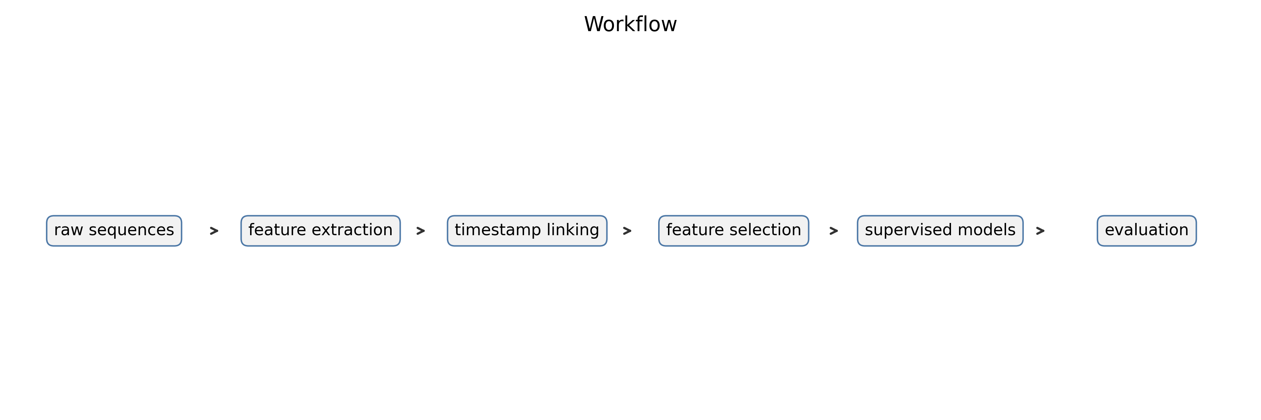
Final contribution: from one-sequence prototype to reproducible pipeline
The midterm deck focused on a Sequence 102 prototype; the final project now scans and processes 50 sequences automatically.
The pipeline builds point-level and track-level supervised datasets using label_id as ground truth.
It links radar, odometry, scenes.json, and camera frames by nearest timestamp, without claiming unimplemented camera projection.
It evaluates feature importance and trains multiple supervised models with imbalance-aware metrics.
Final pipeline: 50 RadarScenes sequences | radar-only supervised label classification

Slide 39
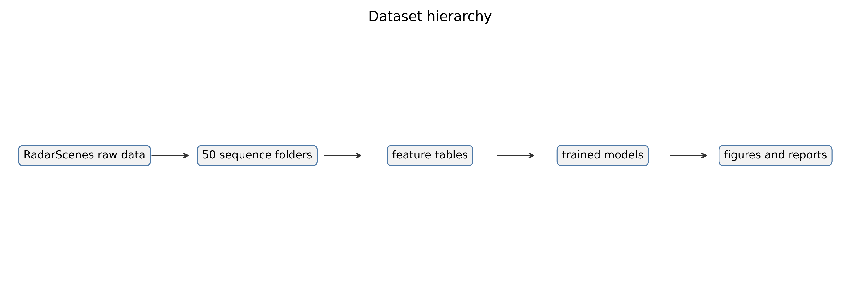
Dataset scale and structure
Processed sequences: 50
Radar detections used: 28,749,044
Camera images available: 10,971
Odometry samples available: 438,809
Sequences do not have equal length or equal sample counts; this is expected and not a problem when splitting carefully.
Final pipeline: 50 RadarScenes sequences | radar-only supervised label classification

Slide 40
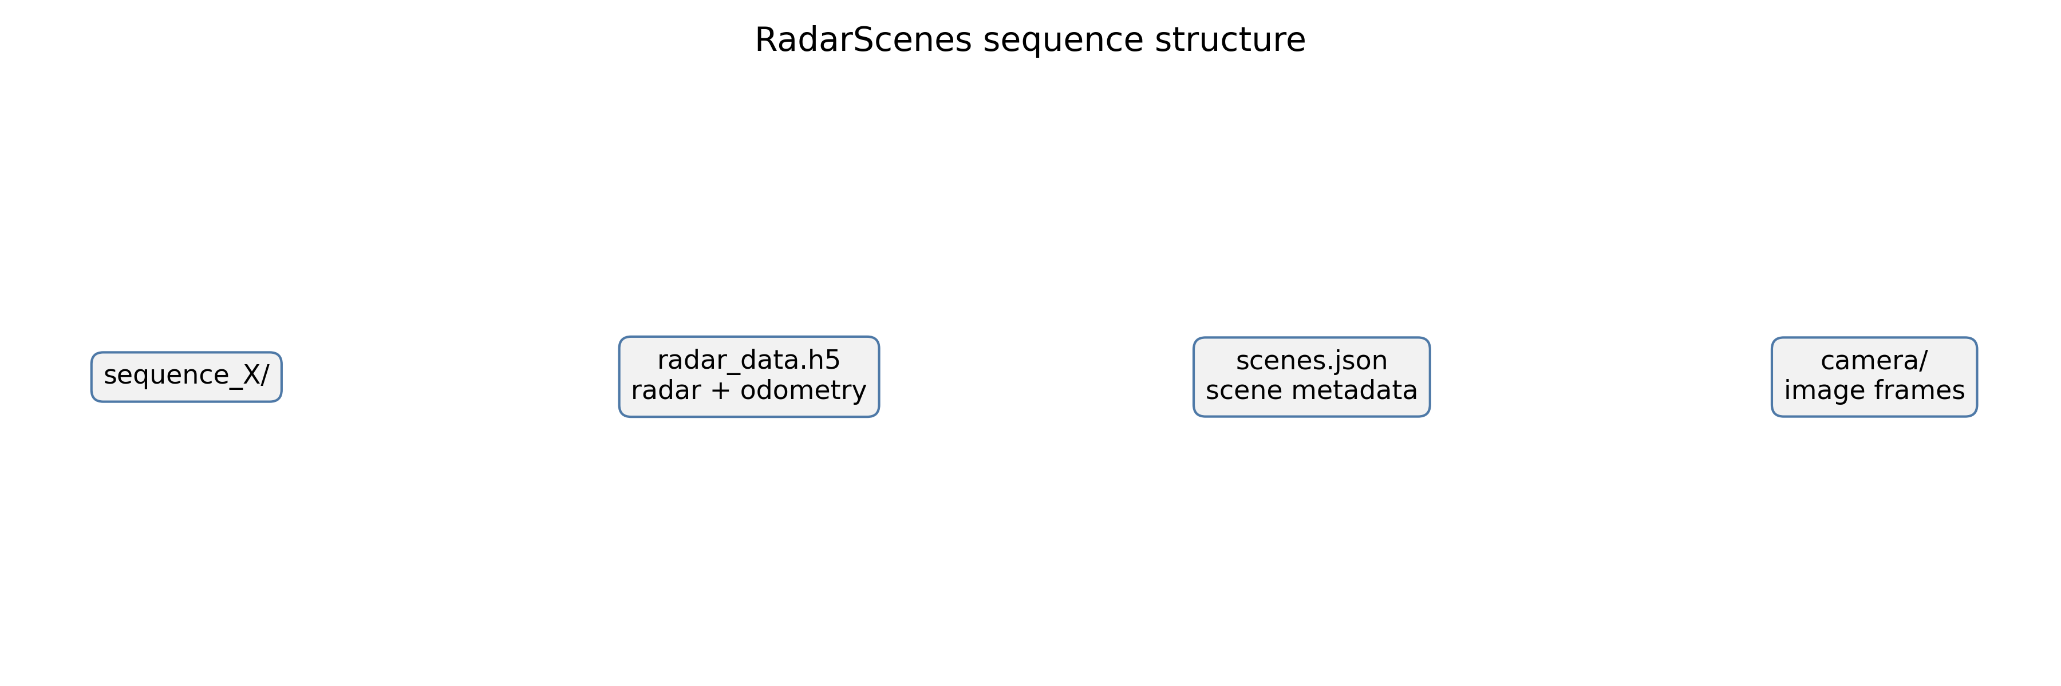
Correct final data unit
Point-level sample: one radar detection with timestamp, sensor_id, geometry, velocity, RCS, and label_id.
Track-level sample: aggregation by sequence_id and track_id with means, standard deviations, duration, and sensor count.
The model target is label_id, mapped to the official RadarScenes object classes.
Static environment is included in Experiment A and excluded in Experiment B.
Final pipeline: 50 RadarScenes sequences | radar-only supervised label classification

Slide 41
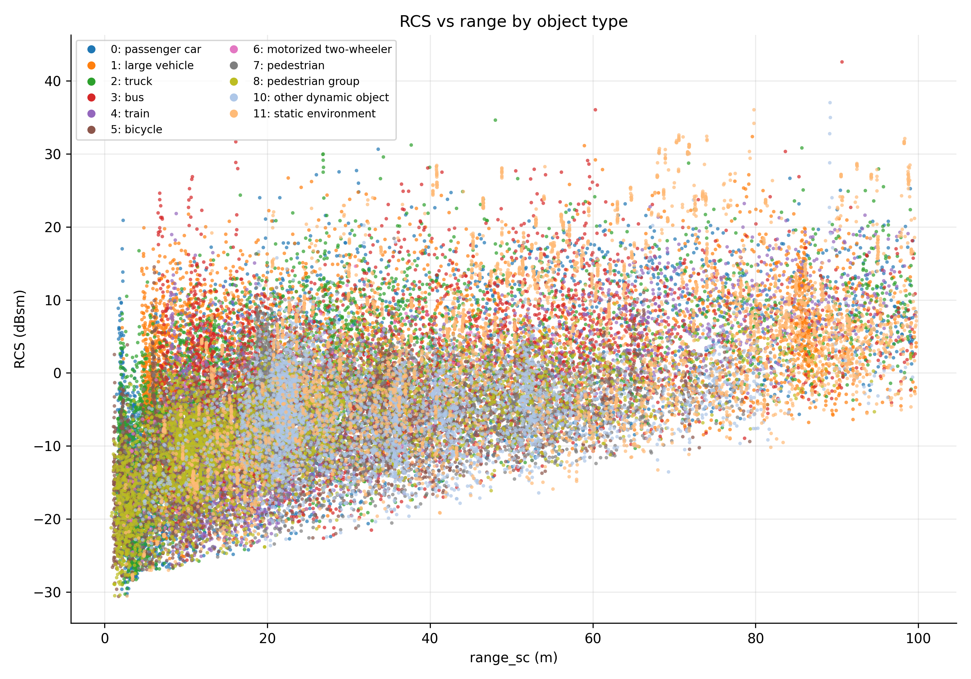
Mathematics: RCS, range, and received power
Radar Cross Section (RCS) describes how strongly a target reflects radar energy back to the sensor.
A simplified monostatic radar equation is:
P_r = (P_t G_t G_r lambda^2 sigma) / ((4 pi)^3 R^4 L)
This explains why range matters: received power decreases approximately with R^4 in the idealized case.
In this dataset, rcs is provided per detection; the project does not claim to compute RCS from raw power.
Final pipeline: 50 RadarScenes sequences | radar-only supervised label classification

Slide 42
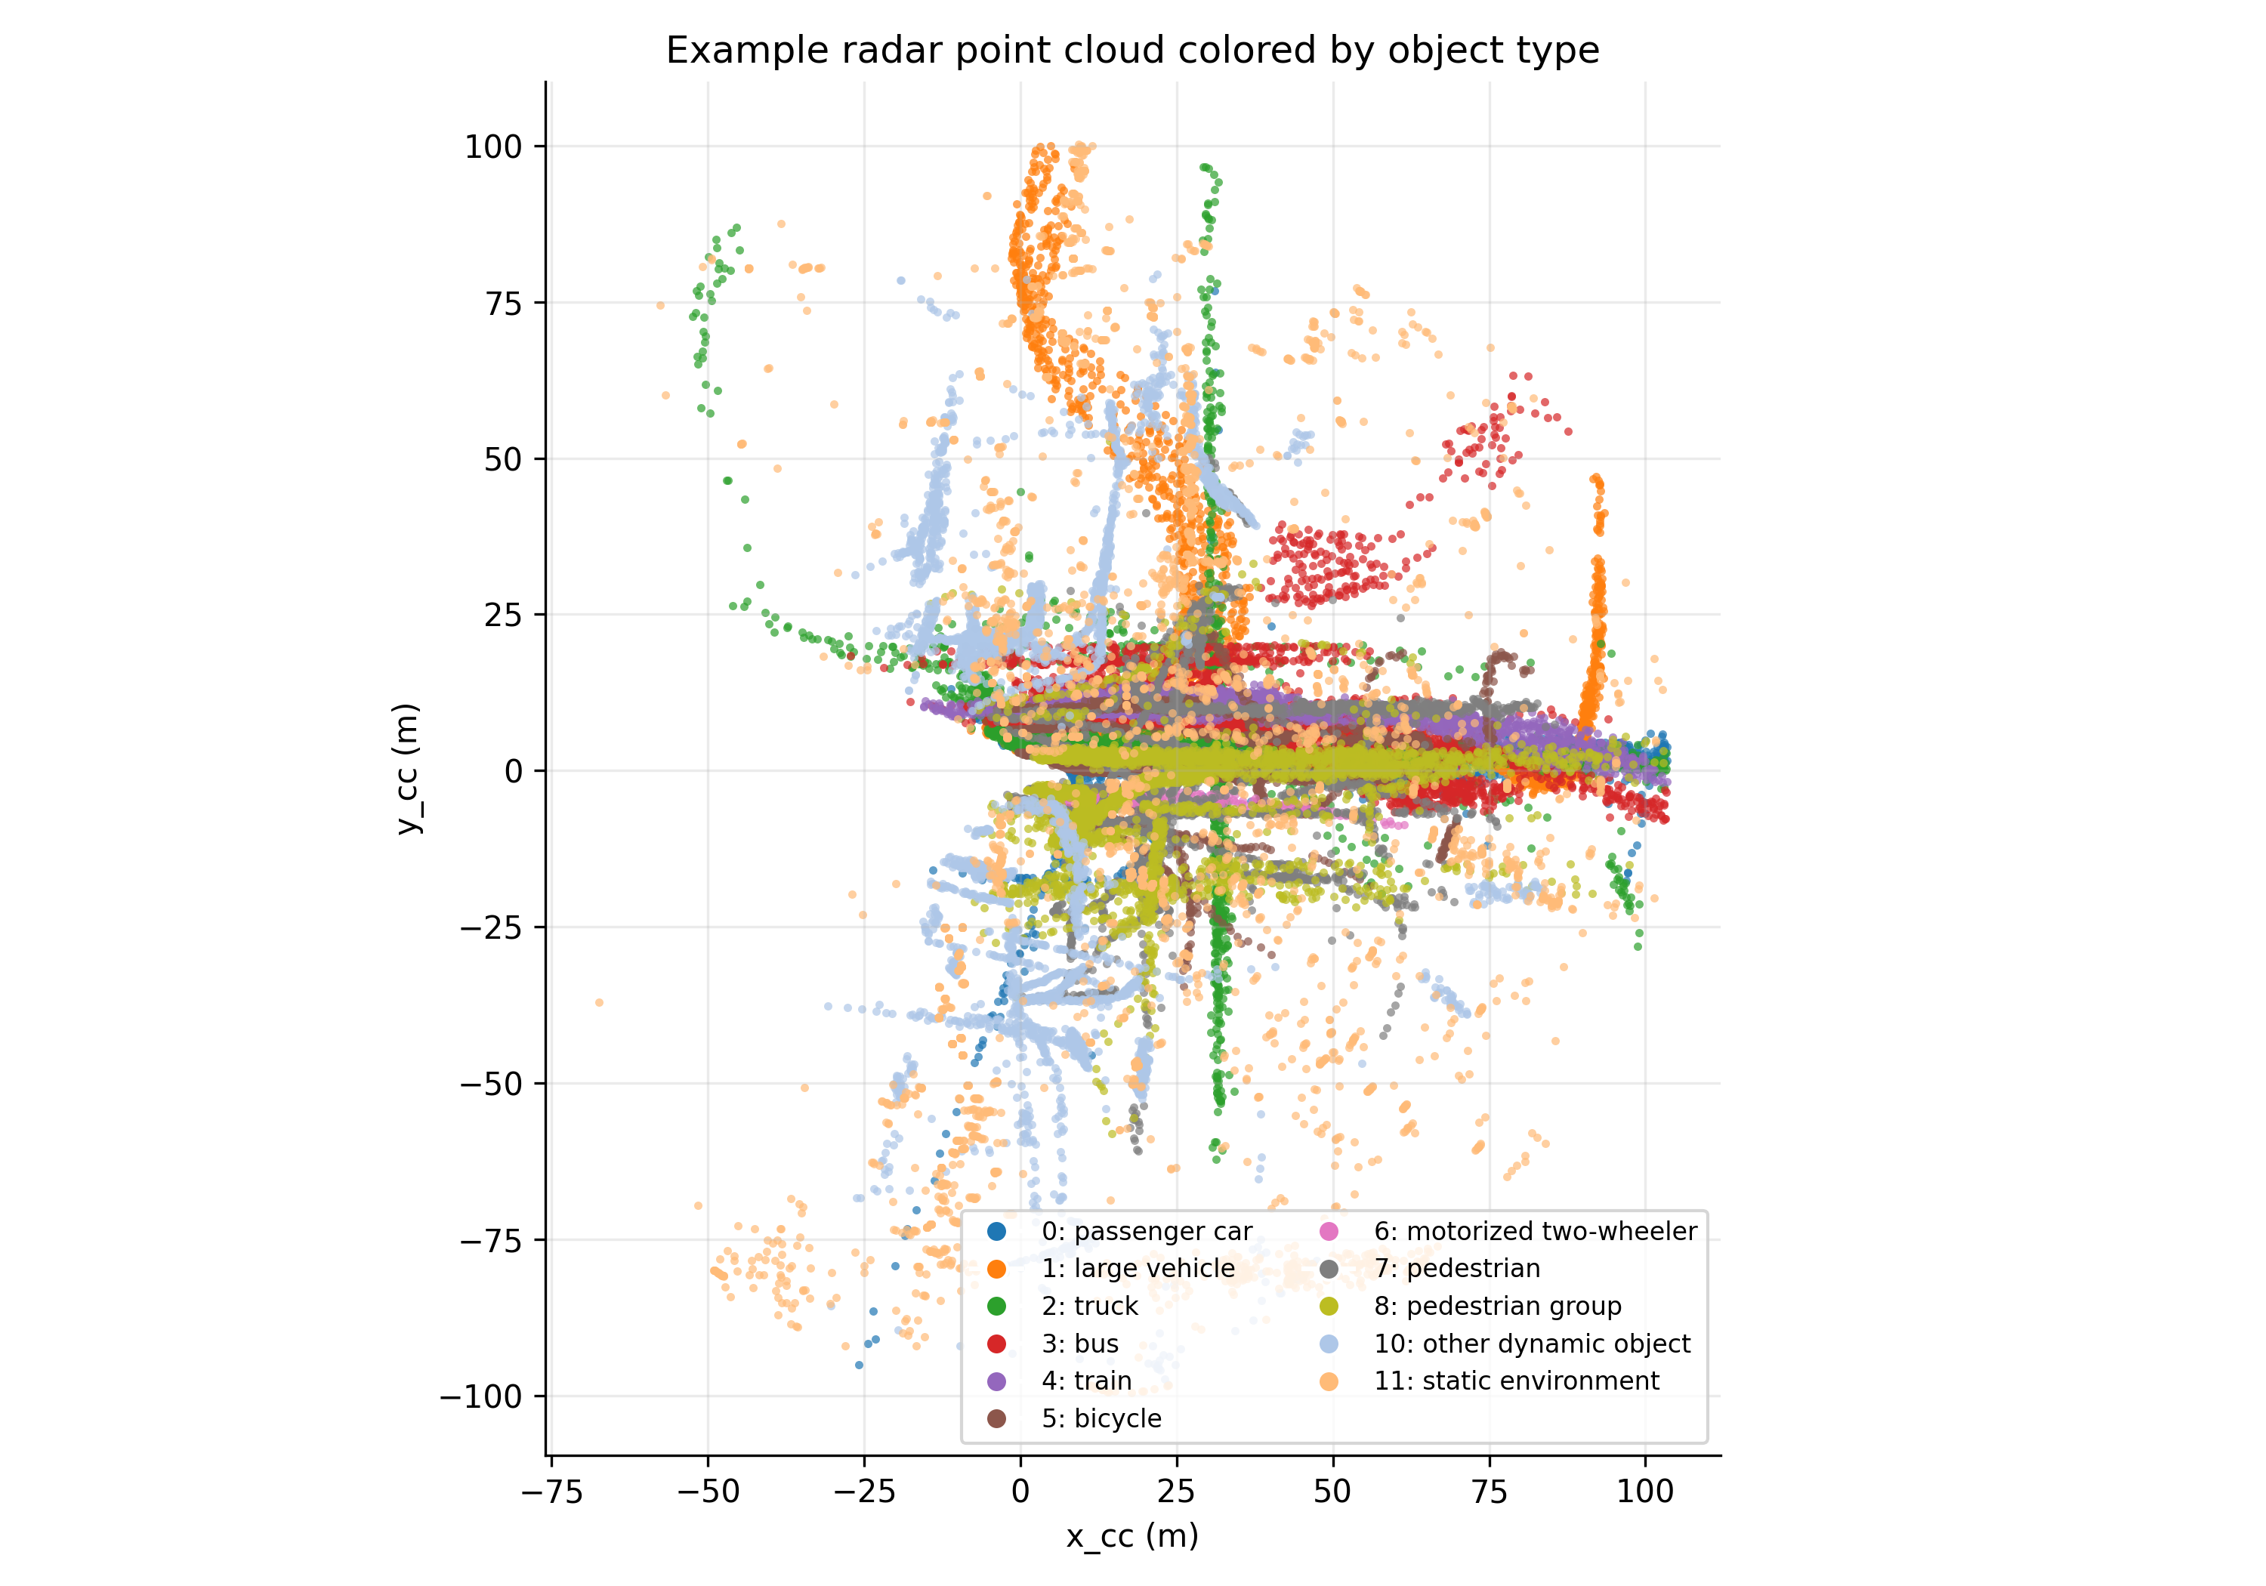
Mathematics: radar coordinates and ego-motion context
Polar-to-Cartesian relationship: x = r cos(theta), y = r sin(theta).
range_sc and azimuth_sc describe sensor-coordinate geometry.
x_cc and y_cc express detections in the car coordinate frame.
x_seq and y_seq express detections in a sequence/global frame linked to ego pose over time.
vr_compensated is important because it reduces ego-motion influence in radial velocity.
Final pipeline: 50 RadarScenes sequences | radar-only supervised label classification

Slide 43
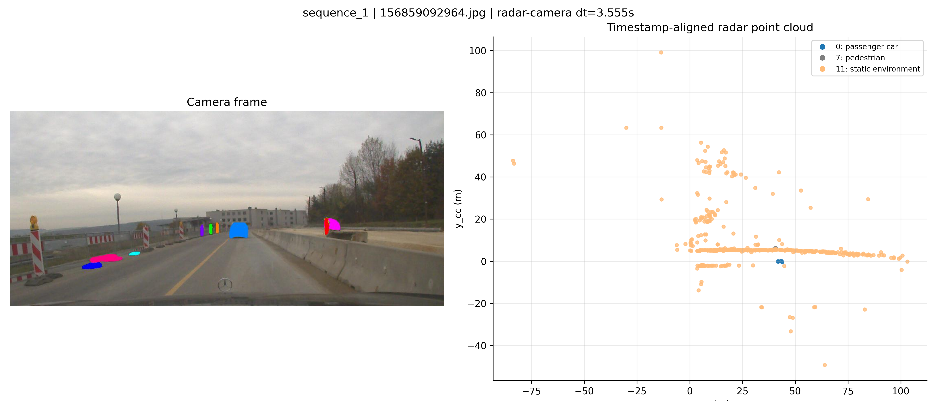
Timestamp alignment: radar, odometry, camera
For each selected camera timestamp t_c, the nearest radar and odometry timestamps are selected:
t_r* = argmin |t_r - t_c|
t_o* = argmin |t_o - t_c|
The output table records radar-camera and radar-odometry time differences.
The figure is a timestamp-aligned view, not a radar projection onto the image.
Final pipeline: 50 RadarScenes sequences | radar-only supervised label classification

Slide 44
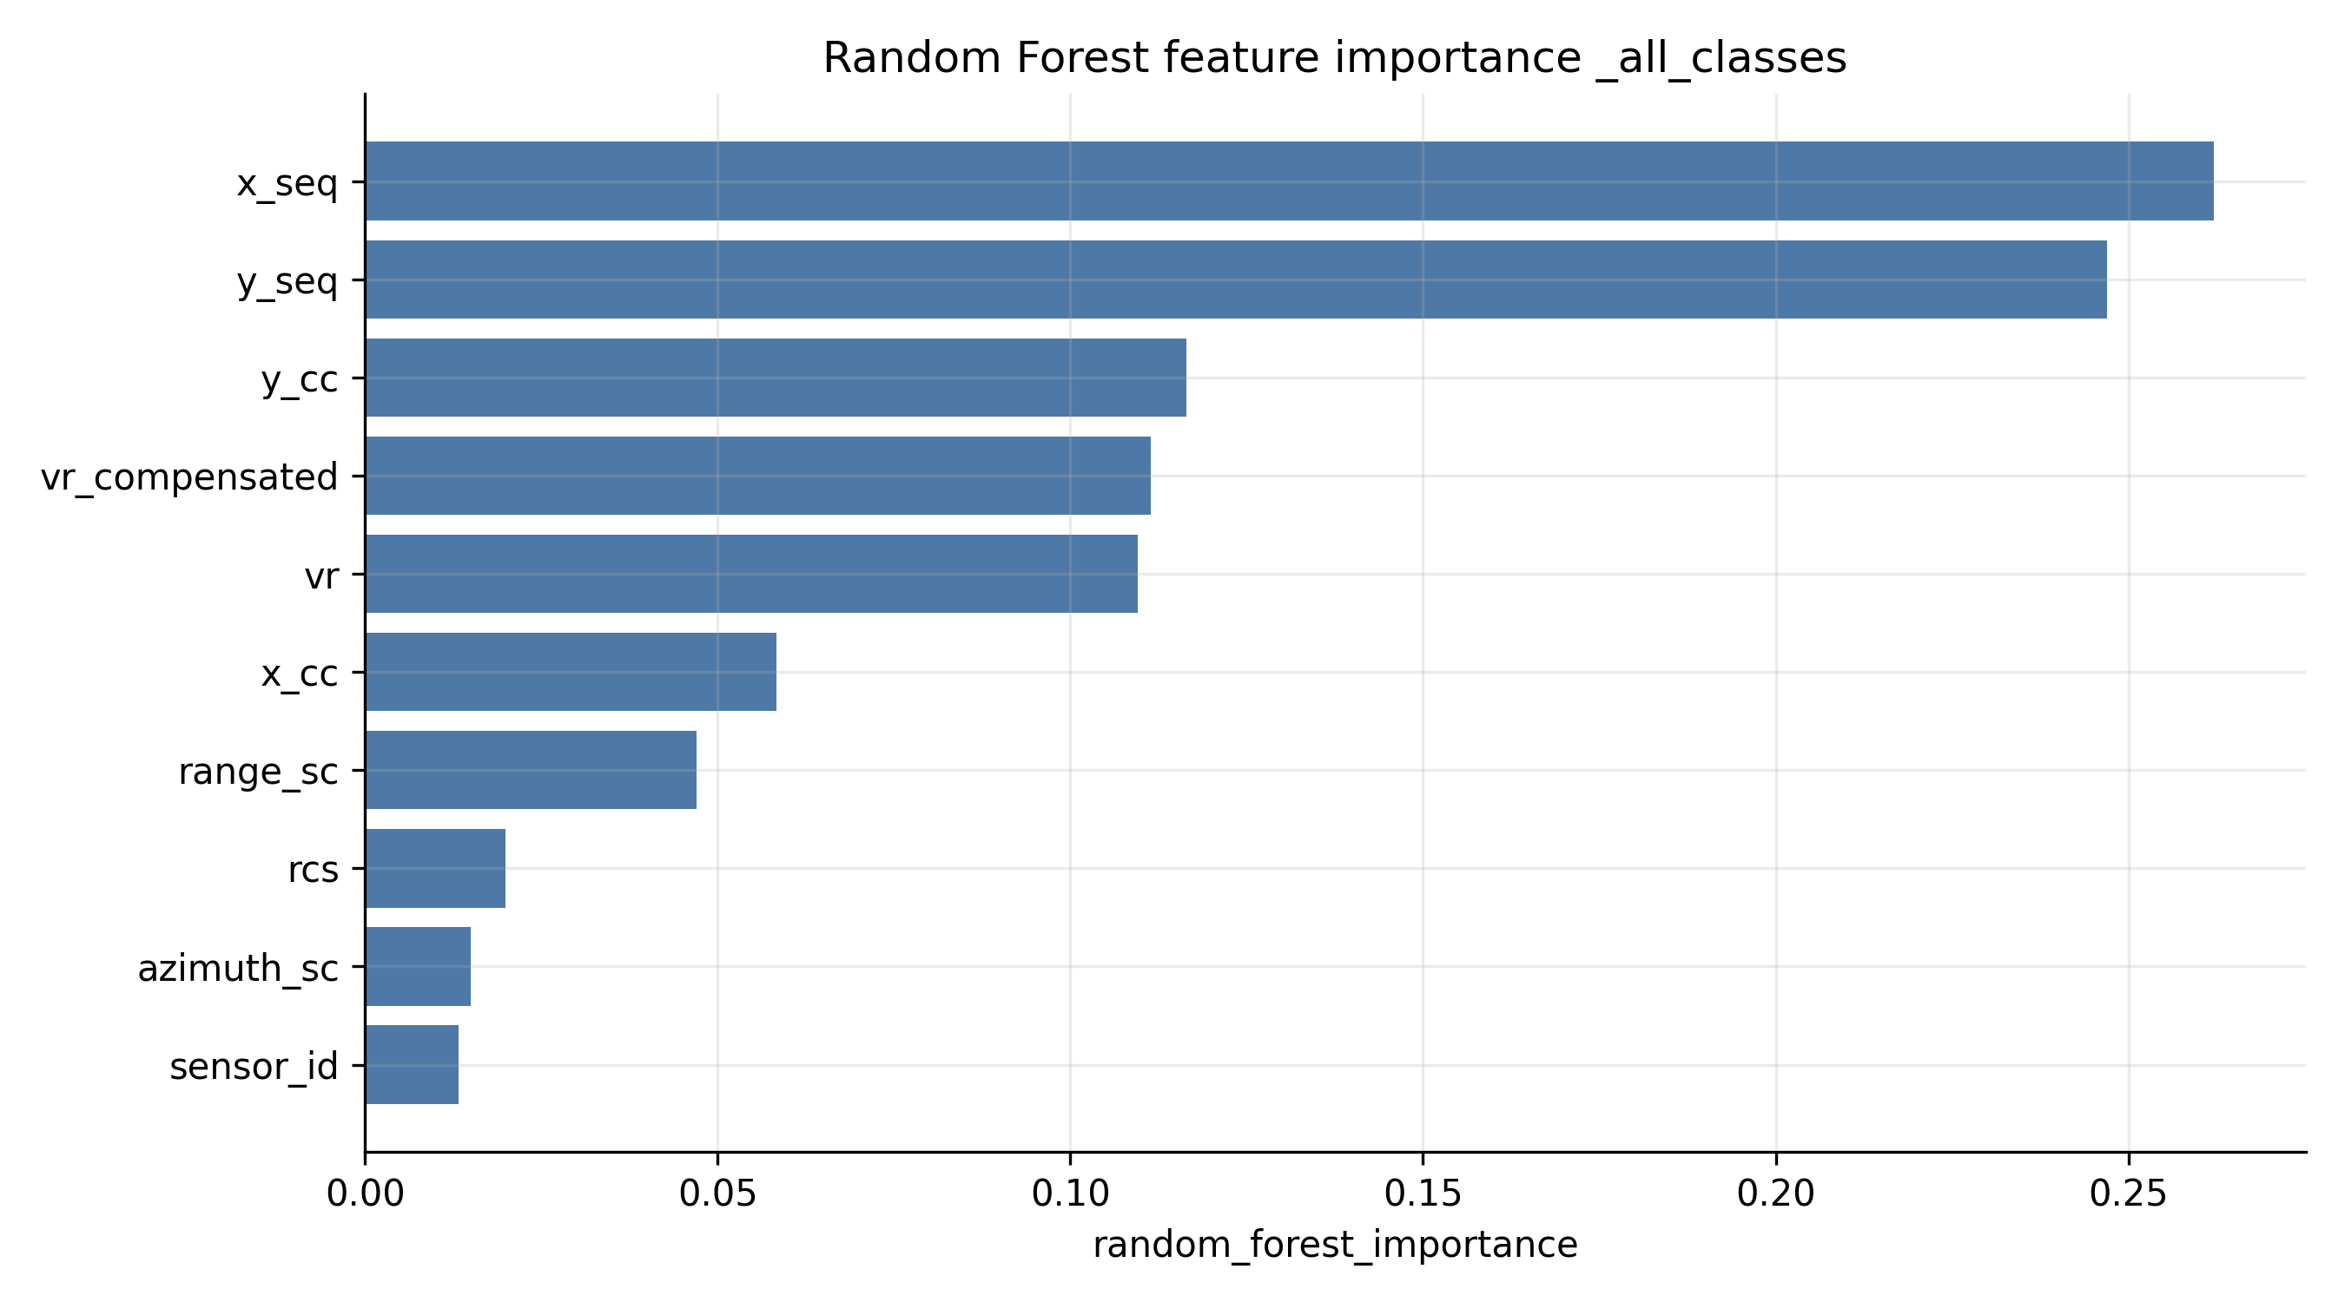
Feature selection: rigorous, not brute-force
Exhaustive subset testing grows as 2^n - 1 feature subsets.
With 10 features, that is 1023 subsets before adding engineered features.
The final project uses mutual information, logistic coefficients, Random Forest importance, and permutation importance.
Agreement across methods is stronger evidence than one ranking alone.
Final pipeline: 50 RadarScenes sequences | radar-only supervised label classification

Slide 45
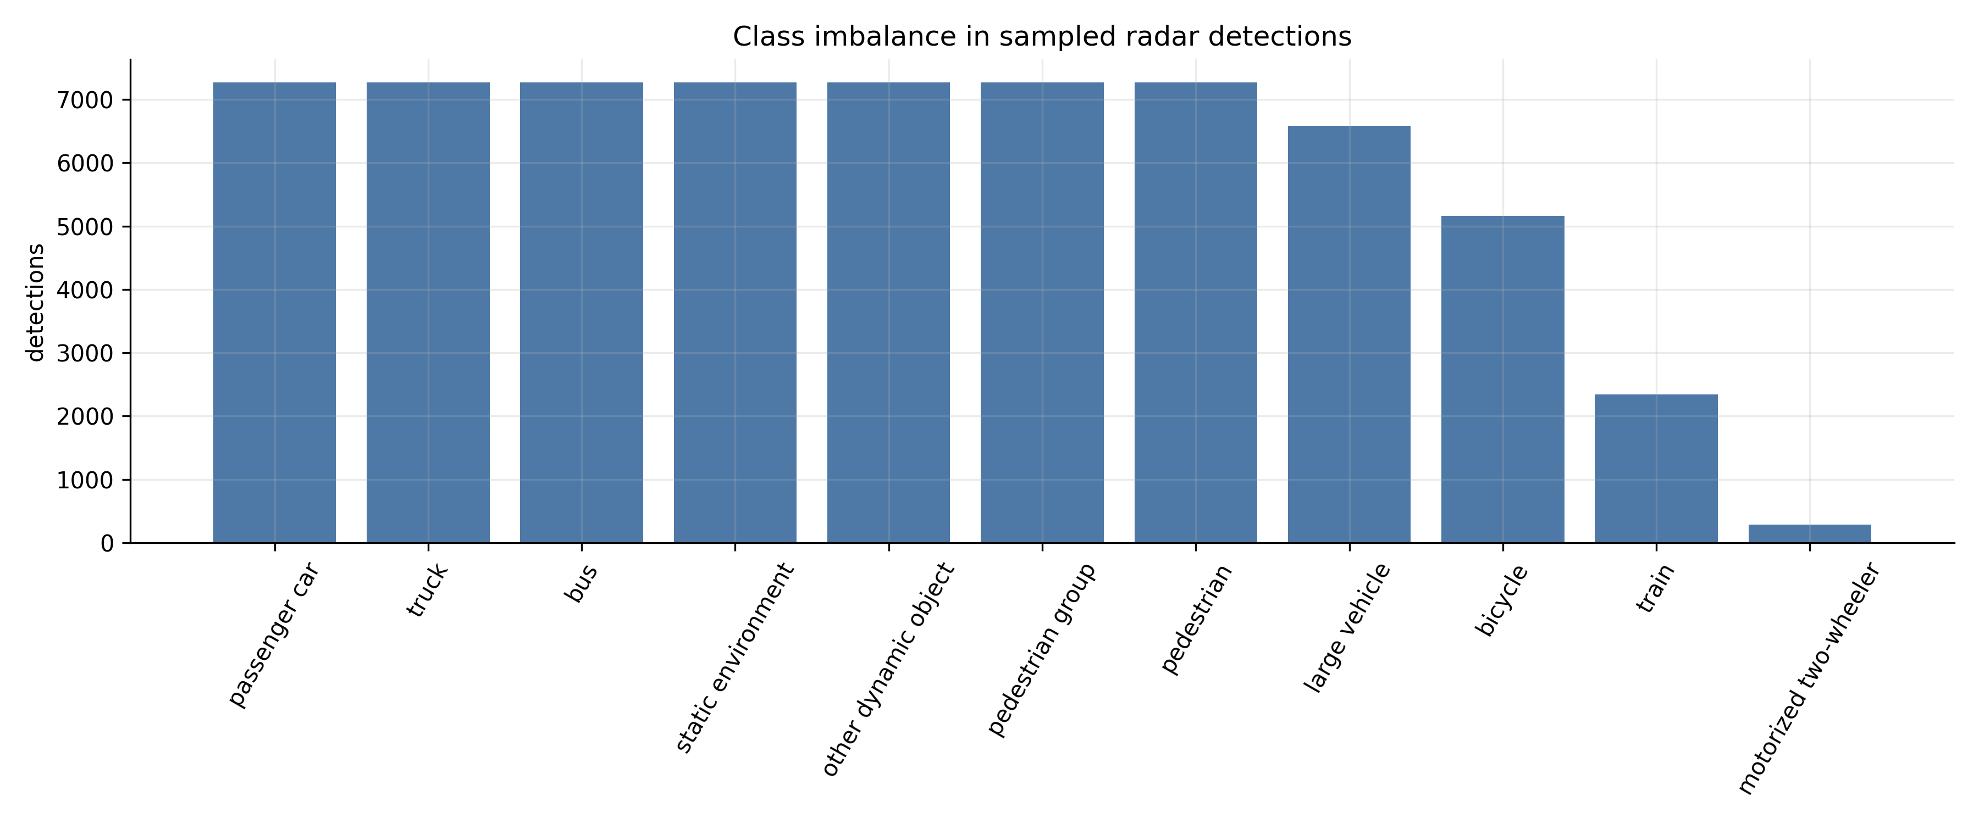
Supervised learning formulation
Input vector x_i = [range, azimuth, rcs, velocity, coordinates, sensor_id].
Target y_i = label_id, using the official class mapping.
Models trained: Logistic Regression, KNN, Linear SVM, RBF SVM, Random Forest, and MLPClassifier.
Preferred split: sequence-level train/test split to test on unseen sequences.
Class imbalance is handled with class weights where available, balanced sampling for expensive stages, and macro metrics.
Final pipeline: 50 RadarScenes sequences | radar-only supervised label classification

Slide 46
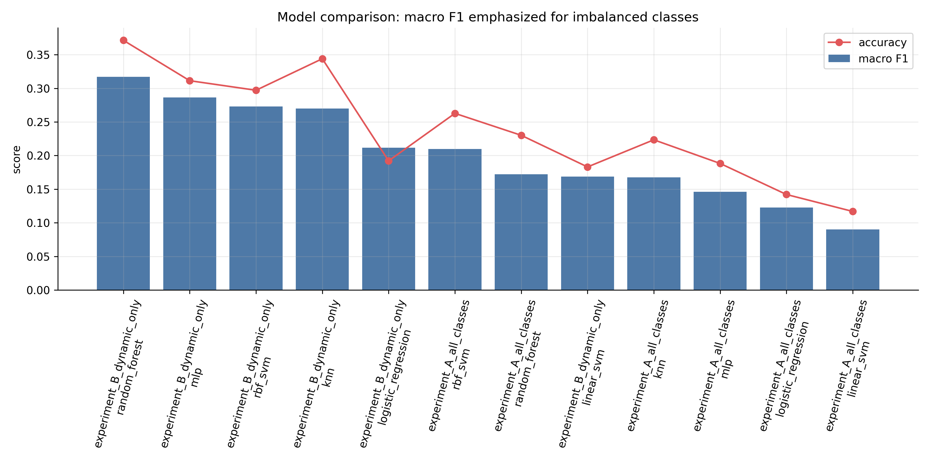
Evaluation mathematics: why macro F1 matters
precision_k = TP_k / (TP_k + FP_k)
recall_k = TP_k / (TP_k + FN_k)
F1_k = 2 precision_k recall_k / (precision_k + recall_k)
macro F1 = average F1 across classes, treating rare and common classes equally.
Accuracy alone is not enough because static/background and frequent classes can dominate.
Final pipeline: 50 RadarScenes sequences | radar-only supervised label classification

Slide 47
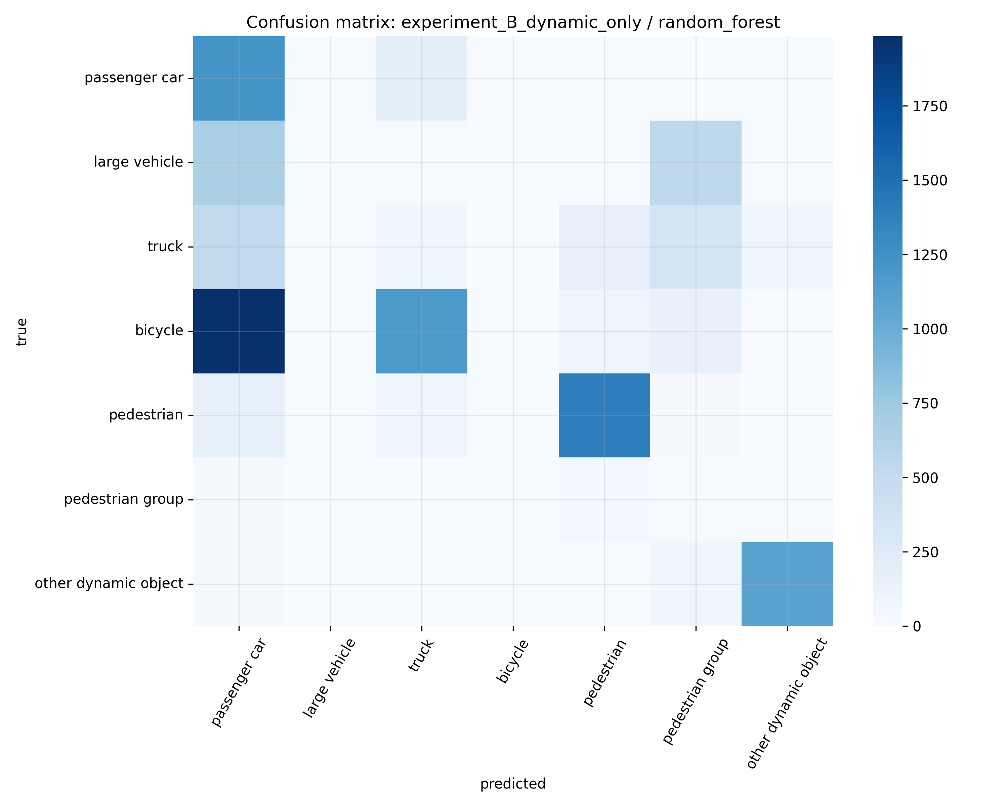
Final model result and interpretation
Best macro F1: experiment_B_dynamic_only / random_forest
Accuracy: 0.371
Macro F1: 0.317
Macro recall: 0.408
Dynamic-only classification performed better than all-class classification, showing the difficulty introduced by static environment imbalance.
The result is a defensible radar-only baseline, not a final production perception model.
Final pipeline: 50 RadarScenes sequences | radar-only supervised label classification

Slide 48
Corrections, limitations, and next steps
Correction: the final work is not Sequence 102 only; it processes 50 sequences generically.
Correction: label_id and sensor_id are categorical, so figures use discrete colors and legends, not continuous colorbars.
Correction: camera/radar examples are timestamp-aligned side-by-side views, not projected overlays.
Limitation: radar points are classified mainly from point features; temporal modeling could improve results.
Next steps: calibration-based camera projection, richer track features, hyperparameter search, and sequence cross-validation.
Final pipeline: 50 RadarScenes sequences | radar-only supervised label classification

Slide 49
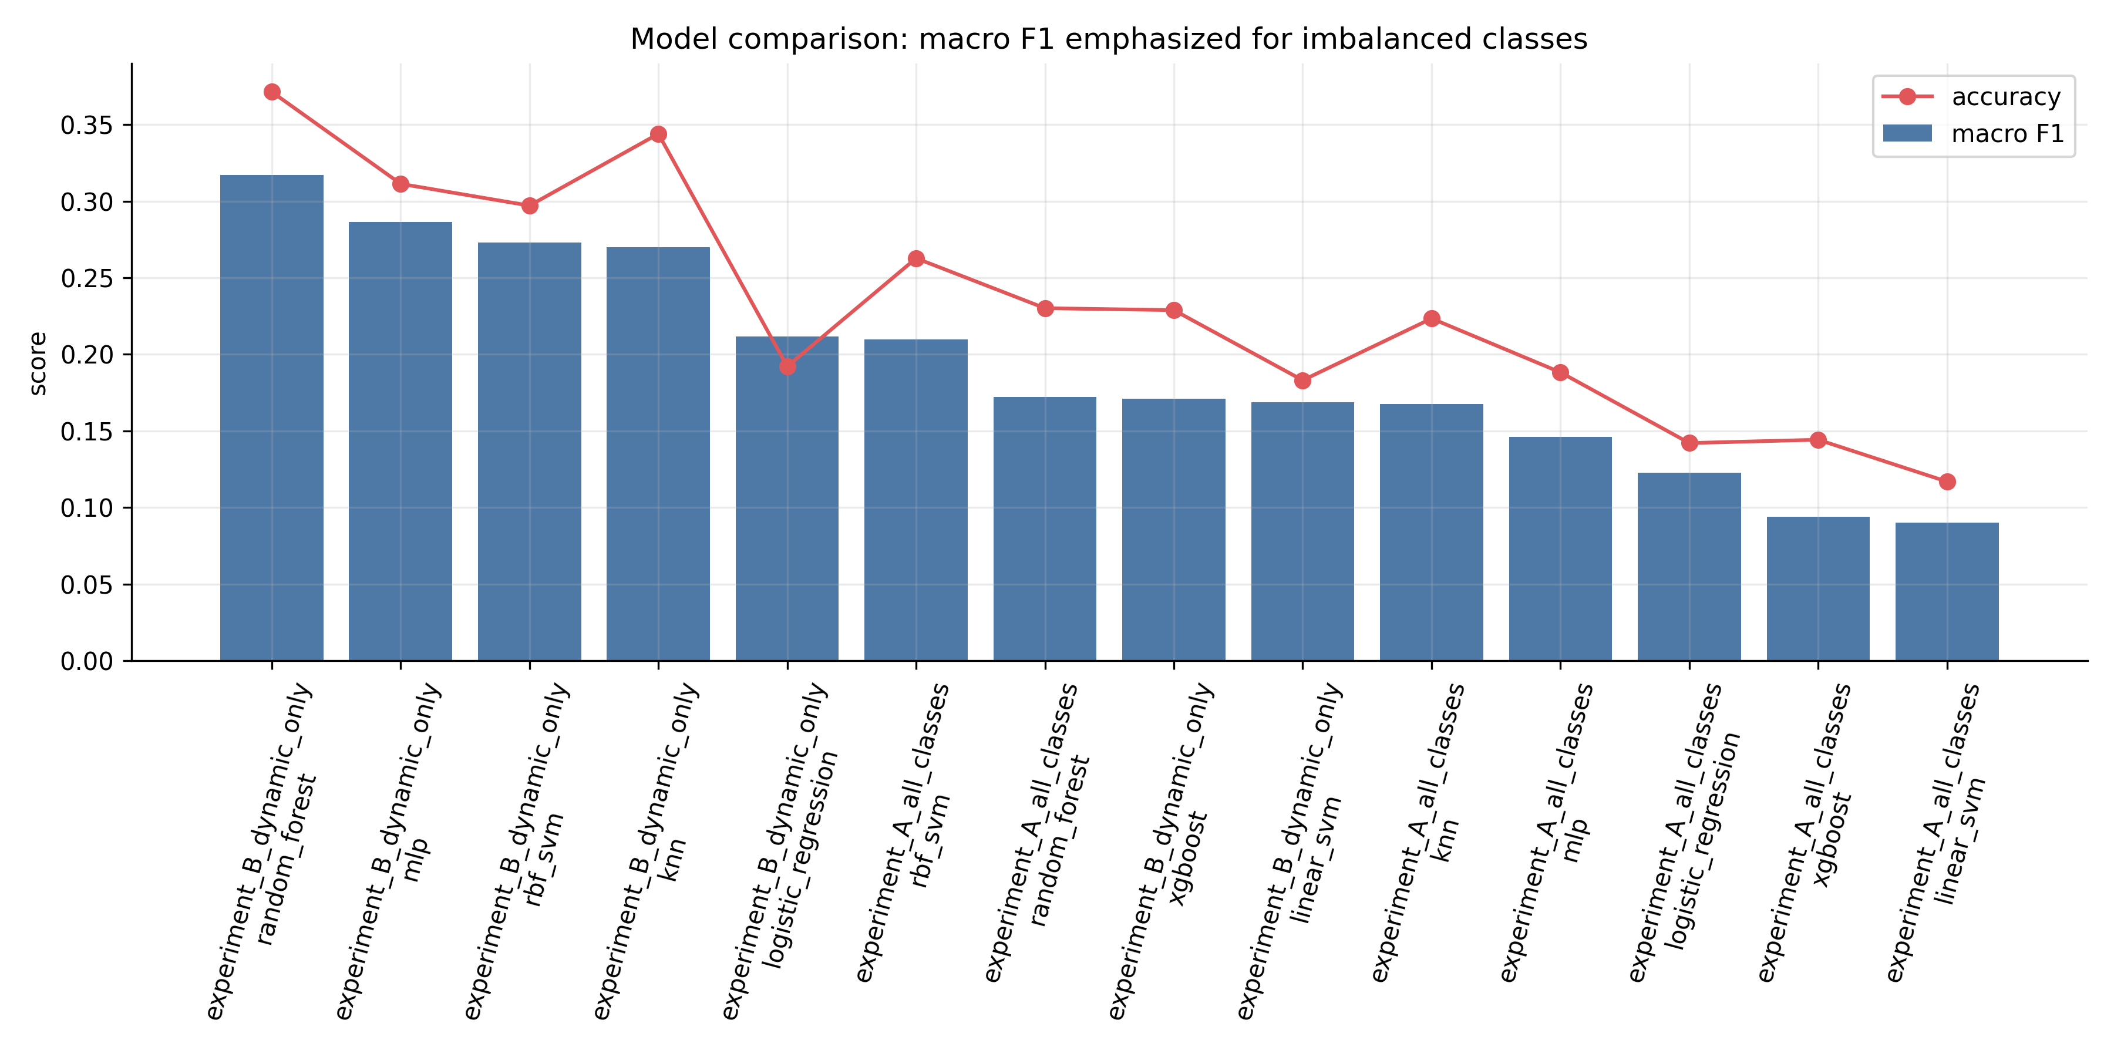
Added model: XGBoost baseline
XGBoost was installed and trained for both final experiments.
The code now label-encodes classes internally because XGBoost expects contiguous class indices, then maps predictions back to official label_id values.
experiment_A_all_classes: accuracy 0.144, macro F1 0.094, macro recall 0.205
experiment_B_dynamic_only: accuracy 0.229, macro F1 0.171, macro recall 0.247
Result: XGBoost did not outperform Random Forest on this radar-only baseline.
Interpretation: stronger boosting models still need good features, careful tuning, and enough minority-class structure; macro F1 remains the key metric.
Final pipeline: XGBoost added, trained, evaluated, and included in model comparison

Slide 50
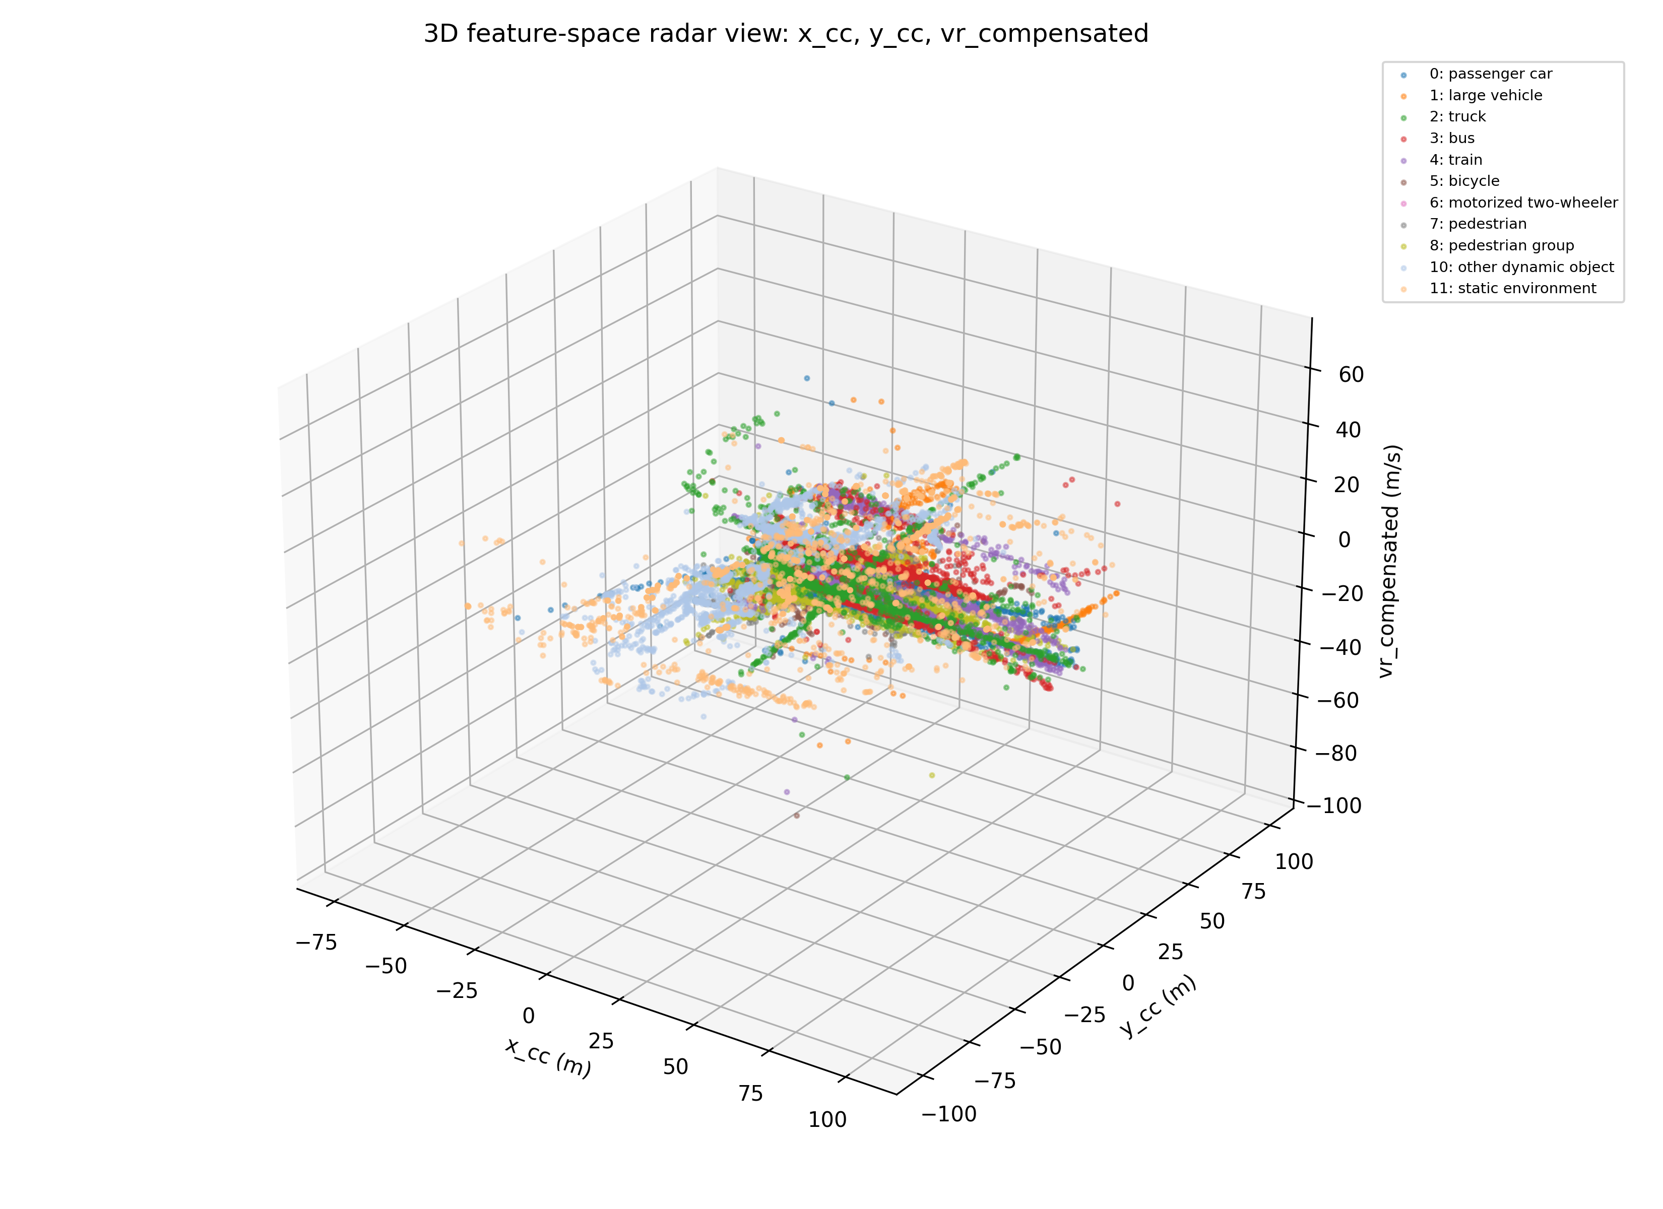
3D feature-space visualization
A 3D visual element was added to the final pipeline.
Axes: x_cc, y_cc, and vr_compensated.
This is useful for inspecting how object labels distribute across position and compensated radial velocity.
Important correction: this is not a physical 3D reconstruction or camera projection because the selected RadarScenes point fields do not provide object height.
The slide therefore calls it 3D feature-space visualization, which is accurate and defensible.
Final pipeline: 3D feature view added without overclaiming physical 3D reconstruction

Slide 51
Data acquisition: what RadarScenes contains
RadarScenes was recorded with one measurement vehicle carrying four automotive radar sensors.
A front-facing documentary camera is included for human scene understanding.
Odometry is stored with radar data and describes ego pose and ego motion.
The full dataset has 158 sequences and over four hours of recordings; this project processes 50 sequences.
The supervised learning target is point-wise label_id, not camera-image annotation.
Final RadarScenes pipeline: data, synchronization, features, models, website, and limitations

Slide 52
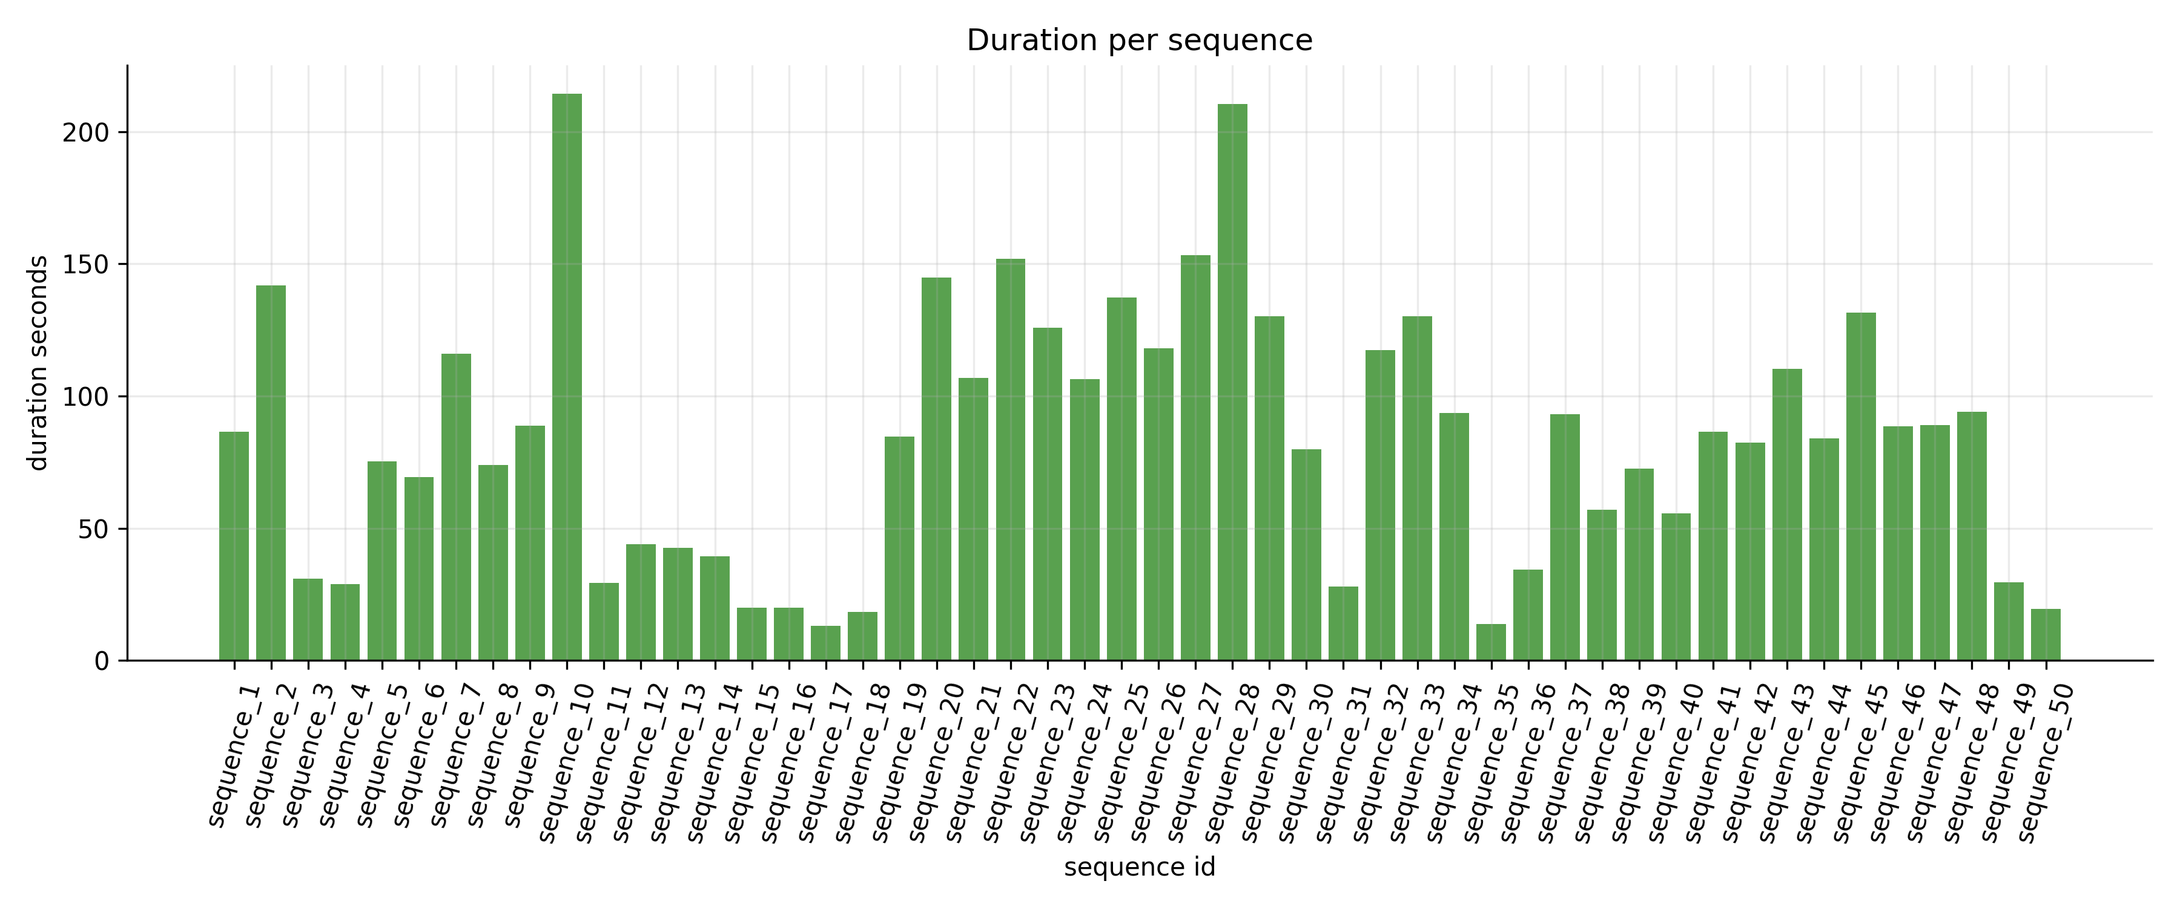
Sequence duration: relevant, but not a problem
Processed 50 sequences are unequal in duration and sample count.
Observed duration range: about 13.2 s to 214.3 s.
Average processed-sequence duration: about 84.3 s.
Longer sequences can contribute more radar detections, camera images, and odometry samples.
This is handled by reporting sequence statistics and using sequence-level train/test splitting where possible.
Final RadarScenes pipeline: data, synchronization, features, models, website, and limitations

Slide 53
Camera, radar, and odometry: the correct relationship
Radar detections are the classification samples.
Camera images are documentary context and are named by timestamp.
Odometry provides ego-vehicle x/y position, yaw, velocity, and yaw rate.
The pipeline links them using nearest timestamps and saves the time differences.
Important correction: the side-by-side figures are timestamp-aligned views, not calibrated radar-to-camera projections.
Final RadarScenes pipeline: data, synchronization, features, models, website, and limitations

Slide 54
Final interactive website
A portable static website was created in FINAL_SUBMISSION/project_website/index.html.
It contains curated final visuals only; unused midterm-specific image dumps were removed.
It includes a camera/radar/odometry relationship explainer with interactive hotspots.
The 3D visualization now has selectable X, Y, and Z radar parameters, sensor filter, label filter, and point limit.
This makes the project easier to defend because the links between dataset, math, features, models, and limitations are visible in one place.
Final RadarScenes pipeline: data, synchronization, features, models, website, and limitations

Slide 55
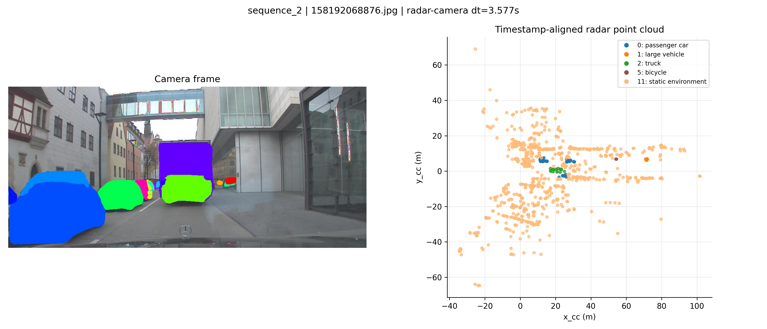
Two timestamp-aligned scenes: same method, different evidence
The images are documentary context; the radar plots are the supervised label-bearing data.
Scene A: sequence_1 | 408 radar detections | mostly static environment
Scene B: sequence_2 | 869 radar detections | cars, truck, large vehicle, bicycles
The correct wording is timestamp-aligned camera and radar view, not radar projected onto camera.
Both examples come from the same link table: nearest camera timestamp, nearest odometry timestamp, and radar points near the selected frame.

Slide 56
What changes between the two scenes?
This comparison prevents the audience from assuming that one frame represents the whole dataset.
Aspect
Scene A: sparse road
Scene B: dense urban street
Meaning for ML
Context
Open road / bridge approach
Urban street with buildings and structure
Road geometry changes the static radar background.
Nearby radar detections
408
869
The number of samples varies by scene and duration.
Labels near frame
400 static, 6 car, 2 pedestrian
785 static, 57 car, 20 truck, 5 large vehicle, 2 bicycle
Class imbalance is present locally and globally.
Camera role
Visual explanation of the road scene
Visual explanation of a more complex scene
Camera is context, not the feature input.
Radar role
Few dynamic objects among static returns
More dynamic object classes among static returns
The classifier learns from radar features and label_id.
Odometry role
Links car coordinates to sequence motion
Same link, more crowded environment
Ego-motion context makes coordinates/velocity interpretable.
Takeaway: unequal sequence/frame content is not an error. It is exactly why the pipeline reports durations, label counts, sensor counts, and macro/per-class metrics.
The two scenes share the same reproducible pipeline, but they expose different failure modes: static dominance in Scene A and denser multi-class separation in Scene B.

Slide 57
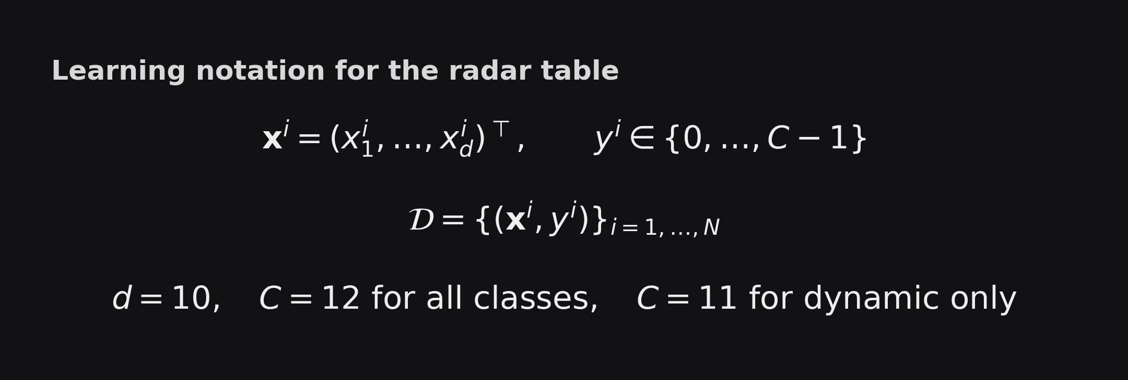
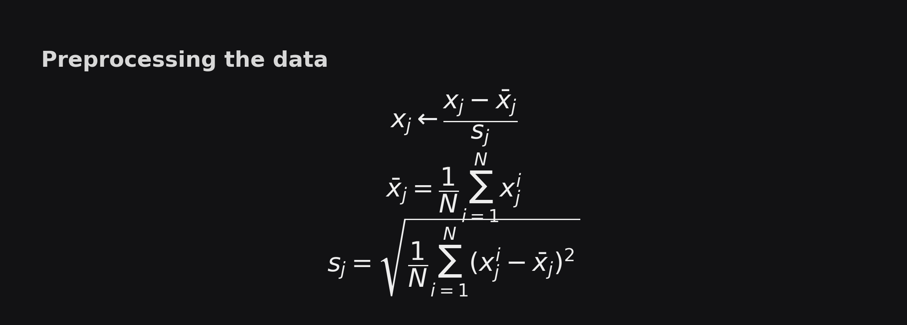
Model detail: Logistic Regression and kNN
Compact version of the deep dive: same data, same scaling, different prediction mechanisms.
Each radar point is one supervised sample: x^i contains range, azimuth, RCS, velocity, coordinates, and sensor_id; y^i is label_id.
The same training/test split and the same StandardScaler transformation are used before Logistic Regression and kNN.
The scaler learns x_bar_j and s_j only from the training samples, then applies the transformation to test samples.
Why this slide matters: both models start from exactly the same normalized feature table.

Slide 58
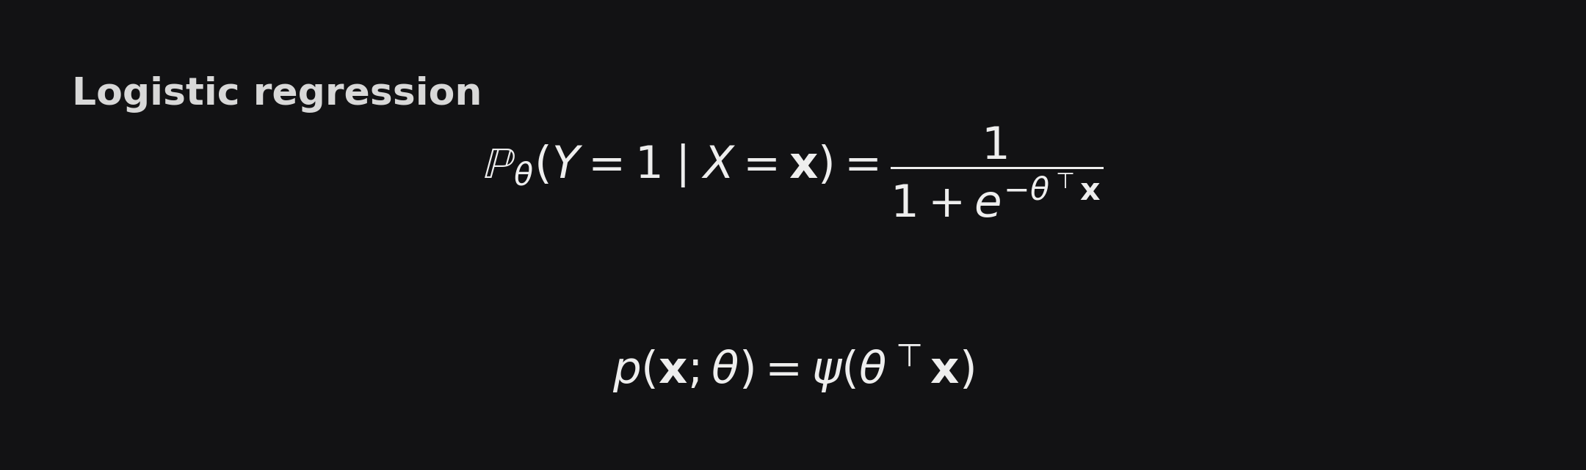


Logistic Regression: learned parameters
The model learns theta: weights on the normalized features.
For multiclass RadarScenes, the implementation learns one theta_c per class.
Prediction chooses the class with the largest estimated probability.
Coefficient magnitudes are interpretable because the features were scaled first.

Slide 59


k-nearest neighbors: stored examples and voting
experiment | model | accuracy | macro recall | macro F1
A: all classes | Logistic Reg. | 0.142 | 0.232 | 0.123
A: all classes | kNN | 0.223 | 0.305 | 0.168
B: dynamic only | Logistic Reg. | 0.192 | 0.285 | 0.212
B: dynamic only | kNN | 0.344 | 0.343 | 0.270
kNN has no learned theta once k is fixed.
Here k = 7: a test point x_new is assigned by majority vote among the 7 closest scaled training points.
It is more local and flexible than Logistic Regression, but prediction is more expensive.
Main takeaway: kNN beats Logistic Regression on macro F1 here, but both are baseline models; Random Forest remains the best final model.

Slide 60



Random Forest: ensemble of decision trees
The model trains many trees on randomized samples/features and combines their votes.
Tree splits choose thresholds that reduce impurity, shown with the Gini decrease.
In the final result, Random Forest is the best model by macro F1.
exp | model | acc | macro recall | macro F1
A all | RF | 0.230 | 0.357 | 0.172
B dyn | RF | 0.371 | 0.408 | 0.317

Slide 61



MLPClassifier: learned nonlinear features
The network maps x through hidden layers of sizes 64 and 32.
Weights W and biases b are optimized from the training set using a cross-entropy objective.
early_stopping=True prevents the model from training too long when validation performance stops improving.
exp | model | acc | macro recall | macro F1
A all | MLP | 0.188 | 0.256 | 0.146
B dyn | MLP | 0.311 | 0.383 | 0.287

Slide 62


RBF SVM: nonlinear boundary through a kernel
The RBF kernel measures similarity in scaled feature space.
Only support vectors SV define the decision function.
It performed strongly on macro F1 but is more expensive than linear models.
exp | model | acc | macro recall | macro F1
A all | RBF SVM | 0.263 | 0.331 | 0.210
B dyn | RBF SVM | 0.297 | 0.368 | 0.273

Slide 63


XGBoost: boosted decision trees
Trees are added sequentially; each new tree tries to improve the current predictions.
The objective combines classification loss with a tree-complexity penalty.
In this project, XGBoost was trained and evaluated, but Random Forest performed better.
exp | model | acc | macro recall | macro F1
A all | XGB | 0.144 | 0.205 | 0.094
B dyn | XGB | 0.229 | 0.247 | 0.171

Slide 64
Model comparison: what to say out loud
exp | model | acc | macro recall | macro F1
A all | MLP | 0.188 | 0.256 | 0.146
A all | RBF SVM | 0.263 | 0.331 | 0.210
A all | RF | 0.230 | 0.357 | 0.172
A all | XGB | 0.144 | 0.205 | 0.094
B dyn | MLP | 0.311 | 0.383 | 0.287
B dyn | RBF SVM | 0.297 | 0.368 | 0.273
B dyn | RF | 0.371 | 0.408 | 0.317
B dyn | XGB | 0.229 | 0.247 | 0.171
Best final model: dynamic-only Random Forest.
Best baseline group after RF: MLP/RBF SVM/kNN are competitive.
XGBoost was included, but underperformed with this setup.
Macro F1 remains the main comparison metric because the dataset is class-imbalanced.

Slide 65
Course framing: why these models belong here
Hypothesis class H: Logistic Regression, kNN, SVM, Random Forest, MLP, and XGBoost are different candidate families.
Loss/evaluation: training minimizes model-specific losses, while the final report compares accuracy, macro recall, and macro F1.
Learning algorithm A: fit the model on the training set, predict on held-out sequences, and select the model with the best validation/test behavior.
Occam's razor explains why simple baselines are kept: use the least complex model that explains the data well enough before trusting heavier models.
This turns the project into model selection, not just trying algorithms randomly.

Slide 66
Lecture 2 connection: design matrix and linear baseline
The RadarScenes feature table is the design matrix A.
Each row is one radar point x^i; each column is one feature x_j.
Linear Regression from lecture 2 becomes a classification baseline once the logistic link is used.
Relevant implementation choice: the project starts with interpretable linear/logistic baselines, then compares more flexible models.
Relevant limitation: if the true radar-label relationship is nonlinear, a linear model may underfit; this motivates Random Forest, RBF SVM, MLP, and XGBoost.
This is also why the final explanation reports both equations and empirical metrics.

