Slide 1

VTI GenericWS
GAIAN Database

Slide 2
GenericWS - Presentation
Access Web services:
  REST - GET / POST
  SOAP
Manage data:
  XML
  JSON
Manage local data files

Slide 3
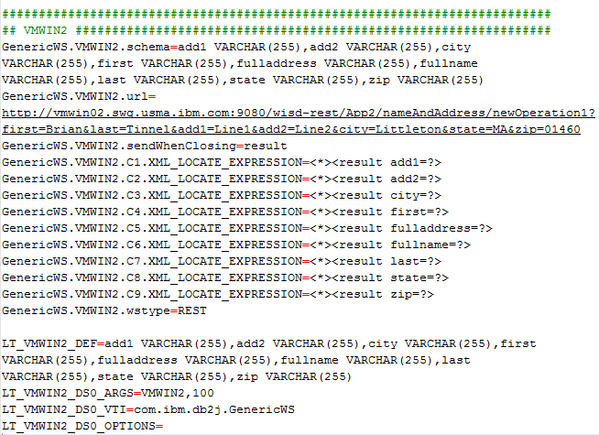
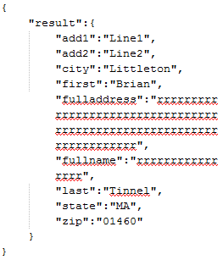
GenericWS - REST + JSON

Slide 4
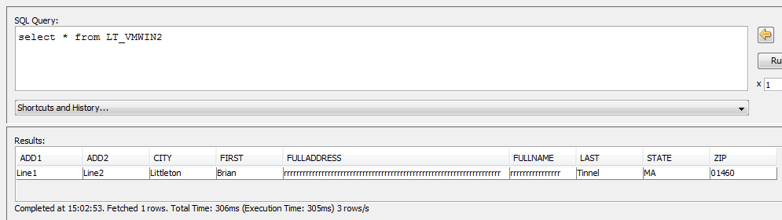
GenericWS - REST + JSON

Slide 5
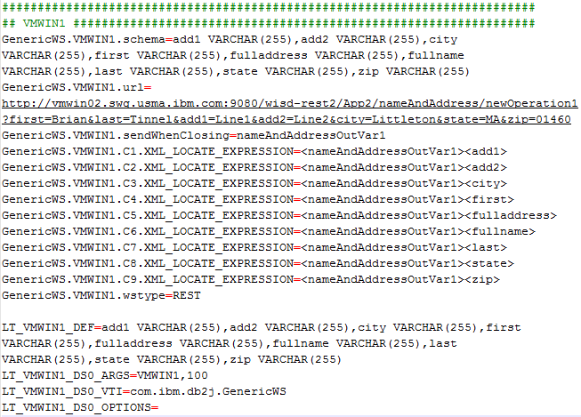
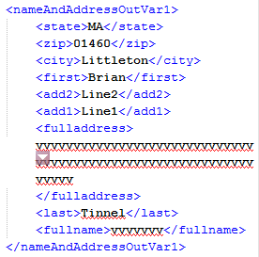
GenericWS - REST + XML

Slide 6
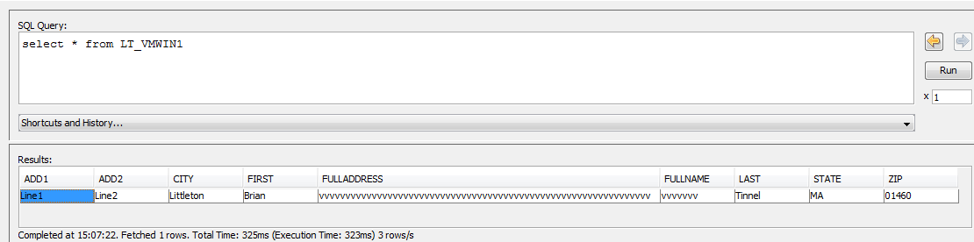
GenericWS - REST + XML

Slide 7
