Slide 1

VTI GenericWS
GAIAN Database

Slide 2
Overview
VTI GenericWS

Slide 3
Overview
Accesses Web services:
  REST - GET / POST
  SOAP
  local data files
Manages data:
  XML / XHTML
  JSON

Slide 4
Architecture
VTI GenericWS

Slide 5
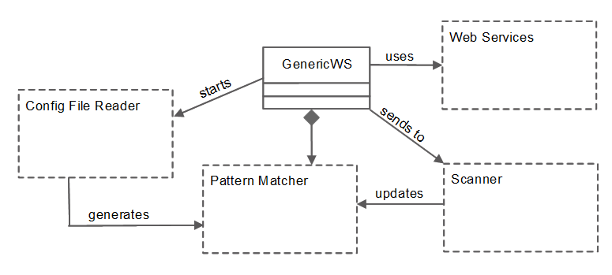
General architecture

Slide 6
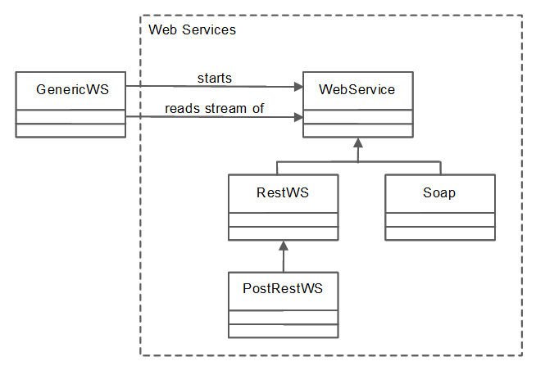
Web Services package

Slide 7
Web Services package
com.ibm.gaiandb.webservices.ws
Purpose:
  Access web services
    Thanks to the URL
    Send data to the web service to initiate request (optional)
  Read returned data which are then accessible by the GenericWS VTI

Slide 8
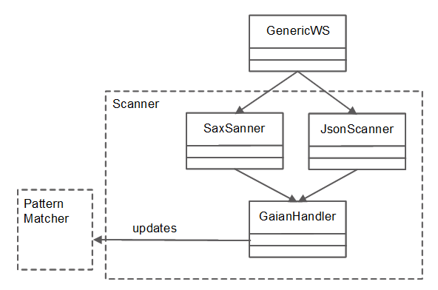
Scanner package

Slide 9
Scanner package
com.ibm.gaiandb.webservices.scanner
Purpose:
  Interpret data received from web services
    Interpret the XML and JSON data.
      Start elements ( <record type=”person”> )
      End element ( </record> )
      Tag's values
  Send the interpreted data to the GenericWS VTI (Pattern Matcher package)

Slide 10
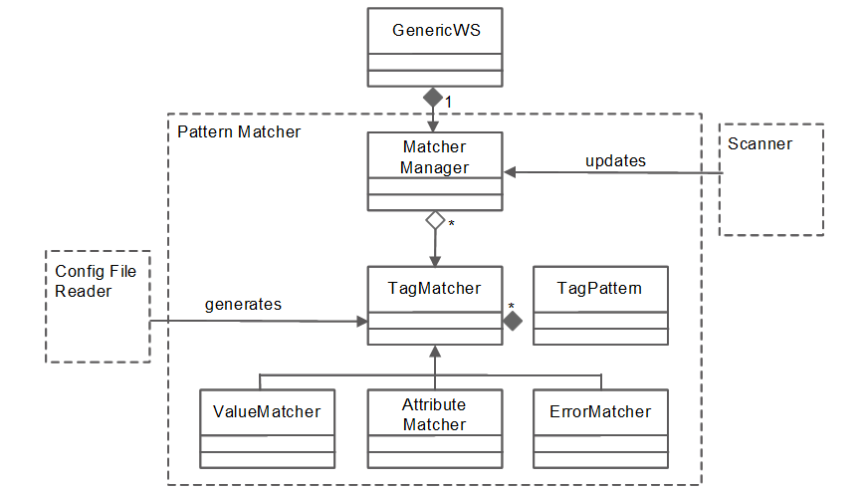
Pattern Matcher package

Slide 11
Pattern Matcher package
com.ibm.gaiandb.webservices.patternmatcher
Purpose:
  Contains all the patterns matching the leafs to find in the XML and JSON trees returned by the web services
    1 pattern = 1 VTI column
  Matcher Manager
    receive scanned element from scanner
    Forward it to all its Tag matchers

Slide 12
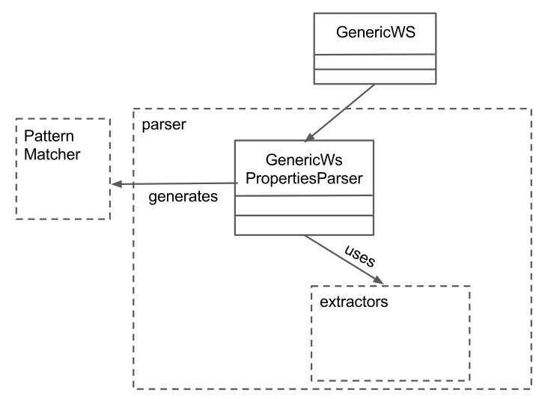
Config File Reader package

Slide 13
Config File Reader package
com.ibm.gaiandb.webservices.parser
Purpose:
  Parse properties value
    GenericWS.prefix.C#.XML_LOCATE_EXPRESSION
  Generate Tag Matchers
    Parse property content into a list of Tag Pattern
  Insert Tag Matchers into the GenericWS's Matcher Manager

Slide 14
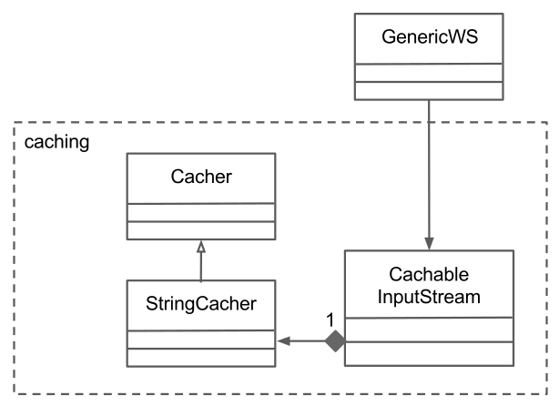
Caching package

Slide 15
Config File Reader package
com.ibm.gaiandb.webservices.caching
Purpose:
  Provide an InputStream which can be cached
    Cached in memory
    Currently no memory release

Slide 16
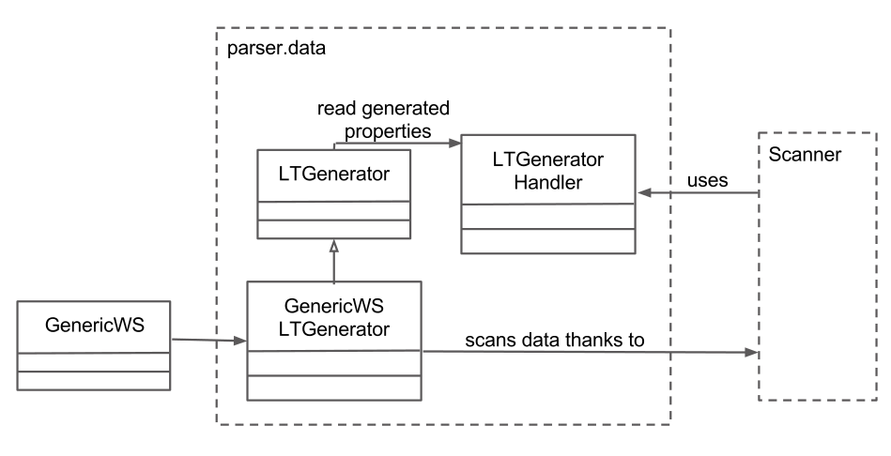
LT generator package

Slide 17
LT generator package
com.ibm.gaiandb.webservices.parser.data
Purpose:
  Used for generating logical tables
    Used by the stored procedure setLtForWs('','','','')
  Request a web service and scans the returned data in order to generate the structure of a logical table
    Currently scans JSON and XML

Slide 18
Properties
VTI GenericWS

Slide 19
Properties
The different properties of GenericWS are all defined as public static final String in the class com.ibm.gaiandb.db2j.GenericWS
Changing the name of this property is then only a String to change in all the application.
Their Java names start with PROP_*
Their possible values (if some) follow the pattern PROP_*_VALUE_*
When their value does not present the right format, the default value is used

Slide 20
Properties
PROP_URL (required)
  Name: “url”
  Url to the web service
  Can be:
    http://www.website.com/webservice
    File:///C:/data/localFile.xml

Slide 21
Properties
PROP_SCHEMA (required)
  Name: “schema”
  Structure of the table to fill
  Based on SQL:
    Name VARCHAR(20), address VACHAR(100), age INT

Slide 22
Properties
PROP_COLUMN_TAG_PREFIX & PROP_COLUMN_TAG_SUFFIX (required)
  Name: “C#.XML_LOCATE_EXPRESSION” with # an integer going from 1 to the number of columns of the VTI (all of them are required)
  Define a leaf of a data tree, starting from the root of the tree.
  1 VTI column = 1 property
  Defined in tree routing language
    C1.XML_LOCATE_EXPRESSION=<records><record value=?>

Slide 23
Properties
PROP_WS_TYPE (optional)
  Name: “wstype”
  Type of web service
  Can be:
    SOAP (PROP_WS_TYPE_VALUE_SOAP = “SOAP”)
    REST (PROP_WS_TYPE_VALUE_REST = “REST”)
    Local file (PROP_WS_TYPE_VALUE_LOCAL_FILE = “LOCAL”)
  Default value “REST”

Slide 24
Properties
PROP_POST_DATA (required/optional)
  Name: “POST_DATA”
  He data to send to the web service to get a result
    Used for SOAP (required)
    Used for REST / POST (optional – by default, REST / GET is used)
  Can be:
    Values to send in user-known format
    C:/data/fileContainingValueToSend.txt
  If the value is the name of a file, will send the content of the file (if it exists)

Slide 25
Properties
PROP_POST_DATA (required/optional)
  For SOAP web service, needs to have the following structure:
    OperationName [, AttributeName, attributeValue]*

Slide 26
Properties
PROP_SEND_WHEN_CLOSING (optional)
  Name: “sendWhenClosing”
  Defined in tree routing language
    <root><records><record value=?>
  Define the main object to return from the received data
  Is auto defined if not given

Slide 27
Properties
PROP_WSDL (optional)
  Name: “wsdl”
  Defined the path to a WSDL file for a SOAP web service
  Can be:
    http://www.website.com/webservice?wsdl
    File:///C:/data/localWsdl.xml
  If not given for a SOAP web service, and for the web service http://www.website.com/webservice, GenericWS will try to access the wsdl file http://www.website.com/webservice?wsdl

Slide 28
Properties
PROP_DATA_FORMAT (optional)
  Name: “DATA_FORMAT”
  Format of the data sent by the web service
  Can be:
    XML (PROP_DATA_FORMAT_VALUE_XML = “XML”)
    JSON (PROP_DATA_FORMAT_VALUE_JSON = “JSON”)
    AUTO (PROP_DATA_FORMAT_VALUE_AUTO = “AUTO”)
  Default value “AUTO”
  AUTO define JSON or XML depending on the first character read on the received data ( '<', '{' or '[' )

Slide 29
Properties
PROP_CACHE_EXPIRES (optional)
  Name: “cache.expires”
  Activate the memory cache for caching the data returned by the web service
  Can be:
    Integer, representing the number of seconds the cache is kept in memory
  Default value “0”

Slide 30
Properties
PROP_APPLY_XML_CONVERTOR (optional)
  Name: “convertToXml”
  Adds a <xml> tag at the beginning of the stream, and a </xml> tag at the end of this one.
  Can be:
    “TRUE” or “FALSE”
  Default value “FALSE”

Slide 31
Properties
PROP_APPLY_HTML_FILTER (optional)
  Name: “applyHtmlFilter”
  Apply a filter in order to remove data from HTML data
  Can be:
    “TRUE” or “FALSE”
  Default value “FALSE”
  Goes hand in hand with the properties
    PROP_ELEMENTS_TO_REMOVE
    PROP_ELEMENT_CONTENTS_TO_REMOVE

Slide 32
Properties
PROP_ELEMENTS_TO_REMOVE (optional)
  Name: “ELT_TO_RMV”
  Remove tags from HTML data
  Can be:
    <nameTag1>,<nameTag2>
  Removes tags given:
    <html><head><link href=”www.ibm.com”></head></html>
    ELT_TO_RMV=<link>
    => <html><head></head></html>
      Even with <link href=”www.ibm.com”> not XML valid ( in this example, the tag is not closed )

Slide 33
Properties
PROP_ELEMENT_CONTENTS_TO_REMOVE (optional)
  Name: “ELT_CONTENT_TO_RMV”
  Remove tags from HTML data
  Can be:
    <nameTag1>,<nameTag2>
  Removes tags given:
    <html><script>if ($val && $val2) echo 'ok'</script></html>
    ELT_CONTENT_ TO_RMV=<script>
    => <html></html>
      Even with <script> content not XML valid ( in this example, it contains special character '&' )

Slide 34
Tree routing language
VTI GenericWS

Slide 35
Tree routing language
Given to the properties sendWhenClosing and C#.XML_LOCATE_EXPRESSION
Purpose:
  Define the path, from the root of a data tree to a leaf to read in order to extract the content of this leaf
    <team><person><name>
    Will return the content of the tag <name>, within a tag <person>, within a tag <team>, this last one being the root of a data tree

Slide 36
Tree routing language
Attribute matching:
  The language can also match the value of the tags' attributes
    <team><person age=”20”><name>
    Will return the content of the tag <name>, within a tag <person>, only if it has an attribute “age” which value is “20” (or “20.0” or “020.00”...) and if it is located within a tag <team>, which is the root of a data tree
  The attribute matching can also use different comparators such as different (<person age!=”20”>), smaller than (<person age-=”20”>) or greater than (<person age+=”20”>)

Slide 37
Tree routing language
Attribute matching:
  The language can also match the value of the tags' attributes with many attributes
    <team><person age=”20” job=“intern”><name>
    The tag person will have to present at least the attributes “age” and “job”, with the specifid value in order to match the pattern
  The comparators smaller than (<person age-=”20”>) and greater than (<person age+=”20”>) are matching values only for integer or float values
  The matching is case sensitive

Slide 38
Tree routing language
Position:
  The language can also match the position of a tag within its parent tag
    <team><person [2]><name>
    Will return the name, only if the tag <person> is the second child of the tag <team>
  The position is 1-based

Slide 39
Tree routing language
Return an attribute:
  The language can also return the value of an atribute
    <team><person job=?><name>
    Will return the “job”-attribute's value of the tag <person>, if this one has a child-tag <name> and a parent tag <team>, which is the root of the data tree
  The pattern can return only one attribute or one value at the time

Slide 40
Tree routing language
Jockers:
  A joker name can be given to the tag pattern. In this situation, any tag (matching the right attributes thought!) will match the pattern.
    <team><* job=?><name>
    Will return the “job”-attribute's value of any tag, if this one has a child-tag <name> and a parent tag <team>, which is the root of the data tree
  The pattern can return only one attribute or one value at the time

Slide 41
Tree routing language
Tree routing language and JSON:
  The pattern work the same way than for XML
    <root><person job=?><name>
  The pattern always starts with a tag <root>
  A not-composed JSON element (String, Integer, Float, Boolean...) will be seen as an attribut for the tree routing language
  A composed JSON element (List, Object) will be seen as a tag

Slide 42
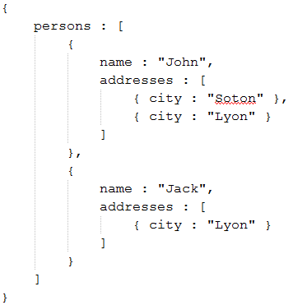
Tree routing language
Tree routing language and JSON:
  Example:
    Returning the name of persons living in Lyon:
<root><persons name=?><addresses city=“Lyon”>

Slide 43
Improvements
VTI GenericWS

Slide 44
Add new web service
Implement a class extending com.ibm.gaiandb.webservices.ws.WebService
In class GenericWS:
  Add static final attribute giving the value of the property
  public static final PROP_WS_TYPE_VALUE_NEWSERVICE = “NEWSERVICE”
  Bring modification to method sendCommand(...)
    Add condition
  else if (wsTypeStr != null && wsTypeStr.equalsIgnoreCase(PROP_WS_TYPE_VALUE_NEWSERVICE)) {…}

Slide 45
Add new data format (1/2)
Add value to the enumeration com.ibm.gaiandb.webservices.scanner.WsDataFormat
Create a scanner (in package “scanner”), using class com.ibm.gaiandb.webservices.scanner.GaianHandler
  Add static final attribute giving the value of the property
  public static final PROP_WS_TYPE_VALUE_NEWFORMAT = “NEWFORMAT”
  Bring modification to method startScan(...)
    Add conditions
  if (format != null && format.equalsIgnoreCase(PROP_DATA_FORMAT_VALUE_NEWFORMAT)) {...}
  else if (readData == WsDataFormat.NEWFORMAT) {...}

Slide 46
Add new data format (2/2)
Complete method defineFormat() in class com.ibm.gaiandb.webservices.scanner.FormatSpecifierInputSteam
Complete constructor in class com.ibm.gaiandb.webservices.parser.data.LogicalTableGenerator
  Add condition
  else if (format == WsDataFormat.NEWFORMAT) {...}

Slide 47
Add new tag's element
Currently: name / position / attributes / attribute-to-find
Add value to enum com.ibm.gaiandb.webservices.parser.extractors.PPElementType
Create an element in the array extractor of the class com.ibm.gaiandb.webservices.parser.extractors.PPElementExtractor
Update method lineToTag(...) in class com.ibm.gaiandb.webservices.parser.properties.GenericWsPropertiesParser

Slide 48
Add new operator
Currently: equal / different / smallerThan / greaterThan
Create an element in the array comparators of the class com.ibm.gaiandb.webservices.parser.properties.AttributeComparator

Slide 49
TODOs
VTI GenericWS

Slide 50
GenericWS : TODO
Complete SOAP
  User / password
Disk caching
Memory release in the caching currently set up
Synchronise caching in GenericWS (method getData() )
Check properties generated by stored procedure setLtForWs(...)
Implement tests for Rest/Post

Slide 51
GenericWS : TODO
Add cobertura for the methods
  vti.genericws.receiveddata.TestInputStreams.testFormatSpecifierInputStream()
  vti.genericws.parsing.TestPPElementExtractors.testPPElementExtractors()
Remove property GenericWS.x.schema
Test if Juno package is in classpath
    Written but commented because it hasn't been tested properly
  GaianDBConfigProcedures.setLogicalTableForWS(...)
  GenericWS.startScan(...)

Slide 52
GenericWS : TODO
Complete HTMLInputStream class.
  Purpose: convert HTML into XHTML
  It can currently
    Remove a tag (even not closed tag) thanks to its name:
      Property ELT_TO_RMV
    Remove the content of a tag (start tag + content + end tag) thanks to its name
      Property ELT_CONTENT_TO_RMV
  It has to
    Check special XML character (', “, <, >, &)
    Check tags' attribute's values are between quotes
    ...

Slide 53
Support
VTI GenericWS

Slide 54
Support
For any question/help on how the VTI has been implemented, please contact:
  remi.fradet@gmail.com

