Slide 1
GAIANDB - VTI GenericWS
Demo

Slide 2
Requirements
GAIANDB
  Version including the VTI Generic WS
Juno package
  (To read the JSON data)
  File juno-5.0.0.30.jar given with the presentation

Slide 3
How to test GenericWS?
This demo will use:
  GAIANDB Server
  GAIANDB Dashboard
It will present results in:
  GAIANDB Dashboard
  gaiandb_config.properties

Slide 4
GenericWS - Presentation
Accesses Web services:
  REST - GET / POST
  SOAP
  local data files
Manages data:
  XML
  JSON

Slide 5
Steps of the tutorial
In order to test the VTI GenericWS, a few web services have been provided, presenting data either in XML format and in JSON format.
For accessing these web services, it is necessary to log in to a server with the link: http://vmwin02.swg.usma.ibm.com.
It is then possible to parameter GAIANDB, thanks to the stored procedure setltforws('','','','') or by writing in the configuration file of GAIANDB.

Slide 6
Stored procedure
setLtForWs('','','','')

Slide 7
Stored Procedure setltforws(...)
The purpose of this stored procedure is to define the logical table the user needs if they want to request on the web service.
When executed, the procedure accesses the web service, interprets the data that it returns, defines the name of the columns of the logical table, and defines the pattern matching the data with each column of the logical table.

Slide 8
Stored Procedure setltforws(...)
SetLtForWs('LT_NAME', 'urlWs', 'urlWsdl', 'postData'):
LT_NAME (required):
  Name of the logical table which is to be generated. This name will also be used as a prefix for the properties generated for the data source.

Slide 9
Stored Procedure setltforws(...)
SetLtForWs('LT_NAME', 'urlWs', 'urlWsdl', 'postData'):
urlWs (required):
  Address of the Web Service which is to be called
  examples:
    http://www.ibm.com/myService
    File:///C:/data/localFile.xml

Slide 10
Stored Procedure setltforws(...)
SetLtForWs('LT_NAME', 'urlWs', 'urlWsdl', 'postData'):
UrlWsdl (optional):
  Location of the WSDL describing the web service
  If this parameter, is NOT empty, the procedure will consider it accesses a SOAP web service
  examples:
    http://www.ibm.com/myService?wsdl
    File:///C:/data/localWsdl.xml

Slide 11
Stored Procedure setltforws(...)
SetLtForWs('LT_NAME', 'urlWs', 'urlWsdl', 'postData'):
postData (optional):
  Data to be sent to the web service (for SOAP and REST/POST web services)
  If this parameter, is empty, the procedure will consider it accesses a REST/GET web service
  examples:
    format=json&cmp=ibm&req=sharePrice
    C:/data/scriptToSendToTheRestPostWs.py
      Will send the content of the file

Slide 12
REST - GET - XML
example

Slide 13
REST - GET - XML example
Log in to the server thanks to the fllowing url
http://vmwin02.swg.usma.ibm.com
Make sure the dashboard is running and is connected to the GAIAN server
In the Dashboard call the procedure:
call setltforws('myXmlRest','http://vmwin02.swg.usma.ibm.com:9080/wisd-rest2/App2/nameAndAddress/newOperation1?first=Brian&last=Tinnel&add1=Line1&add2=Line2&city=Littleton&state=MA&zip=01460','','')
Request the logical table to check its creation
select * from myXmlRest
Check the following lines have been generated in the configuration file (see next slide)

Slide 14
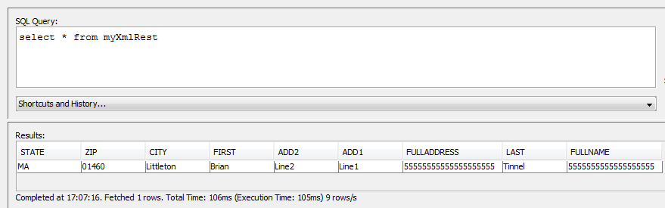
REST - GET - XML example
Check the logical table creation

Slide 15
REST - GET config generation
Check the properties generation
MYXMLREST_DEF=state VARCHAR(255),zip VARCHAR(255),city VARCHAR(255),first VARCHAR(255),add2 VARCHAR(255),add1 VARCHAR(255),fulladdress VARCHAR(255),last VARCHAR(255),fullname VARCHAR(255)
MYXMLREST_DS0_VTI=com.ibm.db2j.GenericWS
MYXMLREST_DS0_ARGS=MYXMLREST,100
GenericWS.MYXMLREST.url=http://vmwin02.swg.usma.ibm.com:9080/wisd-rest2/App2/nameAndAddress/newOperation1?first=Brian&last=Tinnel&add1=Line1&add2=Line2&city=Littleton&state=MA&zip=01460
GenericWS.MYXMLREST.wstype=REST
GenericWS.MYXMLREST.schema=state VARCHAR(255),zip VARCHAR(255),city VARCHAR(255),first VARCHAR(255),add2 VARCHAR(255),add1 VARCHAR(255),fulladdress VARCHAR(255),last VARCHAR(255),fullname VARCHAR(255)
GenericWS.MYXMLREST.C1.XML_LOCATE_EXPRESSION=<nameAndAddressOutVar1><state>
GenericWS.MYXMLREST.C2.XML_LOCATE_EXPRESSION=<nameAndAddressOutVar1><zip>
GenericWS.MYXMLREST.C3.XML_LOCATE_EXPRESSION=<nameAndAddressOutVar1><city>
GenericWS.MYXMLREST.C4.XML_LOCATE_EXPRESSION=<nameAndAddressOutVar1><first>
GenericWS.MYXMLREST.C5.XML_LOCATE_EXPRESSION=<nameAndAddressOutVar1><add2>
GenericWS.MYXMLREST.C6.XML_LOCATE_EXPRESSION=<nameAndAddressOutVar1><add1>
GenericWS.MYXMLREST.C7.XML_LOCATE_EXPRESSION=<nameAndAddressOutVar1><fulladdress>
GenericWS.MYXMLREST.C8.XML_LOCATE_EXPRESSION=<nameAndAddressOutVar1><last>
GenericWS.MYXMLREST.C9.XML_LOCATE_EXPRESSION=<nameAndAddressOutVar1><fullname>
GenericWS.MYXMLREST.POST_DATA=
GenericWS.MYXMLREST.sendWhenClosing=<nameAndAddressOutVar1>

Slide 16
REST - GET config generation
Explaination of the properties
MYXMLREST_DEF=state VARCHAR(255),zip VARCHAR(255),city VARCHAR(255),first VARCHAR(255),add2 VARCHAR(255),add1 VARCHAR(255),fulladdress VARCHAR(255),last VARCHAR(255),fullname VARCHAR(255)
MYXMLREST_DS0_VTI=com.ibm.db2j.GenericWS
MYXMLREST_DS0_ARGS=MYXMLREST,100
Definition of the logical table
  Definition of each of its columns
  Definition of the VTI it uses to access the data
  Definition of the prefix defining this instance of logical table (this prefix is named with the same name than the logical table)

Slide 17
REST - GET config generation
Explaination of the properties
GenericWS.MYXMLREST.url=http://vmwin02.swg.usma.ibm.com:9080/wisd-rest2/App2/nameAndAddress/newOperation1?first=Brian&last=Tinnel&add1=Line1&add2=Line2&city=Littleton&state=MA&zip=01460
GenericWS.MYXMLREST.wstype=REST
GenericWS.MYXMLREST.schema=state VARCHAR(255),zip VARCHAR(255),city VARCHAR(255),first VARCHAR(255),add2 VARCHAR(255),add1 VARCHAR(255),fulladdress VARCHAR(255),last VARCHAR(255),fullname VARCHAR(255)
Properties of the data source
  Url to access the web service
  Type of web service to access (REST / SOAP)
  Definition of the columns representing the data returned by the web service

Slide 18
REST - GET config generation
Explaination of the properties
GenericWS.MYXMLREST.C1.XML_LOCATE_EXPRESSION=<nameAndAddressOutVar1><state>
GenericWS.MYXMLREST.C2.XML_LOCATE_EXPRESSION=<nameAndAddressOutVar1><zip>...
GenericWS.MYXMLREST.sendWhenClosing=<nameAndAddressOutVar1>
Properties of the data source
  Definition of each column: Pattern designing each element from the root of the data tree until the leaf defining the value.
  Pattern (from the root of the tree) defining the object to return. Each leaf defined previously is an element of this object.

Slide 19
REST - GET - JSON
example

Slide 20
REST - GET - JSON example
Log in to the server thanks to the fllowing url
http://vmwin02.swg.usma.ibm.com
Make sure the dashboard is running and is connected to the GAIAN server
In the Dashboard call the procedure:
call setltforws('myJsonRest','http://vmwin02.swg.usma.ibm.com:9080/wisd-rest/App2/nameAndAddress/newOperation1?first=Brian&last=Tinnel&add1=Line1&add2=Line2&city=Littleton&state=MA&zip=01460','','')
Request the logical table to check its creation
select * from myJsonRest
Check the following lines have been generated in the configuration file (see next slide)

Slide 21
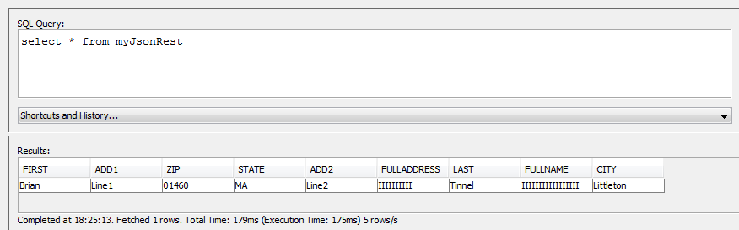
REST - GET - JSON example
Check the logical table creation

Slide 22
REST - GET config generation
Check the properties generation
MYJSONREST_DEF=first VARCHAR(255),add1 VARCHAR(255),zip VARCHAR(255),state VARCHAR(255),add2 VARCHAR(255),fulladdress VARCHAR(255),last VARCHAR(255),fullname VARCHAR(255),city VARCHAR(255)
MYJSONREST_DS0_VTI=com.ibm.db2j.GenericWS
MYJSONREST_DS0_ARGS=MYJSONREST,100
GenericWS.MYJSONREST.url=http://vmwin02.swg.usma.ibm.com:9080/wisd-rest/App2/nameAndAddress/newOperation1?first=Brian&last=Tinnel&add1=Line1&add2=Line2&city=Littleton&state=MA&zip=01460
GenericWS.MYJSONREST.wstype=REST
GenericWS.MYJSONREST.schema=first VARCHAR(255),add1 VARCHAR(255),zip VARCHAR(255),state VARCHAR(255),add2 VARCHAR(255),fulladdress VARCHAR(255),last VARCHAR(255),fullname VARCHAR(255),city VARCHAR(255)
GenericWS.MYJSONREST.sendWhenClosing=<root><result>
GenericWS.MYJSONREST.C1.XML_LOCATE_EXPRESSION=<root><result first=?>
GenericWS.MYJSONREST.C2.XML_LOCATE_EXPRESSION=<root><result add1=?>
GenericWS.MYJSONREST.C3.XML_LOCATE_EXPRESSION=<root><result zip=?>
GenericWS.MYJSONREST.C4.XML_LOCATE_EXPRESSION=<root><result state=?>
GenericWS.MYJSONREST.C5.XML_LOCATE_EXPRESSION=<root><result add2=?>
GenericWS.MYJSONREST.C6.XML_LOCATE_EXPRESSION=<root><result fulladdress=?>
GenericWS.MYJSONREST.C7.XML_LOCATE_EXPRESSION=<root><result last=?>
GenericWS.MYJSONREST.C8.XML_LOCATE_EXPRESSION=<root><result fullname=?>
GenericWS.MYJSONREST.C9.XML_LOCATE_EXPRESSION=<root><result city=?>
GenericWS.MYJSONREST.POST_DATA=

Slide 23
Local File
example

Slide 24
Local file example
Make sure the dashboard is running and is connected to the GAIAN server
In the Dashboard call the procedure:
call setltforws('myLocalFile','File:///C:/data/ibmTeam.xml','','')
  File:///C:/data/ibmTeam.xml is the path to the file given for the demo
    Must start with File:///
    Must use '/' separators
Request the logical table to check its creation
select * from myLocalFile
Check the following lines have been generated in the configuration file (see next slide)

Slide 25
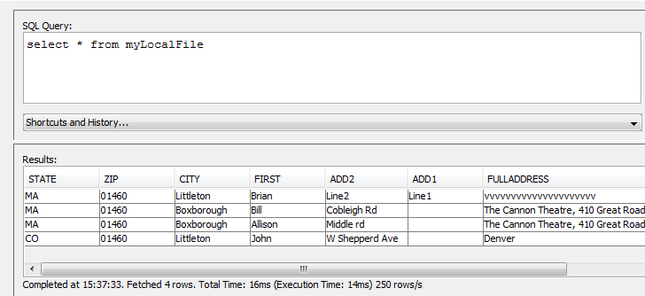
Local file example
Check the logical table creation

Slide 26
Local file config generation
Check the properties generation
MYLOCALFILE_DEF=state VARCHAR(255),zip VARCHAR(255),city VARCHAR(255),first VARCHAR(255),add2 VARCHAR(255),add1 VARCHAR(255),fulladdress VARCHAR(255),last VARCHAR(255),fullname VARCHAR(255)
MYLOCALFILE_DS0_VTI=com.ibm.db2j.GenericWS
MYLOCALFILE_DS0_ARGS=MYLOCALFILE,100
GenericWS.MYLOCALFILE.url=File:///C:/data/ibmTeam.xml
GenericWS.MYLOCALFILE.wstype=LOCAL
GenericWS.MYLOCALFILE.schema=state VARCHAR(255),zip VARCHAR(255),city VARCHAR(255),first VARCHAR(255),add2 VARCHAR(255),add1 VARCHAR(255),fulladdress VARCHAR(255),last VARCHAR(255),fullname VARCHAR(255)
GenericWS.MYLOCALFILE.sendWhenClosing=<team><person>
GenericWS.MYLOCALFILE.C1.XML_LOCATE_EXPRESSION=<team><person><state>
GenericWS.MYLOCALFILE.C2.XML_LOCATE_EXPRESSION=<team><person><zip>
GenericWS.MYLOCALFILE.C3.XML_LOCATE_EXPRESSION=<team><person><city>
GenericWS.MYLOCALFILE.C4.XML_LOCATE_EXPRESSION=<team><person><first>
GenericWS.MYLOCALFILE.C5.XML_LOCATE_EXPRESSION=<team><person><add2>
GenericWS.MYLOCALFILE.C6.XML_LOCATE_EXPRESSION=<team><person><add1>
GenericWS.MYLOCALFILE.C7.XML_LOCATE_EXPRESSION=<team><person><fulladdress>
GenericWS.MYLOCALFILE.C8.XML_LOCATE_EXPRESSION=<team><person><last>
GenericWS.MYLOCALFILE.C9.XML_LOCATE_EXPRESSION=<team><person><fullname>
GenericWS.MYLOCALFILE.POST_DATA=

Slide 27
Local file config generation
Explaination of the properties
GenericWS.MYLOCALFILE.wstype=LOCAL
Sets the data has to be read on a local file
GenericWS.MYLOCALFILE.url=File:///C:/data/ibmTeam.xml
Absolute path of the file, starting by “File:///”

Slide 28
SOAP
example

Slide 29
SOAP example
For this example, the SOAP web service returns a result which is neither XML, nor JSON. The logical table cannot then be created thanks to the stored procedure. This logical table is then going to be created directly from the configuration file.
Make sure the dashboard is running and is connected to the GAIAN server
In the configuration file, copy the following properties (see next slide)
Request the logical table to check its creation
select * from myUnformattedSoap

Slide 30
SOAP example
Properties to write in the configuration file:
GenericWS.MYUNFORMATTEDSOAP.schema=YodaSays VARCHAR(255)
GenericWS.MYUNFORMATTEDSOAP.url=http://www.yodaspeak.co.uk/webservice/yodatalk.php
GenericWS.MYUNFORMATTEDSOAP.POST_DATA=yodaTalk,inputText,I want to eat an ice cream.
GenericWS.MYUNFORMATTEDSOAP.convertToXml=TRUE
GenericWS.MYUNFORMATTEDSOAP.sendWhenClosing=<xml>
GenericWS.MYUNFORMATTEDSOAP.C1.XML_LOCATE_EXPRESSION=<xml>
GenericWS.MYUNFORMATTEDSOAP.wstype=SOAP
MYUNFORMATTEDSOAP_DEF=YodaSays VARCHAR(255)
MYUNFORMATTEDSOAP_DS0_ARGS=MYUNFORMATTEDSOAP,100
MYUNFORMATTEDSOAP_DS0_VTI=com.ibm.db2j.GenericWS

Slide 31
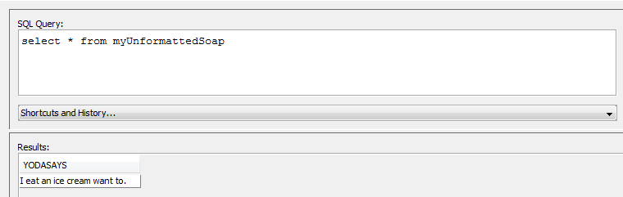
SOAP example
Check the logical table creation

Slide 32
SOAP config generation
Explaination of the properties
GenericWS.MYUNFORMATTEDSOAP.POST_DATA=yodaTalk,inputText,I want to eat an ice cream.
FOR SOAP web services: parameters defining the service and operation to access
  [operationName],[[parameterName1],[parameterValue1]],[[parameterName2],[parameterValue2]],...
  The operation name and the parameter's values and names have not to include any commas.
FOR REST/POST web services: parameters to send to

Slide 33
SOAP config generation
Explaination of the properties
GenericWS.MYUNFORMATTEDSOAP.convertToXml=TRUE
Formating of the returned data
  Encloses the received data with the tags <xml> and </xml>
    example:
      Hello from IBM will become:
      <xml>Hello from IBM</xml>
  (This property is showed with SOAP, but can be used for any kind of web service)

Slide 34
Configurable URL
example

Slide 35
Configurable URL example
This option allow the user to configure the url accessing to the web services. Thus, they can modify the value of the url thank to where clauses in the SGL requests.
However, this option cannot be used for generating te configuration of the logical table with the stored procedure setLtForWs('','','','').
He user has to write the configuration file either by hand, or with a valid url which will be modified manually in the configuration file later on.
This second option will be showed in this demonstration.

Slide 36
Configurable URL example
Log in to the server thanks to the fllowing url
http://vmwin02.swg.usma.ibm.com
Make sure the dashboard is running and is connected to the GAIAN server
In the Dashboard call the procedure:
call setltforws('myConfigurableUrl','http://vmwin02.swg.usma.ibm.com:9080/wisd-rest2/App2/nameAndAddress/newOperation1?first=Brian&last=Tinnel&add1=Line1&add2=Line2&city=Littleton&state=MA&zip=01460','','')
...

Slide 37
Configurable URL example
Open the configuration file
  Remove property
  GenericWS.MYCONFIGURABLEURL.url=http://vmwin02.swg.usma.ibm.com:9080/wisd-rest2/App2/nameAndAddress/newOperation1?first=Brian&last=Tinnel&add1=Line1&add2=Line2&city=Littleton&state=MA&zip=01460
  Add property
  GenericWS.MYCONFIGURABLEURL.url=http://vmwin02.swg.usma.ibm.com:9080/wisd-rest2/App2/nameAndAddress/newOperation1?first=Brian&last=Tinnel&add1=Line1&add2=$add2&city=Littleton&state=$state&zip=01460
Request the logical table to check its creation
select * from myConfigurableUrl where state='MA' and add2='myStreet'
Check the value of the column add2 contains “myStreet”

Slide 38

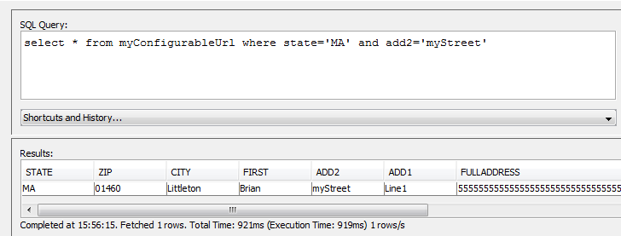
REST - GET - JSON example
Check the logical table creation

Slide 39
Configurable URL example
Explaination of the properties
GenericWS.MYCONFIGURABLEURL.url=http://vmwin02.swg.usma.ibm.com:9080/wisd-rest2/App2/nameAndAddress/newOperation1?first=Brian&last=Tinnel&add1=Line1&add2=$add2&city=Littleton&state=$state&zip=01460
The values of the parameters add2 and state have been set up at $add2 and $state. This means that the qualifiers add2=[value] and state=[value] have to be set during the query.
When writing the url, the variables $add2 or $state cannot be called anything else. For parameterising the parameter zip, the value would be $zip.

Slide 40
Multiple Configurable URLs
example

Slide 41
Multi Configurable URL example
This part will create another logical table based on a configurable url. Like the revious one, it will be configurable on the parameter add2.
A request will then be sent to both tables using a join clause, but with different values for the parameter add2.
The purpose is to show that the qualifiers insertion into the url are independent from each other
Furthermore, one of the received data is in XML format, and the other one on JSON.

Slide 42
Multi Configurable URL example
Log in to the server thanks to the following url
http://vmwin02.swg.usma.ibm.com
Make sure the dashboard is running and is connected to the GAIAN server
In the Dashboard call the procedure:
call setltforws('myConfigurableUrl2','http://vmwin02.swg.usma.ibm.com:9080/wisd-rest/App2/nameAndAddress/newOperation1?first=Brian&last=Tinnel&add1=Line1&add2=Line2&city=Littleton&state=MA&zip=01460','','')
...

Slide 43
Multi Configurable URL example
Open the configuration file
  Remove property
  GenericWS.MYCONFIGURABLEURL2.url=http://vmwin02.swg.usma.ibm.com:9080/wisd-rest/App2/nameAndAddress/newOperation1?first=Brian&last=Tinnel&add1=Line1&add2=Line2&city=Littleton&state=MA&zip=01460
  Add property
  GenericWS.MYCONFIGURABLEURL2.url=http://vmwin02.swg.usma.ibm.com:9080/wisd-rest/App2/nameAndAddress/newOperation1?first=Brian&last=Tinnel&add1=Line1&add2=$add2&city=Littleton&state=MA&zip=01460
Request the 2 logical tables using the join
select cu1.add2 xmlAddress, cu2.add2 jsonAddress, cu1.state
from myConfigurableUrl cu1 JOIN myConfigurableUrl2 cu2
ON cu1.zip=cu2.zip
where cu1.state='MA' and cu1.add2='myStreet' and cu2.add2='myRoad'

Slide 44

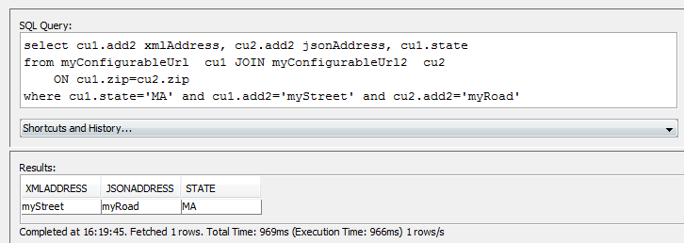
Multi Configurable URL example
Check the logical table creation

Slide 45
Caching
example

Slide 46
Caching example
In order to test the caching, this demo will re-use the logical table generated for the SOAP example. Indeed, this example can take up to 3 seconds to get the result back, so it is easy to see the performance differences.

Slide 47
Caching example
Make sure the dashboard is running and is connected to the GAIAN server and that the properties used for the logical table MYUNFORMATTEDSOAP are still in the configuration file.
In the propertiy file, add the property:
GenericWS.MYUNFORMATTEDSOAP.cache.expires=10
Request the logical table
select * from myUnformattedSoap
Request again the same logical table within 10 seconds
Compare execution times

Slide 48
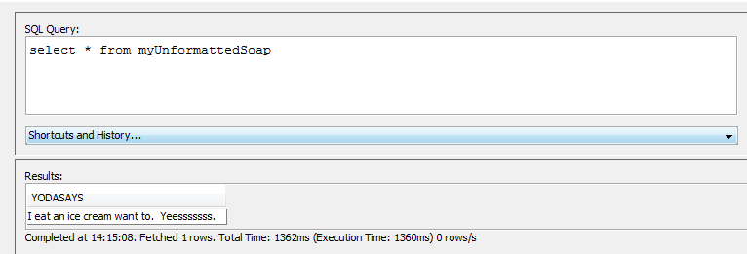
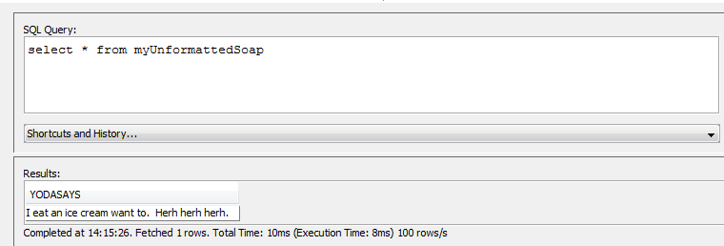
Caching example
Check the logical table creation

Slide 49
Caching example
Therefore, it is showed that if the first execution takes 1360 ms to be executed, the second time the request is done (within 10 seconds) the execution time only takes 8 ms.

