Slide 1
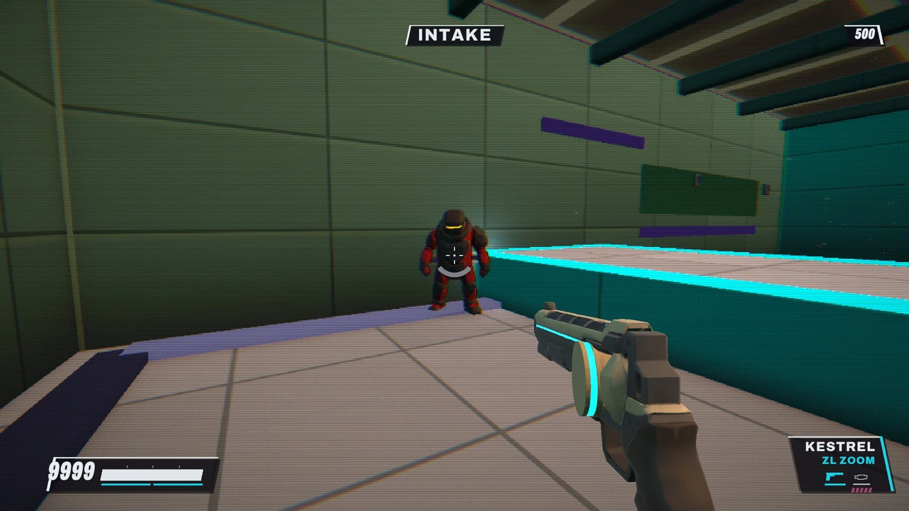

SKYGRIND
A first-person movement shooter at dusk, built Human First, AI in the Middle, Human Last
HUMAN FIRST
AI IN THE MIDDLE
HUMAN LAST
Gaige Geraci · ASU AME 294, Portfolio Game 3 · Demo Day, 28 October 2026
Notes:
SKYGRIND is a first-person movement shooter at dusk: Call of Duty Zombies rounds with ULTRAKILL movement. This talk is about the game and about how it was made: I lead (human first), AI tools do most of the building and generating in the middle, and I come back at the end to play, judge and decide (human last). The screenshot is a real frame from the game: a husk enemy model and the KESTREL revolver.

Slide 2
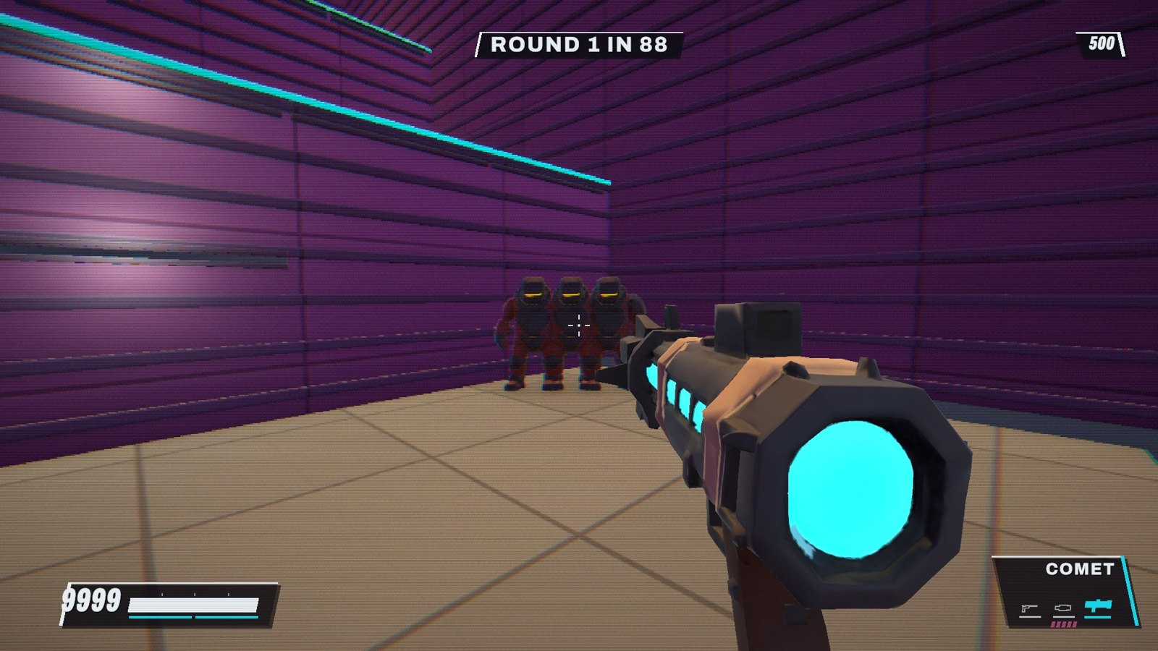




Inspiration: Zombies rounds × ULTRAKILL movement
"cod zombies meets ultrakill as the main, but other games should be inspired"
My one-line brief, 3 October 2026
Movement
Slide, dash, double jump, wall-ride and grapple, on a 120 Hz sim ported line for line from my web prototype
Rounds
Waves of husks, swarmers, spitters, chargers, wardens and drones; points, buys, and a boss at the end of every level
Dusk
One colour language: cyan is yours, red-orange is danger, magenta is the rival, violet-white is the edge of the world
Cyan: yours
Red-orange: danger
Magenta: rival
Violet-white: edge
Notes:
The brief was one line: Zombies meets ULTRAKILL. That gave three pillars. Movement: a fast ULTRAKILL-style kit (slide, dash, double jump, wall-ride, grapple), first built as a web prototype and then ported to Unity line for line so it plays exactly the same. Rounds: a Zombies-style loop of waves, points and buys, with a boss closing each level. Dusk: one strict colour language so the player can read a fight at a glance: cyan is anything you can use, red-orange is danger, magenta is the rival, violet-white is the boundary. The screenshot shows the husk models in the kiln level.

Slide 3



Human First → AI in the Middle → Human Last
1 · HUMAN FIRST
I set the vision and the rules
2 · AI IN THE MIDDLE
AI builds and checks it
3 · HUMAN LAST
I play it and decide
The brief, the pillars and the palette
A written prompt for every build night
Taste in my own words: "too basic ... more powerful", "jump height needs to be lower"
Hard rules: movement stays exact; nothing the player had is lost
Claude Code ported the web game to Unity and built it night by night
Every change checked by tests, play bots and blind A/B frame pairs
ElevenLabs: sound effects and breakcore music
ChatGPT reference images → Tripo 3D models
A play card for each build: keep or drop every change
I judge the feel; numbers never replace playing it
I approve every push, release and public page
And I present it, today
Notes:
This is the whole method. Human first: I decide what the game is, write the prompt for each build, and say what feels wrong in plain words (two real examples are on the slide). I also set rules the AI may not break, like keeping the movement exact. AI in the middle: Claude Code does most of the engineering, and every change is checked by automated tests, play bots and blind A/B comparisons of frames before it ships. ElevenLabs makes the sound and music; ChatGPT makes reference images that Tripo turns into 3D models. Human last: I play every build and decide what stays, and nothing goes public without my approval.

Slide 4





The tools, and why I chose them
Claude Code
The AI engineer. It works across the whole project from the terminal, runs builds and tests itself, and follows my written rules (CLAUDE.md) through long build nights.
Unity 6 + Unity CLI
Unity for a Steam / Switch game. The Unity CLI lets Claude drive my open Editor: compile, run tests, build players, run checks, with no clicking from me.
ElevenLabs
Sound effects and breakcore music from text, fast and in one style
ChatGPT images
Reference art, so I set the look before anything is 3D
Tripo
Image or text to a textured 3D model, exported straight to Unity
GitHub · itch.io
Public code and builds; Claude in Chrome and butler did the uploads
Notes:
Two tools carry the method. Claude Code is the engineer in the middle: it reads and edits the whole project from the terminal, builds and tests the game itself, and follows a rules file I wrote, so I can hand it a long build night and trust the guard rails. Unity is the engine because the target is Steam and hopefully Switch, and the Unity CLI is what made the loop fast: Claude drives my open Unity Editor directly, compiling, running tests, building the game and running checks, without me clicking through menus. Around them: ElevenLabs for all the audio, ChatGPT for reference images, Tripo for 3D models, and GitHub plus itch.io to publish; Claude in Chrome and the butler tool did the uploads.

Slide 5




Four weeks, by the numbers
4,298
2,551
317k
commits since 30 September
automated tests
lines of C#
138
41
19
ElevenLabs sound effects
ElevenLabs breakcore tracks
Tripo 3D models
Cyan: engineering by Claude Code. Orange: generated assets. Counted from the repository on 28 October 2026.
Notes:
Real numbers, counted from the repository today. 4,298 commits in about four weeks; 2,551 automated tests that guard the movement and the rules; about 317 thousand lines of C#. On the asset side: 138 sound effects and 41 music tracks from ElevenLabs, and 19 3D models from Tripo. The point is not the size: it is that a human-led loop can steer this much AI output and still keep the game feeling like one thing.

Slide 6
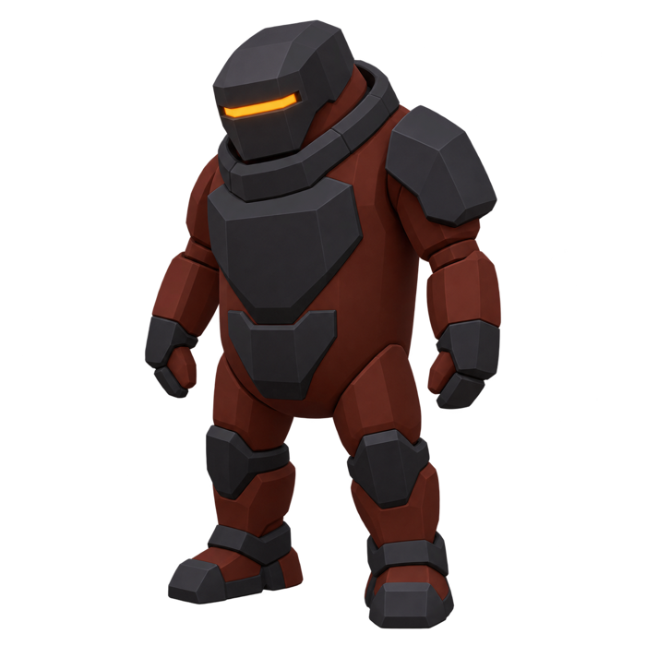
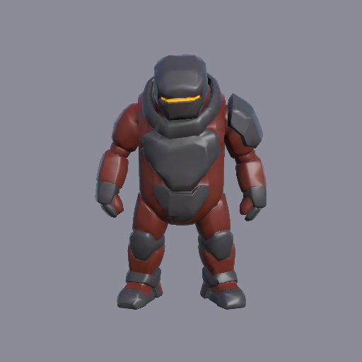
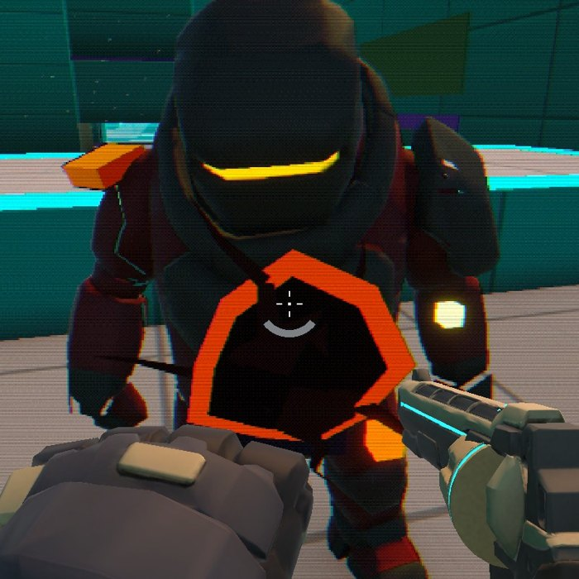
AI in the middle, one asset at a time
1. ChatGPT reference image
2. Tripo 3D model
3. In the game, cut into limbs that walk
Human
I wrote the prompt, chose the image, and judged the model in the game. When a gun came in backwards or grey, I called it and it was fixed.
AI
Generated the image, the mesh and the textures, then cut the model into legs and arms and wrote the walk, wind-up and strike motion.
Notes:
Here is the method on a single asset, the husk enemy. I wrote a prompt and picked the ChatGPT reference image. Tripo turned the image into a textured 3D model. Then Claude cut the static model into body, legs and arms and wrote procedural animation, so it walks, rears back in a wind-up and lunges on the strike. The human part matters at both ends: the first exports had a gun pointing backwards and grey, desaturated textures, and I called both out before they were fixed.

Slide 7
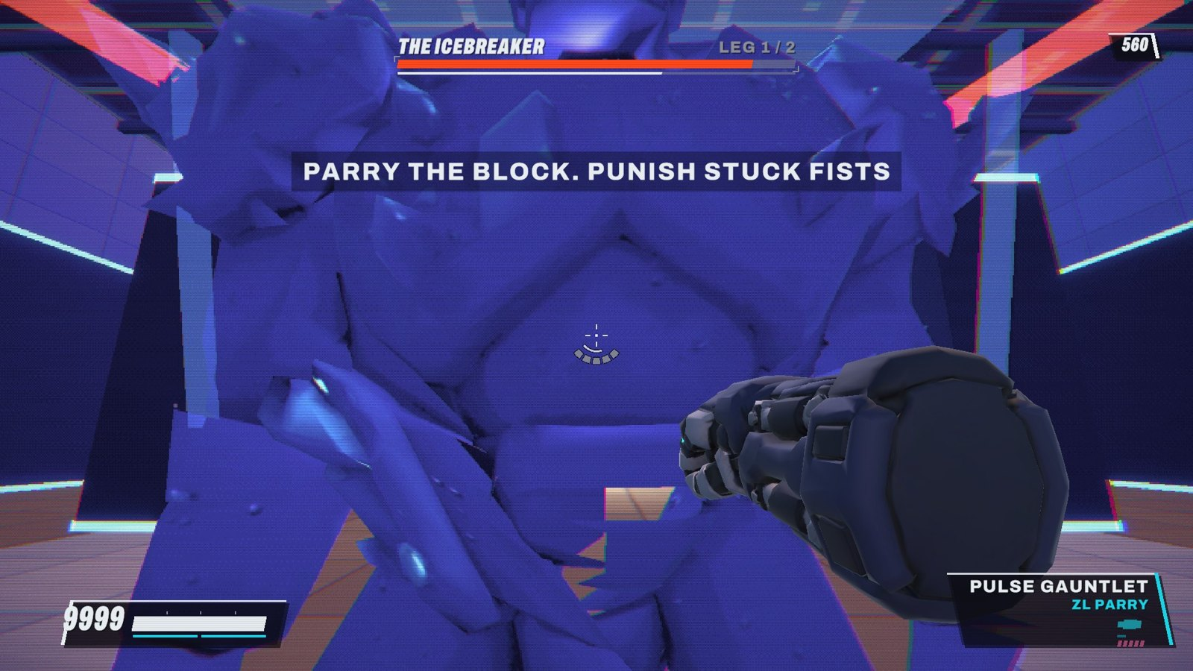
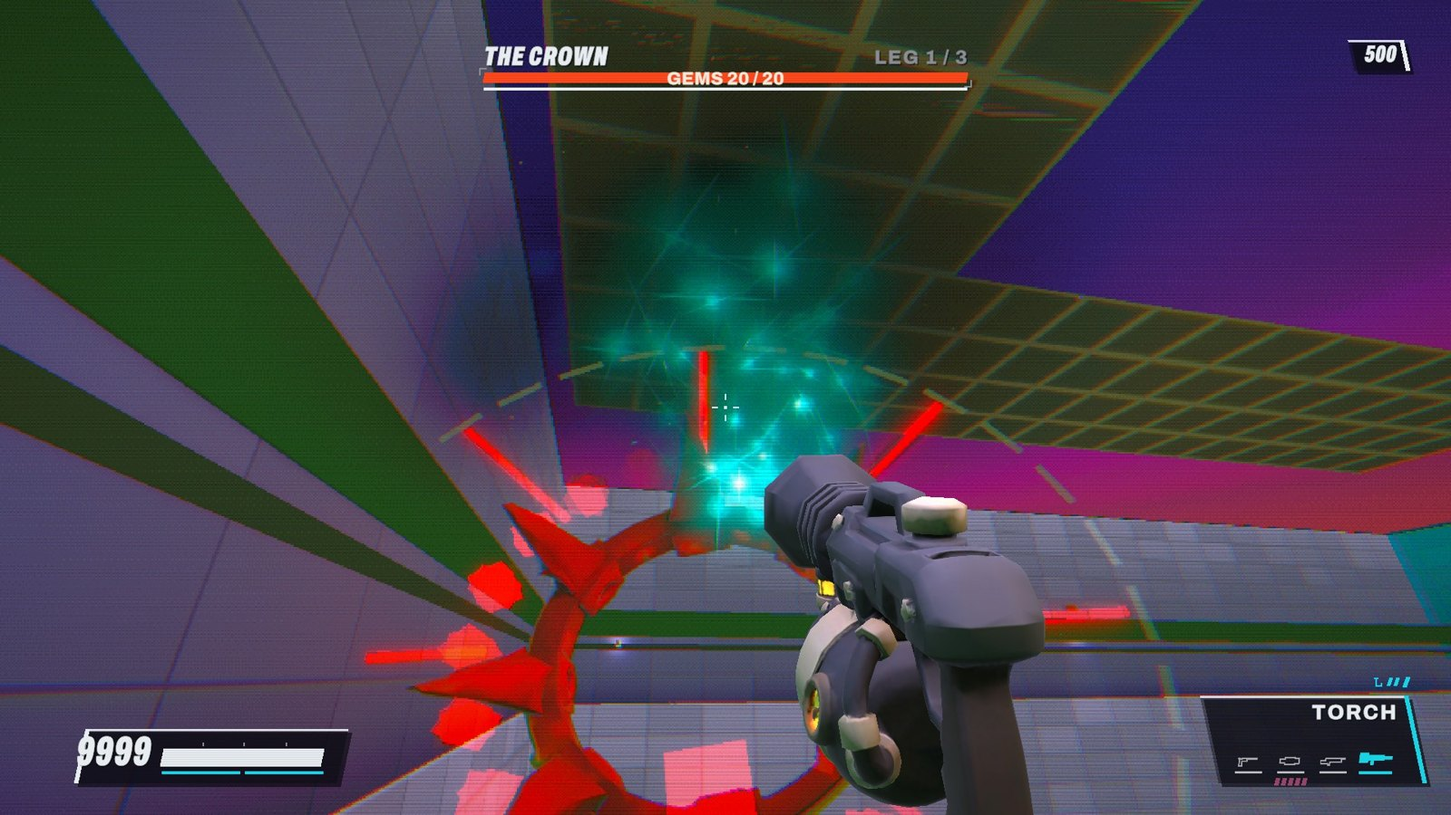
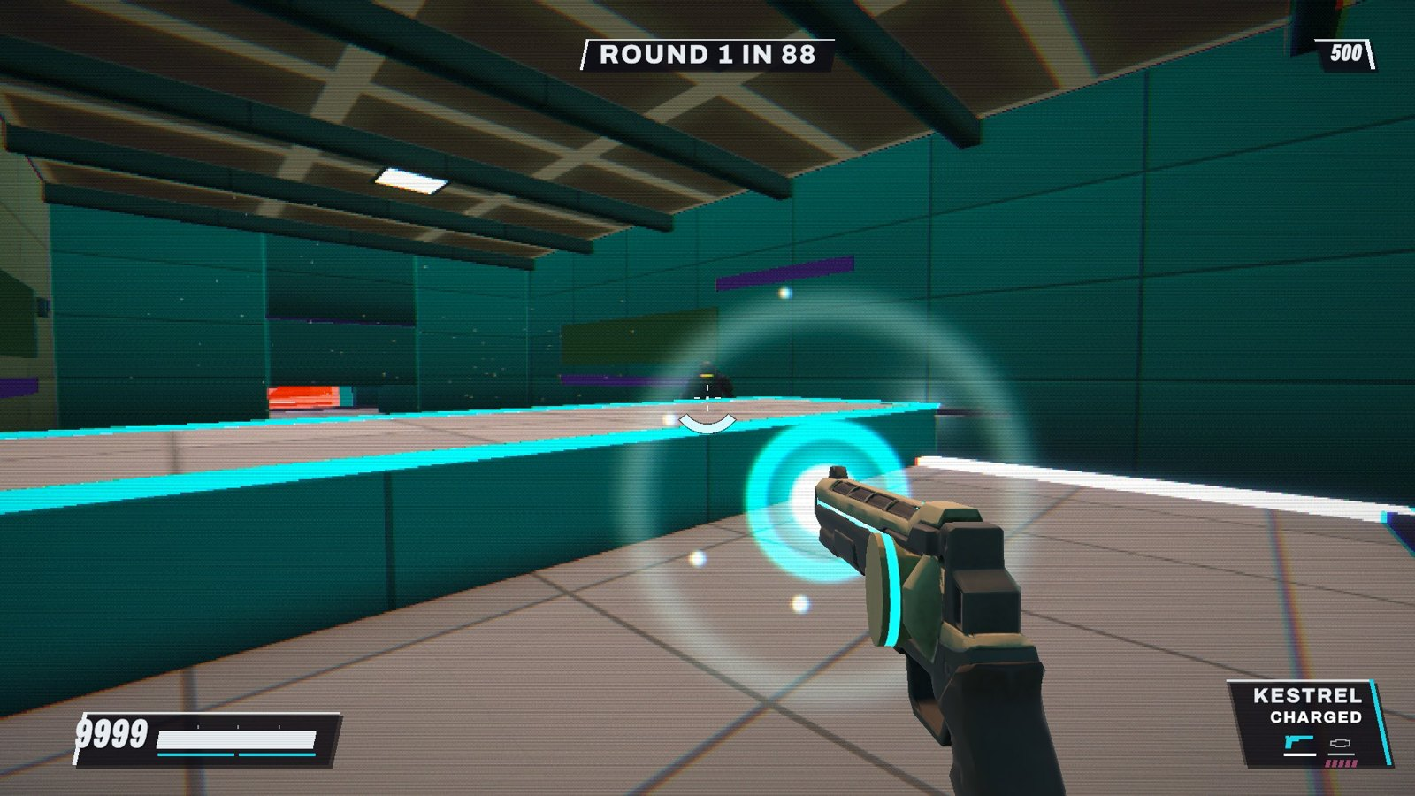
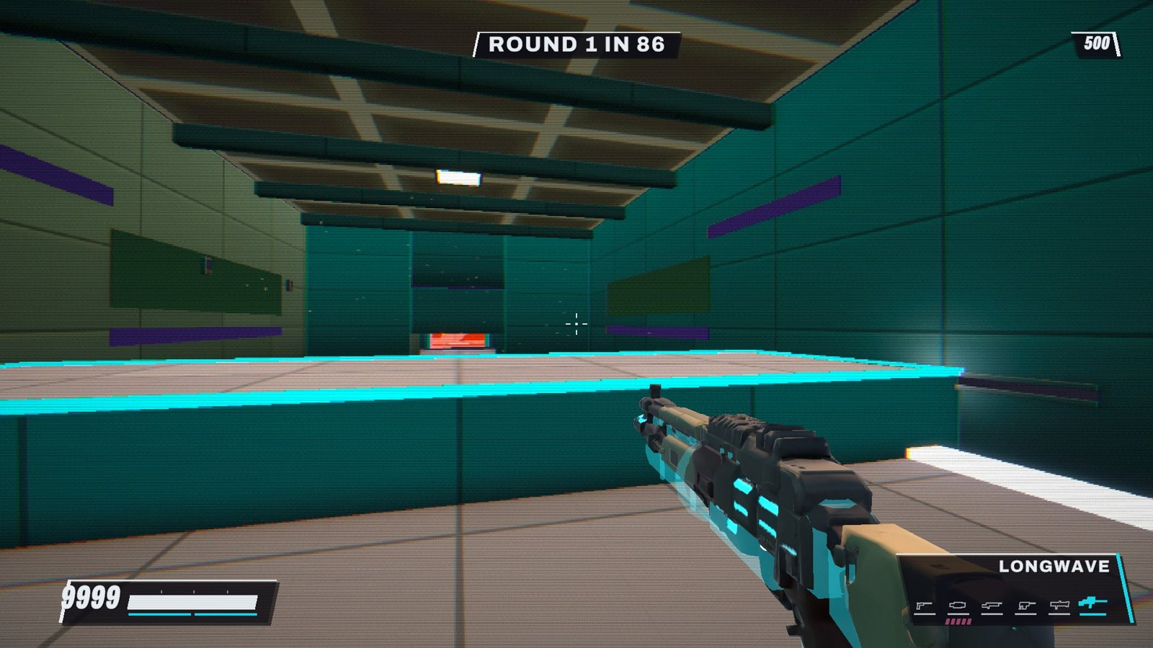
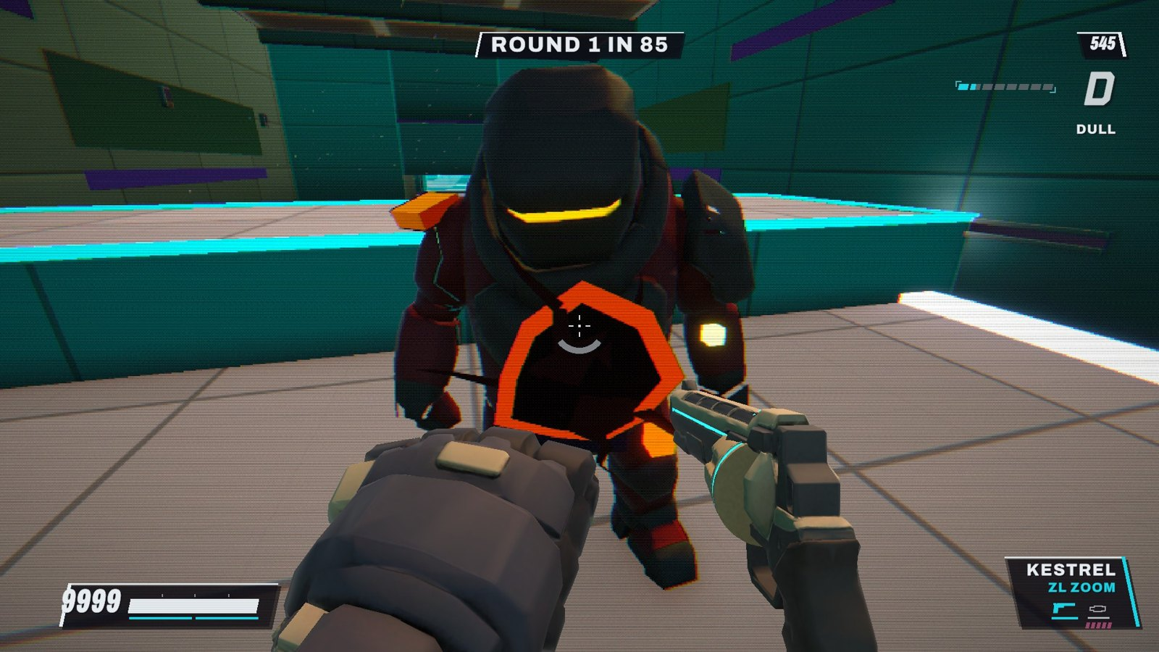
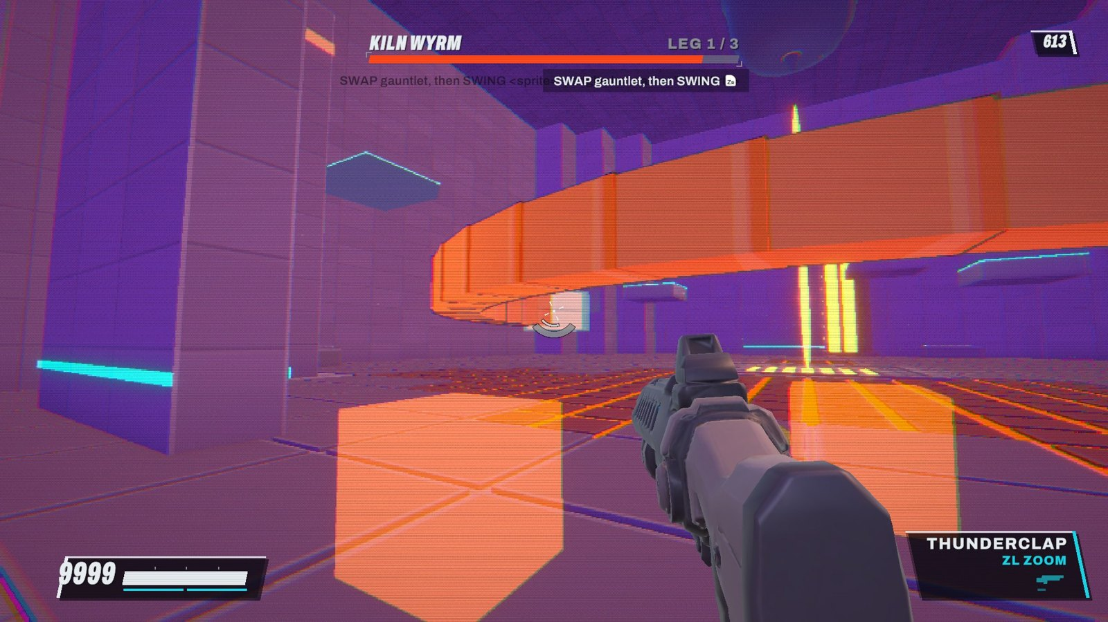
The game today
THE ICEBREAKER: its model rides its own punch moves
THE CROWN spins above its weak-point gems
The KESTREL charge fills the gun's own cyan glow
The LONGWAVE rail rifle, from a text prompt
The gauntlet punch against a husk
THE THUNDERCLAP against the KILN WYRM
Notes:
Every image here is a frame from the real game, captured by the automated check runs (sound muted). Top row: THE ICEBREAKER boss, whose 3D model is attached to its own animation bones so its punches still read; THE CROWN, a spinning boss whose gems are the weak points; and the KESTREL charge, which now fills the cyan glow on the gun itself. Bottom row: the LONGWAVE, made in Tripo from a text prompt; the gauntlet punch; and the THUNDERCLAP shotgun during the KILN WYRM fight.

Slide 8



Just showing up: build, play, present
Every day
Show up, write the prompt, play the build, say what is wrong. The 67 logged build nights came out of that loop.
This deck
Made with AI too: I asked for the story; Claude pulled the real numbers and screenshots from the project and built this PowerPoint; I check it and present it.
Play it
itch.io: gaiger101.itch.io/skygrind
GitHub: github.com/gaigerg101-svg/skygrind-unity
HUMAN FIRST
AI IN THE MIDDLE
HUMAN LAST
The AI does the volume. The human decides what it is for, and whether it is good.
Notes:
The habit that made this work was simply showing up: every day I wrote what I wanted, played what came back, and said what was wrong. This presentation follows the same pattern: I asked for the story and the structure, Claude gathered the real numbers and screenshots and built the PowerPoint, and I am the last step: checking it and presenting it. You can play the game on itch.io, and the code and builds are on GitHub.

