Slide 1
PathwayAI
Making the Hidden Patient Journey Visible
Connect prevention, care preparation, support and community burden planning.
Personal benefit: organize a story, costs and questions for care.
Community benefit: explore Lyme reports and transparent cost illustrations.
Open the working application: pathwayai.streamlit.app
PathwayAI | Team GreenAcorn | Yuwei Zhang | October 15, 2026
1

Slide 2
Four connected pathways
Choose a need. Receive a useful output. Keep the record.
Plan an outdoor visit
Respond to a tick bite
Explore exposure context and prepare a prevention plan.
Remove the tick, record the encounter and know when to seek care.
Care & Support
Community Burden & Action
Organize a story, review costs and time, download a card and find support.
Compare Dutchess and Orange; inspect costs, sources and planning options.
PathwayAI | Team GreenAcorn | Yuwei Zhang | October 15, 2026
2

Slide 3
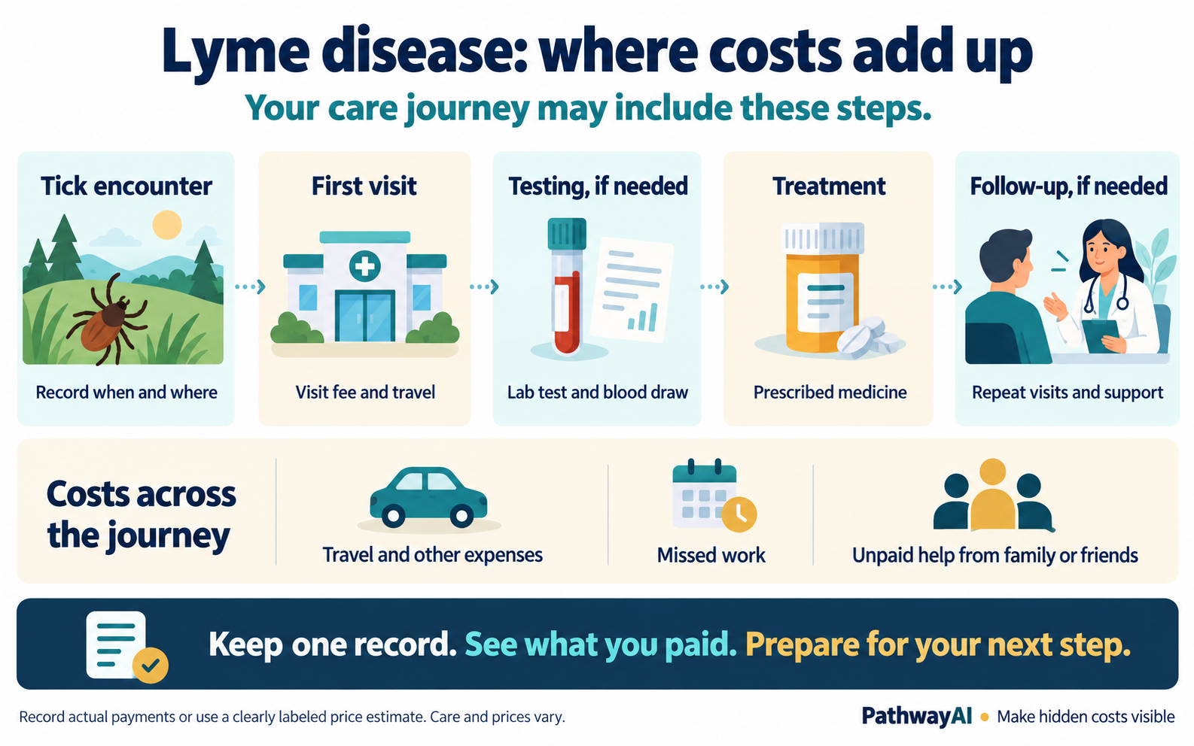
How the journey connects
Costs and time can accumulate at several points in care.
Care varies. This illustration describes possible steps, rather than a required testing or treatment sequence.
PathwayAI | Team GreenAcorn | Yuwei Zhang | October 15, 2026
3

Slide 4
A personal card for care
FICTIONAL DEMONSTRATION | Past 30 days | Not a real patient record
My story and questions
My money and time
I felt tired after an outdoor walk and want help preparing for a visit.
I paid $180 for care and $45 for travel. I missed 3 workdays. An unpaid caregiver helped for 8 hours.
What could explain my symptoms? What care, testing or follow-up is appropriate?
Patient-paid spending: $225
Missed work: 3 days
Unpaid help: 8 hours
Separate work-loss example: 3 × $120/day = $360
Work-loss value = entered days × chosen daily value. It is an estimate, not a bill. Keep it separate from payments; caregiver time stays in hours.
PathwayAI | Team GreenAcorn | Yuwei Zhang | October 15, 2026
4

Slide 5
Hudson Valley community cost illustration
2024 reported cases × published study costs | All cost amounts in 2016 dollars
Measure | Dutchess | Orange | Combined
Reported cases | 1,060 | 964 | 2,024
Medical illustration | $1,412,980 | $1,285,012 | $2,697,992
Other + productivity | $740,940 | $673,836 | $1,414,776
Societal illustration | $2,153,920 | $1,958,848 | $4,112,768
Hook et al. (2022): societal mean $2,032; medical reference $1,333. The $699 remainder combines other expenses and lost productivity.
Study-based illustrations, not measured county spending or individual bills. No adjustment for regional prices, inflation, underreporting or local case mix.
PathwayAI | Team GreenAcorn | Yuwei Zhang | October 15, 2026
5

Slide 6
Evidence reviewers can inspect
Keep surveillance, research, personal records and modeled illustrations distinct.
CDC
Tick and historical case context; prevention and testing guidance.
Census ACS
Language, disability and socioeconomic context.
HRSA AHRF
2024–2025 release; 2023 physician, hospital and bed counts.
NYSDOH
2024 reported Lyme cases and rates; sampled tick observations.
Hook et al. (2022)
Main societal-cost assumptions, in 2016 dollars.
Horn et al. (2025)
Biobank follow-up: 55 of 253 returners reported ongoing symptoms.
CDC PLACES adds modeled adult health context. Disability comparisons retain an unresolved Census source-year note. Survey findings remain separate from county estimates.
PathwayAI | Team GreenAcorn | Yuwei Zhang | October 15, 2026
6

Slide 7
What works now. What comes next.
Personal records now; consent-based community learning as the next pilot phase.
Working MVP
Next community pilot
Prevention and testing education
Reviewed story, costs and time records
Downloadable card and personal visual
Support requests and county comparisons
Interpreter and accessibility resources
Separate consent and secure reporting
Reuse reviewed records
Understand local barriers and needs
Evaluate support connections and results
Personal cards are not automatically pooled. Medication pricing and longer-term burden modeling remain future work. Health benefits and savings require evaluation.
Try PathwayAI: pathwayai.streamlit.app
PathwayAI | Team GreenAcorn | Yuwei Zhang | October 15, 2026
7

