Slide 1
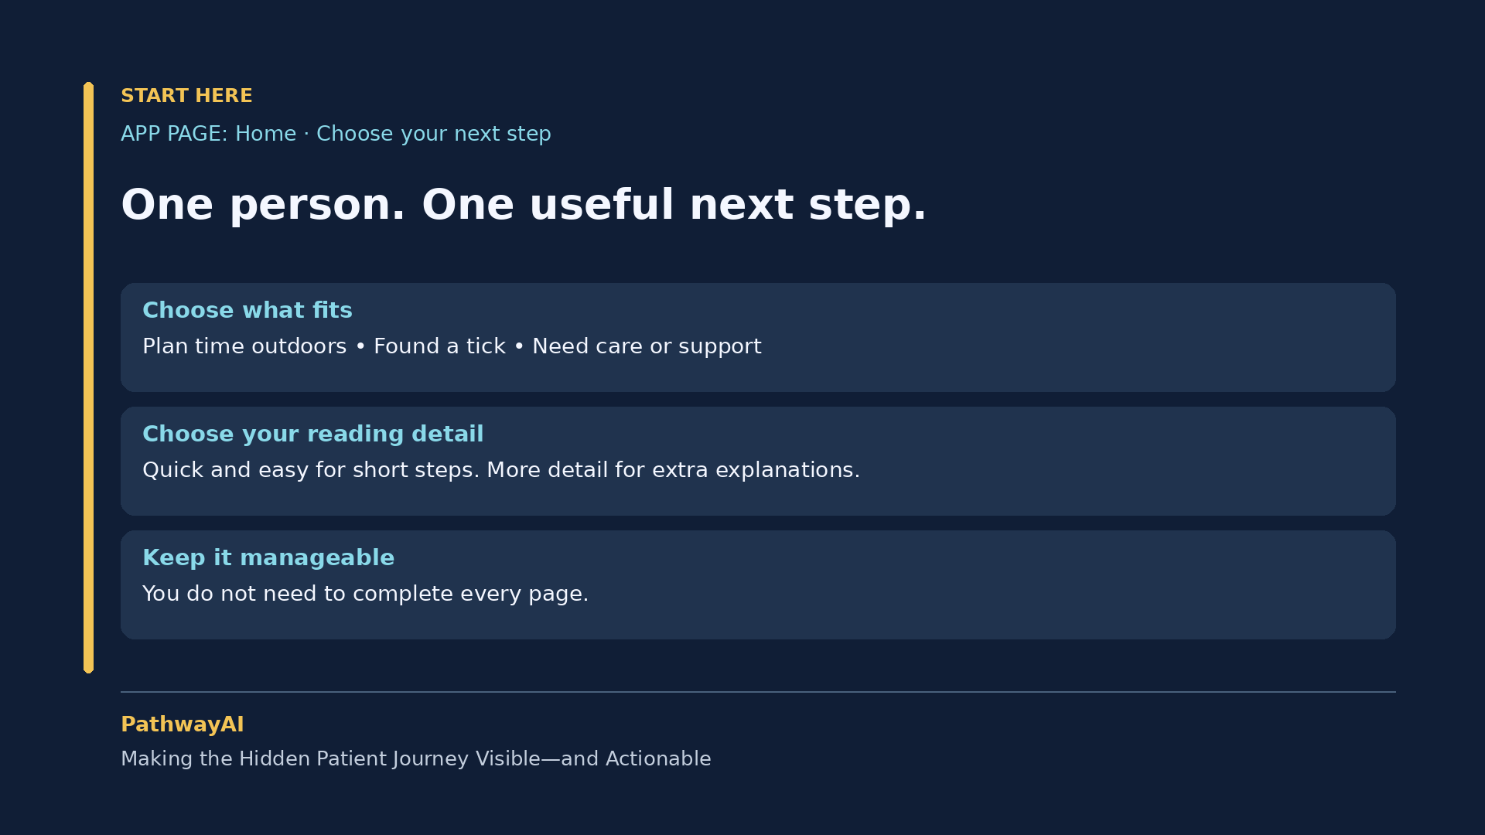
Notes:
Narration cue: Let me show you. All patient details in this demonstration are fictional.

Slide 2
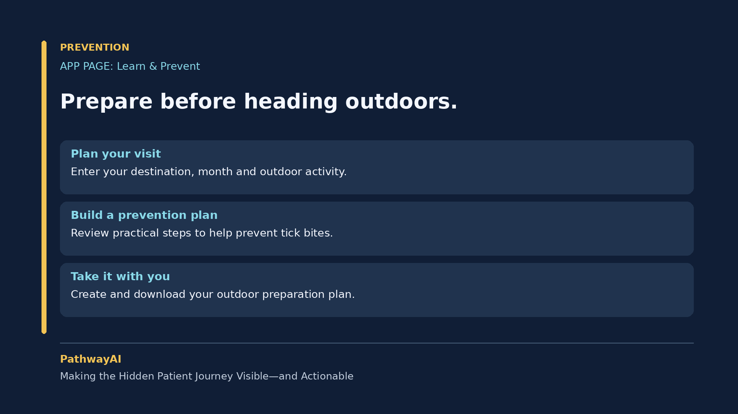
Notes:
Narration cue: First, prevention. People planning time outdoors can find prevention information and download a preparation plan.

Slide 3
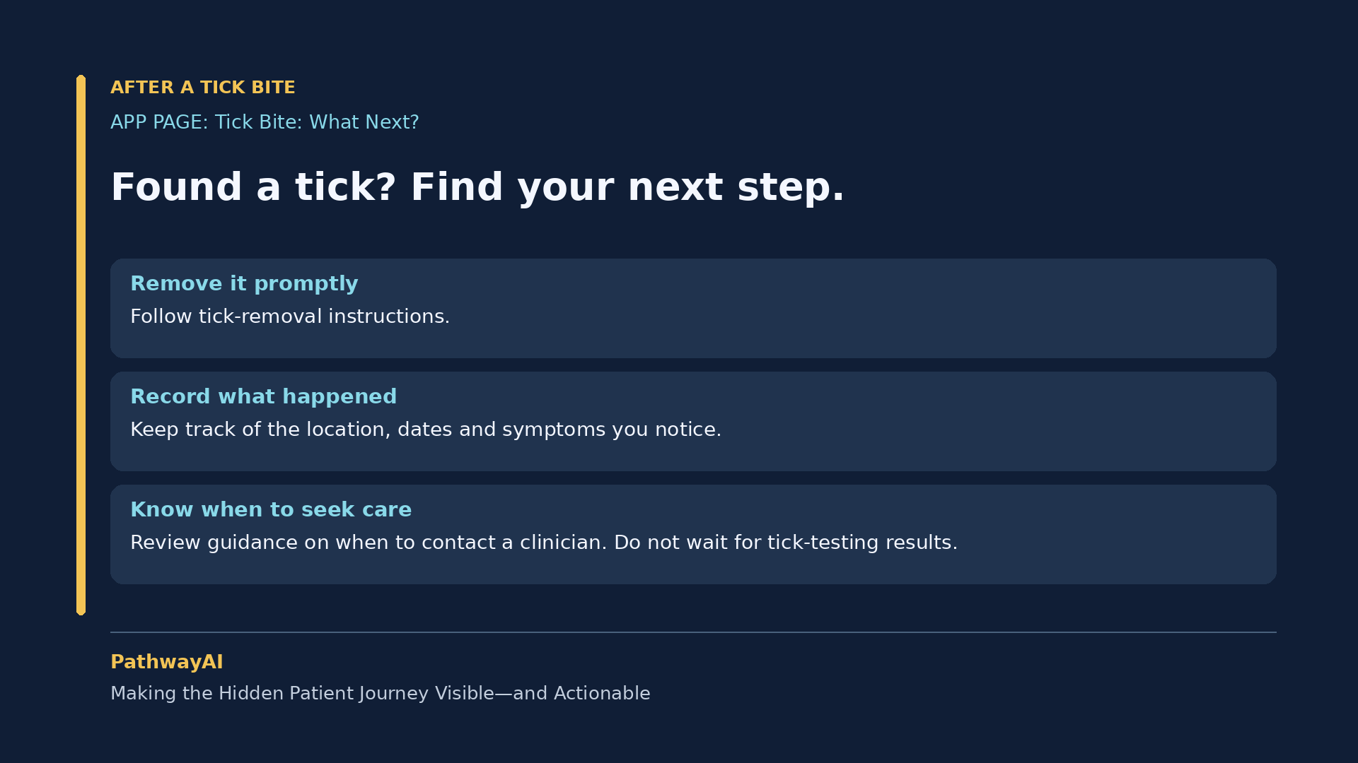
Notes:
Narration cue: If someone finds a tick, the tick-bite page provides removal instructions and guidance on when to contact a clinician.

Slide 4
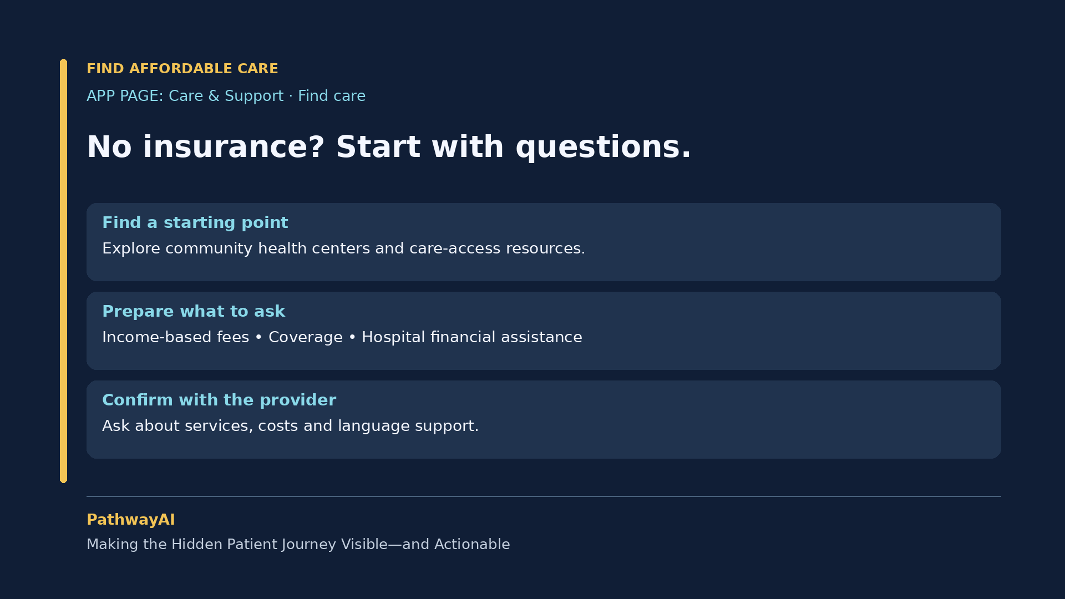
Notes:
Narration cue: But knowing you need care does not mean you know how to get it—especially without insurance.

Slide 5
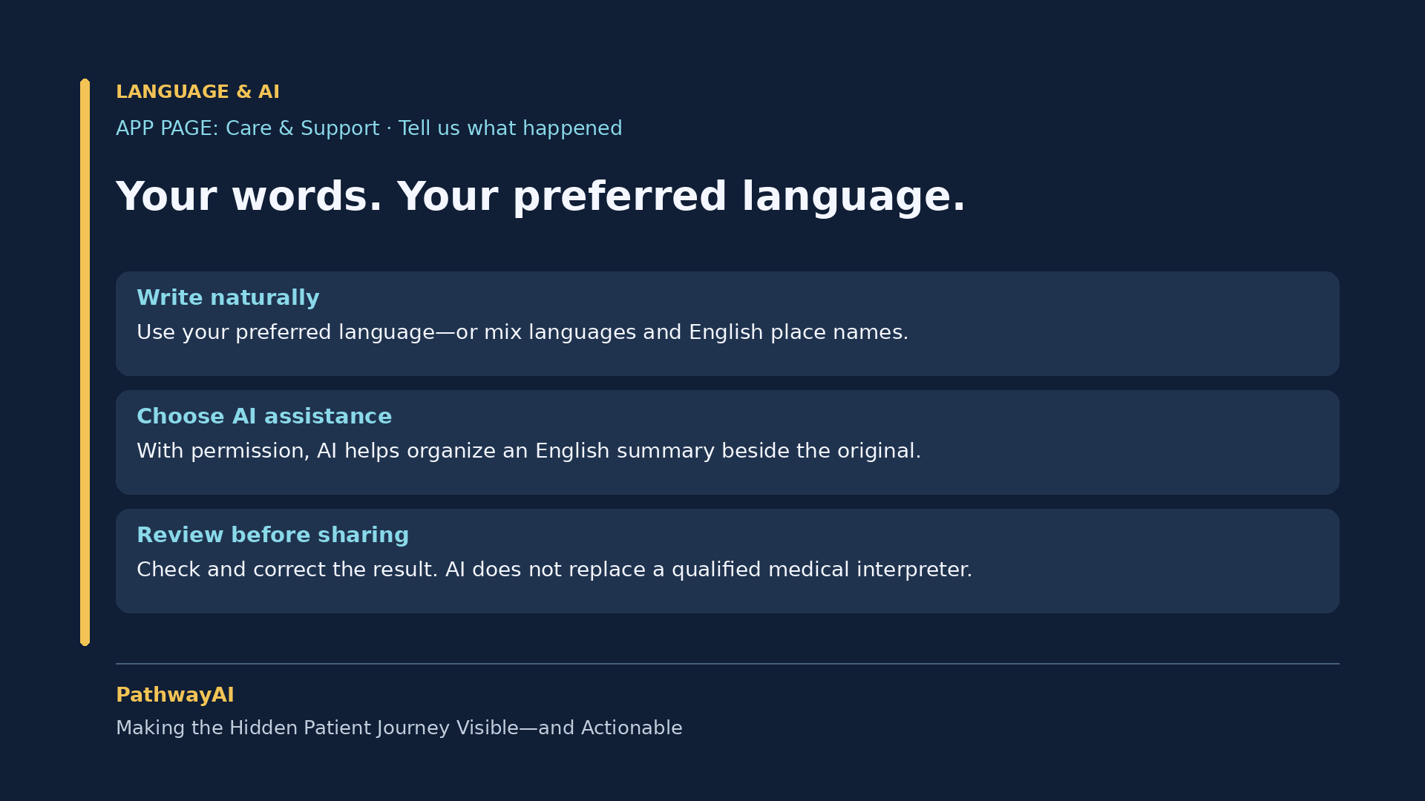
Notes:
Narration cue: People can write in their preferred language—even mixed languages, keeping English place names or medical terms.

Slide 6
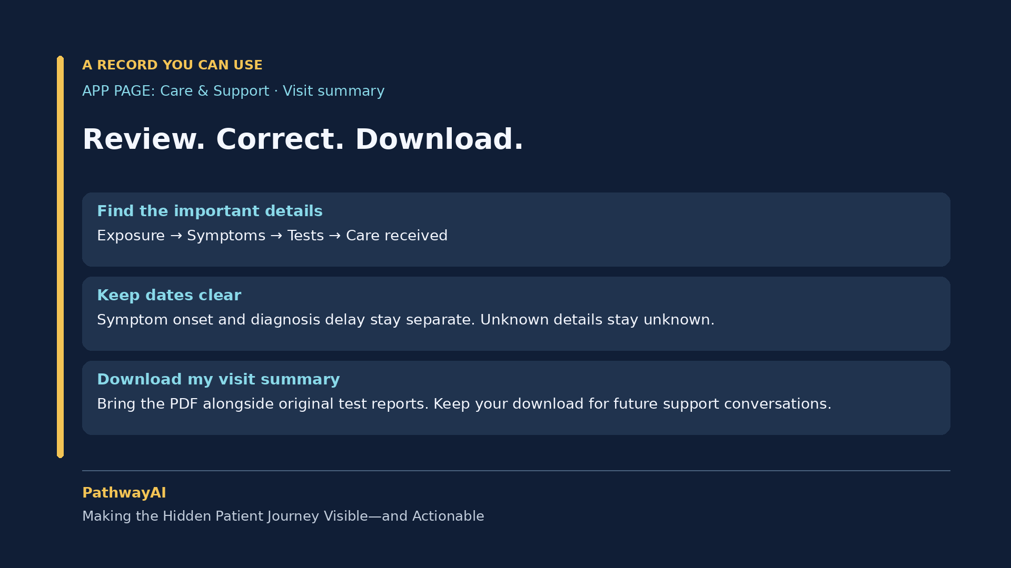
Notes:
Narration cue: Review it, correct it, and select “Download my visit summary.” Here is the PDF they can bring alongside their original test reports.

Slide 7
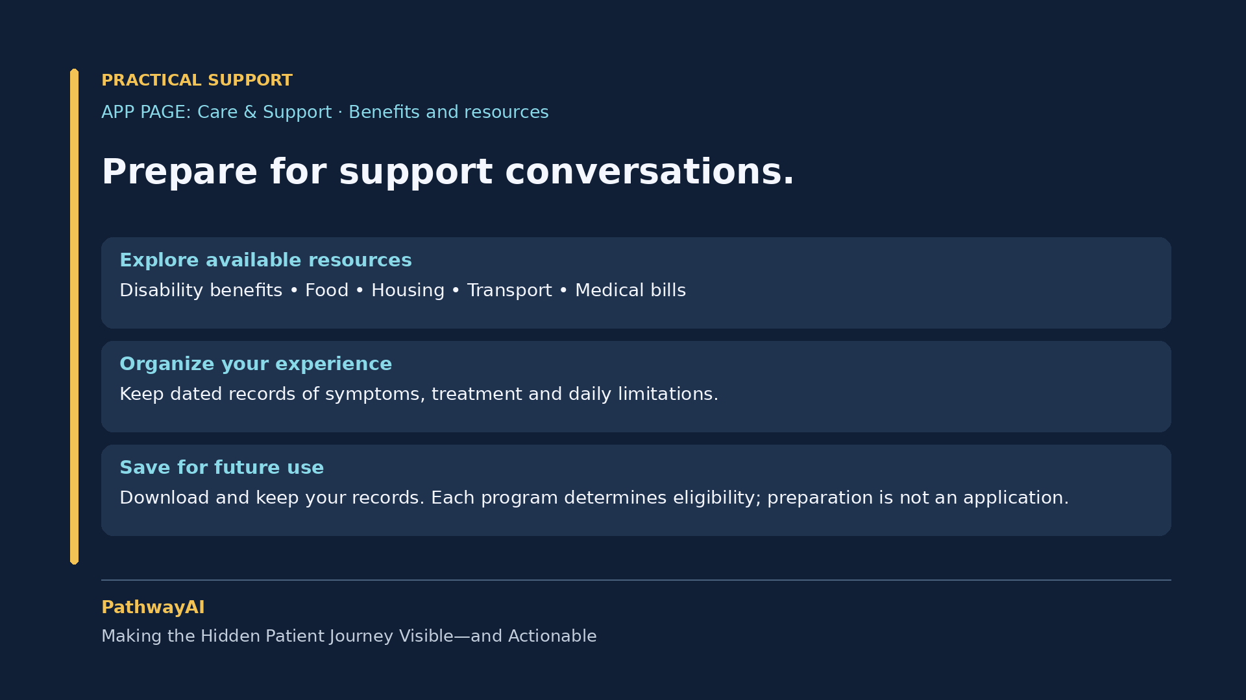
Notes:
Narration cue: They can keep this download for future support conversations. If disability benefits become relevant, dated records may help them prepare.

Slide 8
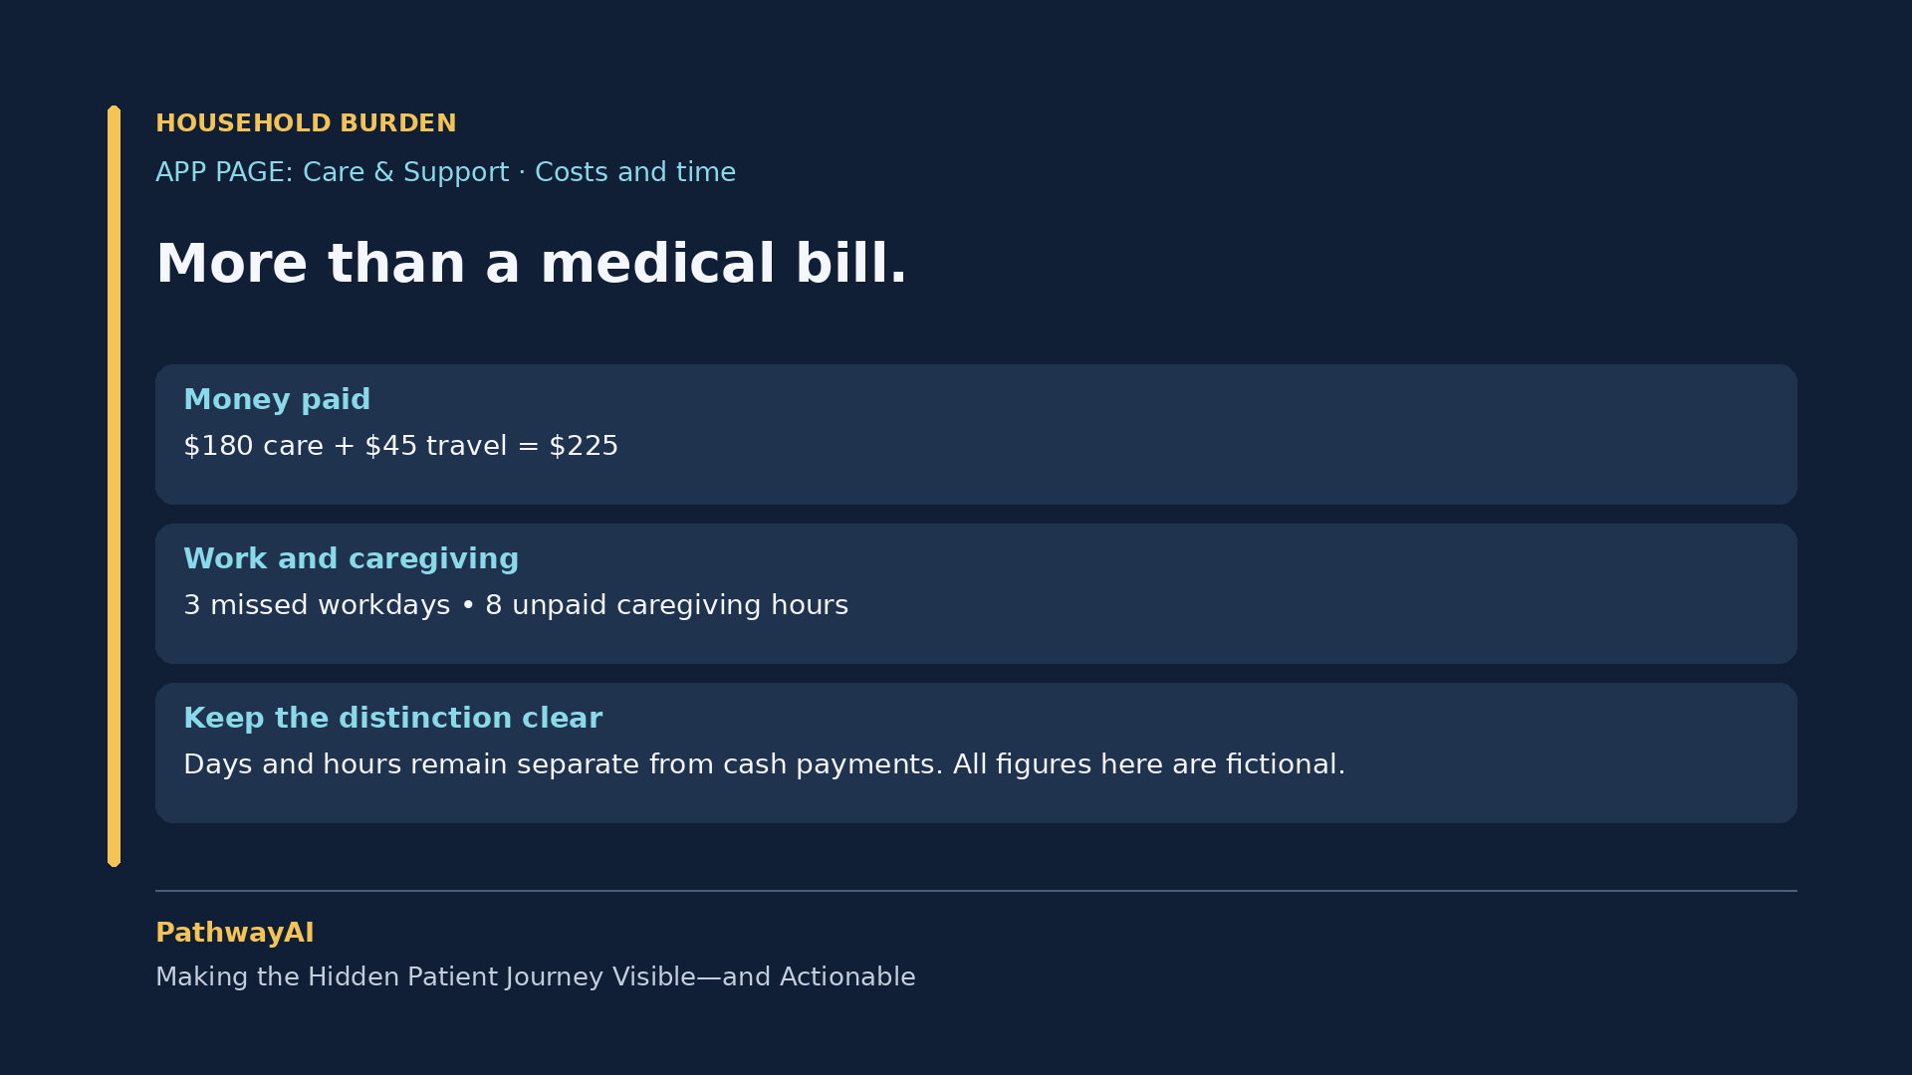
Notes:
Narration cue: Now, make the hidden burden visible. Our fictional patient paid 180 dollars for care and 45 dollars for travel: 225 dollars altogether.

Slide 9
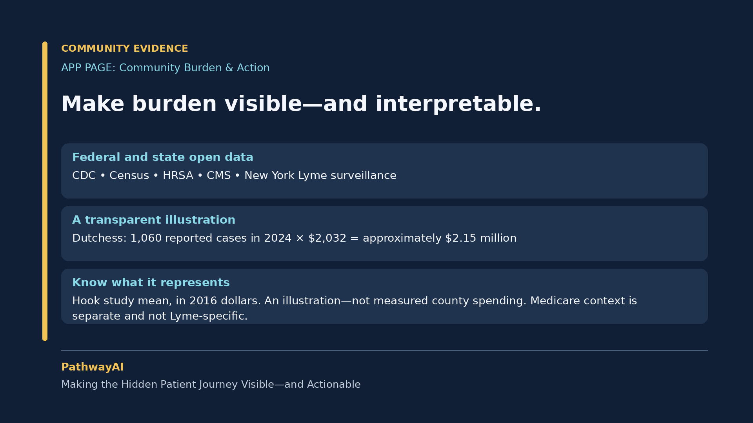
Notes:
Narration cue: PathwayAI combines CDC, Census, HRSA, and CMS open data with New York Lyme surveillance to describe disease patterns, barriers, and healthcare resources.

Slide 10
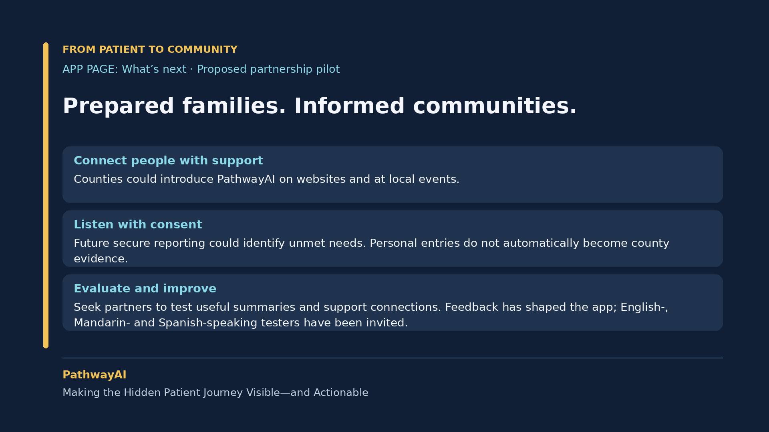
Notes:
Narration cue: Our goal is better-prepared families, voices heard, and communities better informed about where support is needed.

