Slide 1
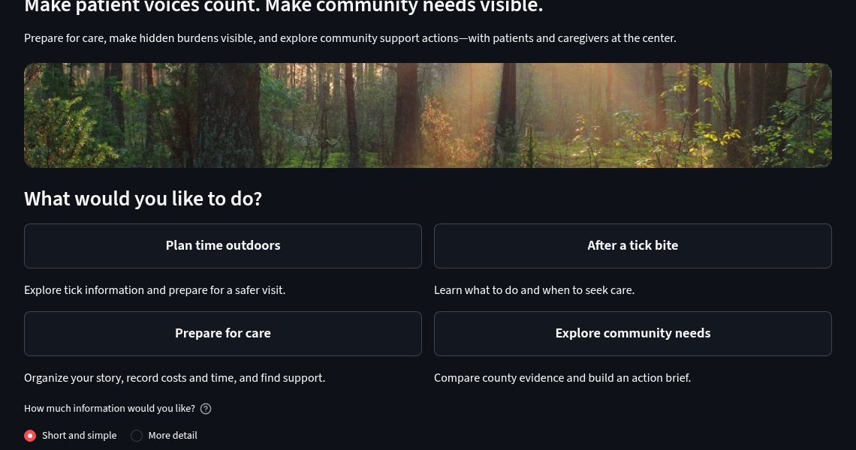
Start with the complete pathway
01 / 17 · START
Start page
Local app screenshots · Fictional entries · Illustrative costs · No live AI response shown

Slide 2
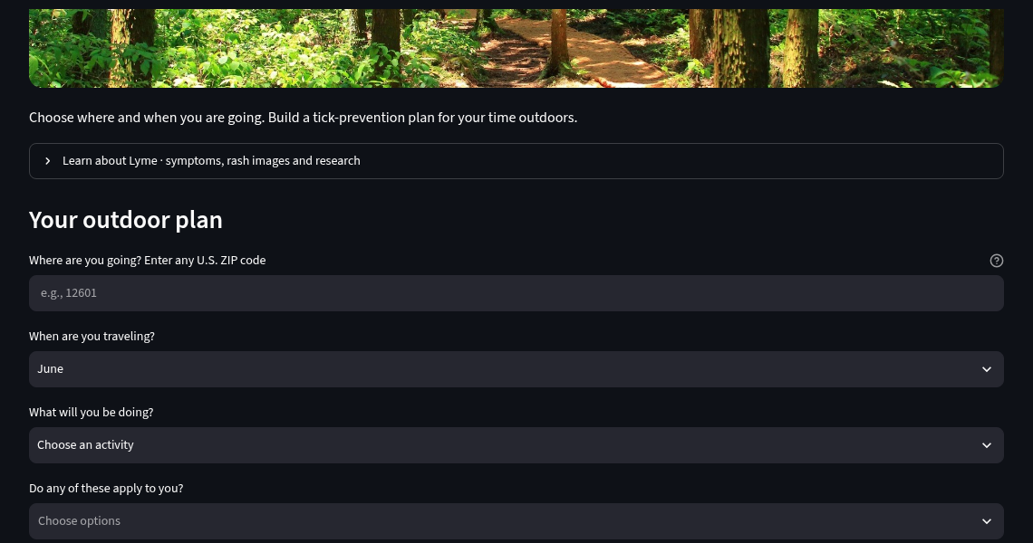
Plan before going outdoors
02 / 17 · PREVENT
Plan time outdoors → Your outdoor plan
Local app screenshots · Fictional entries · Illustrative costs · No live AI response shown

Slide 3
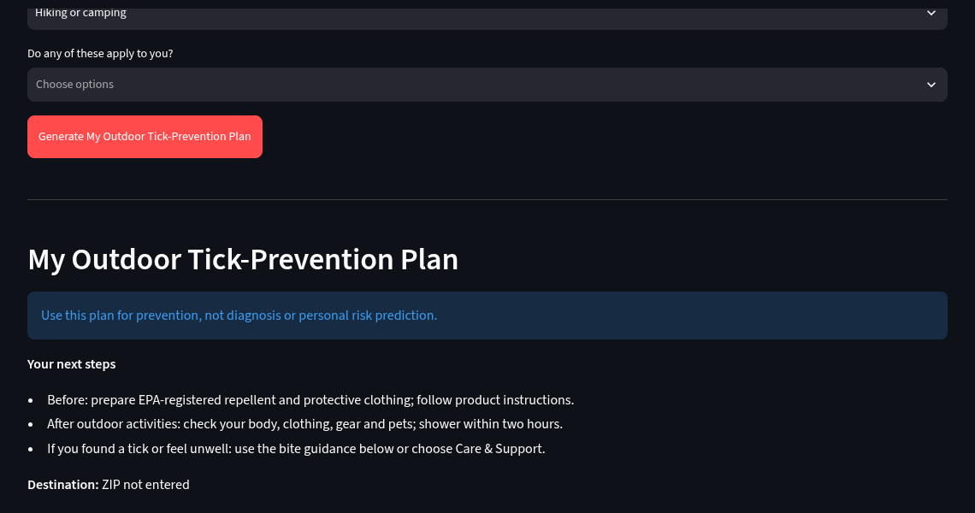
Prepare, check, and respond
03 / 17 · PREVENT
Learn & Prevent → Generate My Outdoor Tick-Prevention Plan
Local app screenshots · Fictional entries · Illustrative costs · No live AI response shown

Slide 4
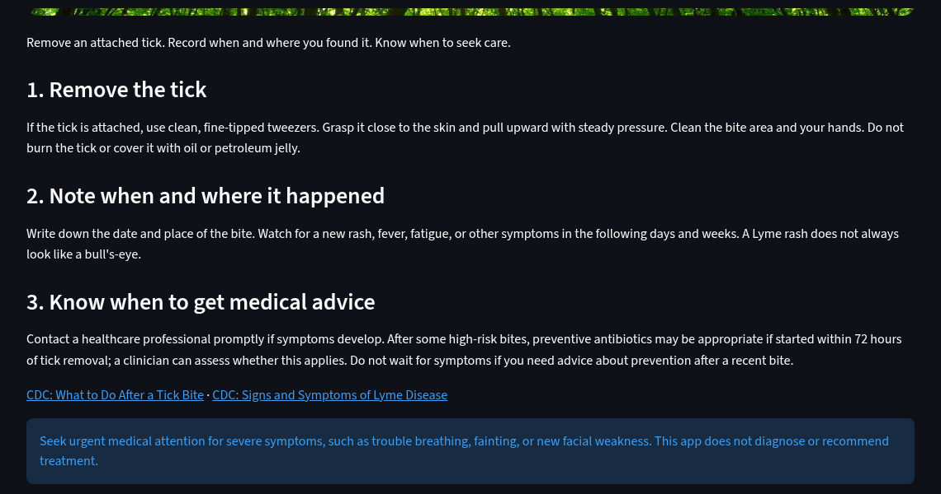
After a tick bite
04 / 17 · RESPOND
After a tick bite → Remove → Record → Seek advice
Local app screenshots · Fictional entries · Illustrative costs · No live AI response shown

Slide 5
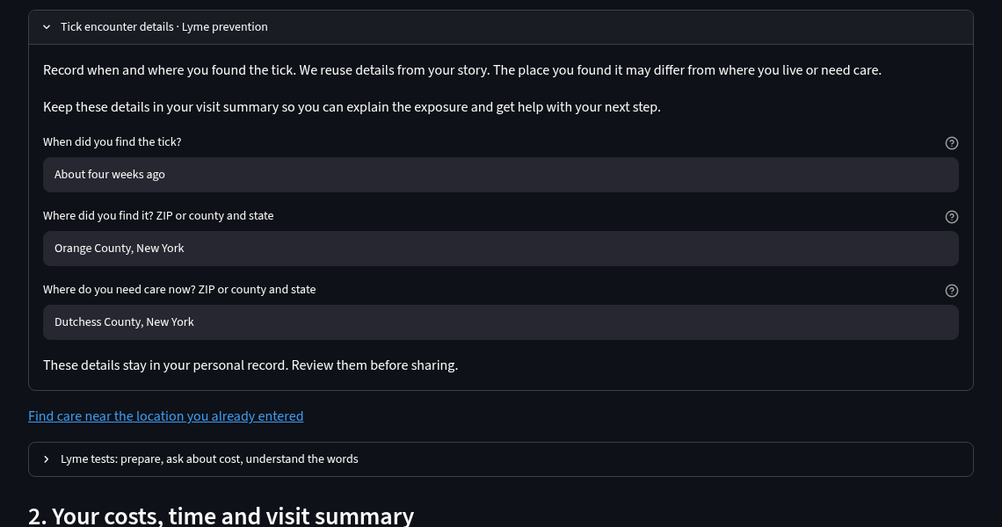
Record when and where
05 / 17 · RESPOND
Prepare for care → Tick encounter details
Local app screenshots · Fictional entries · Illustrative costs · No live AI response shown

Slide 6
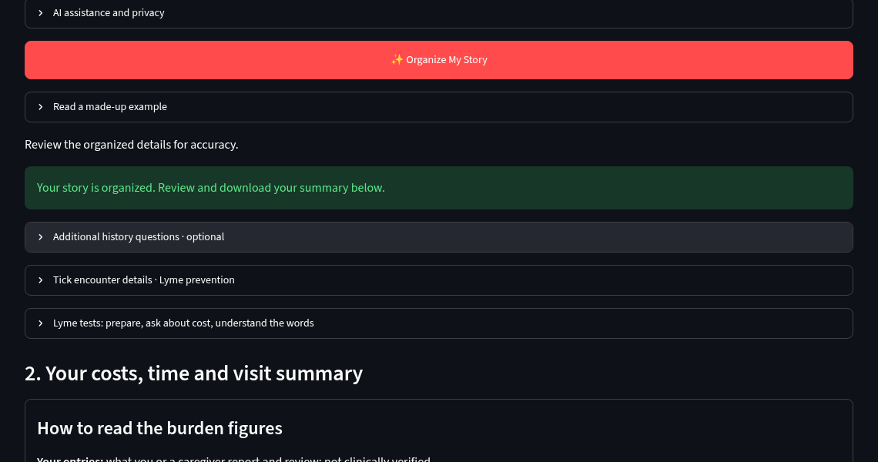
Tell the story once
06 / 17 · CARE
Prepare for care → Tell us what happened → Organize My Story
Local app screenshots · Fictional entries · Illustrative costs · No live AI response shown

Slide 7
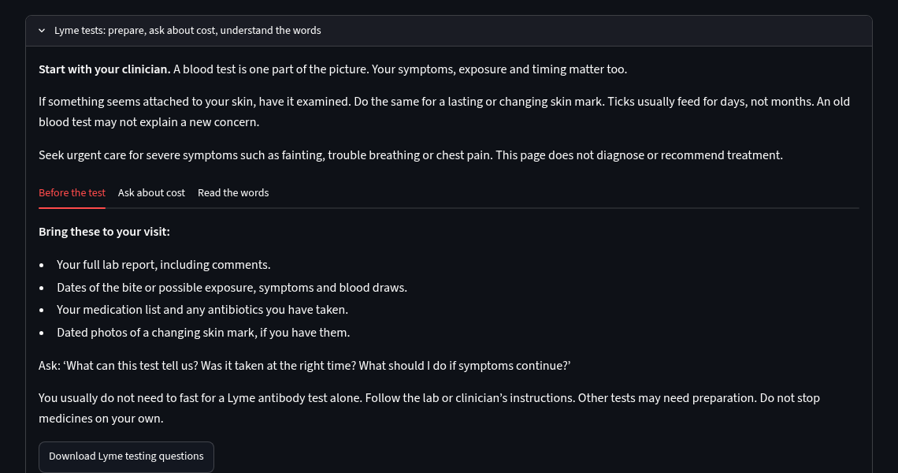
Prepare questions about testing
07 / 17 · CARE
Care & Support → Lyme tests → Before the test
Local app screenshots · Fictional entries · Illustrative costs · No live AI response shown

Slide 8
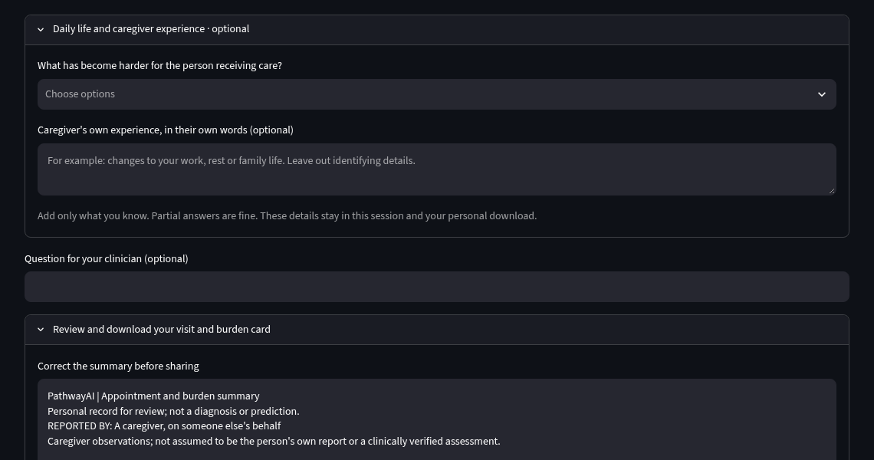
Include daily life and caregiver experience
08 / 17 · CARE
Care & Support → Daily life and caregiver experience
Local app screenshots · Fictional entries · Illustrative costs · No live AI response shown

Slide 9
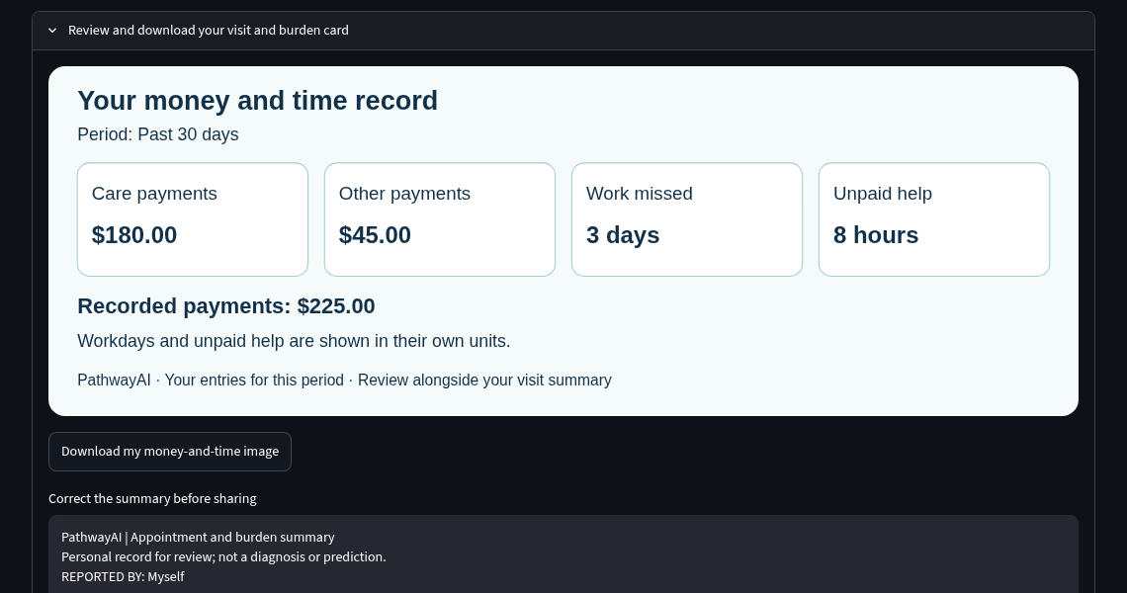
Review payments, work and unpaid help
09 / 17 · BURDEN
Care & Support → Review and download your visit and burden card
Local app screenshots · Fictional entries · Illustrative costs · No live AI response shown

Slide 10
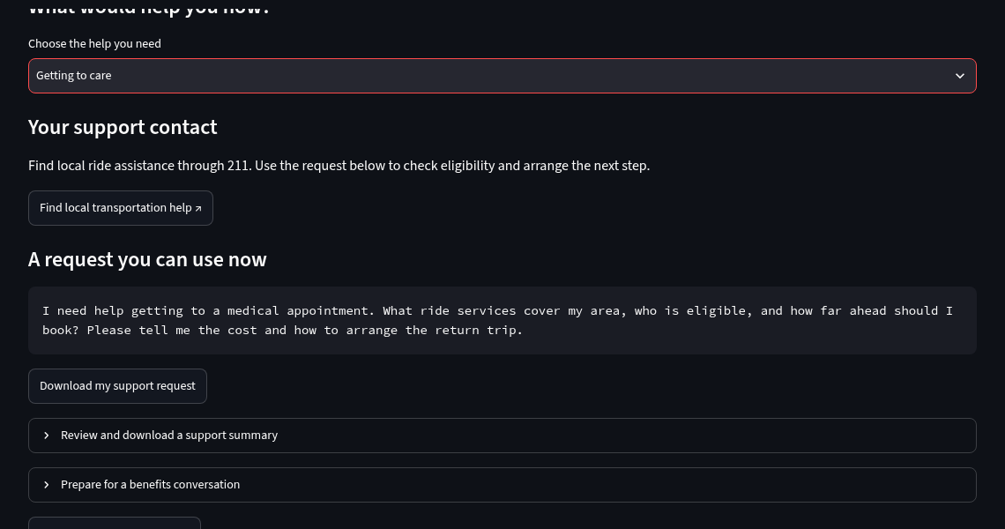
Prepare a request for support
10 / 17 · SUPPORT
Care & Support → Choose the help you need → Getting to care
Local app screenshots · Fictional entries · Illustrative costs · No live AI response shown

Slide 11
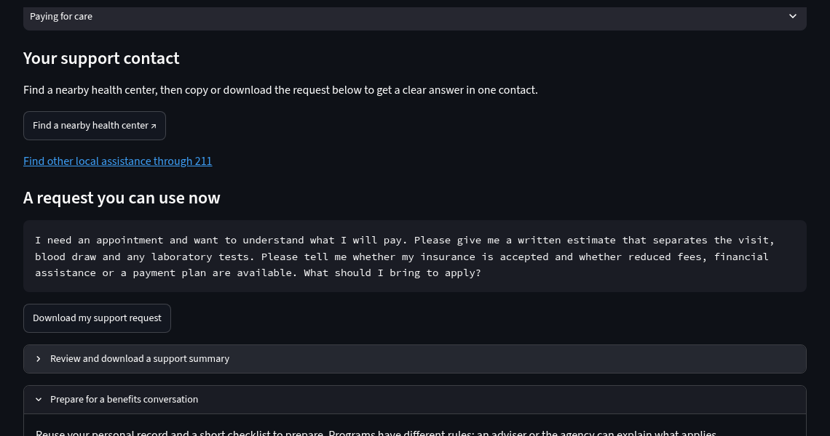
Prepare for a benefits conversation
11 / 17 · SUPPORT
Care & Support → Prepare for a benefits conversation
Local app screenshots · Fictional entries · Illustrative costs · No live AI response shown

Slide 12
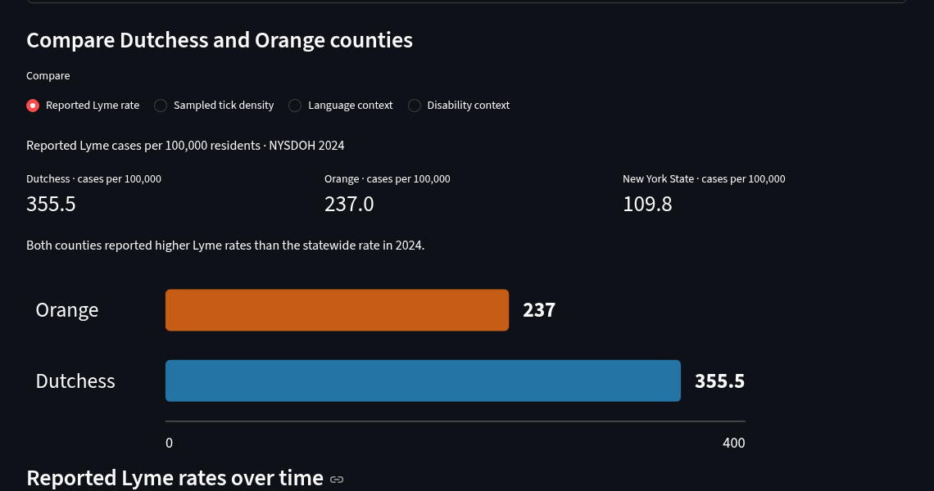
Compare county evidence
12 / 17 · COMMUNITY
Community Burden & Action → Compare Dutchess and Orange
Local app screenshots · Fictional entries · Illustrative costs · No live AI response shown

Slide 13
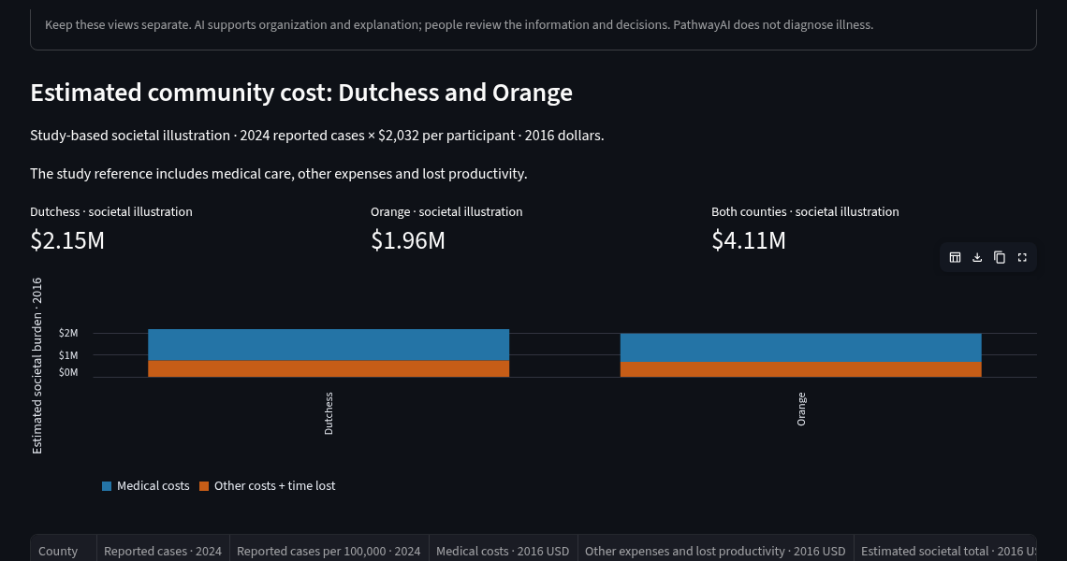
Explore a cost illustration
13 / 17 · COMMUNITY
Community → Estimated community cost: Dutchess and Orange
Local app screenshots · Fictional entries · Illustrative costs · No live AI response shown

Slide 14
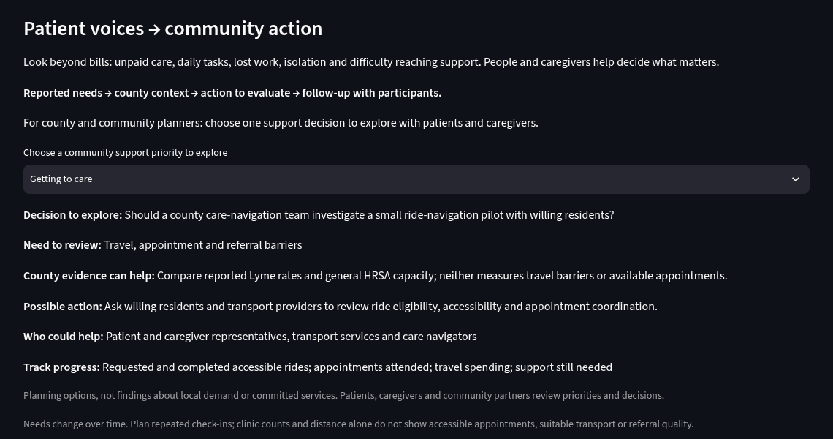
Connect needs with possible actions
14 / 17 · ACTION
Community → Patient voices → community action
Local app screenshots · Fictional entries · Illustrative costs · No live AI response shown

Slide 15
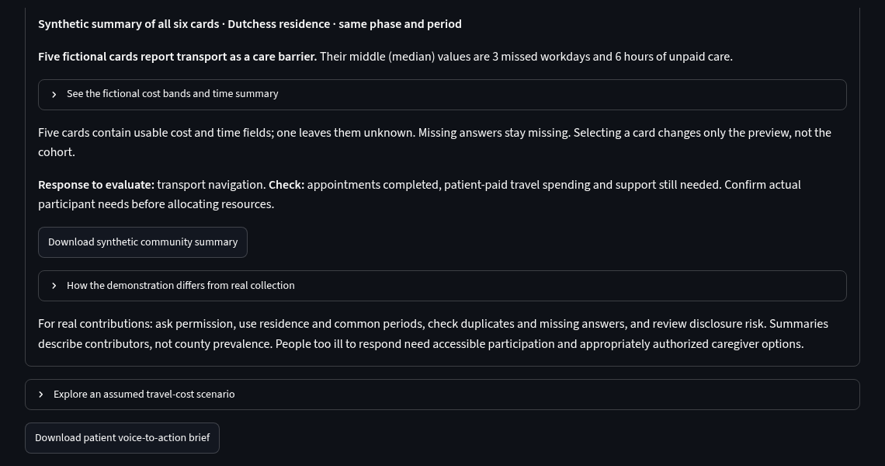
Summarize comparable reports
15 / 17 · ACTION
Community → See how comparable patient reports could be summarized
Local app screenshots · Fictional entries · Illustrative costs · No live AI response shown

Slide 16
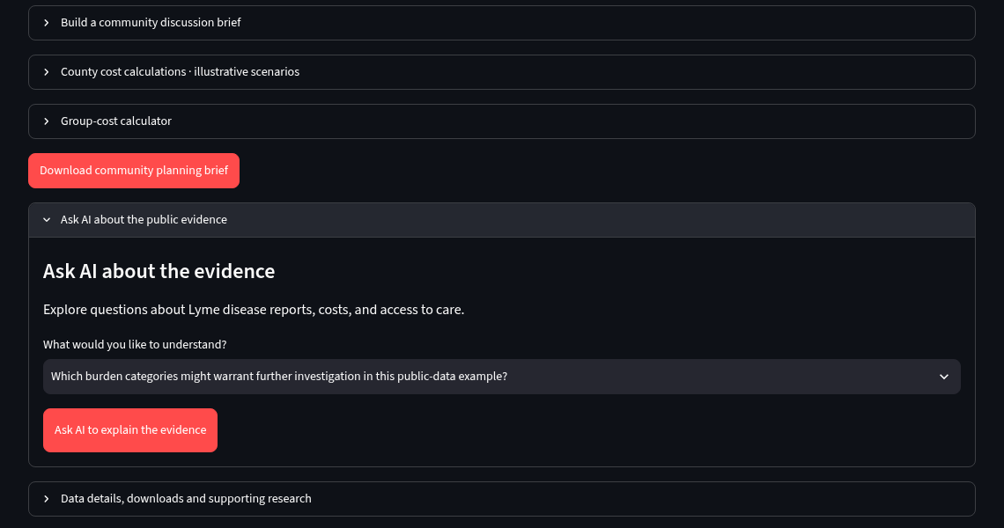
Ask about the public evidence
16 / 17 · AI
Community → Ask AI about the public evidence
Local app screenshots · Fictional entries · Illustrative costs · No live AI response shown

Slide 17
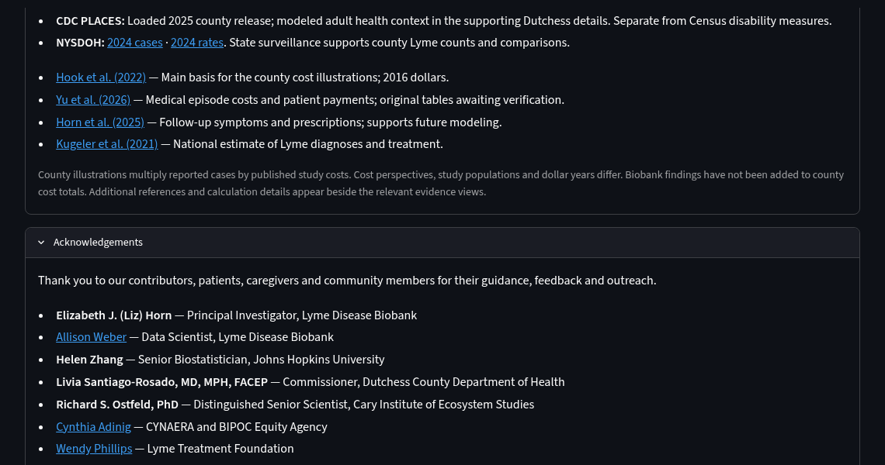
Patients and people remain at the center
17 / 17 · THANK YOU
Sources & Acknowledgements → Acknowledgements
Local app screenshots · Fictional entries · Illustrative costs · No live AI response shown

