Slide 1
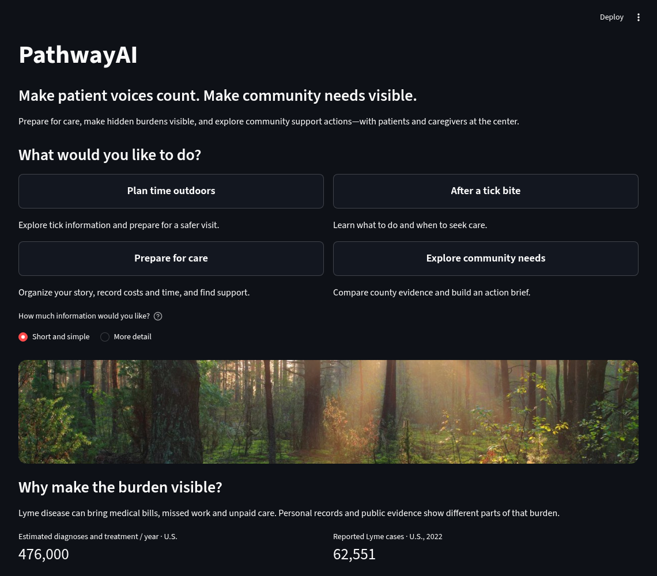
01 / 09
A story. Evidence. A next step.
NAVIGATE
Start page
SPEAKING CUE
Open with the three-part introduction and your background.
Local app screenshot · fictional demo data
Notes:
A patient’s story.
A community’s evidence.
A practical next step.
Today, these often live in different places.
What if we could bring them together, with the patient at the center?
That is PathwayAI.
I’m Yuwei Zhang from Team GreenAcorn. My background is in pathology, with experience at the National Institutes of Health and the Centers for Medicare and Medicaid Services.
My experience taught me to examine evidence. Patients taught me to ask what it misses.
A medical bill can tell us what a visit cost. It cannot tell us what it took to get there.
The travel. The missed work. The unpaid help. The effort of telling the same story again.
Let me show you how PathwayAI makes that journey visible.

Slide 2
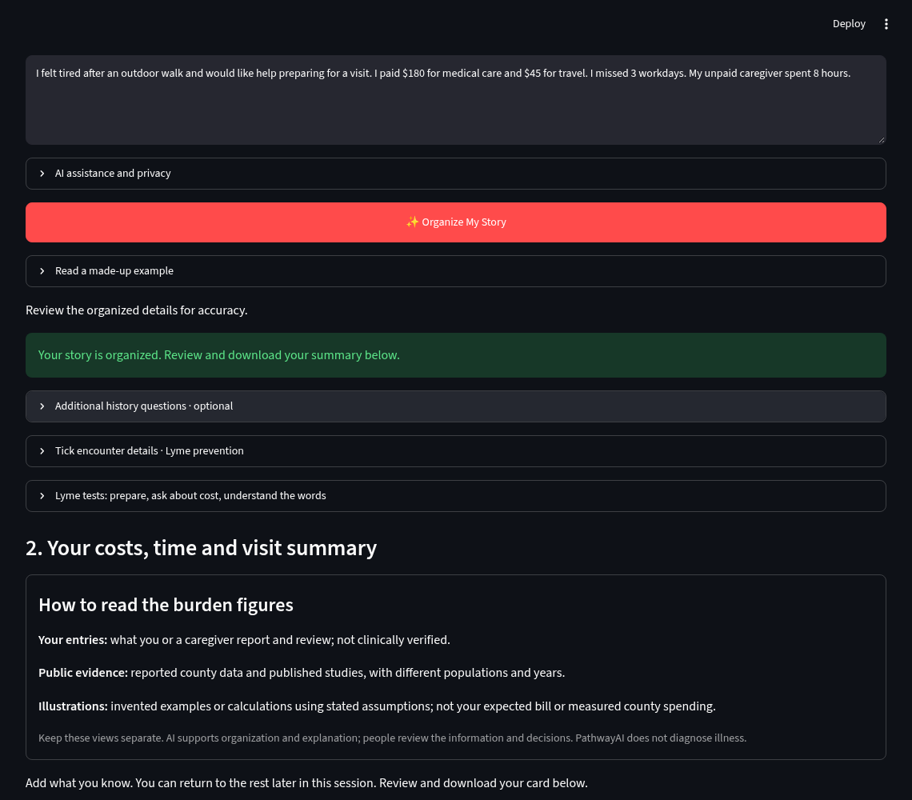
02 / 09
First: the patient story
NAVIGATE
Prepare for care → Tell us what happened → Organize My Story
SPEAKING CUE
Use only this fictional story. Leave external AI off.
Local app screenshot · fictional demo data
Notes:
First, the patient’s story.
This is a fictional example. A person feels tired after an outdoor walk and wants help preparing for care.
Over thirty days, they paid one hundred eighty dollars for care and forty-five dollars for travel, missed three workdays, and received eight hours of unpaid help.
They write a short story. PathwayAI helps organize the details into a record they can check, change, and download.

Slide 3
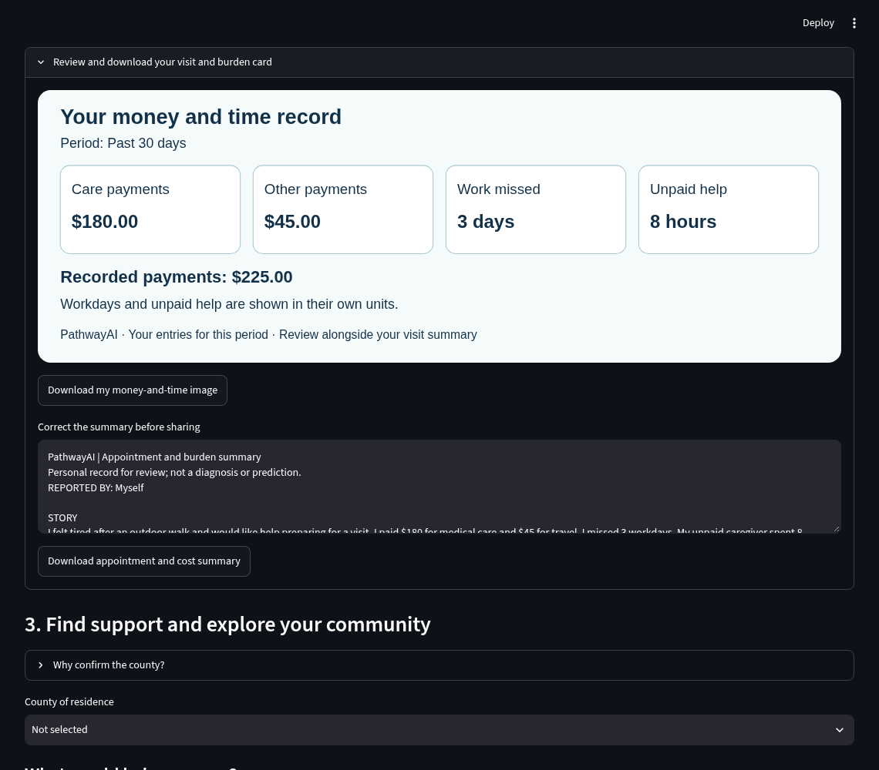
03 / 09
The reviewed personal card
NAVIGATE
Care & Support → Review and download your visit and burden card
SPEAKING CUE
Show $225 paid, 3 missed workdays and 8 caregiver hours. Review before sharing.
Local app screenshot · fictional demo data
Notes:
Two hundred twenty-five dollars paid. Three workdays missed. Eight hours of unpaid help.
We keep those measures separate. If something is unknown, it stays unknown.

Slide 4
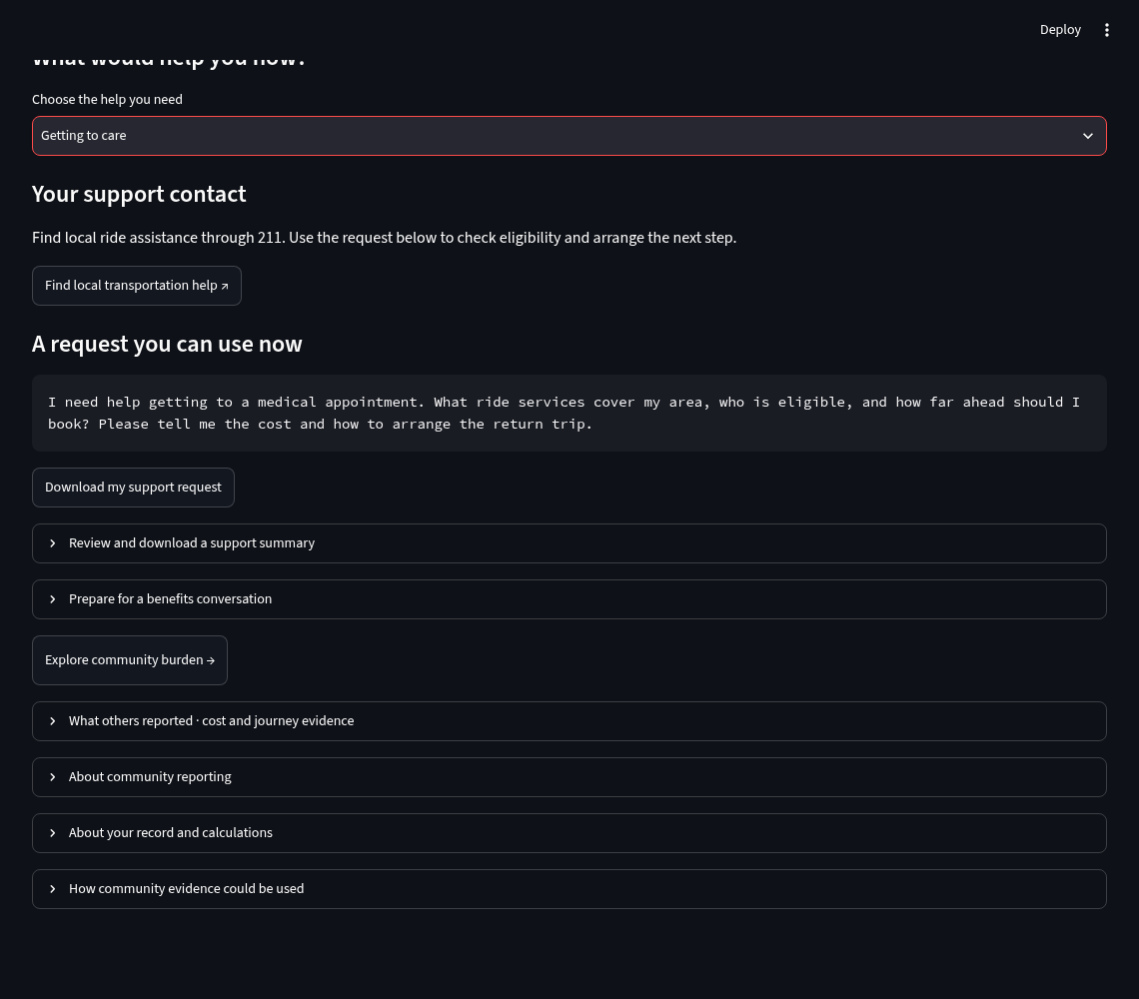
04 / 09
A useful request for support
NAVIGATE
Care & Support → Choose the help you need → Getting to care
SPEAKING CUE
Show the transport request and download. Nothing is sent automatically.
Local app screenshot · fictional demo data
Notes:
They can bring the summary to a visit, prepare a transport request, or use a benefits checklist. Nothing is sent automatically. They choose what to share.

Slide 5
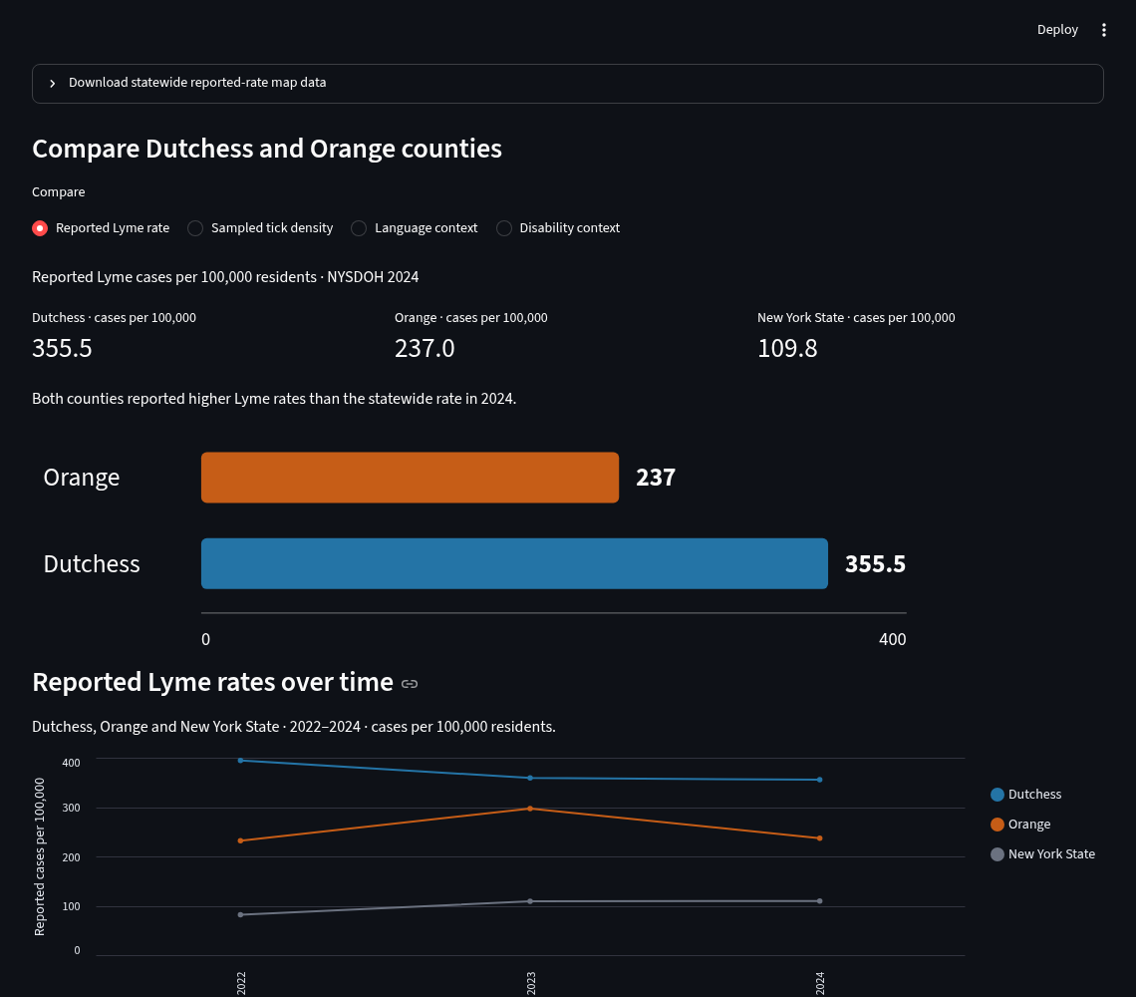
05 / 09
Second: community evidence
NAVIGATE
Explore community burden → Compare Dutchess and Orange counties
SPEAKING CUE
Explain sources, reporting periods and why county context differs from personal experience.
Local app screenshot · fictional demo data
Notes:
Second, the community’s evidence.
Here we compare Dutchess and Orange counties in New York. We use CDC, Census, and HRSA data alongside New York surveillance and published research. Together, these sources provide context about reported disease, healthcare resources, community conditions, and economic burden.
Each source tells part of the story. None tells all of it.
County averages do not describe every resident. One person does not represent the county. PathwayAI keeps these views separate, but makes both visible.

Slide 6
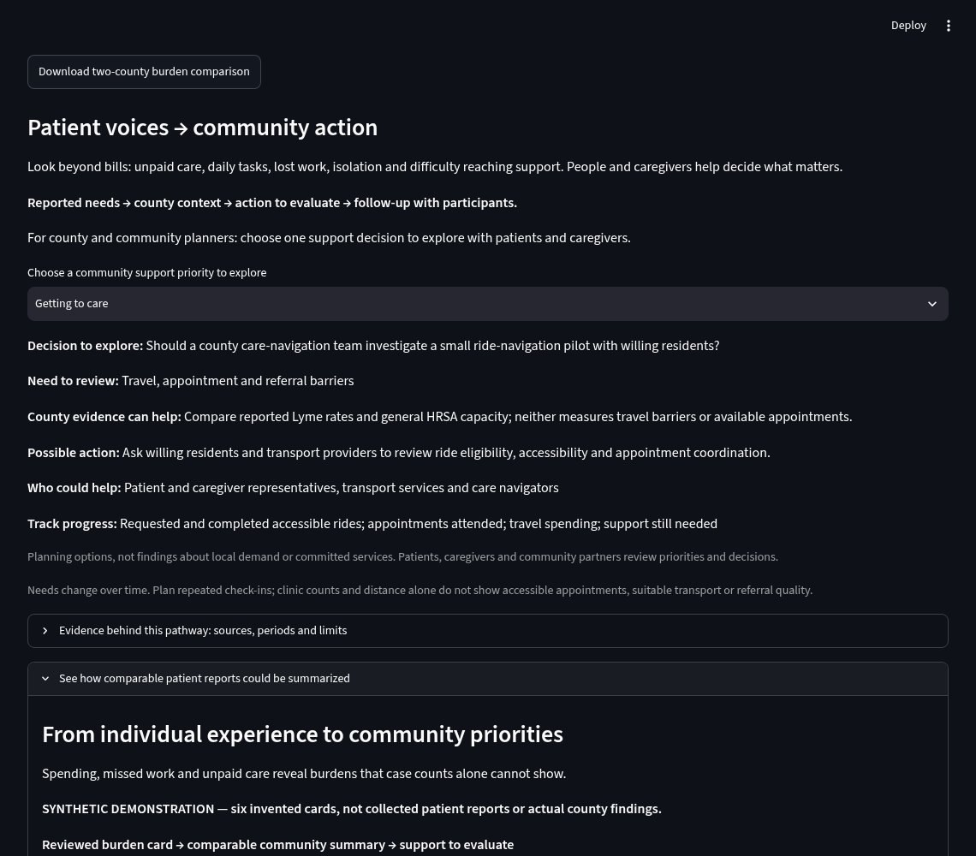
06 / 09
Third: an action to evaluate
NAVIGATE
Community → Patient voices → community action
SPEAKING CUE
The six invented records are a separate demonstration. Show the proposed response and measures.
Local app screenshot · fictional demo data
Notes:
Patient advocates reminded us to look beyond bills: unpaid care, daily life, and the effort of reaching support. Their feedback helped shape the caregiver options, simpler story entry, and support-preparation tools.
Third, a practical next step.

Slide 7
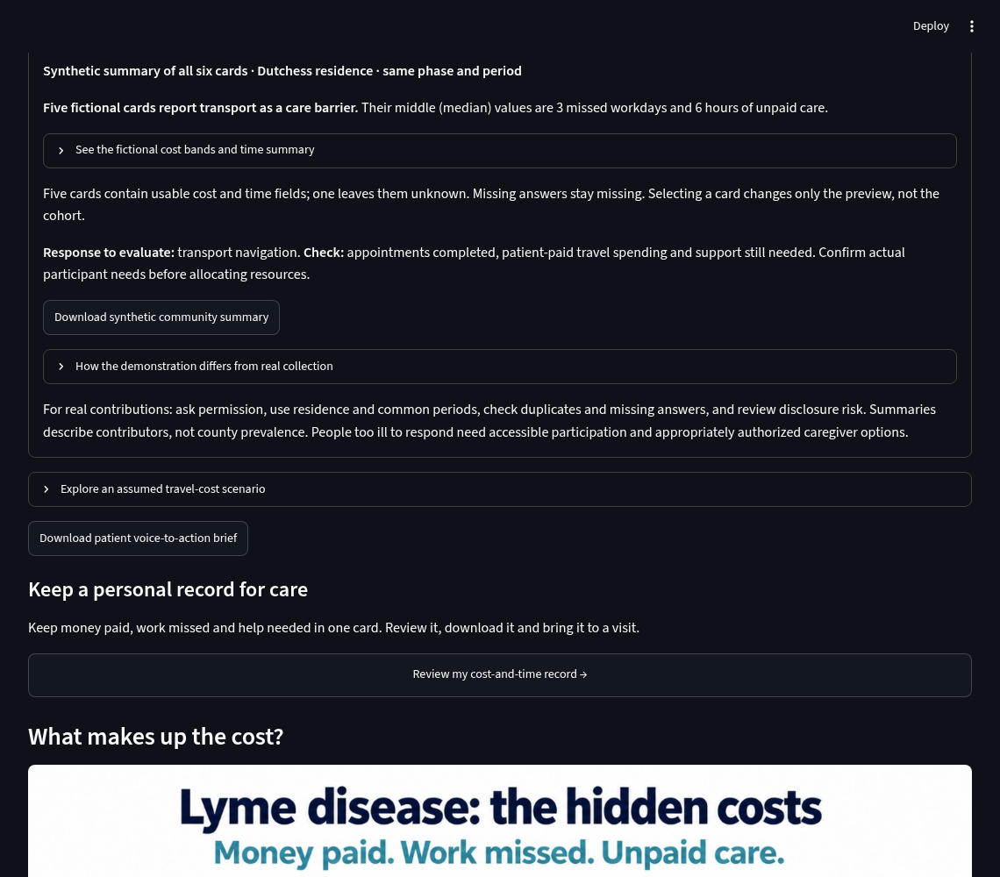
07 / 09
Comparable reports, clearly labeled
NAVIGATE
Community → See how comparable patient reports could be summarized
SPEAKING CUE
Five usable fictional answers; one missing. This is not real county patient data.
Local app screenshot · fictional demo data
Notes:
This demonstration uses six invented records. Five report transportation barriers. One leaves the answer blank. These are examples, not collected patient findings.
What could a community do with real, comparable reports?
A care-navigation team could investigate help arranging suitable rides. Patients and caregivers would help decide whether that is the right priority. Local partners would check what they can provide.
The downloadable planning brief names a proposed action, potential partners, and measures.
Rides requested. Rides completed. Appointments attended. Needs still unmet.
Make burden visible. Plan a response. Learn whether it helps.

Slide 8
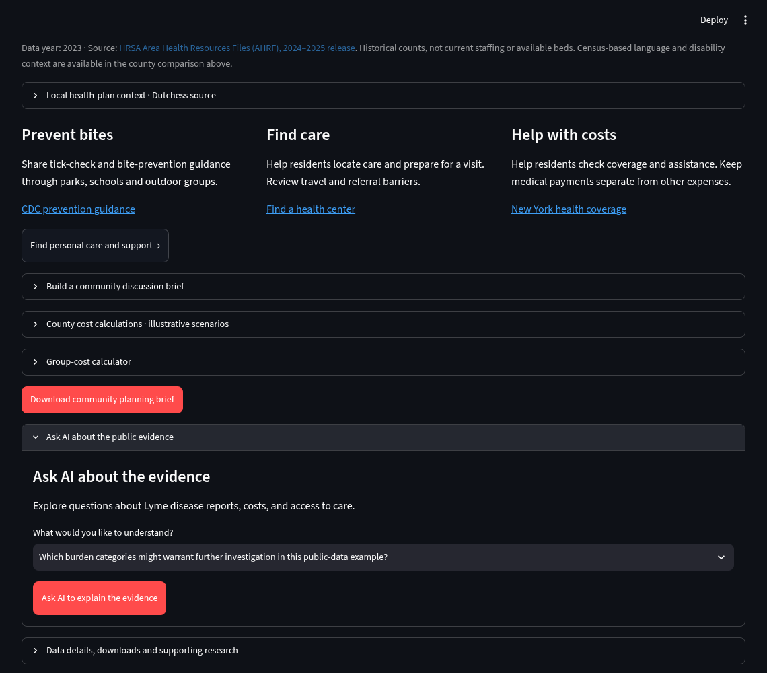
08 / 09
AI with human review
NAVIGATE
Community → Ask AI about the public evidence
SPEAKING CUE
Show the question and privacy explanation. This image does not show a successful live AI answer.
Local app screenshot · fictional demo data
Notes:
Here, a person can ask AI a focused question about the public evidence. It uses a curated summary, keeps source links available, and does not receive private patient cards. Optional story AI requires permission. The local organizer works without it.
AI can organize information, but people review its meaning.
Data can reveal patterns, but it cannot replace lived experience.
Models can explore possibilities, but people remain responsible for decisions.
The patient remains at the center.

Slide 9
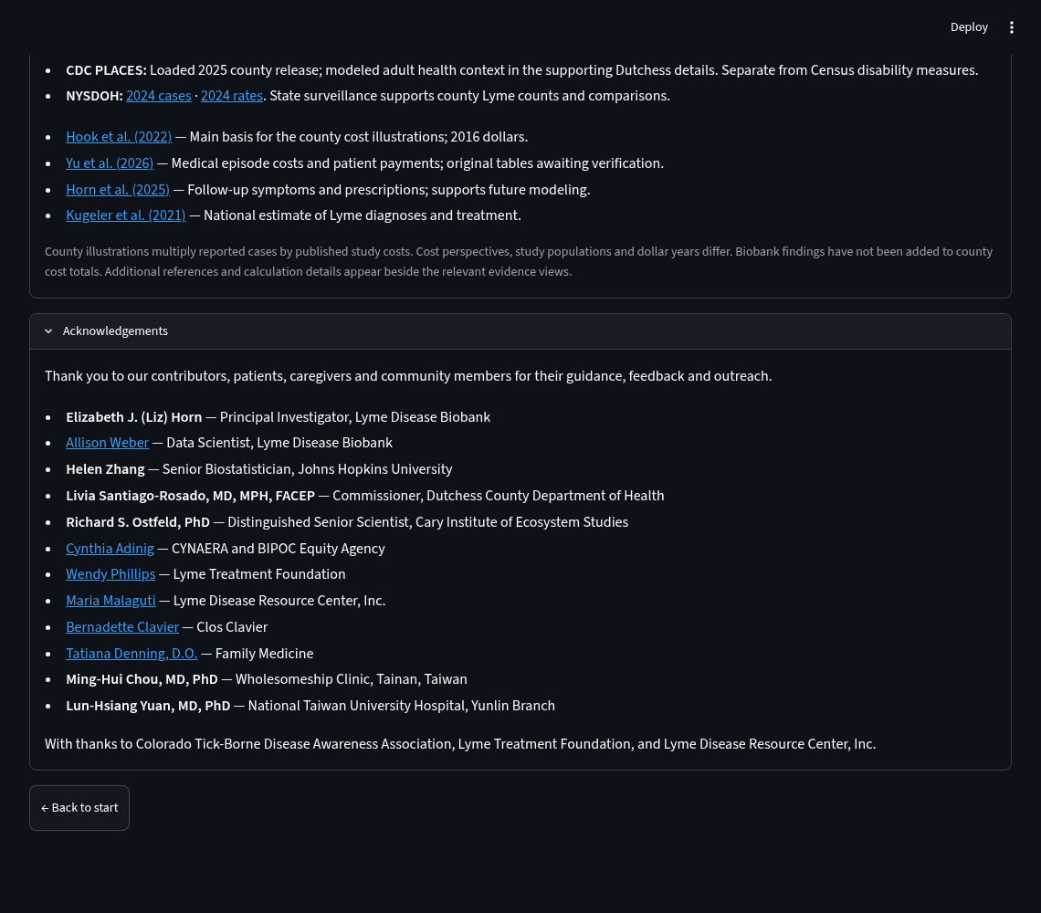
09 / 09
Thank you for helping make it possible
NAVIGATE
Sidebar → Sources & Acknowledgements → Acknowledgements
SPEAKING CUE
Thank patients, caregivers, advocates and experts. Close with the PathwayAI title.
Local app screenshot · fictional demo data
Notes:
PathwayAI does not diagnose. Health benefits and savings need evaluation through a secure, consent-based pilot with patients, caregivers, and community partners.
A clearer story. Evidence in context. An action to evaluate.
To the patients and caregivers who shared their experiences, and the advocates and experts who offered their guidance: thank you.
You helped shape PathwayAI.
Your voices remind us what the data alone cannot tell us—and why this work matters.
PathwayAI: Making the Hidden Patient Journey Visible—and Actionable.
Thank you for helping make it possible.

