Slide 1
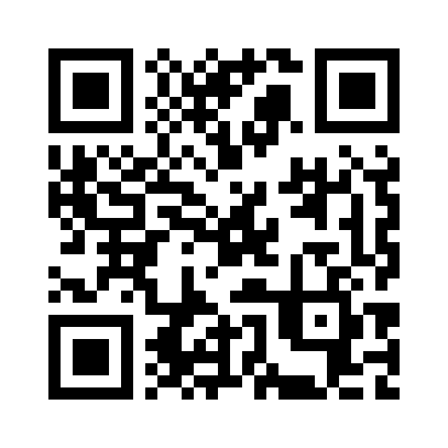
MVP Showcase | October 22, 2026
PathwayAI
Scan to try PathwayAI
MVP Showcase
Making the Hidden Patient Journey Visible
Yuwei Zhang | Team GreenAcorn
pathwayai.streamlit.app
TOPx HHS Tech Sprint
Notes:
FIVE-MINUTE LIVE DEMO SCRIPT
0:00–0:30 | Title slide
SAY
Hello, I’m Yuwei Zhang from Team GreenAcorn, the developer of PathwayAI.
Our goal is to reduce the burden of Lyme disease by connecting prevention, access to care, support and community planning. We make the personal care journey visible, alongside the costs and time that disease reports often miss.
CLICK
Keep the title slide visible. Then switch to the app, already open on the start page.
0:30–3:20 | Live app demonstration
SAY
People begin with what they need today: planning an outdoor visit, responding to a tick bite, preparing for care, or understanding community needs.
I’ll choose Care & Support and use a fictional story. This person paid 180 dollars for care and 45 dollars for travel, missed three workdays, and received eight hours of unpaid help.
When I organize the story, clear amounts are copied into fields the person can check and edit. Unclear values stay for review. AI assistance is optional; I’m using the local organizer today.
Here, I choose the period these entries cover. The card shows 225 dollars in payments, with missed work and unpaid help recorded separately. It can be downloaded and brought to different healthcare providers. That reduces repeated explanation when someone feels tired or has trouble remembering details.
Caregivers can also complete a clearly labeled record. Daily-life effects and the caregiver’s own experience are kept separate. Support resources and ready-to-use requests help people prepare their next conversation.
Now let’s look at Community. Our Hudson Valley pilot view compares Dutchess and Orange counties. We can see reported Lyme rates, trends and a cost breakdown. The comparison supports planning; it is not a scorecard of county performance.
The personal entries remain available when we return to Care & Support during this session. They are not automatically added to the county totals.
CLICK
Choose Care & Support. Paste the fictional story below. Leave external AI off and click Organize My Story. Select Past 30 days. Show the card, visual and download button. Briefly point to caregiver options and support requests. Select Explore community burden; show the county comparison and cost breakdown. If time allows, return with Review my cost-and-time record. Do not open every panel.
3:20–4:20 | Explain evidence while showing the county costs
SAY
The county illustration combines 2024 reported cases with Hook and colleagues’ published cost estimate. Across the two counties, that gives about 4.11 million dollars in 2016 dollars. It is a study-based illustration, not measured county spending.
Federal sources include CDC, Census, HRSA and CDC PLACES, alongside New York surveillance and published research.
Liz Horn clarified that the Biobank’s early-care cohort adds symptom and follow-up context, but does not estimate delayed-diagnosis costs. Those experiences may also be missed by routine healthcare data.
Patient and community feedback helped simplify this workflow. Software tests check that it functions; health benefits and savings still need evaluation.
CLICK
Keep the two-county cost illustration visible. Point to the dollar year. Do not add Biobank percentages to the cost model or claim that delay costs are already estimated.
4:20–5:00 | Return to the title slide and close
SAY
The working MVP is available now. Our next step is a consent-based pilot that reuses reviewed local records to understand barriers and guide support.
We are seeking patients, caregivers, community groups, care teams and data collaborators. Together, we can improve accessibility, strengthen cost evidence and test whether people reach useful support.
PathwayAI’s goal is timely care and less disruption to finances, work and family life. Thank you.
CLICK
Return to the title slide. Finish by 5:00. Leave the app link visible.
FICTIONAL STORY
I felt tired after an outdoor walk and would like help preparing for a visit. I paid $180 for medical care and $45 for travel. I missed 3 workdays. My unpaid caregiver spent 8 hours.

