Slide 1

Amazon Sales Data Analysis
Darshan Gaikwad

Slide 2
INTRODUCTION
Amazon sales data analysis refers to the process of analyzing consumer behavior, sales, and several other data points in order to make improved, data-driven decisions.
By analyzing different metrics, you will be able to increase and improve your performance in terms of conversion rates, sales, etc.
The dataset available contains the various on record numbers achieved by the organization throughout the year 2015.
The information available is also helpful for forecasting the future plans for the organization

Slide 3
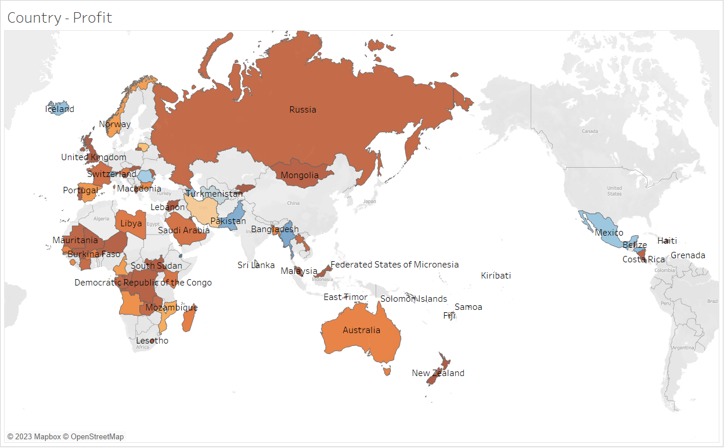
The below map chart depicts the country wise profit.

Slide 4
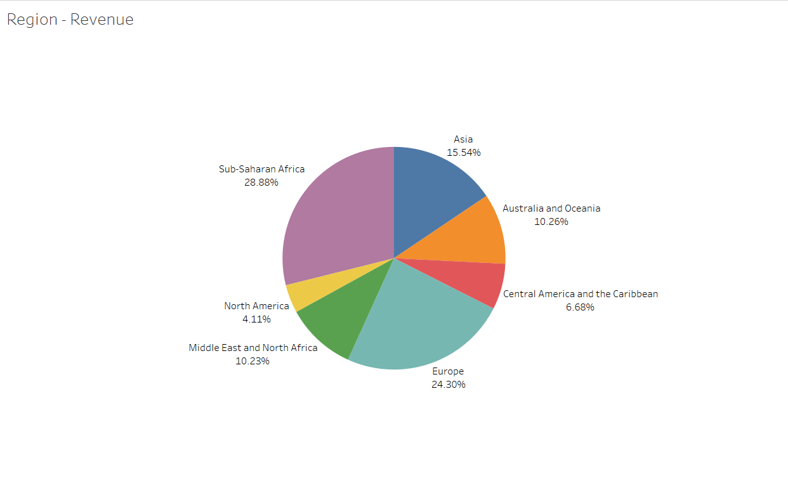
Region wise revenue generated - 2015

Slide 5
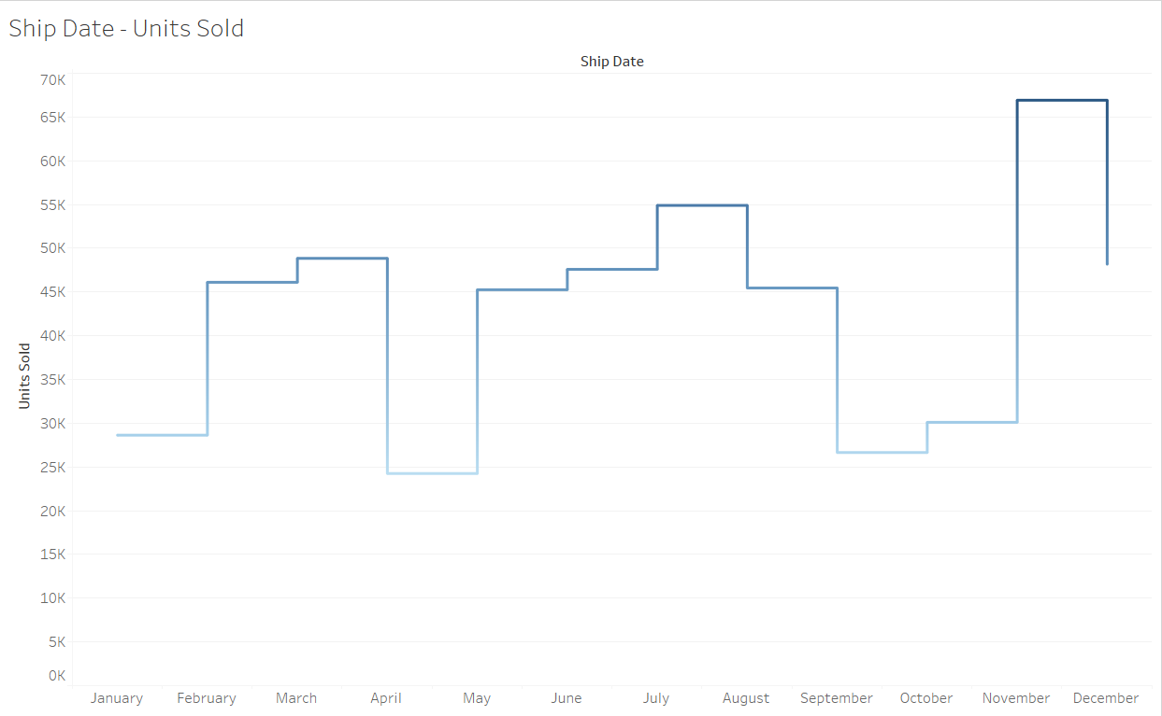
Monthly units sold.

Slide 6
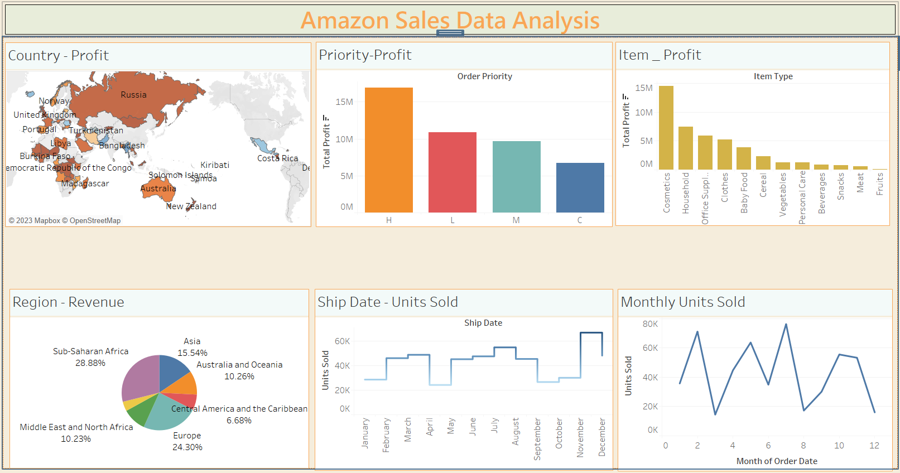
Dashboard !

Slide 7
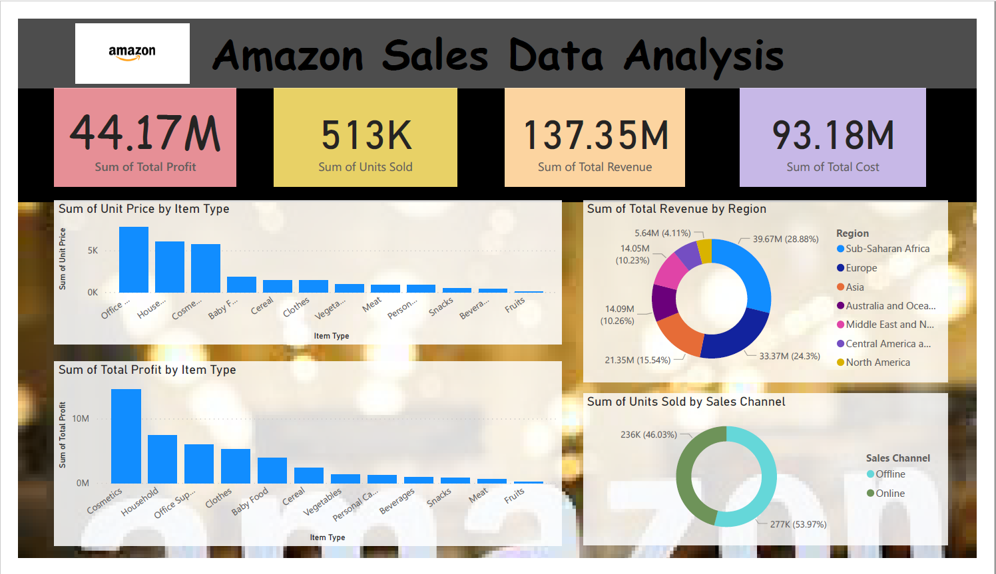
Dashboard!

Slide 8
ThankYou !
Tableau Link - Amazon Data Analysis | Tableau Public
Python code - https://colab.research.google.com/drive/1DqIoBE6l7_gySmyCz1JEYKxW-1D_yKaJ

