Slide 1

Google App Store Data Analysis
By : Darshan Harishchandra Gaikwad

Slide 2
Introduction
The Google Play Store is the official app store for Android devices, providing users with access to millions of applications, games, books, and other content.
The Google Play Store has over 2.8 billion active users globally, making it one of the largest app stores in the world The Google Play Store generates significant revenue through in-app purchases, subscriptions, and advertisements. In 2020, it was estimated that the store generated over $29 billion in revenue.
The Google Play Store allows users to rate and review apps, providing valuable feedback for developers and helping other users make informed decisions about downloading apps.

Slide 3
Data Details
App - Name of the particular application
Category - Category to which domain the application belongs to
Rating - Ratings given to the application by users.
Reviews - No of reviews given
Size - Application size in MB
Installs - No of installs done
Type - Paid or free apps
Genres - Which genres the application belongs i.e Arts Design etc.

Slide 4
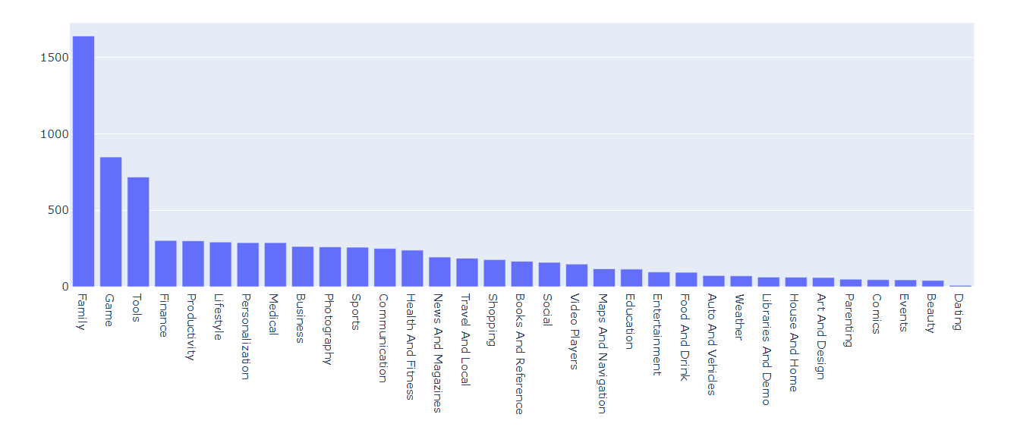
Odservations :
Below chart depicts the category wise trend in descending order.

Slide 5
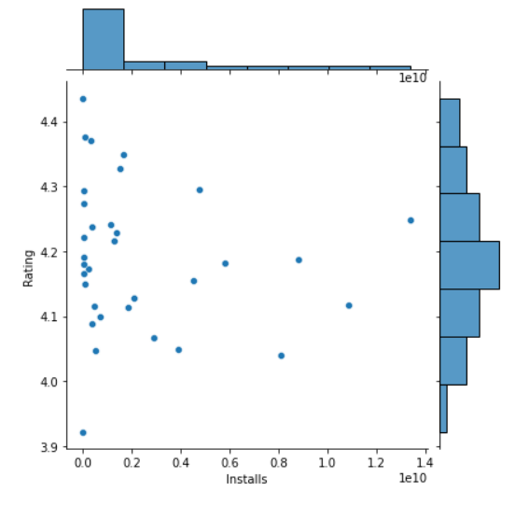
The observation depicts the relationship
between ‘Ratings’ and “Installs”

Slide 6
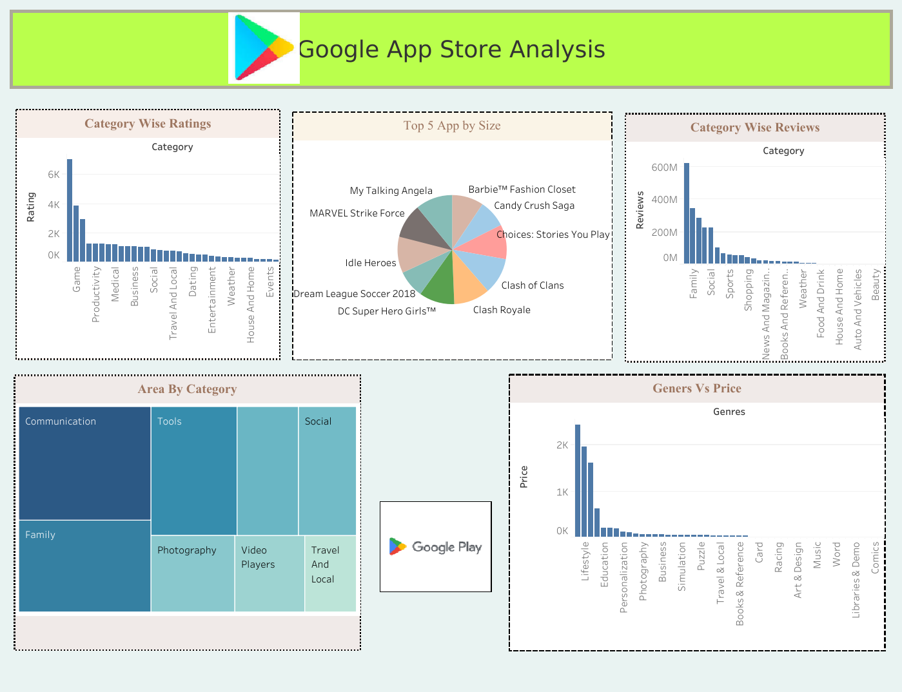
My Dashboard

Slide 7
ThankYou
Tableau Link: Google data analysis | Tableau Public
Python Link :https://colab.research.google.com/drive/1Yib7l0WQ_b67wsgh7PNS8cTiOpU6nHfi#scrollTo=0shfsCAj1H5Z

