Slide 1
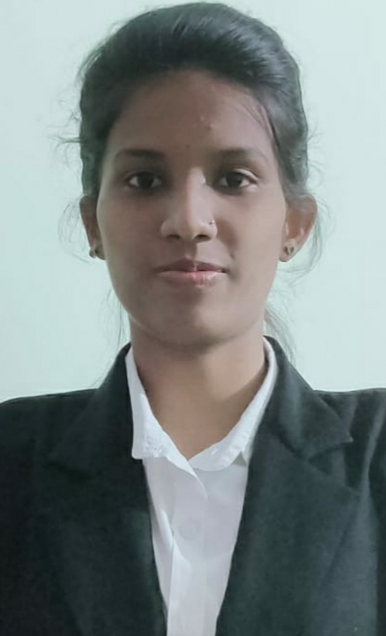
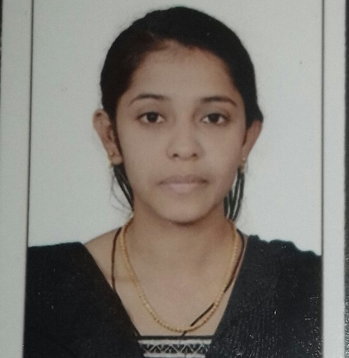

Sonali Sanjaydas Gaikwad
Analyst/Software Engineer
Bachelor of Technlogy, Computer Science and Engineering : 2015-2019
Batch:2022_B06_June_.NetCore_Rashmi
Employee Id :46211888
Skills
C# | Basics, OOPS, Exception Handling ,Arrays ,Collection and Generics, Delegates and Events, File Io and Serialization.
.NET Framework .NET Core | Architecture which includes CTS,CLS,FCL,BCL and CLR. Web API in .NET Core
Ado.net | Basics Architecture
Database | Basic SQL
Tools | GIT
UI Technology | HTML5 and CSS
Add On Skills | Communication Skills, Team Management, UI Designing(Sketching).
Mumbai
SONALI-SANJAYDAS.GAIKWAD@CAPGEMINI.COM
8484839521
A4
Full Stack Developer/SOFTWARE TESTER
Understanding of RDMS concepts using SQL Server.
Practical understanding of C# and SQL concepts using Visual Studio and SQL Server
Hands on experience in developing applications using .NET Framework,.NET CORE, ADO.NET and SQL Server.
Understanding of JavaScript, typescript, HTML5 and CSS.
Understanding of Angular Framework
Understanding of GIT and GitHub
Completed training on I-Transform-Microsoft .NET Core.
Currently working as a software tester on carbon portal.
Project : Portfolio team (sustainability COE)
Azure Certification : AZ-900,AZ-204
Completed case study on CropDeal which is used to The solve the problem of struggle of the farmers who are facing to sell their crop in the market for proper price and many more problems such as cost of transportation, wait time, negotiations for proper price, paying lot of intermittent charges as commissions, etc.
Video Link : https://screenrec.com/share/JsifAcHNr4
https://github.com/gaikwadsonali

