Slide 1
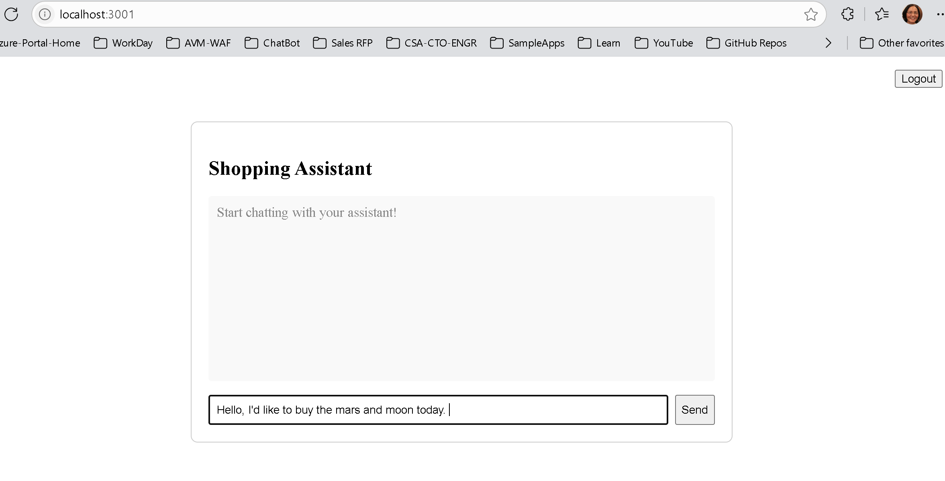
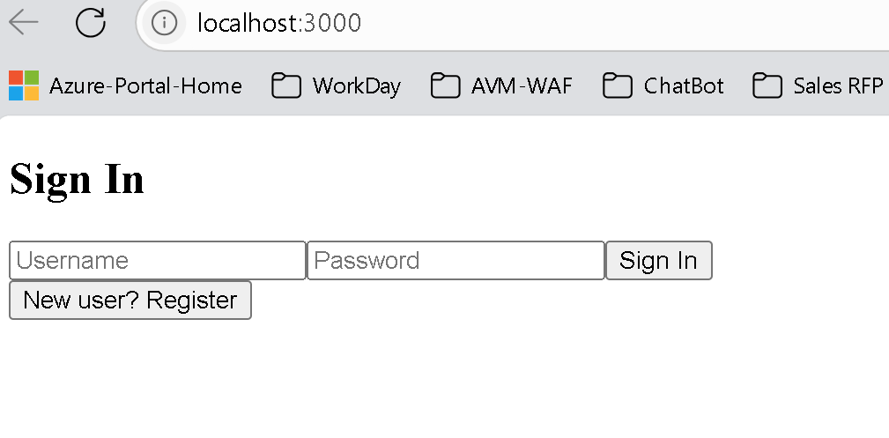

Slide 2
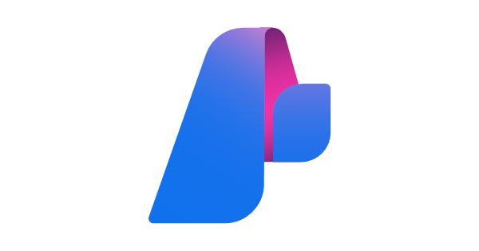

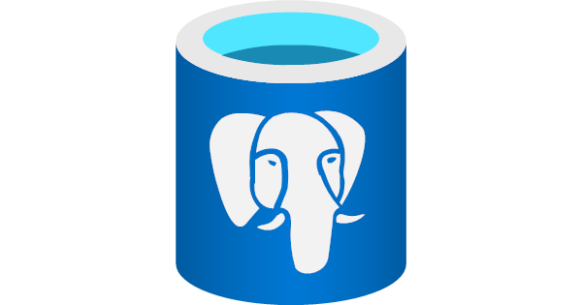
Shopping Assistant Architecture
Azure Container Apps
Frontend
Web App (React)
Backend App (Python FastAPI)
API
Chat with Shopping Agent
Semantic Kernel
Shop Managing Agent, Order Agent,
Cart Agent,
Offer Agent
User Register
User Login
User Logout
Chat
APIs:
User Register
User Login
User Logout
Secure Login
Auth DB in Database.
Token returns to web app.
Chat UI appears after Login

Slide 3
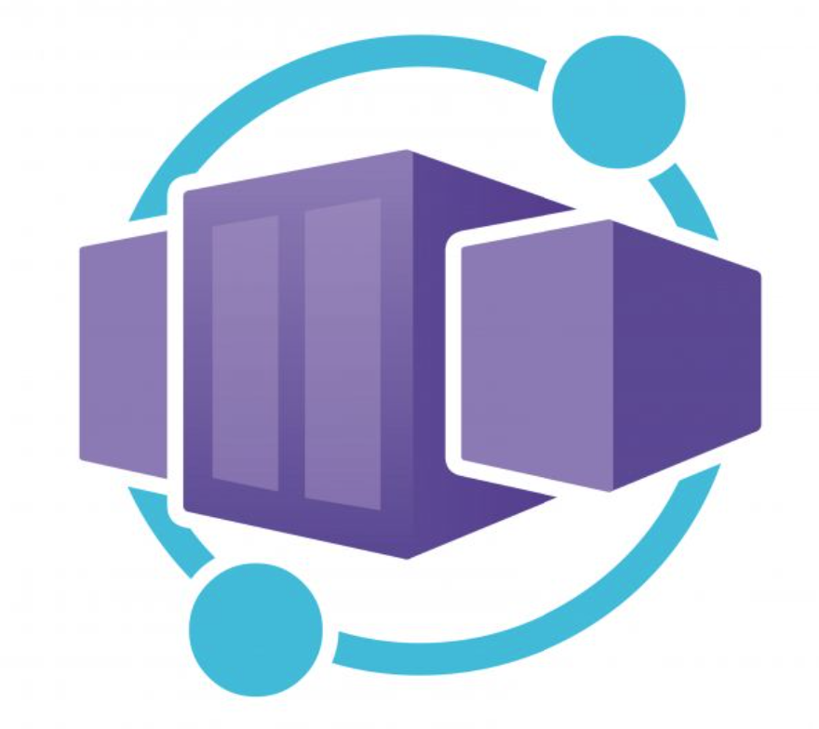
Shopping Assistant Architecture
Frontend
Web App (React)
Backend App (Python FastAPI)
Chat API
Chat with Shopping Agent
Semantic Kernel
Shop Managing Agent, Order Agent,
Cart Agent,
Offer Agent
UI Features
User Register
User Login
User Logout
Chat
Login API Logout API
User Authentication
Notes:
Secure Login
Token returns to Web App
Chat UI appears after Login

Slide 4

Shopping Assistant Architecture
Frontend
Web App (React)
Backend App (Python FastAPI)
Chat API
Chat with Shopping Agent
Semantic Kernel
Shop Managing Agent, Order Agent,
Cart Agent,
Offer Agent
UI Features
User Register
User Login
User Logout
Chat
Login API Logout API
User Authentication
Notes:
Secure Login
Token returns to Web App
Chat UI appears after Login

