Slide 1
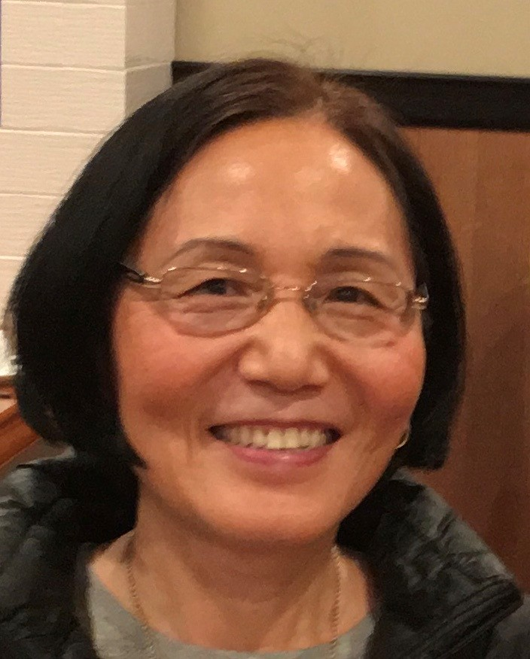
Gaiye “Gail” Zhou a.k.a. Dr. Gail
My Home: Atlanta, Georgia, USA.
My Hobbies: Cooking, Reading, Landscaping, and Hiking.
My Passion #1: Deliver innovative business solutions that are simple, scalable, extensible, and transformational.
My Passion #2: I am relentless on innovation, automation, quality, consistency, and repeatable processes.
SR Architect
Industry Solution Delivery
Prior to Microsoft
Journey @ Microsoft (Since January 2017)
PhD in Electrical and Computer Engineering and Executive MBA (Employer sponsored).
2 Awarded Patents (7,139,722 & 6,925,586), and Many Innovative Solutions delivered.
Industry Knowledge: Telecom, Government, Financial Services, Health Care, Retail, Manufacturing.
10+ Years delivering consulting Projects with repeating customers & projects.
10+ Years leadership roles: Director/VP/SVP.
3 years as Chief Architect for US AF Supply Chain Modernization ($140M Program).
15+ Years of Hands-on Experiences in software engineering (C#/Python/PowerShell/SQL/Java/C++)
2 Years in a Start-up building new product line later acquired by GM. Started my own company that served 3 corporations.
Timeline (Joined Jan 2017)
July 2023 – Now: Large Program Delivery, London Stock Exchange Group (LSEG)
Dec 2021– Jun 2023: Early Access Engineering Customer Innovation Program
Dec 2020–Mar 2022: Azure Analytics and AI Accelerators (AAAP) Program
Jan 2017–Dec 2020: Azure Synapse Customer Success Engineering Program
60+ Customer Engagements, 4 GitHub Repositories, YouTube Channel, and other publications.
Innovation Solution Accelerator Lead, published IP links below:
“Intelligent Field Services”, (Intelligence Field Service Accelerators June 2023)
“Automate PDF forms Processing“ (AAC Article APR 2023)
“Azure PDF Form Processing Automation SA” (PDF Form SA Oct2022)
“Azure Invoice Processing Automation SA” (Invoice SA Mar 2022).
Pioneered APS/Netezza/Redshift/SQL Server to Synapse Migration w. Playbook & Automation.
Published SQL Server to Synapse IP (SQL2Synaspe2021) with YouTube Training.
Led Coca Cola APS->Synapse Migration and created reusable IP (APS2Synapse 2018). This IP has been reused to migrate hundreds more APS to Azure Synapse. It is upgraded (APS2Synapse2021) with YouTube Training.
Led Walgreens’ Netezza to Synapse Migration, delivered workshops & technical guidance till go-live: Testimonials and Case Study.
Led Neogrid’s Netezza and Redshift to Azure Synapse Migration: Case Study.

