Slide 1
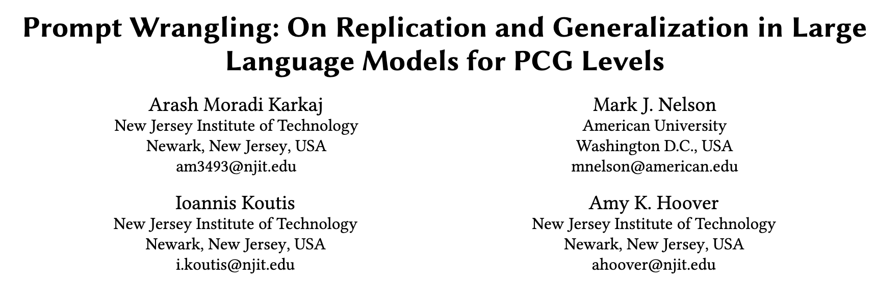

Slide 2
LLM Sampling

Slide 3
LLM Generalization
Generalization
One-Shot Generalization
Zero-Shot Generalization

Slide 4
Replication Experiment
Re-ran Competition: Is it possible for us to re-run the competition locally, later and get the same results?
Intuition: Randomization inherent in Sampling with Temperature
Sample Size of 𝑛 = 10 or 𝑛 = 100
ChatGPT responses per letter per prompt (i.e., 260 responses in total)
ChatGPT responses per letter per prompt (i.e., 2600 responses in total)

Slide 5
Generalization Experiment
One-Shot Generalization
Zero-Shot Generalization

Slide 6
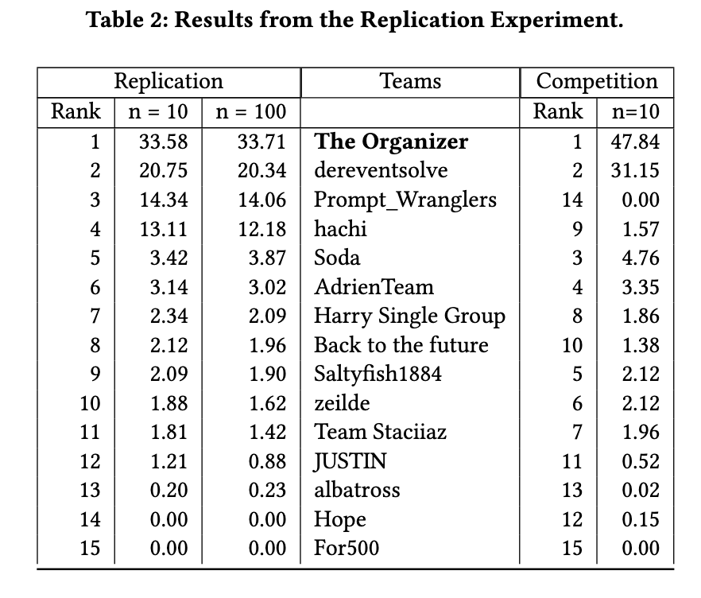
Results: Replication

Slide 7
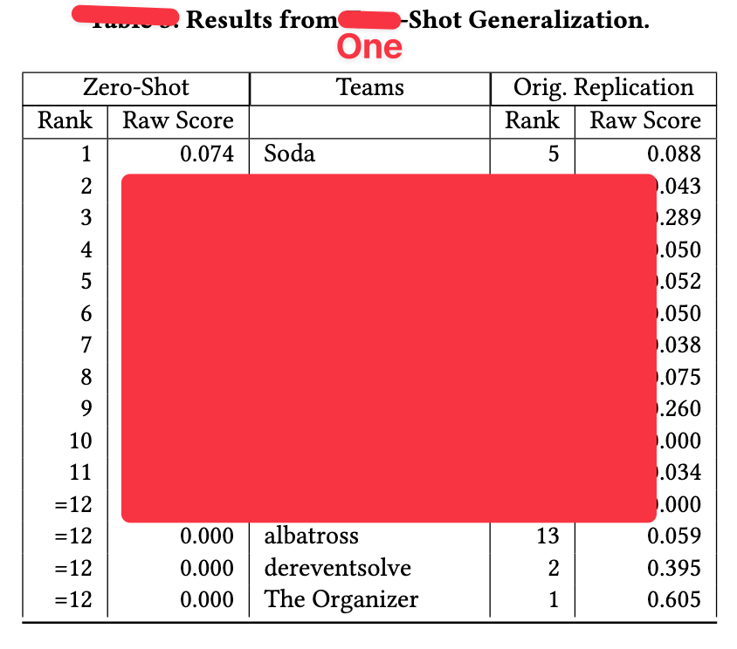
Results: Generalization
One-Shot

Slide 8
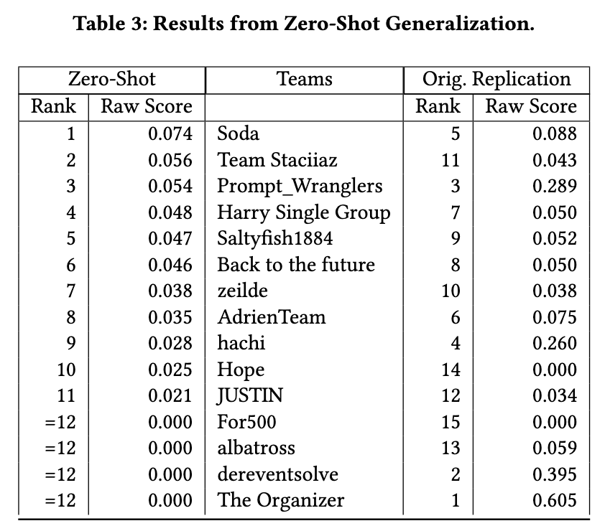
Results: Generalization
Zero-Shot

Slide 9
Discussion
OpenAI ChatGPT Models change a lot, hard to replicate

Slide 12
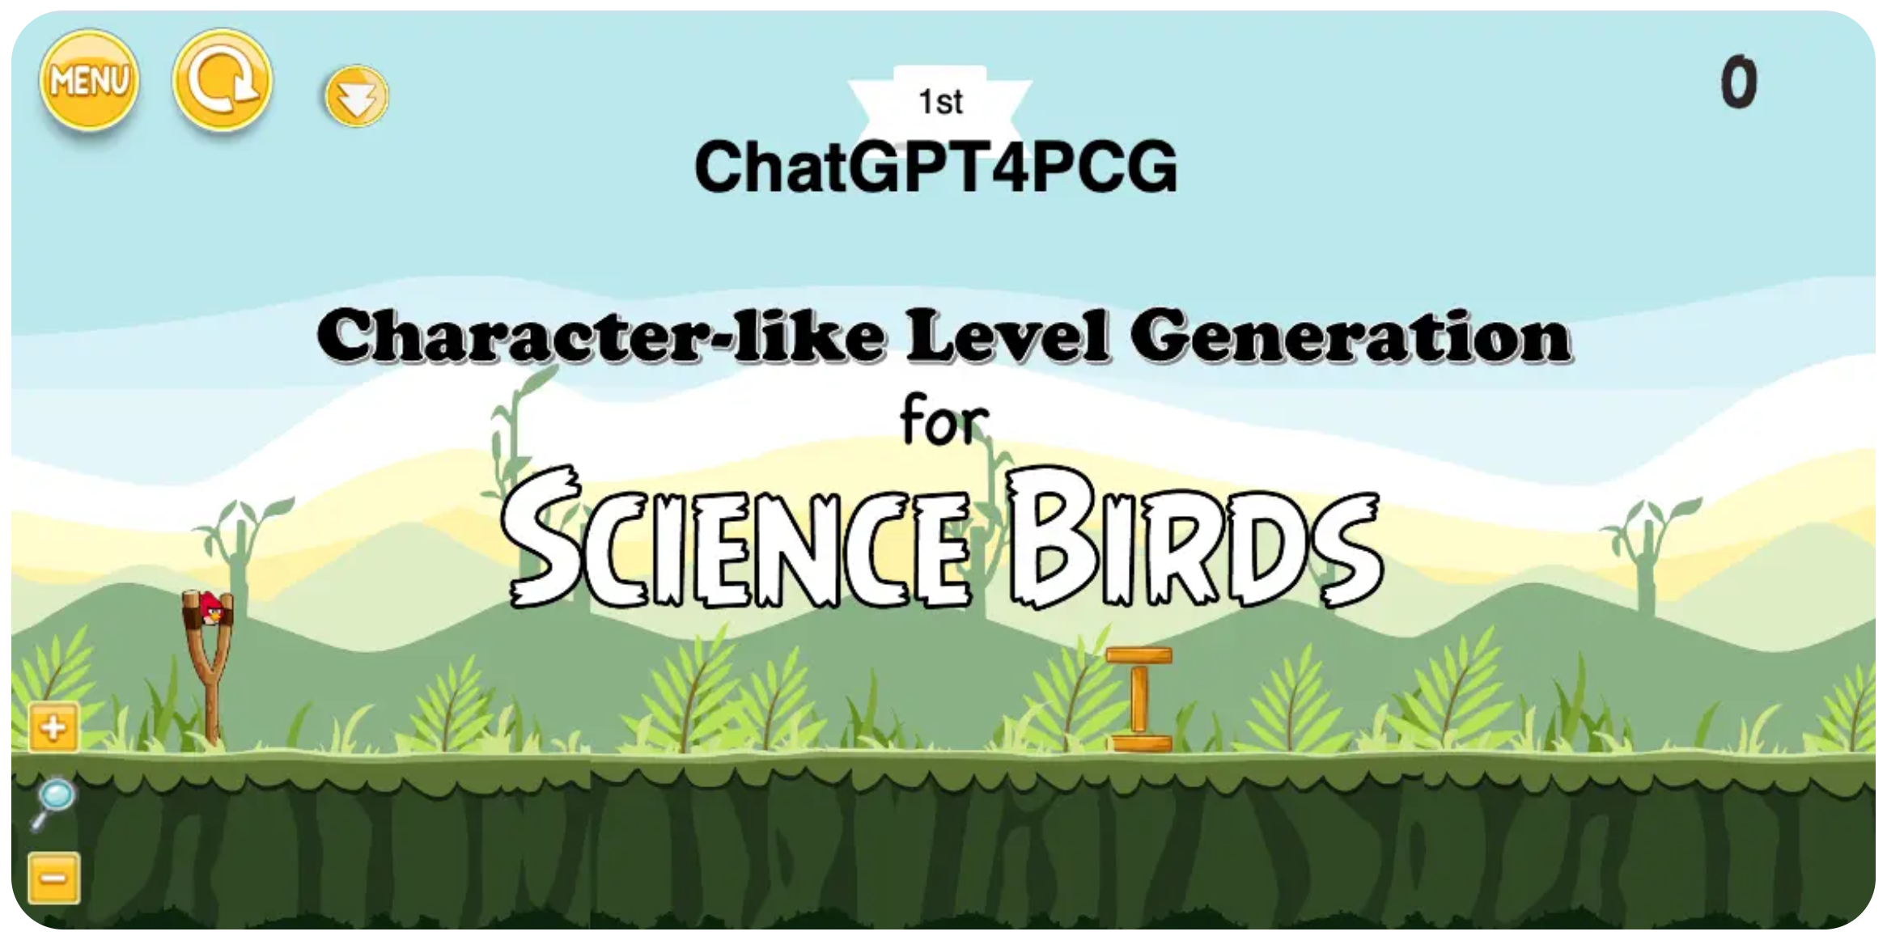
ChatGPT4PCG

Slide 13
Experiment 1: Replication Experiment
The replication experiment investigates whether the original prompts achieve approximately the same scores six months after the competition.
ChatGPT-3.5 is closed source and it is unclear when changes are made that may impact the generated levels.
This experiment also examines whether scores are impacted by increasing the number of levels generated per letter to 100.
The results of the replication experiment show that ChatGPT-3.5 is changing over the time span of six months, and that these small changes can significantly impact how prompts score, whether ten or 100 levels are evaluated.
While the sample size is likely adequate for the competition, to make conclusions about prompts submitted to the competition over the course of years, it will be important to query LLMs with static weights.

Slide 14
Experiment 2: Generalization Experiment
The generalization experiment examines the ability of prompts to generate levels it has not yet seen (i.e., that are not hard-coded in the prompt).
Prompts are modified to contain zero-shots or example letters in the zero-shot setting or one-shot in the one-shot setting.
The prompts in the one-shot setting are tested per letter given that prompts contain different example letters and some letters are more difficult to generate than others.
N-shot prompting is specified for a small subset of prompts and example letters.
The goal of this experiment is to understand whether successful prompts are generalizing or if it is the quality of their lookup tables that determines their score.
Results show that these modified prompts perform significantly worse than their unmodified counterparts and prompts that generalize well are not necessarily those that perform well in the competition.
These results suggest that generalizing with these new level generators is an open problem to explore.

Slide 15

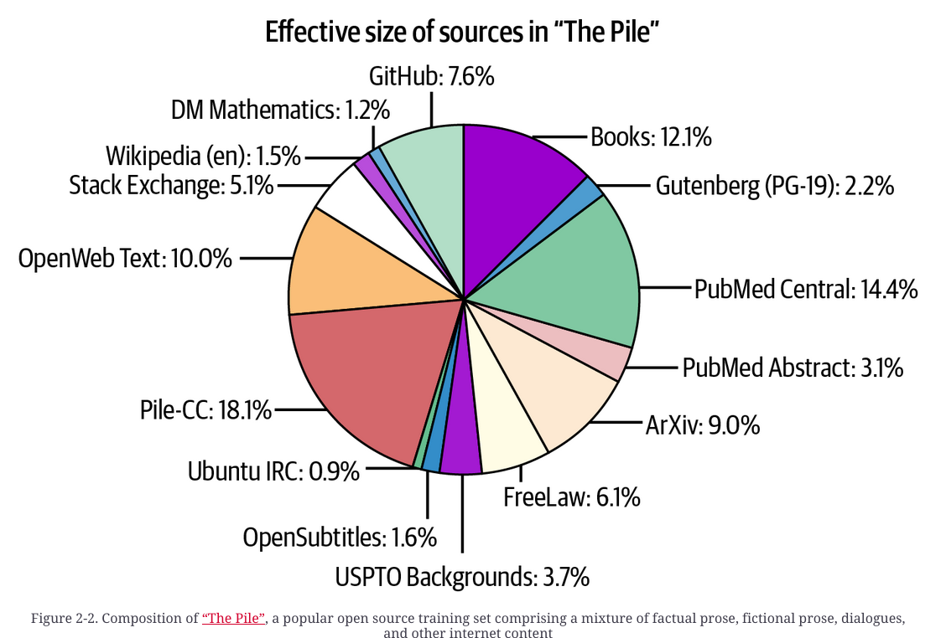

Slide 16
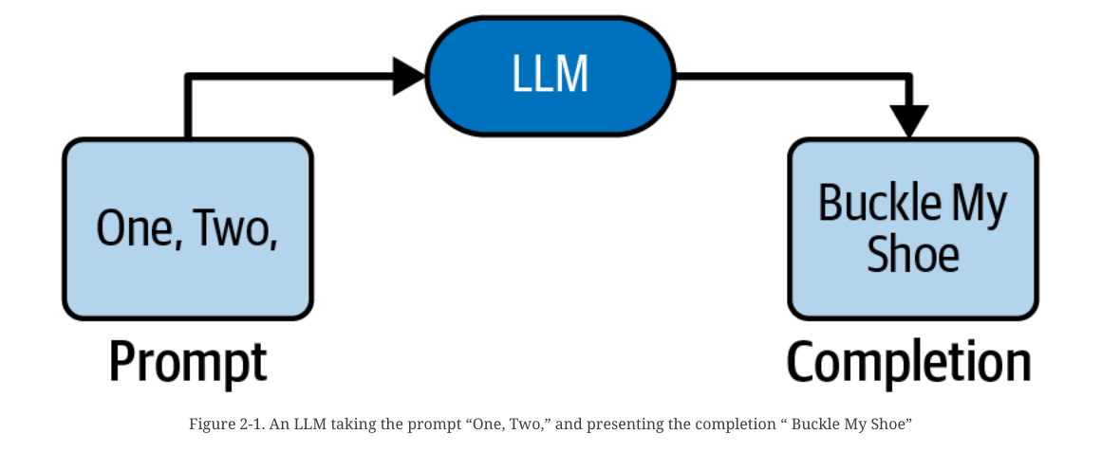
Introduction

