Slide 1
Link-Us
Team Members: 가인온투 && 아불파이즈
Team Name: Goal-Diggers

Slide 2

Introduction to “Link-Us”
Overview of “Link-Us”
Features of “Link-Us”
Test result and interface implementation of “Link-Us”
Contents

Slide 3

Introduction to “Link-Us”
Simply a program that connects different computers running on Linux and exchange Information on per request.

Slide 4

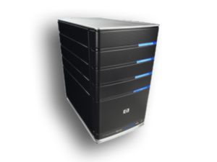
Overview of “Link-Us”

Slide 5

Features of “Link-Us”
Client’s Connectivity: Application that lets different clients connect to each
Text exchangeability: Let’s clients exchange messages between them
Remote Accessibility: Lets one client access to another clients PC
Secured Environment: Password protected entrance to server.

Slide 6
Test result and interface implementation

Slide 7
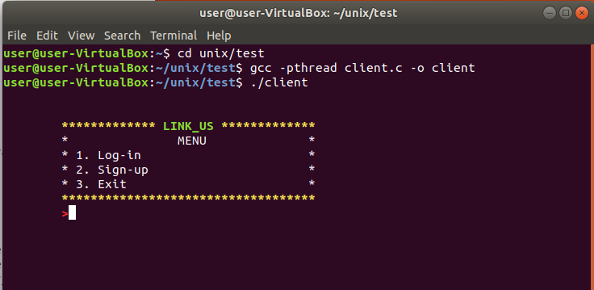
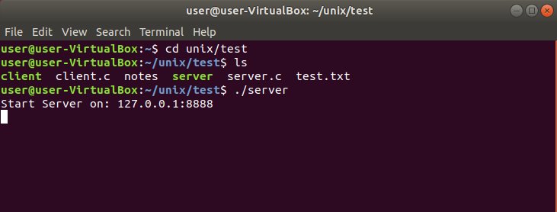
Server.c
Client.c

Slide 8
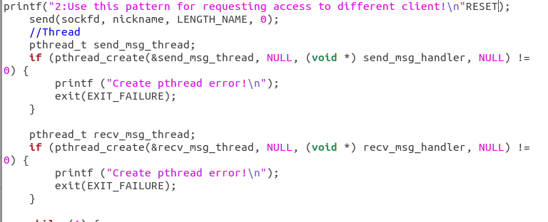
PThread

Slide 9
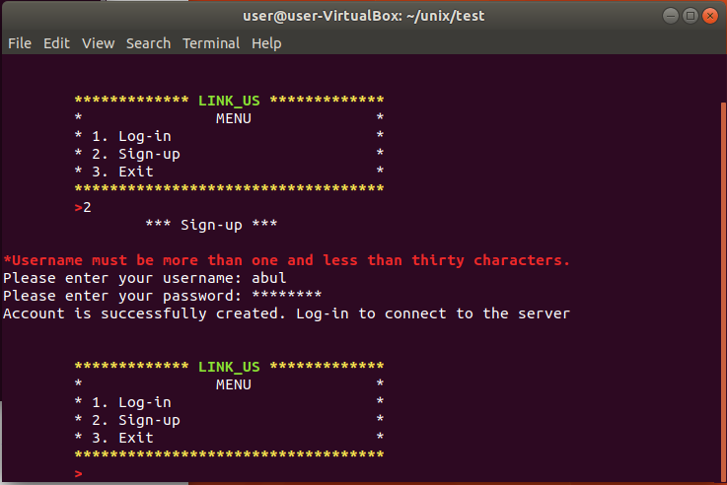
Signing up

Slide 10
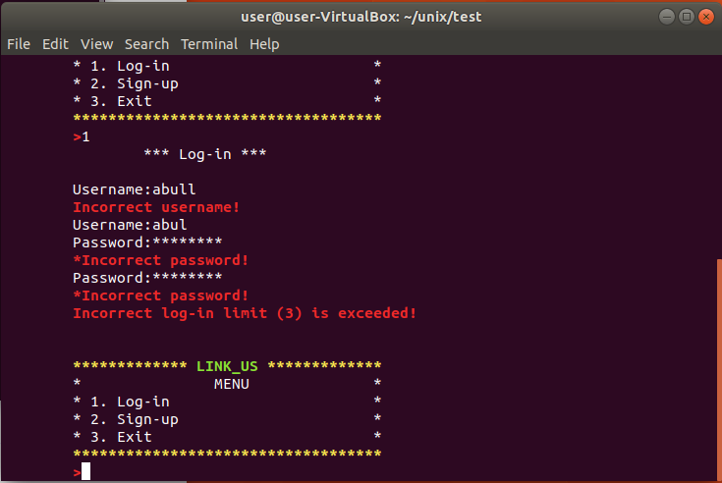
Logging in

Slide 11
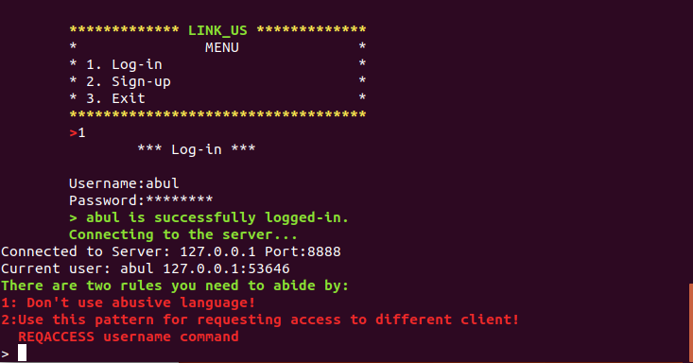
Logging in

Slide 12
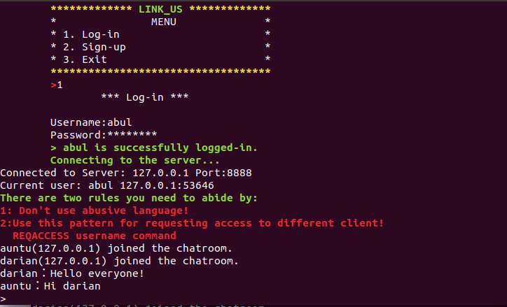
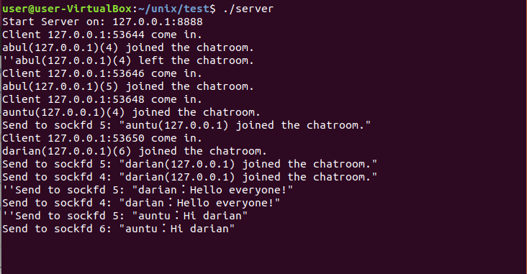
Text exchangeability
Server

Slide 13
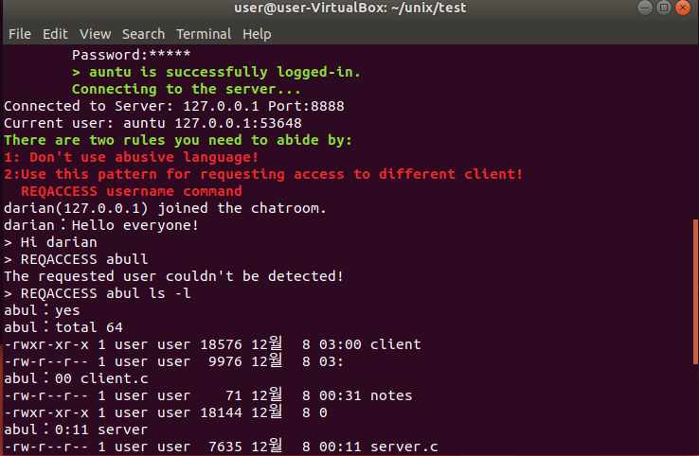
Testing of features

Slide 14
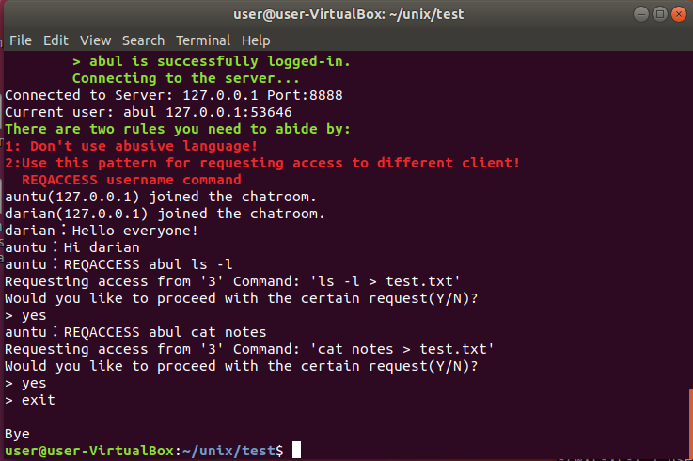
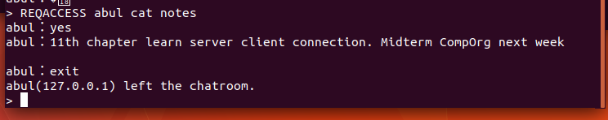
Testing of features

Slide 15
THANK YOU!

