Slide 1


Delivery Risk Intelligence
What our late-delivery model shows: results, reasons and fairness
Objective Give Olist's delivery leaders and the Responsible AI Review Board a clear, neutral picture of what the Module 4 model can tell them about late orders, why it scores orders as it does, and where it falls short, so they can make their own decisions with full information.
Gain Tawodzera · BAN6800 Business Analytics Capstone · Module 5 · Nexford University · November 2026
Live dashboard: [Live dashboard URL: add after deployment]
github.com/gaintawo/delivery-risk-intelligence
Notes:
This session shares what the late-delivery model built in Module 4 shows. My role today is the business analyst: to explain the results clearly and honestly, not to argue for a decision. Everything here can be explored in the live dashboard, and all the code is in the GitHub repository. The model is currently in shadow mode: it scores orders, but nobody acts on the scores.

Slide 2



Who this is for, and what each group needs to know
Delivery leadership
Front-line teams
Ethics and compliance
Head of Logistics (sponsor) · delivery operations lead
Seller support · customer service
Responsible AI Review Board (chaired by the Data Protection Officer, with seller and customer representatives)
Decision-making needs
Decision-making needs
Decision-making needs
Can a daily risk list help plan staff time?
How many late orders would it catch, at what workload?
Progress against goals G1–G5
What does a flag mean for an order?
Can the reasons be explained to a seller or a customer?
What would change in their daily work?
Is it fair across regions and seller sizes? (gate 2)
Is personal data protected (LGPD)?
Is it explainable enough to test with users?
Scope of this session: what the results show. Decisions stay with the Head of Logistics and the Review Board.
Stakeholders and Review Board membership from the Module 1 Vision Document (Section 3) and the Module 2 RACI matrix.
Notes:
Three groups are in the room, taken from the Module 1 stakeholder map. Delivery leadership wants to know whether a daily risk list would be worth the staff time. Seller support and customer service need to know what a flag means and whether the reasons can be explained. The Responsible AI Review Board, chaired by the Data Protection Officer, decides gate 2: whether the model is fair and explainable enough to test with real users. I will present the evidence for each group. I will not make a recommendation; that decision belongs to them.

Slide 3
The problem: few late orders, most of the damage
8.1%
of 96,470 delivered orders arrived after the promised date
2.6★ vs 4.3★
average review: late orders vs on-time orders
53%
of late orders got a 1–2★ review, against 9% of on-time orders
Lateness comes in waves (Black Friday 2017, Feb–Mar 2018). Today no one is warned in advance: the share of late orders flagged early (goal G1) is 0%.
Source: Olist (2018) public dataset, processed by the Module 3 pipeline; delivered orders, Jan 2017–Aug 2018. Last-mile delivery is about 53% of shipping costs (Cascadia, 2024).
Notes:
Why this matters. About 8 percent of delivered orders arrive late. That sounds small, but those orders do most of the damage: late orders average 2.6 stars against 4.3 for on-time orders, and more than half of them get a one- or two-star review. The chart shows that lateness is not steady: it spikes around Black Friday and again in February and March 2018, when one order in five was late. Right now nothing warns the team in advance. That is the gap the project set out to close in Module 1.

Slide 4




How the model works, in plain language
1
2
3
4
An order is placed
The model checks 32 facts
It gives a risk score
The riskiest go on a list
A customer buys on the marketplace and is given a promised date.
Known at that moment: how long the promise is, distance, the seller's track record, recent delivery times to that state, season.
From 0 (very unlikely to be late) to 1, plus the top three reasons in plain words.
Each morning, the riskiest 25% of the day's orders (about 50 of 200) go on a review list.
How it learned
It studied 57,050 past orders (Jan 2017–Feb 2018) and the patterns behind the late ones. It was then tested on 18,603 later orders it had never seen (Jun–Aug 2018). All results in this deck come from that test.
Think of a weather forecast
A 70% chance of rain does not mean it will rain. A high score means "look closer at this order", not "this order will be late".
Notes:
Here is the plain-language model explanation. When an order is placed, the model looks at 32 facts that are known at that moment: how many days were promised, how far the parcel travels, how the seller has performed before, how long deliveries to that state have been taking recently, and the season. It turns these into a risk score from 0 to 1 and lists the three facts that pushed the score up most. Each morning, the riskiest quarter of the day's orders would form a review list, about 50 orders. It learned from 57 thousand past orders and was tested on 18 thousand later orders it had never seen. Like a weather forecast, a high score means 'look closer', not 'this will definitely be late'.

Slide 5
Key results: better than a simple rule, short of the goals
38 in 100
Progress against the Module 1 goals (test period)
Goal
Target
Result
Status
late orders flagged in advance (51 in 100 with fairness-adjusted thresholds). Goal G1: 70.
G1
Spot late orders early
≥ 70% flagged
38% (51% adjusted)
✗ Not met
1.5×
G2
Fewer late deliveries
≤ 5% late
Needs live actions
… Not testable yet
Flagged orders were late 8.2% of the time, against 5.5% for all orders.
G3
More honest dates
Gap 20% smaller
Error 3.4 vs 5.0 days
… Partly ready
11 in 12
G4
Happier customers
25% fewer 1–2★
Needs live actions
… Not testable yet
flagged orders still arrived on time, so any action on a flag has to be cheap and helpful.
G5
Fair to every region
Gap ≤ 10 points
67 pts (25 adjusted)
✗ Not met
Test period Jun–Aug 2018, 18,603 orders. G2 and G4 can only be measured once teams act on flags. G3 uses the separate delivery-days model (Module 4).
Notes:
These are the headline results. Of every 100 orders that turned out late, the model had flagged 38 in advance; with fairness-adjusted thresholds, 51. The Module 1 goal was 70, so goal G1 is not met. Flagged orders were one and a half times as likely to be late as an average order, but most flagged orders still arrived on time: about 11 in 12. Goals G2 and G4 cannot be measured yet, because they depend on what teams do with the flags. The delivery-days model is more accurate than a simple average, which supports G3. The fairness goal G5 is not met; I will come back to that.

Slide 6
Better than a simple rule, but fading month by month
Simple rule = rank orders by the seller's past late rate. The model catches more late orders than that rule.
Flagged: 56 of 83 in June (67%) → 117 of 276 in July (42%) → 210 of 660 in August (32%).
Test period Jun–Aug 2018; 1,019 late orders. Both charts start at zero. Interactive version: dashboard Overview page.
Notes:
Two charts. On the left, the share of late orders that were flagged in advance. A simple rule that ranks orders by the seller's past late rate catches 27 percent. The model catches 38 percent, and 51 percent with the fairness-adjusted thresholds I will explain later. On the right, the late orders in each test month: teal were flagged, grey were missed. In June the model caught two thirds of a small number of late orders; by August it caught under a third, while late orders rose. The model's patterns get stale as conditions change, which matters for how it would be maintained.

Slide 7



What drives a high risk score
Tight promises
Risk rises when the promised days are short compared with how long deliveries to that state have taken in the last 30 days.
Long, cross-state routes
More distance and crossing state lines add risk, especially to the North and Northeast.
Busy season and slow sellers
Black Friday to Christmas, and sellers who are slow to hand parcels to the courier, add risk.
In short: risk is about the promise, not the product.
SHAP values (Lundberg & Lee, 2017), 4,000 test orders. Shows size, not direction; directions are on the dashboard's 'What drives risk' page.
Notes:
This is the SHAP summary, translated. Each bar shows how much a fact moves the risk score on average. The biggest factor is the promise itself: the number of days promised, especially compared with how long deliveries to that state have recently taken. Next come distance and crossing state lines, the Black Friday to Christmas peak, and the seller's past handling time. Product type, price and weight matter very little. In business terms: whether an order is late depends mostly on how realistic the promise was when it was made.

Slide 8
Three real orders, explained
A
Correctly flagged
B
Low risk, on time
C
Missed
Risk score 0.71 · flagged
Risk score 0.29 · not flagged
Risk score 0.40 · not flagged
Maranhão (Northeast) · auto parts · seller in São Paulo · 26 days promised
Santa Catarina (South) · health & beauty · 639 km · 25 days promised
São Paulo to São Paulo · watches & gifts · 249 km · 13 days promised
Top three reasons
Why the score is low
Why it was missed
Deliveries to Maranhão had recently taken almost 20 days
A 2,342 km route
The seller was late on 1 in 3 past orders
The seller hands parcels over in under half a day
The seller has never been late before
25 days promised; recent deliveries took 14
A short, local route
Recent deliveries in São Paulo took about 6 days
Nothing about it looked unusual
What happened: Arrived after 29 days, 3 days late. The customer gave 1★.
What happened: Arrived in 10 days. The customer gave 5★.
What happened: Arrived after 13.7 days, less than a day late. Many misses look like this.
Test-period orders; local SHAP explanations as returned by the API's top_reasons field. Explore any order on the dashboard's 'Order explorer' page.
Notes:
Three real orders from the test period. Order A, to Maranhão in the Northeast, scored 0.71 and was flagged. The reasons: deliveries to that state had recently taken almost 20 days, the route was over 2,300 kilometres, and the seller had been late on a third of past orders. It did arrive three days late, and the customer gave one star. Order B, to Santa Catarina, scored low: the seller is fast and reliable, and the promise was generous. It arrived in ten days. Order C was missed. It was a short local order in São Paulo with a comfortable promise, and it arrived less than a day late. Many missed orders look like this: nothing about them looked risky when they were placed.

Slide 9
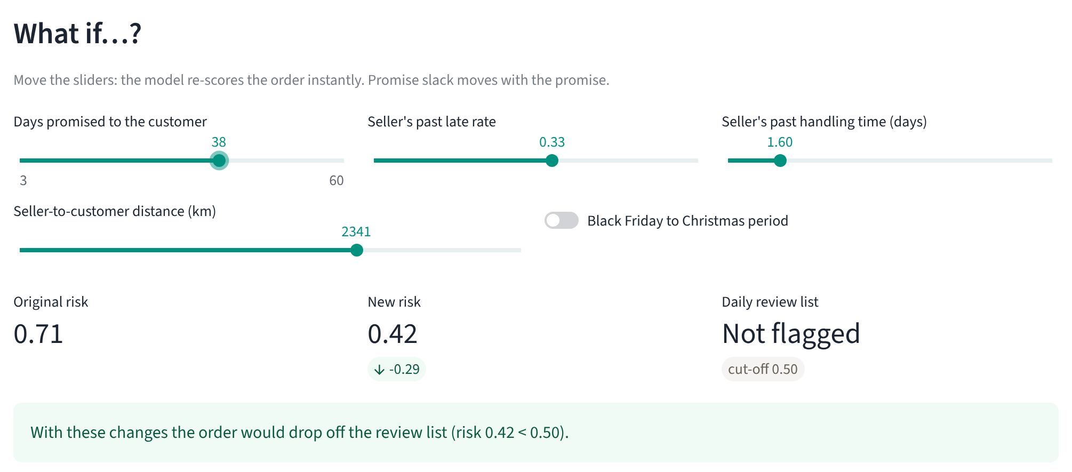
What-if analysis: the promise is the strongest lever
Order A: what if Olist had promised more days?
26 days (actual)
risk 0.71
Flagged
+5 days (31)
risk 0.60
Flagged
+7 days (33)
risk 0.55
Flagged
+10 days (36)
risk 0.47
Not flagged
Dashboard what-if panel: sliders re-score the order live through the Module 4 model.
Same order with a seller who is rarely late (5%): risk 0.66, still flagged. The route and recent state delays outweigh the seller.
Read with care
This shows how the model responds, not proof that the delivery would change. A longer promise lowers the score because it gives the customer a later date. The charter (risk ER5) forbids quietly padding remote customers' dates to make numbers look better.
Across all 3,154 flagged test orders: a median of 5 more promise days would take an order off the list (7 days in the North and Northeast).
Model v3 re-scored with one input changed (promise slack moves with the promise). Population figures from DiCE counterfactuals (Mothilal et al., 2020), Module 4.
Notes:
The what-if analysis asks: if one fact changed, what would the model say? For order A, promising five more days lowers the risk from 0.71 to 0.60; ten more days takes it below the review cut-off. Swapping in a reliable seller barely helps, because the long route and recent delays to Maranhão dominate. Across all flagged test orders, about five extra promise days would take the typical order off the list. Two cautions. This shows how the model reacts, not what would really happen to the parcel. And a longer promise is a later date for the customer; the ethical charter says we must not quietly pad remote customers' dates just to improve the numbers.

Slide 10
Fairness: late orders are not caught equally in every region
The question
Being flagged helps an order. So: is a late order equally likely to be caught wherever the customer lives?
What the test shows
Northeast: 97% caught. Southeast: 30%, yet 8 in 10 late orders are in the Southeast.
Gap: 67 points with standard flags, 25 points with fairness-adjusted flags. The charter allows 10.
Fairness goal G5 is not met either way.
* North has only 9 late orders: too few to judge, so it is shown but not counted in the gap (needs 30 or more).
Recall (equal opportunity) by customer region, computed with Fairlearn (Bird et al., 2020) on the test period. Late orders per region in brackets. Interactive: dashboard 'Ethical compliance' page.
Notes:
Now fairness, in plain terms. Being flagged is good for an order: it gets attention. So the fairness question is whether a late order is equally likely to be caught wherever the customer lives. It is not. With standard flags, 97 percent of late Northeast orders were caught, but only 30 percent in the Southeast, where eight in ten late orders actually are. That is a 67-point gap; the charter allows 10. The orange bars are the fairness-adjusted version, which narrows the gap to 25 points. That is better, but still fails goal G5. The North has only nine late orders in the test, so its result could be chance; I show it but do not count it.

Slide 11


Bias mitigation: what was found, and what was tried
Found
Tried 1: remove location
Tried 2: fairness thresholds
Still open
The model flags 78% of Northeast orders but 18% of Southeast orders.
Retrained without state and region columns.
A separate cut-off per region, set on earlier data (Fairlearn ThresholdOptimizer).
25 points is above the 10-point gate.
It learned from 2017–early 2018, when 13% of Northeast orders were late. By mid-2018 Olist had lengthened those promises: 5.4% late, below the Southeast's 6.2%.
Gap barely moved: 67 → 62 points. Distance carries the same signal (risk ER2, hidden proxy).
Gap 67 → 25 points, and late orders caught rose from 38% to 51% while fewer orders were flagged (23%).
The Review Board gate stays closed and the model stays in shadow mode.
Seller size (risk ER3): late orders from small sellers are caught least often (34%, vs 38% for large and 51% for new sellers), and new sellers get the most false alarms (31% of their on-time orders flagged, vs 22–25%). The regional adjustment raises the catch rate for every seller group, but widens the seller-size gap from 17 to 25 points.
Fairness Metrics Report (Module 4). Hardt et al. (2016) equal opportunity. Disparate impact ratio 0.24 standard, 0.38 adjusted.
Notes:
What caused the bias, and what was tried. The model learned from a period when the Northeast had many more late orders. By mid-2018 Olist had lengthened promises to the Northeast, so the old pattern no longer held. Removing the state and region columns did not help, because distance still tells the model where the customer is. Setting a separate cut-off for each region, with Fairlearn, narrowed the gap from 67 to 25 points, and it also caught more late orders overall. But the gate is 10 points, so it is still not met. For sellers: small sellers' late orders are caught least often, and new sellers get the most false alarms. The regional fix helps every seller group, but widens the seller-size gap, so it is a trade-off, not a solution.

Slide 12


Model limitations: what it can and cannot do
What it can do
What it cannot do
Score every order on the day it is placed, using only facts known then
Rank a day's orders so a team can review the riskiest 50
Catch about 4 late orders a day (about 6 with fairness-adjusted thresholds), more than a simple rule
Explain every score with three plain-language reasons
Catch most late orders: about 6 in 10 are still missed
Be precise: about 11 in 12 flagged orders arrive on time
See courier scans, weather, strikes or traffic: none are in the data
Stay accurate on its own: the catch rate fell from 67% to 32% in three months
Judge every region fairly yet (gate G5 not met)
Data limits: Brazilian orders from 2016–2018 only; the North has few orders; results may not hold today or in another country (for example, East African logistics) without retraining on local data.
Notes:
To be completely clear about limits. The model can score every order on the day it is placed, rank the day's orders, catch roughly four late orders a day, and explain each score. It cannot catch most late orders: six in ten are still missed. It is not precise: most flagged orders arrive on time. It cannot see what happens after the parcel leaves the seller: courier scans, weather, strikes. It loses accuracy within months unless retrained. And it is not yet fair across regions. The data is from Brazil in 2016 to 2018, so it may not reflect today or another market without retraining.

Slide 13

Transparency and ethics
Transparency statement
Ethical AI Charter (Module 1): where each promise stands
Delivery Risk Intelligence is an early-warning aid. It estimates how likely an order is to arrive late, using only facts known when the order is placed. It ranks risky orders above safe ones about 7 times in 10, misses most late orders, and works unevenly across regions. It does not make decisions: a named person does. It is never used to judge or penalise sellers or customers. It stays in shadow mode until the Review Board's fairness gate is met.
Fairness
✗ Not yet met
No worse service because of where you live
Transparency
✓ In place
Top three reasons on every score
Accountability
✓ In place
Advice only; a named person decides
Privacy
✓ In place
No IDs, names or postcodes; state and region only (LGPD)
Support, not punishment
… Check in use
Flags mean help, never seller penalties
How this deck avoids misleading visuals: every chart axis starts at zero; teal always means the standard model and orange the fairness-adjusted one; small groups are labelled 'too few to judge'; failures are shown as plainly as successes.
Charter: Module 1 Vision Document, after NIST AI RMF (NIST, 2023). Privacy plan: Module 2. Brazil's data protection law: Lei 13.709 (Brasil, 2018).
Notes:
This is the transparency statement, in words a seller or customer could read. The model is an early-warning aid, right about which orders are riskier about seven times in ten, and it misses most late orders. It does not decide anything; a named person does. On the right is where each of the five charter promises stands. Transparency, accountability and privacy are in place: every score has its reasons, the tool only advises, and the dashboard shows no IDs or postcodes, in line with Brazil's LGPD. Fairness is not met yet. 'Support, not punishment' can only be checked once the tool is used. Finally, I kept the visuals honest: axes start at zero, colours are consistent, and small groups are labelled.

Slide 14



What the findings mean for the business
The promise drives risk
Promise-setting, not only chasing orders after they slip, shapes lateness. A promise compared with recent delivery times to that state is the strongest signal.
G3 · G2
Most flags are false alarms
Reviewing about 50 orders a day surfaces about 4–6 late ones. That only pays off if a flag triggers a cheap action, such as a seller reminder or an early message to the customer.
G1 · staff time
Accuracy fades quickly
The catch rate fell from 67% to 32% in three months, so a retraining routine and a named owner would be part of the running cost.
Risk R03
Attention would be skewed
With standard flags, review time would go to the Northeast, while most late orders are in the Southeast.
G5 · ER1
The value is not yet proven
In the test quarter, 1,019 late orders led to 332 reviews of 1–2★. Whether early action prevents them can only be measured in a controlled trial.
G2 · G4
Test period Jun–Aug 2018 (90 days, about 207 orders a day). Goal and risk IDs from the Module 1 Vision Document and the Module 2 RAID log.
Notes:
What do the findings mean for the business? First, risk is mostly about the promise: how realistic it was when it was made. That points to promise-setting as much as order-chasing. Second, most flags are false alarms: reviewing 50 orders a day surfaces four to six late ones, so the actions attached to a flag would have to be cheap. Third, accuracy fades within months, which means retraining is part of the cost. Fourth, standard flags would steer attention to the Northeast, while most late orders are in the Southeast. And fifth, the business value is not proven yet. In the test quarter, late orders led to 332 poor reviews; whether early action would prevent any of them can only be measured with a controlled trial.

Slide 15
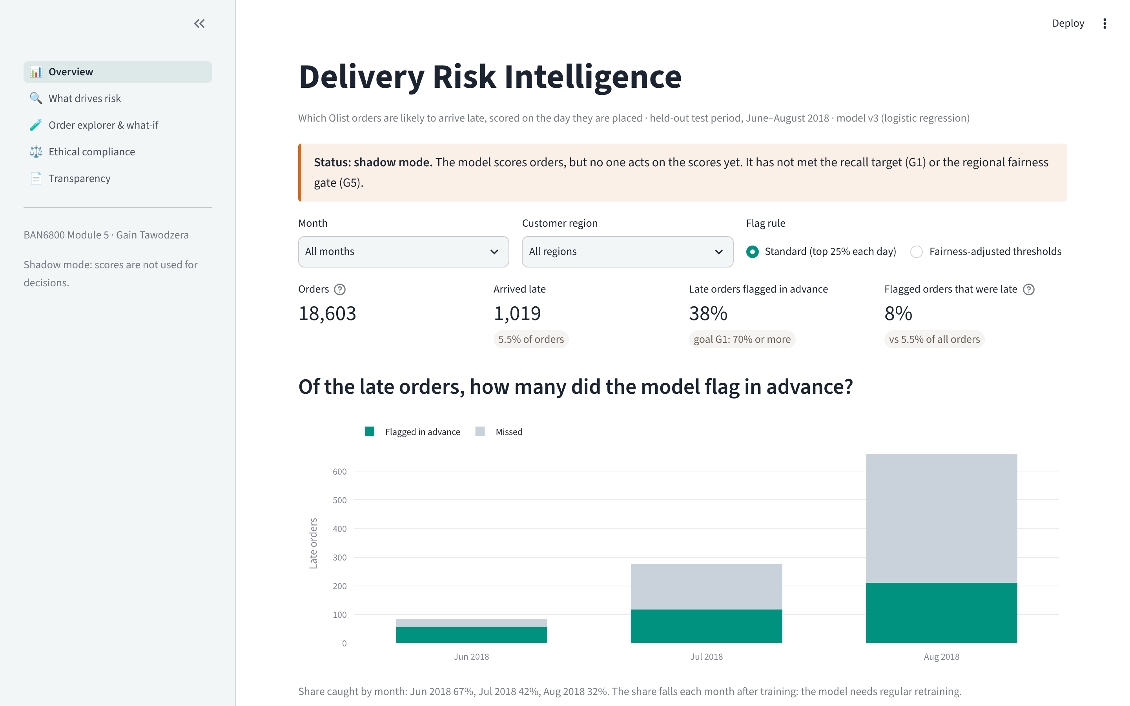

Possible next steps, for stakeholders to weigh
These are options raised by the findings, not a recommendation. Each group decides what, if anything, to take forward.
Everyone
Explore the live dashboard: drivers, any order's reasons, what-if, fairness by region and seller size.
Review Board
Discuss gate 2 using the fairness-adjusted results, the North's small sample and the seller-size trade-off.
Analytics team
Possible work: re-test the XGBoost challenger with fairness thresholds; add courier tracking data; set up monthly retraining.
Operations
Define which low-cost actions a flag could trigger, so a controlled trial could measure G2 and G4 if the gate opens.
Live dashboard: [Live dashboard URL: add after deployment]
Final Project: the deck, dashboard, API and model card come together as one portfolio-ready project.
Notes:
To close, here are possible next steps the findings raise. I am presenting them as options, not a recommendation. Everyone can explore the live dashboard. The Review Board may want to discuss gate 2 using the fairness-adjusted results. The analytics team could re-test the stronger XGBoost challenger, add courier tracking data and set up monthly retraining. Operations could define which cheap actions a flag might trigger, so that if the gate ever opens, a controlled trial could measure whether early action really reduces late deliveries and poor reviews. Thank you; the following slides are backup for questions.

Slide 16
Appendix: Q&A backup deck
Technical detail for questions · references · AI disclosure
A1 Data, split and leakage controls
A2 Algorithms, tuning and champion selection
A3 Full performance metrics
A4 Fairness metrics in full
A5 Robustness and monitoring
A6 Dashboard and API
A7 References
A8–A9 AI Disclosure Form
Notes:
Backup slides for technical questions.

Slide 17
A1. Data, time-aware split and leakage controls
Set | Purchases | Orders | Late rate
Train | Jan 2017 – Feb 2018 | 57,050 | 7.7%
Validation | Mar – May 2018 | 20,550 | 11.7%
Test (held out) | Jun – Aug 2018 | 18,603 | 5.5%
Leakage controls (risk R02)
Every input tagged P (known at purchase) in the data dictionary; training stops otherwise (check_no_leakage).
Seller history and market context use only deliveries completed before the purchase (unit-tested).
Split by time, never shuffled; TimeSeriesSplit cross-validation.
Encoding and scaling fitted inside each fold (scikit-learn pipeline).
Data
Olist public dataset (99,441 orders), Module 3 pipeline: 22/22 Great Expectations checks passed. 96,203 delivered orders, 2017–Aug 2018.
Features
32 inputs known at purchase (26 numeric, 6 categorical) → 107 encoded columns. log(1+x) for skewed values, scaling, median imputation with missing flags, one-hot with rare categories grouped.
Class imbalance
5.5–11.7% late. Class weights (late orders weighted about 12×); judged on recall at capacity and PR-AUC, not accuracy.
Notes:
Backup: data and split. Time-aware split; the test period was never used for training or model choice. Leakage controls as listed.

Slide 18
A2. Algorithms, tuning and champion selection
Algorithm | Search (TimeSeriesSplit, 4 folds) | Best settings | CV PR-AUC | Validation recall
Logistic regression (champion) | C 0.001–10, 8 candidates | C = 0.0042, balanced | 0.174 | 51.3%
Random Forest | trees, depth, leaf, features; 8 candidates | 310 trees, depth 11, leaf 25 | 0.177 | 48.1%
XGBoost (challenger) | trees, depth, rate, sampling, regularisation; 12 | 335 trees, depth 3, rate 0.053 | 0.186 | 48.9%
Selection rule: highest validation recall within the daily 25% capacity. Rolling-origin backtest over three earlier windows confirmed logistic regression (mean recall 47.6% vs 45.8% XGBoost, 44.9% Random Forest).
Disclosure: XGBoost scored better on the test period (recall 47.2%, ROC-AUC 0.77). The backtest was added after the test results had been seen; it used no test data. XGBoost is kept as a documented challenger rather than adopted on test results.
MLflow: 116 runs logged; registry version 3, alias champion (v1 and v2 archived: v2's fixed threshold flagged only 7% of test orders, so the daily-capacity rule replaced it).
Notes:
Backup: why logistic regression and not XGBoost. Chosen on validation, confirmed by backtest; the test advantage of XGBoost is disclosed and kept as a challenger.

Slide 19
A3. Full performance metrics (test period, top 25% of each day flagged)
Model | Accuracy | Precision | Recall | F1 | ROC-AUC | PR-AUC
Majority class (always 'on time') | 0.945 | 0.000 | 0.000 | 0.000 | 0.500 | 0.055
Heuristic: seller's past late rate | 0.721 | 0.059 | 0.273 | 0.097 | 0.497 | 0.055
Logistic regression (champion) | 0.735 | 0.082 | 0.376 | 0.134 | 0.713 | 0.108
Random Forest | 0.738 | 0.088 | 0.406 | 0.145 | 0.710 | 0.095
XGBoost (challenger) | 0.745 | 0.103 | 0.472 | 0.169 | 0.772 | 0.133
Champion + fairness thresholds | – | 0.123 | 0.511 | – | – | –
Champion | Predicted on time | Predicted late
Actually on time | 13,281 | 4,303
Actually late | 636 | 383
Why accuracy misleads: always predicting 'on time' is 94.5% accurate but catches nothing. The model flags 25% of orders by design.
Delivery-days regressor (G3): MAE 3.44 days vs 5.05 for the median; RMSE 5.04 vs 6.42; R² 0.25.
Notes:
Backup: full metrics and confusion matrix.

Slide 20
A4. Fairness metrics in full (customer region, test period)
Metric | Standard | No location columns | Fairness-adjusted
Demographic parity difference | 0.597 | 0.580 | 0.202
Disparate impact ratio (1 = equal) | 0.235 | 0.225 | 0.380
Equalized odds difference | 0.668 | 0.625 | 0.273
Recall gap, judged regions (gate ≤ 0.10) | 0.668 | 0.625 | 0.247
Overall recall / share flagged | 37.6% / 25.2% | 38.2% / 25.2% | 51.1% / 22.7%
Region | Late orders | Recall (95% CI) | Flagged
North | 9 | 78% (44–100%) | 56%
Northeast | 89 | 97% (92–100%) | 78%
Central-West | 45 | 53% (39–69%) | 27%
South | 64 | 38% (25–50%) | 22%
Southeast | 812 | 30% (27–33%) | 18%
Primary metric: equal opportunity (recall parity), because a missed late order is the harm (Hardt et al., 2016).
Demographic parity is reported but not a gate: regions really differ in how often orders are late.
Fairness thresholds: Fairlearn ThresholdOptimizer, true-positive-rate parity, fitted on validation data.
Groups need 30+ late orders to be judged; the North is reported but excluded from the gap.
Notes:
Backup: all fairness metrics, with bootstrap confidence intervals for regional recall.

Slide 21
A5. Robustness and monitoring
Change to inputs | Decisions changed | ROC-AUC
None (reference) | – | 0.713
Promise ±2 days | 4.0–4.6% | 0.713
Distance, freight, price ±10% | 0.5–0.7% | 0.713
5% random noise on all numbers | 2.7% | 0.690
Seller history removed | 10.2% | 0.719
Month after training: Jun / Jul / Aug | – | 0.761 / 0.692 / 0.654
Monitoring signal | Frequency | Action threshold
Recall within capacity | Weekly | Below 45%: review
Recall gap between regions (≥ 30 late each) | Monthly | Above 10 pts: block release
ROC-AUC, last 30 days | Monthly | Below 0.70: retrain
Score drift (PSI); recalibrate cut-off | Monthly | PSI above 0.2
Share of orders flagged per day | Daily | Outside 20–30%
Staff override rate (ER6) | Weekly | Above 50%: review
Release beyond shadow mode requires recall ≥ 55% within capacity, a regional recall gap ≤ 10 points, and Review Board sign-off (gate 2). Source: Model Card, Module 4.
Notes:
Backup: sensitivity analysis and the monitoring plan from the model card.

Slide 22
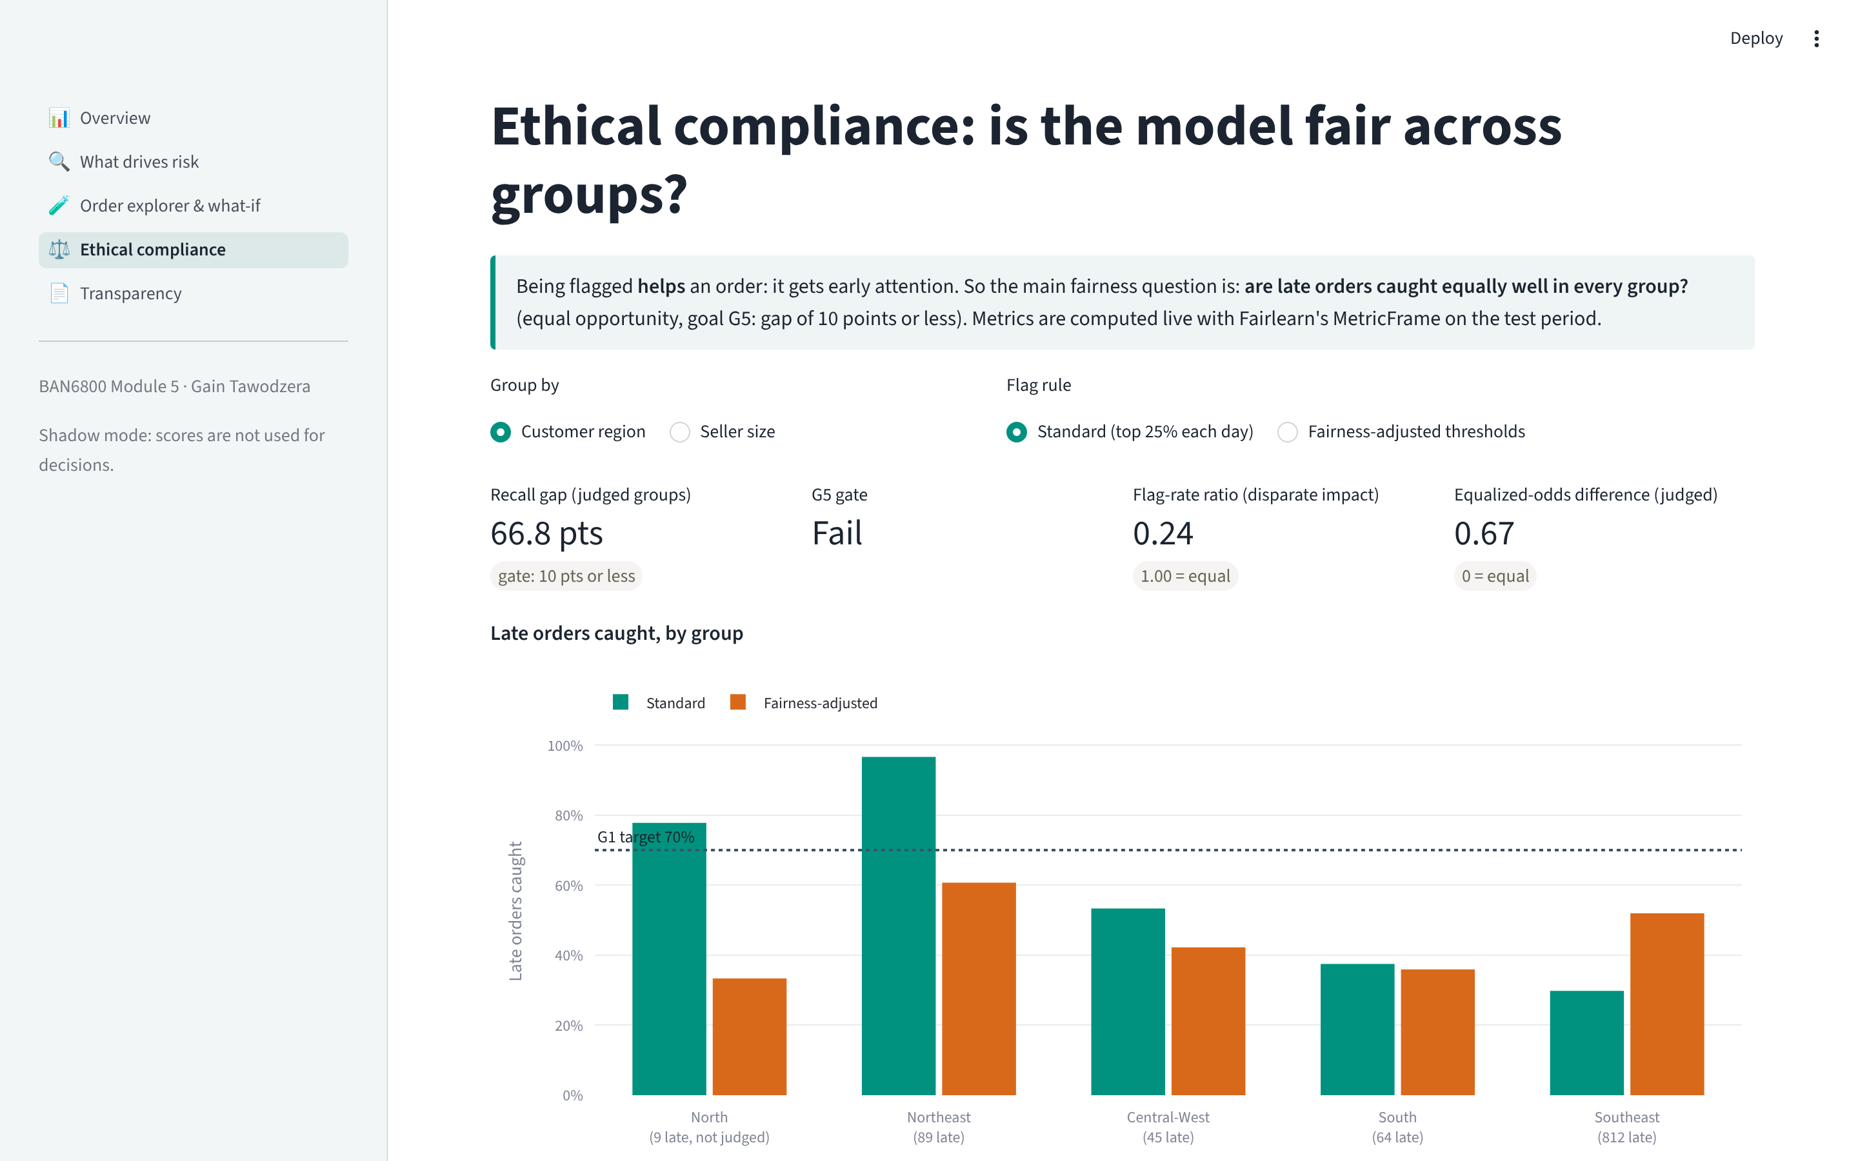
A6. Dashboard and API: how stakeholders use the model
Dashboard (Streamlit, Plotly)
Overview · What drives risk · Order explorer & what-if · Ethical compliance · Transparency. Loads the Module 4 model file; data is a de-identified copy of the test period (no IDs; state and region only).
API demo (FastAPI, api/demo.py)
POST /predict, order A → late_probability 0.71, risk_band high, flagged true, top_reasons: state delivery time 19.6 days (+0.77), distance 2,342 km (+0.40), seller late rate 0.33 (+0.38).
Run it
streamlit run dashboard/app.py · uvicorn api.main:app · python -m api.demo
Tests: 34 automated tests (7 API, 6 dashboard) run in GitHub Actions on every push.
Ethical compliance page: Fairlearn MetricFrame computed live; switch region / seller size and standard / adjusted flags.
Notes:
Backup: how the dashboard and API are built, and the API demo output.

Slide 23
A7. References
Bird, S., Dudík, M., Edgar, R., Horn, B., Lutz, R., Milan, V., Sameki, M., Wallach, H., & Walker, K. (2020). Fairlearn: A toolkit for assessing and improving fairness in AI (MSR-TR-2020-32). Microsoft.
Brasil. (2018). Lei nº 13.709, de 14 de agosto de 2018: Lei Geral de Proteção de Dados Pessoais (LGPD). https://www.planalto.gov.br/ccivil_03/_ato2015-2018/2018/lei/l13709.htm
Cascadia. (2024, January 31). Share of last-mile delivery costs out of total shipping costs in 2018 and 2023 [Graph]. Statista. https://www.statista.com/statistics/1434298/last-mile-share-of-total-shipping-costs/
Hardt, M., Price, E., & Srebro, N. (2016). Equality of opportunity in supervised learning. Advances in Neural Information Processing Systems, 29, 3315–3323.
Knaflic, C. N. (2015). Storytelling with data: A data visualization guide for business professionals. Wiley.
Lundberg, S. M., & Lee, S.-I. (2017). A unified approach to interpreting model predictions. Advances in Neural Information Processing Systems, 30, 4765–4774.
Mitchell, M., Wu, S., Zaldivar, A., Barnes, P., Vasserman, L., Hutchinson, B., Spitzer, E., Raji, I. D., & Gebru, T. (2019). Model cards for model reporting. In Proceedings of the Conference on Fairness, Accountability, and Transparency (pp. 220–229). https://doi.org/10.1145/3287560.3287596
Mothilal, R. K., Sharma, A., & Tan, C. (2020). Explaining machine learning classifiers through diverse counterfactual explanations. In Proceedings of the 2020 Conference on Fairness, Accountability, and Transparency (pp. 607–617). https://doi.org/10.1145/3351095.3372850
National Institute of Standards and Technology. (2023). Artificial intelligence risk management framework (AI RMF 1.0) (NIST AI 100-1). https://doi.org/10.6028/NIST.AI.100-1
Olist. (2018). Brazilian e-commerce public dataset by Olist [Data set]. Kaggle. https://www.kaggle.com/datasets/olistbr/brazilian-ecommerce
Snowflake Inc. (2026). Streamlit documentation. https://docs.streamlit.io
Tawodzera, G. (2026a–d). Delivery risk intelligence [Unpublished assignments, BAN6800 Modules 1–4: vision document, project overview report, data pipeline, model validation report]. Nexford University.
Tawodzera, G. (2026e). Delivery risk intelligence [Source code]. GitHub. https://github.com/gaintawo/delivery-risk-intelligence
Notes:
References in APA 7th edition, as required by Nexford.

Slide 24
A8. AI Disclosure Form (1 of 2)
1. AI tools used
Claude (Opus 5.5) by Anthropic, in the Claude app, 13 November 2026. Used to: write and test the Streamlit dashboard, the dashboard data export and the API demo script; draft slide text, speaker notes and the layout of this deck; compute the figures shown from the Module 4 model. [YOU: other tools, or 'none']
2. How it was used (prompts and iteration)
I uploaded the Module 5 brief in the same conversation used for Modules 1–4. The AI built the dashboard in my repository, tested it, and drafted this deck. [YOU: list your follow-up prompts and what changed as a result]
3. Critical evaluation: weaknesses found and fixed
The first dashboard version said the peak season lowered risk: there are no peak-season orders in the test months, so the comparison was empty. Fixed by asking the model directly.
The 'missed order' example from Module 4 was a near-miss (score 0.60) that the API would have flagged; a typical missed order (0.40) was used instead, so the example is representative.
The deck brief forbids a recommendation; draft wording such as 'should' was replaced by neutral options on slide 15.
[YOU: what you disagreed with, changed yourself, or would do differently]
Notes:
AI disclosure, part 1. Complete the highlighted parts yourself before submission.

Slide 25
A9. AI Disclosure Form (2 of 2)
4. Verification
Every number in this deck is produced by code in the repository from the Module 4 model; it matches the Model Validation Report and the Fairness Metrics Report.
Dashboard pages were rendered and screenshotted; 6 automated dashboard tests and 7 API tests pass in GitHub Actions.
Fairness figures are computed live by Fairlearn on the dashboard and agree with the Module 4 report (e.g. recall gap 66.8 → 24.7 points).
[YOU: which figures, sources or tool documentation you checked yourself, and how]
5. Ethical use
[YOU: The rubric names 'not copying course content into LLMs' as a guideline, and the full brief was shared with the AI. Check NXU's AI policy and explain honestly how you handled this.]
6. Learning and reflection
[YOU: one thing you now understand better (for example, why the fairness adjustment raised both fairness and recall, or how to explain a false alarm to a seller), and how you would present it differently to a live audience]
If NXU provides an official AI Disclosure Form template, copy these answers into it and attach it as required.
Notes:
AI disclosure, part 2. Complete the highlighted parts yourself before submission.

