Slide 1

Delivery Risk Intelligence
Designing a data pipeline for business analytics
Gain Tawodzera · BAN6800 Business Analytics Capstone · Module 3 · Nexford University · November 2026
9
35 / 35
99,441
source tables, 1.55 M rows
data-quality checks passed
orders in one validated table
github.com/gaintawo/delivery-risk-intelligence
Notes:
This module turns the plan from Modules 1 and 2 into a working data pipeline for the Delivery Risk Intelligence project. Everything shown runs against the full public Olist dataset and is in the GitHub repository: the Prefect flow, the Great Expectations suites, the bias checks, the anonymisation code, 21 unit tests and the Dockerfile. The three numbers come from the run of 11 November 2026.

Slide 2
The pipeline feeds a late-delivery prediction model
8.1%
Module 2 technical architecture
1 Ingest and store
Module 3: built
Olist CSVs · download with SHA-256 · typed load
of 96,470 delivered Olist orders arrived after the promised date (measured in this pipeline run)
2 Transform
Module 3: built
clean · integrate · features · anonymise · validate
Business problem
Olist promises a delivery date it cannot check. Late orders get far lower reviews (Module 1).
Analytics needed
Predictive: classify each order as likely late, and estimate days late (Module 4).
Descriptive: late rate by region, month and category for the dashboard (Module 5).
3 Model and audit
Module 4
XGBoost · SHAP · Fairlearn · MLflow
4 Serve and act
Module 5
FastAPI · recommendations · Streamlit dashboard
+ bias detection and privacy audit logging, carried across every layer
Notes:
The use case is unchanged from Modules 1 and 2. Olist, a Brazilian marketplace, gives every order a promised delivery date, but nothing warns anyone when that promise is likely to fail. The pipeline confirms the scale: 8.1 percent of the 96,470 delivered orders arrived late. The analytics needed are predictive (a late-delivery classifier and a days-late regressor in Module 4) and descriptive (late rates by region, month and category for the Module 5 dashboard). On the right is the Module 2 architecture: this module builds layers 1 and 2 in full, and the privacy and bias controls that run across all layers.

Slide 3









Nine stages turn raw files into a trusted table
1 Sources
2 Ingest
3 Clean
4 Integrate
5 Transform
9 Olist CSVs
typed schemas
dedupe · impute · flag
1 row per order
labels · 30 features
9 Load
8 Bias check
7 Validate
6 Anonymise
parquet · SQL · feed
Fairlearn
Great Expectations
hash IDs · drop location
Fail at stage 7 stops the run: nothing is loaded
Brief's stages: sources → ingestion → cleaning → transformation → integration → validation. DRI integrates before transforming, because features such as seller history need all tables joined first.
Notes:
Here is the whole pipeline. Stage 1 downloads any missing source file and fingerprints it. Stage 2 loads all nine tables with explicit types. Stage 3 cleans each table, stage 4 joins them into one row per order, and stage 5 builds the labels and 30 model features. Stage 6 removes or pseudonymises personal data. Stage 7 is the quality gate: three Great Expectations suites, and if the model-ready suite fails, the run stops before anything is written. Stage 8 checks representation bias, and stage 9 writes the outputs. Compared with the brief's order, integration comes before transformation, because features such as a seller's track record need the joined table.

Slide 4
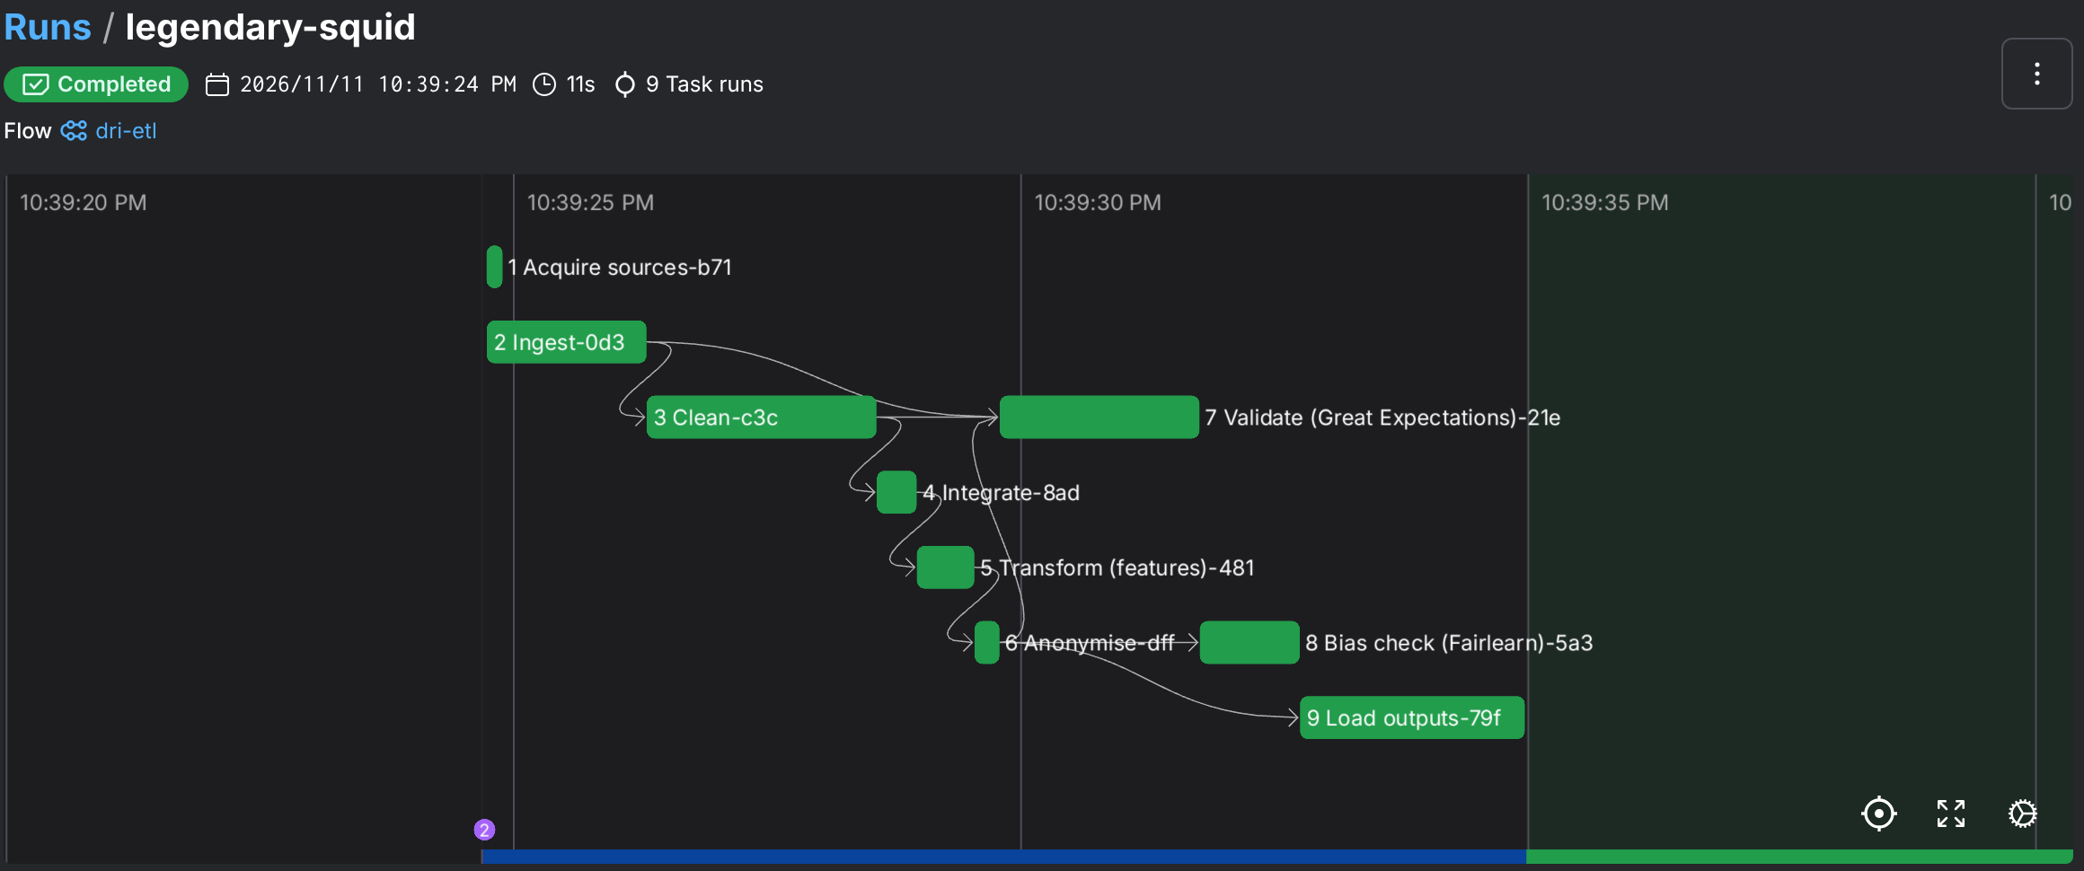



Prefect orchestrates the stages as a DAG
Dependencies come from data
Each task's output feeds the next, so Prefect draws the DAG itself; Validate also reads the raw tables.
Resilient by default
Every task retries once and writes to the privacy audit log.
Hard quality gate
If the model-ready suite fails, the flow raises an error and nothing is loaded.
Prefect UI: flow run of dri-etl, 11 Nov 2026, Completed, 9 task runs in 11 s
@flow(name="dri-etl") # src/pipeline/flow.py
raw = ingest_task(); ready = anonymise_task(transform_task(integrate_task(clean_task(raw))))
validate_task(raw, ready); bias_task(ready); load_task(ready) # gate first, then outputs
Notes:
The DAG is a Prefect flow in src/pipeline/flow.py. Each stage is a task, and passing one task's output into the next defines the dependencies, which is why Prefect can draw the graph. Validate depends on both the raw tables and the final table. Every task retries once and writes to the audit log. Validation is a hard gate: if the model-ready suite fails, the flow raises an error before the load task runs. The screenshot is the real run: completed, nine task runs, eleven seconds.

Slide 5
Lineage: 1.55 M raw rows become 96,470 training orders
Table (Module 2 dictionary) | Rows | Grain
orders | 99,441 | order
order_items | 112,650 | item
order_payments | 103,886 | payment
order_reviews | 99,224 | review
customers | 99,441 | order-customer
sellers | 3,095 | seller
products | 32,951 | product
geolocation | 1,000,163 | coordinate
category_translation | 71 | category
All CSV (UTF-8), relational, linked by hashed keys. Frequency: one historical batch (2016–2018); in production a daily batch.
54 → 41 columns 16 ID, location and timestamp columns removed; 3 hashed keys added
2,971 orders never delivered: kept, but no late label, so outside the training view
lineage.json + audit log record rows, columns, time and decisions for every stage, every run
Notes:
The inputs are the nine tables in the Module 2 data dictionary: all CSV, linked by hashed keys, delivered as one historical snapshot. In production they would arrive as a daily batch. The chart is the lineage at row level. 1.55 million raw rows come in, mostly geolocation points. Cleaning collapses geolocation to one point per postcode prefix, leaving about 569,000 rows. Integration produces exactly one row per order, 99,441, and the code asserts that no join adds or loses an order. Anonymisation keeps every row but cuts the columns from 54 to 41. The training view holds the 96,470 orders that were actually delivered and so have a late or on-time label. Every run writes this lineage to lineage.json and to the audit log.

Slide 6

Every data-quality issue gets an explicit rule
Issue found in the real data | Count | Rule applied
Duplicate geolocation rows | 280,007 | Removed; then one median point per postcode prefix
Timestamps out of order | 1,382 orders | Kept and flagged ts_anomaly; negative durations set to missing
Orders never delivered | 2,971 | Kept; no late label, so excluded from the training view
Postcode missing from geolocation | 1,272 | Fall back to the state's median point (280 customers, 992 sellers)
Products without a category | 610 | Labelled "unknown"; English names joined from translation table
Several reviews for one order | 551 | Latest answer kept, so one outcome per order
Coordinates outside Brazil | 33 | Removed using Brazil's bounding box
Missing or zero product size | 6 | Category median imputed; flagged size_imputed
Undefined payment type | 3 | Removed; instalments below 1 set to 1
Types never guessed
Every column loaded with an explicit string or date type; postcodes zero-padded to 5 digits
Flag, don't hide
Odd records stay in the data with a flag, so the model and the auditor can see them
Tested
Each rule has a unit test on synthetic Faker data (tests/test_clean.py)
Notes:
Every number here comes from the real run, and each issue has one explicit rule. The biggest is geolocation: 280,007 duplicate rows, removed before collapsing to one median point per postcode prefix. 1,382 orders have timestamps out of order, such as a carrier date before payment approval. These are kept and flagged rather than deleted, and the impossible negative durations are set to missing. Orders that were never delivered have no late or on-time outcome, so they stay in the table but not in the training view. Missing locations fall back to the state's centre. Each rule has a unit test using synthetic records made with Faker.

Slide 7
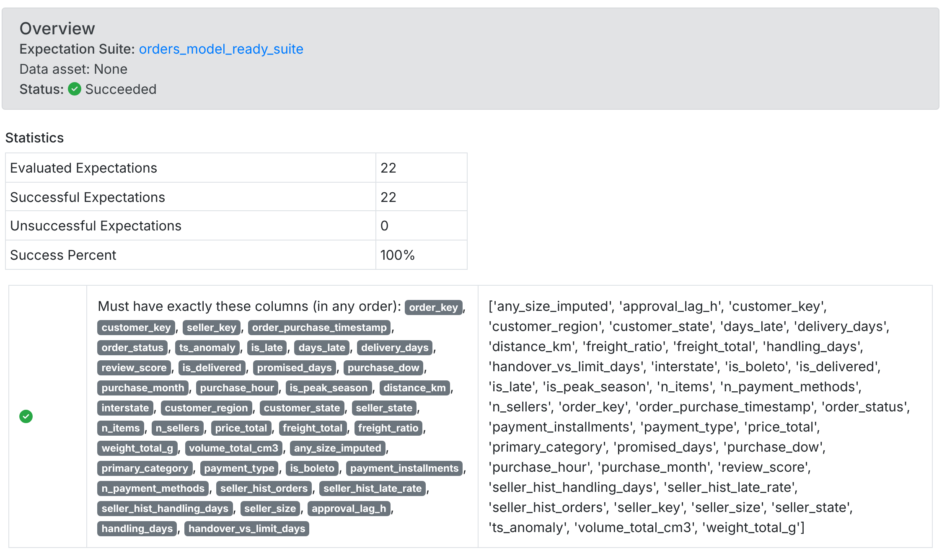
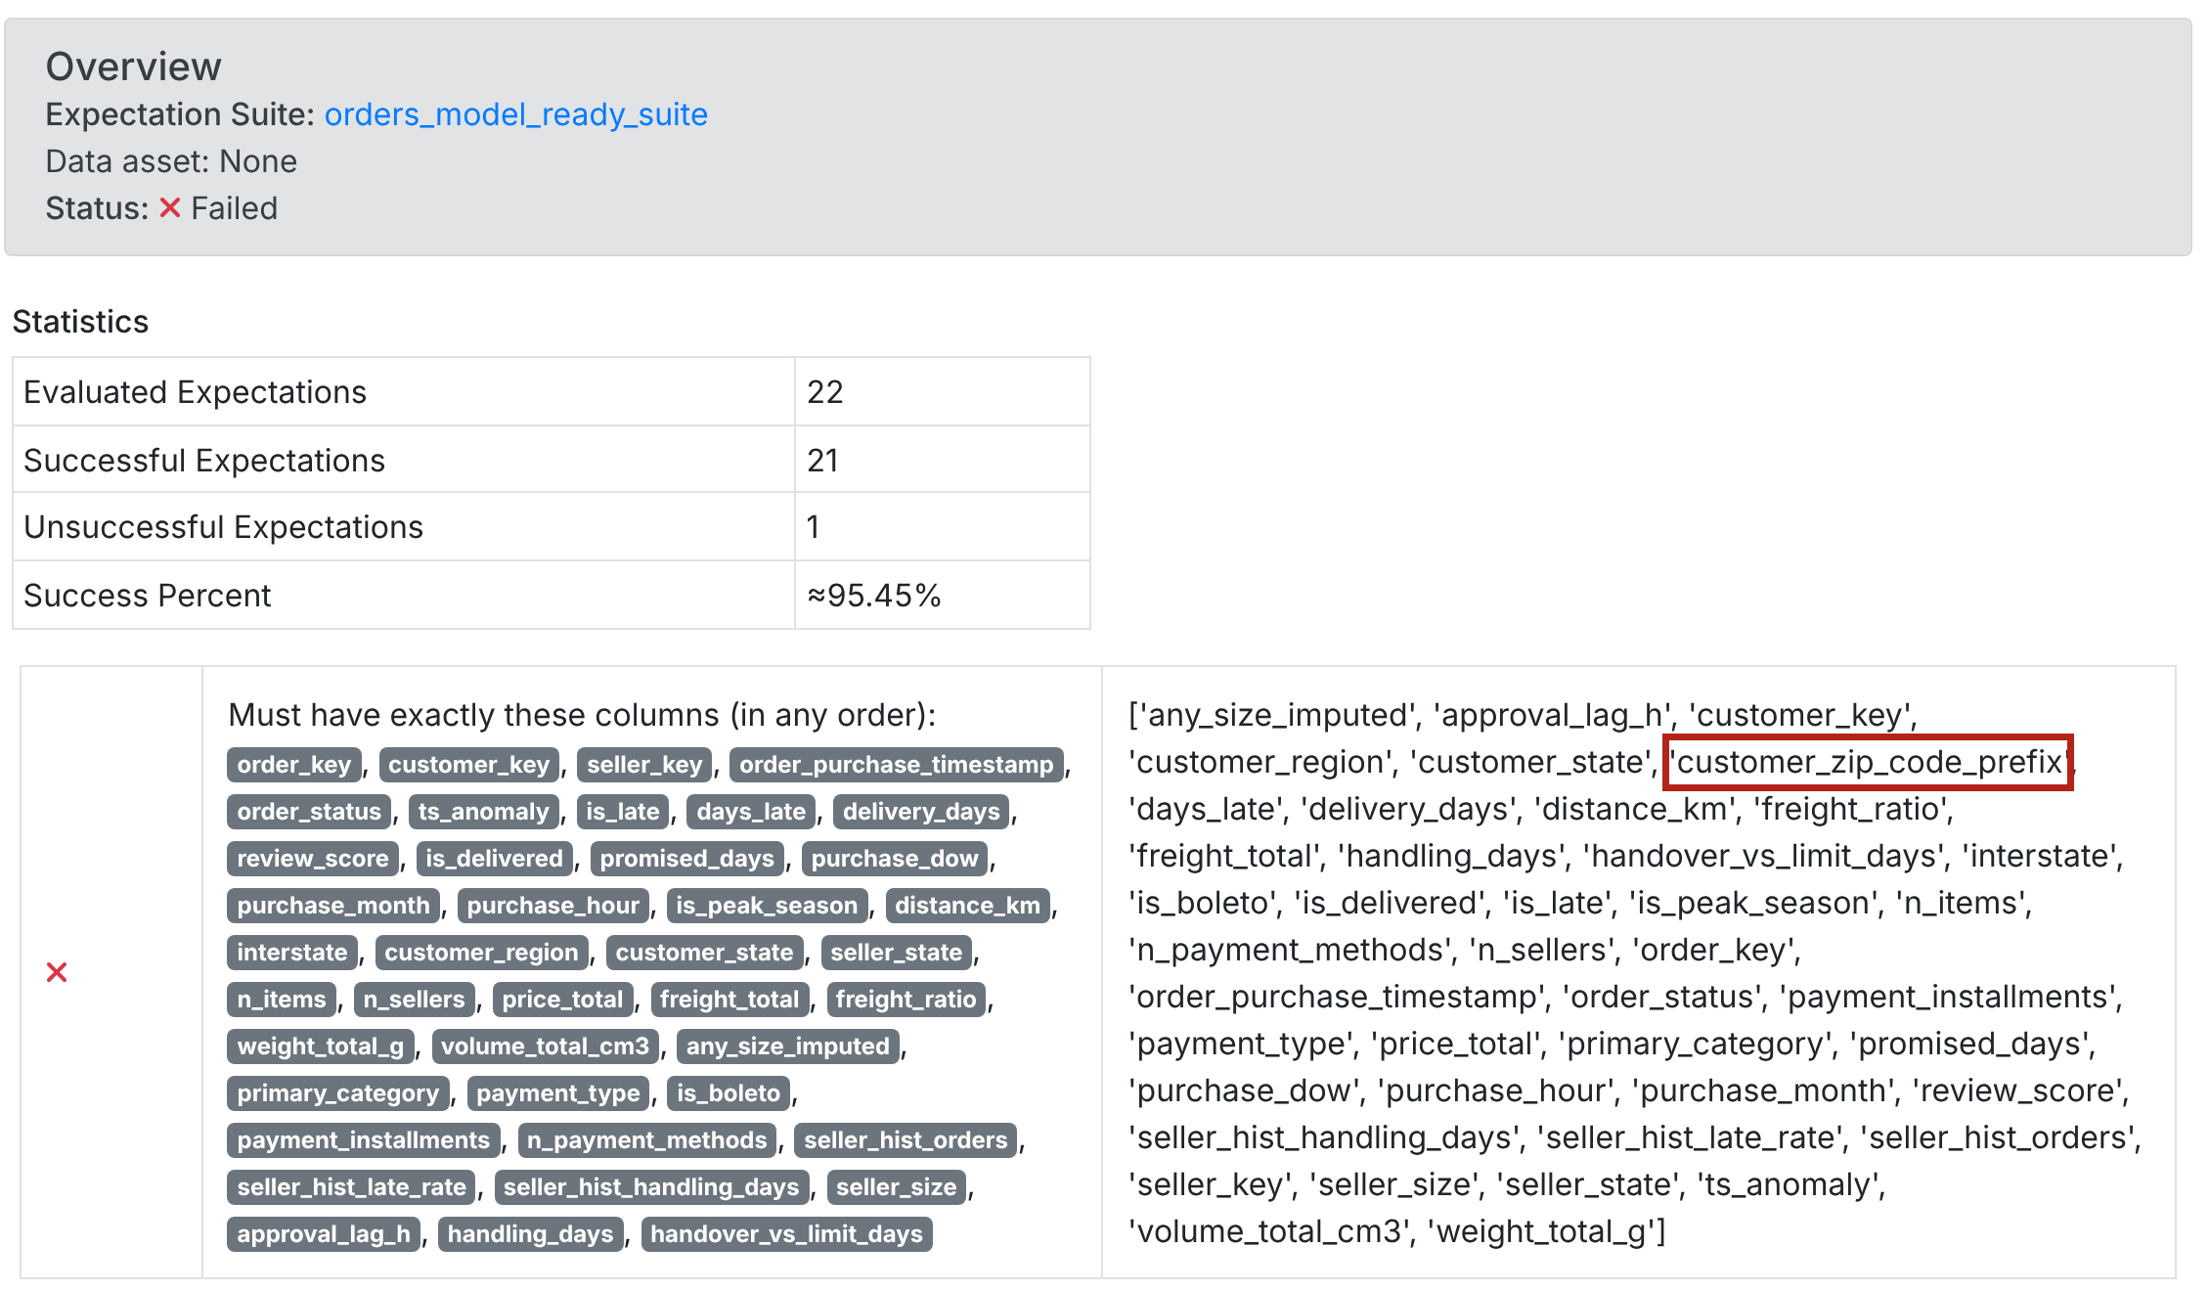
35 checks pass, and the gate blocks a PII leak
8 / 8
raw_orders
5 / 5
raw_order_items
22 / 22
orders_model_ready (gate)
Real run: model-ready table, 99,441 rows, all 22 checks pass
Test: a postcode column leaks in, so the allow-list fails
Great Expectations Data Docs, 11 Nov 2026 · full pages in docs/evidence/screenshots
Notes:
Validation uses Great Expectations with three suites. The two raw suites check the source files, such as unique order IDs, valid statuses, and prices above zero. The model-ready suite is the gate: 22 checks, including an exact column allow-list, so any personal field that slips through stops the run. Left is the real result, 22 of 22 passing on 99,441 rows. On the right I deliberately added a postcode column to a copy of the table: the allow-list check fails, the status is Failed, and in the flow nothing would be loaded. There is also a drift guard: if the late rate moves outside 4 to 15 percent, something upstream has changed. The 22 gate checks cover the column allow-list, unique 16-character keys, no missing labels on delivered orders, valid regions, states and payment types, plausible ranges for days, distance and price, and the late-rate drift guard. Full Data Docs screenshots are in docs/evidence.

Slide 8


Integration builds one row per order for three outputs
order_items
sum per order
orders
Model-ready table
112,650 rows after cleaning
orders_model_ready.parquet · 41 columns
Module 4 training · Restricted
order_payments
main type + totals
99,441
103,883 rows after cleaning
Warehouse table + view
v_training_delivered: 96,470 labelled orders · SQLite now, PostgreSQL via DATABASE_URL
one row per order, checked by an assertion: no join may add or lose an order
customers · sellers
join on keys
SQL access · Restricted
102,536 rows after cleaning
Dashboard feed
reviews · geolocation
region × month × category · 4,385 cells; cells under 5 orders blanked (4.2% of orders)
latest review · distance
117,683 rows after cleaning
Module 5 dashboard · Internal
Item- and payment-level tables are aggregated to order level before any join, so the grain never changes. Features use only facts known at purchase or hand-over; a seller's history counts only orders delivered before this purchase.
Notes:
Integration is where most pipelines quietly go wrong, because joining an item-level table to orders multiplies rows. Here, items and payments are first aggregated to one row per order: totals, number of sellers, the main payment type. Only then are they joined, with customers, sellers, the latest review and the coordinates used for distance. An assertion fails the run if the result is not exactly one row per order. There are three outputs, each tied to an analytics use. The parquet table is the Module 4 training set. The warehouse table and its view of delivered orders give SQL access; the view holds the 96,470 labelled orders. The dashboard feed is aggregated for Module 5, with small cells blanked so it can be shared more widely. Features are leakage-safe: a seller's track record only counts orders delivered before the purchase being scored.

Slide 9
The data under-represents the North and Northeast
0.22 and 0.35
representation ratio for North and Northeast (orders ÷ population); below 0.8 is flagged
14.3% vs 7.5%
late rate in the Northeast vs the Southeast: the regions with least data have the most late orders
1.1 points
late-rate gap between new, small and large sellers: no seller-size bias flagged
Action for Module 4
Report recall per region; block release if the gap exceeds 10 points (G5, ER1); test region-aware weighting.
Fairlearn MetricFrame by region and seller size, 96,470 delivered orders · population: IBGE (2023)
Notes:
The bias suite checks the data before any model exists, for the two groups named in the Module 1 Ethical AI Charter: customer region and seller size. It uses Fairlearn's MetricFrame. The chart compares each region's share of orders with its share of Brazil's population in the 2022 Census. The North places 1.9 percent of orders against 8.5 percent of the population, a representation ratio of 0.22. The Northeast is at 0.35, and the Central-West at 0.73. All three fall below the four-fifths threshold. The important finding is that under-representation and lateness go together: the Northeast's late rate is 14.3 percent, nearly double the Southeast's 7.5. A model trained on this data could learn the Southeast well and miss late orders where they matter most. That is exactly risk ER1, so Module 4 will report recall per region and block release if the gap exceeds 10 points. Seller size shows only a 1.1-point gap, so no bias is flagged there.

Slide 10

Privacy by design: anonymise, restrict, log every access
Anonymise
Govern
Audit
Review text and city names deleted at ingestion
Order, customer and seller IDs replaced by salted SHA-256 keys
Postcodes and coordinates used for distance, then deleted
Output = allow-list of 41 columns, enforced by the GX gate
k-anonymity on state × month: k = 2, so row-level data stays restricted
Restricted: raw files, model-ready table, warehouse (engineer, analysts, audit only)
Internal: suppressed dashboard feed (operations, sponsor)
Retention: 24 months, then delete or rebuild
Secrets in .env and CI secrets; data never in Git
Change only by pull request with CI passing
Every read, transform, PII action, check and write logged as one JSON line
Who, when, dataset, rows, columns, purpose and the file's SHA-256
30 events per run; kept 24 months, append-only
{"actor": "gain.tawodzera", "action": "pii_pseudonymise", "dataset": "orders_integrated", "rows": 99441, ...}
Builds on the Module 1 Ethical AI Charter (ER4 privacy) and the Module 2 Privacy Plan · LGPD (Brasil, 2018) · Tanzania PDPA 2022 for the HESU phase
Notes:
Privacy follows the Module 2 plan and is enforced in code. Free text and city names are deleted as soon as the data is read. IDs become salted, one-way hashes, and the salt lives outside Git. Postcodes and coordinates are used to compute distance and then deleted. The output is an allow-list, checked by the Great Expectations gate. I also measured re-identification risk: on state and purchase month the smallest group is two orders, so the row-level table is restricted, and only the aggregated feed with small cells blanked is shared. The governance framework sets access by role and 24-month retention, and requires every change to go through a pull request. Every read, transformation, PII action, check and write is logged as one JSON line with the actor, purpose and file fingerprint: 30 events per run. The full plans are in docs/data_anonymization_plan.md and docs/data_governance.md.

Slide 11



Anyone can rebuild the same table with one command
Container
21 unit tests
CI on every push
Dockerfile on python:3.13-slim with exact library versions; runs as a non-root user
pytest on synthetic Faker data: cleaning, leakage, PII, audit, the gate
GitHub Actions lints, tests, builds the image and runs the full pipeline on the Olist data
gh repo clone gaintawo/delivery-risk-intelligence
docker build -t dri-pipeline .
docker run --rm -v "$PWD/data:/app/data" dri-pipeline
Scalability
Swap SQLite for PostgreSQL with one setting (DATABASE_URL); move transforms to dbt as volumes grow; schedule the flow with a Prefect deployment for a daily batch.
Run time: 13 s locally for all 9 stages. Clean data is ready for Module 4 modelling.
Collaboration
Git Flow branches, pull requests gated by CI, every stage documented in docs/pipeline.md, and the same container for every teammate.
Notes:
Reproducibility means anyone can rebuild exactly the same table. The Dockerfile pins every library version, and the container runs as a non-root user. There are 21 unit tests on synthetic data made with Faker, so tests never touch real people's data. GitHub Actions runs on every push: it lints, tests, builds the container and runs the whole pipeline on the real Olist data, so the Dockerfile is proven on a clean machine, not just on my laptop. For scale: the warehouse switches from SQLite to PostgreSQL with one setting, transformations can move to dbt, and the flow can be scheduled as a daily Prefect deployment. For collaboration: Git Flow branches, pull requests that must pass CI, and documentation for every stage. The clean, validated table is now ready for modelling in Module 4.

Slide 12
References
Bird, S., Dudík, M., Edgar, R., Horn, B., Lutz, R., Milan, V., Sameki, M., Wallach, H., & Walker, K. (2020). Fairlearn: A toolkit for assessing and improving fairness in AI (MSR-TR-2020-32). Microsoft.
Brasil. (2018). Lei nº 13.709, de 14 de agosto de 2018: Lei Geral de Proteção de Dados Pessoais (LGPD). https://www.planalto.gov.br/ccivil_03/_ato2015-2018/2018/lei/l13709.htm
Great Expectations. (2026). GX Core documentation (Version 1.24). https://docs.greatexpectations.io/
Instituto Brasileiro de Geografia e Estatística. (2023, June 28). De 2010 a 2022, população brasileira cresce 6,5% e chega a 203,1 milhões. TNH1. https://www.tnh1.com.br/noticia/nid/de-2010-a-2022-populacao-brasileira-cresce-65-e-chega-a-2031-milhoes/
Mehrabi, N., Morstatter, F., Saxena, N., Lerman, K., & Galstyan, A. (2021). A survey on bias and fairness in machine learning. ACM Computing Surveys, 54(6), 1–35. https://doi.org/10.1145/3457607
Merkel, D. (2014). Docker: Lightweight Linux containers for consistent development and deployment. Linux Journal, 2014(239), 2.
National Institute of Standards and Technology. (2023). Artificial intelligence risk management framework (AI RMF 1.0) (NIST AI 100-1). https://doi.org/10.6028/NIST.AI.100-1
Olist. (2018). Brazilian e-commerce public dataset by Olist [Data set]. Kaggle. https://www.kaggle.com/datasets/olistbr/brazilian-ecommerce
Prefect Technologies. (2026). Prefect documentation (Version 3). https://docs.prefect.io/
Sweeney, L. (2002). k-anonymity: A model for protecting privacy. International Journal of Uncertainty, Fuzziness and Knowledge-Based Systems, 10(5), 557–570. https://doi.org/10.1142/S0218488502001648
Tawodzera, G. (2026a). Last-mile delivery risk intelligence: Project vision document [Unpublished assignment, BAN6800 Module 1]. Nexford University.
Tawodzera, G. (2026b). Delivery risk intelligence: Business analytics project overview report [Unpublished assignment, BAN6800 Module 2]. Nexford University.
Tawodzera, G. (2026c). Delivery risk intelligence [Source code]. GitHub. https://github.com/gaintawo/delivery-risk-intelligence
Notes:
References follow APA 7th edition, the NXU citation style. Software tools are cited by their official documentation and version.

