Slide 1
6
Discounted Cash Flow Valuation

Slide 2

Chapter 6 – Index of Sample Problems
Slide # 03 - 04 Financial calculator review
Slide # 05 - 07 Ordinary annuity present value
Slide # 08 - 10 Annuity due present value
Slide # 11 - 13 Ordinary annuity future value
Slide # 14 - 16 Annuity due future value
Slide # 17 - 19 Annuity – annual payments
Slide # 20 - 22 Annuity – monthly payments
Slide # 23 - 25 Annuity – quarterly payments
Slide # 26 - 28 Annuity time periods
Slide # 29 - 30 Annuity interest rate
(Index continued on next slide)

Slide 3
Chapter 6 – Index of Sample Problems
Slide # 31 - 33 Present value – uneven cash flows
Slide # 34 - 36 Future value – uneven cash flows
Slide # 37 - 38 Perpetuity present value
Slide # 39 - 41 Effective annual rate
Slide # 42 - 44 Continuous compounding
Slide # 45 - 47 Pure discount loan
Slide # 48 - 49 Interest only loan
Slide # 50 - 52 Amortized loans

Slide 4
3: Financial calculator review
If you invest $100 today for one year at a 10% rate of return, how much money will you have one year from now?
Enter 1 10 ±100
N I/Y PV PMT FV
Solve for 110
(continued on next slide)

Slide 5
4: Financial calculator review
Enter 1 10 ±100
N I/Y PV PMT FV
Solve for 110
You are spending $100 by investing it. You input that as a negative value using the “±” key. You are receiving $110 back at the end of one year. That is the positive value.
Positives and negatives are used to denote the direction of the cash flow. Generally you use a positive value to indicate a cash inflow and a negative value to indicate a cash outflow. All dollar amounts in this type of problem are, in actuality, positive values.

Slide 6
5: Ordinary annuity present value
You will receive $12,000 a year for the next ten years from a trust fund your grandmother is establishing.
What is this gift worth today at a 9% discount rate?

Slide 7
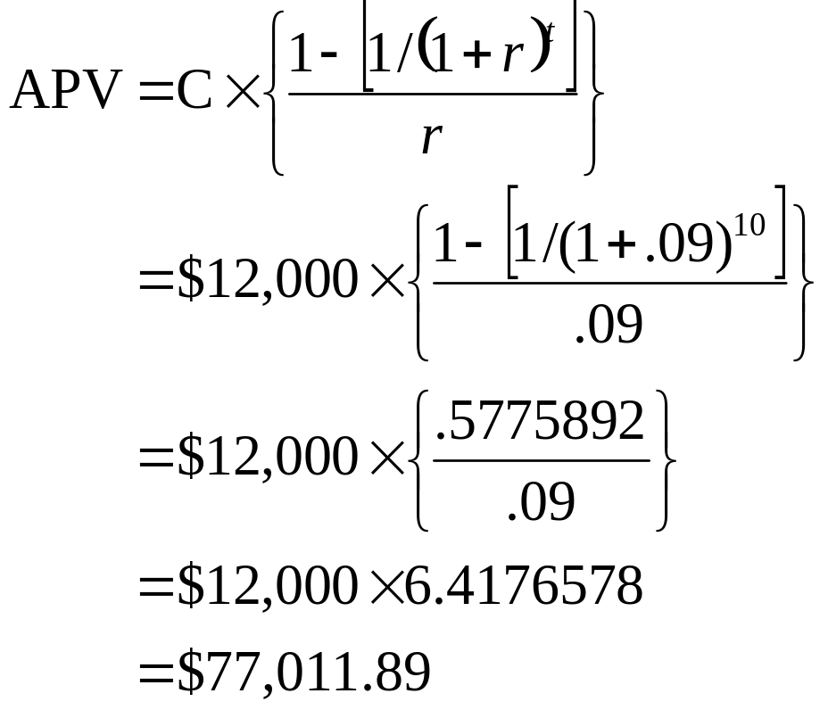
6: Ordinary annuity present value

Slide 8
7: Ordinary annuity present value
Enter 10 9 12,000
N I/Y PV PMT FV
Solve for -77,011.89

Slide 9
8: Annuity due present value
You are buying some land from your parents today. You agree to pay them $5,000 a year for six years. The first payment is due today.
What is the actual selling price of the land if your parents are only charging you 3% interest?

Slide 10
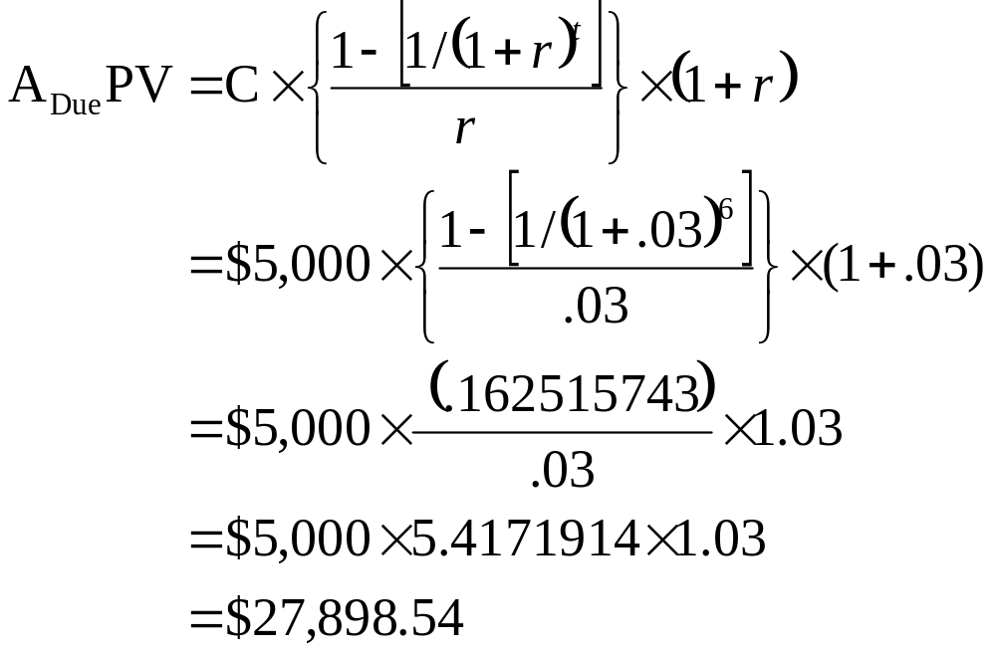
9: Annuity due present value

Slide 11
10: Annuity due present value
Enter 6 3 ±5,000BGN
N I/Y PV PMT FV
Solve for 27,898.54

Slide 12
11: Ordinary annuity future value
You are planning on investing $3,500 in the stock market every year for your retirement. You will make your first investment at the end of this year. The average rate of return you expect to earn is 7%.
How much money do you expect to have when you retire forty years from now?

Slide 13
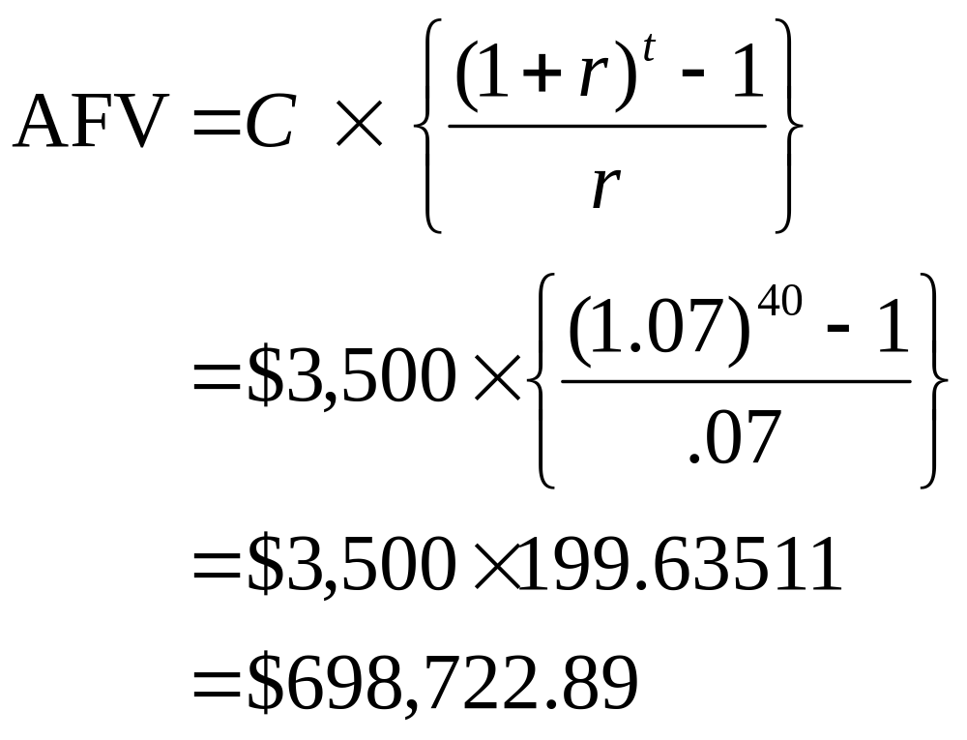
12: Ordinary annuity future value

Slide 14
13: Ordinary annuity future value
Enter 40 7 ±3,500
N I/Y PV PMT FV
Solve for 698,722.89

Slide 15
14: Annuity due future value
Your parents are giving you $3,000 at the beginning of each year for four years. You are saving this money and earning a 2.5% rate of return on your savings.
How much money will you have at the end of the four years?

Slide 16
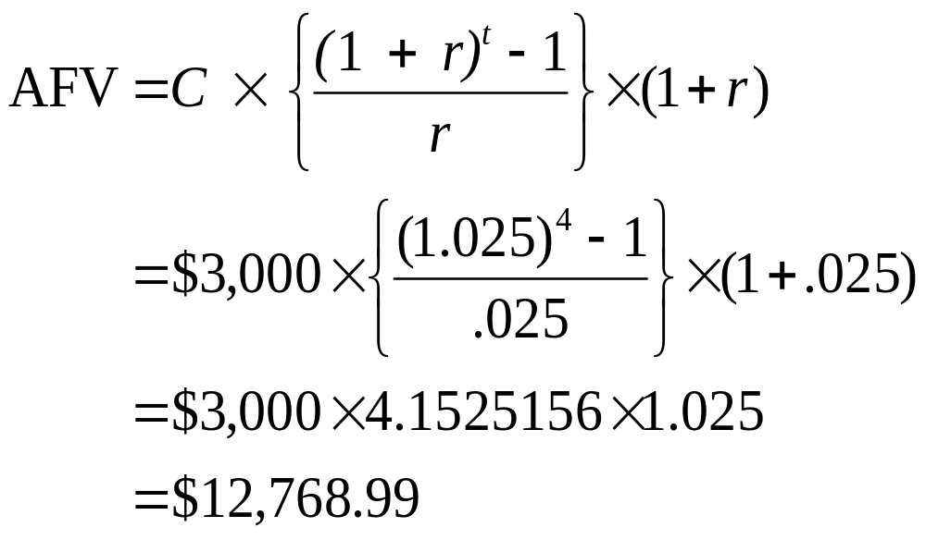
15: Annuity due future value

Slide 17
16: Annuity due future value
Enter 4 2.5 ±3,000BGN
N I/Y PV PMT FV
Solve for 12,768.99

Slide 18
17: Annuity – annual payments
You plan on retiring at age 60 and then living another 25 years. Your goal is to have $500,000 in your retirement savings on the day you retire and spend it all by the time you die. During your retirement, you expect to earn 5% on your savings.
How much money can you withdraw from your savings each year during your retirement if you withdraw the funds on the last day of each year?
What if you withdraw the money on the first day of each year?

Slide 19
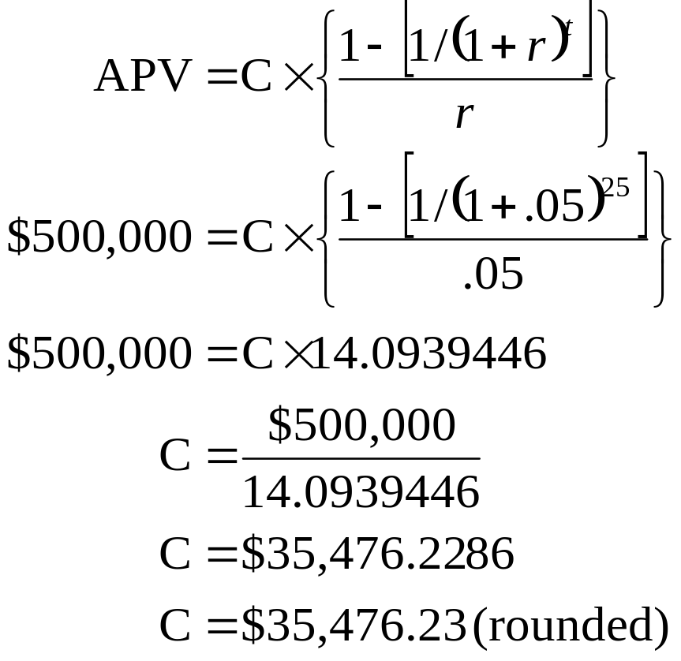
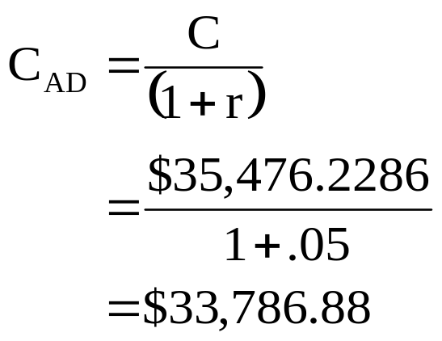
18: Annuity – annual payments

Slide 20
19: Annuity – annual payments
Enter 25 5 ±500,000
N I/Y PV PMT FV
Solve for 35,476.23
Enter 25 5 ±500,000
N I/Y PV PMT FV
Solve for 33,786.88BGN

Slide 21
20: Annuity – monthly payments
You currently owe $3,780 on your credit card. You are not charging any more on the account. The interest rate is 1.5% per month.
How much do you have to pay each month if you want to have this bill paid off within two years?

Slide 22
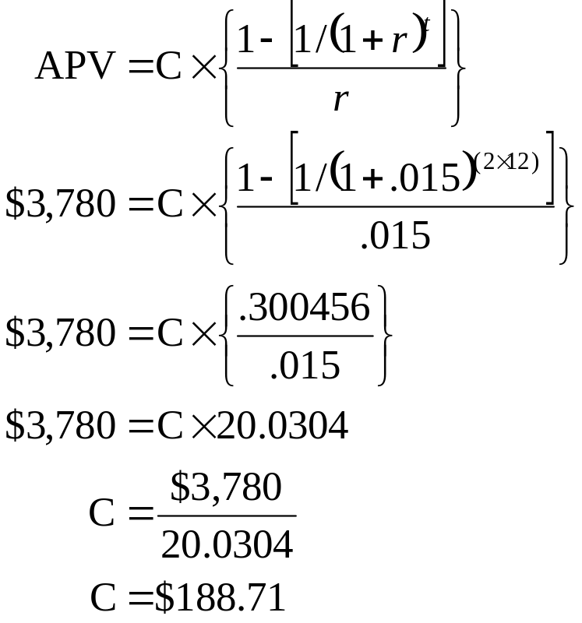
21: Annuity – monthly payments

Slide 23
22: Annuity – monthly payments
Enter 2x12=24 1.5 3,780
N I/Y PV PMT FV
Solve for -188.71

Slide 24
23: Annuity – quarterly payments
Your company recently borrowed $12,000 to buy some office equipment. The financing terms call for eight equal quarterly payments. The interest rate is 10%.
What is the amount of each quarterly payment?

Slide 25
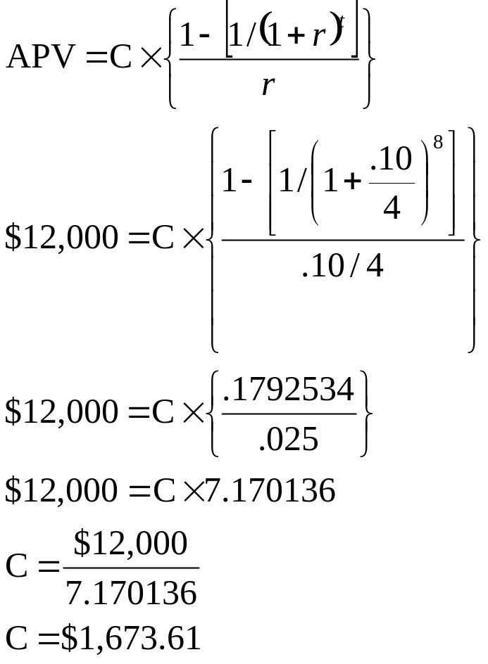
24: Annuity – quarterly payments

Slide 26
25: Annuity – quarterly payments
Enter 8 10%/4 12,000
N I/Y PV PMT FV
Solve for -1,673.61

Slide 27
26: Annuity time periods
You own a landscaping business. Your goal is to purchase a professional lawnmower costing $7,500. To do this, you are saving $2,000 a year. Your savings account pays 3% interest.
How long will you have to wait to buy the lawnmower if you want to pay cash for the purchase?

Slide 28
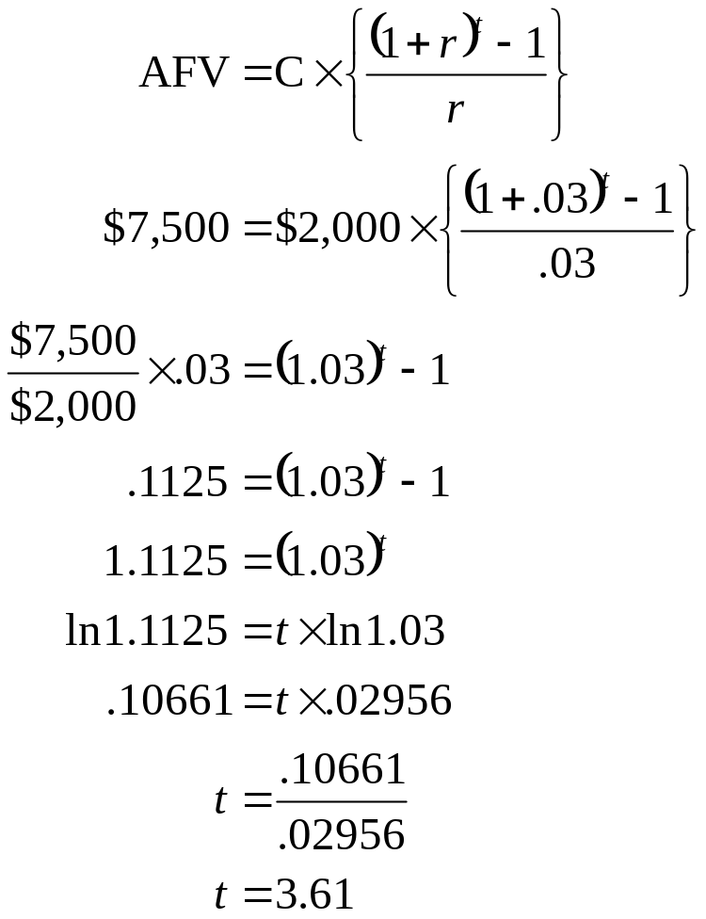
27: Annuity time periods

Slide 29
28: Annuity time periods
Enter 3 ±2,000 7,500
N I/Y PV PMT FV
Solve for 3.61

Slide 30
29: Annuity interest rate
You owe $1,000 on your credit card. At the end of each month you pay $20 towards the balance. You’ve been told that it will take you 99.11 months to pay off this account.
What annual interest rate are you paying?

Slide 31
30: Annuity interest rate
Enter 99.11 1,000 ±20
N I/Y PV PMT FV
Solve for 18.9%/12

Slide 32
31: Present value – uneven cash flows
You are going to receive $500 one year from now, $700 two years from now and $1,200 three years from now.
What are these payments worth to you today at a 9% discount rate?

Slide 33
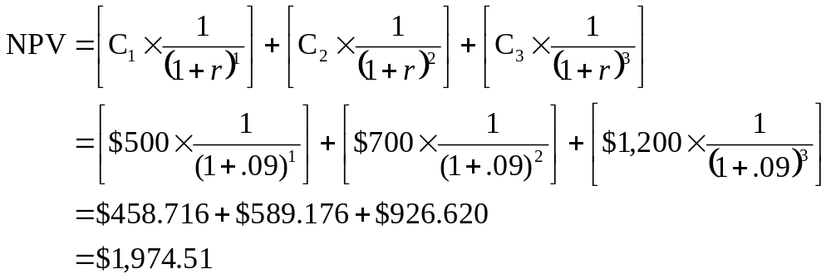
32: Present value – uneven cash flows

Slide 34
33: Present value – uneven cash flows
Enter 1 9 500
N I/Y PV PMT FV
Solve for - 458.716
Enter 2 9 700
N I/Y PV PMT FV
Solve for -589.176
Enter 3 9 1,200
N I/Y PV PMT FV
Solve for -926.620
Total PV = $458.716 + $589.176 + $926.620 = $1,974.512 ≅ $1,974.51

Slide 35
34: Future value – uneven cash flows
You have $500 in your investment account today. You are going to add the following amounts to this account:
End of year 1 $600
End of year 2 $700
End of year 3 $800
Assume you earn an 8% rate of return.
How much money will you have in your account three years from now?

Slide 36
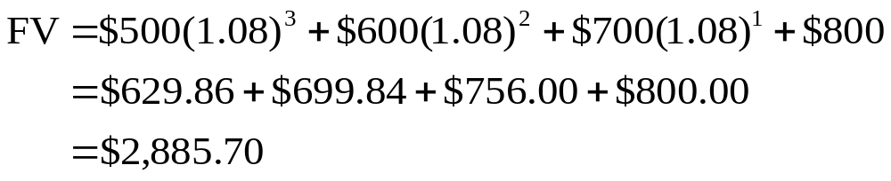
35: Future value – uneven cash flows

Slide 37
36: Future value – uneven cash flows
Enter 3 8 ±500
N I/Y PV PMT FV
Solve for 629.86
Enter 2 8 ±600
N I/Y PV PMT FV
Solve 699.84
Enter 1 8 ±700
N I/Y PV PMT FV
Solve for 756.00
Total FV = $629.86 + $699.84 + $756.00 + $800.00 = $2,885.70

Slide 38
37: Perpetuity present value
You are establishing a trust fund to provide $100,000 in scholarships to college students each year in perpetuity.
How much money are you contributing to this trust if the discount rate is 8%?

Slide 39
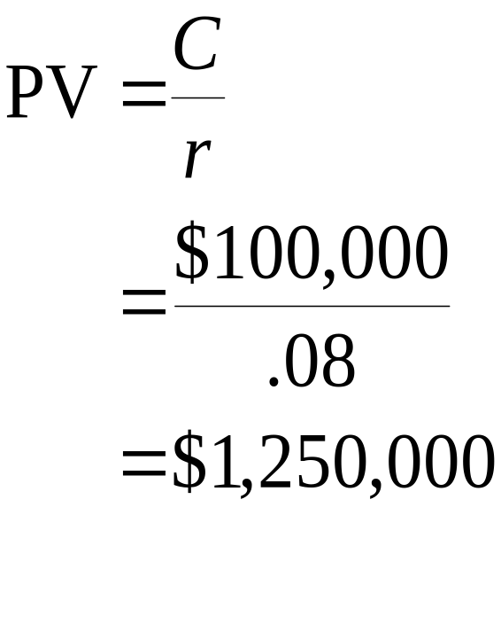
38: Perpetuity present value

Slide 40
39: Effective annual rate
You have a credit card with a quoted annual percentage rate of 17.9%. Interest is applied to your account monthly.
What is the effective annual rate?

Slide 41
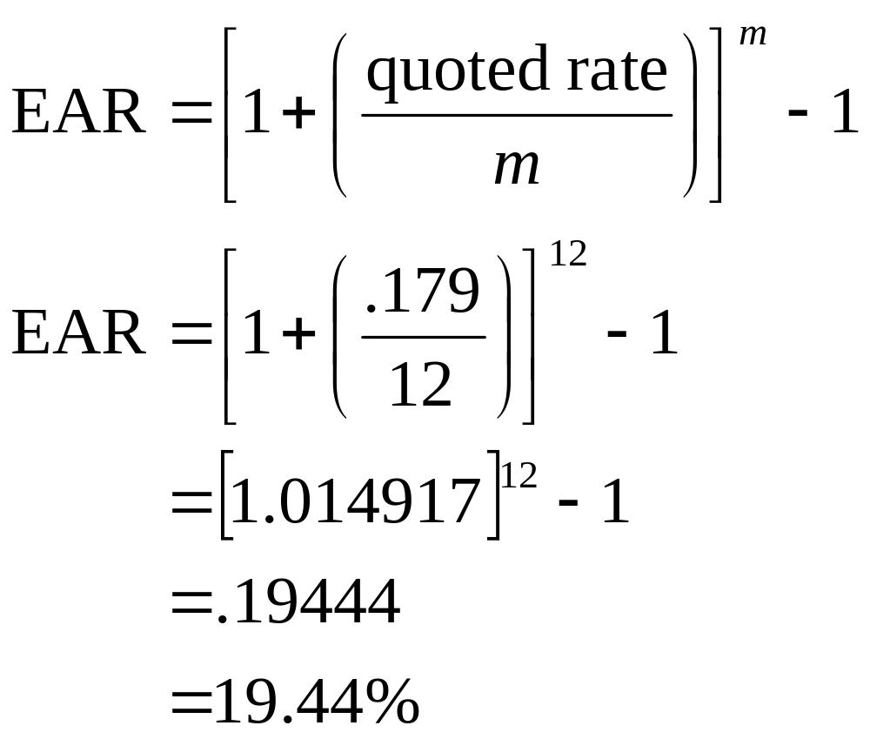
40: Effective annual rate

Slide 42
41: Effective annual rate
Enter 17.9 12
NOM EFF C/Y
Solve for 19.44

Slide 43
42: Continuous compounding
What is the effective annual rate of 14.9% compounded continuously?

Slide 44
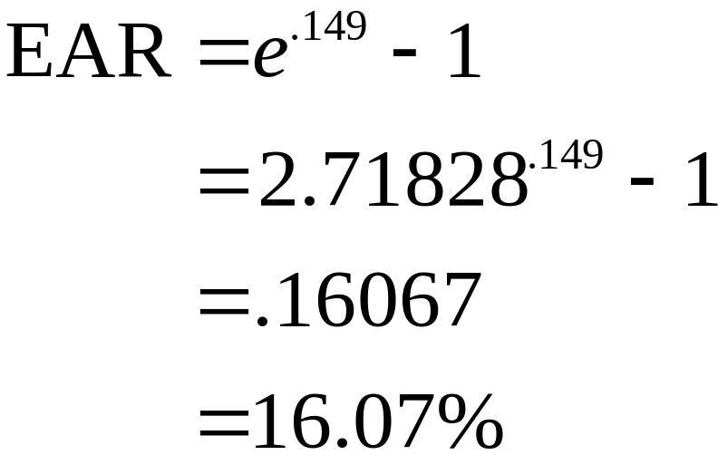
43: Continuous compounding

Slide 45
44: Continuous compounding
.149
2nd
e^{x}
-1
=
.16067
Which is rounded to 16.07%

Slide 46
45: Pure discount loan
You are borrowing money today at a 9% interest rate. You will repay the loan in one lump sum payment of $5,000 two years from today.
How much are you borrowing today?

Slide 47
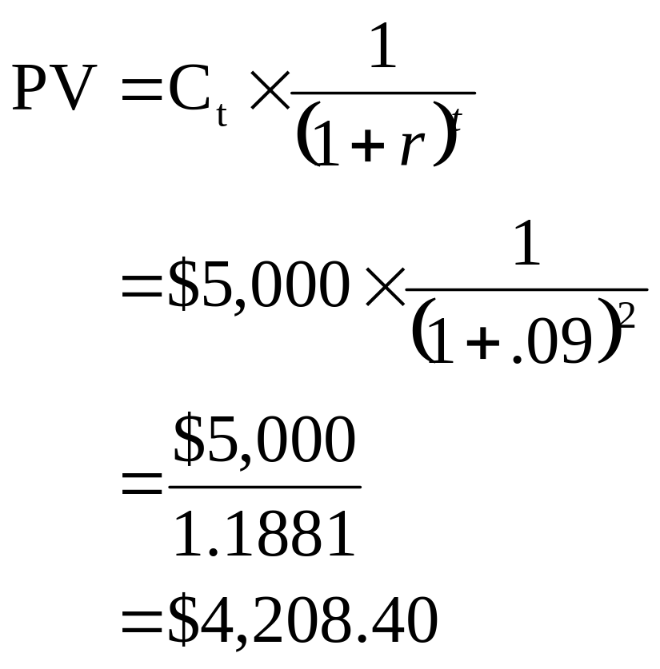
46: Pure discount loan

Slide 48
47: Pure discount loan
Enter 2 9 ±5,000
N I/Y PV PMT FV
Solve for 4,208.40

Slide 49
48: Interest only loan
You are borrowing $2,500 today for five years at a 7% rate of interest. This is an interest only loan with payments paid annually.
How much must you pay each year until this loan is repaid in full?

Slide 50
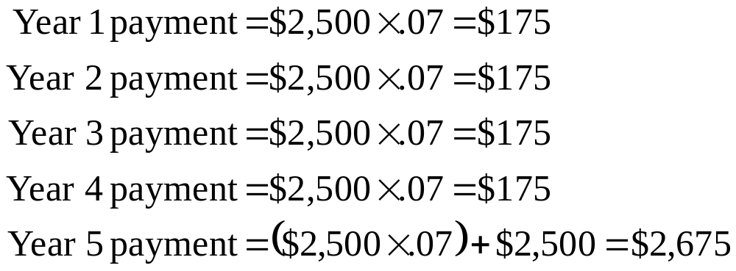
49: Interest only loan

Slide 51
50: Amortized loan
You borrow $1,000 at 8% interest. This loan is being amortized over five years with payments being made annually.
What is the amount of each annual payment?

Slide 52
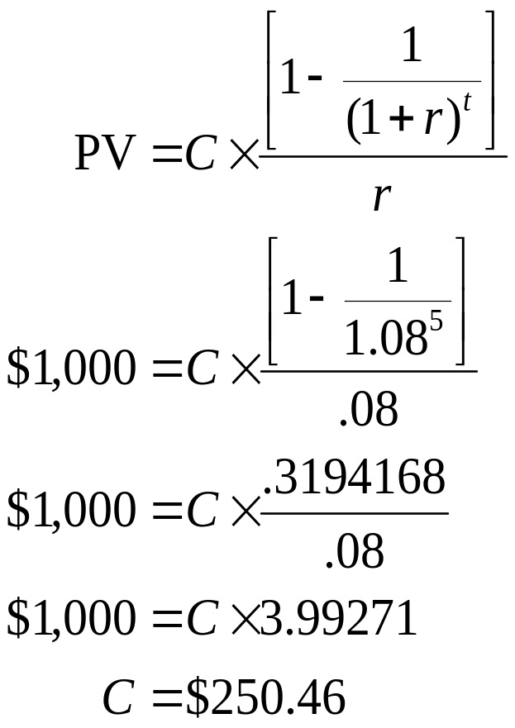
51: Amortized loan

Slide 53
52: Amortized loan
Enter 5 8 1,000
N I/Y PV PMT FV
Solve for -$250.46

Slide 54
6
End of Chapter 6

