Slide 1


















Lidec 2 – Sculi
Milestones

Slide 2
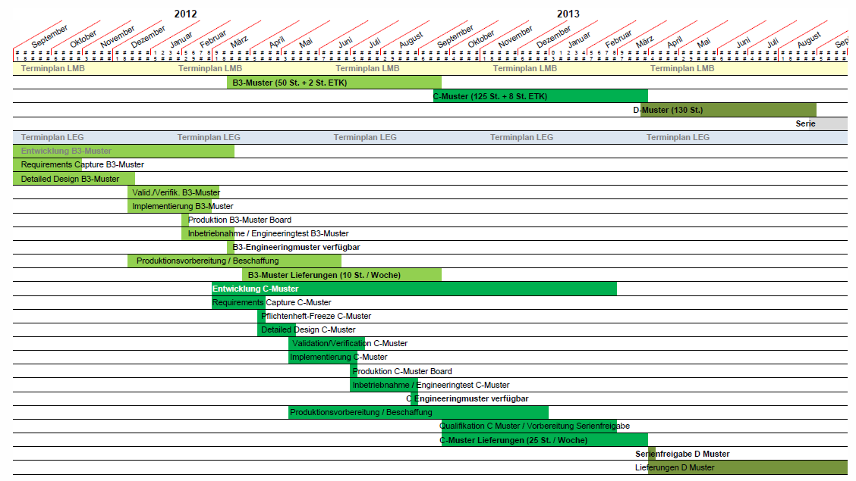
Lidec 2 Milestones
Today
Sculi for Lidec 2

Slide 3
Sculi for Lidec 2
The current list of features required for the Lidec 2 is in analysis

Slide 4

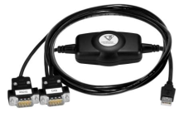

Lidec 2 - Sculi
Team Lidec 2
Team Sculi
ODX
Edit ODX files
Own compressed format
Sculi
USB → CAN
UDS protocol
Lidec 2

Slide 5
How to reach the milestones - possibilities
Sculi 1 – Add new features for Lidec 2
Sculi 2 – Focus on Lidec 2
1
2

Slide 6
Sculi 1 – Add new features for Lidec 2
1
Advantages
Usage of the current features available in Sculi 1
One product for all ECUs
Disadvantages
Integration of new development in a bad architecture ! (development of dead code)
Only 2 persons in the Team are able to do the integration in Sculi 1 ! (the others do not have Delphi know-how)
We will have the same stability problems (known Delphi support issues on Windows 7)
Same user experience (cannot be improved)

Slide 7
Sculi 2 – Focus on Lidec 2
2
Advantages
100 % .Net/C# → better stability by using the .Net Framework (Windows XP / Windows 7 / Windows 8)
All the Team is able to work in .Net/C# environment
Disadvantages
2 products on the market until Sculi 2 contains all the features of Sculi 1

Slide 8
But !
Some features / bugs have to be fixed in Sculi 1
Monitor Emulation (Master 4)
Variable Editor bugs (Master 4)
SCR
Lidec 1 connection establishment speed
Integration of PAMS Licenses files

Slide 9
Suggestion
→ 1st July
All the team is working on Sculi 1
1st July →
The team is working in iterations on Sculi 1 / Sculi 2
Sculi 1 : 1 week
Sculi 2 : 3 weeks

