Slide 1

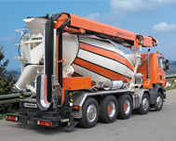
















Lidec 2 – Sculi
ODX – UDS - Milestones

Slide 2

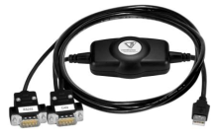

Sontheim
Team Lidec 2
Team Sculi
ODX
Edit ODX files
Own compressed format
1
Sculi
USB → CAN
UDS protocol
3
2
Lidec 2

Slide 3
Decisional Matrix
 | Sontheim | Team Sculi
(1) Parse ODX (XML) files | MDT 85’000 € Does not support the current standard (2.2.0) Written in C (COM server) .Net/C# wrapper do not follow the Microsoft conventions | 3 Months Team Sculi only need to parse this XML file in order to know the frames to send
(2) UDS Library | No UDS Library (J2534) 12’000 € | 3 Months A UDS Library used by the “UDS Uploader” is currently developed in Delphi → Migration in .Net + add new services
(3) USB → CAN | CAN Fox (USB – CAN – RS232) 73.50€ (500 st.) (to be tested)

Slide 4
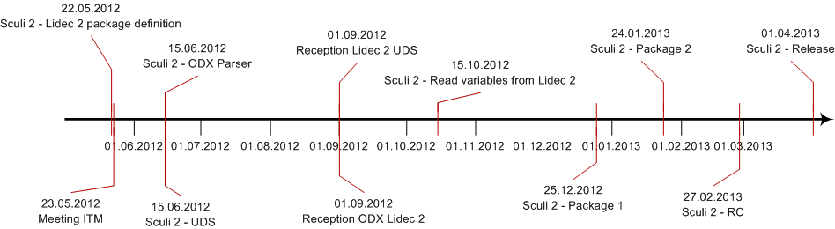
Timeline

