Slide 1
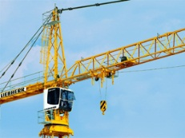
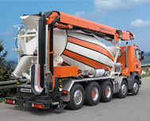


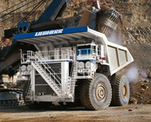
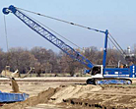
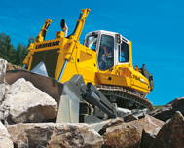








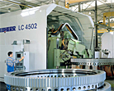
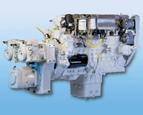
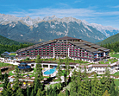
Lidec 2 – Sculi

Slide 2
Agenda
Lidec 2 Milestones
Lidec 2 – Sculi: User Requirements
Definition of “Risk”
Sculi 1 or Sculi 2
Planning 2012 → 2015

Slide 3
Stufe 4 Engine & Lidec 2 Milestones
Stufe 4 Motoren Planung
B-Muster Prototyp-Motoren (ohne AGN) 03/2012
C-Muster Prototype-Motoren (LMB internal only) 06/2012
D-Muster Prototyp-Motoren 01/2013
D-Muster-Motoren inkl. SCR-Anlage 02/2013
SCRF Serien Lösung (nur für 1 Motor/Leistung/Gerät*) 01/2015
Einführung Emissionstufe T4f 01/2014
LIDEC2 Planung
B3-Muster 04/2012
C-Muster 10/2012
D-Muster 04/2013
SOP 09/2013

Slide 4
Lidec 2 – Sculi : User requirements
Markus Burri (LMB) has been defined as Key Person for the motor diagnostic
Responsible to define what is necessary for the motor diagnostic
Responsible for the definition of the features priorities
The general features and priorities for the Lidec 2 for March 2013 have been defined (Lidec2_user_priorities.xlsx)
Read general information of the ECU
Read messages (active / passive with additional info’s)
Read variables (read only)
Record variables over the time (oscilloscope)
A prototype has been created (Expression Blend) in order to show how the tool will looks like with the various requested features waited for this first package. This prototype has been shown and approved by Markus Burri.
An “User Requirement” document is currently written and will define the scope and functionalities of each features. This document will required the signature of the customer services for approval.

Slide 5
Definition of “Risk”
“Risk is any potential situation or event that could negatively affect a project’s ability” (Classification and Analysis of Risks in Software Engineering - Hooman Hoodat & Hassan Rashidi)
Risk categories
Software Requirement Risks (Lack of report for requirements, impossible requirements, …)
Software Cost Risks (Lack of good estimation in project, technology, personal change, …)
Software Scheduling Risks (Lack of enough skills, shortage of personnel, …)
Software Quality Risks (Lack of testing, lack of good guidelines, …)
Software Business Risks (Product that no one want them, …)
As Project Manager, my role is to evaluate the risk and to suggest the best way to reach the goal

Slide 6
How to reach the goal
2 possibilities:
Sculi 1: Add features for the support of Lidec 2 diagnostic
Sculi 2: Starting the development of a new product
1
2

Slide 7
Sculi 1 – Add features for the support of Lidec 2 diagnostic
1
What are the major risks:
Software Cost Risks
The bridge between Delphi and .Net/C# is not an easy job. A lot of time will be wasted and used for non-planed tasks.
It known that the current architecture of Sculi 1 is bad (approved in LWN on 21th September 2011). Adding new features implies a large risk of regressions, when shared part of code must be changed.
Software Scheduling Risks
Only 2 persons are able to work on the Delphi part of Sculi 1.
In the case we are late in the planning, it will be very hard to find qualified persons quickly with Delphi know-how.
Software Quality Risks
The current stability problem of Sculi 1 will be also the same for the diagnostic of Lidec 2 (bad user experience)
Advantages
Usage of the current features available in Sculi 1
One product for all ECUs

Slide 8
Sculi 2 – Starting the development of a new product
2
What are the major risks:
Software Cost Risks
Lack of good estimation (time) in project
Software Quality Risks
Until all the features of Sculi 1 are migrated to Sculi 2, the usage of two diagnostic tools will be necessary
Advantages
The user experience can be improved and focus on what the users are really waiting for
100 % .Net/C# → better stability by using the .Net Framework (Windows XP / Windows 7 / Windows 8)
All the Team is able to work in .Net/C# environment (knowledge)
The integration of external libraries will be easier
Future oriented

Slide 9
Planning Sculi 2 - Lidec 2
2012 |  |  |  |  |  |  |  |  |  | 2013
03 | 04 | 05 | 06 | 07 | 08 | 09 | 10 | 11 | 12 | 01 | 02 | 03 | 04 | 05
Scope Definition of Sculi 2.0
cw22
cw36
Information Screen
Read Messages
cw40
cw44
Read Variables
Oscilloscope
cw49
Integration of PAMS Security
cw03
Sculi 2.0 Alpha 1
Sculi 2.0 Alpha 2
Sculi 2.0 Alpha 3
Sculi 2.0 Beta
Sculi 2.0 RC
Sculi 2.0 Released
Reserved
Stage 4 B-Sample Engines
Stage 4 D-Sample Engines

Slide 10
Planning Sculi 2
2012 |  |  |  | 2013 |  |  |  | 2014 |  |  |  | 2015
Q1 | Q2 | Q3 | Q4 | Q1 | Q2 | Q3 | Q4 | Q1 | Q2 | Q3 | Q4 | Q1 | Q2 | Q3 | Q4
Development Sculi 2.0
For basis LIDEC2 diagnostic
Q1/2013
Development Sculi 2.4
With full LIDEC 2 diagnostic
Q1/2014
Development Sculi 2.8
Replacement of all Sculi 1 (Included all Machine and Engine features)
Q1/2015
Development Sculi 2.12
With Master 5 support, workflows and pattern recognition system
Q4/2015
Sculi 2.0
Sculi 2.4
Sculi 2.8
Sculi 2.12
Stage 4 B-Sample Engines
Stage 4 D-Sample Engines
Stage 4 Engines SOP

